Slide 1
Layer2Layer
Input Layer
Hidden Layer
Output Layer

Slide 2
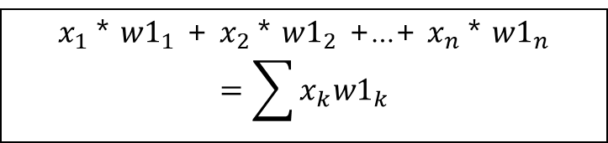
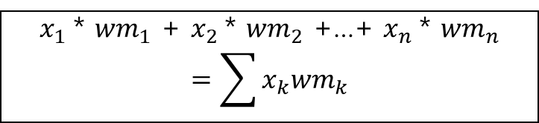


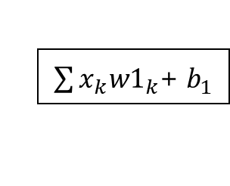










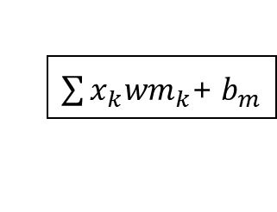
Layer2Layer
Input Layer
Weight(1~m층)
Bias
W1
$x_{1}$* ${w1}_{1}$ + $x_{2}$* ${w1}_{2}$ +…+ $x_{n}$* ${w1}_{n}$
$$=\sum{x_{k}{w1}_{k}}$$
$${ x}_{1}$$
$${ w1}_{1}$$
$${ b}_{1}$$
$\sum{x_{k}{w1}_{k}}$+${ b}_{1}$
Wm
$${ wm}_{1}$$
$$x_{2}$$
$${ w1}_{2}$$
$${ b}_{2}$$
$${ wm}_{2}$$
.
.
.
.
.
.
.
.
.
.
.
.
.
.
.
.
.
.
$${ wm}_{n}$$
$$x_{n}$$
$${ w1}_{n}$$
$x_{1}$* ${wm}_{1}$ + $x_{2}$* ${wm}_{2}$ +…+ $x_{n}$* ${wm}_{n}$
$$=\sum{x_{k}{wm}_{k}}$$
$${ b}_{m}$$
$\sum{x_{k}{wm}_{k}}$+${ b}_{m}$

Slide 3
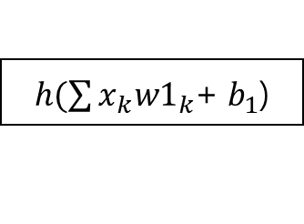




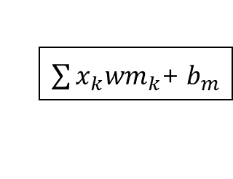

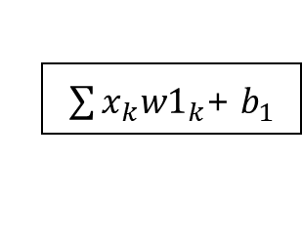


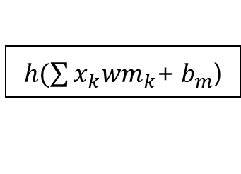
Layer2Layer
Bias
Activation Function
Hidden Layer
$${ b}_{1}$$
$\sum{x_{k}{w1}_{k}}$+${ b}_{1}$
$h(\sum{x_{k}{w1}_{k}}$+${ b}_{1}$)
$${ x′}_{1}$$
$${ b}_{2}$$
$${x′}_{2}$$
.
.
.
$$h$$
.
.
.
.
.
.
.
.
.
$${ b}_{m}$$
$\sum{x_{k}{wm}_{k}}$+${ b}_{m}$
$h(\sum{x_{k}{wm}_{k}}$+${ b}_{m}$)
$${x′}_{m}$$

Slide 4
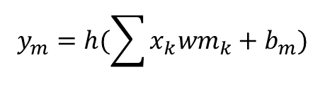
$$y_{m}=h(\sum{x_{k}{wm}_{k}+b_{m})}$$

Slide 5
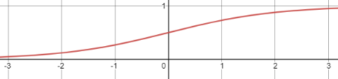
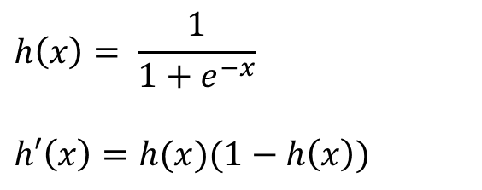
Sigmoid
$$h\left(x\right)= \frac{1}{1+e^{−x}}$$
$$h′\left(x\right)=h(x)(1−h\left(x\right))$$

Slide 6
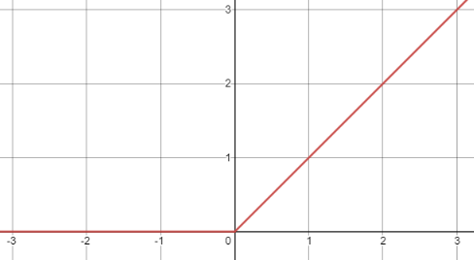
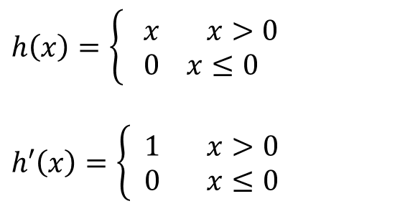
ReLU
$$h\left(x\right)=\left\{\begin{aligned} x x>0 \\ 0 x≤0\end{aligned}\right.$$
$$h′\left(x\right)=\left\{\begin{aligned} 1 x>0 \\ 0 x≤0\end{aligned}\right.$$

Slide 7
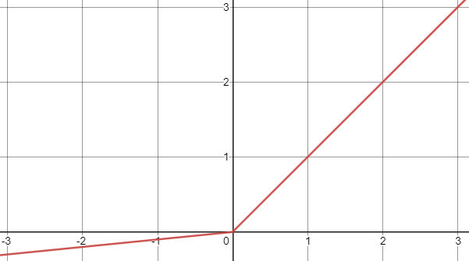
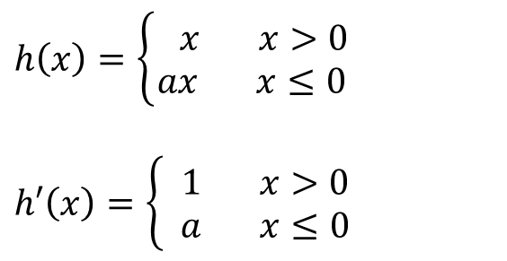
Leaky ReLU
$$h\left(x\right)=\left\{\begin{aligned} x x>0 \\ ax x≤0\end{aligned}\right.$$
$$h′\left(x\right)=\left\{\begin{aligned} 1 x>0 \\ a x≤0\end{aligned}\right.$$

Slide 8
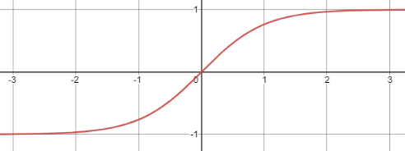
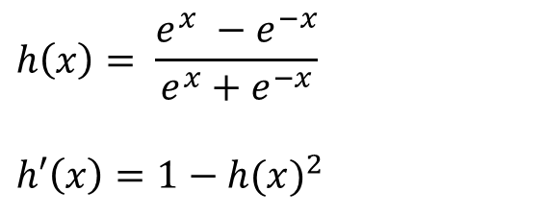
tanh
$$h\left(x\right)= \frac{e^{x} −e^{−x}}{e^{x}+e^{−x}}$$
$$h′\left(x\right)=1−{h(x)}^{2}$$

Slide 9
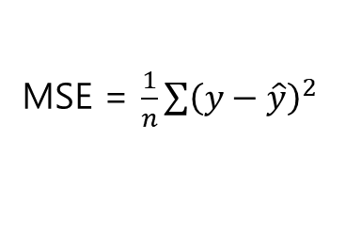
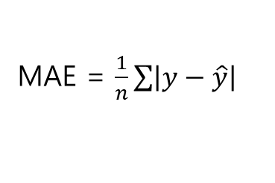
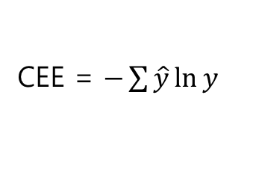
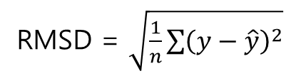
MAE = $\frac{1}{n}\sum{\left|y−\hat{y}\right|}$
MSE = $\frac{1}{n}\sum{{\left(y−\hat{y}\right)}^{2}}$
RMSD = $\sqrt{\frac{1}{n}\sum{{\left(y−\hat{y}\right)}^{2}}}$
CEE = $−\sum{\hat{y}\ln{y}}$

Slide 10
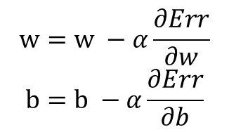
$$w=w −α\frac{∂Err}{∂w}$$
$$b=b −α\frac{∂Err}{∂b}$$

Slide 11
Layer2Layer
Input Layer
Hidden Layer
Output Layer
Feed-Forword
Predict Result
Cost
Layer2Layer
Real(Train) Result
Input Layer
Hidden Layer
Output Layer
Back-Propagation

Slide 12
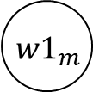

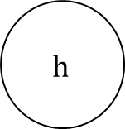
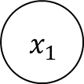


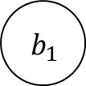

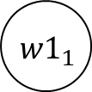
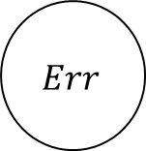
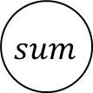
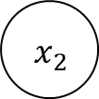

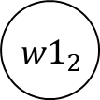








$${ w1}_{1}$$
①
$$∗$$
$$mul$$
$${ x}_{1}$$
$${ w1}_{2}$$
$$∗$$
$$mul$$
Sigmoid
MSE = $\frac{1}{2}{\left(y−\hat{y}\right)}^{2}$
②
$${ x}_{2}$$
⑤
$$sum$$
④
⑥
.
.
.
③
$cost$
net
$$h$$
$$\hat{y}$$
$$Err$$
$$+$$
$${ b}_{1}$$
$${ w1}_{m}$$
$${ y}_{ }$$
$$∗$$
$$mul$$
$${ x}_{m}$$

Slide 13









MSE = $\frac{1}{2}{\left(y−\hat{y}\right)}^{2}$
② $\frac{∂}{∂\hat{y}}Err$
$$cost$$
① $Err$
$$Err$$
$$\hat{y}$$
$${ y}_{ }$$
Err = ${\frac{1}{2}\left(y−\hat{y}\right)}^{2}$
② $\frac{∂}{∂\hat{y}}Err$ = $\frac{1}{2}∗2∗\left(y−\hat{y}\right)∗−1$ $\hat{y}$에 대해서 미분
= -$\left(y−\hat{y}\right)$

Slide 14





Sigmoid
③$\frac{∂\hat{y}}{∂net}\frac{∂}{∂\hat{y}}Err$
② $\frac{∂}{∂\hat{y}}Err$
net
$$h$$
$$\hat{y}$$
③ $\frac{∂\hat{y}}{∂net}\frac{∂}{∂\hat{y}}Err$ = ${h\left(net\right)}^{′} ∗$-$\left(y−\hat{y}\right)$
$h′\left(x\right)=h(x)(1−h\left(x\right))$ sigmoid미분 값 = sigmoid(1-sigmoid)
③ $\frac{∂\hat{y}}{∂net}\frac{∂}{∂\hat{y}}Err$ = $h\left(net\right)∗\left(1−h\left(net\right)\right)∗\text{−} \left(y−\hat{y}\right)$

Slide 15







$$sum$$
④$\frac{∂net}{∂+}\frac{∂\hat{y}}{∂net}\frac{∂}{∂\hat{y}}Err$
③ $\frac{∂\hat{y}}{∂net}\frac{∂}{∂\hat{y}}Err$
$$+$$
net
$${ b}_{1}$$
⑤$\frac{∂\hat{y}}{∂net}\frac{∂}{∂\hat{y}}Err$
+의 역전파는 그대로 지나간다.($∗$1과 같음)
④ $\frac{∂net}{∂+}\frac{∂\hat{y}}{∂net}\frac{∂}{∂\hat{y}}Err$ = $1∗h\left(net\right)∗\left(1−h\left(net\right)\right)∗\text{− }\left(y−\hat{y}\right)$
⑤ $\frac{∂net}{∂+}\frac{∂\hat{y}}{∂net}\frac{∂}{∂\hat{y}}Err$ = $1∗h\left(net\right)∗\left(1−h\left(net\right)\right)∗\text{− }\left(y−\hat{y}\right)$

Slide 16








$$mul$$
⑥$\frac{∂+}{∂\sum{ }}\frac{∂net}{∂+}\frac{∂\hat{y}}{∂net}\frac{∂}{∂\hat{y}}Err$
$$mul$$
.
.
.
④ $\frac{∂net}{∂+}\frac{∂\hat{y}}{∂net}\frac{∂}{∂\hat{y}}Err$
$$sum$$
$$mul$$
도 +이므로 역전파는 그대로 지나간다.(*1과 같음)
⑥ $\frac{∂+}{∂\sum{ }}\frac{∂net}{∂+}\frac{∂\hat{y}}{∂net}\frac{∂}{∂\hat{y}}Err$ = $1∗h\left(net\right)∗\left(1−h\left(net\right)\right)∗\text{− }\left(y−\hat{y}\right)$

Slide 17







⑦ $\frac{∂\sum{ }}{∂{w1}_{1}}\frac{∂+}{∂\sum{ }}\frac{∂net}{∂+}\frac{∂\hat{y}}{∂net}\frac{∂}{∂\hat{y}}Err$
$${ w1}_{1}$$
⑥ $\frac{∂+}{∂\sum{ }}\frac{∂net}{∂+}\frac{∂\hat{y}}{∂net}\frac{∂}{∂\hat{y}}Err$
$$∗$$
$$mul$$
$${ x}_{1}$$
$∗$의 역전파는 곱셈 대상을 곱해주면 된다.
⑦ $\frac{∂\sum{ }}{∂{w1}_{1}}\frac{∂+}{∂\sum{ }}\frac{∂net}{∂+}\frac{∂\hat{y}}{∂net}\frac{∂}{∂\hat{y}}Err \text{=} x_{1} ∗h\left(net\right)∗\left(1−h\left(net\right)\right)∗\text{− }\left(y−\hat{y}\right)$

Slide 18










$$\frac{∂Err}{∂{w1}_{1}}=\frac{∂\sum{ }}{∂{w1}_{1}}\frac{∂+}{∂\sum{ }}\frac{∂net}{∂+}\frac{∂\hat{y}}{∂net}\frac{∂Err}{∂\hat{y}}$$
$$\frac{∂Err}{∂b_{1}}=\frac{∂net}{∂b_{1}}\frac{∂\hat{y}}{∂net}\frac{∂Err}{∂\hat{y}}$$
$$x_{1}$$
$$1$$
$$−\left(y−\hat{y}\right)$$
$$1$$
$$−\left(y−\hat{y}\right)$$
$$1$$
$$h\left(net\right)∗\left(1−h\left(net\right)\right)$$
$$h\left(net\right)∗\left(1−h\left(net\right)\right)$$

Slide 19




























1 Layer
2 Layer
$${ w10}_{1}$$
$${ w20}_{1}$$
$$∗$$
$$mul$$
$$∗$$
$$mul$$
$${ x1}_{1}$$
$${ x2}_{1}$$
$$∗$$
$$mul$$
$$∗$$
$$mul$$
$${ w11}_{1}$$
$${ w21}_{1}$$
$${ w10}_{2}$$
$${ w20}_{2}$$
$$∗$$
$$mul$$
$$∗$$
$$mul$$
$${ x1}_{2}$$
$${ x2}_{2}$$
$$∗$$
$$mul$$
$$∗$$
$$mul$$
$${ w11}_{2}$$
$${ w21}_{2}$$
.
.
.
.
.
.

Slide 20




1 Layer
2 Layer
$${ w10}_{1}$$
$${ w20}_{1}$$
$$∗$$
$$mul$$
$A_{total}$
$$∗$$
$$mul$$
$${ x1}_{1}$$
$${ x2}_{1}$$
$A_{1}$
$$∗$$
$$mul$$
$A_{2}$
$$∗$$
$$mul$$
$${ w11}_{1}$$
$${ w21}_{1}$$
$$A_{total}=A_{1}+A_{2}$$

Slide 21





Slide 22






















Input Layer
Weight
Hidden Layer
Weight
Output Layer
$${ x}_{1}$$
$${ w1}_{1}$$
$${ w1}_{1}$$
$${ w1}_{1}$$
$${ w1}_{1}$$
$${ x}_{1}$$
$${ w2}_{1}$$
$${ x}_{1}$$
$$x_{2}$$
$${w1}_{2}$$
$${w1}_{2}$$
$${w1}_{2}$$
$${w1}_{2}$$
$$x_{2}$$
$${w2}_{2}$$
.
.
.
.
.
.
.
.
.
.
.
.
.
.
.
.
.
.
.
.
.
$$x_{15}$$
$${w1}_{15}$$
$${w1}_{15}$$
$${w1}_{15}$$
$${w1}_{15}$$
$$x_{6}$$
$${w2}_{6}$$
6
sigmoid
1
sigmoid

Slide 23
Input Layer
Hidden Layer
Output Layer
train_x
w1
i2hLayer
w2
h2oLayer
train_y
sigmoid
sigmoid
Loss
Error
15
6
1

Slide 24
Input Layer
Hidden Layer
Output Layer
train_x
w1
i2hLayer
w2
h2oLayer
sigmoid
sigmoid
Loss
a1
a2
=cost
Error
15
6
1

Slide 25








Input Layer
Weight
Hidden Layer
Weight
Output Layer
$${ x}_{1}$$
$${ w1}_{1}$$
$${ w1}_{1}$$
$${ w1}_{1}$$
$${ w1}_{1}$$
$${ x}_{1}$$
$${ w2}_{1}$$
$${ w1}_{1}$$
$${ w1}_{1}$$
$${ x}_{1}$$
$$x_{2}$$
$${w1}_{2}$$
$${w1}_{2}$$
$${w1}_{2}$$
$${w1}_{2}$$
$$x_{2}$$
$${w2}_{2}$$
$${w1}_{2}$$
$${w1}_{2}$$
.
.
.
.
.
.
.
.
.
.
.
.
.
.
.
.
.
.
.
.
.
.
.
.
.
.
.
$${ x}_{2}$$
$$x_{15}$$
$${w1}_{15}$$
$${w1}_{15}$$
$${w1}_{15}$$
$${w1}_{15}$$
$$x_{6}$$
$${w2}_{6}$$
$${w1}_{15}$$
$${w1}_{15}$$
$${ x}_{3}$$
6
sigmoid
3
softmax

Slide 26
Input Layer
Hidden Layer
Output Layer
train_x
w1
i2hLayer
w2
h2oLayer
train_y
sigmoid
sigmoid
Loss
b1
b2
Error
15
6
3

Slide 27
Input Layer
Hidden Layer
Output Layer
train_x
w1
i2hLayer
w2
h2oLayer
sigmoid
softmax
Loss
a1
a2
b1
b2
Error
15
6
3

Slide 30
Input Layer
Hidden Layer
Output Layer
train_x
w1
i2hLayer
w2
h2oLayer
sigmoid
sigmoid
b1
b2
15
6
3

