Slide 1

HW #1
1) $V_{o}=DV_{g}, D=0.6$
2) $\frac{{∆i}_{L}}{i_{L}}, \frac{∆i_{L}}{6}∗100=0.1, ∆i_{L}=6m[A]$
$$L=\frac{V_{g}−V}{2∆i_{L}}=\frac{50−30}{2∗6∗{10}^{−3}}∗0.6∗\frac{1}{50∗{10}^{3}}=0.02=20m\left[H\right]$$
3) $I_{L}=6\left[A\right], i_{Lmax}=6.006 \left[A\right], i_{Lmin}=5.994 [A]$
4) $q=c2∆V, ∆v=\frac{q}{2c}=\frac{∆i_{L}T_{s}}{8C}$
$$\frac{∆v}{v_{o}}=0.5\%=\frac{∆i_{L}T_{s}}{8C} ∗\frac{1}{30}, C=\frac{6∗{10}^{−3}∗\left(\frac{1}{50∗{10}^{3}}\right)∗100}{30∗8∗0.5 }=0.1μ[F]$$
$$∆v=0.15[V]$$

Slide 2
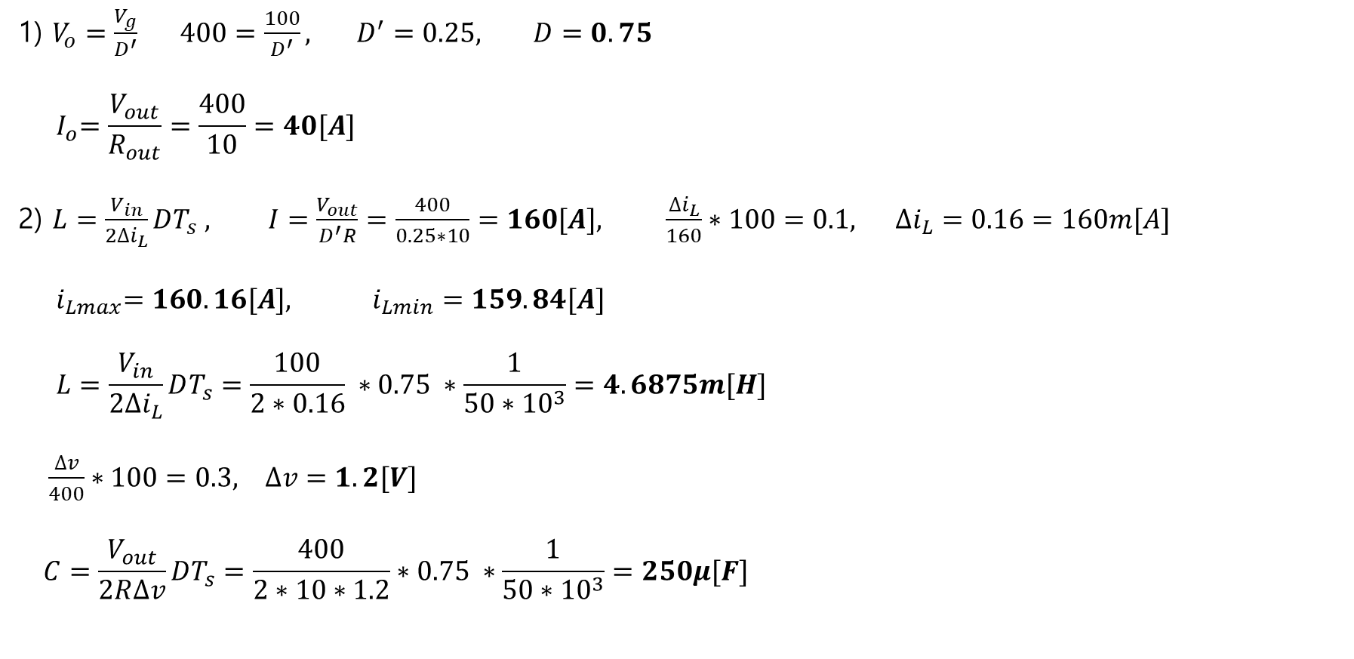
HW #2
1) $V_{o}=\frac{V_{g}}{D^{′}} 400=\frac{100}{D^{′}}, D^{′}=0.25, D=0.75$
$${ I}_{o}=\frac{V_{out}}{R_{out}}=\frac{400}{10}=40[A]$$
2) $L=\frac{V_{in}}{2∆i_{L}}DT_{s} , I=\frac{V_{out}}{D^{′}R}=\frac{400}{0.25∗10}=160[A], \frac{∆i_{L}}{160}∗100=0.1, ∆i_{L}=0.16=160m[A]$
$${ i}_{Lmax}=160.16[A], i_{Lmin}=159.84[A]$$
$$L=\frac{V_{in}}{2∆i_{L}}DT_{s}=\frac{100}{2∗0.16} ∗0.75 ∗\frac{1}{50∗{10}^{3}}=4.6875m[H]$$
$\frac{∆v}{400}∗100=0.3, ∆v=1.2[V]$
$$C=\frac{V_{out}}{2R∆v}DT_{s}=\frac{400}{2∗10∗1.2}∗0.75 ∗\frac{1}{50∗{10}^{3}}=250μ[F]$$

Slide 3
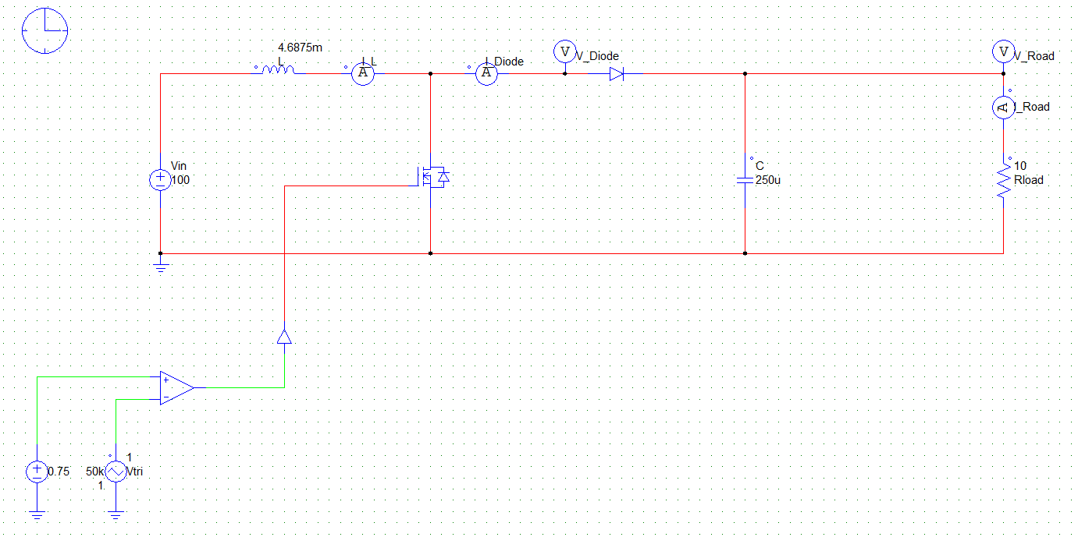
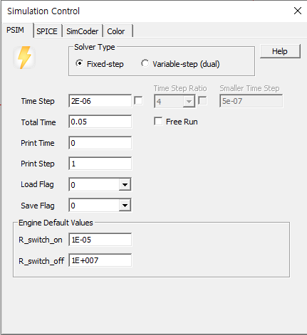
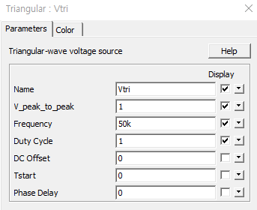

Slide 4
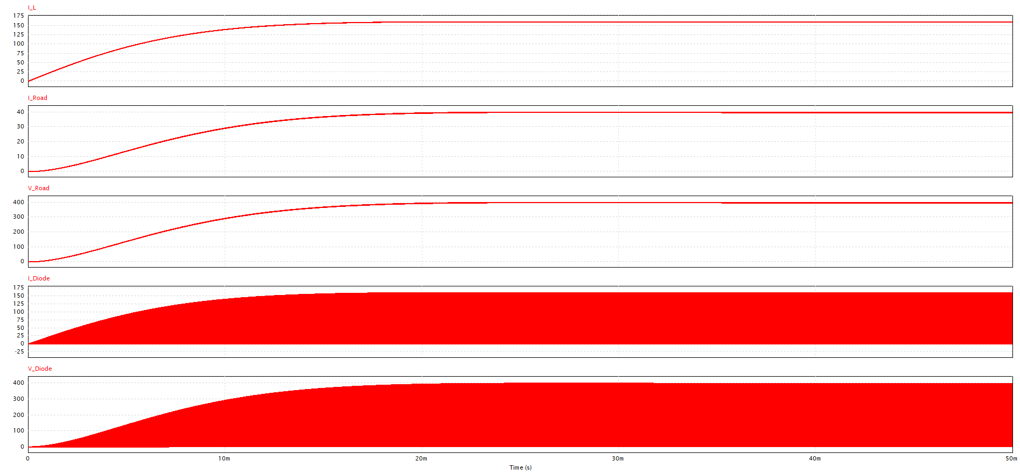

Slide 5
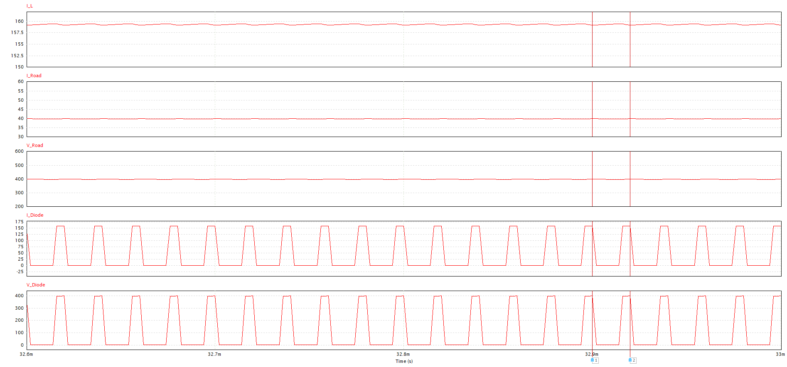
파형 (x-axis 조절 32.6m to 33msec)

