Slide 1
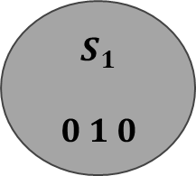
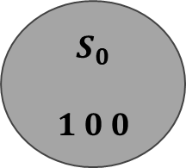
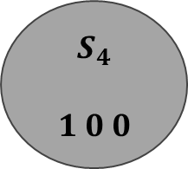
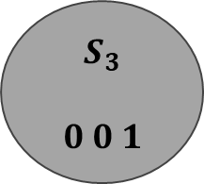
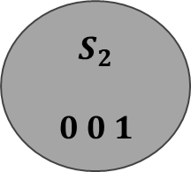
V=0
$$S_{0}$$
$$1 0 0$$
V=1
V=0, 1
$$S_{4}$$
$$1 0 0$$
$$S_{1}$$
$$0 1 0$$
V=0, 1
V=0, 1
$$S_{3}$$
$$0 0 1$$
$$S_{2}$$
$$0 0 1$$
V=0, 1

Slide 2
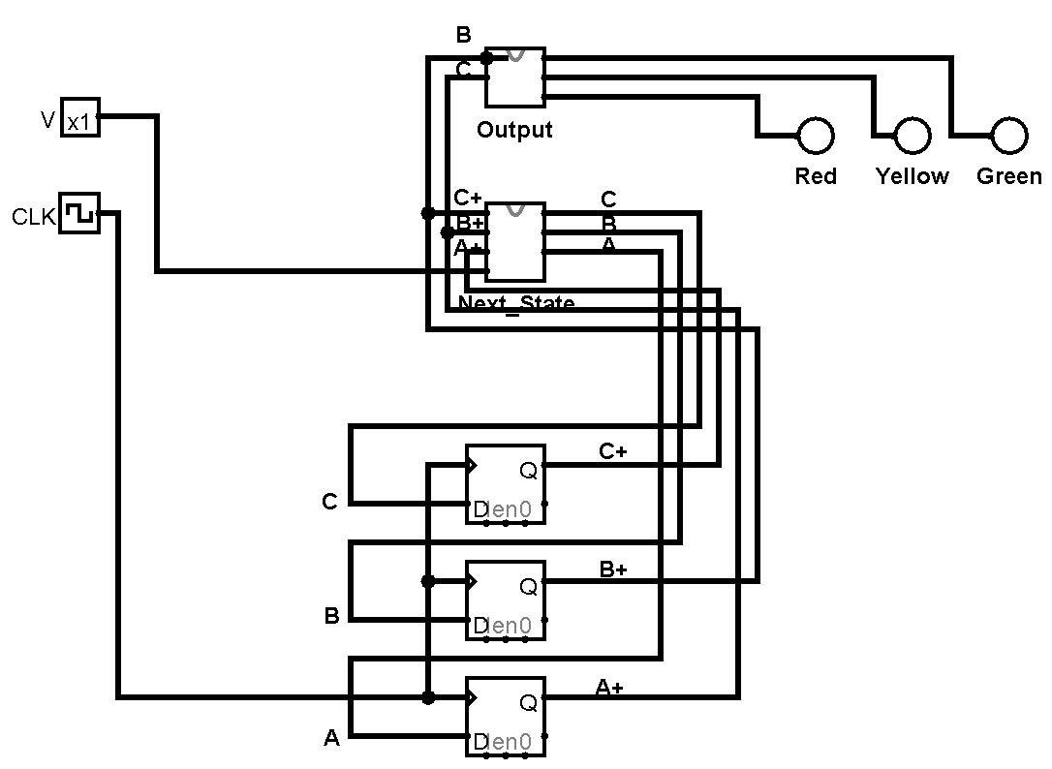
Next State Circuit & Output Circuit
Input
Output
Update

