Slide 1
Neural correlates of emotional responses to music
Souvik Saha (3704112)
Ananya Kulkarni (3647062)
-> Paper
- > Dataset

Slide 2
Authors | Team Last 2 Brain Cells | Proposed Approach
Visual inspection for artefacts | mne-ICLabel | Automated approach, saves time
50Hz Notch Filter + 0.1-45Hz Band Pass | 0.1-45Hz Band Pass filter | 50 Hz notch is unnecessary with 0.1-45Hz Bandpass
Infomax ICA in EEGLAB | Downsampled - 100Hz | First doing the downsampling to reduce ICA process times
Downsampled - 100Hz | FastICA in mne-python | Using FastICA to further reduce processing times
Exclusion of data if 1. they were marked as having EMG, movement or bad electrode artefacts 2. Amplitude is > +- 100 uV | Exclusion of data if 1. they were marked as having EMG, movement or bad electrode artefacts 2. Amplitude is > +- 100 uV | Same approach as authors

Slide 3
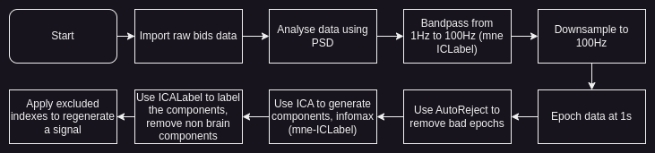
Actual approach

Slide 4
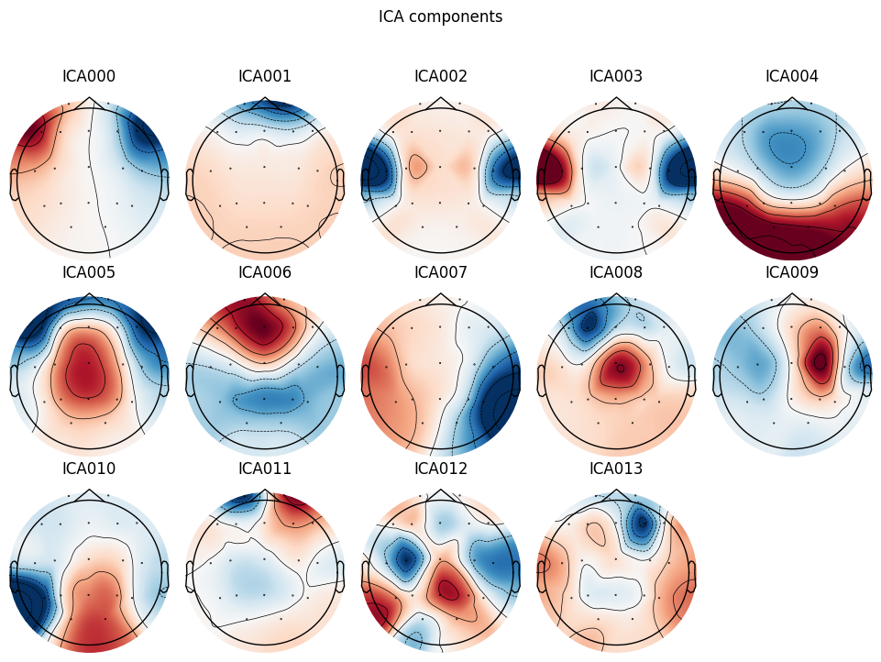
ICA Components

Slide 5
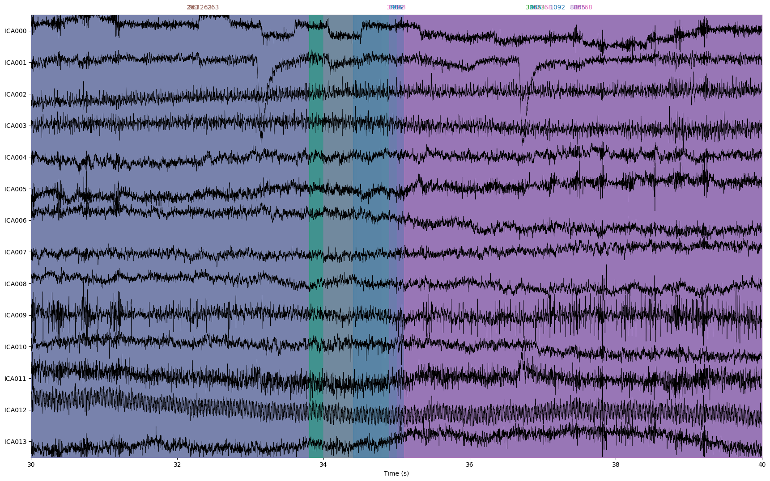
ICA Components plotted
0. 'eye blink', 1. 'eye blink', 2. muscle artifact', 3. 'muscle artifact', 4. 'brain', 5. 'brain', 6. 'brain', 7. 'brain', 8. 'brain', 9. 'brain', 10. 'brain', 11. 'other', 12. 'line noise', 13. 'other'

Slide 6
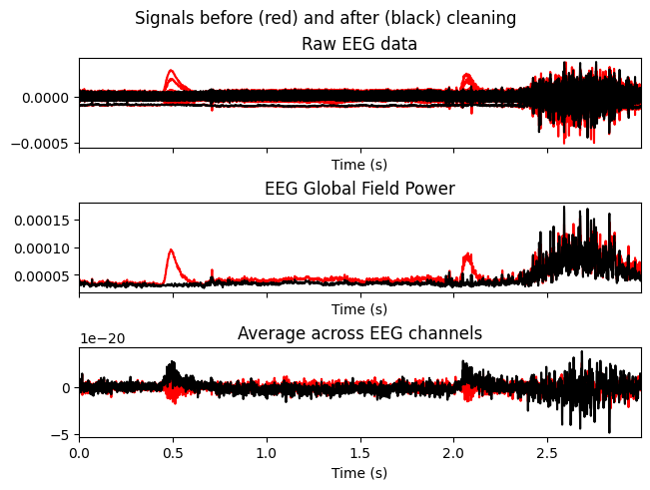
Results after ICA channel removal

Slide 7
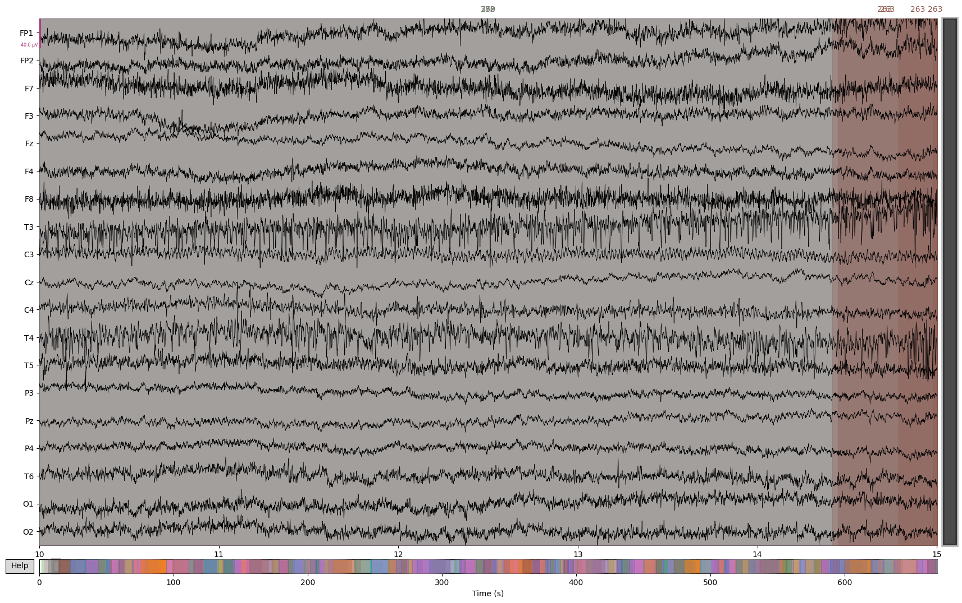
Data before preprocessing

Slide 8
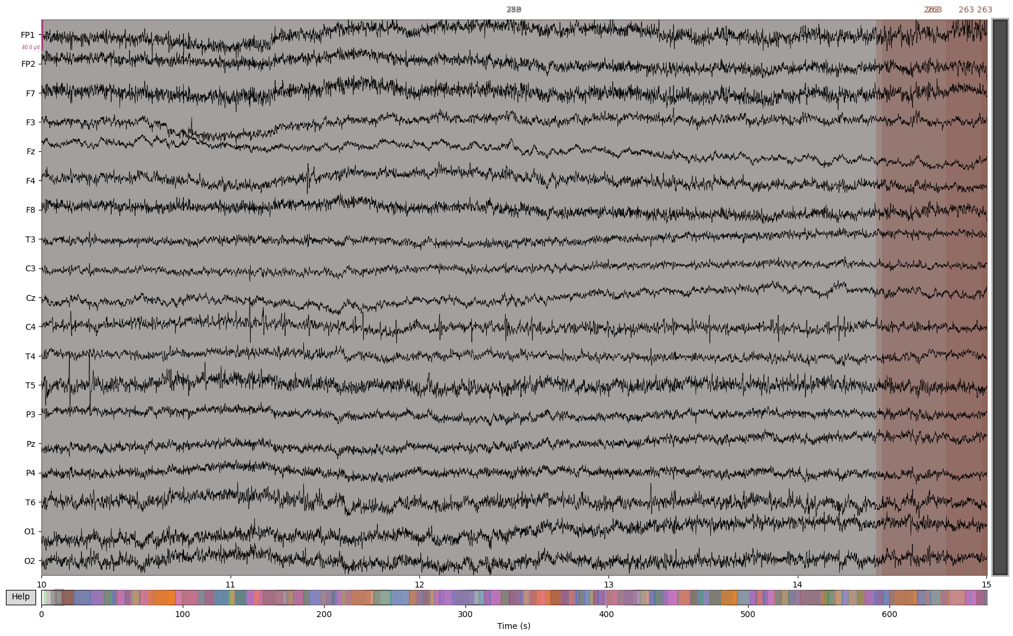
Data after preprocessing

Slide 9
Further proposed steps
Collect emotional response data from event.json files
Calculate the PCA of these emotional responses.
Calculate correlation between asymmetry measure(?) and PC of induced correlation
Repeat, with subject demographics also considered as factors

