Slide 1
Neural correlates of emotional responses to music
Souvik Saha (3704112)
Ananya Kulkarni (3647062)
-> Paper
-> Dataset

Slide 2
Authors | Team Last 2 Brain Cells | Proposed Approach
Visual inspection for artefacts | mne-ICLabel | Automated approach, saves time
50Hz Notch Filter + 0.1-45Hz Band Pass | 0.1-45Hz Band Pass filter | 50 Hz notch is unnecessary with 0.1-45Hz Bandpass
Infomax ICA in EEGLAB | Downsampled - 100Hz | First doing the downsampling to reduce ICA process times
Downsampled - 100Hz | FastICA in mne-python | Using FastICA to further reduce processing times
Exclusion of data if 1. they were marked as having EMG, movement or bad electrode artefacts 2. Amplitude is > +- 100 uV | Exclusion of data if 1. they were marked as having EMG, movement or bad electrode artefacts 2. Amplitude is > +- 100 uV | Same approach as authors

Slide 3
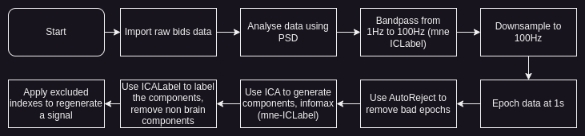
Actual approach

Slide 4
Preprocessing Pipeline Steps
1. Reads the raw data from the BIDS dataset
2. Reads the annotations from the BIDS dataset
3. Sets the EEG reference to average
4. Sets the montage to standard_1020
5. Filters the data between 1Hz and 100Hz
6. Downsamples the data to 200Hz
7. Breaks the data into 1s epochs

Slide 5
8. Applies autoreject to the epochs
9. Fit ICA to the epochs
10. Applies ICALabel to the ICA components
11. Removes the ICA components that are not brain or other
12. Applies the ICA to the raw data
13. Filters the data between 1Hz and 40Hz to remove line noise
14. Saves the data as EDF

Slide 6
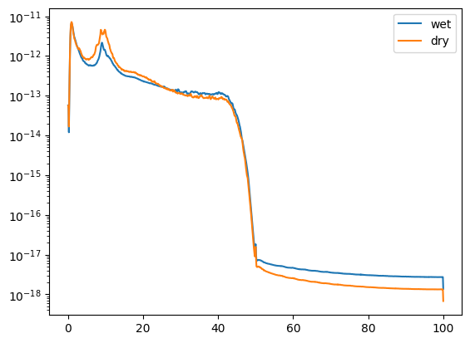
Dry and Wet Runs

Slide 7
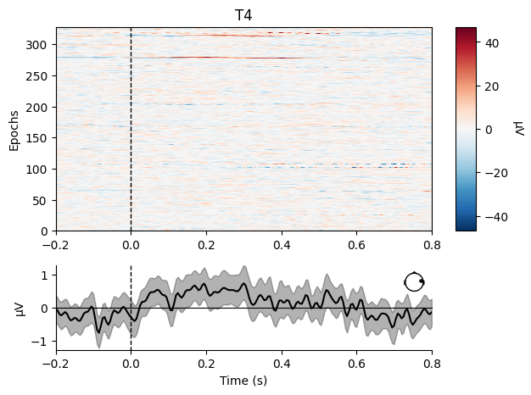
Epoching

Slide 8
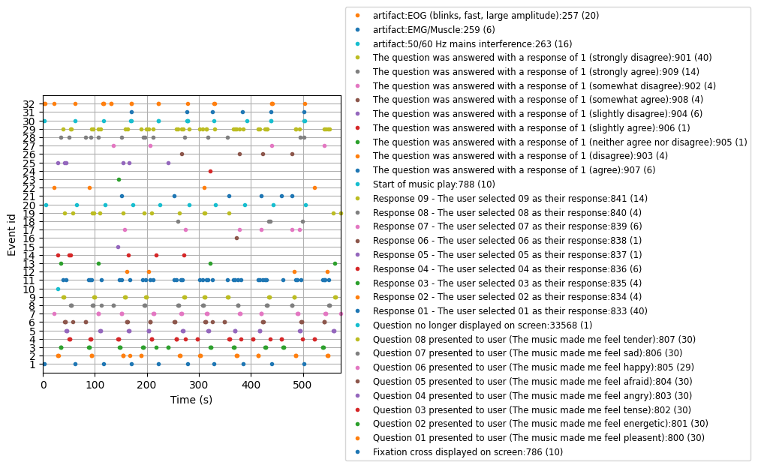

Slide 9
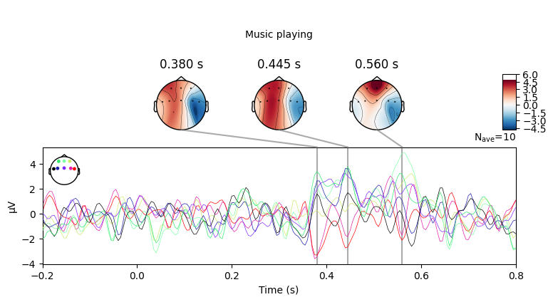
Music Playing vs Rest

Slide 10
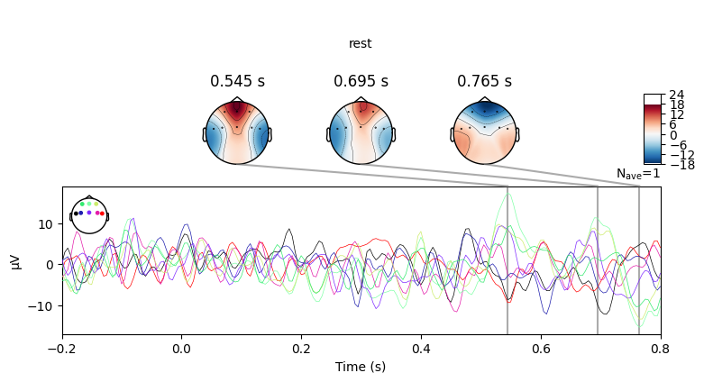

Slide 11
Further proposed steps
Calculate the PCA of these emotional responses.
Calculate correlation between asymmetry measure(?) and PC of induced correlation
Repeat, with subject demographics also considered as factors
Perform emotion based epoching followed by regression.

