Slide 1
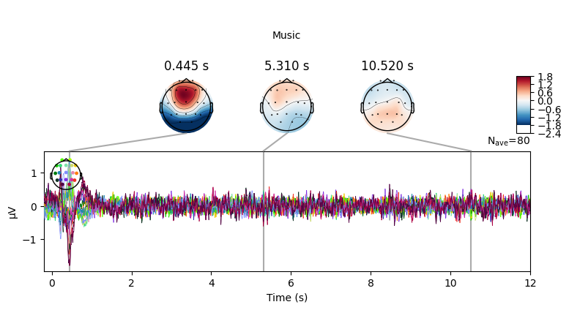
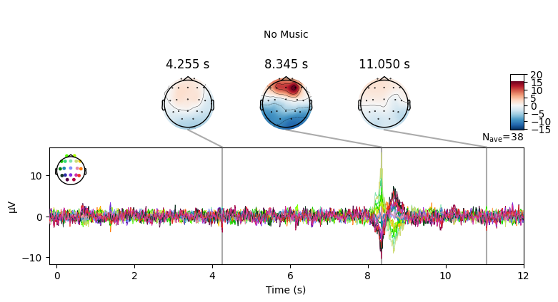
Last Two Brain Cells
12s reponse with and without music
Roadblocks -
No labels for the type of music being played, music link is dead -> not sure how to classify based on emotional data, Also hard to aggregate from the events.tsv

Slide 2
Suggestions
1. Authors do a PCA, Connection analysis, use metadata for emotions
Contact authors
Classification
Time freq analysis

