Slide 1





제주 소원 팔찌
Travel + Connect + Protect
Jeju Wish-Band
TEAM Jeju Wish-Band
Advisors
Team Members
University
Country
Asst. Prof. Dr. Vera Sa-ing
Assoc. Prof. Dr.Cattareeya Suwanasri
Mr. Pitak Patumwan
Miss Pitchayapa Thongnuan
Miss Abhinya Suwanasri
Mr. Ilja Triantafyllidis
King Mongkut's University of Technology North Bangkok (KMUTNB)
Thailand
Team Leader
Miss Chotika Wittayakom
Notes:
Hello everyone
1

Slide 2





Team Jeju Wish-Band • KMUTNB, Thailand
Three Hidden Challenges
2024: one famous spot drew 300× the foreign visitors of a local site
1
2
3
Over-tourism
Unseen local shops
Safety gaps
Famous spot : Seongsan Ilchulbong 224,136
Village shops and restaurants miss out on customers and income.
Rescuers may not know your location, health, language or who to call.
Local site : Hangpaduri Historic Site 747
foreign visitors in 2024
Sources: Jeju Province (2024).
Notes:
INTRO 0:08-0:20, CHOTIKA: Crowds: one famous spot drew 300 times the foreign visitors of a local site. Local shops stay unseen. And in an emergency, rescuers may not know your location, health or language.

Slide 3


Team Jeju Wish-Band • KMUTNB, Thailand
Meet the Jeju Wish-Band
Jeju volcanic-stone beads + NFC
No app download. No battery. SOS at any station, even with a dead phone.
AI picks places, food and activities for you
TRAVEL
Stamps at local shops unlock a market voucher
CONNECT
SOS sends your info to the help desk
PROTECT
Notes:
INTRO 0:20-0:30, CHOTIKA: So we made the Jeju Wish-Band: volcanic-stone beads that open a smart island app. No download, no battery. Travel, Connect, Protect. Let us show you. (Hold up a band.)

Slide 4
Team Jeju Wish-Band • KMUTNB, Thailand
Live Demo
LIVE DEMO
1
2
3
4
AI picks
Tap 3 stations
Voucher unlocked
5-tap SOS
AI picks today’s place, food and activity from weather, interests and crowd level
Place, food, activity: beep + stamp
4,000 KRW at Dongmun Market
No phone? Tap the band 5 times
Watch the phone app and the help desk update live
Notes:
Cue card. Skip on stage if you go straight from slide 4 to the browser.
DEMO 0:55-1:15, OHM: This is my band's app. Each pick tells me why: fits my diet, local family business, quiet hidden spot. And if I feel like nature today, I tap it, and the picks change for today.
DEMO 1:15-1:50, OHM: Connect. I go there and tap my band. (place) Two beeps, and the stamp is on my phone and on the help desk. (food) Every pick sends me to a local business. (activity) Food, place and activity: that unlocks a 4,000 won Dongmun Market voucher.
DEMO 1:50-2:10, PITCHAYAPA: Protect. What if my phone is dead? I just tap my band five times at any station. (Ohm taps 5x) The help desk gets an SOS with my last location, my health notes, my language and my emergency contact.
DEMO 2:10-2:30, PITCHAYAPA: Staff press Acknowledge, then Dispatch, and the traveler sees on the phone that help is coming and when. The app also has a hold-to-send SOS button and a Helping Map to the nearest help. (Press Acknowledge, Dispatch, Enter twice; open the SOS tab on the phone view.)
BACKUP: no beep in 2 s -> press the matching Demo control button (Place/Food/Activity tap, 5-tap band SOS). Late at 2:10 -> skip Acknowledge/Dispatch.

Slide 5
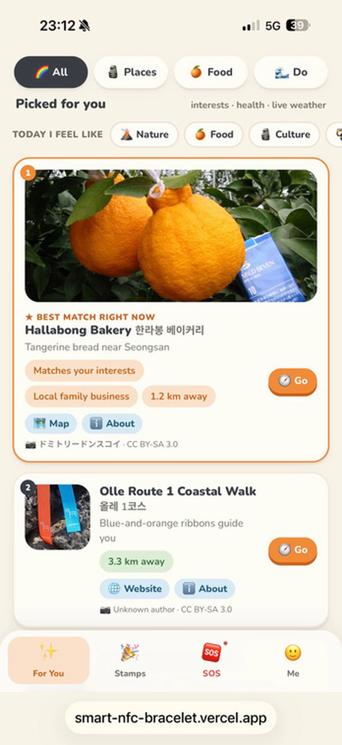

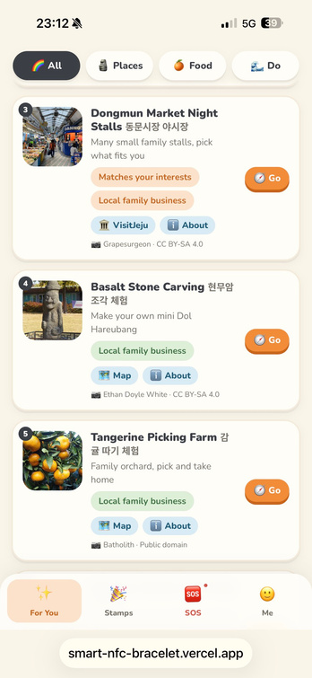
Team Jeju Wish-Band • KMUTNB, Thailand
Live Demo
1
AI picks
AI picks today’s place, food and activity from weather, interests and crowd level
Notes:
Cue card. Skip on stage if you go straight from slide 4 to the browser.
DEMO 0:55-1:15, OHM: This is my band's app. Each pick tells me why: fits my diet, local family business, quiet hidden spot. And if I feel like nature today, I tap it, and the picks change for today.
DEMO 1:15-1:50, OHM: Connect. I go there and tap my band. (place) Two beeps, and the stamp is on my phone and on the help desk. (food) Every pick sends me to a local business. (activity) Food, place and activity: that unlocks a 4,000 won Dongmun Market voucher.
DEMO 1:50-2:10, PITCHAYAPA: Protect. What if my phone is dead? I just tap my band five times at any station. (Ohm taps 5x) The help desk gets an SOS with my last location, my health notes, my language and my emergency contact.
DEMO 2:10-2:30, PITCHAYAPA: Staff press Acknowledge, then Dispatch, and the traveler sees on the phone that help is coming and when. The app also has a hold-to-send SOS button and a Helping Map to the nearest help. (Press Acknowledge, Dispatch, Enter twice; open the SOS tab on the phone view.)
BACKUP: no beep in 2 s -> press the matching Demo control button (Place/Food/Activity tap, 5-tap band SOS). Late at 2:10 -> skip Acknowledge/Dispatch.

Slide 6
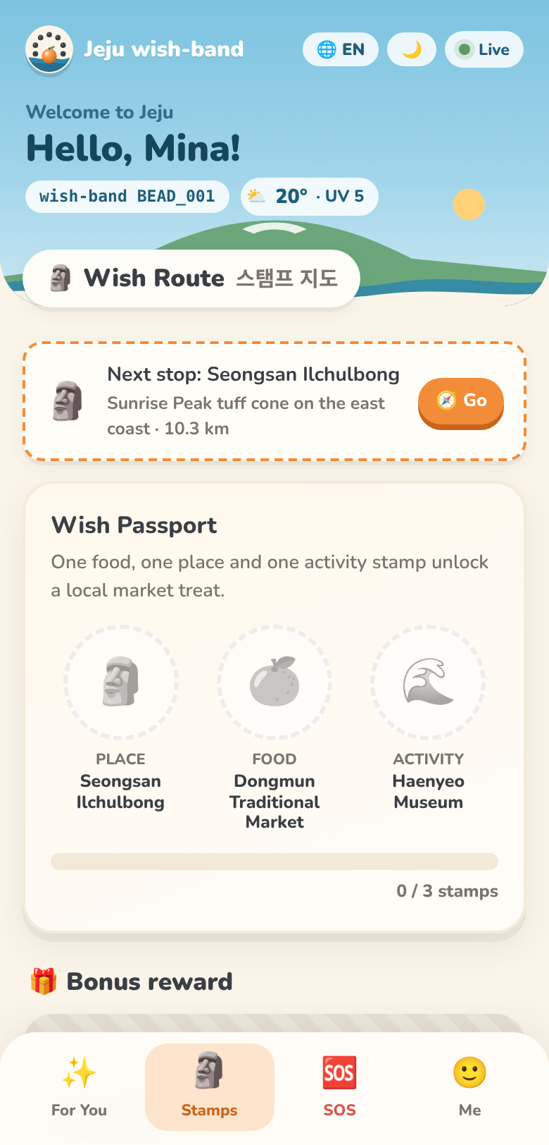
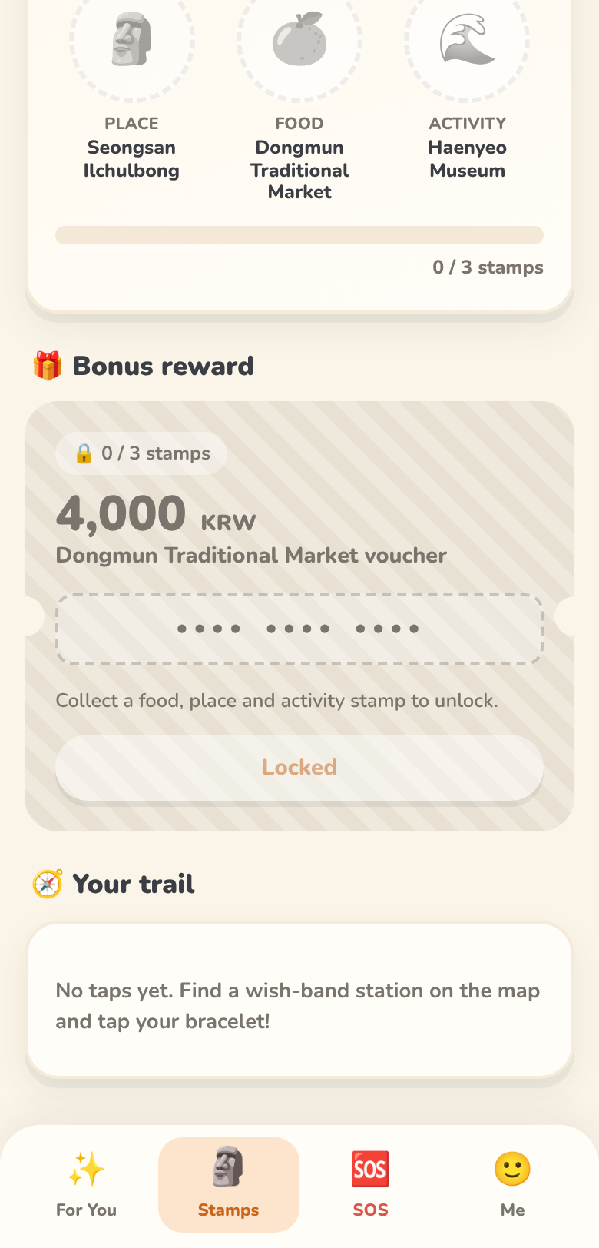
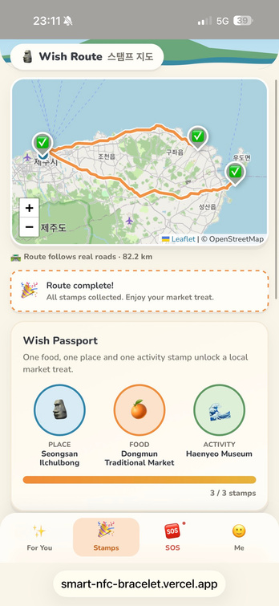
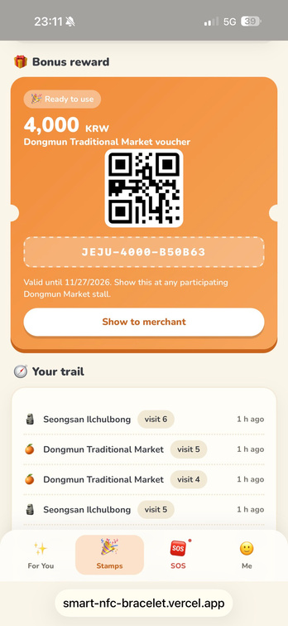
Team Jeju Wish-Band • KMUTNB, Thailand
Live Demo
2
Tap 3 stations, unlock a voucher
Collect 3 stamps (place, food or activity) and redeem at Dongmun Market
Ready: 0 / 3 stamps, voucher locked

Slide 7
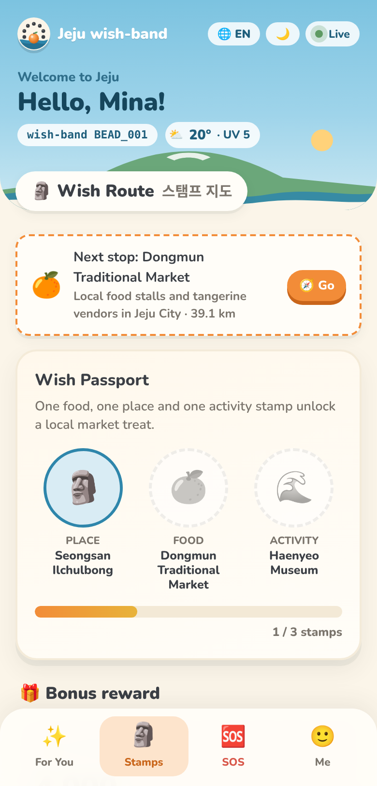
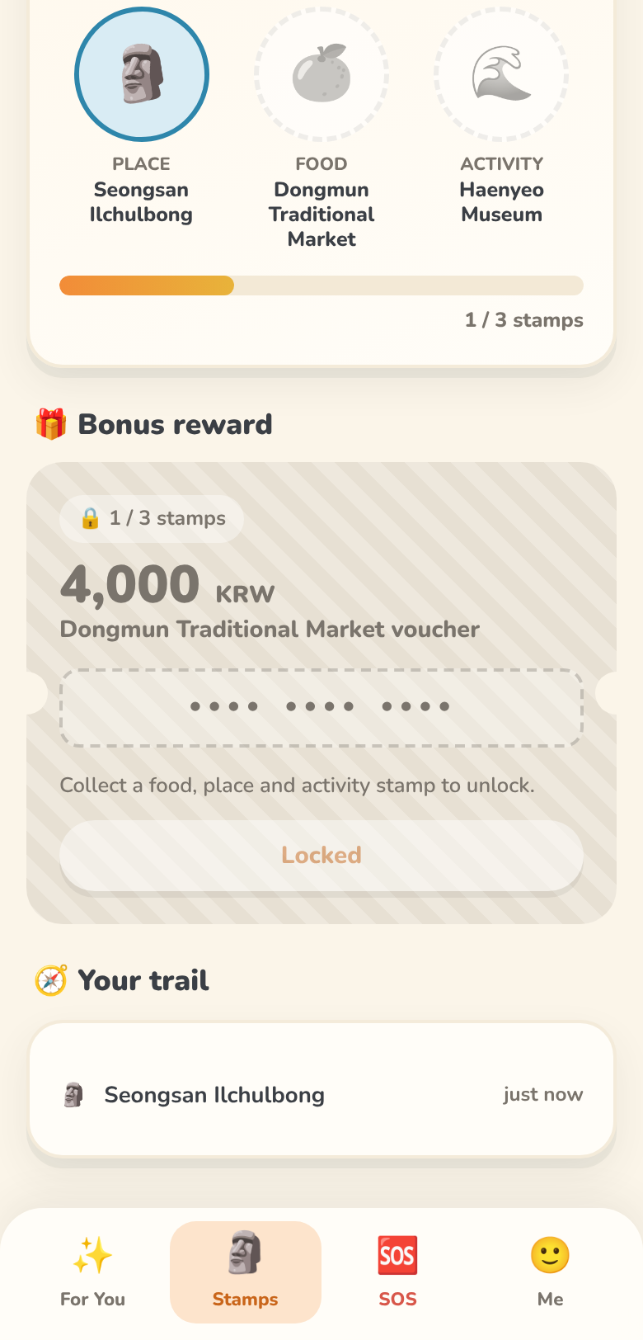
Team Jeju Wish-Band • KMUTNB, Thailand
Live Demo
2
Tap 3 stations, unlock a voucher
Collect 3 stamps (place, food or activity) and redeem at Dongmun Market
1st tap: place stamp (Seongsan Ilchulbong)

Slide 8
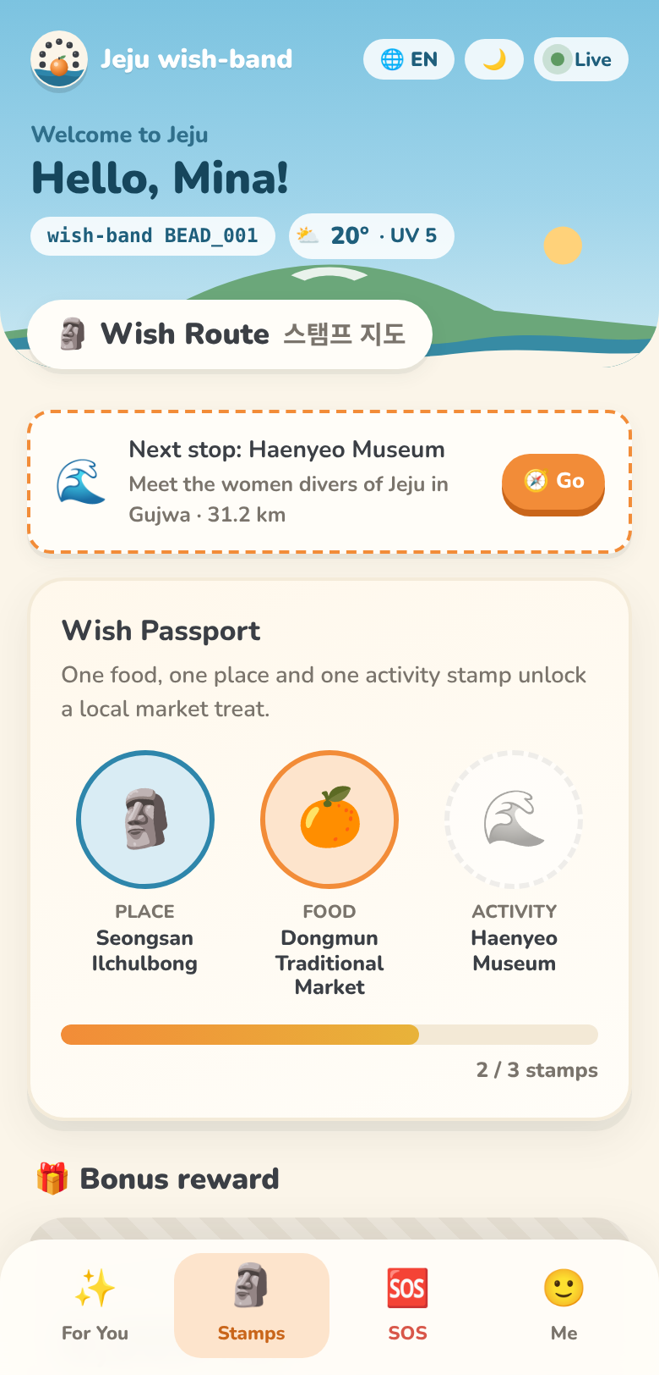
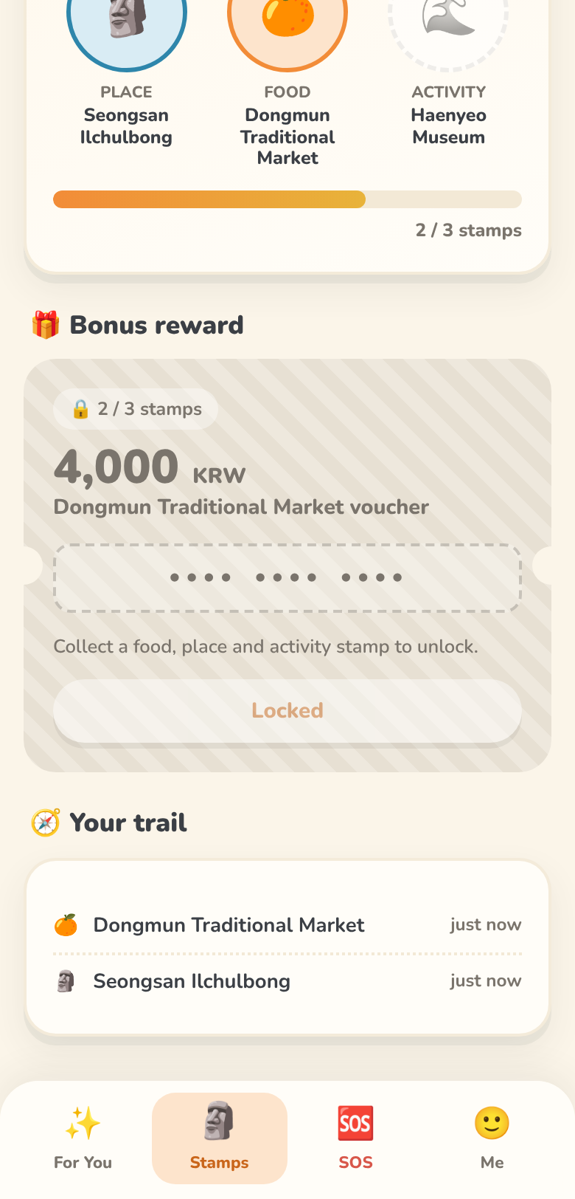
Team Jeju Wish-Band • KMUTNB, Thailand
Live Demo
2
Tap 3 stations, unlock a voucher
Collect 3 stamps (place, food or activity) and redeem at Dongmun Market
2nd tap: food stamp (Dongmun Market)

Slide 9
Team Jeju Wish-Band • KMUTNB, Thailand
Live Demo
2
Tap 3 stations, unlock a voucher
Collect 3 stamps (place, food or activity) and redeem at Dongmun Market
3rd tap: activity stamp. 3 / 3, 4,000 KRW voucher unlocked!
Notes:
Cue card. Skip on stage if you go straight from slide 4 to the browser.
DEMO 0:55-1:15, OHM: This is my band's app. Each pick tells me why: fits my diet, local family business, quiet hidden spot. And if I feel like nature today, I tap it, and the picks change for today.
DEMO 1:15-1:50, OHM: Connect. I go there and tap my band. (place) Two beeps, and the stamp is on my phone and on the help desk. (food) Every pick sends me to a local business. (activity) Food, place and activity: that unlocks a 4,000 won Dongmun Market voucher.
DEMO 1:50-2:10, PITCHAYAPA: Protect. What if my phone is dead? I just tap my band five times at any station. (Ohm taps 5x) The help desk gets an SOS with my last location, my health notes, my language and my emergency contact.
DEMO 2:10-2:30, PITCHAYAPA: Staff press Acknowledge, then Dispatch, and the traveler sees on the phone that help is coming and when. The app also has a hold-to-send SOS button and a Helping Map to the nearest help. (Press Acknowledge, Dispatch, Enter twice; open the SOS tab on the phone view.)
BACKUP: no beep in 2 s -> press the matching Demo control button (Place/Food/Activity tap, 5-tap band SOS). Late at 2:10 -> skip Acknowledge/Dispatch.

Slide 10
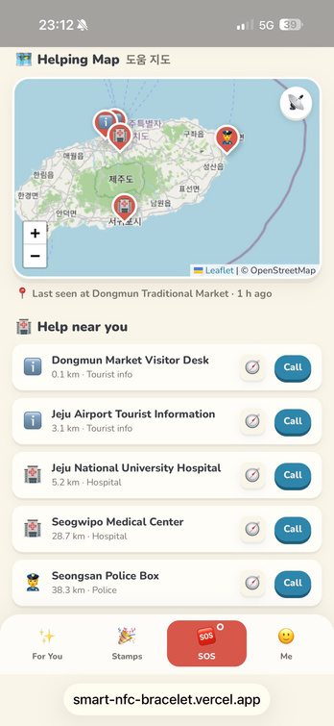
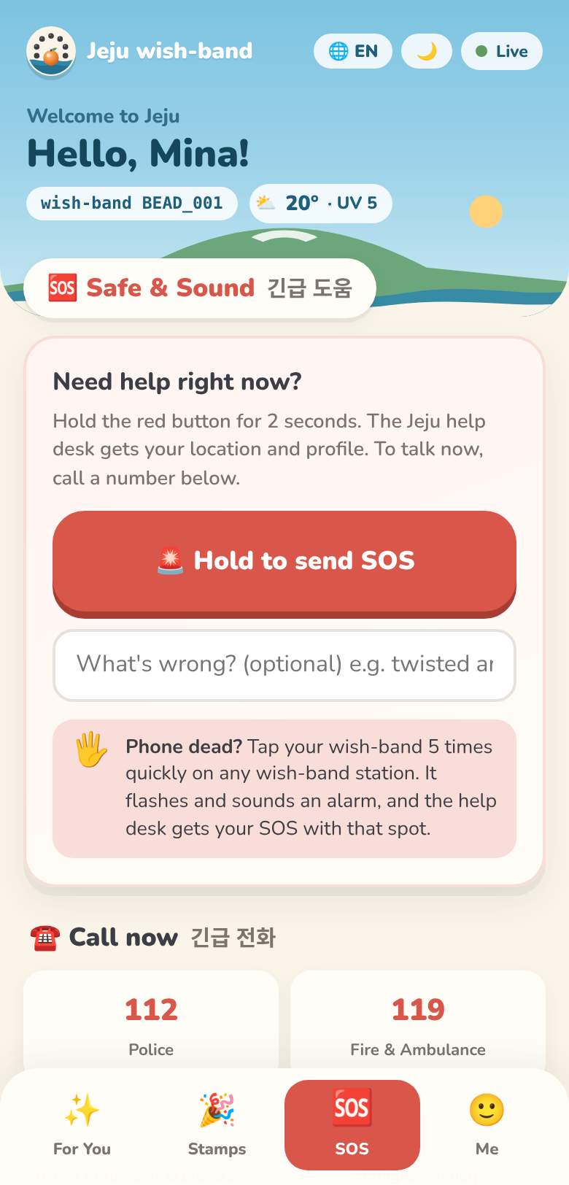
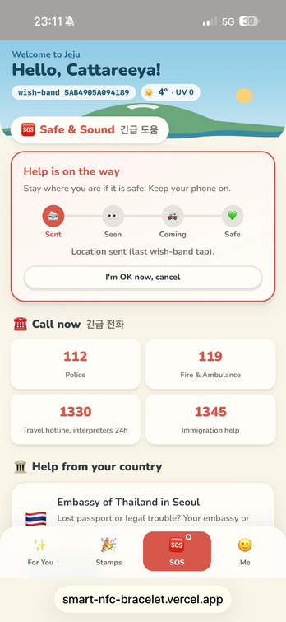
Team Jeju Wish-Band • KMUTNB, Thailand
Live Demo
3
2
5-tap SOS
Tap 3 stations
Place, food, activity: beep + stamp
No phone? Tap the band 5 times
Idle: everyone safe. Hold SOS on the phone, or tap the band 5 times

Slide 11
Team Jeju Wish-Band • KMUTNB, Thailand
Live Demo
3
2
5-tap SOS
Tap 3 stations
Place, food, activity: beep + stamp
No phone? Tap the band 5 times
SOS sent: help desk sees the alert and last location
Notes:
Cue card. Skip on stage if you go straight from slide 4 to the browser.
DEMO 0:55-1:15, OHM: This is my band's app. Each pick tells me why: fits my diet, local family business, quiet hidden spot. And if I feel like nature today, I tap it, and the picks change for today.
DEMO 1:15-1:50, OHM: Connect. I go there and tap my band. (place) Two beeps, and the stamp is on my phone and on the help desk. (food) Every pick sends me to a local business. (activity) Food, place and activity: that unlocks a 4,000 won Dongmun Market voucher.
DEMO 1:50-2:10, PITCHAYAPA: Protect. What if my phone is dead? I just tap my band five times at any station. (Ohm taps 5x) The help desk gets an SOS with my last location, my health notes, my language and my emergency contact.
DEMO 2:10-2:30, PITCHAYAPA: Staff press Acknowledge, then Dispatch, and the traveler sees on the phone that help is coming and when. The app also has a hold-to-send SOS button and a Helping Map to the nearest help. (Press Acknowledge, Dispatch, Enter twice; open the SOS tab on the phone view.)
BACKUP: no beep in 2 s -> press the matching Demo control button (Place/Food/Activity tap, 5-tap band SOS). Late at 2:10 -> skip Acknowledge/Dispatch.

Slide 12
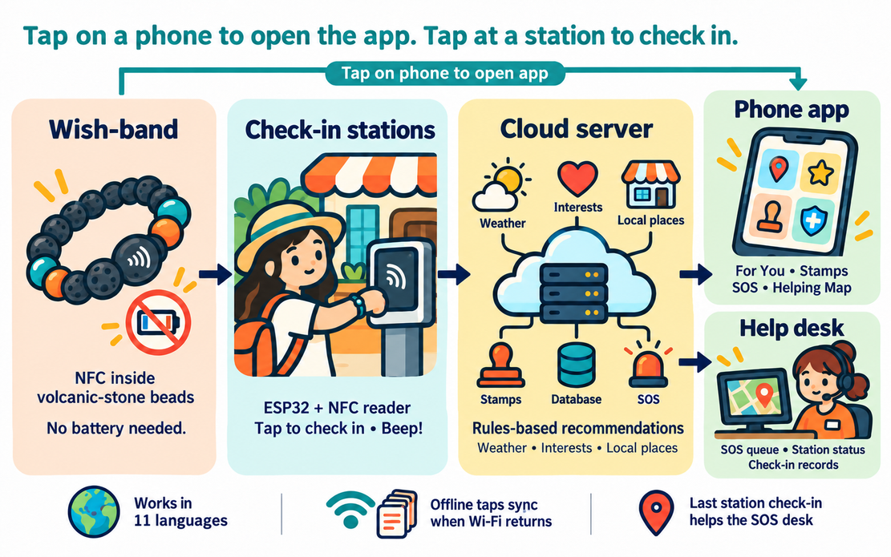
Team Jeju Wish-Band • KMUTNB, Thailand
How It Works
Notes:
Q&A backup slide. Show only if judges ask how the system works.

Slide 13
Team Jeju Wish-Band • KMUTNB, Thailand
How We Will Measure It
Recommendation conversion
User satisfaction
How many AI picks turn into a real visit
Short survey in the app after the trip
Check-ins and stamps
Last-location success
Taps at local places and shops
SOS alerts that arrive with a usable location
Notes:
Q&A backup slide. Indicators from the advisor's abstract. Do not quote demo numbers as results.

Slide 14
Team Jeju Wish-Band • KMUTNB, Thailand
Who Pays?
Three groups gain, so three groups can pay
1
2
3
Travelers
Local businesses
Tourism & safety bodies
✓ 10,000 KRW refundable deposit per band
✓ Keep the band as a souvenir (sale)
✓ Partner shop listing (ranking stays fair)
✓ Co-fund the 4,000 KRW voucher
✓ Pilot program funding
✓ Anonymous visitor-flow insights
Notes:
Q&A backup. From our Business Model Canvas. The deposit is returned, so it is not revenue; it covers lost bands. Listing fees, co-funding and pilot funding are not confirmed yet: say 'we will validate them in the pilot'.

Slide 15
Team Jeju Wish-Band • KMUTNB, Thailand
Our Wish
SMARTER
trips for visitors
FAIRER
income for locals
SAFER
Jeju for everyone
That is our wish.
Notes:
CLOSE 2:30-3:00, CHOTIKA: Smarter trips for visitors. Fairer income for locals. A safer Jeju for everyone. That is our wish. Next, we will run a field trial with real visitors and local shops, and measure every pick, stamp and SOS. You're welcome to try a station with your band after the session. Thank you!

Slide 16
Team Jeju Wish-Band • KMUTNB, Thailand
Jeju Wish-Band
— Feel free to ask anything ! —
Thank You
for
Your Kind Attention
제주 소원 팔찌

Slide 17
Team Jeju Wish-Band • KMUTNB, Thailand
How It Works
Tap the band on a phone to open your app. Tap it on a station to check in.
Phone app
For You, Stamps, SOS, Helping Map
Wish-band
Check-in stations
Cloud server
NFC tag in volcanic-stone beads. No battery.
ESP32 + NFC reader, beeps on every tap
AI picks from weather + your interests + crowd level, stamps, SOS, live weather, database
Help desk
Works in 11 languages. If Wi-Fi drops, stations queue taps and send them later.
Your last tap location is kept, so the help desk can find you after an SOS.
SOS queue, station status, check-ins
Notes:
Q&A backup slide. Show only if judges ask how the system works.

Slide 18
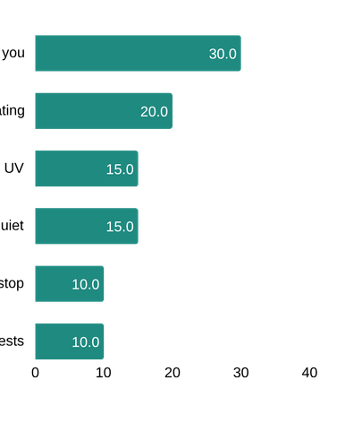
Team Jeju Wish-Band • KMUTNB, Thailand
Travel: How Our AI Picks
1
Check first
2
Score each place
3
Picks
✓ Food fits your diet
✓ Not visited yet
✓ OK for your mobility
✓ Bad weather moves outdoor spots down
Place
Quiet hidden spot
Food
Fits your diet
Activity
Matches your interests
Rules-based AI ranking today. Next: it learns from real trial visits.
Pick “Today I feel like” and the list changes for today. Live weather updates it.
Notes:
DEMO 0:30-0:55, OHM: Travel is our main feature. Our AI first checks three things: the food fits my diet, I haven't been there yet, and I can reach it with my mobility. Then it scores every place: how near it is, its rating, today's weather and UV, my interests, and extra points for local, quiet spots.
Then PITCHAYAPA switches to the demo screen (admin desk left, Phone view right).
Weights from lib/core.js: 0.30 near + 0.20 rating + 0.15 weather/UV + 0.15 local & quiet + 0.10 next stop + 0.10 interests, multiplied by the diet, visited, weather and mobility gates.

Slide 19
Team Jeju Wish-Band • KMUTNB, Thailand
Your Data, Your Choice
Ask first
Trial data counts only after the traveler agrees. They can leave at any time.
1
Only what helps
Name, language, diet, health notes, emergency contact. Nothing more.
2
Kept safe
The band holds only a link, no personal data. Staff-only help desk. Anonymous IDs in reports.
3
Next: a random code in each band link and automatic deletion after the trip, in line with Korea’s PIPA.
Notes:
Q&A backup. Built today: trial consent with withdrawal, admin PIN and station keys (set ADMIN_PIN and STATION_KEY on Vercel), anonymous participant IDs in exports, staff can delete a band's data. Planned: random token in the tag URL, auto-delete after the trip (PIPA).

Slide 20
Team Jeju Wish-Band • KMUTNB, Thailand
Why Not Just an App?
 | Typical map app | Jeju Wish-Band
What comes first | Popular, top-rated places | Places that fit you, local and quiet boosted
Diet needs | Search and hope | Unsafe food is filtered out
Local shops | Compete with big names | Stamps + voucher bring visitors in
Emergency | Call and explain yourself | SOS sends location, health, language, contact
Dead phone | Nothing | Tap the band 5 times at a station
Notes:
Q&A backup. Do not name or criticise a specific app. Key line: map apps send everyone to the same top-rated places; we push local and quiet places up, filter unsafe food, and the band still works for SOS when the phone is dead.

