Slide 1
Tutorial 2 CSI3130-Database II
27 September 2022

Slide 2
Query Processing in memory
Query processing algorithms help minimise the I/O cost. But here will discuss the techniques which help minimise the memory access costs.
These techniques are : Cache - Conscious Algorithms and query compilation.
They can speed up processing once data has been brought into the in-memory buffer.

Slide 3
Cache Conscious Algorithms
Goal: to minimise cache misses, make best use of data fetched into the cache as part of cache line (typically 64 bytes).
For external merge-sort: use runs that are as large as L3 cache to avoid cache misses during a sorting run. Then merge runs as usual in merge sort as merging is cache efficient.
For hash-join: First create partitions such that build and probe partitions fit in memory. Then sub-partition further such that build sub-partition + index fits in L3 cache which minimises the cache misses.

Slide 4
Query compilation
Traditional databases query processors act as interpreters that execute a query plan. However, there is a significant overhead due to interpretation.
To avoid overhead due to interpretation, modern main-memory databases compile query plans into machine code or intermediate level byte-code. With this and some other optimizations, compiled code has been found to be ten times faster than interpreted code.

Slide 5
Column - Oriented storage
When we need to access a small number of attributes in large schema then then storing a relation by column is efficient than row as selection operation on small no. of attributes has low cost in column store.
Because column stores permit efficient access to many values for a given attribute at once, they are well suited to exploit the vector-processing capabilities of modern processors. This capability allows certain operations (such as comparisons and aggregations) to be performed in a parallel on multiple attribute values.
e.g. Apache Cassandra

Slide 6
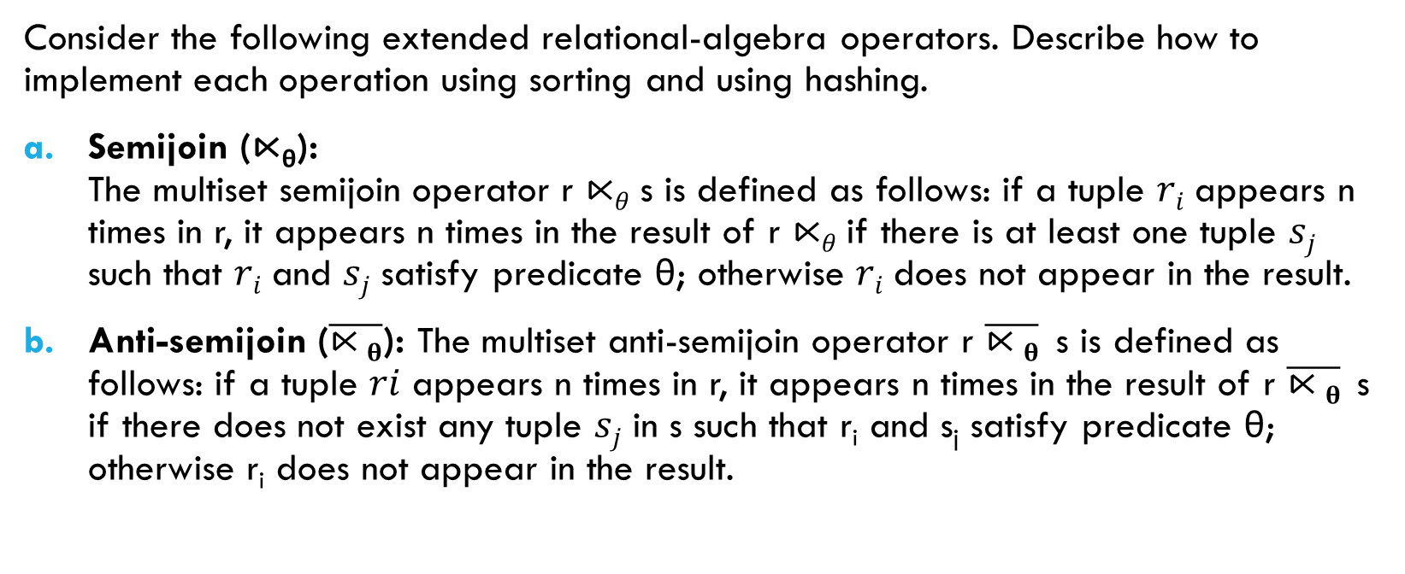
Q1
Consider the following extended relational-algebra operators. Describe how to implement each operation using sorting and using hashing.
Semijoin (⋉_{θ}): The multiset semijoin operator r ⋉_{𝜃} s is defined as follows: if a tuple 𝑟_{𝑖} appears n times in r, it appears n times in the result of r ⋉_{𝜃} if there is at least one tuple 𝑠_{𝑗} such that 𝑟_{𝑖} and 𝑠_{𝑗} satisfy predicate θ; otherwise 𝑟_{𝑖} does not appear in the result.
Anti-semijoin ($\overline{⋉θ}$): The multiset anti-semijoin operator r $\overline{⋉θ}$ s is defined as follows: if a tuple 𝑟𝑖 appears n times in r, it appears n times in the result of r $\overline{⋉θ}$ s if there does not exist any tuple 𝑠_{𝑗} in s such that r_{i} and s_{j} satisfy predicate θ; otherwise r_{i} does not appear in the result.

Slide 7
Semijoin (⋉_{θ}): Semijoin using sorting: - Sort both r and s on the join attributes in 𝜃. - Perform a scan of both r and s similar to the merge algorithm and add tuples of r to the result whenever the join attributes of the current tuples of r and s match. Semijoin using hashing: - Create a hash index in s on the join attributes in 𝜃. - Iterate over r, and for each distinct value of the join attributes, perform a hash lookup in s. If the hash lookup returns a value, add the current tuple of r to the result. * Note that if r and s are large, they can be partitioned on the join attributes first and the above procedure applied on each partition. If r is small but s is large, a hash index can be built on r and probed using s; and if an s tuple matches an r tuple, the r tuple can be output and deleted from the hash index

Slide 8
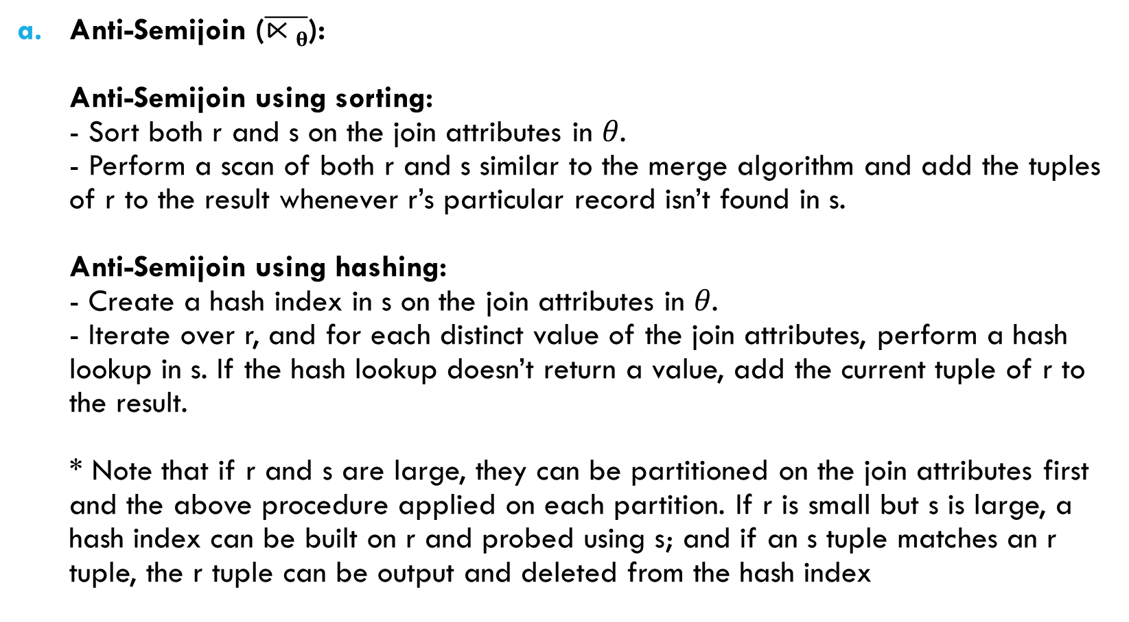
Anti-Semijoin ($\overline{⋉θ}$): Anti-Semijoin using sorting: - Sort both r and s on the join attributes in 𝜃. - Perform a scan of both r and s similar to the merge algorithm and add the tuples of r to the result whenever r’s particular record isn’t found in s. Anti-Semijoin using hashing: - Create a hash index in s on the join attributes in 𝜃. - Iterate over r, and for each distinct value of the join attributes, perform a hash lookup in s. If the hash lookup doesn’t return a value, add the current tuple of r to the result. * Note that if r and s are large, they can be partitioned on the join attributes first and the above procedure applied on each partition. If r is small but s is large, a hash index can be built on r and probed using s; and if an s tuple matches an r tuple, the r tuple can be output and deleted from the hash index

Slide 9
Q2
Write pseudocode for an iterator that implements a version of the sort–merge algorithm where the result of the final merge is pipelined to its consumers. Your pseudocode must define the standard iterator functions open(), next(), and close(). Show what state information the iterator must maintain between calls.

Slide 10
SortMergeJoin::open() begin repeat read M blocks of the relation sort the in-memory part of the relation write the sorted data to a run file Ri until the end of the relation read one block of each of the N run files Ri, into a buffer block in memory 𝒅𝒐𝒏𝒆_{𝒓} := false end SortMergeJoin::close() begin clear all the N runs from main memory and disk; end

Slide 11
boolean SortMergeJoin::next() begin if the buffer block of any run Ri is empty and not end-of-file(Ri) begin read the next block of Ri (if any) into the buffer block; end if all buffer blocks are empty return false; choose the first tuple (in sort order) among the buffer blocks; write the tuple to the output buffer; delete the tuple from the buffer block and increment its pointer; return true; end

Slide 12
Q3
Write pseudocode for an iterator that implements indexed nested loop join, where the outer relation is pipelined. Your pseudocode must define the standard iterator functions open(), next(), and close(). Show what state information the iterator must maintain between calls. [H/W]

Slide 13
Q4
Show that the following equivalences hold. Explain how you can apply them to improve the efficiency of certain queries: a. E1 ⋈_{θ} (E2 − E3) ≡ (E1 ⋈_{θ} E2) − (E1 ⋈_{θ} E3)
b. σ_{θ}(E1⟕E2) ≡ σ_{θ}(E1)⟕ E2, where θ uses only attributes from E1. [H/W]

Slide 14
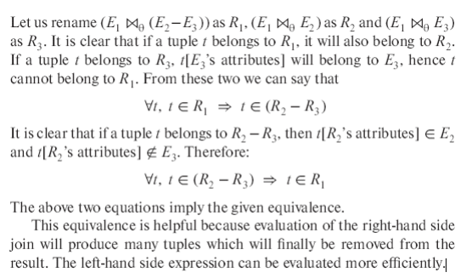
a.

Slide 15
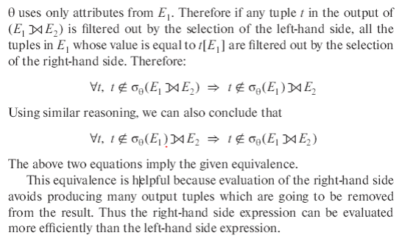
b.

