Slide 1

DECISION CONTROL STATEMENTS
&
LOOPS

Slide 2
DECISION CONTROL / FLOW CONTROL STATEMENTS

Slide 3
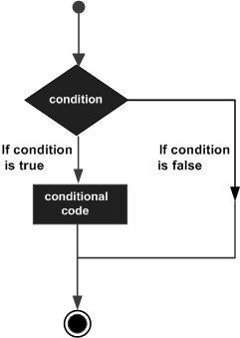
Decision Controls
Decision making structures require that the programmer specifies one or more conditions to be evaluated or tested by the program, along with a statement or statements to be executed if the condition is determined to be true, and optionally, other statements to be executed if the condition is determined to be false.

Slide 4
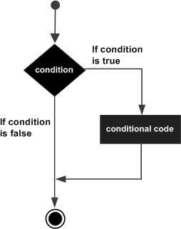
If Statement
The if statement is used to check some given condition and perform some operations depending upon the correctness of that condition.
It is mostly used in the scenario where we need to perform the different operations for the different conditions.
The syntax of the if statement is given below:
if(expression){
//code to be executed
}

Slide 5
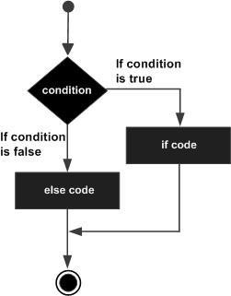
If-else Statement
The if-else statement is used to perform two operations for a single condition.
The if-else statement is an extension to the if statement using which, we can perform two different operations, i.e., one is for the correctness of that condition, and the other is for the incorrectness of the condition.
Here, we must notice that if and else block cannot be executed simultaneously. Using if-else statement is always preferable since it always invokes an otherwise case with every if condition.
The syntax of the if-else statement is given below:
if(expression){
//code to be executed if condition is true
}
else{
//code to be executed if condition is false
}

Slide 6
Nested If/If-else Statement
It is always legal in C programming to nest if/if-else statements, which means you can use one if
or else if statement inside another if or else if statement(s).
The syntax of the if-else statement is given below:
if( boolean_expression 1)
{
/* Executes when the boolean expression 1 is true */ if(boolean_expression 2)
{
/* Executes when the boolean expression 2 is true */
}

Slide 7
If-else-If ladder Statement
The if-else-if ladder statement is an extension to the if-else statement.
It is used in the scenario where there are multiple cases to be performed for different conditions.
In if-else-if ladder statement, if a condition is true then the statements defined in the if block will be executed, otherwise if some other condition is true then the statements defined in the else-if block will be executed.
At the last if none of the condition is true then the statements defined in the else block will be executed.
There are multiple else-if blocks possible. It is similar to the switch case statement where the default is executed instead of else block if none of the cases is matched.

Slide 8
If else-if ladder Statement
if(condition1){
//code to be executed if condition1 is true
}else if(condition2){
//code to be executed if condition2 is true
}
else if(condition3){
//code to be executed if condition3 is true
}
...
else{
//code to be executed if all the conditions are false
}

Slide 9
C Switch Statement
The switch statement in C is an alternate to if-else-if ladder statement which allows us to execute multiple operations for the different possible values of a single variable called switch variable.
Here, We can define various statements in the multiple cases for the different values of a single variable.
switch(expression){ case value1:
//code to be executed; break; //optional case value2:
//code to be executed;
break; //optional
......
default:
code to be executed if all cases are not matched;
}

Slide 10
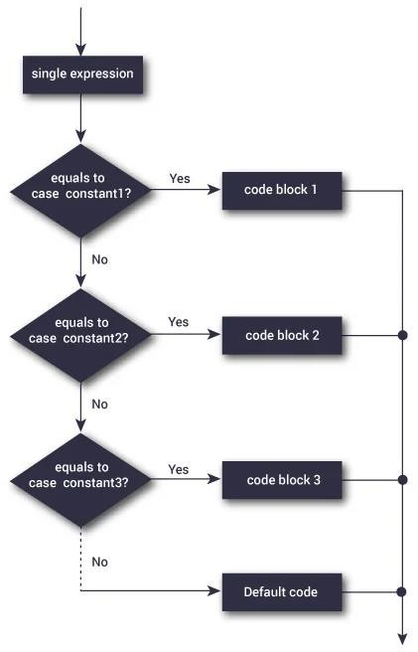
C Switch Statement

Slide 11
Exercise
Q1) Write a program to make a simple calculator using Switch statement
Q2) Write a program to find largest of three numbers.
Q3) Write a program to check whether the number is prime or not.

Slide 12

Solutions

Slide 13
LOOPS
CSI 3130-Databases 2

Slide 14
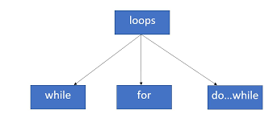
LOOPS
Loop is a sequence of instructions that is repeated until a certain condition is reached.

Slide 15
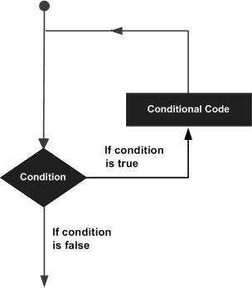
Basic execution of loops
A loop statement allows us to execute a statement or group of statements multiple times. Once the condition becomes false the loop terminates.

Slide 16
FOR loop
A for loop is a repetition control structure which allows us to write a loop that is executed a specific number of times.
The loop enables us to perform n number of steps together in one line.
Syntax:
for (initialization expr; test expr; update expr)
{
// body of the loop
// statements we want to execute
}

Slide 17
FOR loop FLOW

Slide 18
For loop program
Print 1 to 5
#include <stdio.h> void main ()
{
For(int i=1; i<6; i++)
{
printf("%d\n", i);
}
}
i<6 | output | i++
i<6 | 1 | 2
2<6 | 2 | 3
3<6 | 3 | 4
4<6 | 4 | 5
5<6 | 5 | 6
6<6==false | - | -

Slide 19
While loop
Here, statement(s) may be a single statement or a block of statements.
while loops are used in situations where we do not know the exact number of iterations of loop beforehand.
First Condition is evaluated.
If the condition is true then statement part is executed then again it checks the condition.
If the condition is false then out of the while loop.
Syntax:
initialization expression;
while (test_expression)
{
// statements
update_expression;
}

Slide 20
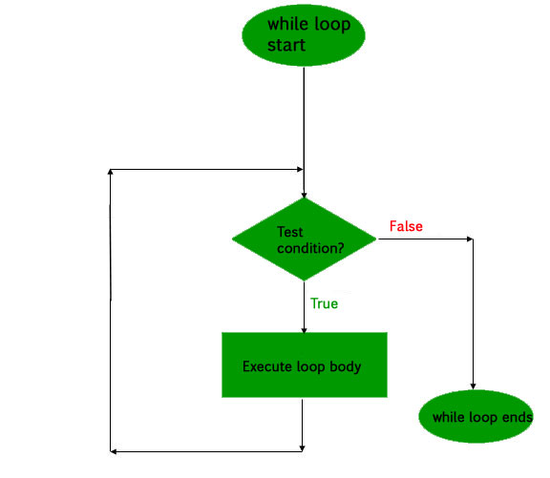
While loop FLOW

Slide 21
While loop program
Program to print 1 to 5 numbers:
#include <stdio.h> void main ()
{
int a = 1; while( a < 6 )
{
printf("%d\n", a);
a++;
}
}
a<6 | output | a++
1<6 | 1 | 2
2<6 | 2 | 3
3<6 | 3 | 4
4<6 | 4 | 5
5<6 | 5 | 6
6<6==false | - | -

Slide 22
Do-while
A do...while loop is similar to a while loop, except the fact that it is guaranteed to execute at least one time irrespective of test condition.
First statement part is executed and then the condition part is evaluated.
If the condition is true then again statement part executed and then again to the condition part.
If the condition is false then out of do-while loop.
Note: Do-While is a exit controlled Loop.
Notice the semi – colon(“;”) in the end of loop.
Syntax:
do
{
//Statements
}
while(condition);

Slide 23
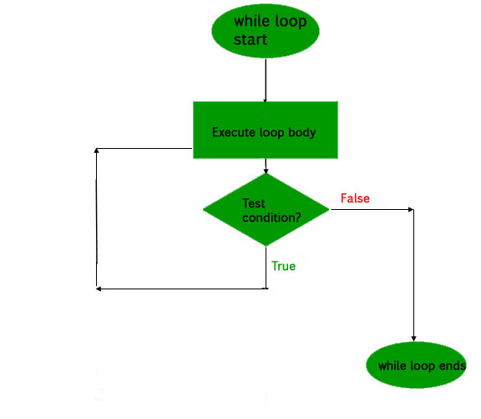
Do-while FLOW

Slide 24
Do-while program
Print 0 to 5
#include <stdio.h> void main ()
{
int a = 0;
do { printf("%d\n", a); a + +;
}
while( a < 6 );
}
output | a++ | A<6
0 | 1 | 1<6
1 | 2 | 2<6
2 | 3 | 3<6
3 | 4 | 4<6
4 | 5 | 5<6
5 | 6 | 6<6==false

Slide 25
BREAK AND CONTINUE
CSI 3130-Databases 2

Slide 26
Break
The break is a loop control statement which is used to terminate the loop.
As soon as the break statement is encountered from within a loop, the loop iterations stops there and control returns from the loop immediately to the first statement after the loop.
Syntax:
break;
Basically break statements are used in the situations when we are not sure about the actual number of iterations for the loop
or
we want to terminate the loop based on some condition.

Slide 27
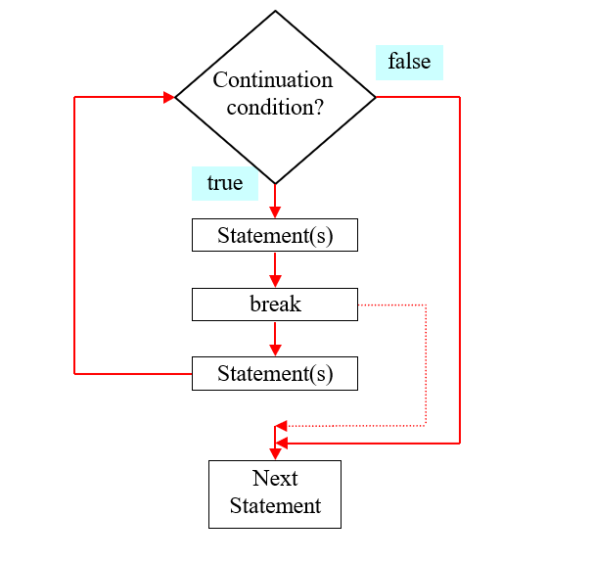
The Break Flow

Slide 28
Example of Break
// Using break to exit a loop
#include <stdio.h>
main() {
int i;
for(i=0; i<100; i++) {
if(i == 10) break; // terminate loop if i is 10
printf("%d \n", i);
}
printf("Loop complete.");
}

Slide 29
OUTPUT OF PROGRAM
OUTPUT:
0
1
2
3
4
5
6
7
8
9
Loop Complete.

Slide 30
Continue
Continue is also a loop control statement just like the break statement.
Continue statement is opposite to that of break statement, instead of terminating the loop, it forces to execute the next iteration of the loop.
As the name suggest the continue statement forces the loop to continue or execute the next iteration.
When the Continue statement is executed in the loop, the code inside the loop following the continue statement will be skipped and next iteration of the loop will begin.

Slide 31
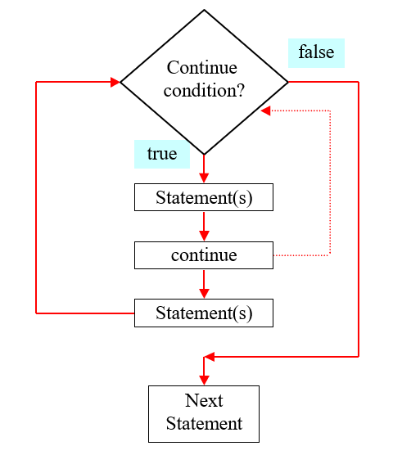
Continue Workflow

Slide 32
Example of continue
int main()
{ for (int j=0; j<=8; j++)
{ if (j==4)
{
/* The continue statement is encountered when * the value of j is equal to 4.
*/ continue; } /*
This print statement would not execute for the * loop iteration where j ==4 because in that case * this statement would be skipped. */
printf("%d ", j);
}
return 0;
}

Slide 33
OUTPUT OF PROGRAM
OUTPUT:
0
1
2
3
5
6
7
8

