Slide 1
Diamonds Price Prediction
End_To_End Project
SHAI For AI

Slide 2
Main Goal:
The main goal of the project is to try to predict the price of the Diamond using the features Provided from the Dataset .
The predicted price will be evaluated Using RMSE.

Slide 3
Discovering The Data:
The Data Contains 11 Features:
- Numerical Features = {Id , Carat , Table , Depth , X , Y , Z , Price }
- Categorical Features = { Color , Clarity , Cut }
The Price Feature is the Target Feature.
There are no missing values in all the columns.

Slide 4
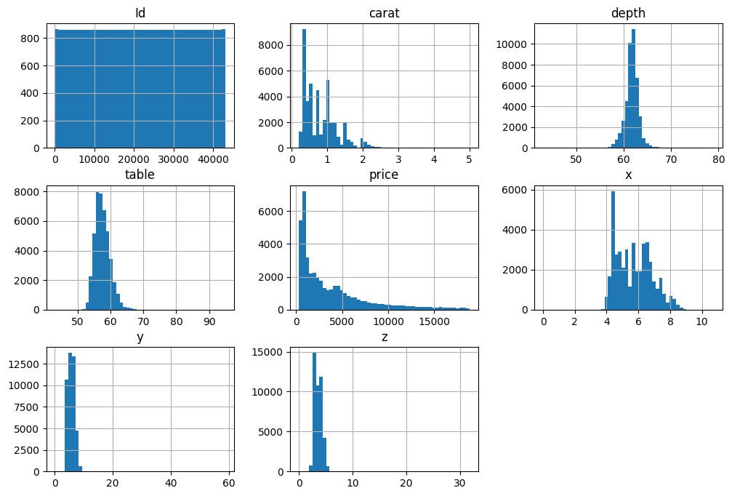
Data Visualization :
From the previous Histogram , We can Notice some insights :
The Id Column is not useful , It is just a counter Identification .
The Depth is normally Distributed which is Kinda Good.
The Price & Carat Columns is very Skewed to the right , and this should be Fixed

Slide 5
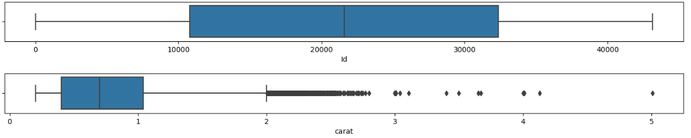
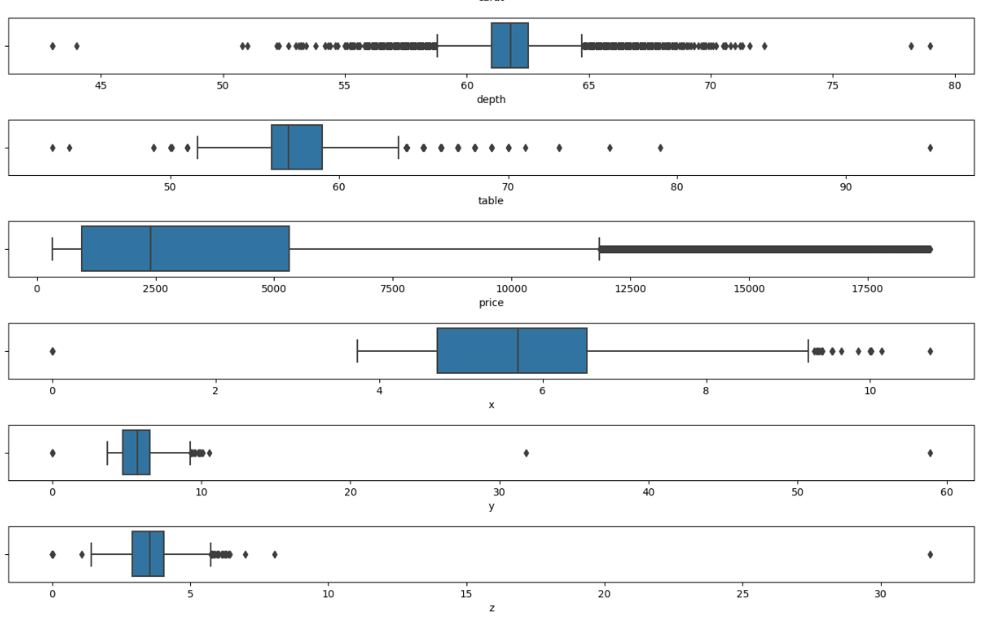
Data Visualization :
From the previous Boxplots , We can Notice some insights :
In the {x,y,z} Columns we have some zero values which make the object 2D or 1D, so We should drop them.
There are a lot of Outliers in Most of the columns , So I will try to get rid of them

Slide 6
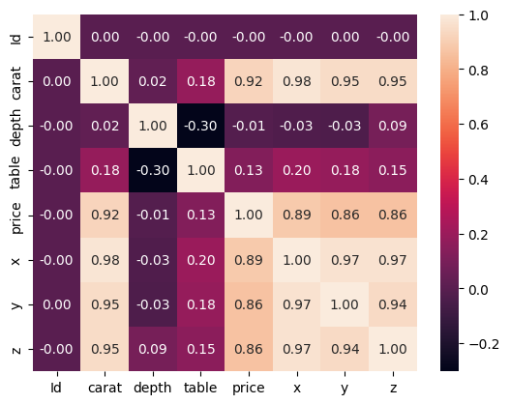
Data Visualization :
From the previous Heatmap , We Can Notice some insights :
The { x , y , z } features have a very postitive Linear Corrleation between each other and with some other features like { Carat , Price} .
From the previous insight , We see that it is good to apply feature Combining on these 3 features.

Slide 7
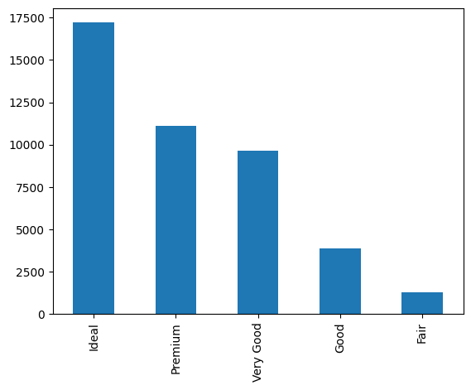
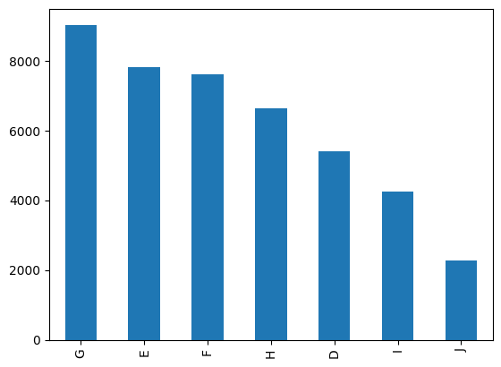
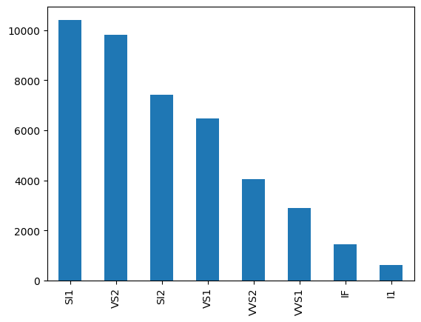
Data Visualization :
From the previous Barplots for Categorical Columns{ Cut , Color , Clarity }, We Can Notice some insights :
The Disparity between The Occurrence of each categories in the Cut , Clarity Columns , its unbalanced , So We have to fix it .

Slide 8
Data Preprocessing :
The Preprocessing stage went through many steps :
Handling the 1D , 2D Diamond.
Handling Outliers for each feature .
Handling Duplicate Records/Rows.
Handling the skewed distribution features ,by apply the log function on them.
Handling the unbalanced categories ,by applying Manual Method / Feature Hasher.

Slide 9
Data Preparing :
The main goal of this stage , is to prepare the data to training by applying some Feature Transformation and Scaling methods.
For Numerical Feature :
Standard Scaler
Robust Scaler ( Good For features that have many outliers)
For Categorical Feature:
One Hot Encoder
Ordinal Encoder
Manual Encoder ( Function I code it myself,its like baseline)

Slide 10
Model Training :
In this stage, I applied different Approaches,which are combined pipelines .
I will mention some of them :
Manual feature Hasher + Ordinal Encoder + Robust Scaler
Manual feature Hasher + One Hot Encoder + Standard Scaler
And I applied Each Approach on many models , I will mention some of them :
Linear Regression , SVM , XGBoost Regressor , CatBoost Regressor ,
Random Forest and Decision Tree
Also I applied Some methods , Like Random Search and Grid Search to get the best parameters.

Slide 11
Model Evalution :
I will mention some RMSE Results for some Approaches/Models:
RMSE | Approach + Model
543 | Standad Scaler +One Hot Encoder+ XGBoost
560 | Robust Scaler + Ordinal Encoder + Randomized Search + CatBoost
651 | Robust Scaler + OneHotEncoder + ManualHasher + CatBoost

Slide 12
THANKS

