Slide 1
Heuristic A* Search
for Large Sliding Puzzles
Manhattan vs Linear Conflict vs Disjoint Pattern Databases
Anthony Kwasi
CS 57200 - Heuristic Problem Solving | Track B: Search & Optimization
Purdue University - Spring 2026

Slide 2
Agenda
1
Problem & motivation
Why the 15-puzzle still matters
2
Background
A*, IDA*, admissible heuristics
3
System design
Pluggable heuristic architecture
4
Three heuristics
Manhattan, Linear Conflict, Disjoint PDB
5
Experimental setup
Ablation methodology and seeds
6
Headline result
15.2x speedup at depth 50
7
Analysis & limitations
Why PDB wins; what is left
8
Future work & demo
Where to go next
Anthony Kwasi | CS 57200 | Spring 2026
2 / 13

Slide 3
The 15-puzzle: a canonical hard search problem
~10¹³
Why it matters
Brute-force BFS exhausts memory on 4x4.
Optimality requires admissible heuristics.
Direct analogue for warehouse routing, robot path planning, and game AI.
Benchmark for evaluating heuristic quality on the same instances.
reachable states on 4x4
~80
maximum optimal depth
~2.13
average branching factor
Anthony Kwasi | CS 57200 | Spring 2026
3 / 13

Slide 4
Background: A*, IDA*, and admissibility
A* search
IDA*
Best-first with f(n)=g(n)+h(n). Admissible h yields optimal solutions; consistent h avoids re-expansion.
Iterative-deepening DFS bounded by f-threshold. Memory O(d) - the only practical option at depth 80.
Hart, Nilsson & Raphael (1968)
Korf (1985)
Admissibility
Heuristic quality
h(n) <= true cost from n. Required for optimality. Empirically signals as identical solution depths across heuristics.
Closer h is to true cost, fewer nodes A* expands. Stronger heuristics trade compute for fewer expansions.
Russell & Norvig (2021)
Pearl (1984)
Anthony Kwasi | CS 57200 | Spring 2026
4 / 13

Slide 5
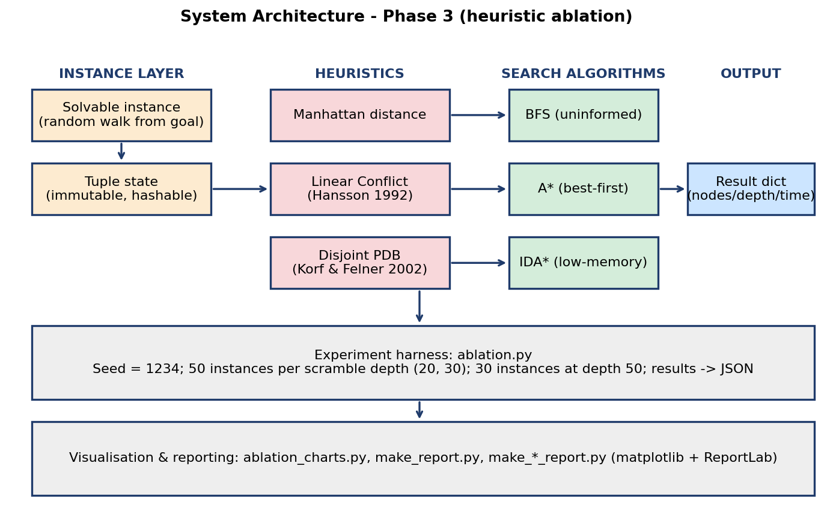
System design: pluggable heuristic architecture
Key idea
Solvers accept a heuristic callable, not a hard-coded function.
Adding a new heuristic = one import line, one CLI flag.
Same code path tested in BFS, A*, and IDA*.
Ablation becomes a one-line change.
Anthony Kwasi | CS 57200 | Spring 2026
5 / 13

Slide 6
Three admissible heuristics
Manhattan distance
Linear Conflict
Disjoint PDB (4-4-4-3)
Sum |dr| + |dc| per tile
O(n^2) evaluation
Ignores tile interactions
Baseline for all comparisons
Manhattan + 2 per row/col conflict
Greedy max-conflict removal
Captures pairwise interactions
Typical 3-5x speedup on 4x4
4 disjoint tile groups
0-1 BFS in projected space
Sum of group lookups (additive)
1.6 M entries, ~4 s build
Russell & Norvig 2021
Hansson, Mayer & Yung 1992
Korf & Felner 2002
Anthony Kwasi | CS 57200 | Spring 2026
6 / 13

Slide 7
Experimental setup
Protocol
Reproducibility seeds
Random walk from goal -> guaranteed solvable instances
Three scramble depths: 20, 30, 50
50 instances per cell at d=20/30; 30 at d=50
Per-search caps: 5-10 M node expansions
Bootstrap mean and 95% CI, 1000 resamples
Pure Python 3.9 - no C extensions
Phase 2 main
42
3x3 depth sweep
99
4x4 depth sweep
77
Phase 3 ablation
1234
Running any script twice produces identical metrics.
Anthony Kwasi | CS 57200 | Spring 2026
7 / 13

Slide 8
Headline result
15.2x
fewer A* nodes expanded by Disjoint PDB vs Manhattan
at scramble depth 50 - 30 random instances, all solved optimally
9.7x
3.5x
100%
wall-clock speedup
Linear Conflict speedup
admissibility preserved

Slide 9
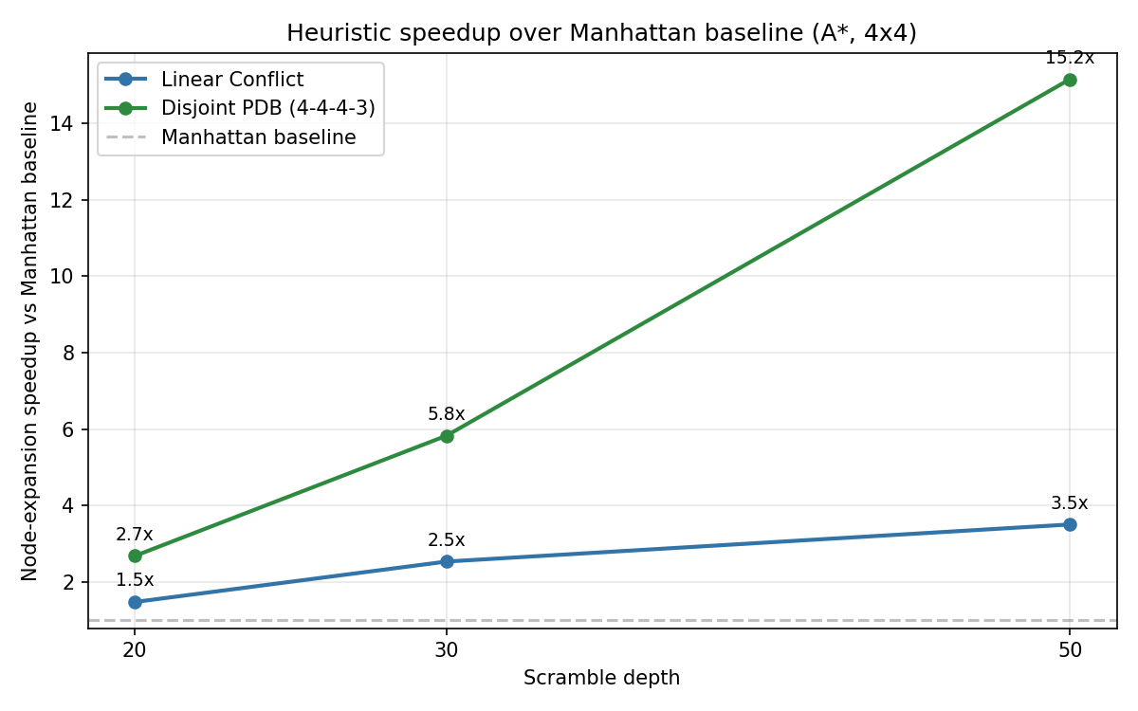
Node-expansion speedup grows with depth
Read
Linear Conflict: steady 1.5-3.5x
Disjoint PDB: 2.7x at d=20 grows to 15.2x at d=50
Gap widens because Manhattan error scales with depth
PDB captures within-group exact costs
Anthony Kwasi | CS 57200 | Spring 2026
9 / 13

Slide 10
Results: A* nodes expanded with 95% CI
Depth | Heuristic | Solved | Mean nodes | 95% CI
20 | Manhattan | 50/50 | 268 | [203, 343]
20 | Linear Conflict | 50/50 | 182 | [141, 229]
20 | Disjoint PDB | 50/50 | 100 | [72, 130]
30 | Manhattan | 50/50 | 5,896 | [3,758, 8,425]
30 | Linear Conflict | 50/50 | 2,328 | [1,528, 3,263]
30 | Disjoint PDB | 50/50 | 1,012 | [634, 1,467]
50 | Manhattan | 30/30 | 206,058 | [80,300, 348,433]
50 | Linear Conflict | 30/30 | 58,840 | [21,729, 101,422]
50 | Disjoint PDB | 30/30 | 13,600 | [5,980, 22,300]
Solution depths matched across all heuristics - admissibility confirmed empirically.
Anthony Kwasi | CS 57200 | Spring 2026
10 / 13

Slide 11
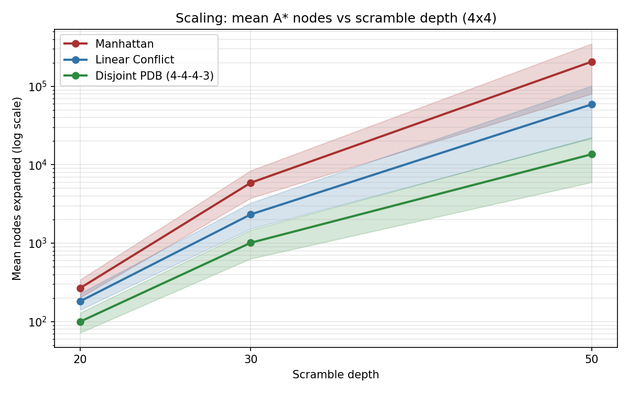
Why does PDB win at depth?
Three reinforcing reasons
Heuristic error.
Manhattan ignores tile interactions; its error grows roughly linearly with depth.
Captured structure.
PDB stores exact within-group cost - the interaction Manhattan misses.
Per-call cost.
PDB lookup = single dict access. Linear Conflict pays an inner loop per call.
Anthony Kwasi | CS 57200 | Spring 2026
11 / 13

Slide 12
What is left on the table
Pure Python overhead
Non-canonical partition
Absolute runtimes lag C/C++; ratios are the meaningful quantity.
4-4-4-3 fits in 1.6 M entries. 7-8 partition would dominate but needs a multi-hour build.
Depth ceiling
No tie-breaking
Only random instances tested up to d=50. Pathological d~80 instances unexplored.
Asai-Fukunaga prefer-larger-g shown to help. Not implemented in this deliverable.
Anthony Kwasi | CS 57200 | Spring 2026
12 / 13

Slide 13
Takeaways
1
Pluggable heuristics make ablation cheap.
One callable, one CLI flag - nothing else changes.
2
Disjoint PDB delivers 15.2x at d=50.
Wall-clock speedup of 9.7x. Strict optimality preserved.
3
Pure Python is enough for the science.
Ratios are reproducible; 4 s build time keeps grading easy.
Future work
Canonical 5-5-5 / 7-8 PDB | Asai-Fukunaga tie-breaking | Transposition tables in IDA* | Generalise to 24-puzzle
Repo: github.com/AnSikwa/Heuristics-Project_Anthony-Kwasi

