Slide 1
HTML
Group 1
Trương Châu Minh Huy – Trần Tuấn An – Phạm Đăng Khoa – Đặng Mạnh Hùng

Slide 2
What is HTML?
HTML is a markup language for describing web documents (web pages).
HTML stands for Hyper Text Markup Language
A markup language is a set of markup tags
HTML documents are described by HTML tags
Each HTML tag describes different document content

Slide 3

HTML Tags
HTML tags are keywords (tag names) surrounded by angle brackets:
HTML tags normally come in pairs like <p> and </p>
The first tag in a pair is the start tag, the second tag is the end tag
The end tag is written like the start tag, but with a slash before the tag name

Slide 4
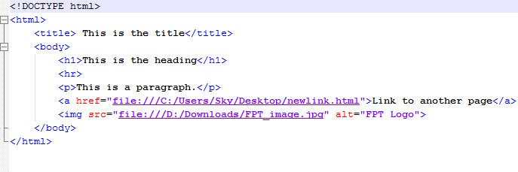
HTML Page Structure
There are an example of basic HTML page structure.
Start tag
HTML Elements
End tag
Notes:
Nested HTML Elements

Slide 5
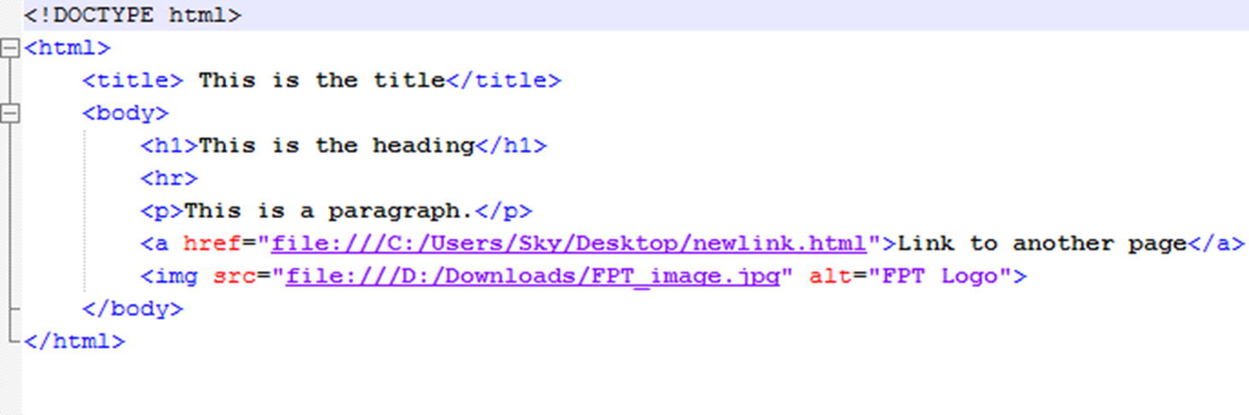
HTML Page Structure
HTML elements with no content are called empty elements.

Slide 6
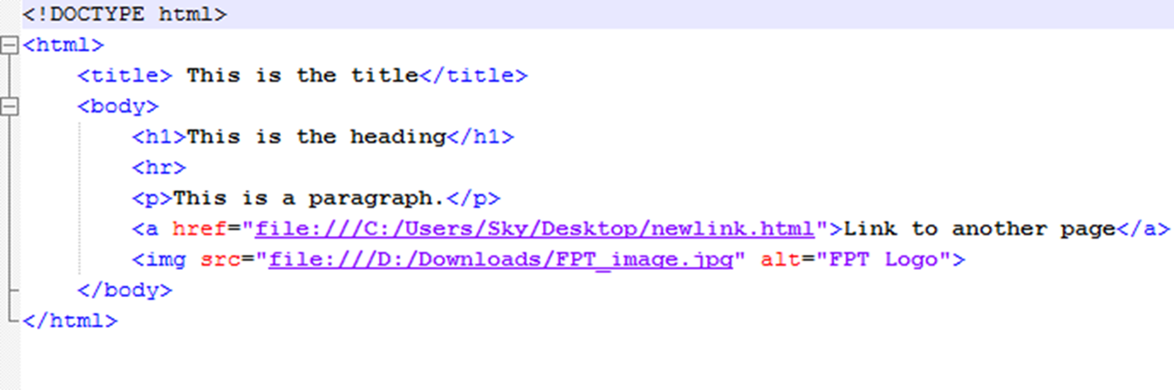
HTML Page Structure
HTML Attributes
HTML elements can have attributes
Attributes provide additional information about an element
Attributes are always specified in the start tag
Attributes come in name/value pairs like: name="value“

Slide 7
HTML <!DOCTYPE> Declaration
Definition and Usage
The <!DOCTYPE> declaration must be the very first thing in your HTML document, before the <html> tag.
The <!DOCTYPE> declaration is not an HTML tag; it is an instruction to the web browser about what version of HTML the page is written in.

Slide 8
HTML <html> Tag
Definition and Usage
The <html> tag tells the browser that this is an HTML document.
The <html> tag represents the root of an HTML document.
The <html> tag is the container for all other HTML elements (except for the <!DOCTYPE> tag).

Slide 9
HTML <head> Tag
Definition and Usage
The <head> element is a container for all the head elements.
The <head> element must include a title for the document, and can include scripts, styles, meta information, and more.
The following elements can go inside the <head> element:
<title> (this element is required in the head section)
<style>
<base>
<link>
<meta>
<script>
<noscript>
Notes:
The <title> tag is required in all HTML documents and it defines the title of the document.
The <title> element:
defines a title in the browser toolbar
provides a title for the page when it is added to favorites
displays a title for the page in search-engine results
The <style> tag is used to define style information for an HTML document.
Inside the <style> element you specify how HTML elements should render in a browser.
Each HTML document can contain multiple <style> tags.
The <base> tag specifies the base URL/target for all relative URLs in a document.
There can be at maximum one <base> element in a document, and it must be inside the <head> element.
The <link> tag defines a link between a document and an external resource.
The <link> tag is used to link to external style sheets.
Metadata is data (information) about data.
The <meta> tag provides metadata about the HTML document. Metadata will not be displayed on the page, but will be machine parsable.
Meta elements are typically used to specify page description, keywords, author of the document, last modified, and other metadata.
The metadata can be used by browsers (how to display content or reload page), search engines (keywords), or other web services.
The <script> tag is used to define a client-side script, such as a JavaScript.
The <script> element either contains scripting statements, or it points to an external script file through the src attribute.
Common uses for JavaScript are image manipulation, form validation, and dynamic changes of content.
The <noscript> tag defines an alternate content for users that have disabled scripts in their browser or have a browser that doesn't support script.
The <noscript> element can be used in both <head> and <body>.
When used inside the <head> element: <noscript> must contain <link>, <style>, and <meta> elements.
The content inside the <noscript> element will be displayed if scripts are not supported, or are disabled in the user's browser.

Slide 10
HTML <body> Tag
Definition and Usage
The <body> tag defines the document's body.
The <body> element contains all the contents of an HTML document, such as text, hyperlinks, images, tables, lists, etc.

Slide 11
Q&A

Slide 12
Thanks for your attention!

