Slide 1


Electric Vehicles Market Size Analysis

Slide 2
Market size analysis for electric vehicles involves a multi-step process that includes defining the market scope, collecting and preparing data, analytical modelling, and communicating findings through visualization and reporting. Below is the process you can follow for the task of electric vehicles market size analysis:
Define whether the analysis is global, regional, or focused on specific countries.
Gather information from industry associations, market research firms (e.g., BloombergNEF, IEA), and government publications relevant to the EV market.
Use historical data to identify trends in EV sales, production, and market.
Analyze the market size and growth rates for different EV segments.
Based on the market size analysis, provide strategic recommendations for businesses looking to enter or expand in the EV market.

Slide 3
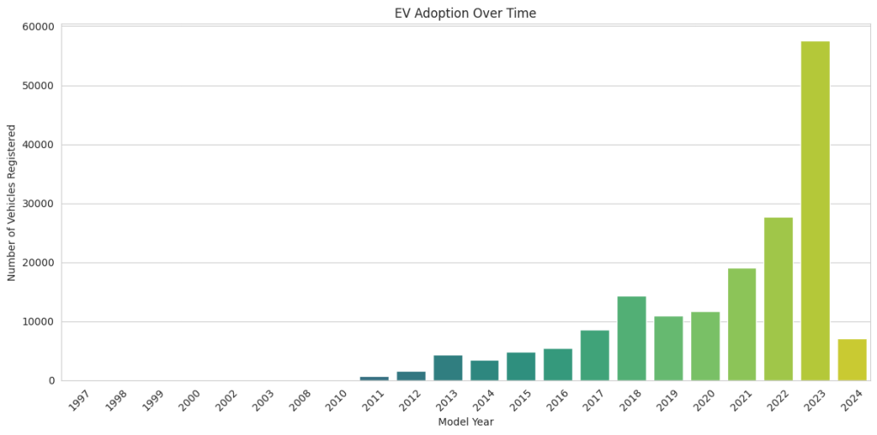
From the above bar chart, it’s clear that EV adoption has been increasing over time, especially noting a significant upward trend starting around 2016. The number of vehicles registered grows modestly up until that point and then begins to rise more rapidly from 2017 onwards. The year 2023 shows a particularly sharp increase in the number of registered EVs, with the bar for 2023 being the highest on the graph, indicating a peak in EV adoption.

Slide 4
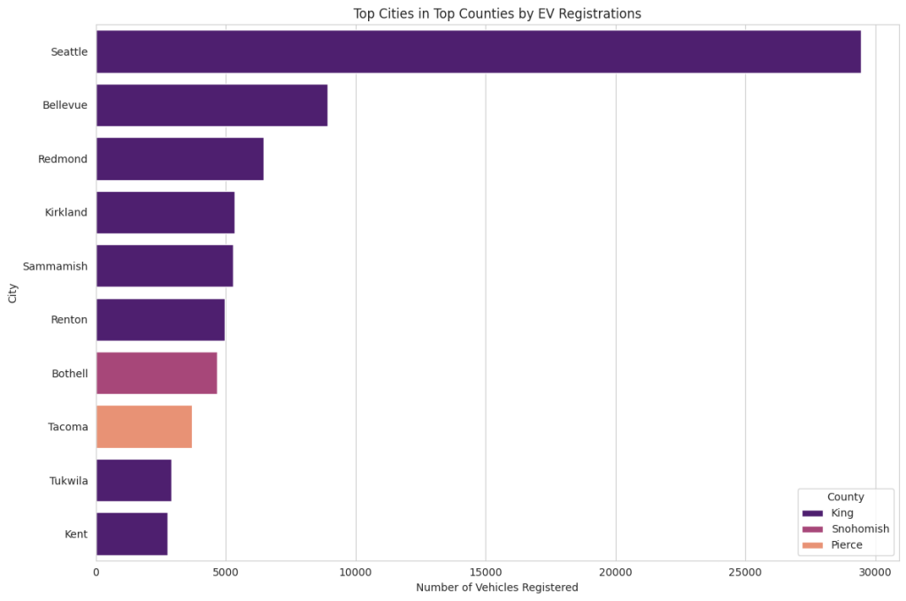
Seattle, which is in King County, has the highest number of EV registrations by a significant margin, far outpacing the other cities listed.
Bellevue and Redmond, also in King County, follow Seattle with the next highest registrations, though these are considerably less than Seattle’s.
Cities in Snohomish County, such as Kirkland and Sammamish, show moderate EV registrations.
Tacoma and Tukwila, representing Pierce County, have the fewest EV registrations among the cities listed, with Tacoma slightly ahead of Tukwila.
The majority of cities shown are from King County, which seems to dominate EV registrations among the three counties.
Overall, the graph indicates that EV adoption is not uniform across the cities and is more concentrated in certain areas, particularly in King County.

Slide 5
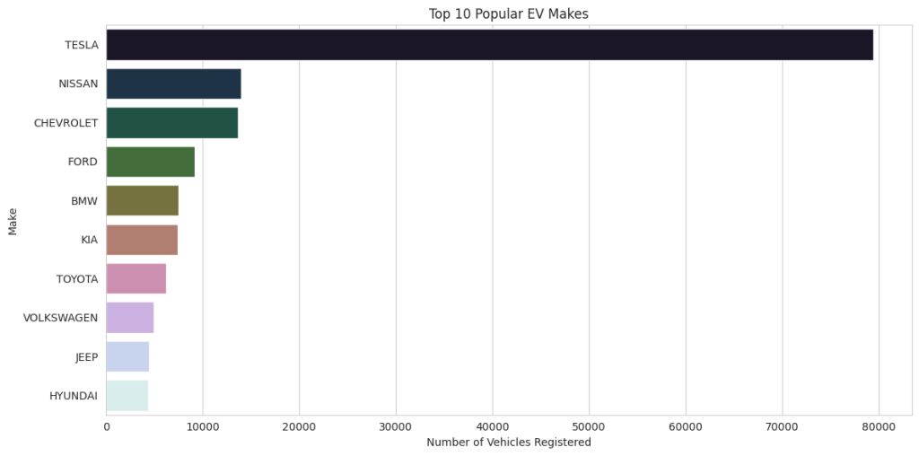
The above chart shows that:
TESLA leads by a substantial margin with the highest number of vehicles registered.
NISSAN is the second most popular manufacturer, followed by CHEVROLET, though both have significantly fewer registrations than TESLA.
FORD, BMW, KIA, TOYOTA, VOLKSWAGEN, JEEP, and HYUNDAI follow in decreasing order of the number of registered vehicles.

Slide 6
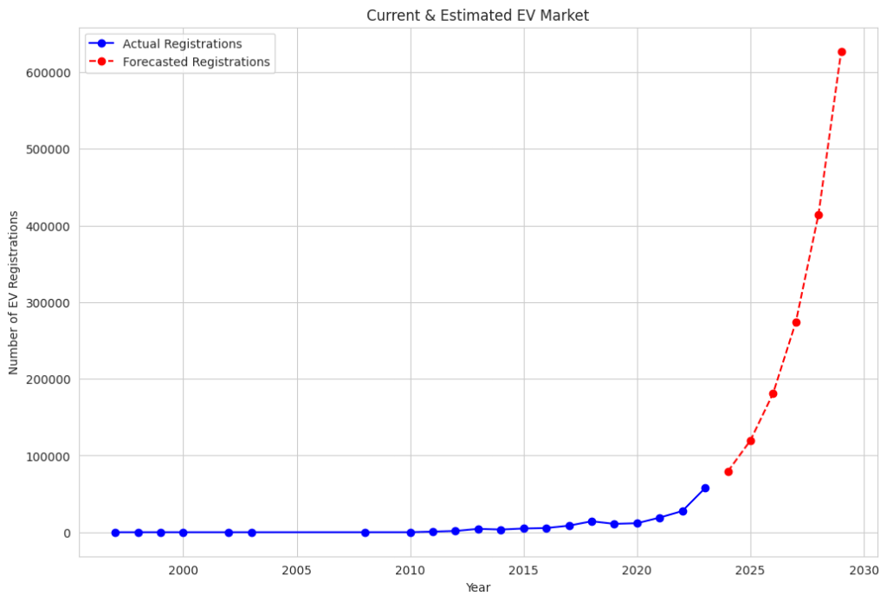

Slide 7

Summary :
So, market size analysis is a crucial aspect of market research that determines the potential sales volume within a given market. It helps businesses understand the magnitude of demand, assess market saturation levels, and identify growth opportunities. From our market size analysis of electric vehicles, we found a promising future for the EV industry, indicating a significant shift in consumer preferences and a potential increase in related investment and business opportunities.

