Slide 1


Slide 2
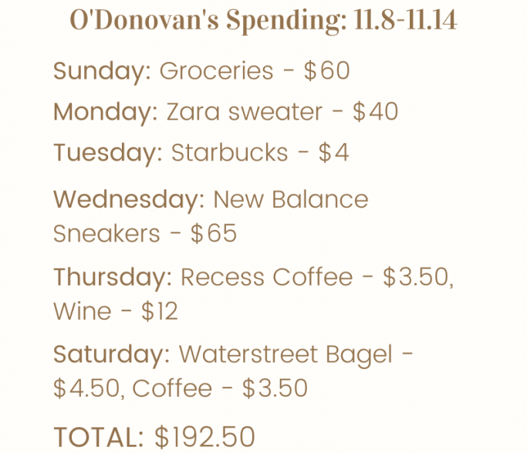

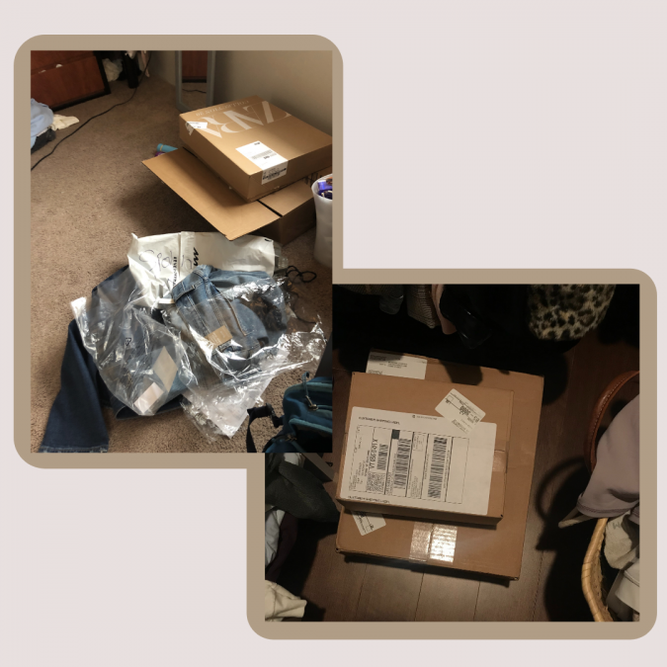
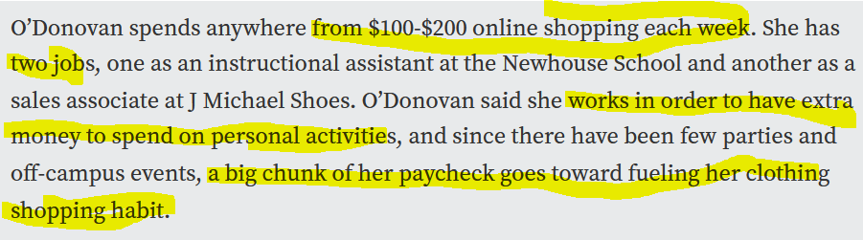
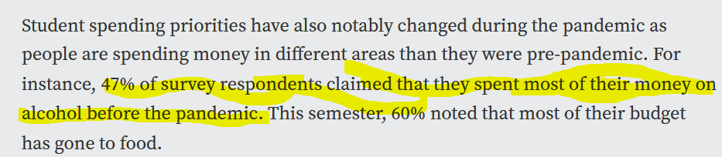
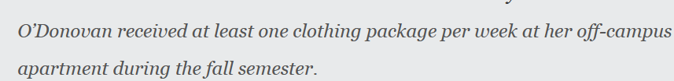
Problem
https://www.thenewshouse.com/life-and-style/how-covid-19-has-changed-student-spending-habits/

Slide 3

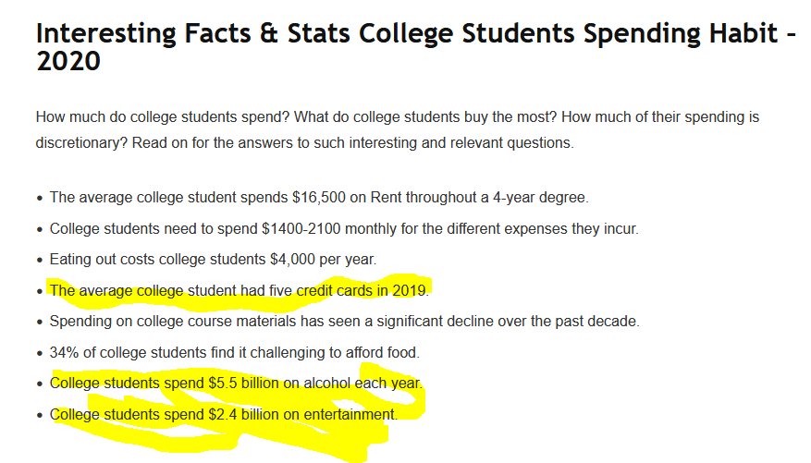
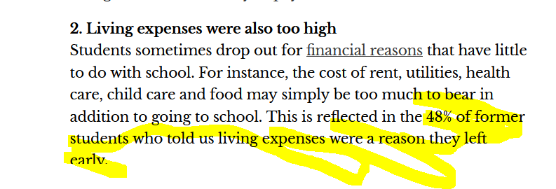
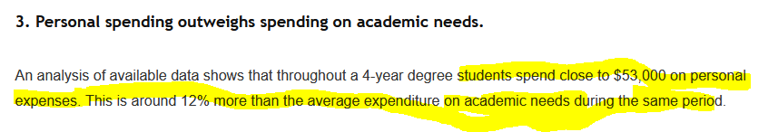
Problem
https://admissionsly.com/college-student-spending-statistics/
https://theconversation.com/why-community-college-students-quit-despite-being-almost-finished-175420

Slide 4
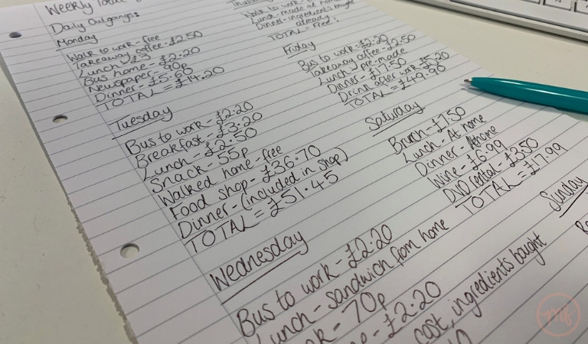
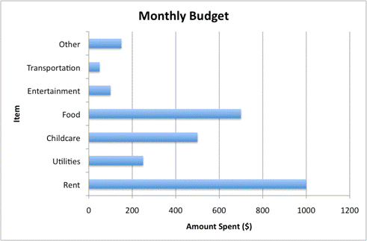
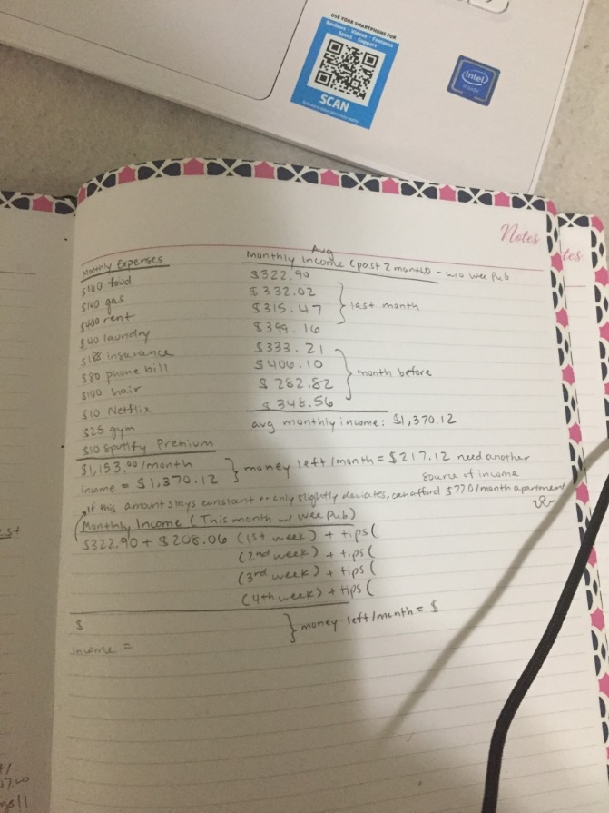
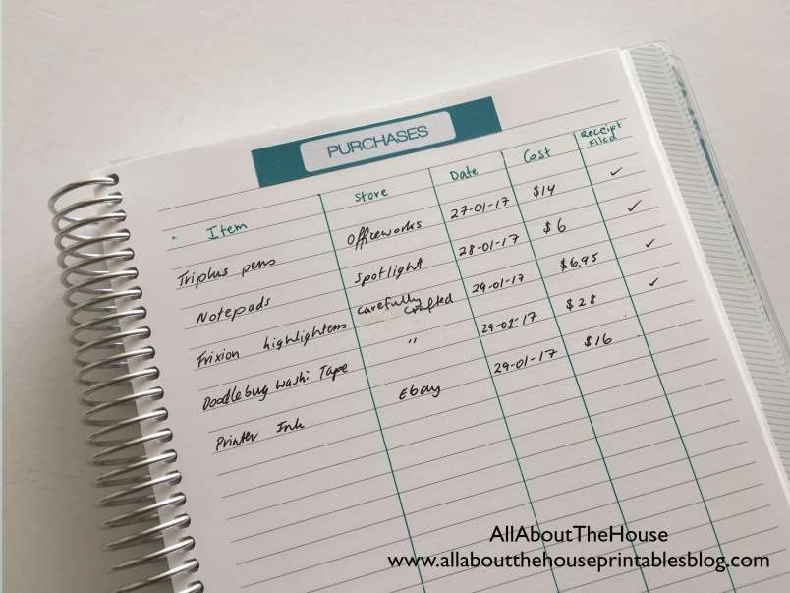
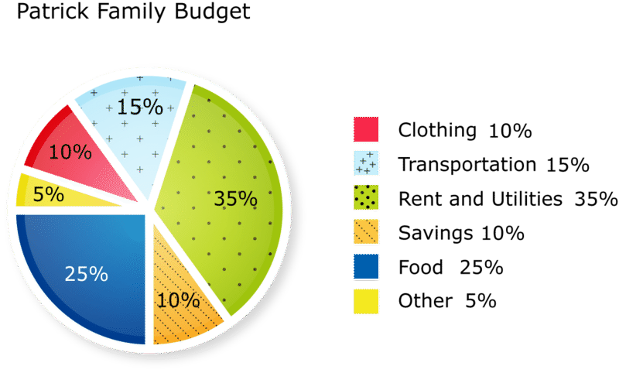
Solution
Transaction Recorder
vs

Slide 5
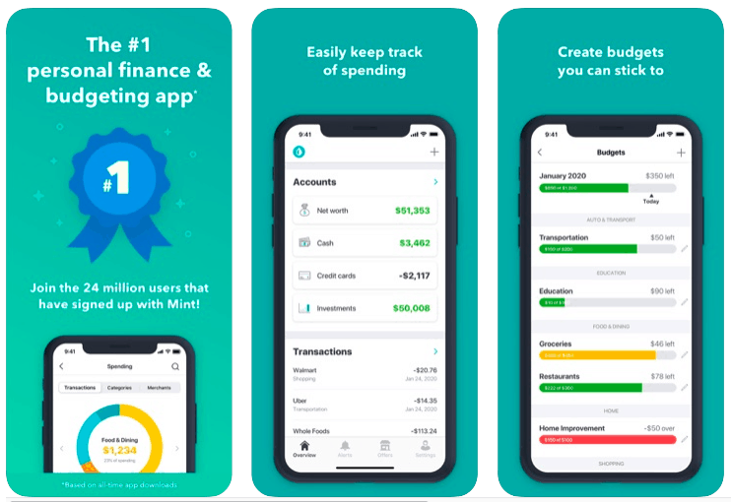
Solution
Financial Planer

Slide 6
Customer
B2B
B2B2C
B2C
Students within university – we charge a small fee for managing budget through bank
Small fee to lock bank account when spending too much
Small fee for successful financial planning goal
Service for small start up from student to help with financial
Service for company to help with student advice, student services.

Slide 7
Road Map
We are here
Test and prototype with the students about what to see and how to use
Get user feedback
Implement the feature to plan budget – financial planning
Application with transaction viewer
Graphical of the money spending based on categories
1 month
3 month
2 month
Implement user feedback
Marketing campaign
Test and prototype with the students about what to see and how to use
Get user feedback
1 month

