Slide 1
PCI TOI
Compiled by Oliver Yang
Nov, 2017
http://oliveryang.net

Slide 2
Agenda
PCI/PCIe Basic
PCIe errors handling
Case study - analysis PCIe errors
References

Slide 3
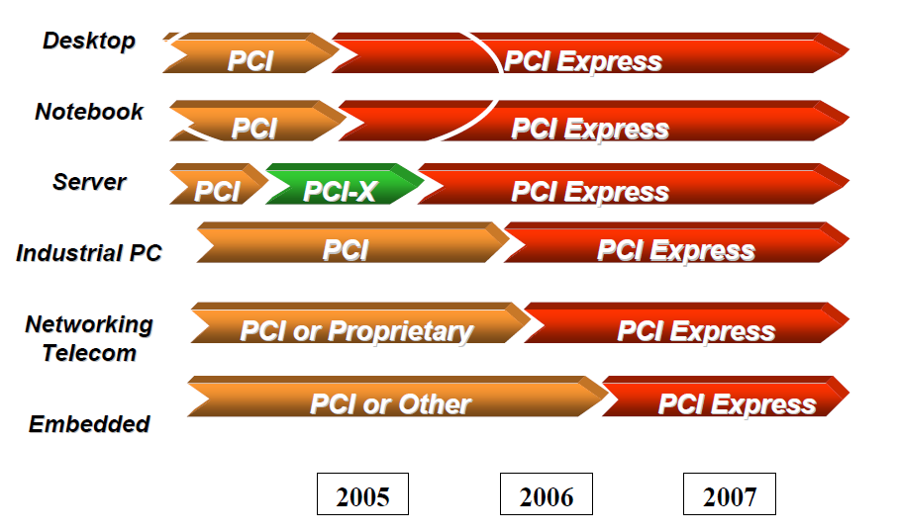
Transition from PCI/PCI-X to PCIe

Slide 4
PCI Throughput
Bandwidth(Gbps) = Frequency(Mhz) x bit(Bytes)
PCI / PCI-X | 32bit 33Mhz | 32bit 66Mhz | 64bit 66Mhz | 64bit 133Mhz
Bandwidth | 1.056 Gbps | 2.112 Gbps | 4.224 Gbps | 8.512 Gbps

Slide 5
PCIe Throughput
GT/s vs. Gbps
PCIe 1.x and 2.x use 8b/10b encoding
PCIe 3.x uses 128/130 encoding.
Bandwidth(Gbps) = Per lane(Gbps) x Number of Lane
Real bandwidth is much slower because of overhead of PCIe itself
One x8 PCIe 2.x slot only could hold dual ports 10G NIC
One x8 PCIe 3.x slot only could hold four ports 10G NIC
Link Bandwidth | Raw Bit Rate x1 | x1 | x8 | x32
PCIe 1.x | 2.5 GT/s | 2Gbps | 16Gps | 64Gps
PCIe 2.x | 5.0 GT/s | 4Gbps | 32Gps | 128Gps
PCIe 3.x | 8.0 GT/s | 8Gbps | 64Gps | 256Gps

Slide 6
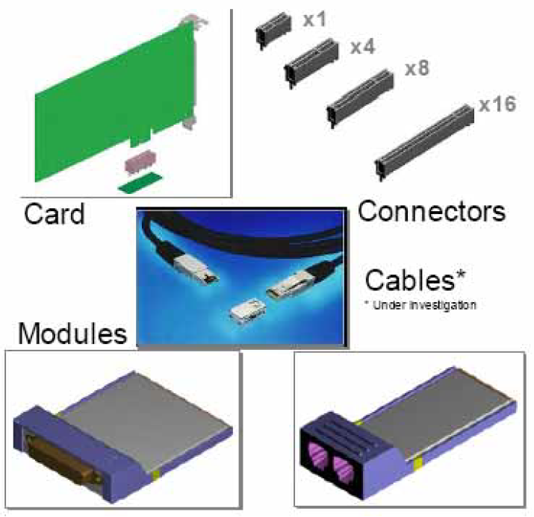
PCI Express Mechanicals

Slide 7
PCI vs. PCIe
PCI uses a shared parallel bus
Bandwidth shared between devices on the bus
Only one device may own the bus at any time
Large number of parallel signals
Wait states may be added by Initiator or Target
PCI-Express uses a serial point to point interconnect
Full bandwidth dedicated to that link
No need for arbitration
Low number of signals
No wait states

Slide 8
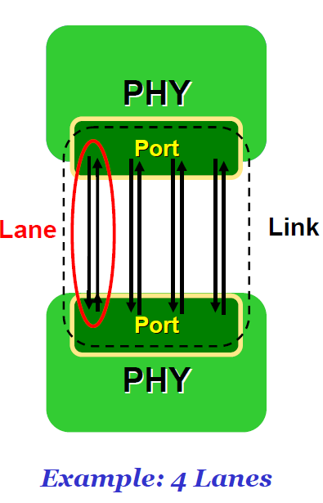
PCIe Link
Port
A group of transmitters and receivers located on the same chip that define a link
Lane
A set of differential signal pairs, one pair for transmission and one pair for reception
Link
A dual-simplex communications path between two components
A xN link is composed of N lanes

Slide 9
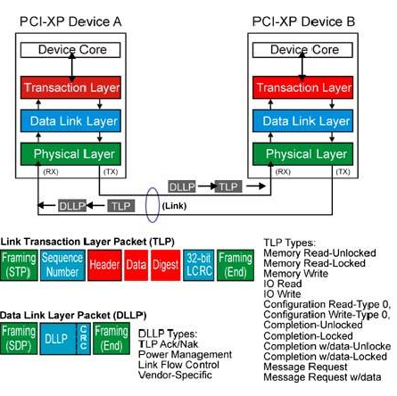
PCIe – Packet Based Protocol

Slide 10
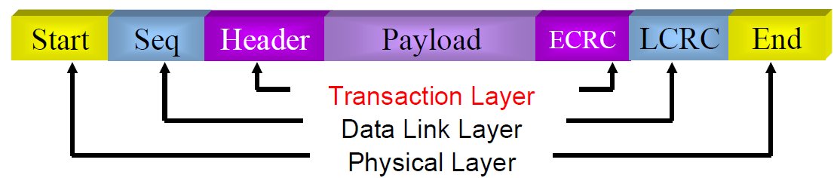
Transaction Layer
Responsible for
Post and Non-Posted transactions
Memory read/write, IO read/write, Configuration read/write etc.
Managing link flow control
Enforcing ordering and Quality of Service(QoS)
Power management control/status
Header Information may include
Address/Routing
Data transfer Length
Transaction descriptor
End to End CRC checking provides additional security(optional)

Slide 11
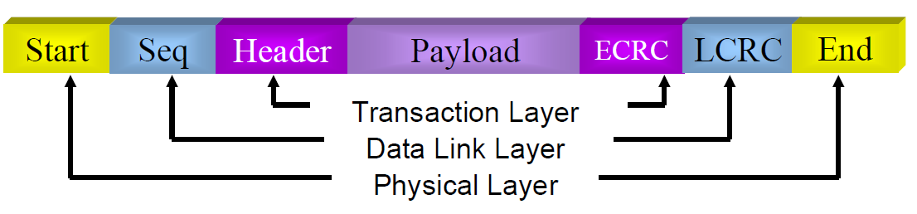
Physical Link and Data Link Layers
Packets are transmitted serially
Credit based Flow Control
Each device transmits periodic flow control packets to inform transmitter of buffer space
Ensures that receiving device has buffer space for the packet
ACK/NAK ensure correct delivery of data
Different link status for power management
Can re-train the link in the event of catastrophic failure
Only one or some of the lanes may be corrupted
Retraining may allow fall back to lower bandwidth system.

Slide 12
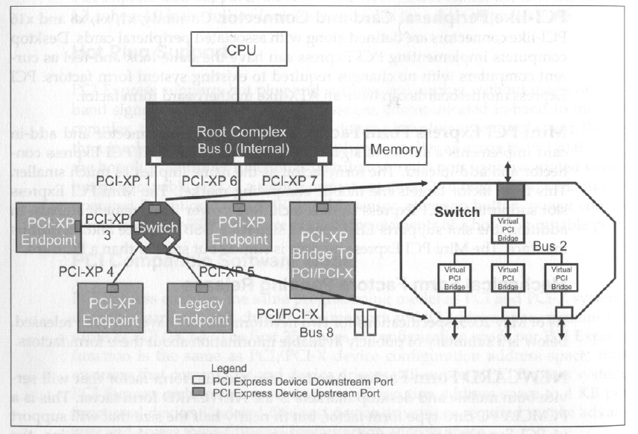
PCIe Fabric

Slide 13
PCIe Terminologies
RC (Root Complex)
A defined PCIe System Element that includes
A Host Bridge
Zero or more Root Complex Integrated Endpoints
Zero or more Root Complex Event Collectors (Support RC EPs)
One or more Root Ports.
Root Port
A PCI Express Port on a Root Complex that maps a portion of the Hierarchy through an associated virtual PCI-PCI Bridge.
Switch
A defined System Element that connects two or more Ports to allow Packets to be routed from one Port to another.
To configuration software, a Switch appears as a collection of virtual PCI-to-PCI Bridges.
EP (Endpoint)
A Function that has a Type 00h Configuration Space header.

Slide 14
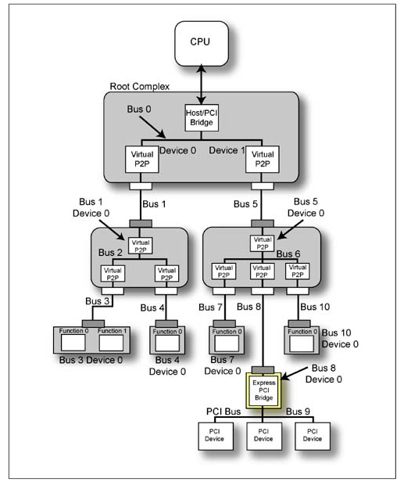
Domain:Bus:Device.Function
Domain
Address range[0-65535]
Each Domain have its separate bus range [0-255]
x86 only have one PCI Domain: 0
Bus
Address range [0-255]
Devices from RC is attached to bus 0
x86 could have multiple RCs, but all of RCs shared [0-255] bus range.
Device
Address range [0-31]
Function
Address range [0-7]

Slide 15
PCI Address spaces
Address spaces
Configuration Space (Accessed by Bus/Device/Function)
Configuration Access Mechanism#1
- Legacy in/out to IO ports 0xCF8 and 0xCFC.
MMIO (memory mapped IO)
- ACPI MCFG table provide the base address.
Memory Space (Accessed mov instructions)
Pointed by 32bit or 64bit BARs which are initialized by BIOS or OS
IO Space (Accessed by in/out instructions)
Pointed by IO BARs which are initialized by BIOS or OS
Legacy space with size limitations.
Usages
Config Space is standard for OS device enumeration and management.
Memory and IO Spaces are device private

Slide 16
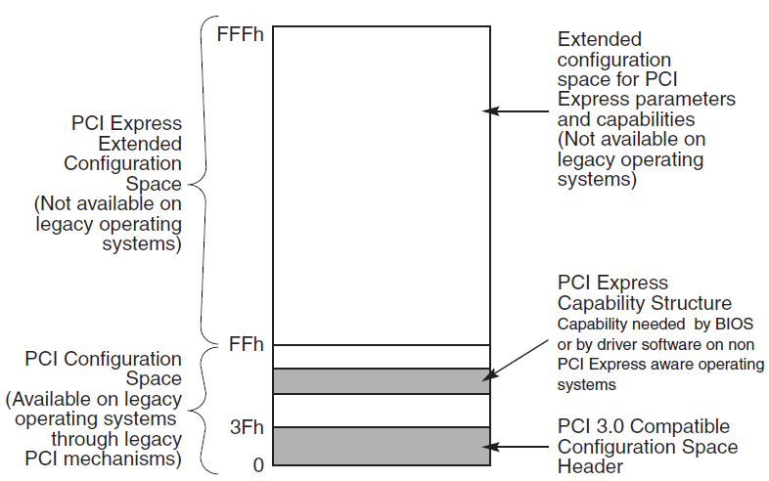
4K PCIe Config Space Layout

Slide 17
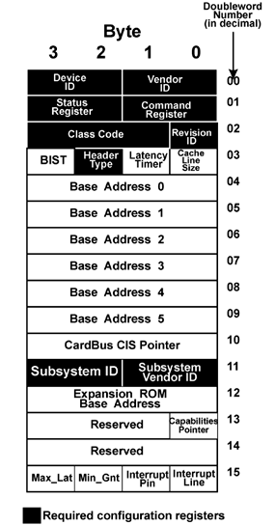
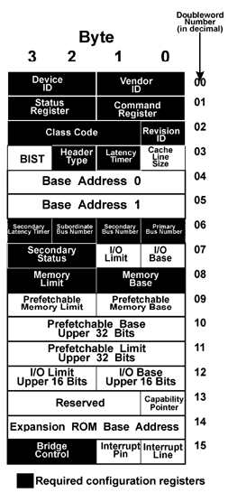
PCI Config Space [0 - 63]
Two header types
Type 0 - for regular EPs
Type 1 - for switches and bridges
Device Identification
VendorID: PCI-SIG assigned
DeviceID: Vendor self-assigned
Subsystem VendorID: PCI-SIG
Subsystem DeviceID: Vendor
Address Decode controls
Software reads/writes BARs to determine required size and maps appropriately
Memory, I/O, and bus-master enables

Slide 18
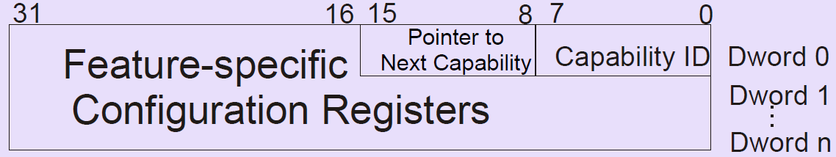
PCI Config Space [63 - 255]
Linked list
Follow the list! Cannot assume fixed location of any given feature in any given device
First entry in list is stored at offset of 0x34h in PCI config space.
Features defined in their related specs:
PCI-X
PCIe
PCI Power Management
Etc…

Slide 19
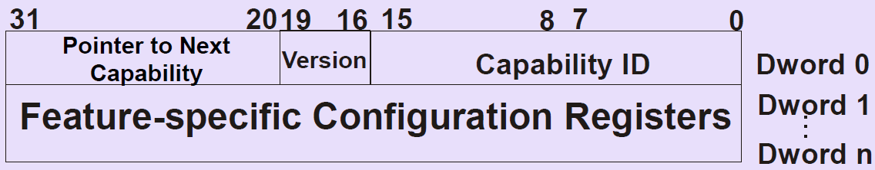
PCI Config Space [256 - 4095]
PCI Express only
Linked list
Follow the list! Cannot assume fixed location of any given feature in any given device
First entry in list is *always* at 100h
Features defined in PCI Express specification

Slide 20
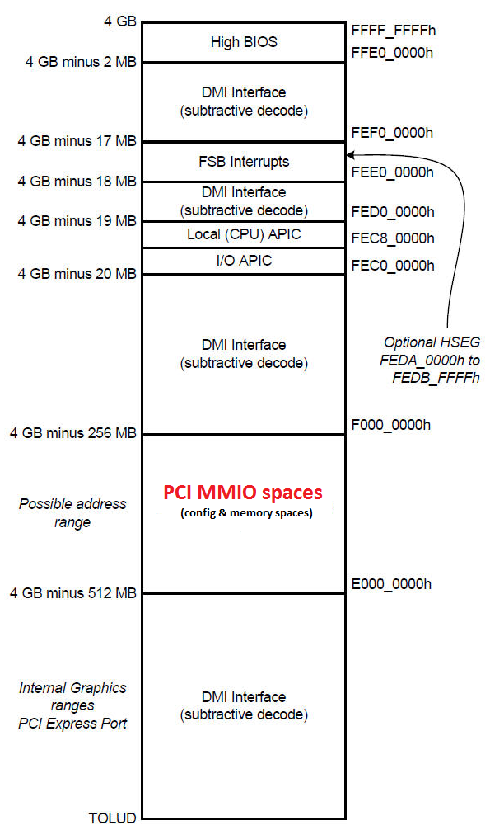
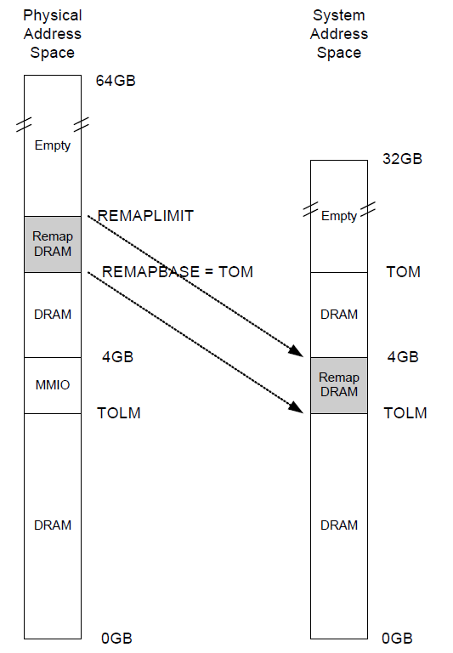
PCI Hole and DRAM Remap

Slide 21
PCIe INTx/MSI/MSI-X Differences
INTx
PCIe defined the INTx messages to emulate INTx (INTA/B/C/D pins) assertions
On x86, INTx messages will target to IOAPIC in PCH/South Bridge
On x86 IOAPIC sends a Intel defined interrupt message to North Bridge
LAPIC within the CPU die will receive INTx eventually
MSI
Each PCIe functions config space has a PCIe MSI capability structure which allow up to 32 MSI vectors. All of 32 vectors share a same MSI address and MSI data pair, which means all 32 vectors target a same CPU core.
MSI address and MSI data are initialized by OS interrupt vector allocation code
PCIe device write the MSI data to MSI address by using a PCIe DMA write
On x86, MSI address is the LAPIC address
On x86, MSI data a Intel defined format, which defined interrupt delivery mode.
MSI-X
Similar with MSI, but MSI-X capability structure allows up to 2048 vectors, and each MSI-X vectors defines the separate MSI address and data pairs, which could target to different CPU cores.

Slide 22
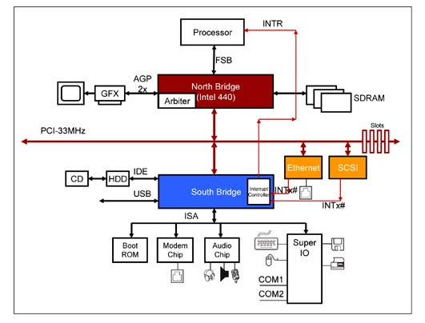
Legacy PCI Interrupt on x86

Slide 23
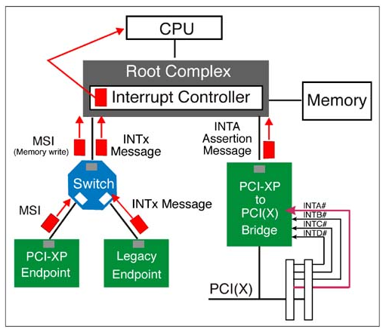
Message Based PCIe Interrupts

Slide 24
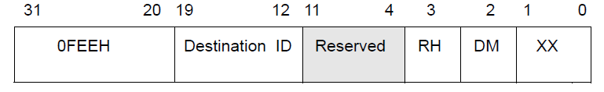
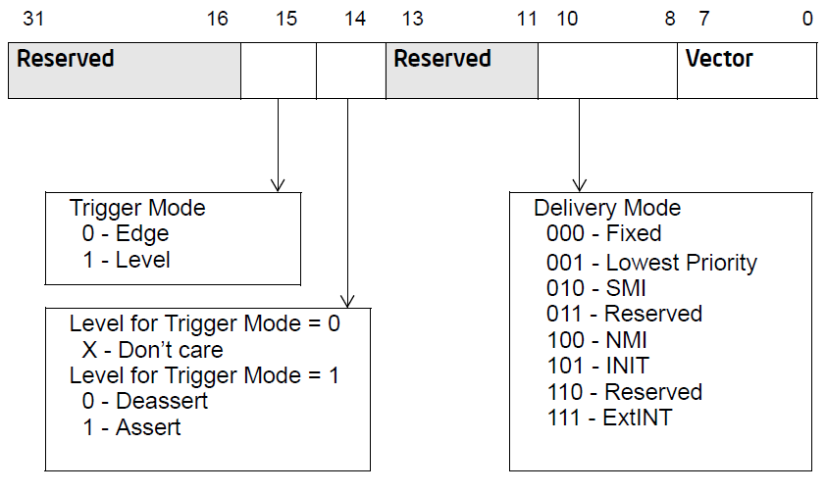
MSI Address and Data on x86

Slide 25
x86 DMA Transactions in PCIe
There are 4 possible DMA transactions
Device memory to host memory
PCIe DMA write transaction, memory write TLP
Host memory to device memory
PCIe DMA read transaction, memory read TLP
Device memory to device memory
PCIe peer to peer
Host memory to host memory
Not PCIe related.
Supported by Intel CPU uncore DMA engine since Nehalem
PCIe DMA
PCIe devices are bus master devices who can start a DMA transaction
Each PCIe devices might have multiple built-in DMA engines
On x86, without IOMMU support, DMA address is equal to MMU physical memory address
If IOMMU enabled, a DMA address is an IO address. IOMMU translate an IO address to a MMU physical address

Slide 26
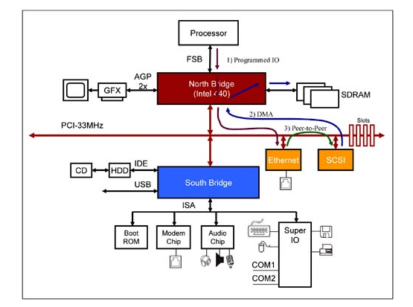
PCI Bus Transactions

Slide 27
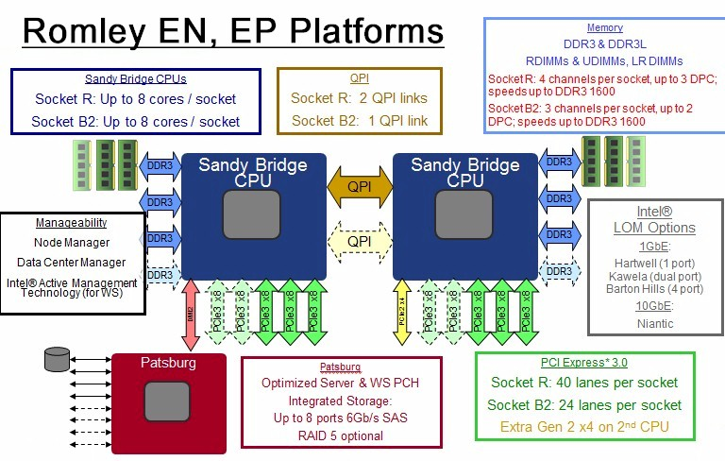
Sandy Bridge Board

Slide 28
Agenda
PCI/PCIe Basic
PCIe errors handling
Case study - analysis PCIe errors
References

Slide 29
PCIe Errors Classification
PCIe Errors
Correctable Errors
Uncorrectable Errors
Fatal Errors
Non-Fatal Errors

Slide 30
PCIe Errors Registers in Config Space
PCI Config Space
Legacy PCI
PCIe AER
CE Status
UE Status
Device Specific
Device Status
Secondary Status(Bridge only)

Slide 31
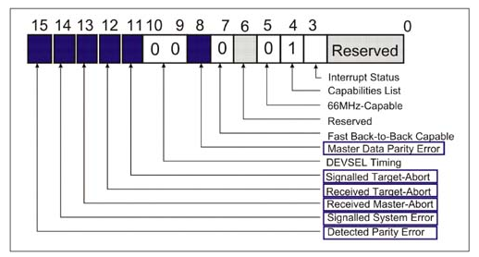
PCI Device Status Register

Slide 32
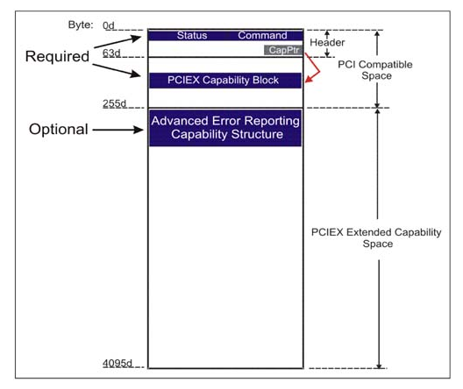
PCIe AER(Advance Error Reporting) Registers

Slide 33
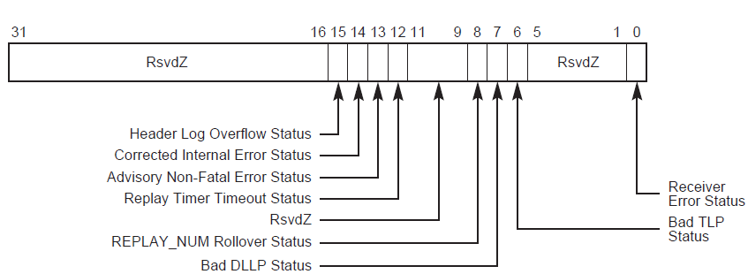
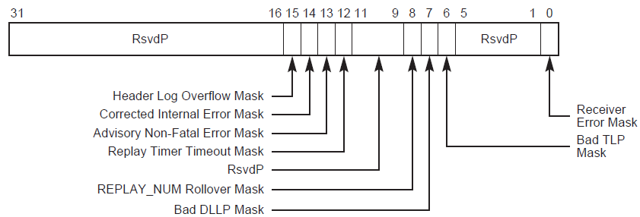
AER CE Status and Mask Registers

Slide 34
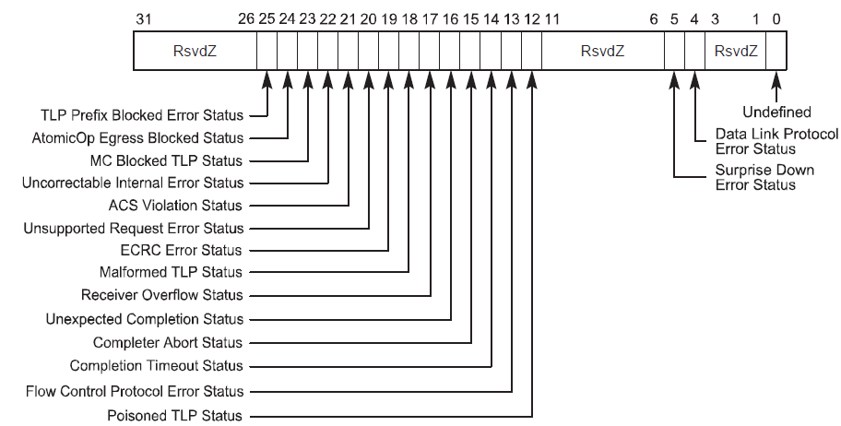
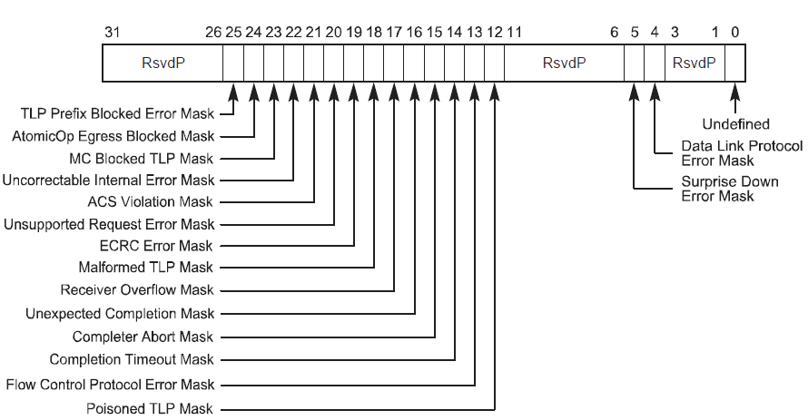
AER UE Status and Mask Registers

Slide 35
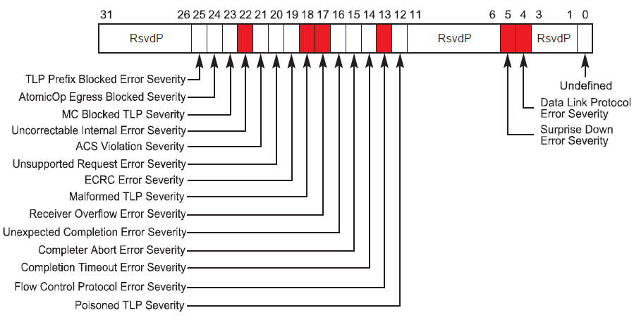
AER UE Severity Registers
Red color indicates the Fatal UEs

Slide 36
PCIe Error Signaling
PCIe error signaling
Completion Status other than success: UR, CA, CRS
Error Messages: ERR_COR, ERR_NONFATAL, ERR_FATAL
Error Forwarding, aka Data Poisoning
Error Interrupts
System interrupts
SMI - Handled by BIOS SMI interrupt handler
NMI – Handled by OS NMI interrupt handler
x86 standard NMI
Vendor customized NMI
Root Port device interrupts
MSI or INTx handled by OS PCIe AER bus driver

Slide 37
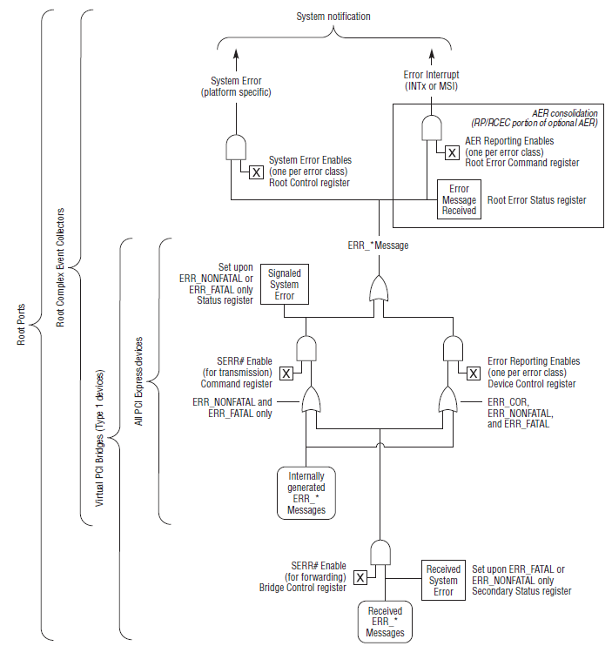
PCIe error signaling control
PCIe errors signaling could be controlled at different levels
EP, Switch, Root Port
AER CE/UE mask registers
#SERR enable in PCI command register
Device control registers in PCIe capability
Root Port only
Root Error Command register
Root Control register

Slide 38
PCIe Error Handling on Linux
PCIe AER bus driver handles all of PCIe CEs and UEs
Negotiate with BIOS by ACPI _OSC method and get error handling control
Disable SMI and register per Root Port MSI or INTx interrupts handlers.
Handled errors interrupts with below strategies
CE - Error logging and clear the registers
Non-fatal UE
- Disable all drivers associated within the device hierarchy
- Error logging and registers dump
- Call driver callbacks to reset the PCIe devices
- Enable all affected drivers again if recover success
Fatal UE
- Disable all drivers within the device hierarchy
- Error logging and registers dump
- Call driver callbacks to log errors, and reset PCIe links, devices
- Enable all affected drivers again if recover success

Slide 39
Agenda
PCI/PCIe Basic
PCIe error handling
Case study - analysis PCIe errors
References

Slide 40
Kernel panic for PCIe UEs – part I
On a x86 box, below command could trigger a kernel panic
# dd if=/dev/mem of=/dev/null
The panic just means the system is panicked by HW errors, which could be either a HW fault or a software(driver) bug.
Look at the SEL logs to understand what HW errors are detected
It was the completion abort PCIe UEs reported by device 84:0.0
# grep HL bios.txt
ELOG(109) -N- Completer Abort Status Bus:84H Dev:00H Fn:00H SID:FFFFFFFFH FEP:0FH HL:D0CF1D27CE200000800808FF00000002H
The HL field in SEL log is PCIe TLP header log dump, which is actually from the TLP packet that caused the error.
Now decode the header log: D0CF1D27CE200000800808FF00000002
00000002 is the first 4(0-3) bytes of TLP header which tells us this TLP is a Memory Read Request TLP, and packet header has 3DW length(12bytes). So the D0CF1D27 is useless.
800808FF tells us the PCIe TLP Requester(device) ID is 80:1.0 which is the PCIe Root Port.
CE200000 is 32bit memory address according to Memory Read Request TLP packet format.
Run lspci, we found that CE200000 is the start address in PLX switch memory(BAR0).
# lspci -s 84:0.0 -vvv | grep -i reg
Region 0: Memory at ce200000 (32-bit, non-prefetchable) [size=128K]
Then we know PLX switch(84:0:0) send PCIe Root Port(80:1.0) a completion abort TLP, indicate the its device register read failure happened at memory address CE200000
This HW failure should be HW/FW problems, as PLX bar0 is not owned by Linux OS.

Slide 41
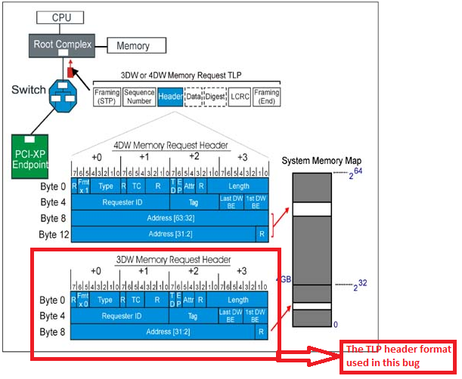
Kernel panic for PCIe UEs – part II

Slide 42
Agenda
PCI/PCIe Basic
PCIe error handling
Case study - analysis PCIe errors
References

Slide 43
References for this TOI material
PCI Express System Architecture (Book)
PCI Express Base Specification Revision 3.0
PCI Local Bus Specification Revision 3.0
The PCI Express Advanced Error Reporting Driver Guide HOWTO

Slide 44
Q&A

