Slide 1
Linux NUMA Optimization TOI
Oliver Yang
Feb, 2016
http://oliveryang.net

Slide 2
Agenda
Overview
Kernel Facilities
Known Gaps
Opportunities

Slide 3
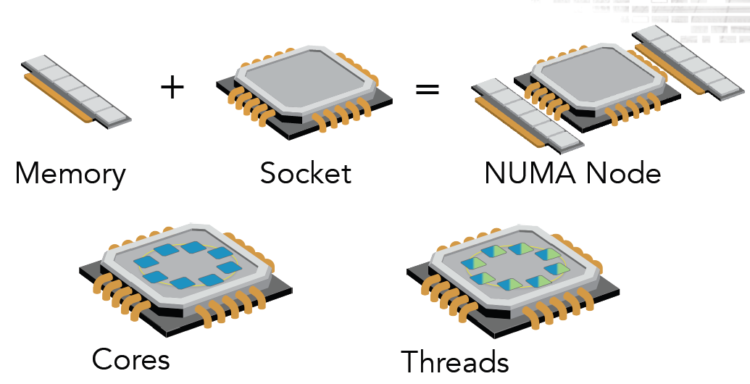
Nodes, Sockets, Cores, Threads

Slide 4
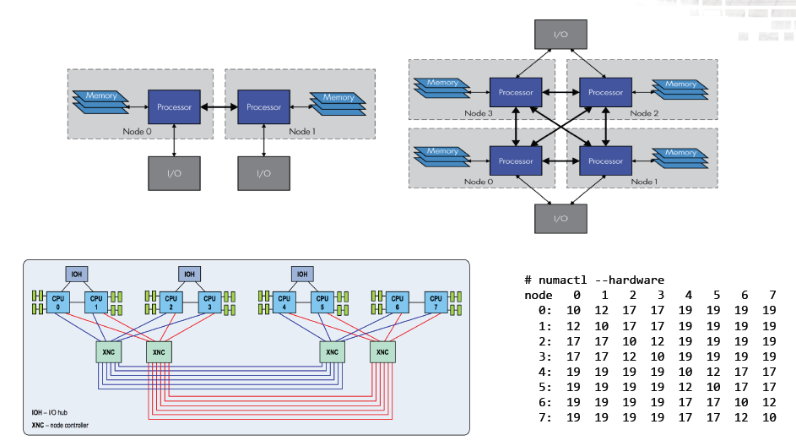
2/4/8 Sockets Servers

Slide 5
CPU NUMA Affinity
x86 changes since Nehalem
Memory controller is integrated in die
Has local and remote memory access
Worst case NUMA-node relative latency
Intel 4 socket / 4 node: 1.5x
AMD 4 socket / 8 node: 2.7x
8 socket / 8 node: 2.8x
32 node blade system: 5.5x

Slide 6
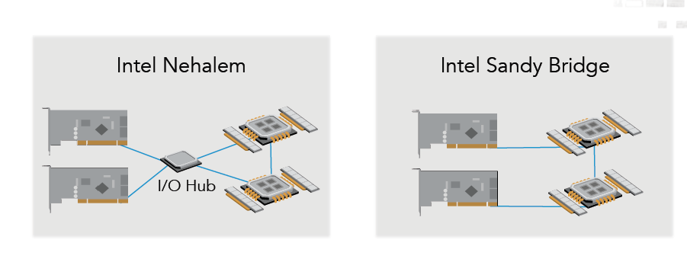
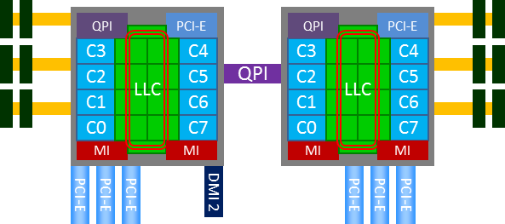
Device NUMA Affinity
Changes after the Sandy Bridge
No I/O hubs
PCIe Root-Complex is in the die
Devices connected to CPU directly
NUMA Node

Slide 7
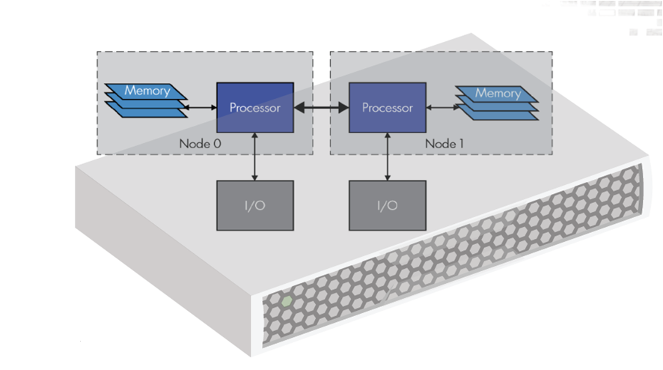
Why NUMA Affinities?
4. Mem Write
3. Mem Read
2.Interrupt
1. DMA

Slide 8
Agenda
Overview
Kernel Facilities
Known Gaps
Opportunities

Slide 9
Key Requirements
Device affinity
DMA Memory locality
Are DMA buffers close to the devices?
Interrupt locality
Are interrupts close to DMA buffers?
CPU affinity
Host Memory locality
Are memory buffers close to the running threads on the processors?
Scheduling locality
Are processes/threads close to its memory buffers?
Protocols stacks (Network/IO etc..) locality
Are data locality could be kept in the same NUMA nodes in the stack?

Slide 10
DMA Memory Locality
Kernel buffer allocation
dev_to_node VS. numa_node_id
dev_to_node: get device numa node from device tree
numa_node_id: get memory numa node per current CPU id
Use dma_alloc_coherent directly
Specify device numa node id in kernel APIs
Use__netdev_alloc_skb instead of alloc_skb (not work for 3.2)
int node = dev->dev.parent ? dev_to_node(dev->dev.parent) : -1;
skb = __alloc_skb(length + NET_SKB_PAD, gfp_mask, 0, node);
Use kmalloc_node instead of kmalloc
int node = dev->dev.parent ? dev_to_node(dev->dev.parent) : -1;
data = kmalloc_node(rx_buf_sz, GFP_KERNEL, node);
Use alloc_pages_node instead of alloc_pages
User space buffer allocation
No standard way, but could be done with kernel customizations.

Slide 11
Interrupt Locality
Hardware IRQ
Capabilities of different type of interrupts
Local APIC interrupt delivery mode in Linux kernel
Logical mode when CPU <= 8
Local APIC chipset will do irq balance among 8 CPUs
No NUMA affinity issues under this mode on latest x86 platform
Physical flat mode when CPU > 8
One interrupt vectors just can be bound to one CPU at a time.
IRQ balance can break NUMA affinity
Soft IRQ
After kernel code triggers it, a soft IRQ will be fired on the same core
IRQ balance could impact the affinity of soft IRQ as well
Type | Max Vectors | Bound to multi-CPUs | Shared
INTx | 1 | No | Yes
MSI | 32 | No | No
MSI-X | 2048 | Yes | NO

Slide 12
Host Memory Locality
Kernel memory allocation
Slab allocator always returns memory from local NUMA node
kmalloc and kmem_cache_alloc are NUMA aware
kmalloc VS. kmalloc_node
kmalloc allocates memory from local NUMA node per caller’s CPU.
kmalloc_node allocates memory per node arguments, which could be any of NUMA nodes.
Page allocator
alloc_pages returns page from local NUMA node by default
alloc_pages VS. alloc_pages_node
User space memory allocation
Application hugetlb pages
OS kernel can do NUMA aware hugetlb reservation
Standard malloc in glibc also considers NUMA affinity
Kernel page fault will try to return the page from local NUMA node first
Local fault - memory on same node as CPU
Remote fault - memory on different node than CPU

Slide 13
NUMA Aware Kernel Memory Allocator
CPU
Cache
Layer
kmem_cache0
kmem_cache1
kmem_cache0
kmem_cache1
Socket 0
Socket 0
Socket 1
Socket 1
CPU 0
CPU 1
CPU 0
CPU 1
CPU 2
CPU 3
CPU 2
CPU 3
Slab
Layer
Numa node 0
Numa node 0
Numa node 1
Numa node 1
Page
Allocator
Numa node 0
Numa node 1
Zone
Zone
Zone
Zone
Zone
Zone

Slide 14
Scheduling Locality
Scheduler is NUMA aware
Trade-off between affinity/locality and CPU availabilities.
Scheduling domain are based on ACPI table
Support SMT->SMP->NUMA topology and hierarchy
Threads migration policy reflects to different scheduling domain
Hyper thread CPUs level: No NUMA affinity issues
Physical CPUs level: lose cache locality but has the NUMA affinity
NUMA node level: Lose both cache locality and NUMA affinity
Short running tasks could have better localities
Threads migration might break the affinities for long running processes
Threads wakeup could trigger threads migration (Major reasons in Linux OS)
Runq load balance could be driven periodically by kernel.
Avoid tasks migration to get better localities
Bind kernel thread to a specific CPU
Use kthread_create_cpu instead of kthread_create
Bind user processes to a specific CPU
Use mbind() and set_mempolicy() system call

Slide 15
Summary
Major NUMA features are available
Kernel APIs are NUMA aware
Core kernel services are NUMA aware
There are some gaps…
Performance profiling tools
Micro-benchmarks
Throughput VS. Latency
Had a NUMA mechanism in kernel, but lack of end-to-end affinity from kernel to user space
DMA buffer affinity
Interrupt affinity
Kernel threads affinity (CPU/Cache/Memory)
Application threads affinity (CPU/Cache/Memory)

Slide 16
Agenda
Overview
Kernel Facilities
Known Gaps
Opportunities

Slide 17
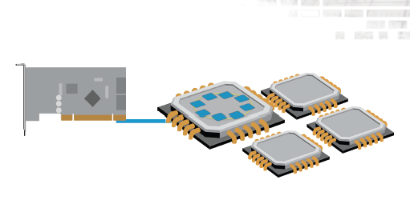
How To Identify Gaps
Full stack efforts, need check OS whole data path
Hardware
SLIC placements vs. QPI/PCIe bandwidth
Firmware
Key ACPI tables
ACPI SRAT for CPU affinity information
ACPI SLIT for NUMA domain information
ACPI DSDT table for device affinity information
Kernel & Drivers
DMA affinity
Interrupt affinity
Kernel threads affinity
Thread modeling
Threads migrations
Memory allocation
Application
User process affinity
Thread modeling
Threads migrations
Memory allocation

Slide 18
Full Stack View
Network
NIC Drivers
IO
Multipath
SAS driver
TCP/IP
Socket APP
SCSI mid layer
RAID Driver
Block
Kernel
Scheduler
Memory management
Device management

Slide 19
Kernel
Device affinity
Interrupt affinity
Current irqbalance are not good enough.
How can it work with TCP flow and GUTs
DMA affinity
Had the bug in DMA buffer affinity code path.
Need evaluate DMA buffer affinity perf differences on Apollo
DMA affinity can be determined by user space
CPU affinity
Kernel memory management
Need investigate recent NUMA scheduling features in mainline
Scheduling
Need investigate thread migration features in mainline
Profiling tools
Need port some tools: NUMAtop/Some perf event features/IRQstat etc.
Need investigate how to leverage tracepoints

Slide 20
Network
Device affinity
There is a trade-off between CPU availabilities and DMA buffer affinity
Not all device drivers are optimized for DMA buffer affinity.
For example, ixgbe doesn’t support, but bnx2x support
How to set interrupts affinity when enable multiple device queues
Stop using old irqbalance.
CPU affinity
Very big gap for data copy between kernel and user space
Kernel buffer and user buffer might be on different NUMA nodes
Following kernel features need to be investigated,
Flow Steering support
RFS: Receive Flow Steering
Flow director support in NICs (with multiple queues/interrupts)
Scheduler tuning might be required.

Slide 21
Idea Of Receive Flow Steering
CPU on which transmits for a flow occur is “remembered”
On receive for that flow, remembered cpu is looked up and packet steered to that CPU

Slide 22
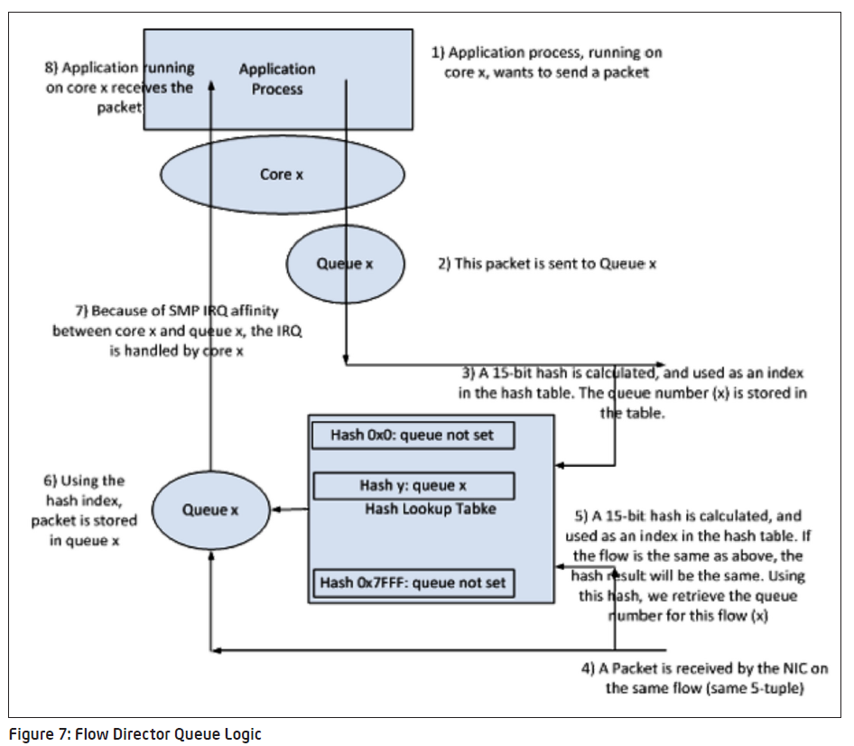
Network – Flow Director On Intel NIC

Slide 23
Agenda
Overview
Kernel Facilities
Known Gaps
Opportunities

Slide 24
Kernel Investigations – NUMA tools
NUMA profiling tools
numactl
numastat
numad
Sysfs
Lstopo
NUMAtop: https://01.org/numatop
Top(NUMA version): https://gitorious.org/procps/procps
Irqstat: https://github.com/lanceshelton/irqstat
perf mem-loads event – available in 3.10 kernel
c2c data-sharing tool(c2c == “cache to cache”)

Slide 25
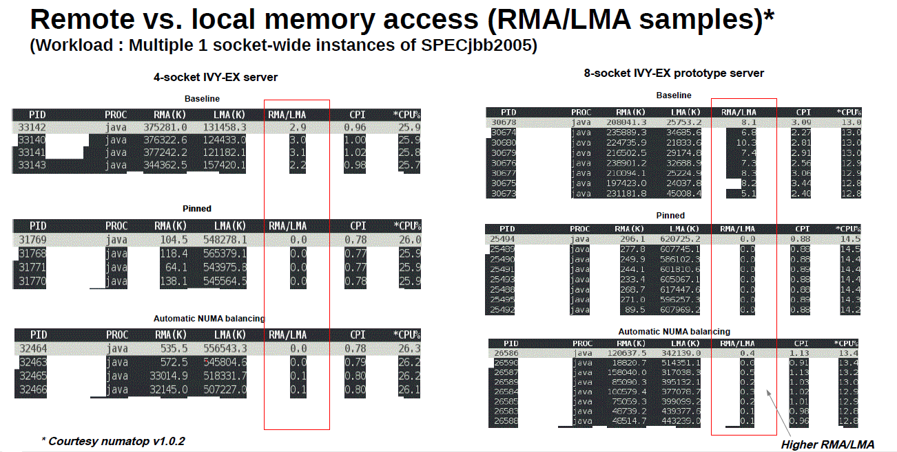
NUMA Top

