Slide 1
VMKernel Storage TOI
Compiled by Oliver Yang
Jan, 2016
http://oliveryang.net

Slide 2
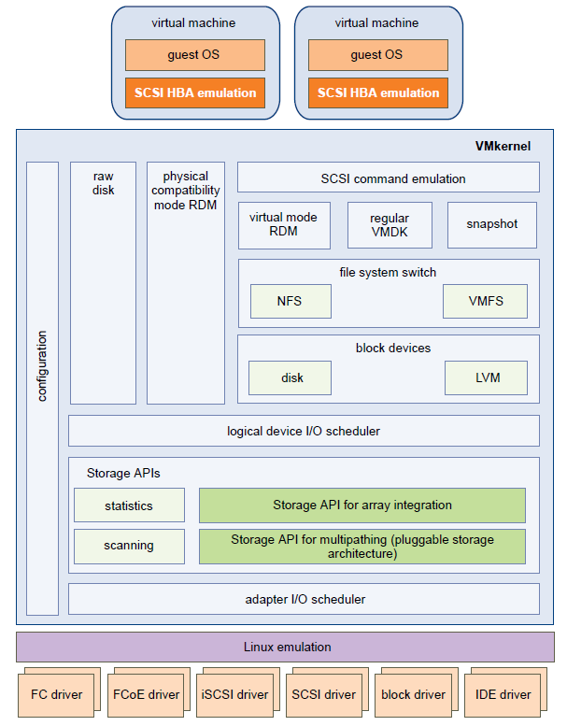
VMKernel Storage Stack
Notes:
For more information, please refer to http://oliveryang.net/2016/01/vm-basic-1

Slide 3
VMFS – A Cluster FS For VM
Share storage LUN
Multiple VM data stores shared from same VMFS volume
Multiple vSphere Host read/write concurrently
Each virtual machine is encapsulated in a small set of files
VM detects the VMDK file as a local SCSI target
File locking is used

