Slide 1
Linux Crash Dump Analysis
Oliver Yang Jul, 2017
http://oliveryang.net

Slide 2
Agenda
Welcome to panic
Getting started
Advanced Studies
Case Studies
References

Slide 3
Agenda
Welcome to panic
Getting started
Advanced Studies
Case Studies
References
“Computers crash. It's just a fact of life.”
from the “panic” book

Slide 4
Kernel Panic
An action taken by an operating system upon detecting an internal fatal error from which it cannot safely recover.
Kernel printed errors messages via console
Freeze the system to dump the memory to dump device
Reboot
Save vmcore file to filesystem

Slide 5
Causes
Bugs in kernel, modules or drivers
Panic
Exception or trap
Assertion or BUG_ON
Oops
If panic_on_oops gets set
Triggers for system, process hang
Watchdogs
Sysrq
Fatal hardware errors…
Intel MCE (Machine Check Exceptions)
PCIE Uncorrectable Errors
Firmware bugs

Slide 6
Debug Information
Console messages
System's configurations
Hardware
Software (kernel, apps)
Full system logs around the panic time
Kernel core dump
Other information dump…
MCE banks and registers
PCIe TLP packets and registers
IPMI SEL logs (BIOS and SMI logs)
STB (Service Tool Bundle) is developed for Solaris and Linux OSes vendors

Slide 7
Kernel Crash Dump
Memory snapshot while kernel panic
Kernel pages only (by default)
User pages dump is supported
Data on swap device is not included
Memory consistence
Dump after death
Very small partial of memory may not be consistent
Depends on dump mechanisms
Live dump is always not consistent!
Kernel dump utilities
Kdump (mainline)
Disk dump
Net dump

Slide 8
Agenda
Welcome to panic
Getting started
Advanced Studies
Case Studies
References

Slide 9
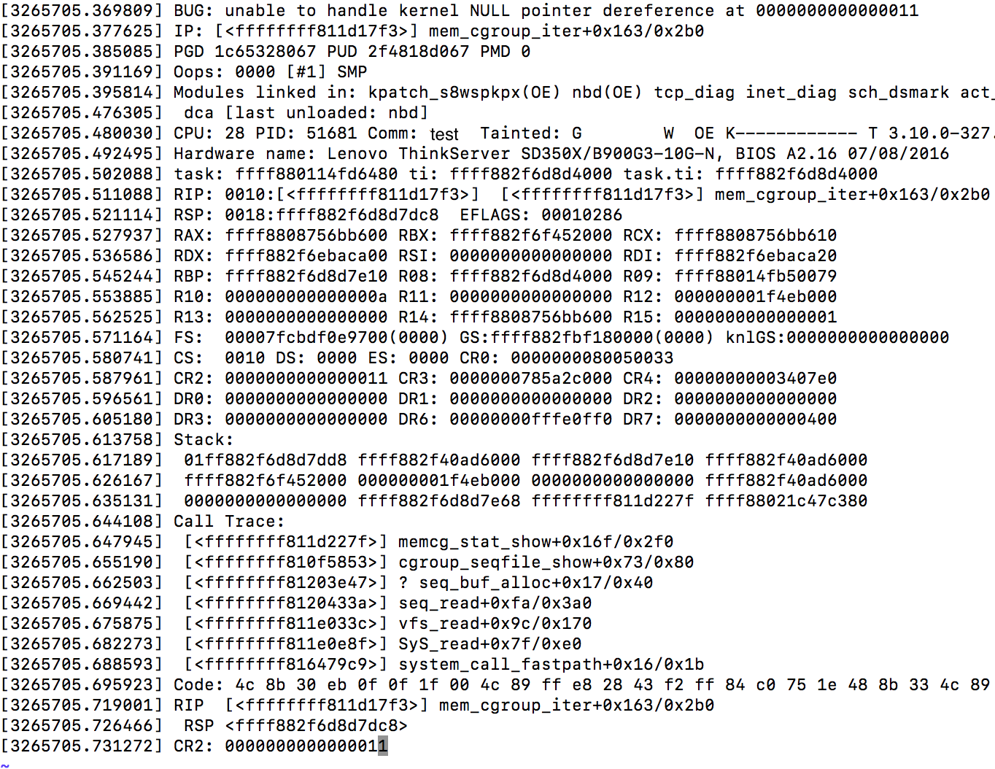
Panic - Console Messages

Slide 10
Header & Register Dumps
[3265705.369809] BUG: unable to handle kernel NULL pointer dereference at 0000000000000011
[3265705.377625] IP: [<ffffffff811d17f3>] mem_cgroup_iter+0x163/0x2b0
[3265705.385085] PGD 1c65328067 PUD 2f4818d067 PMD 0
[3265705.391169] Oops: 0000 [#1] SMP
[3265705.395814] Modules linked in tcp_diag inet_diag sch_dsmark sch_ingress binfmt_misc..[snipped]..[3265705.480030] CPU: 28 PID: 51681 Comm: test Tainted: G W OE K------------ T 3.10.0.x86_64 #1
[3265705.492495] Hardware name: Lenovo ThinkServer SD350X/B900G3-10G-N, BIOS A2.16 07/08/2016
[3265705.502088] task: ffff880114fd6480 ti: ffff882f6d8d4000 task.ti: ffff882f6d8d4000
[3265705.511088] RIP: 0010:[<ffffffff811d17f3>] [<ffffffff811d17f3>] mem_cgroup_iter+0x163/0x2b0
[3265705.521114] RSP: 0018:ffff882f6d8d7dc8 EFLAGS: 00010286
[3265705.527937] RAX: ffff8808756bb600 RBX: ffff882f6f452000 RCX: ffff8808756bb610
[3265705.536586] RDX: ffff882f6ebaca00 RSI: 0000000000000000 RDI: ffff882f6ebaca20
[3265705.545244] RBP: ffff882f6d8d7e10 R08: ffff882f6d8d4000 R09: ffff88014fb50079
[3265705.553885] R10: 000000000000000a R11: 0000000000000000 R12: 000000001f4eb000
[3265705.562525] R13: 0000000000000000 R14: ffff8808756bb600 R15: 0000000000000001
[3265705.571164] FS: 00007fcbdf0e9700(0000) GS:ffff882fbf180000(0000) knlGS:0000000000000000
[3265705.580741] CS: 0010 DS: 0000 ES: 0000 CR0: 0000000080050033
[3265705.587961] CR2: 0000000000000011 CR3: 0000000785a2c000 CR4: 00000000003407e0
[3265705.596561] DR0: 0000000000000000 DR1: 0000000000000000 DR2: 0000000000000000
[3265705.605180] DR3: 0000000000000000 DR6: 00000000fffe0ff0 DR7: 0000000000000400
[….......... Snipped.................]

Slide 11
Stack & Call Trace
[3265705.613758] Stack:
[3265705.617189] 01ff882f6d8d7dd8 ffff882f40ad6000 ffff882f6d8d7e10 ffff882f40ad6000
[3265705.626167] ffff882f6f452000 000000001f4eb000 0000000000000000 ffff882f40ad6000
[3265705.635131] 0000000000000000 ffff882f6d8d7e68 ffffffff811d227f ffff88021c47c380
[3265705.644108] Call Trace:
[3265705.647945] [<ffffffff811d227f>] memcg_stat_show+0x16f/0x2f0
[3265705.655190] [<ffffffff810f5853>] cgroup_seqfile_show+0x73/0x80
[3265705.662503] [<ffffffff81203e47>] ? seq_buf_alloc+0x17/0x40
[3265705.669442] [<ffffffff8120433a>] seq_read+0xfa/0x3a0
[3265705.675875] [<ffffffff811e033c>] vfs_read+0x9c/0x170
[3265705.682273] [<ffffffff811e0e8f>] SyS_read+0x7f/0xe0
[3265705.688593] [<ffffffff816479c9>] system_call_fastpath+0x16/0x1b
[3265705.695923] Code: 4c 8b 30 eb 0f 0f 1f 00 4c 89 ff e8 28 43 f2 ff 84 c0 75 1e 48 8b 33 4c 89 f7 e8 69 43
f2 ff 48 85 c0 49 89 c6 74 69 4c 8b 78 70 <41> f6 47 10 01 74 d6 4d 85 ff 0f 94 c0 4d 85 e>
[3265705.719001] RIP [<ffffffff811d17f3>] mem_cgroup_iter+0x163/0x2b0
[3265705.726466] RSP <ffff882f6d8d7dc8>
[3265705.731272] CR2: 0000000000000011

Slide 12
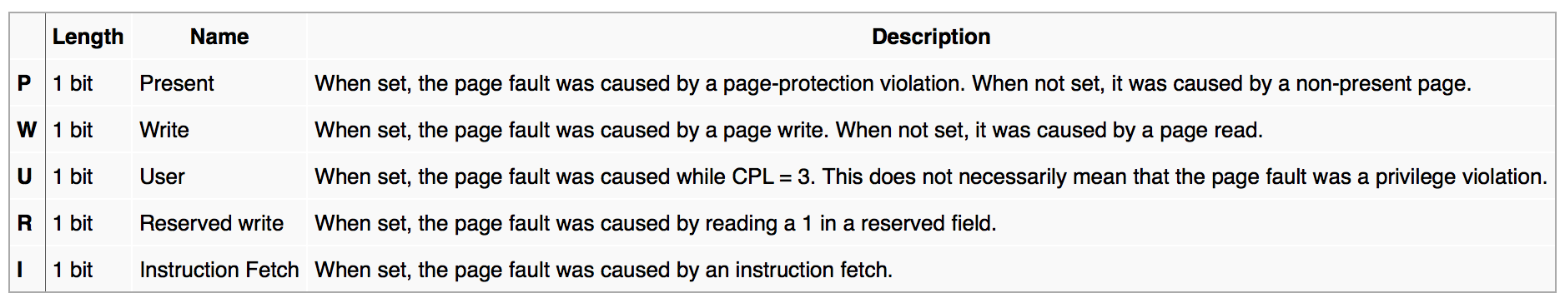
Type
TSC based timestamp and instruction which caused the panic
[3265705.369809] BUG: unable to handle kernel NULL pointer dereference at 0000000000000011
[3265705.377625] IP: [<ffffffff811d17f3>] mem_cgroup_iter+0x163/0x2b0
[3265705.385085] PGD 1c65328067 PUD 2f4818d067 PMD 0
[3265705.391169] Oops: 0000 [#1] SMP
[3265705.395814] Modules linked in tcp_diag inet_diag sch_dsmark sch_ingress binfmt_misc..[snipped]..[3265705.480030] CPU: 28 PID: 51681 Comm: test Tainted: G W OE K------------ T 3.10.0.x86_64 #1
[3265705.492495] Hardware name: Lenovo ThinkServer SD350X/B900G3-10G-N, BIOS A2.16 07/08/2016
[3265705.502088] task: ffff880114fd6480 ti: ffff882f6d8d4000 task.ti: ffff882f6d8d4000
[3265705.511088] RIP: 0010:[<ffffffff811d17f3>] [<ffffffff811d17f3>] mem_cgroup_iter+0x163/0x2b0
[3265705.521114] RSP: 0018:ffff882f6d8d7dc8 EFLAGS: 00010286
[3265705.527937] RAX: ffff8808756bb600 RBX: ffff882f6f452000 RCX: ffff8808756bb610
[3265705.536586] RDX: ffff882f6ebaca00 RSI: 0000000000000000 RDI: ffff882f6ebaca20
[3265705.545244] RBP: ffff882f6d8d7e10 R08: ffff882f6d8d4000 R09: ffff88014fb50079
[3265705.553885] R10: 000000000000000a R11: 0000000000000000 R12: 000000001f4eb000
[3265705.562525] R13: 0000000000000000 R14: ffff8808756bb600 R15: 0000000000000001
[3265705.571164] FS: 00007fcbdf0e9700(0000) GS:ffff882fbf180000(0000) knlGS:0000000000000000
[3265705.580741] CS: 0010 DS: 0000 ES: 0000 CR0: 0000000080050033
[3265705.587961] CR2: 0000000000000011 CR3: 0000000785a2c000 CR4: 00000000003407e0
[3265705.596561] DR0: 0000000000000000 DR1: 0000000000000000 DR2: 0000000000000000
[3265705.605180] DR3: 0000000000000000 DR6: 00000000fffe0ff0 DR7: 0000000000000400
[….......... Snipped.................]
Panic messages printed by show_fault_oops which is handled by CPU exception handler. The page fault address is included.
x86 exception-specific exception error code for this page fault. See x86 implementation:
int __die(const char *str, struct pt_regs *regs, long err);

Slide 13

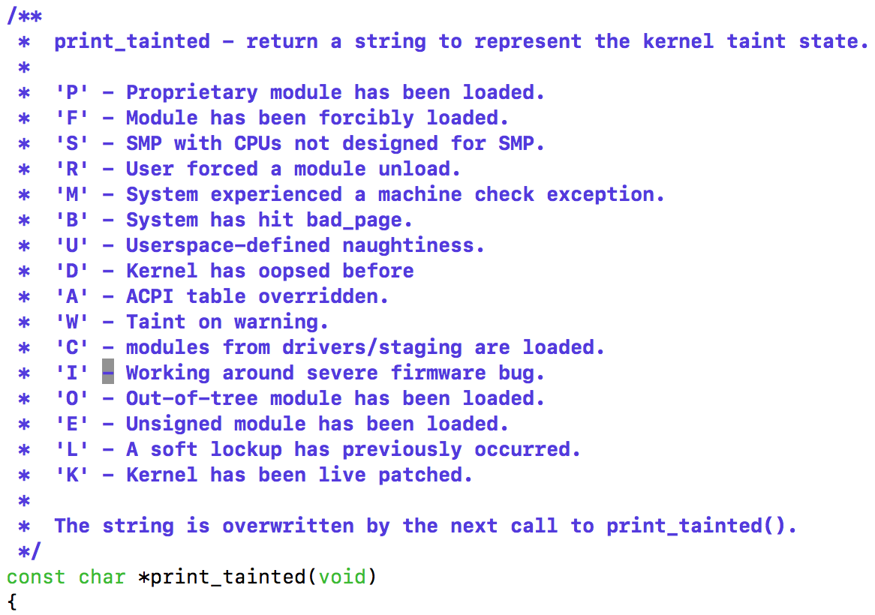
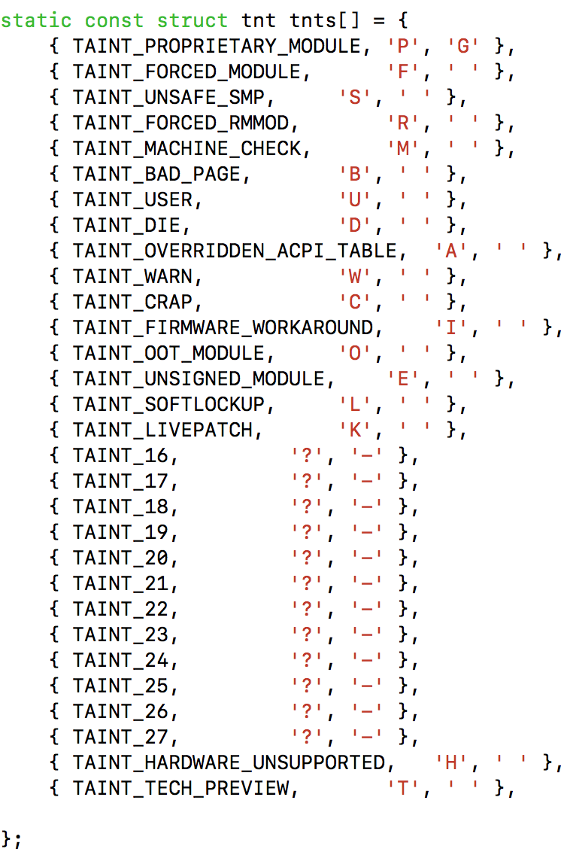
CPU PID Comm Taint Version
[3265705.369809] BUG: unable to handle kernel NULL pointer dereference at 0000000000000011
[3265705.377625] IP: [<ffffffff811d17f3>] mem_cgroup_iter+0x163/0x2b0
[3265705.385085] PGD 1c65328067 PUD 2f4818d067 PMD 0
[3265705.391169] Oops: 0000 [#1] SMP
[3265705.395814] Modules linked in tcp_diag inet_diag sch_dsmark sch_ingress binfmt_misc..[snipped]..[3265705.480030] CPU: 28 PID: 51681 Comm: test Tainted: G W OE K------------ T 3.10.0.x86_64 #1
[3265705.492495] Hardware name: Lenovo ThinkServer SD350X/B900G3-10G-N, BIOS A2.16 07/08/2016
[3265705.502088] task: ffff880114fd6480 ti: ffff882f6d8d4000 task.ti: ffff882f6d8d4000
[3265705.511088] RIP: 0010:[<ffffffff811d17f3>] [<ffffffff811d17f3>] mem_cgroup_iter+0x163/0x2b0
[3265705.521114] RSP: 0018:ffff882f6d8d7dc8 EFLAGS: 00010286
[3265705.527937] RAX: ffff8808756bb600 RBX: ffff882f6f452000 RCX: ffff8808756bb610
[3265705.536586] RDX: ffff882f6ebaca00 RSI: 0000000000000000 RDI: ffff882f6ebaca20
[3265705.545244] RBP: ffff882f6d8d7e10 R08: ffff882f6d8d4000 R09: ffff88014fb50079
[3265705.553885] R10: 000000000000000a R11: 0000000000000000 R12: 000000001f4eb000
[3265705.562525] R13: 0000000000000000 R14: ffff8808756bb600 R15: 0000000000000001
[3265705.571164] FS: 00007fcbdf0e9700(0000) GS:ffff882fbf180000(0000) knlGS:0000000000000000
[3265705.580741] CS: 0010 DS: 0000 ES: 0000 CR0: 0000000080050033
[3265705.587961] CR2: 0000000000000011 CR3: 0000000785a2c000 CR4: 00000000003407e0
[3265705.596561] DR0: 0000000000000000 DR1: 0000000000000000 DR2: 0000000000000000
[3265705.605180] DR3: 0000000000000000 DR6: 00000000fffe0ff0 DR7: 0000000000000400
[….......... Snipped.................]
Panic Task

Slide 14
HW FW Registers
[3265705.369809] BUG: unable to handle kernel NULL pointer dereference at 0000000000000011
[3265705.377625] IP: [<ffffffff811d17f3>] mem_cgroup_iter+0x163/0x2b0
[3265705.385085] PGD 1c65328067 PUD 2f4818d067 PMD 0
[3265705.391169] Oops: 0000 [#1] SMP
[3265705.395814] Modules linked in tcp_diag inet_diag sch_dsmark sch_ingress binfmt_misc..[snipped]..[3265705.480030] CPU: 28 PID: 51681 Comm: test Tainted: G W OE K------------ T 3.10.0.x86_64 #1
[3265705.492495] Hardware name: Lenovo ThinkServer SD350X/B900G3-10G-N, BIOS A2.16 07/08/2016
[3265705.502088] task: ffff880114fd6480 ti: ffff882f6d8d4000 task.ti: ffff882f6d8d4000
[3265705.511088] RIP: 0010:[<ffffffff811d17f3>] [<ffffffff811d17f3>] mem_cgroup_iter+0x163/0x2b0
[3265705.521114] RSP: 0018:ffff882f6d8d7dc8 EFLAGS: 00010286
[3265705.527937] RAX: ffff8808756bb600 RBX: ffff882f6f452000 RCX: ffff8808756bb610
[3265705.536586] RDX: ffff882f6ebaca00 RSI: 0000000000000000 RDI: ffff882f6ebaca20
[3265705.545244] RBP: ffff882f6d8d7e10 R08: ffff882f6d8d4000 R09: ffff88014fb50079
[3265705.553885] R10: 000000000000000a R11: 0000000000000000 R12: 000000001f4eb000
[3265705.562525] R13: 0000000000000000 R14: ffff8808756bb600 R15: 0000000000000001
[3265705.571164] FS: 00007fcbdf0e9700(0000) GS:ffff882fbf180000(0000) knlGS:0000000000000000
[3265705.580741] CS: 0010 DS: 0000 ES: 0000 CR0: 0000000080050033
[3265705.587961] CR2: 0000000000000011 CR3: 0000000785a2c000 CR4: 00000000003407e0
[3265705.596561] DR0: 0000000000000000 DR1: 0000000000000000 DR2: 0000000000000000
[3265705.605180] DR3: 0000000000000000 DR6: 00000000fffe0ff0 DR7: 0000000000000400
[….......... Snipped.................]
Exception/Trap Frame

Slide 15
Stack & Call Trace
The top contents of the stack
[3265705.613758] Stack:
[3265705.617189] 01ff882f6d8d7dd8 ffff882f40ad6000 ffff882f6d8d7e10 ffff882f40ad6000
[3265705.626167] ffff882f6f452000 000000001f4eb000 0000000000000000 ffff882f40ad6000
[3265705.635131] 0000000000000000 ffff882f6d8d7e68 ffffffff811d227f ffff88021c47c380
[3265705.644108] Call Trace:
[3265705.647945] [<ffffffff811d227f>] memcg_stat_show+0x16f/0x2f0
[3265705.655190] [<ffffffff810f5853>] cgroup_seqfile_show+0x73/0x80
[3265705.662503] [<ffffffff81203e47>] ? seq_buf_alloc+0x17/0x40
[3265705.669442] [<ffffffff8120433a>] seq_read+0xfa/0x3a0
[3265705.675875] [<ffffffff811e033c>] vfs_read+0x9c/0x170
[3265705.682273] [<ffffffff811e0e8f>] SyS_read+0x7f/0xe0
[3265705.688593] [<ffffffff816479c9>] system_call_fastpath+0x16/0x1b
[3265705.695923] Code: 4c 8b 30 eb 0f 0f 1f 00 4c 89 ff e8 28 43 f2 ff 84 c0 75 1e 48 8b 33 4c 89 f7 e8 69 43
f2 ff 48 85 c0 49 89 c6 74 69 4c 8b 78 70 <41> f6 47 10 01 74 d6 4d 85 ff 0f 94 c0 4d 85 e>
[3265705.719001] RIP [<ffffffff811d17f3>] mem_cgroup_iter+0x163/0x2b0
[3265705.726466] RSP <ffff882f6d8d7dc8>
[3265705.731272] CR2: 0000000000000011
Back trace
Instruction Address
Code: Instructions
Stack Pointer
Please refer to Documentation/oops-tracing.txt

Slide 16
Crash - Post-mortem Debugging
A tool for Linux crash dump analysis
Maintained by David Anderson from Red Hat
Understands all core dump formats
Kdump, diskdump, xendump etc.
Understands key kernel data structures & meta data
Tasks, page table, Slab, files, page cache, devices etc.
Also working for live system
Can be extended via…
Patch contributions to core commands
Crash extension modules loading by extend command
Support gdb scripts
Python scripts
Eppic scripts
See https://people.redhat.com/anderson/extensions.html

Slide 17
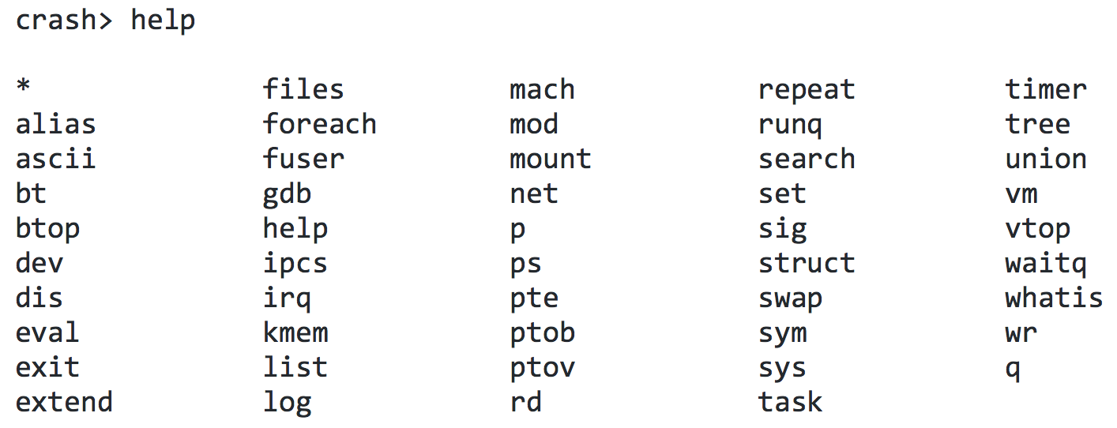
Invoking Crash
Running crash with…
vmcore or living system
Build out vmlinux and modules debug binaries
Or kernel-debuginfo & kernel-debuginfo-common-x86_64
The help <command> shows the manual and examples

Slide 18
Agenda
Welcome to panic
Getting started
Advanced Studies
Case Studies
References

Slide 19
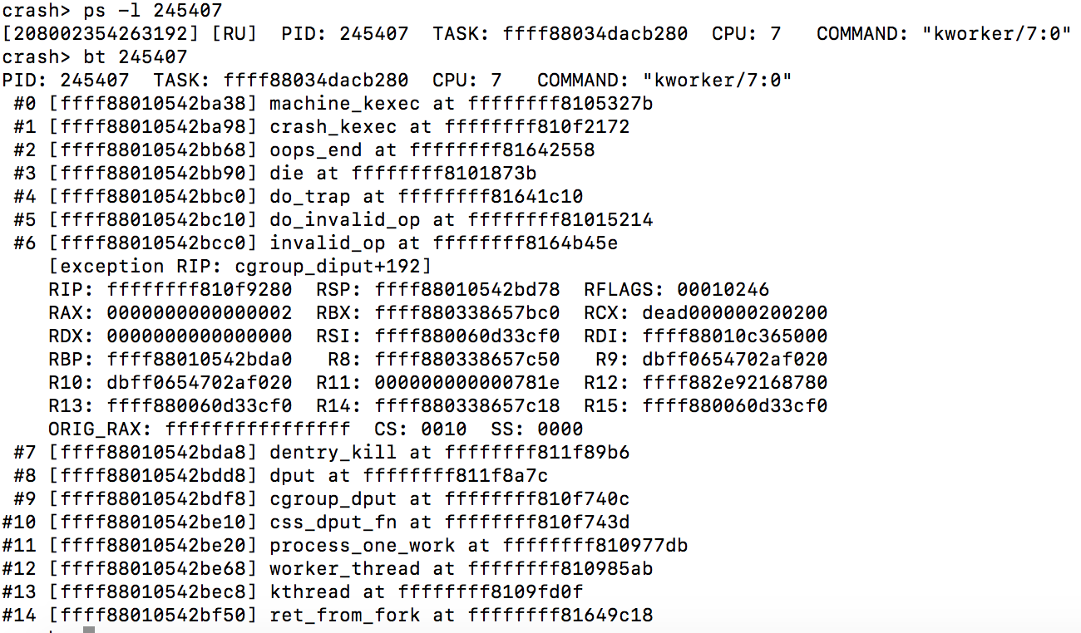
Panic Process Status
Scheduling timestamp nanoseconds
Scheduling Status: RUN
Panic Location
Stack
Call trace

Slide 20
Panic Location
RIP could give panic location
Find source code location by dis –l
crash> dis -l cgroup_diput+192
/usr/src/debug/kernel-3.10.0/kernel/cgroup.c: 889
0xffffffff810f9280 <cgroup_diput+192>: ud2
crash> l *cgroup_diput+192
0xffffffff810f9280 is in cgroup_diput (kernel/cgroup.c:889).
884 {
885 /* is dentry a directory ? if so, kfree() associated cgroup */
886 if (S_ISDIR(inode->i_mode)) {
887 struct cgroup *cgrp = dentry->d_fsdata;
888
889 BUG_ON(!(cgroup_is_removed(cgrp)));

Slide 21
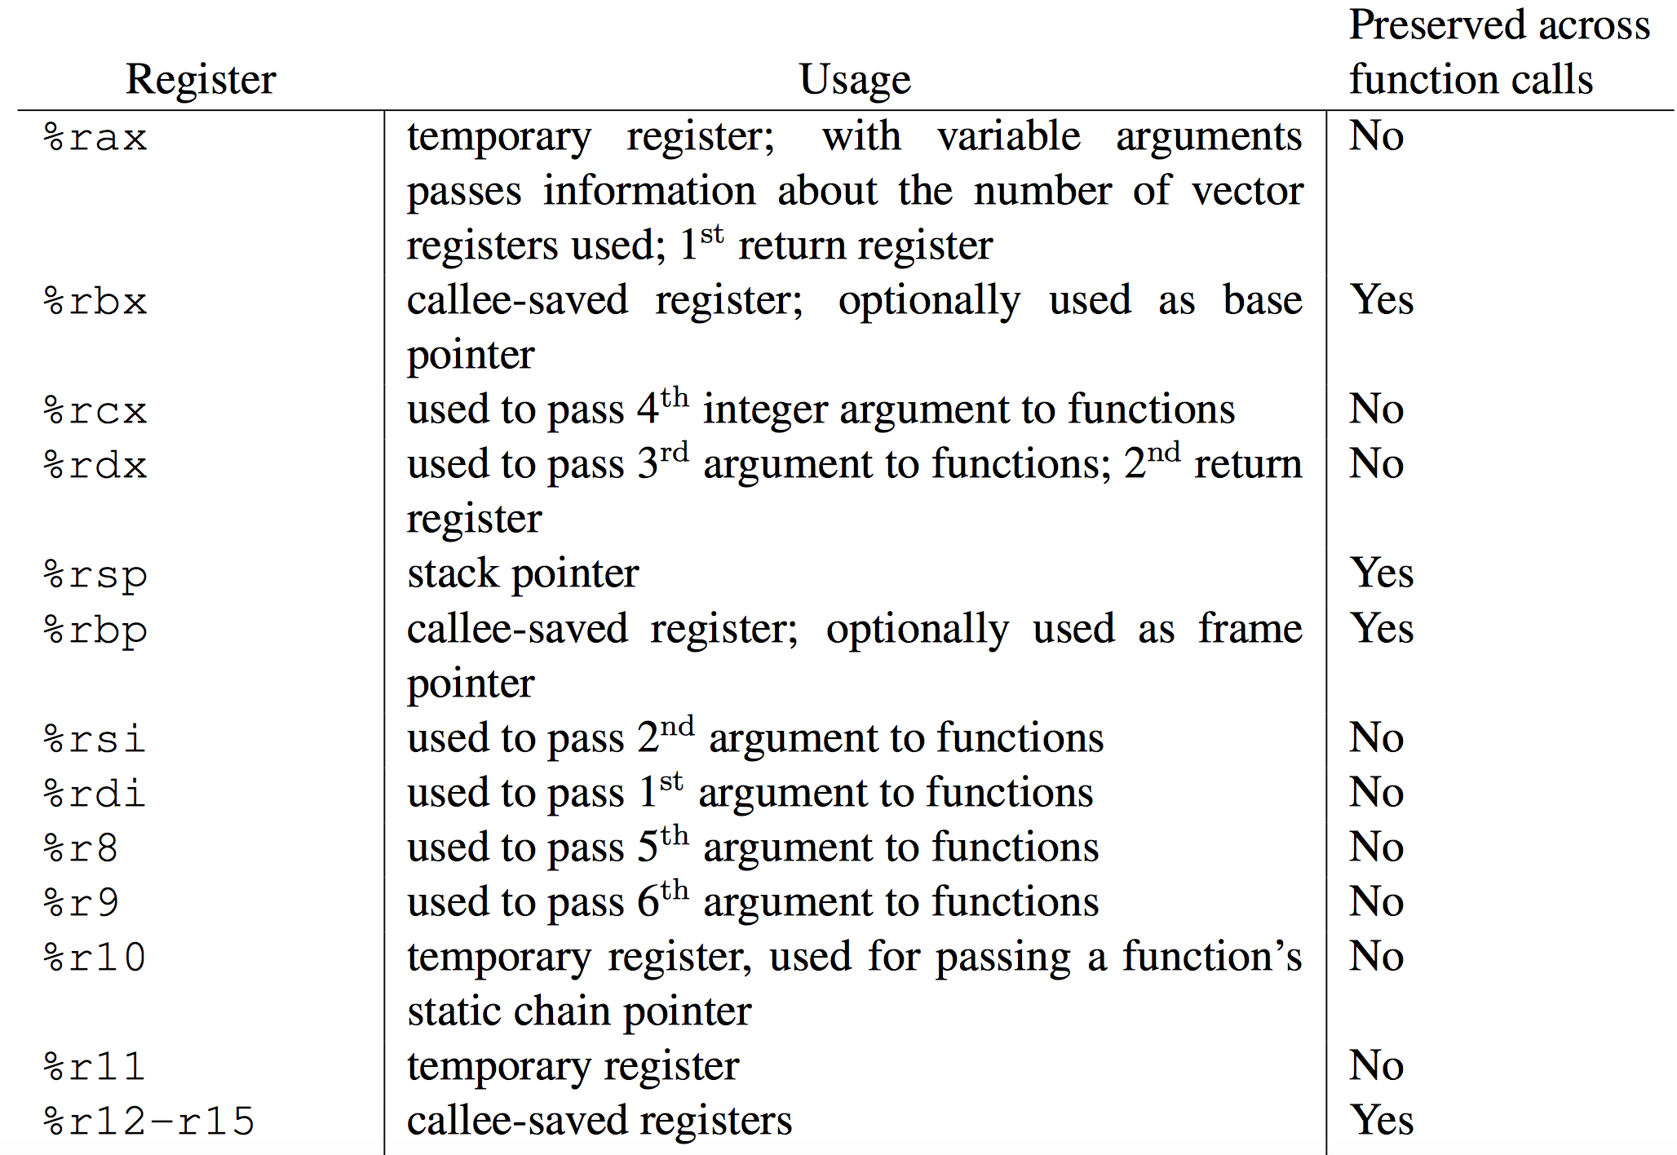
x64 SystemV ABI

Slide 22
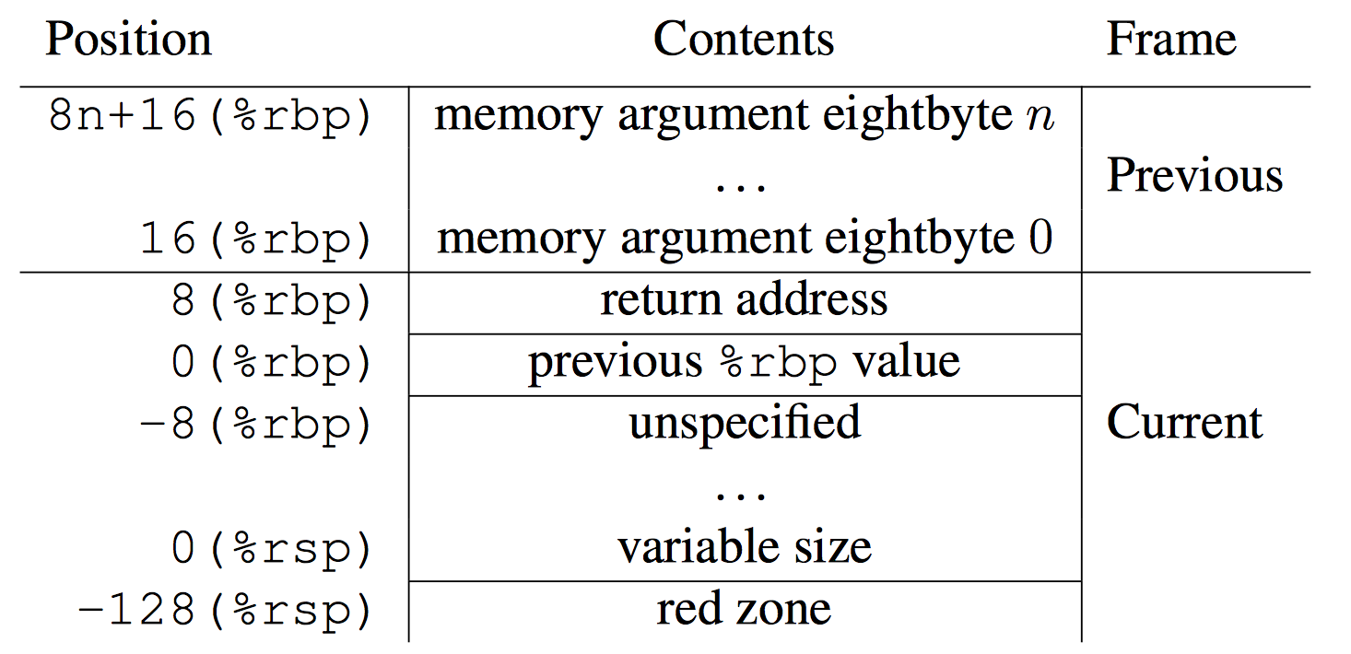
x64 Stack Frame
Local Variable

Slide 23
Function Prologue
crash> dis cgroup_diput 10
0xffffffff810f91c0 <cgroup_diput>: nopl 0x0(%rax,%rax,1) [FTRACE NOP]
0xffffffff810f91c5 <cgroup_diput+5>: push %rbp
0xffffffff810f91c6 <cgroup_diput+6>: mov %rsp,%rbp
0xffffffff810f91c9 <cgroup_diput+9>: push %r15
0xffffffff810f91cb <cgroup_diput+11>: mov %rsi,%r15
0xffffffff810f91ce <cgroup_diput+14>: push %r14
0xffffffff810f91d0 <cgroup_diput+16>: push %r13
0xffffffff810f91d2 <cgroup_diput+18>: push %r12
0xffffffff810f91d4 <cgroup_diput+20>: push %rbx

Slide 24
Function Epilogue
crash> dis cgroup_diput+144 8
0xffffffff810f9250 <cgroup_diput+144>: pop %rbx
0xffffffff810f9251 <cgroup_diput+145>: pop %r12
0xffffffff810f9253 <cgroup_diput+147>: pop %r13
0xffffffff810f9255 <cgroup_diput+149>: pop %r14
0xffffffff810f9257 <cgroup_diput+151>: pop %r15
0xffffffff810f9259 <cgroup_diput+153>: pop %rbp
0xffffffff810f925a <cgroup_diput+154>: retq
0xffffffff810f925b <cgroup_diput+155>: nopl 0x0(%rax,%rax,1)

Slide 25
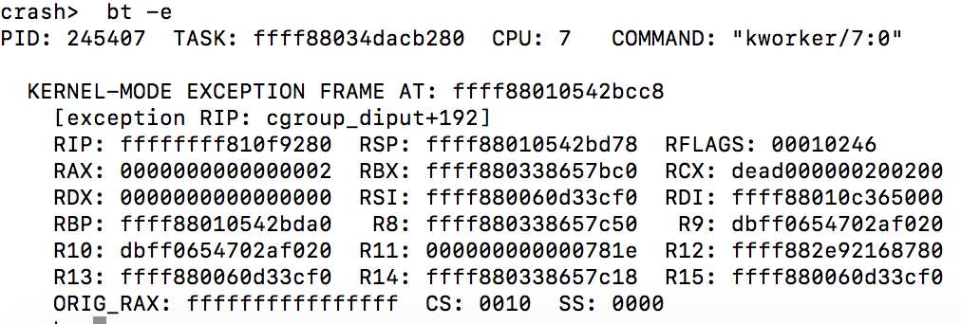
Arguments and return values
Find arguments and return values from registers
Exception Frame saves the context of…
System call
Panic exceptions
bt –e

Slide 26
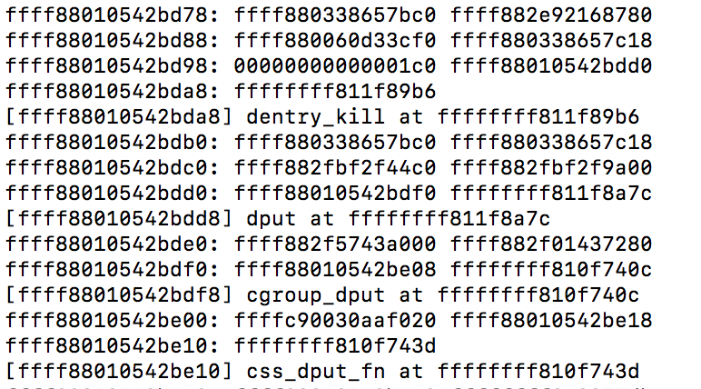
Stack Dump
bt -f

Slide 27
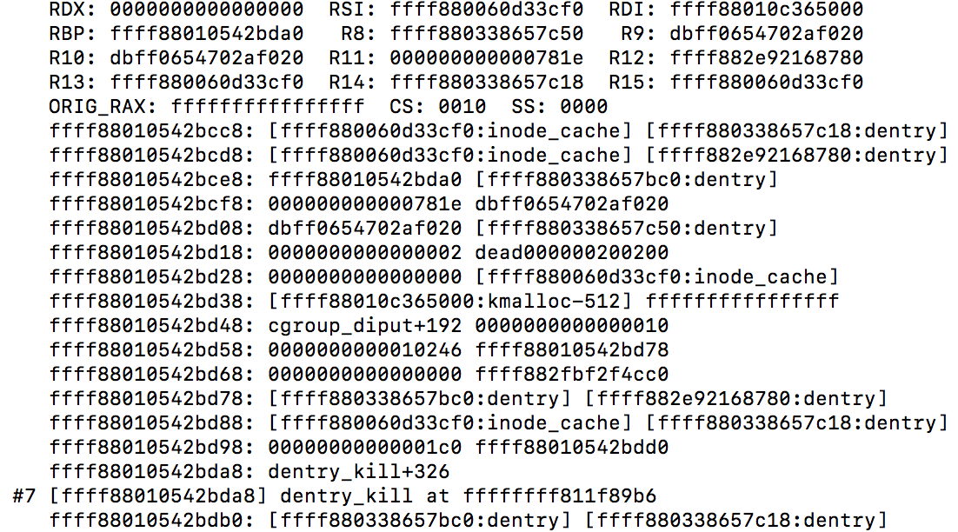
Find Arguments From Stack
bt -FF

Slide 28
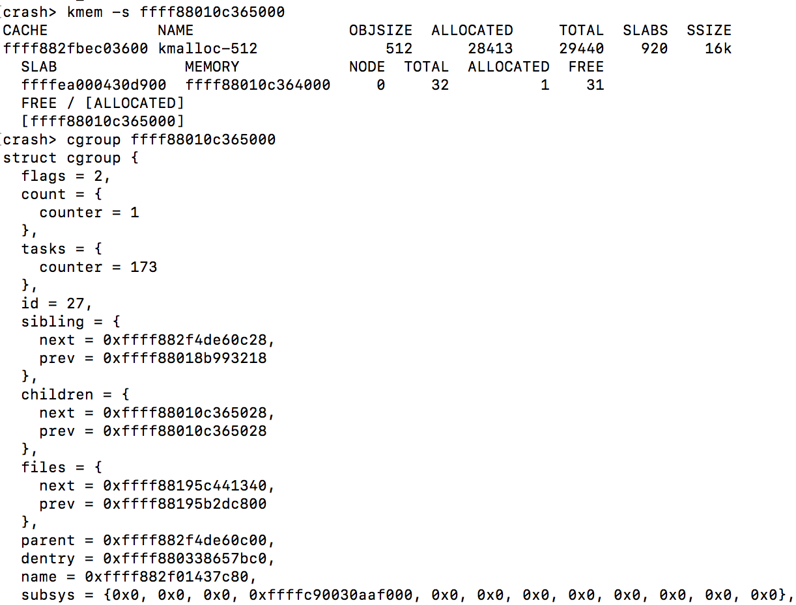
Heap/Kmem Dump

Slide 29
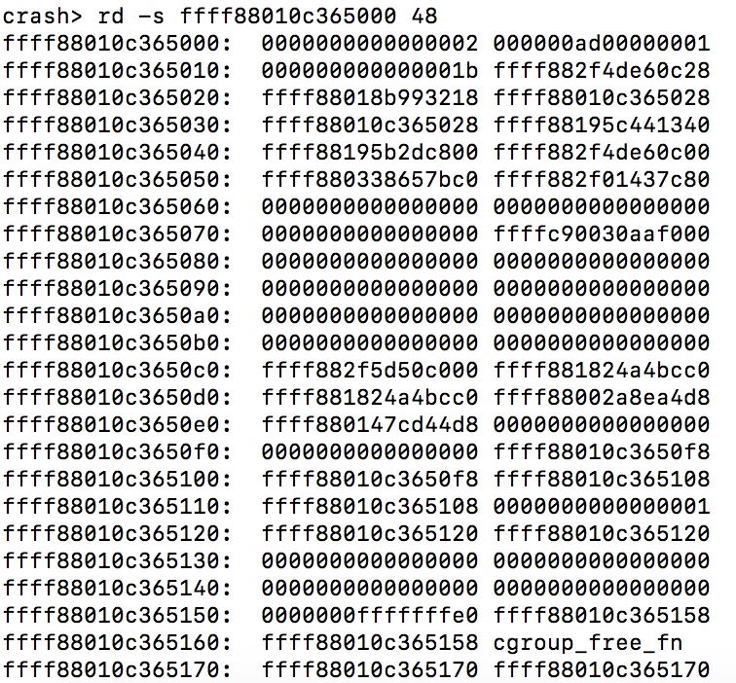
Raw Memory Dump

Slide 30
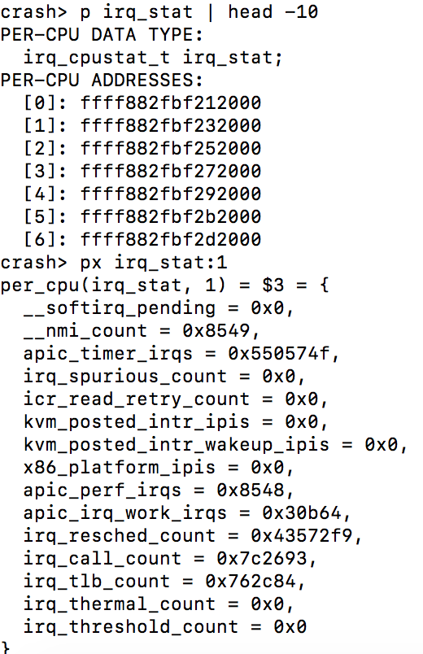
Global Variables Dump
The p command could be used directly
The px means hex dump
The :1 indicate the data instance on CPU 1.

Slide 31
Global Tasks Status
Check per-CPU runq and on CPU tasks
Runq
bt -a
All running/uninterruptable/interruptable tasks
foreach RU bt
foreach UN bt
foreach IN bt
List kernel/user tasks
ps –k
ps –u

Slide 32
Files and IO
Filesystem information
mount
Who open the files
foreach files -R system.journal
fuser /usr/lib/libkfm.so.2.0.0
Process files and page cache
files 1954
files -c 1954
Block devices and its request queues
dev -d

Slide 33
Networking
All NIC interfaces and its net devices
net
net -n 2618
Dump arp cache
net -a
All sockets
foreach net –s

Slide 34
Walkers
Walk a link list
Using list command, here is an example,
crash> dentry.d_name 0xffff882f5a1a8180
crash> dentry -o 0xffff882f5a1a8180 | grep d_sub
[ffff882f5a1a8220] struct list_head d_subdirs;
crash > list -H ffff882f5a1a8220 -o 144 -s dentry.d_name
Walk a tree
tree -t radix -r address_space.page_tree ffff880bd08412a8
Create customized walkers by writing scripts

Slide 35
Agenda
Welcome to panic
Getting started
Advanced Studies
Case Studies
References

Slide 36
Sysrq Crash
Make sure crash dump (kdump) works
Trigger a kernel panic by sysrq
echo c > /proc/sysrq-trigger
Waiting for reboot and saving the core file
Using crash to check the core file
Explain how sysrq crashes the kernel

Slide 37
Read Files From Page Cache
Using vi to open a text file in system
Invoking crash against living system
Walking the file pages from page cache
Dump the file contents from memory
See my page cache debug blog.

Slide 38
Agenda
Welcome to panic
Getting started
Advanced Studies
Case Studies
References

Slide 39
References
Documentation/admin-guide/bug-hunting.rst
Documentation/admin-guide/tainted-kernels.rst
Crash White Paper
x64 System V ABI
Page cache debug support for crash

