Slide 1
VMware Virtual SAN TOI - part 1
Compiled by Oliver Yang
Jan, 2016
http://oliveryang.net

Slide 2
Agenda
Background
Industry Problems
VSAN Solution Analysis
Market Analysis

Slide 3
Hyperscale (Webscale)
An datacenter infrastructure which is created by web companies and cloud providers such as Google, Amazon, and Facebook
Commodity hardware
x86 server
Software defined
Computing - Virtualization based(Docker, VM)
Network - SDN(software defined network)
Storage - SDS(software defined storage)
Everything is a service - (Cloud: IaaS/PaaS/SaaS)
Scale out and elastic – Distributed design
High availability - Self-Healing Design
Automation and orchestration - API-based control and rich analytics

Slide 4
Server SAN
Software Defined Storage
Software Defined Traditional Storage
Control path only
EMC ViPR Controller (CoprHD)
Virtual Appliance
Data & control path
vVNX, DD VE
Server SAN
Data & control path
VSAN, Scale IO
Hyperscale
Flash
Software-Defined
Storage
Server
SAN
Server SAN is a new infrastructure architecture built on high-growth trends of hyperscale, SDS and flash.
Notes:
Please refer to http://wikibon.org/Server_SAN

Slide 5
Hyper-converged Storage
Server SAN vs HCI
Server SAN
Storage only solution
Hyper-converged storage
Part of infrastructure: HCI
Compute + Net + Storage
Hyper-converged
Hypervisor agnostic
Nutanix
Hypervisor built-in
VSAN
Software Defined Storage
Server SAN
Hyper-converged
Hypervisor converged
VSAN

Slide 6
Agenda
Background
Industry Problems
VSAN Solution Analysis
Market Analysis

Slide 7
Customer Pain Points - I
Can’t meet virtualization/cloud requirements
Cloud/virtualization gives agility, flexibility and automation
Host VM deployment and workload change are faster and flexible
Traditional storage requires can match the host changes
Static class of devices
Matching right storage to app is not flexible and limited by silos boundary
Rigid provisioning
Lack of automation
Lack of granular control
Frequent data migrations
Notes:
References:
http://www.vmware.com/files/pdf/products/vsan/VMware_Virtual_SAN_Whats_New.pdf
http://www.sandisk.cn/content/dam/sandisk-main/en_us/assets/resources/enterprise/white-papers/taking-advantage-of-the-virtual-san-storage-revolution-without-the-flash-storage-chanllenges.pdf

Slide 8
Customer Pain Points - II
High OPEX caused by multiple storage silos
Needs dedicate storage administration teams
Requires vendor specific skillsets
Fragment management process per different silos
AFA block, SAN block, NAS file, DAS SSD, Data Protection…
Time consuming process
Slow reaction to request
High TCO from purpose built storage
Exponential data growth from 3rd platform apps, but IT budget is flat
Purpose built storage is expensive for scaling, upgrade and replacement
Not commodity
Low utilization
Over-provisioning and over-purchasing

Slide 9
Agenda
Background
Industry Problems
VSAN Solution Analysis
Market Analysis

Slide 10
Related Solutions
VMWare Virtual San
Certificated generic x86 server + VSAN stack
EVO:RAIL
Engineered appliance
Certificated EVO:RAIL hardware
Pre-installed VSAN software stack
Vendor specific value-add software
Major players in market
EMC VSPEX BLUE (1st market share)
Dell Engineered Solutions, NetApp EVO:RAIL, Supermicro EVO:RAIL
HP CS 200-HC EVO:RAIL (Discontinued, replaced by in-house HCI product)
EVO:SDDC (EVO:RACK)
Rack Scale
Rack mounted hardware: Server + Network switch + DAE(Disk Array Enclosure)
Pre-installed VMWare cloud software
Notes:
https://www.vmware.com/products/evorail/pricing
Purchasing Options
VMware EVO:RAIL can be purchased either as an all-in-one solution or the VMware EVO:RAIL vSphere Loyalty Program. All-in-One Solution Buy a VMware EVO:RAIL appliance as a single SKU (including the hardware and the VMware software) to get all the benefits of hyper-converged infrastructure in one step: simplified VM lifecycle, software-defined building block, highly resilient by design, lower TCO. This is ideal for new VMware customers or for existing customers implementing a new IT projects. vSphere Loyalty Program If you are an existing vSphere customer, you can apply your vSphere licenses towards the purchase of EVO:RAIL appliances. This lets you preserve your existing investment in VMware software while reducing the overall cost of an EVO:RAIL appliance purchase.
- See more at: https://www.vmware.com/products/evorail/pricing#sthash.5TyPyeSF.dpuf

Slide 11
Software vs Appliance

Slide 12
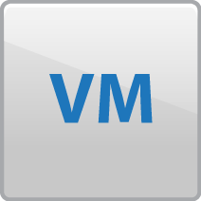




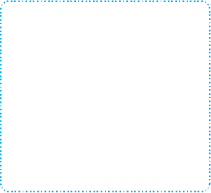








VMware SDS Solution - SBPM
Policy-driven Control Plane
Virtual Data Services
Data Protection
Mobility
Performance
Virtual Data Plane
Hypervisor-converged
Storage pool
SAN/NAS Pool
Object Storage Pool
x86 Servers
Cloud Object Storage
Virtual SAN
SAN / NAS

Slide 13



VSAN Architecture
The Basics
Runs on any standard x86 server
Policy-based management framework
Embedded in vSphere kernel
High performance flash architecture
Built-in resiliency
Deep integration with VMware stack
vSphere + VSAN
…
SSD
Hard disks
SSD
Hard disks
SSD
Hard disks
VSAN Shared Datastore

Slide 14
EVO:RAIL Packaging Summary
Notes:
VLP: just replace duplicate price.

Slide 15
EVO:SDDC (EVO:RACK)

Slide 16
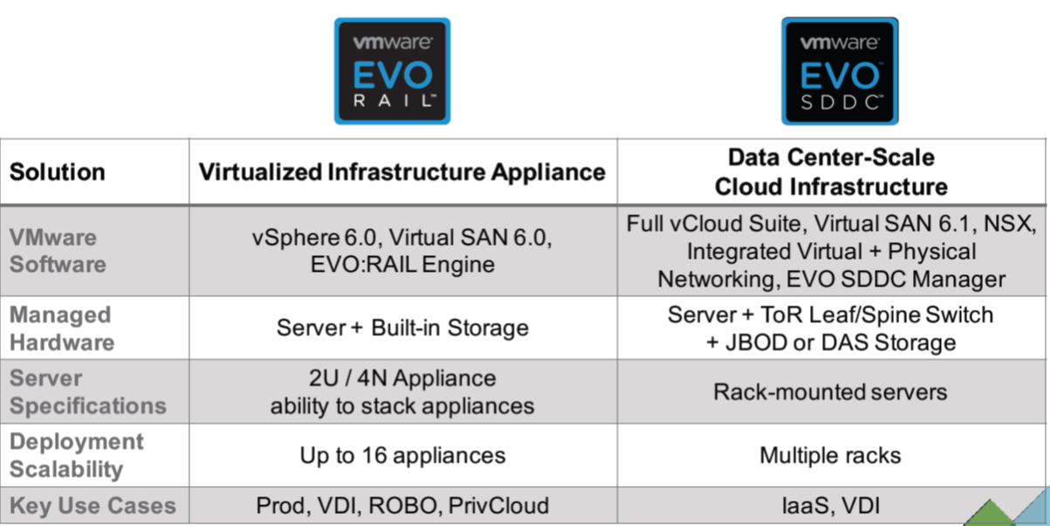
EVO:RAIL vs EVO:SDDC

Slide 17
VSAN Advantages
Radically Simple
High Performance
Lower TCO
Integrated with VMware stack
Managed directly through vSphere Web Client
Two click Install
Simplified storage configuration
No LUNs
Automated VM provisioning
Simplified capacity planning
Embedded in vSphere kernel
Flash-accelerated
Up to 2M IOPs from 32 nodes cluster
Granular and linear scaling
Server-side economics
No Fiber Channel Network
No large upfront investments
Grow-as-you-go
Easy to operate with powerful automation
No specialized skillset

Slide 18
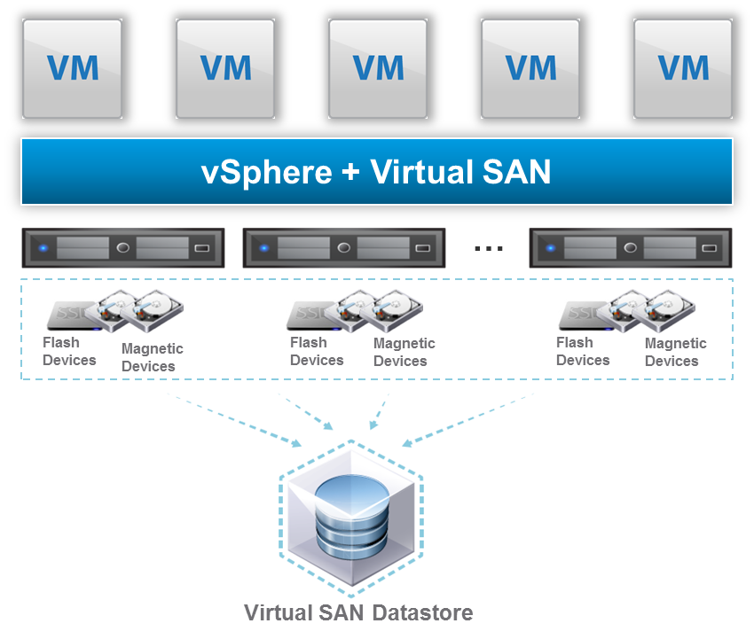
Customer Use Cases
Virtual Desktop Infrastructure (VDI)
1
6
Data Protection Target
Remote Office Branch Office (ROBO)
2
Data Analytics
(Big Data)
7
3
Mission-Critical Applications
(Production)
8
Test / Dev (Devops)
Management Cluster (ITops)
4
9
Disaster Recovering
DMZ Isolation Deployment
5
SDDC IaaS Use Case
(Data center Consolidation)
10
Notes:
References:
https://blogs.vmware.com/virtualblocks/2015/09/14/vmworld-recap-virtual-san-use-cases-and-stretched-clusters/
VSAN isn’t just for VDI or Test/Dev
Many VSAN customers start to run Production and even Mission Critical workloads on VSAN
MS Exchange / SQL
Oracle
SAP
Billing Systems (6-7 million customers!)
Physical system runs for 22 hours
Virtual system on traditional storage 14 hours
Virtual system on VSAN 3 hours!

Slide 19
Use Case Adoption
Secondary Storage Use Cases
(Use Case 1- 7)
EVO:RAIL
Primary Storage Use Cases
(Use Case 8)
EVO:RAIL
SDDC IaaS Use Cases
(Use Case 9- 10)
EVO:SDDC

Slide 20
VSPEX BLUE Use Cases

Slide 21
EMC VSPEX Blue Value-add
Software Value-add
VSPEX BLUE Manager
Hardware monitoring, patch, software upgrade, and integrates with EMC Connect Home
VSPEX BLUE Market
Offers value-add EMC software products included with VSPEX BLUE.
EMC SECURE REMOTE SUPPORT – Online support facilities
Hardware value-add
Any storage vendor specific advantages ? TBD
Same x86 white box as EMC ECS
Solution value-add
EMC solutions integration
Integrate with EMC Cloud Array for cloud storage expansion
Integrate with EMC recover point for VM level CDP, DR, Replication
Leverage VMWare VDPA to integrate with Avamar for backup
Current Data Domain DDR could be data protection target
PARTNER ECOSYSTEM
Notes:
Refer to,
http://www.emc.com/about/news/press/2015/20150203-01.htm
http://www.robsteele.co/emc-vspex-blue-keynote-recap/

Slide 22
Agenda
Background
Industry Problems
VSAN Solution Analysis
Market Analysis

Slide 23
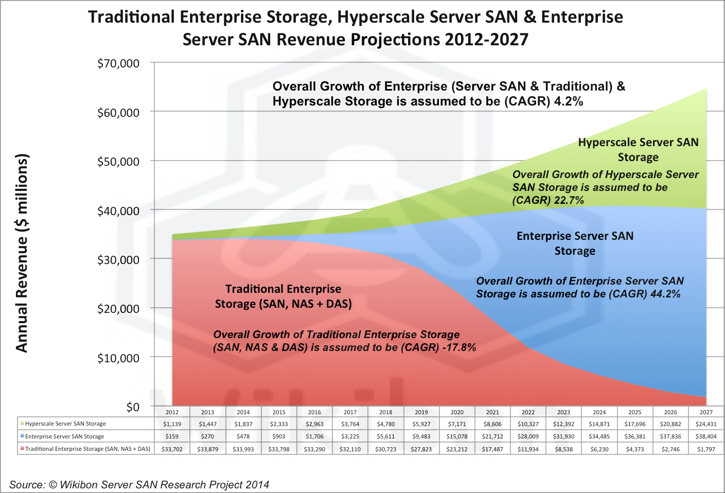
Market Trend

Slide 24
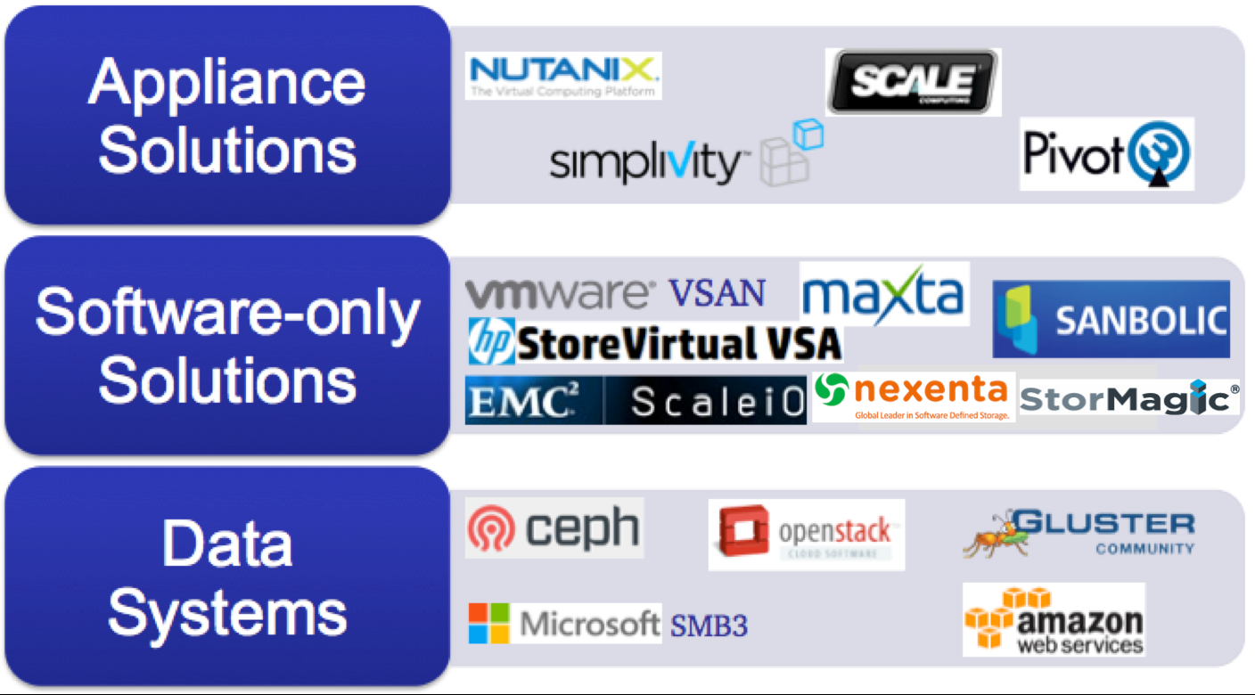
Market Players
Notes:
Microsoft
http://www.hyper-v.nu/archives/dvanderpeijl/2015/06/hyperconverged-with-windows-server-2016/
Storage Spaces Direct
With Storage Spaces Direct we have the ability to pool local disks of multiple servers to one big virtual disk.

Slide 25
VSAN TCO Analysis
1. Full clones 2. Usable capacity
3. Estimated based on 2013 street pricing, Capex (includes storage hardware + Software License costs)
4. Source: Taneja Group

Slide 26
EMC Scale IO Use Cases
VSI
VDI
Devops
Production
Mission Critical Applications
Virtual Server Infrastructure
Virtual Desktop Infrastructure
Test & Dev
Notes:
VMware Virtual SAN is designed specifically around tight integration with vSphere – with the objective of providing super-simple management and very high levels of performance for vSphere VMs. Virtual SAN is always deployed in a hyper-converged configuration, where storage is converged with the vSphere compute nodes. Virtual SAN is targeted at the generalist IT professional, not just storage experts.
ScaleIO has a different design point – to provide highly scalable server-based storage for heterogeneous platforms, including multiple hypervisors and physical servers. ScaleIO has its own installation, configuration and management workflows which are typically driven by expert storage administrators.

