Slide 1
Using Linux Trace Tools For diagnosis, analysis, learning and fun…
OLIVER YANG
JUL, 23 2016
HTTP://OLIVERYANG.NET

Slide 2
AGENDA
Overview
Trace Building Blocks
Diagnosis, Analysis and Learning
For Fun…

Slide 3
What Is Dynamic Trace?
Trace probe could be pre-defined or defined on the fly
All probes are not enabled by default, zero performance impacts
Users could enable one or multiple probes and hooks dynamically
Hook functions could be predefined or defined dynamically
Could be defined by CLI or programming scripts
While probes get hit, hook functions could be invoked
Hook function could be following functions
Print trace logs
Event logs, stack trace, function graph, timestamp, duration calculation, histogram
Drop into kernel debugger (Not support by Linux?)
Panic to save core files

Slide 4
Why Dynamic Trace?
Classic use cases…
Functional issues diagnosis
Performance analysis
System behaviors learning
New use cases…
NFV (IOVISOR)
Security...
Diagnosis
Analysis
Learning
Trace

Slide 5
Dynamic Trace - Pros vs. Cons
Pros
Good coverage by massive probes
Available in production mode
Fine granularity, could be API or source code lines level
Optimized for less overhead
Building blocks for new tools development
Have community and ecosystem support
Trace toolkits and application support
Cons
Tools supporting programming need significant learning time
Master a new script language
Skills to process massive tracing data
Some dynamic trace scripts could crash kernel, like SystemTap
Performance could be impacted if the trace scripts are not well designed

Slide 6
Dynamic Trace history
2004: Linux kprobes (2.6.9)
2005: Solaris Dtrace (10)
2008: Linux ftrace (2.6.27)
2009: Linux perf (2.6.31)
2009: Linux tracepoints (2.6.32)
2012: Dtrace: Oracle Unbreakable Enterprise Linux (2.6.39)
2012: Linux uprobes (3.5)
2010-2016: ftrace, kprobe, perf_events enhancements (3.7, 3.9 ...4.6)
Ftrace: mcount hook supports saving arguments
Kprobe: optimization by using ftrace mcount hook
2014-2016: eBPF patches (3.15,3.19,4.0,4.1...4.6)

Slide 7
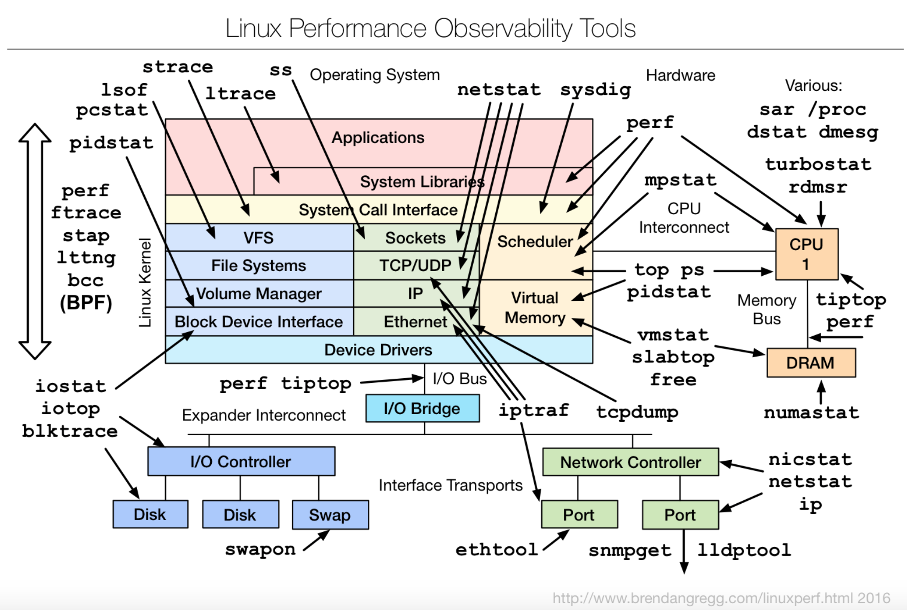
Big picture

Slide 8
AGENDA
Overview
Trace Building Blocks
Diagnosis, Analysis and Learning
For Fun…

Slide 9
Conceptual View
User space Tools
Kernel Tracing Framework
Kprobe
Uprobe
Perf Event
(PMU)
Mcount
Ttracepoint
Debugfs scripts
(perf-tools)
blktrace
SystemTap
Perf
BCC
Other tools…
(oprofile/ktap/LTTng)
Ftrace & Tracefs
Stap module
Perf event syscalls
(perf_event_open)
eBPF
Common
Building
Blocks
Mcount hook registration

Slide 10
Trace Event Type
Software
Events
Predefined
Mcount
Dynamic
Kprobe
Hardware
Events
Uprobe
CPU
Trace events
Perf Events (PMU)
Tracepoint

Slide 11
Mcount (Ftrace)
Kernel function entry trace
Implicit instrumentation at function entry point
Compiler insert instrumentations at kernel build time
By leveraging gcc –pg option
Replace instrumentation with noop instructions at kernel boot time
While tracer is enabled, noop got replaced by calling mcount hook function
Transparent to its users, not declarations in code

Slide 12
Tracepoint
Kernel predefined trace probe
Explicit instrumentation in kernel code
Predefined by kernel & driver code, which need explicit declarations
By default off, but leaves the noop instructions for dynamic enabling
After enable, the noop instruction gets replaced by jump, which goes to real tracing code

Slide 13
Kprobe
Define a trace event in kernel dynamically
Replace the probed instruction with a breakpoint, mcount hook, or jump instruction
Hit the probe then jump to kprobe instruments
Three type of probes, for writing kernel modules based on C language
Kprobe: any instructions in a kernel function
Jprobe: entry point of a kernel function, for handling arg list (support mcount hook)
Return Probe: return point of a kernel function, for handling return address

Slide 14
Uprobe
Define a trace event in user space dynamically
Handle userspace breakpoints in kernel
Analogous to kprobes
No signals / context switches between tracer and tarcee
Multiple tracers allowed
Two type of probes
Uprobe: setting breakpoints for any instructions in user space functions
Uretprobe: hit the probe while return from user space function
Notes:
Advantages of uprobes over conventional debugging include:
1. Non-disruptive.
Unlike current ptrace based mechanisms, uprobes tracing wouldnt
involve signals, stopping threads and context switching between the
tracer and tracee.
2. Much better handling of multithreaded programs because of XOL.
Current ptrace based mechanisms use single stepping inline, i.e they
copy back the original instruction on hitting a breakpoint. In such
mechanisms tracers have to stop all the threads on a breakpoint hit or
tracers will not be able to handle all hits to the location of
interest. Uprobes uses execution out of line, where the instruction to
be traced is analysed at the time of breakpoint insertion and a copy
of instruction is stored at a different location. On breakpoint hit,
uprobes jumps to that copied location and singlesteps the same
instruction and does the necessary fixups post singlestepping.
3. Multiple tracers for an application.
Multiple uprobes based tracer could work in unison to trace an
application. There could one tracer that could be interested in
generic events for a particular set of process. While there could be
another tracer that is just interested in one specific event of a
particular process thats part of the previous set of process.
4. Corelating events from kernels and userspace.
Uprobes could be used with other tools like kprobes, tracepoints or as
part of higher level tools like perf to give a consolidated set of
events from kernel and userspace. In future we could look at a single
backtrace showing application, library and kernel calls.

Slide 15
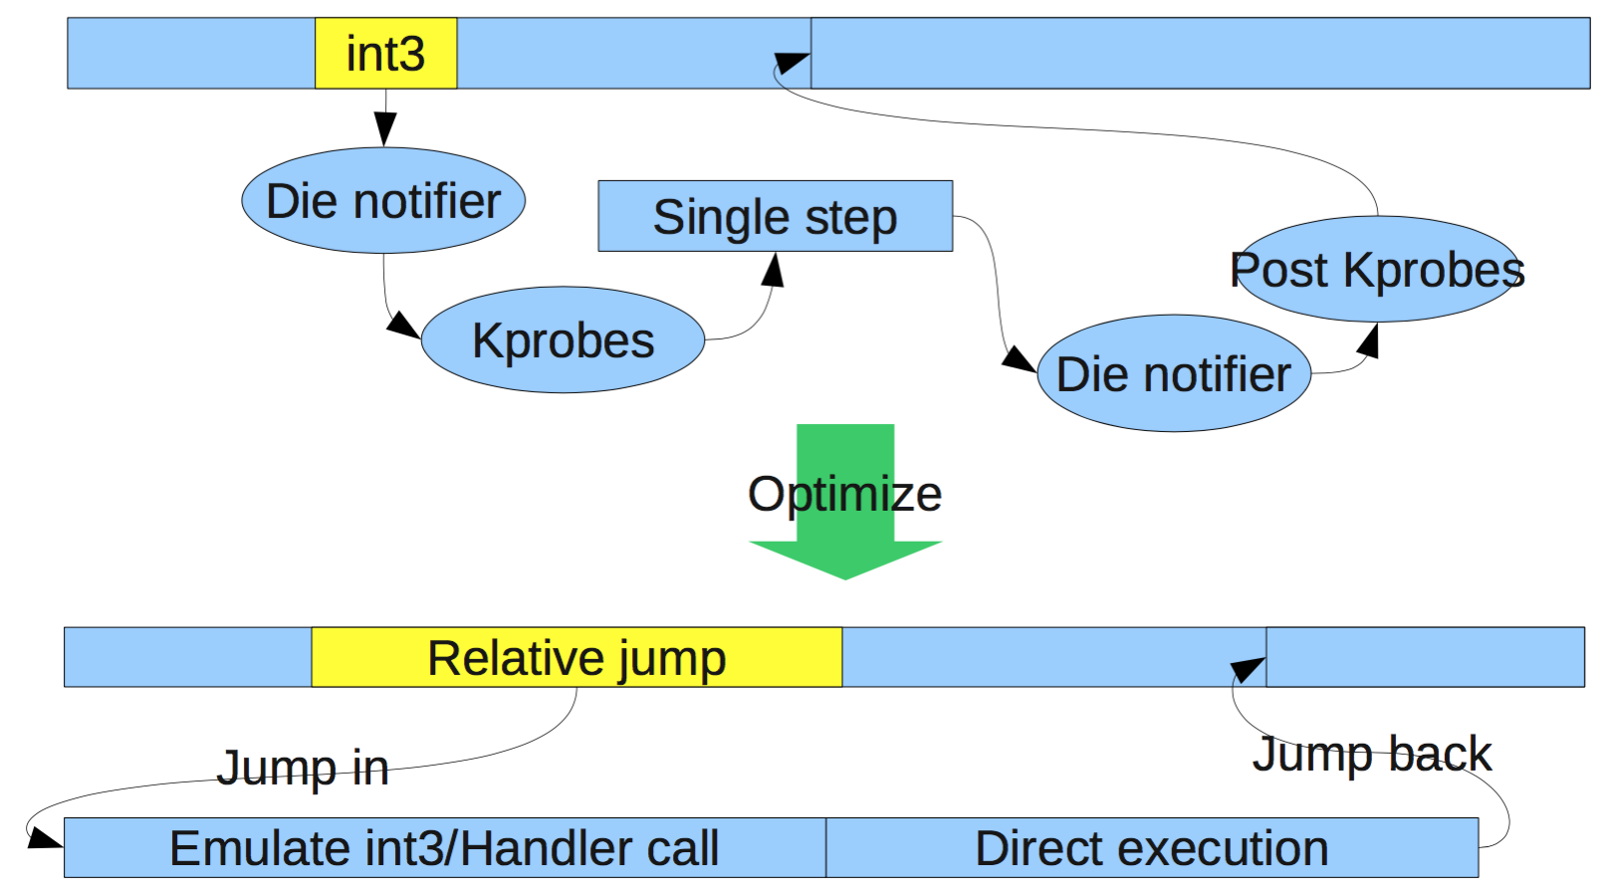
Trace Internal - Kprobe Example
3 core technologies
Binary hot patch
Breakpoint
Language support

Slide 16
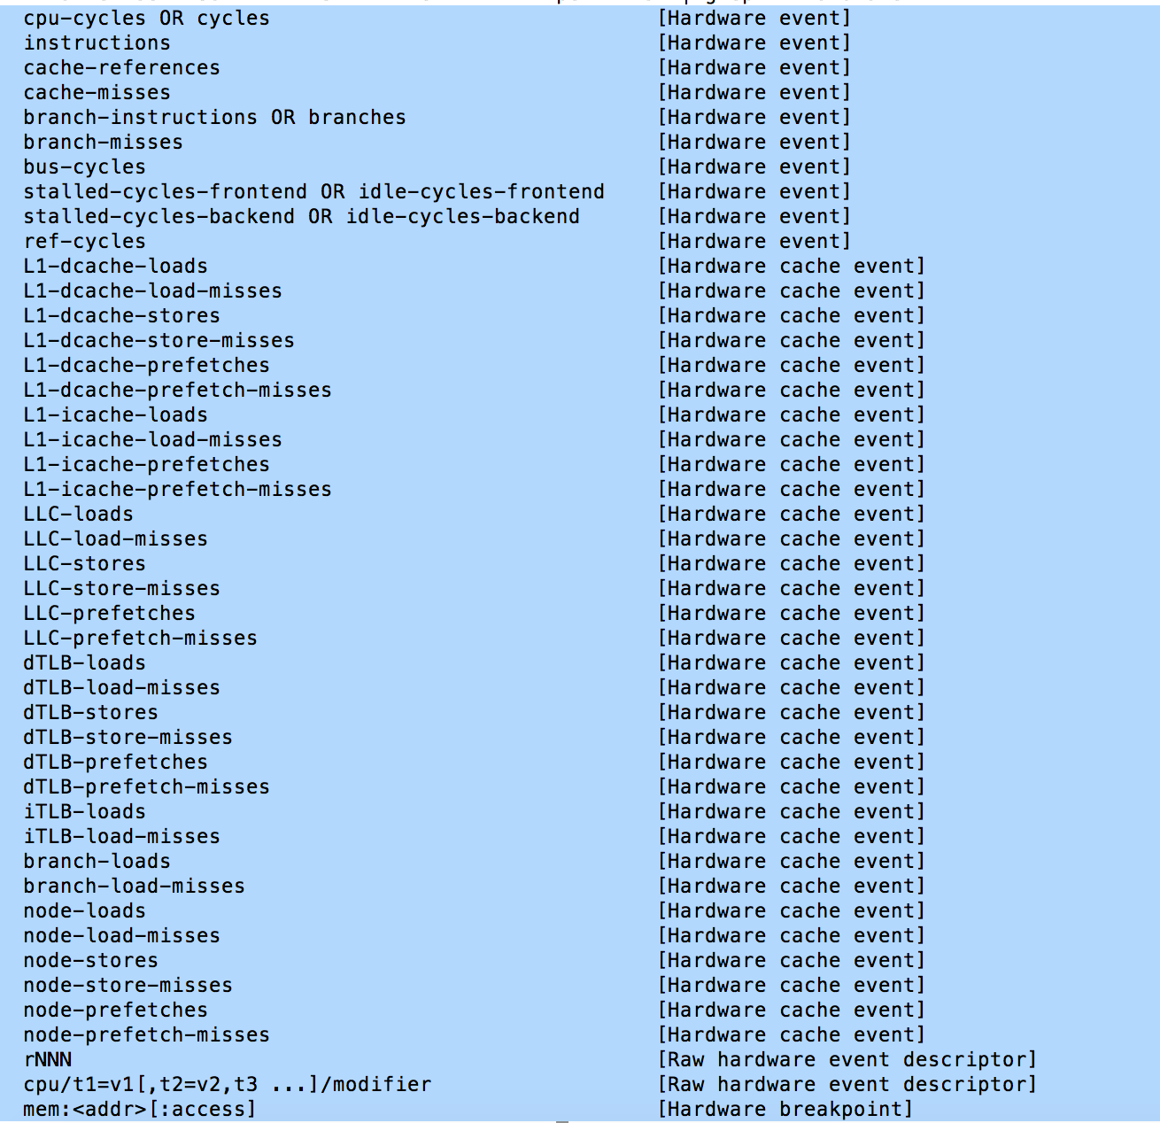
Hardware Events
Based on hardware mechanisms
CPU PMU registers
Hardware breakpoints
Still works for VM
Depends on PMU virtualization
Perf events
Unified syntax to refer the events
sudo perf list | grep -i hardware

Slide 17
AGENDA
Overview
Trace Building Blocks
Diagnosis, Analysis and Learning
For Fun…

Slide 18
Functional Issues Diagnosis
Troubleshooting
Error monitoring
Bug report and fixes
Trace data presentation
Stack backtrace
Inputs arg values
Return value
Error handling branch
Print any global or local variables
Trace events related to errors

Slide 19
Diagnosis Process
A. Find a problem
B. Make an assumption or ask a question
C. Find the proper tracepoints or understand related source code
D. Search a trace tool or write your own trace tool
May need consult from programming manuals
E. Verify assumption by running tracing tools
F. Trace results analysis
May need write a tool to process trace data
G. Repeat step B until address the issues

Slide 20
Diagnosis Example - 1
A. rmmod: ERROR: Module sampleblk is in use
B. Why did rmmod return the error? What was the error?
C. Run strace rmmod to study rmmod process
Results showed that it is module reference code issue
module:module_get trace point could help on this issue
D. The tool tpoint could trace the trace points: module:module_get
E. Run tpoint and reproduce the bug
$ sudo ./tpoint module:module_get
Tracing module:module_get. Ctrl-C to end.
systemd-udevd-2986 [000] .... 196.382796: module_get: sampleblk call_site=get_disk refcnt=2
systemd-udevd-2986 [000] .... 196.383071: module_get: sampleblk call_site=get_disk refcnt=3
F. Got the tpoint logs, found that who is using the module
Please find the detailed information from Linux Block Driver – 1 section 4.2.

Slide 21
Diagnosis Example - 2
Problem: An unauthorized application is removing SQLite journal file
Find what could you probe, and list source code line by line,
# perf probe -L do_unlinkat | head -n2
<do_unlinkat@/lib/modules/4.6.0-rc3+/build/fs/namei.c:0>
0 static long do_unlinkat(int dfd, const char __user *pathname)
# perf probe -V do_unlinkat | grep pathname
char* pathname
Using perf probe to get the 2nd arg of do_unlinkat
# perf probe --add 'do_unlinkat pathname:string'
Monitor all file removing operation within 3600 seconds
# perf record -e probe:do_unlinkat –aR sleep 3600
# perf script
sysmon 1964 [056] 237504.227636: do_unlinkat: (ffffffff810ed1b0) pathname="/ddr/registry/m0/alerts_floating.db3-journal"
sysmon 1964 [056] 237509.233384: do_unlinkat: (ffffffff810ed1b0) pathname="/ddr/registry/m0/alerts_floating.db3-journal”

Slide 22
Diagnosis Example - 3
For example 2, using SystemTap could address the same issue,
Query the do_unlinkat available input arguments and local varibales,
$ sudo stap -L 'kernel.function("do_unlinkat")'
kernel.function("do_unlinkat@fs/namei.c:3857") $dfd:int $pathname:char const* $path:struct path $last:struct qstr $type:int $delegated_inode:struct inode*
Run below SystemTap one liner command,
$ sudo stap -e 'probe kernel.function("do_unlinkat") { printf("%s \n", kernel_string($pathname))} ’
Notes:
Green is function name and source code information.
Red is input arguments
Blue is local variable
Please find SystemTap book from here.

Slide 23
Perf Analysis - Conceptual View
Application & Benchmark
Application library
System call
Kernel
hypervisor/hardware
App & Test Centric
Resource & Machine Centric

Slide 24
Perf Analysis - Methodologies
App & Test Centric
Problem statement method
Functional diagram method
Resource & Machine Centric
Resource Analysis
USE Method
Workload Analysis
RED Method
Kernel Resource Analysis
Workload Characterization

Slide 25
Perf Analysis - Trace vs. Profiling
Trace
Hit the probe, and record
Trace buffer could overflow, and trace events could be dropped
Profiling
Sampling the probe events with certain frequency (typically 1HZ)
Driven by timer (1HZ = 1ms)
NMI interrupts – by CPU PMU NMI events, which is better
Timer interrupts
Trace data presentation
Function graph
Timestamp or Latency calculations for each operations or functions
Stack back trace or function name statistic related to quick or fast path
Perf Histogram: latency, data size, trace events counters
Virtualized trace data
Excel (Line Chart, Histogram), Flamegraph, Heatmap

Slide 26
Analysis - Workload Characterization
Who should be perf analysis target?
Identify application (pid, tid, users)
Why should it be analysis target?
Bad perf number or metrics?
Computing - Busy CPU
Storage - Throughput, IOPS
Network – RX/TX throughput, IP forwarding
How to trace or profiling the target?
Reproduce problem by running app, micro-benchmark
Select tools or writing scripts
What should be investigated for the target?
Computing - on/off CPU analysis, code path and context
Storage and Network - IO pattern analysis, code path, context

Slide 27
Analysis - USE Method
For every resource, check…
Utilization - busy time or sleep time
Saturation - queue length or time
Error - software or hardware errors
Resource include…(refer to Brendan’s USE check list)
Computing
App, sheduler, memory allocator, major/minor faults, swaping, locks...
CPU, Memory, Interconnection (QPI)
Storage
App, file system, block layer, multi-path, raid, protocol stacks(SCSI, NVMe), disk driver
PCIe bus, Storage bus (SAS, NVMe...), Disk or HBA counters
Network
App, TCP, UDP, NIC driver, bonding, virtual switch...
PCIe bus, NIC perf counters

Slide 28
Analysis - Trace Example 1
Trace file IO size distribution to understand workload
The ./fiohist.stp is written by SystemTap scripts
$ sudo fio fs_seq_write_sync_001
$ sudo ./fiohist.stp 94302
starting probe
^C
IO Summary:
read read write write
name open read KB tot B avg write KB tot B avg
fio 7917 0 0 0 3698312 14793248 4096
Write I/O size (bytes):
process name: fio
value |------------------------------------------------------------------------------------------------------ count
1024 | 0
2048 | 0
4096 |@@@@@@@@@@@@@@@@@@@@@@@@@@@@@@@@@@@@@@@@@@@@@@@@@ 3698312
8192 | 0
16384 | 0

Slide 29
Analysis - Trace Example 2
Block IO latency analysis to understand the workload
The iosnoop is based on Ftrace and written by bash & awk (perf-tools project)
$ sudo ./iosnoop -d 253,1 -s –t
Tracing block I/O. Ctrl-C to end.
STARTs ENDs COMM PID TYPE DEV BLOCK BYTES LATms
11165.022265 11165.022273 fio 11426 W 253,1 2486 57344 0.01
11165.022278 11165.022291 fio 11426 W 253,1 3142 130560 0.01
11165.022292 11165.022305 fio 11426 W 253,1 3397 130560 0.01
11165.022305 11165.022319 fio 11426 W 253,1 3652 130560 0.01
11165.022319 11165.022333 fio 11426 W 253,1 3907 130560 0.01
Visualize trace data by Heatmap tool,
sudo ./iosnoop -d 253,1 -s -t > iosnoop.log
grep '^[0-9]' iosnoop.log | awk '{ print $1, $9 }' | sed 's/\.//g' | sed 's/$/0/g' > trace.txt
./trace2heatmap.pl --unitstime=us --unitslatency=us --maxlat=200 --grid trace.txt> heatmap.svg

Slide 30
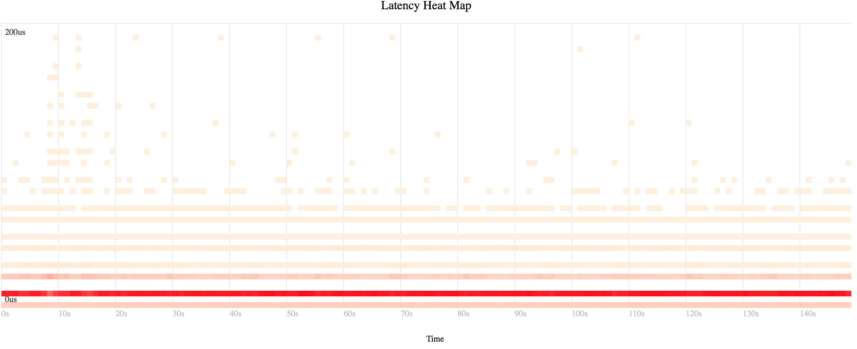
Analysis - Heatmap
Visualize example 2 tracing data by Heatmap,
sudo ./iosnoop -d 253,1 -s -t > iosnoop.log
grep '^[0-9]' iosnoop.log | awk '{ print $1, $9 }' | sed 's/\.//g' | sed 's/$/0/g' > trace.txt
./trace2heatmap.pl --unitstime=us --unitslatency=us --maxlat=200 --grid trace.txt> heatmap.svg

Slide 31
Analysis - Profiling Example
Run FIO with write sequential IO test
Sampling all applications and kernel activities on CPU
$ sudo perf record -a -g --call-graph dwarf -F 997 sleep 60
$ sudo perf report > perf_record_fs_seq_write_sync_001.log
Visualize profiling data by Flamegraph,
sudo perf script | stackcollapse-perf.pl > out.perf-folded
cat out.perf-folded | flamegraph.pl > perf-kernel.svg

Slide 32
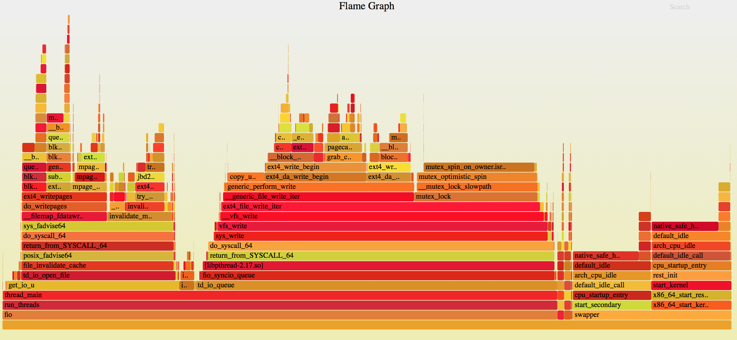
Analysis - Flamegraph

Slide 33
System Behaviors Learning
Learn runtime code path
Function pointers
Multiple code paths
Chain of stack backtraces
Understand system behaviors under real workload
Fast vs. slow code path
Identify hot code path
Present trace logs
Backtrace
Function graph
Statistic based on stack backtrace

Slide 34
Learning - Backtrace Example
Understand block driver run time code path under real work load
# stap --all-modules -e 'probe module("sampleblk").function("sampleblk_request") { print_backtrace() print("===\n") }'
0xffffffffa04a1030 : sampleblk_request+0x0/0x0 [sampleblk]
0xffffffff81313793 : __blk_run_queue+0x33/0x40 [kernel]
0xffffffff8131380a : queue_unplugged+0x2a/0xb0 [kernel]
0xffffffff81318e81 : blk_flush_plug_list+0x1d1/0x220 [kernel]
0xffffffff8131928c : blk_finish_plug+0x2c/0x40 [kernel]
0xffffffffa0729590 : ext4_writepages+0x4e0/0xcf0 [ext4]
0xffffffff8119cd3e : do_writepages+0x1e/0x30 [kernel]
0xffffffff81190b66 : __filemap_fdatawrite_range+0xc6/0x100 [kernel]
0xffffffff811d5d96 : SyS_fadvise64+0x216/0x250 [kernel]
0xffffffff81003c12 : do_syscall_64+0x62/0x110 [kernel]
0xffffffff816bb721 : return_from_SYSCALL_64+0x0/0x6a [kernel]
===

Slide 35
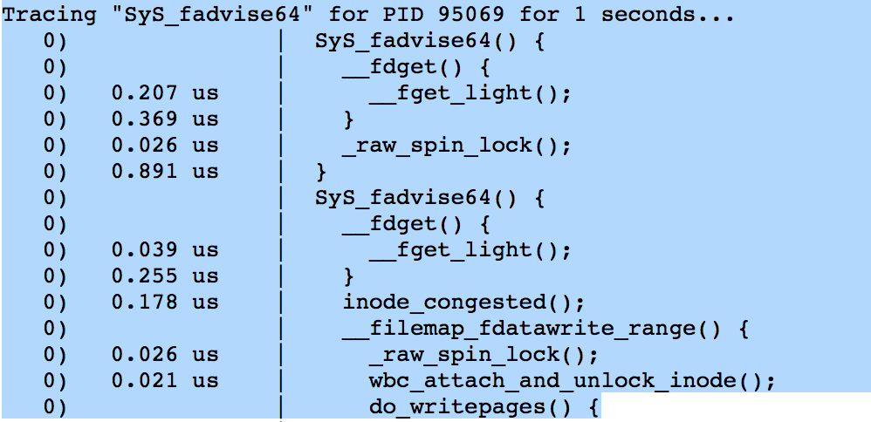
Learning – Function Graph Example
Backtrace vs. Function Graph
Bottom to top vs. top to bottom
Direct code path, vs. full code path coverage
Less tracing overhead vs. bigger overhead
Understand fadvise64 syscall behaviors
$ sudo ./funcgraph –d 1 -p 95069 SyS_fadvise64 > functiongraph.log

Slide 36
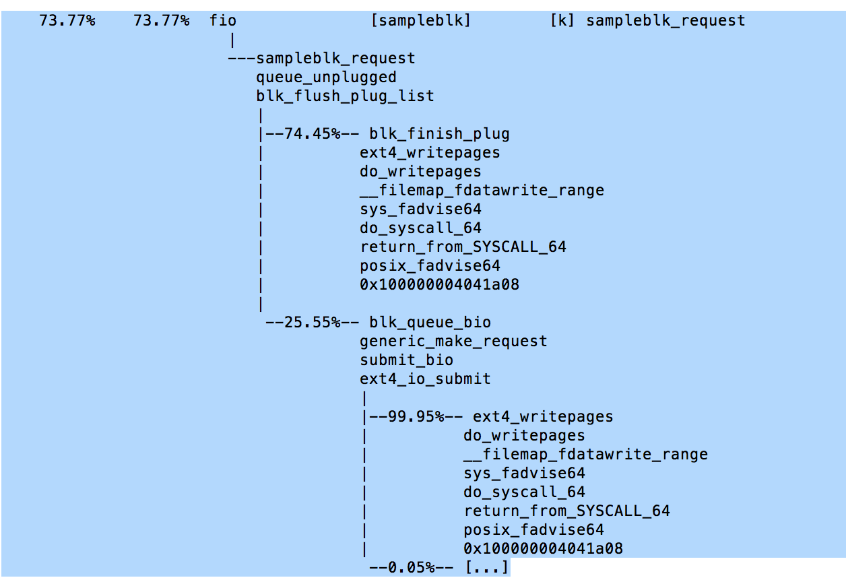
Learning - Hot Path Example

Slide 37
Learning – Uprobe Example
Under FIO benchmark behaviors
Question: How and why fadvise64 system call gets called?
Trace fio by using perf probe:
$ sudo perf probe -x /lib64/libc.so.6 -F | grep fadvise64
$ sudo perf probe -x /lib64/libc.so.6 -L posix_fadvise64
$ sudo perf probe -x /lib64/libc.so.6 -V posix_fadvise64
$ sudo perf probe -x /lib64/libc.so.6 -a 'posix_fadvise64 advise’
$ sudo perf record -e probe_libc:posix_fadvise64 -aR -g --call-graph dwarf sleep 60
$ sudo perf report
$ sudo perf script
Please access trace logs here.

Slide 38
AGENDA
Overview
Trace Building Blocks
Diagnosis, Analysis and Learning
For Fun…

Slide 39
Have Fun!
Practice (70%)
Learn (10%)
Discuss (20%)
Practice first
Have the basic concepts about use cases
Use it before understand
Leverage toolkits and examples
Discuss efficiently
Define question clearly
Know the knowledge dependencies
Learn objectively
Have a specific goal
Use case: Developer vs. Admin
What are learning outcomes
Select proper tracers per goals
Find right references: books, documents

Slide 40
Resources
Links
Brendan Gregg website – many good articles
Brendan’s Linux Perf collections
Perf examples by Brendan Gregg
Oliver Yang’s Blog - blogs tagged with perf or trace
Document
Ftrace Document
Kprobe Event Document
Tracepoint Document
Uprobe Event Document
SystemTap Document Collection
System Methodology Holistic Performance Analysis on Modern Systems
By Brendan Gregg, ACM Applicative System Methodology 2016.1
Book
Systems Performance: Enterprise and the Cloud by Brendan Gregg

Slide 41
Q & A
Thank You

