Slide 1
VIrtual Machine Backup TOI - part 1
Compiled by Oliver Yang
Jan, 2016
http://oliveryang.net
Notes:
Declaration: All pictures in this slides were searched via google. The copyright were belong to original authors.

Slide 2
Agenda
Backup concepts
Traditional Backup Pain Points
VM Backup Use Cases
Market Analysis

Slide 3
Backup Window
The period of time when backups are permitted to run
Ensure backup has no interferences with normal operations
Backup window is limited by backup performance
Simultaneously backup jobs from backup source
SDDC caused high application/VM density than physical
Backup server workload
Data protection performance

Slide 4
RPO and RTO
RPO - recovery point objective
Key data protection requirements per backup window
CDP(Continuous Data Protection)
RPO is zero
Near CDP or CRR(Continuous Remote Replication)
RPO is close to zero
Regular backup
Could be minutes, hourly, daily, weekly, monthly
RTO - recovery time objective
Maximum allowable or maximum tolerable outage
RTO is close to zero
Stretched clusters: Active-active data center (Not real DR: see notes)
CDP + VMware vCenter Site Recovery Manager
Key requirements for recover performance SLA
Associate with availability of backup infrastructure
Notes:
CDP and Near CDP are different,
CDP doesn’t need snapshot the VM or filesystem, no app consistence.
App can mark the tag for consistence tag. That is why Consistence Group for LUNs is required.
2. Near CDP need VM snapshot or storage snapshot. That need application/OS flush pending/dirty data for app consistence.
Differences between Stretched clusters and SRM,
http://www.vmware.com/files/pdf/techpaper/Stretched_Clusters_and_VMware_vCenter_Site_Recovery_Manage_USLTR_Regalix.pdf

Slide 5
Backup Methods
Available methods
Full
Incremental
Differential
Synthetic
Factors for choosing the backup methods
RPO
RTO
Backup windows
Retention timeframes
Infrastructure
Budgets

Slide 6
Backup Consistent State
Crash consistent
Snapshot without any quiescing
File system consistent
Snapshot with OS quiescing but without app quiescing
Application consistent
Snapshot with both OS and app quiescing

Slide 7
Agenda
Backup concepts
Traditional Backup Pain Points
VM Backup Use Cases
Market Analysis

Slide 8
Physical vs. Virtual
Physical Data Center
SDDC
Flexible, easy to move
Static, difficult to move
Disruptive maintenance
Non-disruptive maintenance
Quick provision due to VM features
Slow provision due to manual work
Hardware failure has bigger impacts if no HA solution
Network and storage configuration and connection are static needs multiple teams cooperation
VM move from network or storage from one to another quickly and easily
Hardware failure has smaller impacts even without HA solution

Slide 9
Backup VM As Physical

Slide 10
Pain Points Of Traditional Backup
Bigger VM backup overhead
SDDC caused high application/VM density than physical
One VM backup agent could cause the perf/QOS problems to other VMs
CPU, memory, storage, network overheads
High OPEX by OS none-transparent backup
Various backup agents
OS level agent with coarse granularity
App level agent with fine granularity
Shadow copy depends on OS implementation
Machine backup is complex
OS and file need different backup methods

Slide 11
Pain Points Of Traditional Restore
Machine recovery is complex
Very difficult to test and verify of backups regularly
Need a separate test environment
Restoring multi-tier applications is a challenge

Slide 12
Agenda
Backup concepts
Traditional Backup Pain Points
VM Backup Use Cases
Market Analysis

Slide 13
VM Data Protection Use Cases
RPO | RTO | Solution | Comments
Zero | Minutes | Stretched clusters | Site level Active-Active HA & load balance
 |  | CDP + SRM | Site level sync replication Disaster Recovery orchestration & automation
Minutes | Minutes | Near CDP or CRR | VM Replication & Backup
Hours | Minutes | Backup or Replication | VM Replication & Backup Traditional backup & restore
Hours | Hours | Backup or Replication | VM Replication & Backup Traditional backup & restore Cloud backup & restore

Slide 14
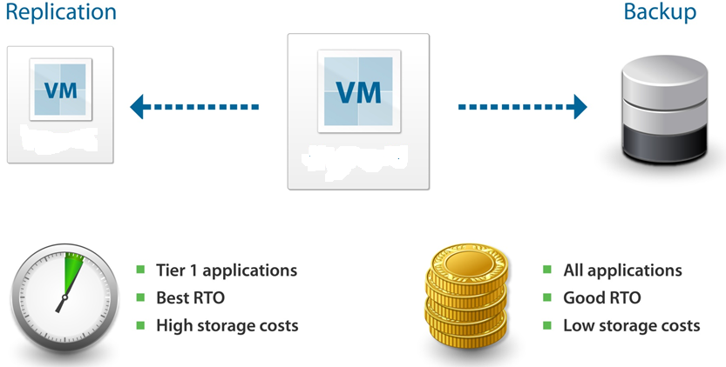
Use Case: VM Replication & Backup

Slide 15
Gen1: Backup VM By Virtual Disk Files

Slide 16
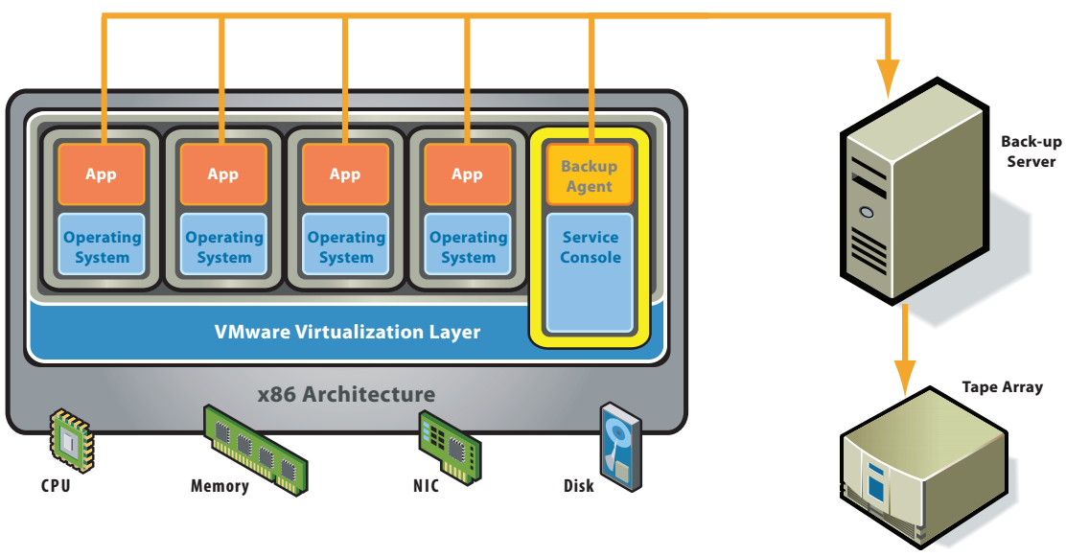
Gen1: Backup VM By Virtual Disk Files

Slide 17
Gen2: VCB(Virtual Consolidated Backup)

Slide 18
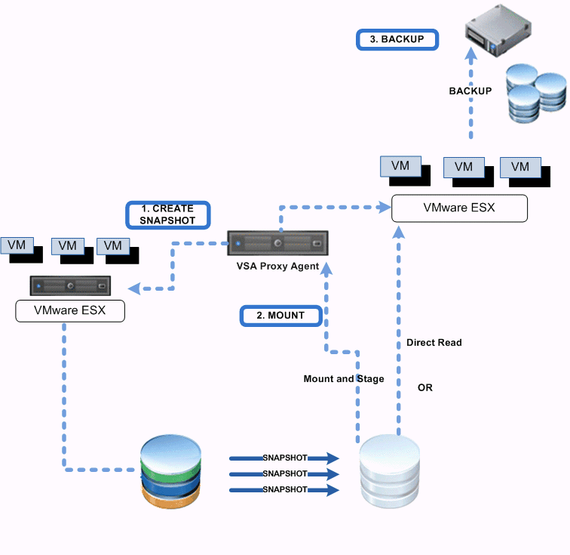
Gen3A: VADP Physical Proxy
Physical proxy appliance
Can be merge with backup server
Requests a snapshot of the virtual machine hosted on the VMFS datastore.
Enables LAN-free data transfer
Use CBT for incremental backup
Deduplication & compress by
Backup proxy
Backup server
Backup target storage
Notes:
Backups using vSphere VADP environment provides significant performance improvements over VCB.
During backups, the Backup proxy agent requests a snapshot of the virtual machine hosted on the VMFS datastore. The snapshot VMDK and virtual machine configuration files are then copied to the storage media without requiring any dedicated disk cache on the proxy server. In the case of incremental backups, Change Block Tracking (CBT) helps quickly identify the data blocks on the virtual machine that have changed since the last backup.
Similarly, during restores, virtual machines are restored directly to the appropriate ESX Server and datastore without the need for staging on the proxy server with VMware Converter. This approach provides much faster restores.

Slide 19
Gen3B: VADP VM Appliance
VM proxy appliance
A VM with HotAdd access to VM disks on the datastore.
Enables LAN-free data transfer
Deduplication & compress
By backup proxy
By backup server
By target storage

Slide 20
Veeam SDDC Solution (Nutanix)
Nutanix could be secondary cluster as data protection storage
Nutanix defined capacity-rich nodes for data protection use cases

Slide 21
Veeam Features For VM Backup
Off-host LAN free backup
Less overhead by VADP
Using storage network instead of VM network
Uniform backup method: Image-level backup
Near CDP (<15min RPO & RTO)
Empty block, deleted data ignorance
Inline deduplication and compression
App level data consistence with fine granularity
Quiesce the VM by VM tools/drivers
Windows: Microsoft VSS service
One time full backup and incremental forever
Block level incremental backup
VM snapshot -> VADP(CBT) -> snapshot merge back
VMware: VADP(vStorage APIs for Data Protection)
Easy and portable restore for whole VM
Note: Red color indicates Veeam strengths over other VM backup products

Slide 22
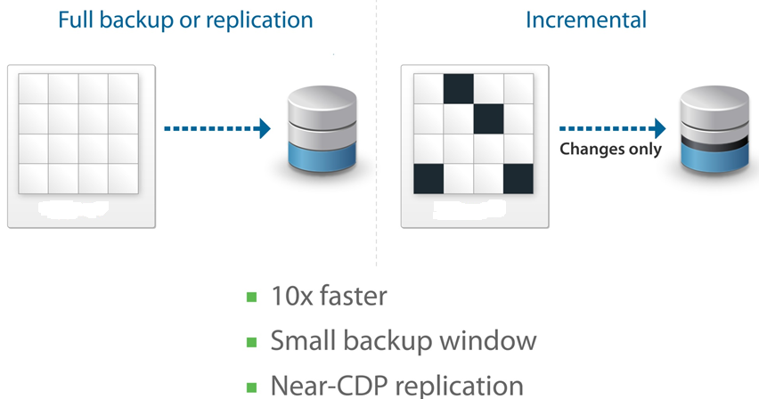
CBT – Change Block Tracking

Slide 23
Veeam Features For VM Restore
Easier and quick restore
1 click restore with a single or group VMs
Easier test and verify backup
Automatic verification
On demand sandbox vs. dedicate virtual lab
High backup usability
Instant recover + Storage vMotion
Fine granularity restore based on one method
Image level restore
Full or incremental VM recovery with efficient VM search
File level restore
File instant index and search
Explorer for any type of file systems per VM images
Application level restore
RDB table & records, Exchange mail items, Active Directory etc…
Note: Red color indicates Veeam strengths over other VM backup products

Slide 24
Other Veeam Features
Unlimited Scale-out Backup Repository
Management overheads with massive VMs
Global Pool - break backup target storage silos
Storage Aware Placement
Self-service backup - a backup storage cloud
Cloud backup & recovery

Slide 25
Agenda
Backup concepts
Traditional Backup Pain Points
VM Backup Use Cases
Market Analysis

Slide 26
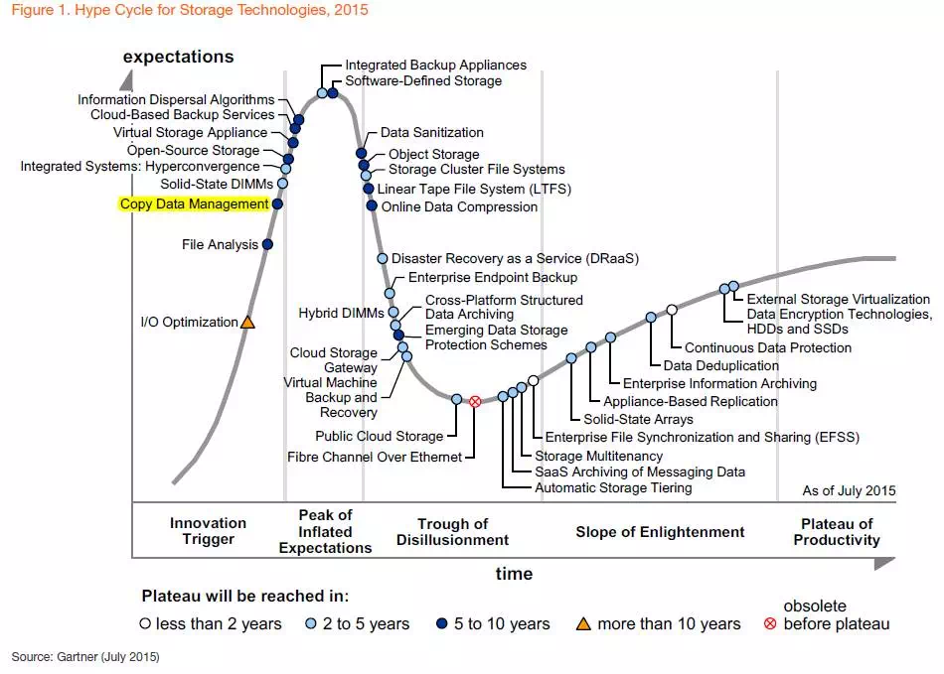
Gartner Hyper Cycle
Still has a long way to go
2 to 5 years to be a mature technology

Slide 27
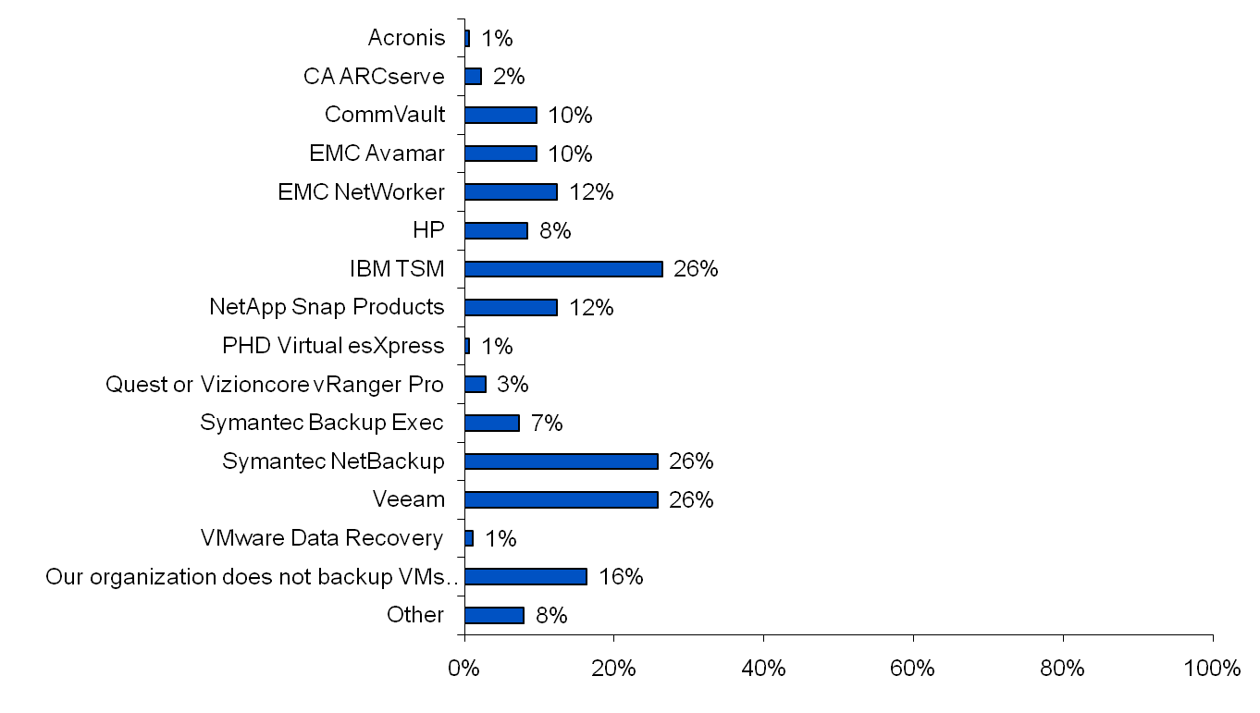
Gartner Market Survey
Question: What backup vendor and/or product(s) does your organization use for backing up its x86 virtual machines (VMs)?
* From the Gartner US and EMEA Data Center Conferences in 4Q2010

