Slide 1
Kernel Memory Corruption Debug Based On SLAB Implementation
Oliver Yang
Jan 15, 2014
http://oliveryang.net

Slide 2
Agenda
Basic concepts
Debugging methods
Case study
Potential improvements

Slide 3
Agenda
Basic concepts
Debugging methods
Case study
Potential improvements

Slide 4
Memory corruption causes
Hardware bugs
X86 Machine Check errors
CPU
DIMM
QPI
PCIe errors
Some legacy or low end x86 box’s RAS protection had the big gaps
Lots of CFDs caused by DIMM UEs and CPU errors
Platform SEL logs might not have debug information

Slide 5
Memory corruption causes
Software bugs
Use before initilaization
Use after free on heap, stack, global
Reference invalid memory
Double free
Out of bound memory access
Heap overflow
Stack overflow
Global overflow
Data race
Race conditions on memory modifications

Slide 6
Challenges
Memory corruption: one of most intractable issues
Hard to get root causes by a core dump file
The source of the memory corruption and its manifestation may be far apart, making it hard to correlate the cause and the effect.
Difficult to reproduce
Symptoms appear under unusual conditions, making it hard to consistently reproduce the error
Kernel memory debugging is more difficulty
Difficult to triage due to cross component boundary
Lack of debugging facilities and tools

Slide 7
Kernel memory APIs
io_remap
vmalloc
kmalloc
kmem_cache_alloc
get_user_pages
SLAB allocator
alloc_pages __get_free_pages
Buddy System (pages)

Slide 8
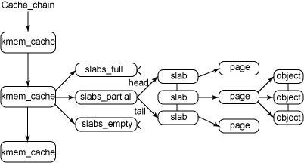
SLAB Intro

Slide 9
Slab Structure
array_cache[N_CPUS]
Per-CPU local cache
array_cache *shared
array_cache *alien
kmem_cache
slabs_partial
kmem_list3[N_NODES]
slabs_full
Global Slab Layer
slabs_free
Page allocator

Slide 10
Slab - Layered Design
CPU
Cache
Layer
kmem_cache0
kmem_cache1
kmem_cache0
kmem_cache1
Socket 0
Socket 0
Socket 1
Socket 1
CPU 0
CPU 1
CPU 0
CPU 1
CPU 2
CPU 3
CPU 2
CPU 3
Slab
Layer
Numa node 0
Numa node 0
Numa node 1
Numa node 1
Page
Allocator
Numa node 0
Numa node 1
Zone
Zone
Zone
Zone
Zone
Zone

Slide 11
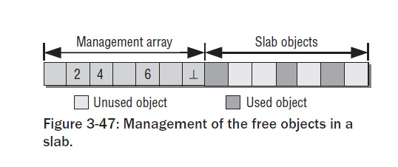
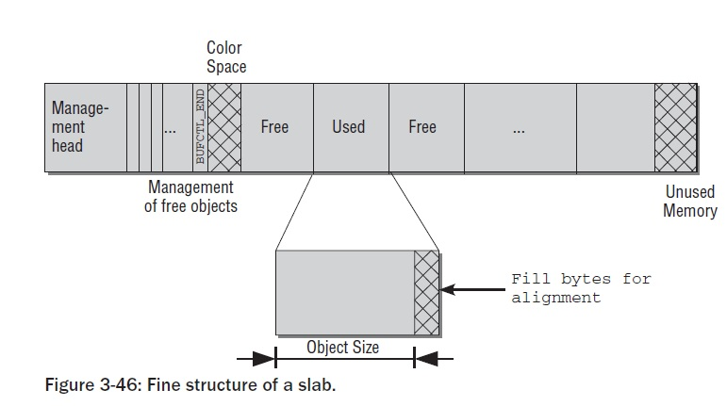
Slab memory layout

Slide 12
SLAB debugging use cases
Use-after-free
Poison, check at next alloc
If off_slab and nPAGEs, record the call stack of last free, then unmap the slab page
Use-before-initialization
Poison, check at debugging time
Double free, check the memory outside of object
Redzone, mark INACTIVE at free time
Bufctl, mark FREE at free time
Buffer overflow
Redzone, check redzone at free
Memory Leak
Traverse all the slab, and aggregate the callers (STORE_USER)

Slide 13
Object layout for debugging
Object
redzone1
8 bytes
redzone2
8 bytes
caller IP
8 bytes

Slide 14
Redzone
#define RED_INACTIVE 0x09F911029D74E35BULL /* when obj is inactive */
#define RED_ACTIVE 0xD84156C5635688C0ULL /* when obj is active */
Allocation
! INACTIVE. (X)
set redzone ACTIVE
Initialization
set redzone INACTIVE
ctor()
! INACTIVE. (X)
Destroy
! INACTIVE. (X)
Deallocation
check redzone
ACTIVE. Y
INACTIVE (double free)
else, overwritten
set redzone INACTIVE

Slide 15
Poison
#define POISON_INUSE 0x5a /* for use-uninitialised poisoning */
#define POISON_FREE 0x6b /* for use-after-free poisoning */
#define POISON_END 0xa5 /* end-byte of poisoning */
Allocation
! (6b 6b … 6b 5a) (X)
ctor()
5a 5a … 5a a5
Initialization
6b 6b … 6b a5
Destroy
! (6b 6b … 6b a5) (X)
Deallocation
6b 6b … 6b a5
Panic
NN 5a … NN a5

Slide 16
Other Debug Features
Save caller IP
State for management array tacking
BUFCTL_END
BUFCTL_FREE
BUFCTL_ACTIVE
SLAB_LIMIT

Slide 17
Agenda
Basic concepts
Debugging methods
Case study
Potential improvements

Slide 18
Kernel Core Analysis
Identify corruption location
Confirm corruption pattern
Search potential culprit
Nail down issue by code

Slide 19
Identify corruption location
Understand the scenario
Study the source code
Verified the scenario in kernel core files

Slide 20
Confirm Corruption Pattern
Get to familiar with the corrupted data structure
Learn related data structure and source code
Jump out the box - dump the raw memory pages
Basic knowledge of kernel memory allocators
Slab/Slub/vmalloc/ioremap/page allocators
Are they similar with any known corruption patterns?
Is it a possible corruption pattern caused by HW error?
If yes, confirm from BIOS SEL logs
For patterns caused by SW bugs, please refer to page 5.

Slide 21
Search potential culprit
Search the pointer if culprit owns the pointer
Per corruption pattern, determine possible pointer address
Run search -k <pointer address> to get all references
Using kmem and rd to determine the references owners
Search the corruption data if culprit owns that pattern
Per corruption pattern, determine the basic corrupted data
Run search -k <data pattern> to get all references
Using kmem and rd to confirm the references owners

Slide 22
Nail down issue by code
Narrow down the source code in possible culprit
Per corruption pattern, determine data structure
Per corruption pattern, determine the related memory API
Find the memory signature if possible
Any debug code could be enabled for catching bugs?
Run the testing with debug code enabled

Slide 23
Agenda
Basic concepts
Debugging methods
Case study
Potential improvements

Slide 24
A Slab corruption bug - 1
Identify the corruption location
Get the back trace, and find the panic location
cache_alloc_refill+0x17b
Dump the corrupted memory
crash> slab ffff810262bf5040
struct slab {
list = {
next = 0x20a00150463, <====== bad pointer
prev = 0xffff810c0ec002c0
},
……………………………..
Understand why the corruption cause the panic
Unable to handle kernel paging request at 0000020a0015046b

Slide 25
A Slab corruption bug - 2
Confirm the corruption pattern
Get to familiar with the corrupted data structure
Slab struct is at or close to the page boundary
Jump out the box - dump the raw memory pages
Not only check the slab, but also dump the adjacent pages
Are they similar with any known corruption patterns?
Shouldn’t be HW bug, as the corruption pattern had the significant pattern
It looked like the buffer overflow bug.

Slide 26
A Slab corruption bug - 3
Correlate corruption with potential culprit
Search the pointer if culprit owns the pointer
The pointer address might be ffff810262bf4000 because,
the corruption pattern seemed to start here.
the kmem ffff810262bf4000 indicated it is not allocated by slab
Search who reference the pointer?
crash> search -k ffff810262bf4000
ffff810262f03928: ffff810262bf4000
Who is the owner of ffff810262f03928?
crash> rd ffff810262f03920 -64 128
Found the signature: qla2xxx_ts_11 and QLE2562

Slide 27
Agenda
Basic concepts
Debugging methods
Case study
Potential improvements

Slide 28
Improvements for memory corruption debug
Using debug kernel in…
Kernel/Driver unit testing
Release testing
Increase the debugability for kernel/driver
Avoid to use the page allocator if SLUB/SLAB allocation is possible
Consider to implement some debug features
Create module/driver unique memory signature
Introduce the redzone and posion code in module/driver
Use kernel debug features
Replace Slab with Slub which enables SLUG_DEBUG
Debug page alloc
Kmemcheck
KASAN

Slide 29

Q&A
Thank you!

