Slide 1
Docker Use Cases Summary
Compiled by Oliver Yang (Nov, 2015)
http://oliveryang.net
Some figures in the slides were from via google search. For these figures, all rights belong to the original author!

Slide 2
Docker = Container?
Questions before start
A fact: container is 10+ years old technology
Why Docker is hot, instead of LXC (container)?
What is the key value of Docker technology?
Why does Microsoft also want to integrate with Docker?
Why does Linux Foundation operate open container project?

Slide 3
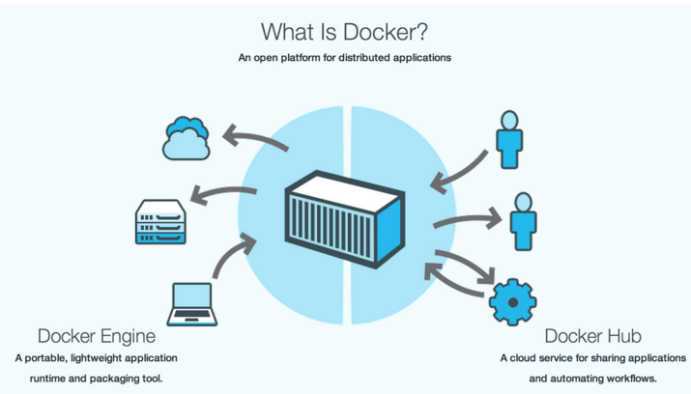
What is Docker
Docker Hub & docker engine
What is OCI?
Runtime
standard
Format standard

Slide 4
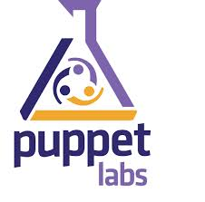
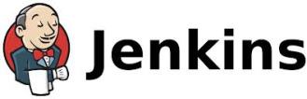
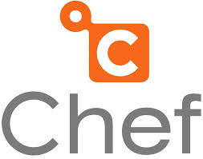













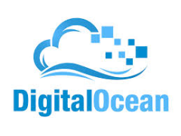
Docker Ecosystem
Docker IMAGES runs everywhere
Open container Initiative
Container formats and runtime industry standards. (Linux foundation).
Applications
1000’s of Dockerized applications available at index.docker.io
PaaS & IaaS
Private PaaS: OpenShift, Cloudfoundry
Public PaaS: Deis, Voxoz, Cocaine, Baidu PaaS
Public IaaS: Amazon, Azure, Digital Ocean
Private IaaS: vcloud, Openstack
DevOps Tools
Chef, Puppet, Jenkins, Travis, Salt, Ansible
Orchestration tools
Kubernetes, Mesos, Heat
SaaS
PaaS
IaaS
OS
Virtualization

Slide 5
Use case 1: IaaS Multi-tenants
VM vs. Container
VMs are isolated. Each VM has full OS instance with a separate kernel.
Containers are isolated, but share same kernel.
Guest
OS
A
Guest
OS
B
Guest
OS
C
Benefits
Faster deployment
Less overhead
Faster restart
VM
Bins/Libs
Bins/Libs
Bins/Libs
Kernel
Kernel
Kernel
Guest
OS
A
Guest
OS
B
Guest
OS
C
Container
Docker
Hypervisor (Type 2)
Bins/Libs
Bins/Libs
Bins/Libs
Host OS
Host OS
Server
Server

Slide 6
Use case 2: App packaging
VM images Vs. Docker image
App
A
App
A’
App
B
Application and all its dependencies could be build, ship and run by a Docker image. Each container may just have one of few of apps, which is more light weight than running a full OS in one container.
Bins/
Libs
Bins/
Libs
Bins/
Libs
VM
Guest
OS
Guest
OS
Guest
OS
Benefits
Easy deployment
Easy porting, address dependency pains
Light weight, fast start
Guest
OS
Guest
OS
App A
App A’
App B
App B’
App B’
App B’
Container
Docker
Hypervisor (Type 2)
Bins/Libs
Bins/Libs
Host OS
Host OS
Server
Server

Slide 7
Use case 3: New SW release model
Docker registry & Docker Hub
Continuous Integration and Delivery with…
Docker Trusted Registry
Docker hub
Benefits
Ship faster & easier
Better app portability
Docker
Container
Image Registry
Container A
Push
Search
Pull
Source Code Repository
Run
Dockerfile
For
A
Build
Container A
Container B
Container C
Docker
Docker Engine
Host 1 OS (Linux)
Host 2 OS (Linux)

Slide 8
Use case 4: Software Update
Layered image format - Docker is better than VM
Docker
Container
Image Registry
App
A
Push
App Delta
Bins/
Libs
Bin
Base
Container
Image
Container Mod A’
Container Mod A’’
App Delta
Update
App
A’’
App
A
Bin
App Delta
Bins/
Libs
Bins/
Libs
Bin
Docker Engine
Docker Engine
Host running A wants to upgrade to A’’. Requests update. Gets only diffs
Host is now running A’’
Benefit - Easy upgrade and changes

Slide 9
Use case 5: Docker migration
Docker with CRIU: Native checkpoint and Restore
Docker container live migration
Need CRIU support
Stateful containers need Flocker support
Benefits
Faster migration or boot for error handling
Load balance
Seamless kernel upgrade
App A
App B
App C
App D
App E
App B’
App F
App G
Container
Docker
Container
Docker
Bins/Libs
Bins/Libs
Bins/Libs
Bins/Libs
Host OS
Host OS
Server
Server
# docker checkpoint <id>
# docker restore <id>

Slide 10
CaaS: Container as a Service
New Cloud computing concept
App code
SaaS
App runtime
PaaS
App container
CaaS
VM (Compute, Network, Storage)
IaaS

Slide 11
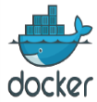




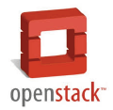
Use case 6: CAAS building blocks
New PaaS solution
Docker
Docker
Docker
Docker
APP
APP
APP
APP
Benefits
Fast deployment
Elastic scale
Performance
Elastic scale
PaaS
(Docker cluster mgmt)
IaaS
Swarm
OS (purpose built for Docker)
Hypervisor (optional)

Slide 12
Cloud Native APP
Enterprise App vs. Cloud Native APP
Enterprise Apps
Cloud Native Apps
Thick, client-server app on thick client
Mobile & IOT
Thin app on mobile, tablet, smart devices
Well-defined stack:
- O/S
- Runtime
- Middleware
OS
D
Assembled by developers using micro-services
PaaS & SaaS
Running on any available set of physical resources
(public/private/
virtualized)
Monolithic
Physical
Infrastructure
IaaS

Slide 13

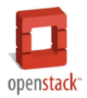
Use case 7: Micro-service Building Blocks
Cloud native APP platform
Cloud computing requirements
Elastic & On demand computing by cloud native app over webscale infra
Purpose built solution for cloud native app
VMware Photon Platform, other PaaS/IaaS solutions
Benefits
On demand computing
Modularization, isolation
Error detection & resilient
Stateless
elastic scale
elastic scale
Stateful
PaaS
(Docker cluster mgmt)
IaaS
Swarm
OS (purpose built for Docker)

Slide 14

Use case 8: VM as a Service
Alternative CAAS solution
Docker image aware hypervisors
vSphere Integrated Containers
Hyper: Kvm, Xen
Benefits
Docker ecosystem
Security
Performance
PaaS
Mirco VM
jeVM
hyperVM
App runtime
No containers
Inside the VM!
App container
CaaS
Hypervisor
IaaS
Mini OS
Docker image
VM (Compute, Network, Storage)
Hyper kernel

Slide 15
Use case 9: UNIKEREL AS SERVICE
Alternative CAAS solution
What is the Unikernel?
Library operating systems
Specialized, single address space machine images
Run directly on hypervisor or hardware
Many different Unikernel projects
Docker image aware Unikernel
Support Docker CLI
Run app over Unikernel by “docker run”
Benefits
Docker ecosystem
Security
Performance
APP
Docker
Unikernel
Hypervisor or Bare Metal
Unikernel Images
Docker image

Slide 16
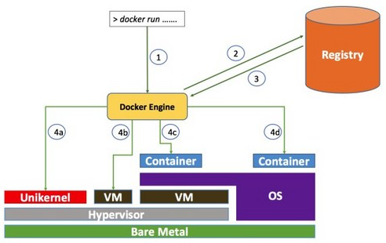
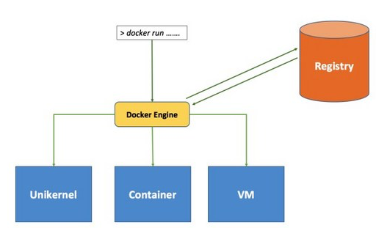
Docker != Container
Container, VM, Unikernel
Docker is an entry point

Slide 17
Docker is a solution
Container Vs. Docker
LXC is machine oriented, Docker is app oriented.
Docker’s key innovation is Docker image.
Docker creates the standards & ecosystem for clouds
SaaS – software release standard
Container image standards for build, ship and run
Ecosystem for Docker hub and registry
Cloud native app with micro-service architecture
PaaS – next wave of innovations
Key building blocks of various PaaS platforms
Docker image could be run over PaaS various containers implementation(Eg. Cloud Foundry)
IaaS
VMWare two container solutions VS. open source solutions (Hyper, Coreos, Atomic)
VMware vSphere Integrated Containers: Accelerate PaaS adoption in enterprise market
Introducing the Photon Platform: Purpose-Built for Running Cloud-Native Applications

