Slide 1

Tourist Rentals and Housing Markets: A Counterfactual Analysis of Touristic flats License Cancellation in Barcelona
Ana Cláudia da Costa

Slide 2


What happens to housing prices if all Tourist Flats licenses are cancelled?
Hypothesis
Removing Touristic Flats reduce selling prices?
Removing Touristic Flats reduce rental prices?

Slide 3


motivation
Housing affordability is a major public concern, and Barcelona faces an intense tourism pressure.
The city government announced that by 2028 all the hut licences will not be renewed.
What will be the impact on the housing market?
Let’s try to answer it.

Slide 4


Glossary – key terms
HUT – Tourist Flats (Habitatge d’Ús Turistic)
HUT Density – Number of HUTs per hectare
Baseline Prediction – Predicted price with existing HUTs
Counterfactual Prediction – Predicted price assuming no HUTs
Impact (%) – Percentage difference between baseline and counterfactual

Slide 5
Important note:
This is not a forecast of what will actually happen, but a model‑based simulation of what could happen if HUTs disappear, assuming that the relationships observed today remain stable.

Slide 6



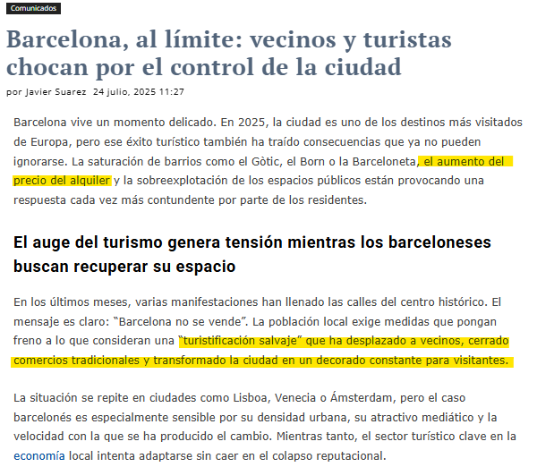
News!!!

Slide 7







Data & tech

Slide 8

Dataset overview
73 Neighborhoods
Variables:
Selling Price
Rental Price
Income per capita
Population density
Foreigh population density
Hotel density
HUT count
HUT density

Slide 9
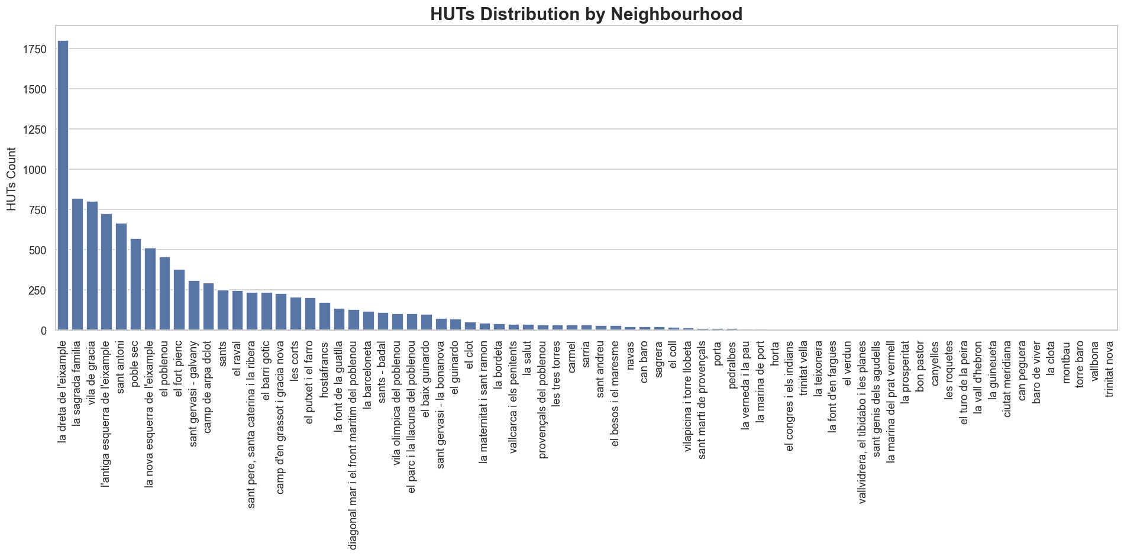
HUTs distribution
10.721
HUTs are highly unevenly distributed
Strong concentration in central áreas
Motivates spatial analysis

Slide 10
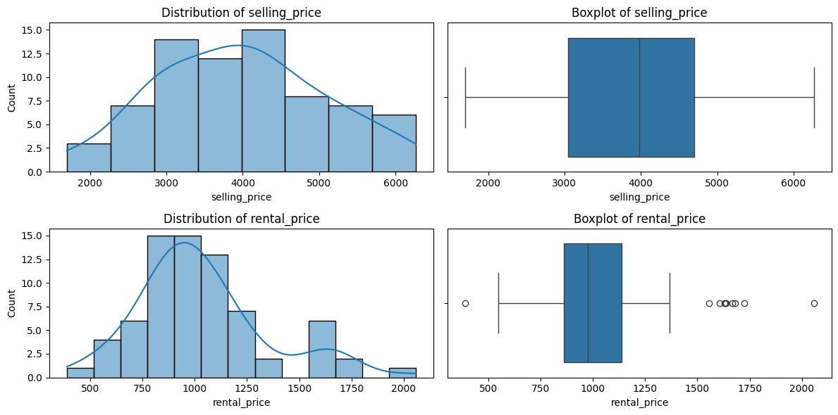
Variables distribution – Housing market
Strong right‑skewness; a few expensive neighborhoods drive dispersion.

Slide 11
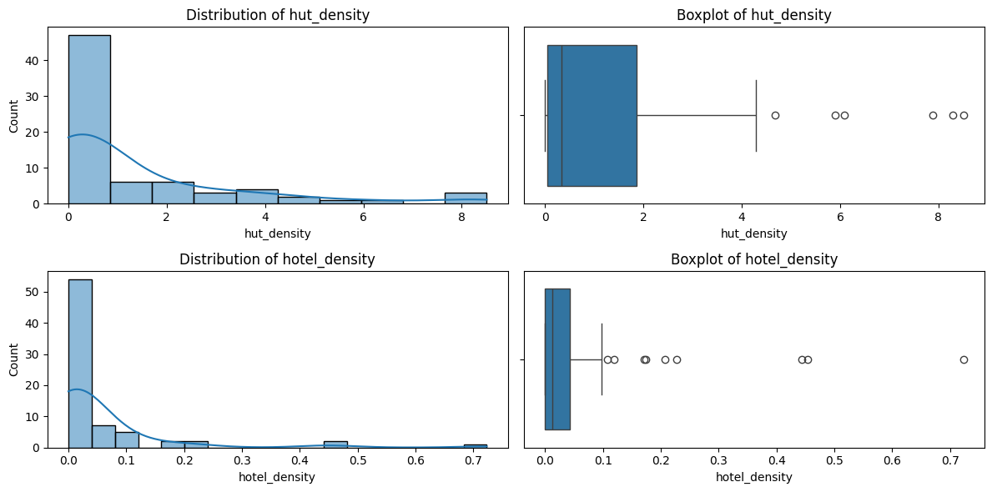
Variables distribution – tourism pressure
Tourism pressure is extremely concentrated in central areas.

Slide 12
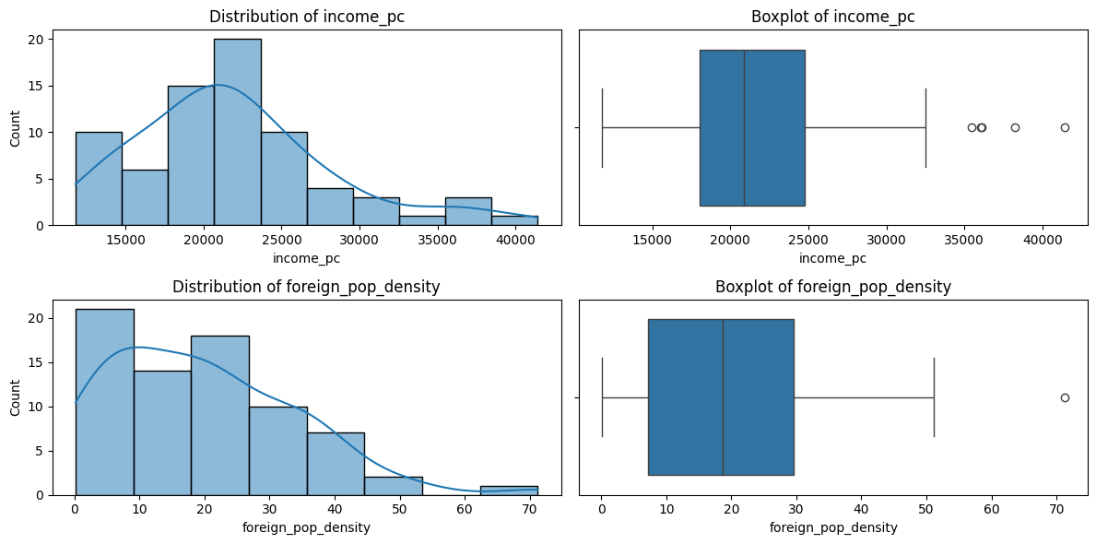
Variables distribution – socioeconomic variables
Strong socioeconomic inequality across neighborhoods.

Slide 13
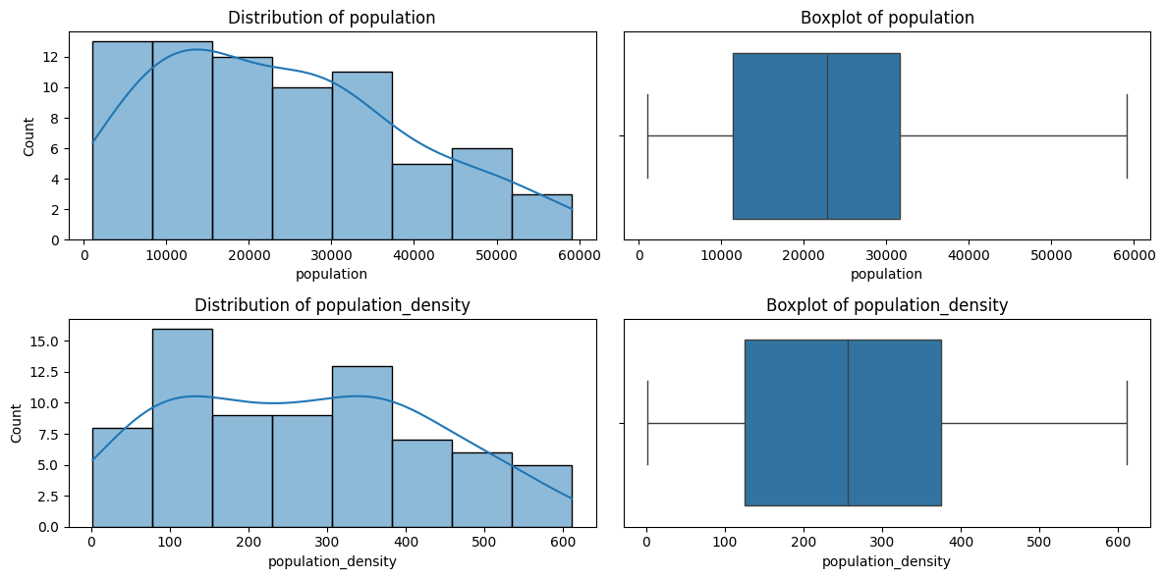
Variables distribution – demografics
Demographic densities are extremely uneven, with strong central concentration..

Slide 14
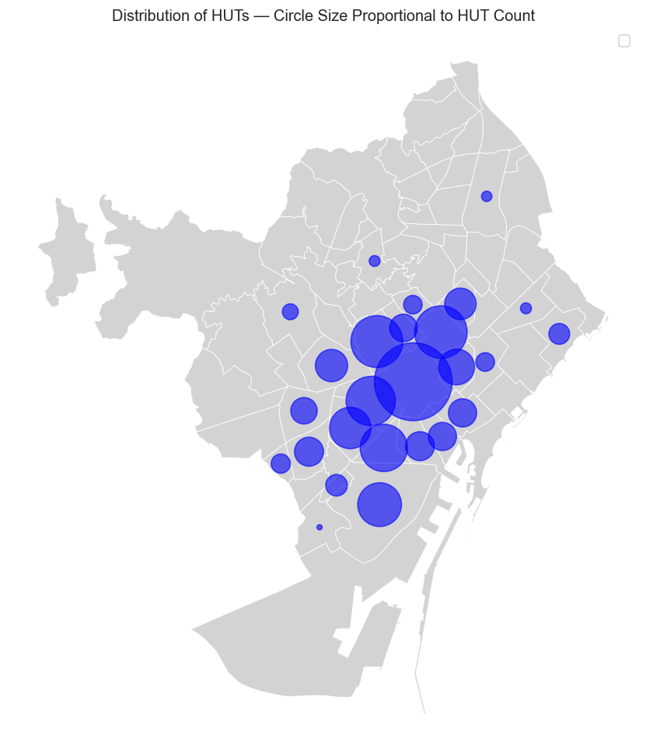
HUTs density
Visual concentration of tourist flats
Clear spatial clusters
Highlights areas most exposed to policy change

Slide 15
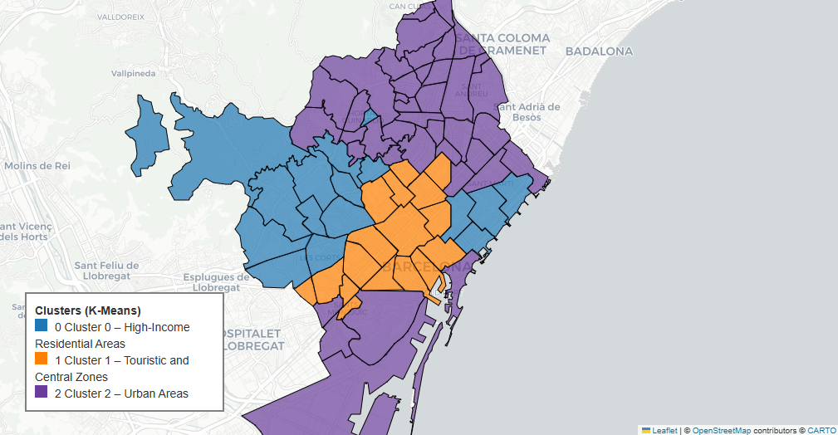
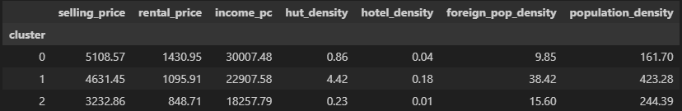
Unsupervised Clustering of Barcelona Neighborhoods (K‑means)
Clusters reflect socio-economic and functional differences
Highlights structural heterogeneity across the city
Support the need for econometric controls in the model

Slide 16
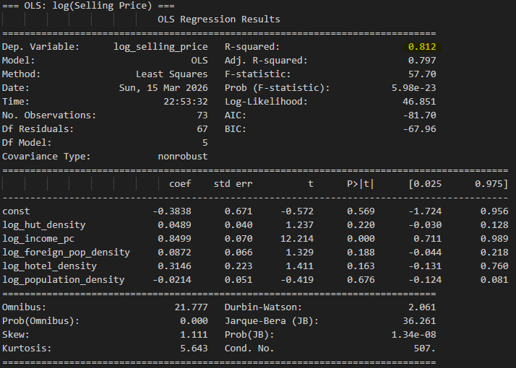
Model Selling Price
Dependent Variables
log(selling_price)
log(rental_price)
Key regressor
Hut density
Controls
Income per capita
Populatin density
Foreigh Population density
Hotel density

Slide 17
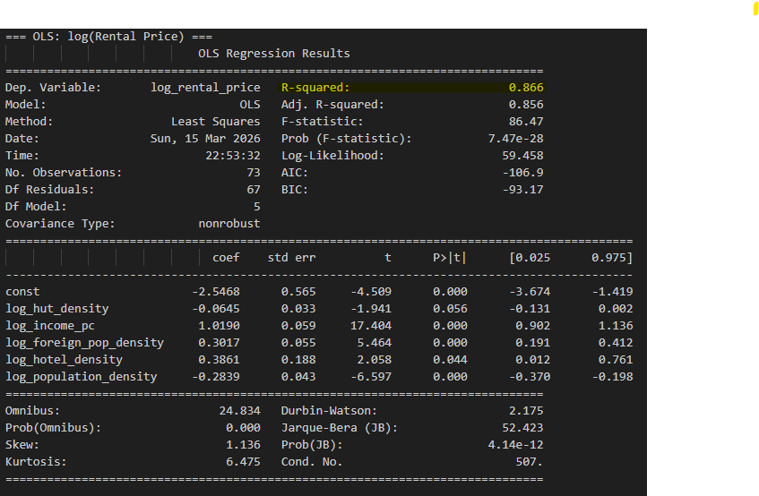
Model Rental Price
Dependent Variables
log(selling_price)
log(rental_price)
Key regressor
Hut density
Controls
Income per capita
Populatin density
Foreigh Population density
Hotel density

Slide 18


Why a Counterfactual Is Needed: Insights from Other Cities
🇳🇱 Amsterdam
Partial ban on short‑term rentals in 3 central districts (2020).
Rent prices: little to no measurable impact.
Sale prices: growth slowed slightly (~2–5%), but no price drop.
Policy was not city‑wide, so not comparable to a full elimination.
🇪🇸 Palma de Mallorca
Near‑total ban on tourist rentals in apartments (2018).
Only detached single‑family homes allowed.
Price effects: evidence is mixed, no strong decreases.
Market is much smaller and more tourism‑dependent → not comparable to Barcelona.

Slide 19
counterfactual
Goal – Simulate the effect of removing all HUTs from the city
Estimate baseline model
Predicts prices with actual HUT density
Set HUT density = 0
Predict counterfactual prices
Compute percentage impacts

Slide 20
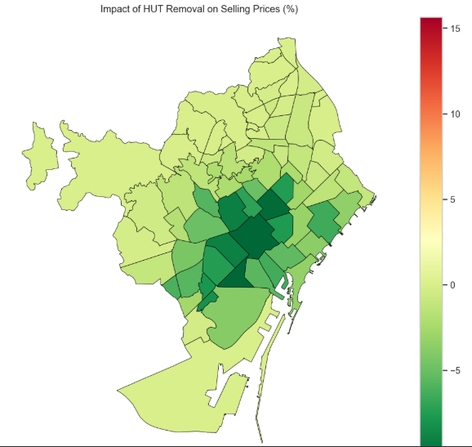
Impact on selling prices
Selling price decrease in high tourism areas
Strongest effects in central neighborhoods
HUT inflate property values

Slide 21
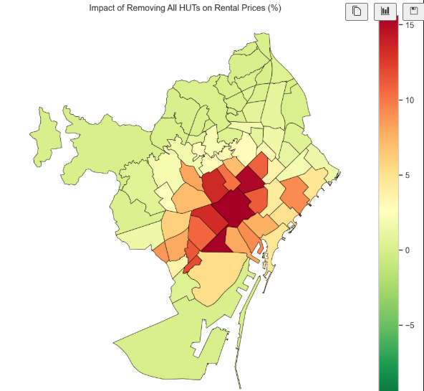
Impact on rental prices
Rental price increase when HUTs disappear
Strongest effects in central and dense areas
Demand shifts back to the residential market

Slide 22
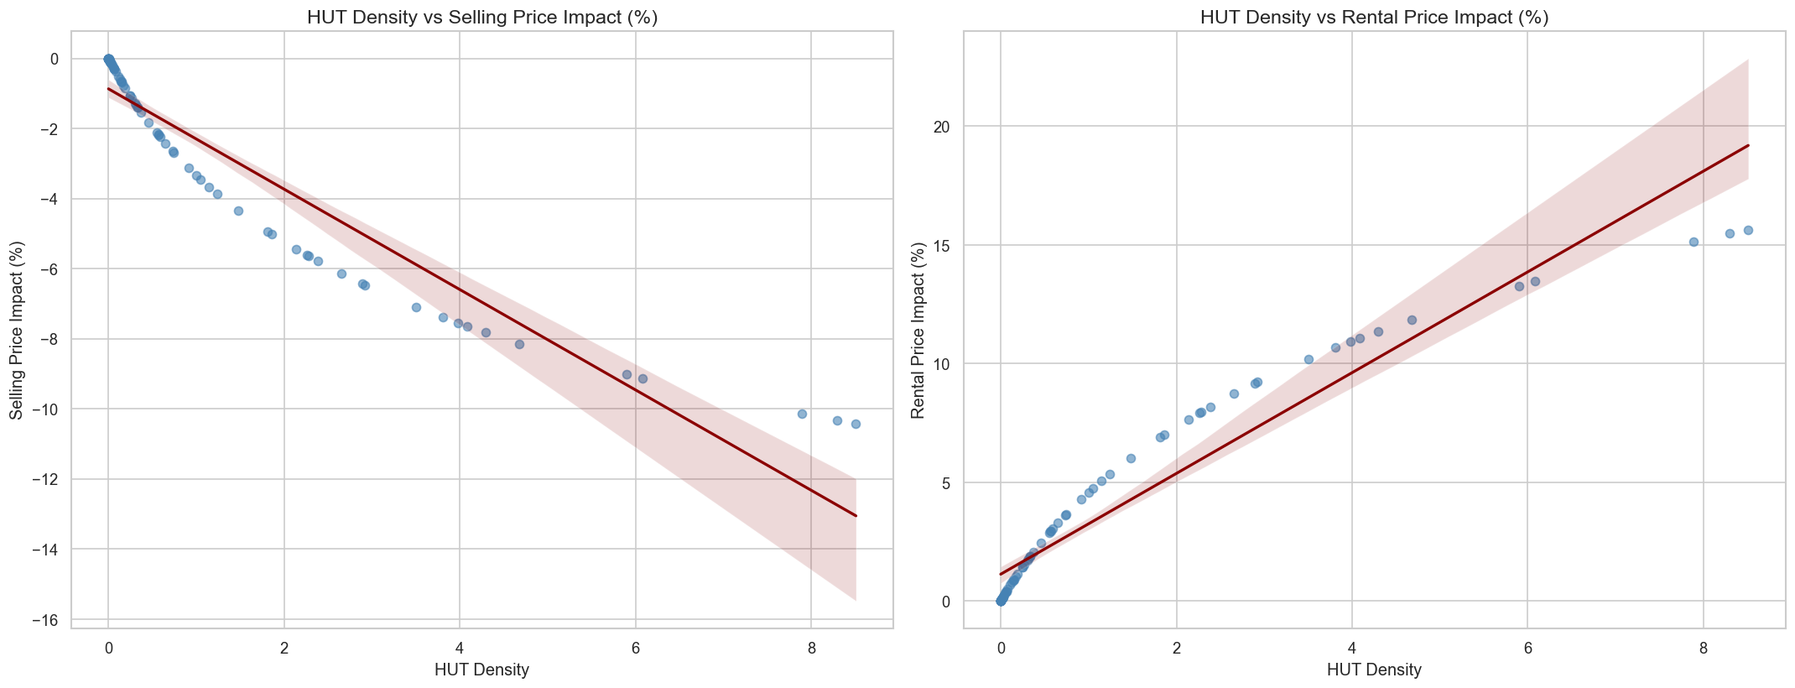
Linear relationship
Confirms opposite effect on the two markets

Slide 23
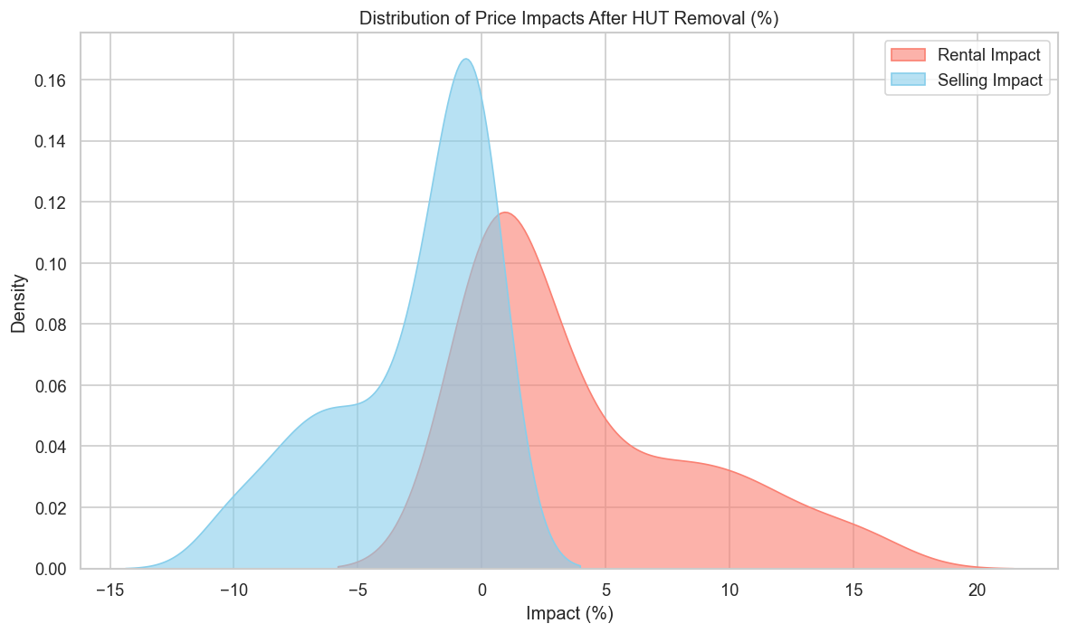
Distribution of impacts
Selling impacts clusters below zero
Rental impacts clusters above zero
Clear assimetry between the two markets
Strong visual confirmation of the hypotesis

Slide 24
Limitations
Model-based scenario, not real-world impact
No behavioral or long-run adjustments
Static relationships assumed
No real control group
Small rental effect – cautious interpretation

Slide 25
Conclusion
Considering the variables in this study:
Removing HUTs
Lower selling prices
Raises rental prices
Effects are spatially concentrated
Tourist pressure significantly shapes housing markets
Counterfactual partially confirms the hypothesis

Slide 26

Thank you

