Slide 1


Dinko Jakovljević
Microsoft Student Partner | BambooLab
dinko.jakovljevic@studentpartner.com

Slide 2
Agenda
About XAML
Syntax
Code-Behind
XAML Namespaces and Namespace Mapping
Data binding

Slide 3
About XAML

Slide 4
About XAML
eXtensible Application Markup Language
Declarative XML-based language
Used for initializing structured values and objects
XAML defines UI elements, data binding, eventing, etc.

Slide 5
About XAML
Xaml elements map directly to CLR object instances (Common Language Runtime)
Xaml attributes map to CLR properties and events on objects
Everything that is implemented in XAML can be expressed in C# or VB.NET
Notes:
CLR the virtual-machine component of Microsoft's .NET framework, manages the execution of .NET programs
Converts compiled code into machine instructions which the computer'sCPU then executes.^{[1]} The CLR provides additional services including memory management, type safety, exception handling,garbage collection, security and thread management

Slide 6
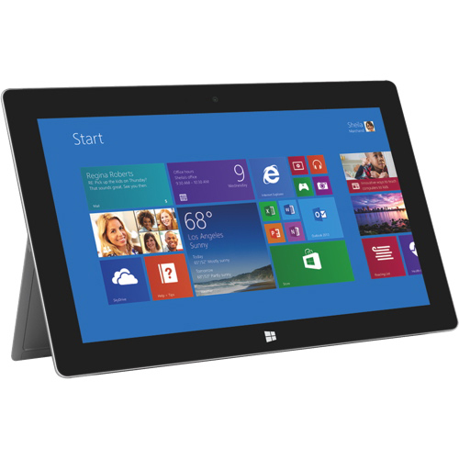
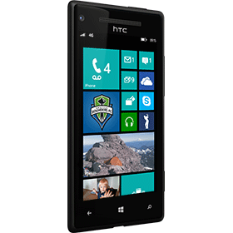
Where we can find XAML?

Slide 7
About XAML
Xaml filescan be created:
Visual Studio
Microsoft Expression Blend
Various text editors (XAMLPad)

Slide 8
Why is XAML so interesting?
You can create visible UI elements in the declarative XAML markup, and then separate the UI definition from the run-time logic by using code-behind files

Slide 9
Why is XAML so interesting?
XAML directly represents the instantiation of objects in a specific set of backing types defined in assemblies
XAML enables a workflow where separate parties can work on the UI and the logic of an application, using potentially different tools.
Notes:
This is unlike most other markup languages, which are typically an interpreted language without such a direct tie to a backing type system

Slide 10
Syntax

Slide 11
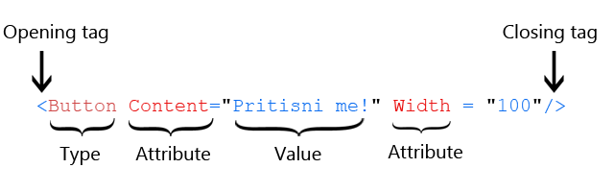
Syntax
XAML is a language based on XML and follows or expands upon XML structural rules.

Slide 12
Little more syntax
<Grid x:Name="ColorGrid" Background="#F29F05" Width="410" Height="110" Margin="35,0,0,30" Tap="Taxi_Tap"> <TextBlock Text="{Binding Name}" Foreground="Black" FontSize="30" Margin="10,0,0,0" /> <TextBlock Text="{Binding Price}" Foreground="Black" Margin="10,50,0,0"/> <TextBlock Text="{Binding Description}" Foreground="Black" Margin="10,75,0,0"/> <Image Width="50" Height="50" VerticalAlignment="Center" HorizontalAlignment="Right" Margin="0,0,25,0" Source="/Assets/Icons/Phone.png"></Image> <TextBlock Name="Number" Text="{Binding MobileNumber}" Visibility="Collapsed"/>
</Grid>

Slide 13
Syntax
The object elements StackPanel and Button each map to the name of a class that is defined by WPF and is part of the WPF assemblies.
<StackPanel>
<Button Content="Pritisni me!"/>
</StackPanel>

Slide 14
C# Code
StackPanel stackPanel = new StackPanel();
this.Content = stackPanel;
Button button = new Button();
button.Margin= new Thickness(20);
button.Content = "OK"; stackPanel.Children.Add(button);

Slide 15
Attribute syntax
An attribute syntax names the property that is being set in attribute syntax, followed by the assignment operator (=).
The value of an attribute is always specified as a string that is contained within quotation marks
<Button Content="Pritisni me!" Width="200" Margin="0 100 0 0"/>

Slide 16
Property element syntax
The content of tag is an object element of the type that the property takes as its value.
<typeName.propertyName>
...
</typeName.propertyName>
Notes:
For some properties of an object element, attribute syntax is not possible, because the object or information necessary to provide the property value cannot be adequately expressed within the quotation mark and string restrictions of attribute syntax
Generally, the content of that tag is an object element of the type that the property takes as its value . After specifying content, you must close the property element with an end tag

Slide 17
Property element syntax
<Button>
<Button.Content>
Pritisni me!
</Button.Content>
<Button.Margin>
0 100 0 0
</Button.Margin>
<Button.Width>
200
</Button.Width>
</Button>
Notes:
If an attribute syntax is possible, using the attribute syntax is typically more convenient and enables a more compact markup, but that is often just a matter of style, not a technical limitation

Slide 18
Attribute syntax (Events)
Attribute syntax can also be used for members that are events rather than properties.
<Button Click="Button_Click" >Click Me!</Button>
Notes:
Attribute syntax can also be used for members that are events rather than properties. In this case, the attribute's name is the name of the event. In the WPF implementation of events for XAML, the attribute's value is the name of a handler that implements that event's delegate.

Slide 19
Markup Extension
Markup extensions are dynamic placeholders for attribute values in XAML.
FontFamily="{StaticResource PhoneFontFamilyNormal}"
Notes:
They resolve the value of a property at runtime.
Markup extensions are surrouded by curly braces (Example: Background="{StaticResource NormalBackgroundBrush}"). WPF has some built-in markup extensions, but you can write your own, by deriving fromMarkupExtension.

Slide 20
Markup Extension
Built-in markup extensions:
Binding StaticResource DynamicResource TemplateBinding x:Static x:Null
Notes:
Binding To bind the values of two properties together.
StaticResource One time lookup of a resource entry
DynamicResource Auto updating lookup of a resource entry
TemplateBinding To bind a property of a control template to a dependency property of the control
x:Static Resolve the value of a static property.
x:Null Return null

Slide 21
Elements
XAML is the primary format for declaring a Silverlight UI and elements in that UI.
Typically at least one XAML file in your project represents a "page" metaphor in your application for the initially displayed UI.

Slide 22
Grid Panel
The grid is a layout panel that arranges its child controls in a tabular structure of rows and columns. Its functionality is similar to the HTML table but more flexible.
Notes:
A cell can contain multiple controls, they can span over multiple cells and even overlap themselves.

Slide 23
Grid Panel
The grid has one row and column by default.
RowDefinition item -> RowDefinition collection
ColumnDefinition item -> ColumnDefinition collection
Notes:
The grid has one row and column by default. To create additional rows and columns, you have to add RowDefinitionitems to the RowDefinitions collection and ColumnDefinition items to the ColumnDefinitions collection.

Slide 24
Grid Panel
The size can be specified as an absolute amount of logical units, as a percentage value or automatically.
Fixed
Fixed size of logical units (1/96 inch)
Auto
Takes as much space as needed by the contained control
Star (*)
Takes as much space as available (after filing all auto and fixed size)
Notes:
FixedFixed size of logical units (1/96 inch)
AutoTakes as much space as needed by the contained control
Star (*)Takes as much space as available (after filling all auto and fixed sized columns), proportionally divided over all star-sized columns. So 3*/5* means the same as 30*/50*. Remember that star-sizing does not work if the grid size is calculated based on its content.

Slide 25
StackPanel
In WPF is a simple and useful layout panel.
It is good for creating any kind of lists.
ItemsControls like ComboBox, ListBox or Menu use StackPanel as their internal layout panel.
Notes:
The StackPanel in WPF is a simple and useful layout panel. It stacks its child elements below or beside each other, dependening on its orientation. This is very useful to create any kinds of lists. All WPF ItemsControls like ComboBox,ListBox or Menu use a StackPanel as their internal layout panel.

Slide 26
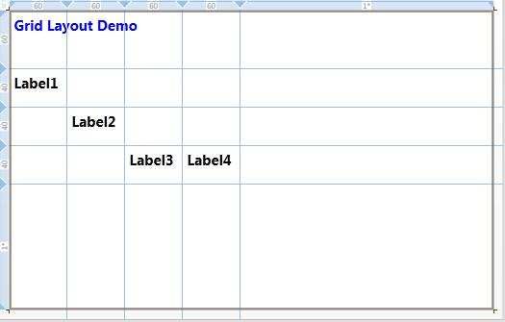
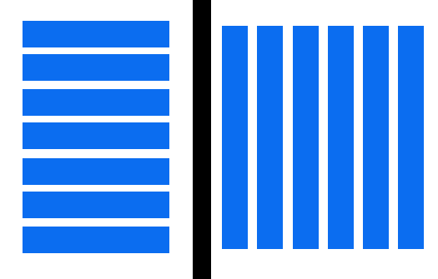
Grid vs StackPanel

Slide 27
DEMO

Slide 28
Code behind

Slide 29
Code behind
Code-behind is a term used to describe the code that is joined with markup-defined objects, when a XAML page is markup-compiled
<Button Click="Button_Click" >Click Me!</Button>
Notes:
Attribute syntax can also be used for members that are events rather than properties. In this case, the attribute's name is the name of the event. In the WPF implementation of events for XAML, the attribute's value is the name of a handler that implements that event's delegate.
The XAML language includes language-level features that make it possible to associate code files with markup files, from the markup file side.

Slide 30
Code behind and XAML
MainPage.xaml
XAML code
MainPage.xaml.cs
MainPage.xaml
<Button Click="Button_Click" >Click Me!</Button>

Slide 31
Code behind and XAML
MainPage.xaml
MainPage.xaml.cs
Code Behind
MainPage.xaml.cs
private void Press(object sender, RoutedEventArgs e) { }

Slide 32
Code behind and XAML
namespace SSA_primjer
{ public partial class MainPage : PhoneApplicationPage
{
// Constructor
public MainPage()
{
InitializeComponent();
}
private void Press(object sender, RoutedEventArgs e) { }
}
}

Slide 33
Inline Code
<Page xmlns="http://schemas.microsoft.com/winfx/2006/xaml/presentation" xmlns:x="http://schemas.microsoft.com/winfx/2006/xaml" x:Class="MyNamespace.MyCanvasCodeInline" >
<Button Name="button1" Click="Clicked">Click Me!</Button> <x:Code><![CDATA[
void Clicked(object sender, RoutedEventArgs e)
{
button1.Content = "Hello World";
}
]]></x:Code>
</Page>
Notes:
Notice that the code is inside the x:Code element and that the code must be surrounded by <CDATA[...]]> to escape the contents for XML, so that a XAML processor (interpreting either the XAML schema or the WPF schema) will not try to interpret the contents literally as XML.

Slide 34
Inline Code
x:Code is a directive element defined in XAML
The code that is defined inline can interact with the XAML on the same page
You should consider avoiding or limiting the use of inline code
Notes:
In terms of architecture and coding philosophy, maintaining a separation between markup and code-behind keeps the designer and developer roles much more distinct

Slide 35
DEMO

Slide 36
XAML Namespaces

Slide 37
What is a XAML Namespace?
A XAML namespace is an extension of the concept of an XML namespace.
It rely on the XML namespace syntax, the convention of using URI and so on.
Notes:
The techniques of specifying a XAML namespace rely on the XML namespace syntax, the convention of using URIs as namespace identifiers, using prefixes to provide a means to reference multiple namespaces from the same markup source, and so on

Slide 38
XAML Namespace Declaration
Within the namespace declarations in the root tag of many XAML files, you will see that there are typically two XML namespace declarations.
xmlns="http://schemas.microsoft.com/winfx/2006/xaml/presentation"
xmlns:x="http://schemas.microsoft.com/winfx/2006/xaml"
Notes:
Within the namespace declarations in the root tag of many XAML files, you will see that there are typically two XML namespace declarations. The first declaration maps the overall WPF client / framework XAML namespace as the default. – first declaration
The second declaration maps a separate XAML namespace, mapping it (typically) to the x: prefix – second declaration
The relationship between these declarations is that the x: prefix mapping supports the intrinsics that are part of the XAML language definition, and WPF is one implementation that uses XAML as a language and defines a vocabulary of its objects for XAML. Because the WPF vocabulary's usages will be far more common than the XAML intrinsics usages, the WPF vocabulary is mapped as the default.

Slide 39
XAML Namespace Declaration
The XAML namespace defines many commonly-used features that are necessary even for basic WPF applications.
Code – behind to XAML file through a partial class x:Class
Keyed resource of an element x:Key
Notes:
For instance, in order to join any code-behind to a XAML file through a partial class, you must name that class as the x:Class attribute in the root element of the relevant XAML file.
Or, any element as defined in a XAML page that you wish to access as a keyed resource should have the x:Key attribute set on the element in question

Slide 40
Mapping to Custom Classes
You can map XML namespaces to assemblies using a series of tokens within an xmlns prefix declaration.
The CLR namespace declared within the assembly that contains the public types to expose as elements.
clr-namespace:

Slide 41
Mapping to Custom Classes
Example:
<Page x:Class="WPFApplication1.MainPage"
xmlns:custom="clr-namespace:SDKSample;assembly=SDKSampleLibrary">
</Page>

Slide 42
Data binding

Slide 43
Data binding
Data binding provides a simple way for Windows Runtime apps using C++, C#, or Visual Basic to display and interact with data.
A data binding consists of a target and a source.
Notes:
The way data is displayed is separated from the management of the data.
The target is usually a property of a control, and the source is usually a property of a data object.
Every binding includes:
A binding source, which is an object with data that you want to render.
A binding target, which is a DependencyProperty of a FrameworkElement for rendering the data.
A Binding object, which moves the data between the source and target, and can reformat it using an optionalvalue converter.

Slide 44
Data binding
When a binding is established and the data changes, the UI elements that are bound to the data can display changes automatically.
Notes:
A connection, or binding, between the UI and a data object allows data to flow between the two

Slide 45
Data binding syntax
The binding is created in XAML by using the {Binding ...}
The source is set in code by setting the DataContex property for the TextBox

Slide 46
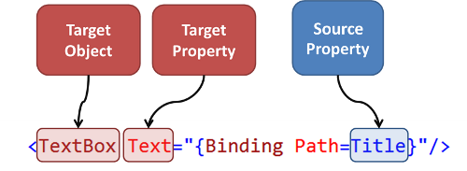
Data binding

Slide 47
Data context
Data context is inherited.
A child element can override this behavior by setting the Source property on its binding object, or by setting its DataContext.
Useful when we have multiple bindings that use the same source.
Notes:
If you set the data context on a parent element, its children will use the same data context.
This override then applies to the children of the child element.
Setting the data context is useful when you want to have multiple bindings that use the same source. To set the source for a single binding, set the Source property on the Binding object.

Slide 48
Other sources
ElementName property – useful when you are binding to other elements in your app (slider + width of button)
RelativeSource property – useful when the binding is specified in a ControlTemplate

Slide 49
Other sources
Binding.Path property – supports a variety of syntax options for binding to nested properties, attached properties.

Slide 50
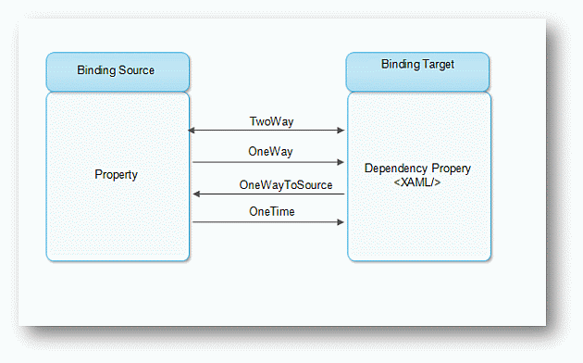
Direction of the data flow
Notes:
OneTime bindings update the target with the source data when the binding is created.
OneWay bindings update the target with the source data when the binding is created, and any time the data changes. This is the default mode.
TwoWay bindings update both the target and the source when either changes

Slide 51
Change notification
For changes to the source object to propagate to the target, the source must implement the INotifyPropertyChanged interface.
INotifyPropertyChanged has the PropertyChanged event.
Notes:
This event tells the binding engine that the source has changed so that the binding engine can update the target value

Slide 52
DEMO

Slide 53
?

Slide 54
Hvala na pažnji ☺

