Slide 1
C#
All the awesomeness you need for SSA.
Igor Ralić
dizzy.hr
igrali@outlook.com
twitter.com/igrali
igrali.com

Slide 2
C# basics
OOP in C#
Advanced C#

Slide 3
Why do Java developers wear glasses? -Because they don't C#!

Slide 4
C#
Simple, object-oriented, managed, type-safe
Familiar to C, C++, Java (and more) devs
Developed by Microsoft / Anders Hejlsberg
C# 5
Standardized – Ecma, ISO

Slide 5
Managed?
Depends on services provided by runtime environment
Common Language Runtime (CLR) executes managed code
CLR features
memory management
exception handling
standard types
...

Slide 6
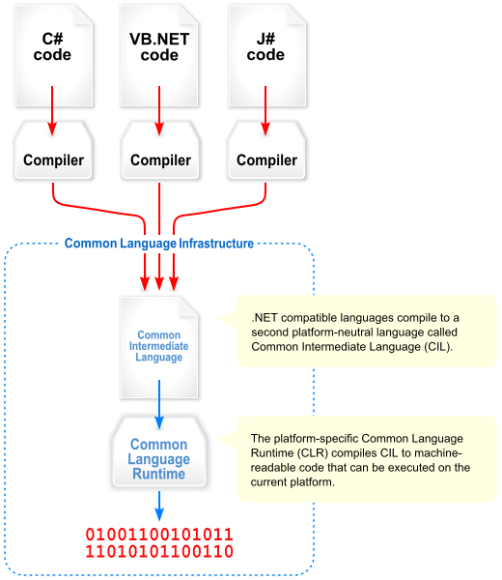
.NET Framework
Microsoft developer platform
C# works with .NET ☺
Language independence
CLR
Common Language Runtime
.NET Framework Class Library

Slide 7
2002
2006
2007
2010
2012
2005
2003
.Net 1
C# 1
.Net 1.1
.Net 2
C# 2
.Net 3
.Net 3.5
C# 3
.Net 4
C# 4
.Net 4.5
C# 5
C# 1.2
VAR
DYNAMICS
GENERICS
PARTIAL CLASSES
ANONYMOUS
NULLABLE
N/A
LINQ
INITIALIZERS
AUTO PROPS
EXTENSIONS
LAMBDA
PARTIAL METHODS
OPTIONAL ARGS
COVARIANCE
ASYNC
CALLER ATTR

Slide 8
Our second program

Slide 9
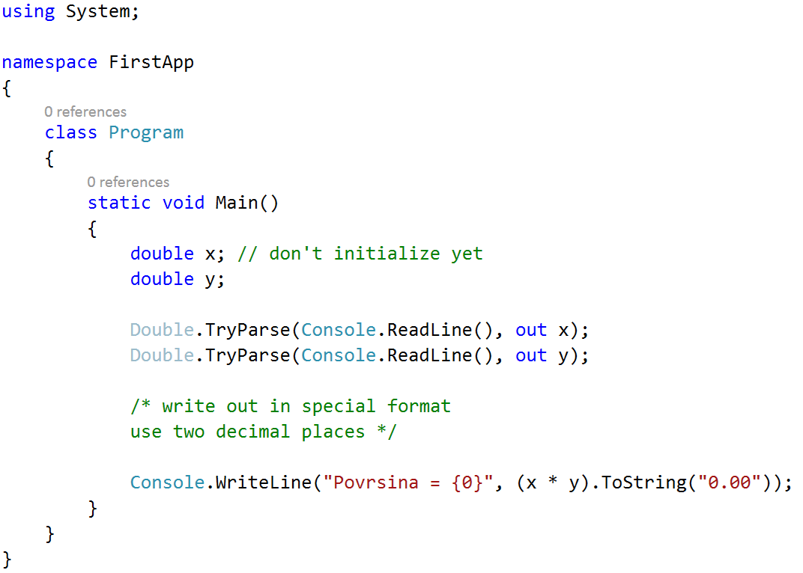
Layout matters!

Slide 10
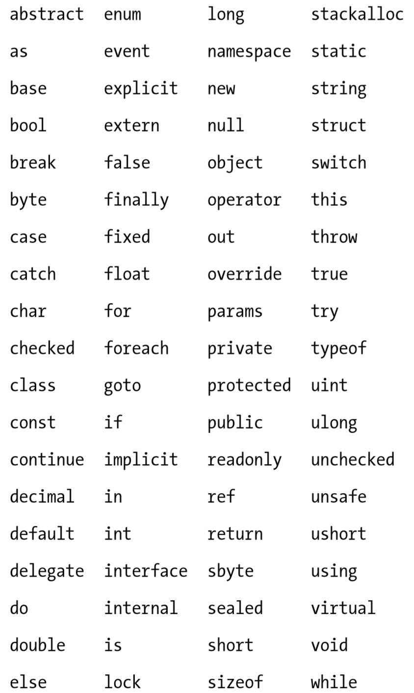
Identifiers and keywords
Identifiers
Program, Main, x, y …
Start with letter or underscore, case-sensitive
Keywords
using, class, static, void
Can’t use as identifiers

Slide 11
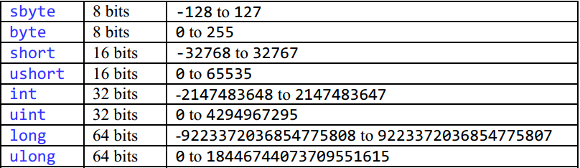
Storing numbers
Integers
Real numbers
float, double, decimal
Type | Approximate range | Precision
float | -3.4 × 10³⁸to +3.4 × 10³⁸ | 7 digits
double | ±5.0 × 10⁻³²⁴ to ±1.7 × 10³⁰⁸ | 15-16 digits
decimal | (-7.9 x 10²⁸ to 7.9 x 10²⁸) / (10^{0 to 28}) | 28-29 significant digits

Slide 12
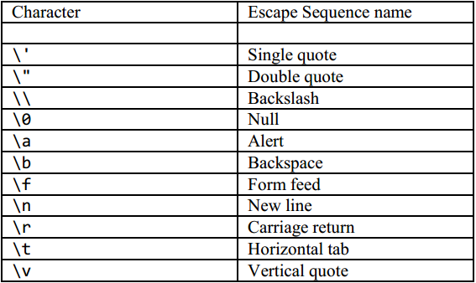
Storing text and state
char
string
Immutable
StringBuilder is mutable
Store state – bool
true - false

Slide 13
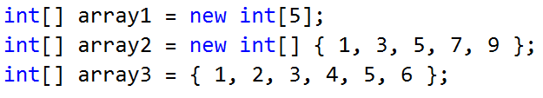
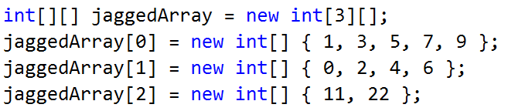
Arrays
Fixed number of elements of type
Contiguous block of memory
Highly efficient access
Indexer starting at 0

Slide 14
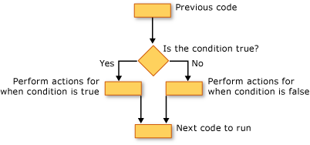
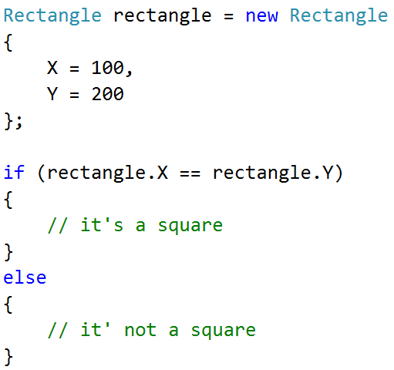
Controlling program flow
if – else if – else
can be nested
Break down conditions

Slide 15
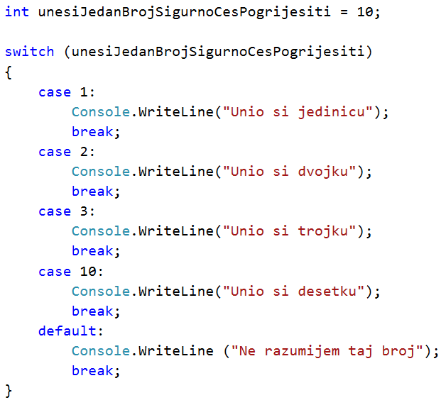
Switch statement
Branch based on a selection of
possible value

Slide 16
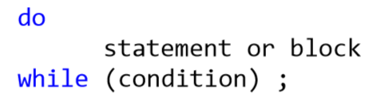

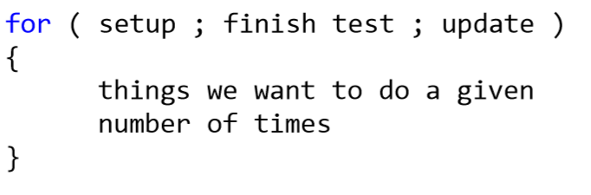
Loops
Repeat something a certain number of times
do – while
while
for
break
continue

Slide 17
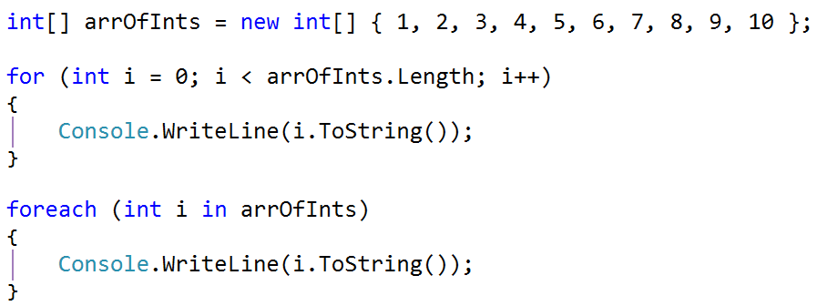
foreach
Iterate over each element in an enumerable object
Array, Collection, List<T>

Slide 18

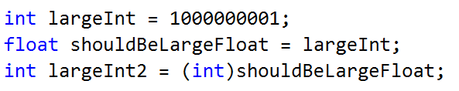
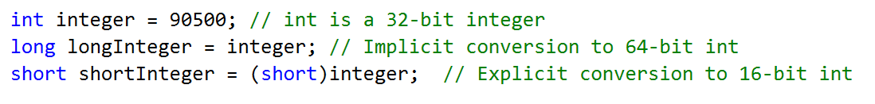
Conversions
Implicit
Automatic
Only when no information will be lost
Explicit
Require a cast

Slide 19
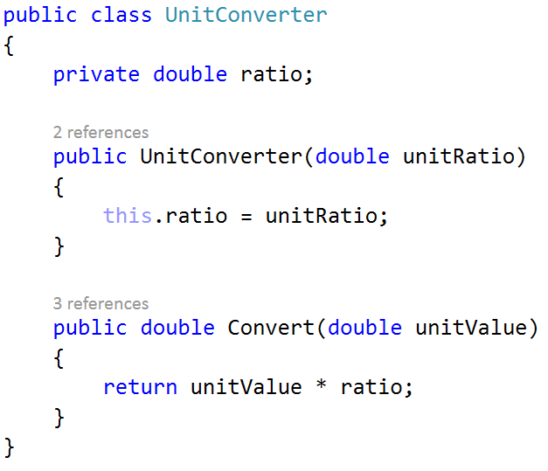

Types
Blueprints for values
Bunch of predefined types
More in .NET framework
System.DateTime
Custom types

Slide 20
Predefined value & reference types
Value types
Signed integers – sbyte, short, int, long
Unsigned integers – byte, ushort, uint, ulong
Real numbers – float, double, decimal
Logical – bool
Character – char
Reference types
String, object

Slide 21
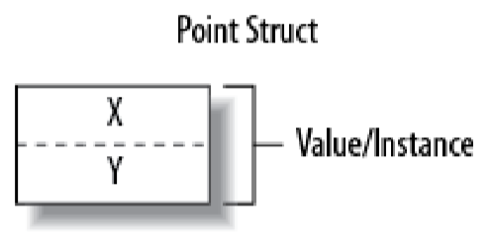
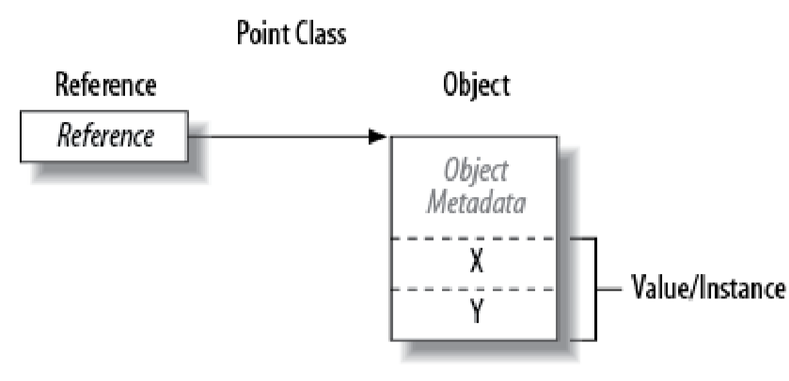
Value vs. reference types
Value types
numeric types, char, bool
struct, enum types
Reference types
class, array, delegate
Null reference
Image source: C# 5.0 Pocket Reference by Joseph Albahari and Ben Albahari

Slide 22
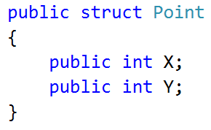
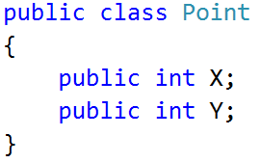
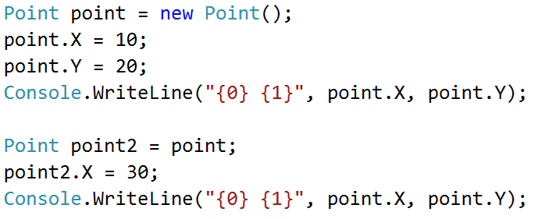
Value vs. reference types

Slide 23
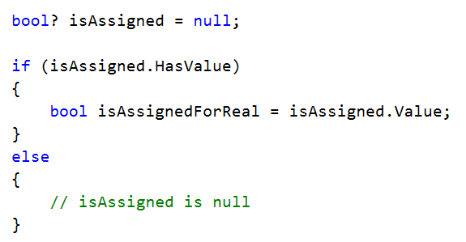
Nullable type
Null useful to represent nonexistent value
What about value types?
tip + ?

Slide 24
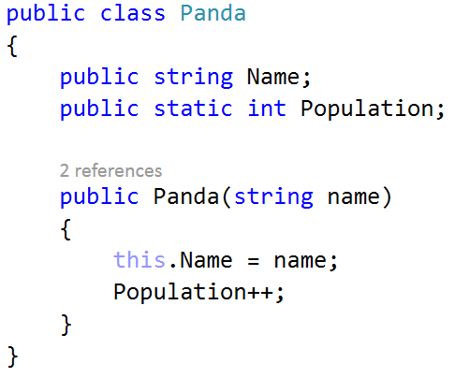
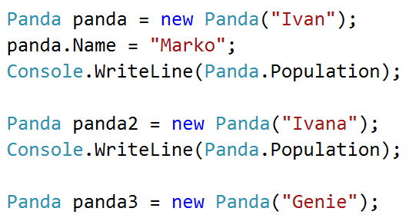
Instance vs. Static
Instance members operate on instances ☺
Static operate on the type itself

Slide 25
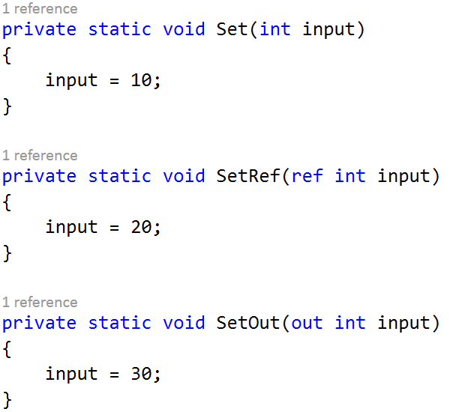
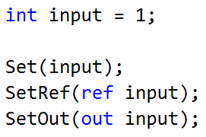
Method parameters
Parameter modifier | Passed by | Variable must be assigned
none | Value | Going in
ref | Reference | Going in
out | Reference | Going out

Slide 26
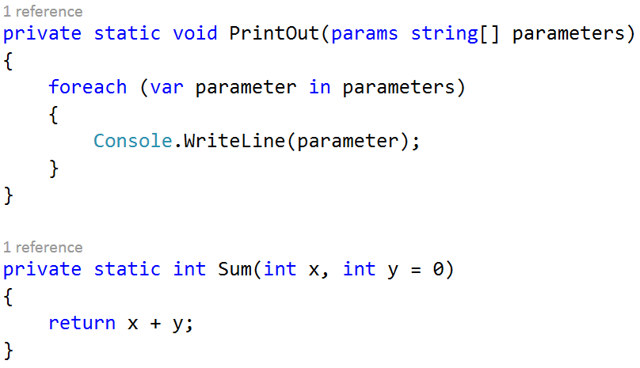
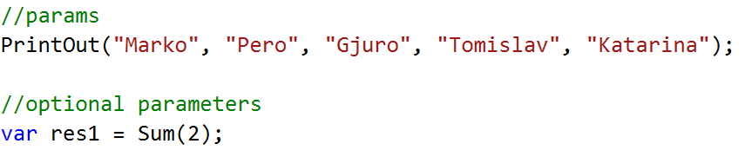
Method parameters
Params
Optional parameters

Slide 27
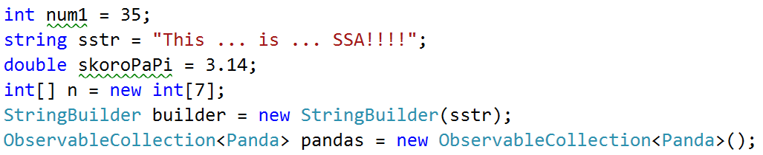
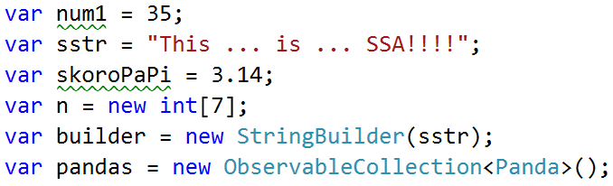
var – implicitly typed variables
Compiler can (most of the time) infer the type

Slide 28
Object-oriented

Slide 29
OOP in C#
Inheritance
Inherit members from parent class
Reuse, extend or modify behavior defined in other classes
Encapsulation
Hide internals of a class
Polymorphism
Subytpe polymorphism
Take different shapes

Slide 30
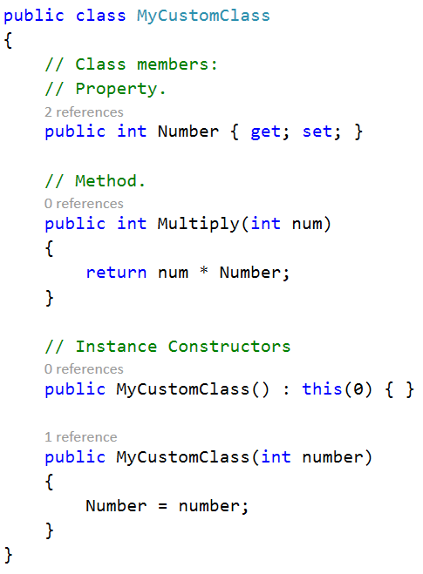
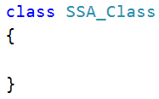
Classes
Most common kind of reference type
Blueprint for objects
Object = instance of a class
Reference type
Unlike structs
Supports inheritance
Unlike structs

Slide 31
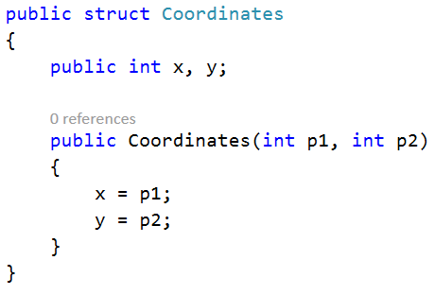
Structs
Cannot initialize fields in declaration
Unless const or static
Cannot declare parameterless constructor
Value types
Cannot inherit from another struct or class
Can be instantiated without using new operator

Slide 32
Access modifiers
Promotes encapsulation
public
Fully accessible, implicit for enum and interface members
internal
Accessible within the containing assembly
private
Accessible only within containing type, implicit for class/struct members
protected
Accessible only within the containing type and subclasses

Slide 33
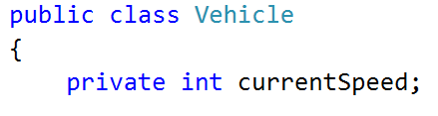
Basic elements
Fields
Variable member of class or struct
Can be readonly – cannot be modified after construction
Initialization is optional – default value
Initializers run before constructors

Slide 34
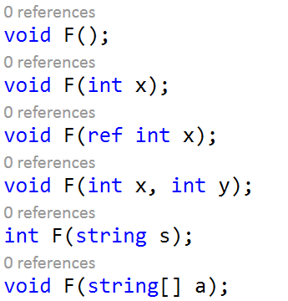
Basic elements
Methods
Perform an action
Can take input from the caller
Can return output
Can be overloaded

Slide 35
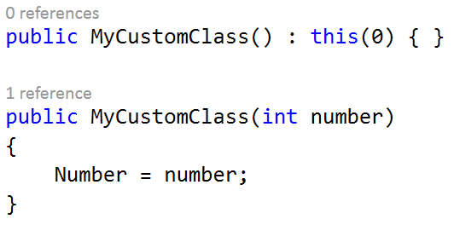
Basic elements
Instance constructors
Run initialization code
Almost like a method – no return type, same name as type name
Can be overloaded
One constructor can call another one – the called one gets executed first
Implicit parameterless constructor
Until you define at least one constructor
Don’t need to be public

Slide 36
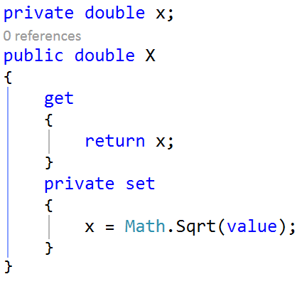
Basic elements
Properties
Similar to public fields, with get/set logic
get – read
set – assign
Read-only if it has just a getter
Write-only if it has just a setter (very rare)
Can change accessibility
Automatic properties

Slide 37
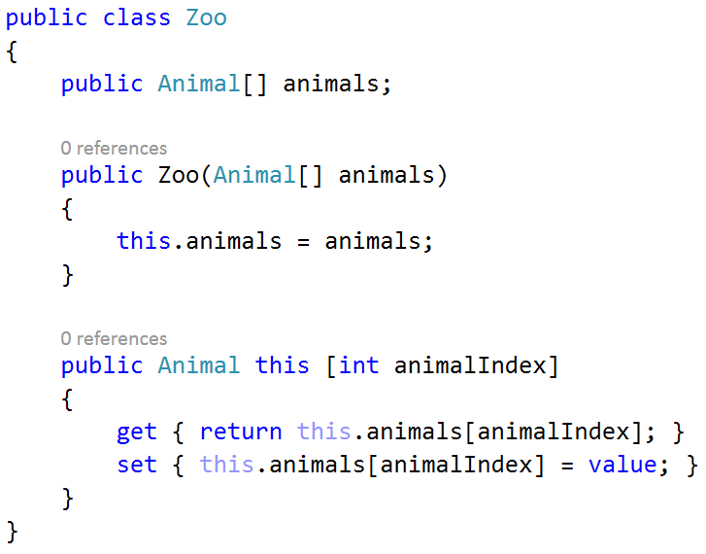
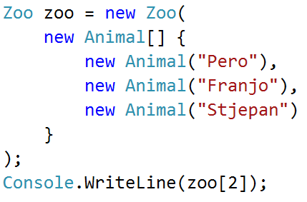
Indexers
Access to inner
list/dictionary of values

Slide 38
Inheritance
Derived class extends base class
A class can inherit from a single class
Only multiple interfaces can be implemented
A class can be inherited by many classes
Animal
Dog
Frog
Cat

Slide 39
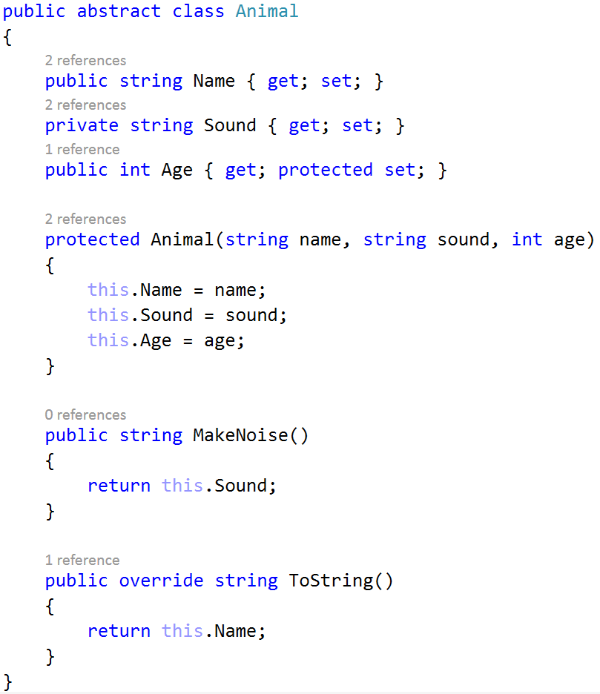
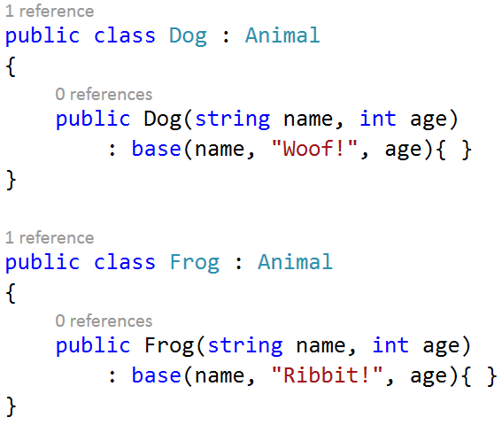

Slide 40
Constructors & inheritance
Subclass must declare its own constructor
Can use keyword base to access base class’s constructors
Base class constructors always execute first

Slide 41
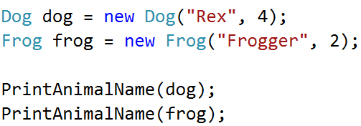
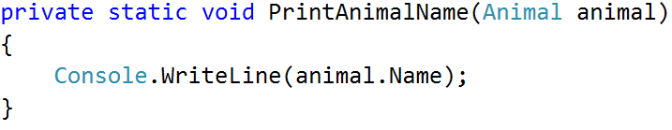
Polymorphism
Two aspects
Objects of a derived class may be treated as objects of a base class in places such as method parameters
Base classes may define and implement virtual methods, and derived classes can override them

Slide 42
Virtual members
Methods, properties, indexer and events
Function marked as virtual can be overridden
With specialized implementation

Slide 43
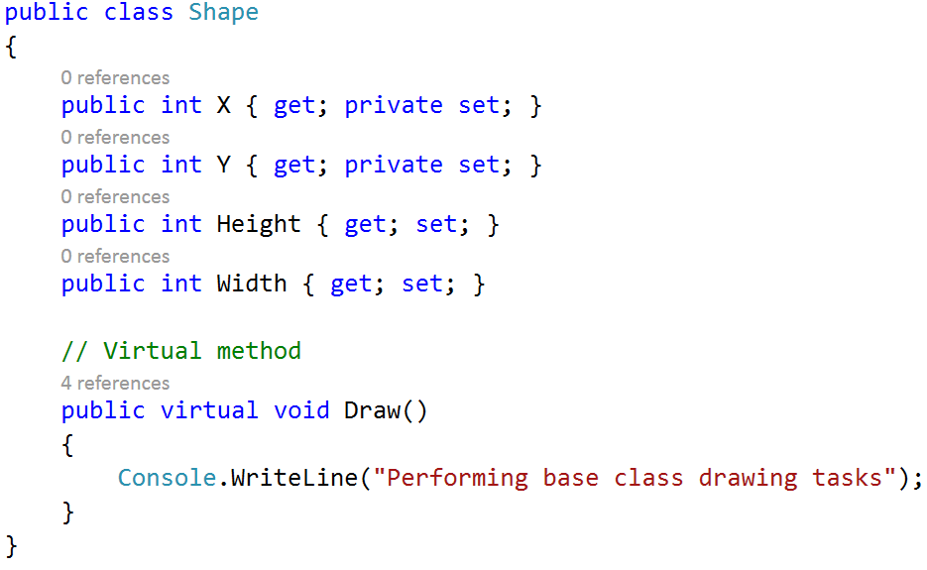
Virtual members

Slide 44
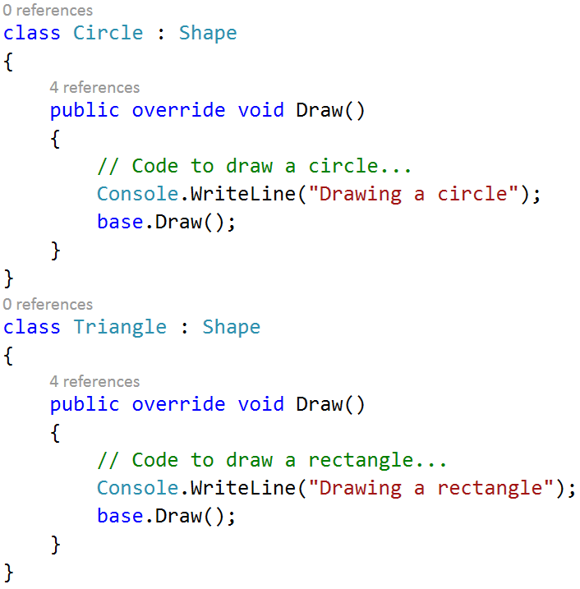
Virtual members

Slide 45
Abstract classes and members
Abstract class cannot be instantiated
Abstract classes can define abstract members
Like virtual, except they don’t provide default implementation
Derived classes of the abstract class must implement all abstract methods.

Slide 46
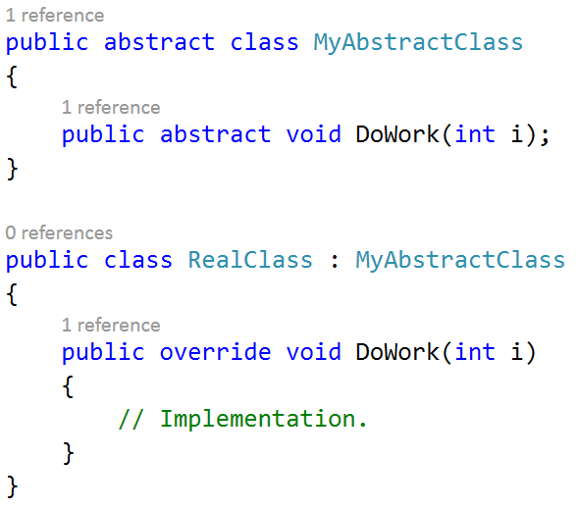
Abstract classes and members

Slide 47
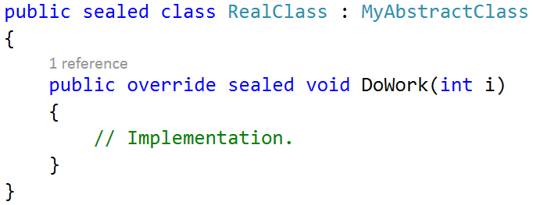
Sealing functions and classes
Overriden function member may seal its implementation
keyword sealed

Slide 48
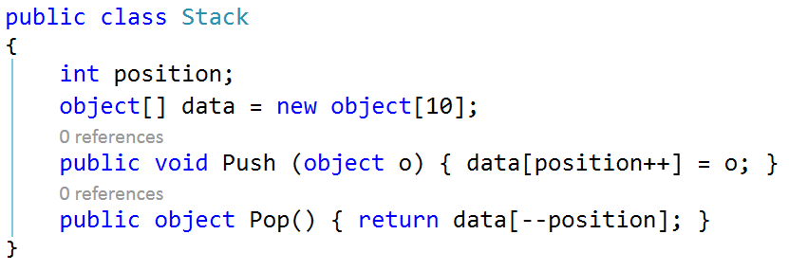
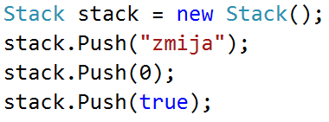
System.Object
Base class for all types
Any type can be implicitly upcast to object

Slide 49

Boxing and unboxing
Boxing
Cast a value-type instance to a reference-type instance
Unboxing
Reverse – cast a reference-type instance to a value-type instance
Computationally expensive – best if avoided – see generics!

Slide 50
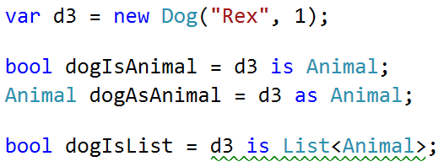
Is & As
is operator returns true if an object is an instance of a type
as attempts to cast to a specified type
null if not possible
does not raise an exception

Slide 51

Interfaces
Specification – no implementation!
Contract
All members implicitly abstract
Class/struct can implement multiple interfaces
Reminder: class can only inherit from one class!
May extend other interfaces

Slide 52


Interfaces
Windows Phone Silverlight
DialogService : IDialogService
with MessageBox
Windows 8.1 WinRT
DialogService : IDialogService
with MessageDialog

Slide 53


Enums
Useful when storing state information
Whenever you think of something in terms of state
Comparing enum values is much smarter than comparing hardcoded strings

Slide 54
Advanced C# concepts

Slide 55

Generics
Write code that’s reusable across types – type parameters
Inheritance & generics
Increase type safety
Reduce casting and boxing/unboxing
Supply type
arguments
T
Very bad implementation ☺

Slide 56



Generics

Slide 57

Generics
Most of the data structures and collection implemented this way
Lists, dictionary, stack, queue, observable collection ...

Slide 58


Generic methods
Methods can be generic, too!

Slide 59
Generic constraints
Constraint | Description
where T: base-class | Base-class constraint
where T: interface | Interface constraint
where T: class | Reference-type constraint
where T: struct | Value-type constraint
where T: new() | Parameterless constructor constraint
where U: T | Naked type constraint

Slide 60

Delegates
A type-safe reference to a method in a class
Very useful when we want to pass a method to somewhere else so it can execute it when needed

Slide 61


Action & Func
Action
Do something with certain parameters, return nothing
Func
Do something with certain parameters, return something

Slide 62



Action & Func

Slide 63

Events
Publish – subscribe
+= subscriber starts listening
-= subscriber stops listening
Class allows others to give
it delegates
Those delegates then get
invoked when event occurs

Slide 64


Slide 65


Slide 66

Anonymous functions
In C# 2.0, lambdas used nowadays

Slide 67
Lambda expressions (not lamba ☺ )
Unnamed method in place of delegate instance

Slide 68

Lambdas
(parameters) => expression-or-statement-block
(x) => x*x; read: x goes to

Slide 69

Lambdas
Possible to capture outer variables – a closure
captured variables

Slide 70

Lambdas
What’s the output?

Slide 71

Exceptions
Bad things happen
try-catch-finally
catch Exception or a subclass of Exception
try combined with catch block(s), finally block or both

Slide 72

Exceptions
Catch multiple
exceptions,
cleanup resources
after
StackTrace
Message
InnerException

Slide 73


Extension methods
Extend existing type with new methods
Static method of static class

Slide 74

Async
Better asynchronous model in C# 5.0
async & await
return to caller instead of blocking it
concurrency
multithreading
callback

Slide 75

Async await
Almost as
simple as
sync
calls

Slide 76

Async lambdas
Both named and unnamed methods can be async
Can be useful with event handlers

Slide 77
And so much more...

Slide 78
Sources
MSDN documentation
http://msdn.microsoft.com/en-us/library/618ayhy6.aspx
C# Yellow Book – Rob Miles
http://www.robmiles.com/c-yellow-book/
C# 5.0 Pocket Reference
Joseph Albahari and Ben Albahari (O’Reilly)

Slide 79
More good resources
Programming in C# - Jump Start – MVA
http://www.microsoftvirtualacademy.com/training-courses/developer-training-with-programming-in-c
.NET Book Zero
http://www.charlespetzold.com/dotnet/
Pluralsight courses
https://pluralsight.com/training/offers/?cc=dreamspark

Slide 80
C#
All the awesomeness you need for SSA.
Igor Ralić
dizzy.hr
igrali@outlook.com
twitter.com/igrali
igrali.com

