Slide 1


Ivan Marković
MSP Lead
Software Developer at SPAN d.o.o.
ivan.markovic@studentpartner.com

Slide 2
Agenda
Web Apps
ASP.NET MVC
Web API
Demo, demo, demo, …

Slide 3
What is web application?
A web application or web app is any software that runs in a web browser.

Slide 4
Architecture of web app
User
Client
Server
DB

Slide 5

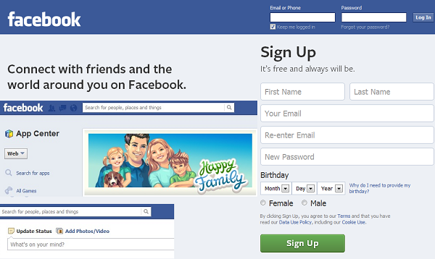
Web page != web app
Web app
Web page
Notes:
Web stranica uglavnom prikazuje nekakvu obavijest, samo daje informacije

Slide 6
How does it work?
User
1
6
Client
Server
DB
2
5
3
4

Slide 7
Developing web apps
Developing web apps:
Front-end web developer
Developing UI
Back-end web developer
Developing application logic

Slide 8
ASP.NET vs PHP Code Example
ASP.NET | PHP
< %@ Page Language="C#" %> <html> <head></head> <body> < % for (int i = 1; i <= 100; i++) { Response.Write((i + (i - 1)).ToString() + "<br />"); } %> </body> </html> | <html> <head></head> <body> < ?php for ($i = 1; $i <=100; $i++) { echo $i + ($i - 1) . "<br />"; } ?> </body> </html>

Slide 9
ASP.NET vs PHP Tools
ASP.NET : Visual Studio + IIS + Microsoft SQL
PHP: Eclipse + Xampp + MySQL

Slide 10
Razvoj web aplikacija
HTML+CSS+JavaScript
ASP.NET
PHP
SQL

Slide 11
MVC

Slide 12
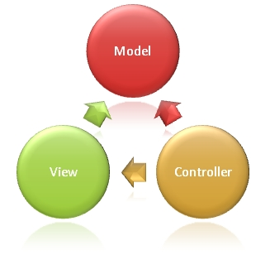
MVC
ASP.NET MVC
Web application framework
Alternate for ASP.NET Web Forms
MVC=Model-View-Controller
Architectural pattern

Slide 13
Advantages of an MVC-Based Web Application
Easier to manage complexity(input logic, business logic, and UI logic)
Better support for test-driven development(TDD)
Better for large teams of developers

Slide 14
Model

Slide 15
Entity framework(EF)
Object relational mapper(ORM) framework for .NET
Eliminates the need for most of the data-access code that developers usually need to write.

Slide 16
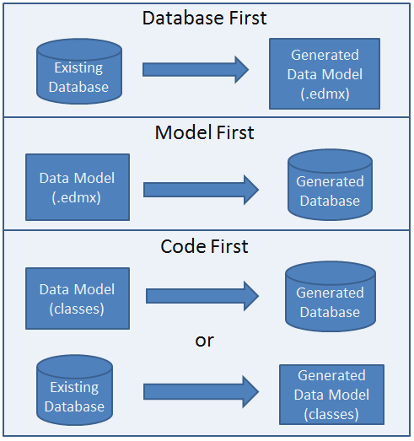
Entity Framework Development Approaches

Slide 17
View

Slide 18
Razor
View Engine for ASP.NET
Optimized arround HTML

Slide 19
Razor-example
<!DOCTYPE html>
<html lang="en">
<head>
<meta charset="utf-8" />
<title>Web Pages Demo</title>
</head>
<body>
<h1>Hello Web Pages</h1>
<p>The time is @DateTime.Now</p>
</body>
</html>

Slide 20
Controller

Slide 21
Controller
The ASP.NET MVC framework maps URLs to classes that are referred to as controllers
The base class for all controllers is the ControllerBase class

Slide 22
The Controller class is responsible for the following processing stages:
Locating the appropriate action method to call and validating that it can be called.
Getting the values to use as the action method's arguments.
Handling all errors that might occur during the execution of the action method.

Slide 23
Action Methods
ASP.NET MVC applications is organized around controllers and action methods.
The controller defines action methods. Controllers can include as many action methods as needed.
/[Controller]/[ActionName]/[Parameters]

Slide 24
Demo, demo, demo, …

Slide 25
Q & A
?

Slide 26
Thank you!
ivan.markovic@studentpartner.com

