Slide 1


Ivan Marković
MSP Lead
Software Developer at SPAN d.o.o.
ivan.markovic@studentpartner.com

Slide 2
Agenda
Waterfall or Agile
Scrum
ALM

Slide 3
Waterfall or Agile

Slide 4
Methodology vs framework
A methodology is a set of principles, tools and practices which can be used to guide processes to achieve a particular goal.
A framework is a loose but incomplete structure which leaves room for other practices and tools to be included but provides much of the process required.

Slide 5
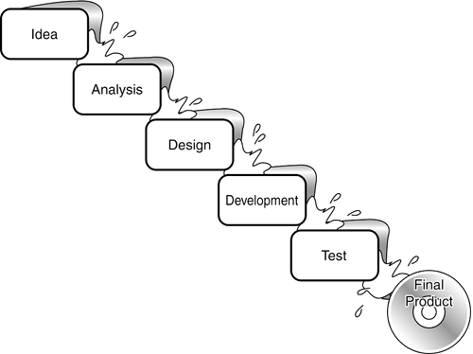
Waterfall development

Slide 6
FBI ACS System
Built with 1970s-era software tools
Natural
ADABAS
IBM Green screens

Slide 7
FBI – Virtual Case File
The Goal – Replace ACS
The Plan- Spec it and cotranct it on fixed bid
Science Applications International Corporation(SAIC) awarded primary software contract
Other vendors for smaller pieces
The Projection
3 years
$ 380m

Slide 8
FBI – Virtual Case File
2001 – Coding starts
January 2005 – All code scrapped
$170m spent

Slide 9



FBI – Virtual Case File
FBI Director Robert
Mueller asked congress
for more money to
keep going
Three times
Start over!

Slide 10
Sentinel
2006 Lockheed Martin wins software contract
The NEW Plan:
4 phases
$450m
6 years

Slide 11

Sentinel
Really hopeful this time

Slide 12
Sentinel
2010
1.5 phase done
$421m spent
2 years remain

Slide 13

Sentinel
They need another $351m and 6 years

Slide 14
Sentinel Scrums
2010
2011
2012
Jeff Johnson
Chad Fulghram
FBI cancels contract with external software vendors
Software complete- Dec 2011
$30m spent
All field tests passed and complete- May ‘12
Long wait for proprietary hardware

Slide 15
Agile
Individuals and interactions over processes and tools
Working software over comprehensive documentation
Customer collaboration over contract negotiation
Responding to change over following a plan

Slide 16
Waterfall development
Pros
Cons
Clear plan/clear vision
Accurately estimate timetable and budgets
Plan oriented -> More secure
Rigid
Inflexible
Problem with late testing and feedback

Slide 17
Agile development
Pros
Cons
Flexible, adaptive
No clearly defined end-goals
Collaboration
Feedback
Lack of structure
Quite time consuming (customer involvment)
Possible person drop is problem

Slide 18
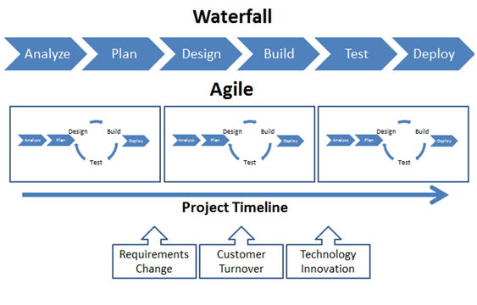
Waterfall vs Agile

Slide 19
Scrum

Slide 20
Scrum is..
A framework for Agile software development
A set of rules
Easy to learn
Difficult to master

Slide 21
Scrum is used for
Managing the work of: small teams, large organizations, everything in between
Fixed-price work
Developing software of every type imaginable

Slide 22
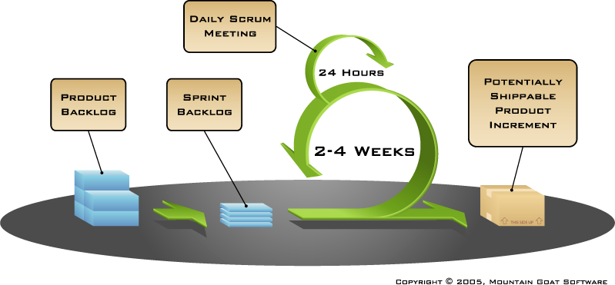
Scrum

Slide 23
Sprints
Scrum projects make progress in a series of “sprints”
Typical duration is 2–4 weeks or a calendar month at most
A constant duration leads to a better rhythm
Product is designed, coded, and tested during the sprint

Slide 24
Roles
Product owner
Scrum Development team (3-9 people)
Scrum Master

Slide 25
Development team
5-9 people
Programmers, testers, user expirience designers, etc.
Teams are self-organizing

Slide 26
Ceremonies
Sprint planning
Sprint review
Sprint retrospective
Daily scrum meeting

Slide 27
Sprint planning
Team selects items from the product backlog they can commit to completing
Sprint backlog is created
Tasks are identified and each is estimated (1-16 hours)
Collaboratively, not done alone by the ScrumMaster
High-level design is considered

Slide 28
The daily scrum
Parameters
Daily
15-minutes
Stand-up
Not for problem solving
Whole world is invited
Only team members, ScrumMaster, product owner, can talk
Helps avoid other unnecessary meetings

Slide 29
The daily scrum
What did you do yesterday?
What will you do today?
Is anything in your way?

Slide 30
The sprint review
Team presents what it accomplished during the sprint
Typically takes the form of a demo of new features or underlying architecture
Informal
2-hour prep time rule
No slides
Whole team participates
Invite the world

Slide 31
Sprint retrospective
Periodically take a look at what is and is not working
Typically 15–30 minutes
Done after every sprint
Whole team participates
ScrumMaster
Product owner
Team
Possibly customers and others

Slide 32
Artifacts
Product backlog
Sprint backlog

Slide 33


Product backlog
The requirements
A list of all desired work on the project
Ideally expressed such that each item has value to the users or customers of the product
Prioritized by the product owner
Reprioritized at the start of each sprint
This is the product backlog

Slide 34
Developer vs Project Manager
http://www.youtube.com/watch?v=ptCzqugFn_w

Slide 35
ALM
Microsoft ALM

Slide 36
What is ALM?
ALM = Application Lifecycle Management
Microsoft’s view of ALM
Plan and Track
Design
Develop
Automated Build
Testing
Test Lab Management

Slide 37
Visual Studio
Integrated development environments (IDE)
Visual Studio Express – free
http://www.visualstudio.com/en-us/products/visual-studio-express-vs.aspx

Slide 38
Team Foundation Server
Version Control
Agile Planning & Collaboration
Build
Test Case Management
Reporting

Slide 39
Team Foundation Version Control vs GIT
FEATURE | TFS | GIT
Save source code | Yes | Yes
Version history | Yes | Yes
Offline commit | No | Yes
GUI Support | Strong | Poor
Analytics and charting | Yes | No
Installation | ½ day | 10 minutes
Cost | $$$ | Free

Slide 40
Visual Studio Online
Based on the capabilities of Team Foundation Server
5 users FREE (VS Online Basic)
$20 per additional user, per month
Access your code from anywhere

Slide 41
VS Online+TFS+VS+Power Point
Demo...

Slide 42
Q & A
?

Slide 43
What’s next?
15.11. – Poslovni plan, Sunčica Oberman Peterka (EFOS)
Radionica: Osmišljavanje ideja po grupama, pisanje kratkog plana
19.11. – C#... , Igor Ralić (dizzy.hr)

Slide 44
Thank you!
ivan.markovic@studentpartner.com

