Slide 1
SSA 2014/2015 6. Tech predavanje
Leo Tot | MSP
leo.tot@studentpartner.com

Slide 2
WCF services
REST services
ASP.NET services

Slide 3
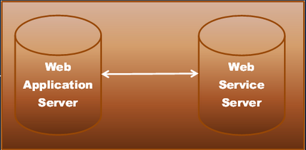
WCF Services
What are WCF services??
What are distributed app’s ?
A.K.A. Connected Systems

Slide 4
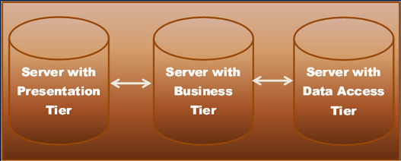
WCF Services
Another example of connected systems („Enterprise system”)
Why would we break-down app into different „tiers”?

Slide 5
WCF Services
What are interoperable app’s??
An app that can comunicate with any other app that is build on any platform
JAVA Maybe??
.NET Maybe??

Slide 6
WCF Services
So then...Why should we build distributed app’s??
Better use of other enterprise services (e.g. PayPal)
Better scalability
What other technologies we have to build distributive app’s?
Enterprise services
Web Services
.NET Remoting services
msnQ services

Slide 7
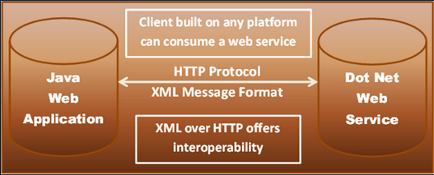
WCF Services
So why did Microsoft came up with WCF??
Example! 1st client demands...
Therefore we need to bulid a Web service (ASP.NET Web service maybe?)

Slide 8
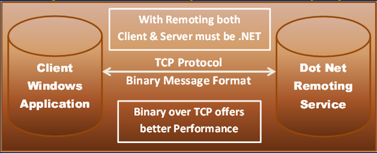
WCF Services
2nd client demands...
Therefore we need to build a .NET Remoting service!!

Slide 9
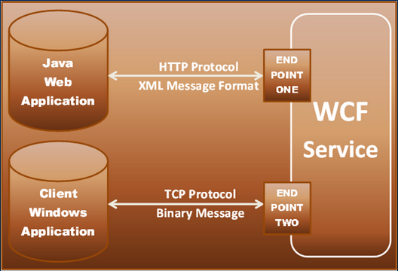
WCF Services
So why not this?

Slide 10
WCF Services
WCF is then represented as a differen programming model, and its whole purpose is to unify all this communication technologies under one roof!!
Enterprise services
Web services
WCF services
msnq services
.NET remoting

Slide 11
REST Services
What are REST services??
REST = Representational State Tranfer
Architectual style for designing networked app’s.
Communication using HTTP protocols which support CRUD operations (Create, Read, Update, Delete)
Based on representation of resources

Slide 12
REST Services
Why use REST??
ENTER THE REST!!
HTTP verbs
GET
POST
PUT
DELETE

Slide 13
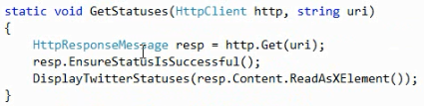
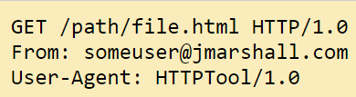
REST Services - HTTP verbs/methods
GET verb
Simlest HTTP method
Main job is to ask server for a resource.
Get method is for GETting stuff from server
In the get method, data we send is appended to the URL

Slide 14
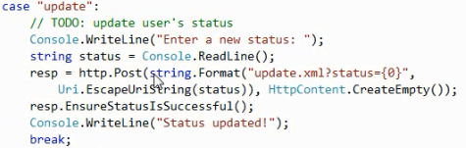
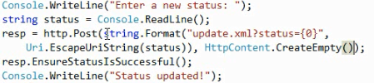
REST Services - HTTP verbs/methods
POST verb
Used to submit(post) data to be processed to the identified resource. (e.g. HTML form)
This data is included in the body of the request
This may resuslt in the creation of new resource, or update of existing resource, or both!

Slide 15
REST Services - HTTP verbs (basic)
PUT
Used to submit(post) data to be updated to the identified resource. (e.g. HTML form)
Like the POST method, the data is included in the body of the request.

Slide 16
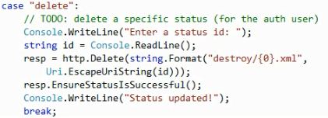
REST Services - HTTP verbs/methods
DELETE verb
Used to delete specific resource

Slide 17
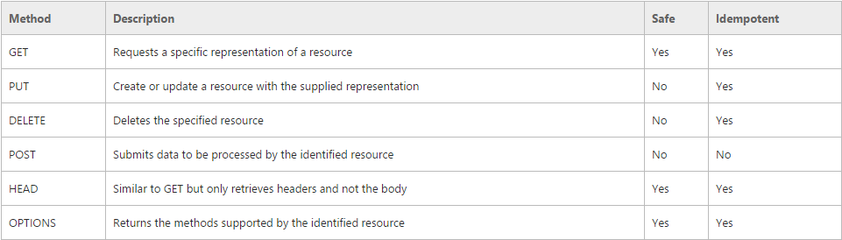
REST Services - HTTP verbs/methods
Some common HTTP Methods

Slide 18
Q’s
???

Slide 19
Thank you for your attention
☺

