Slide 1
MPRA case study

Slide 2
Variations in the non-coding genome
It has been estimated that 90% of variants identified in Genome-Wide Association Studies lie within the non-coding genome
Direct effect of variants is not as directly identifiable
Notes:
dificultad para identificar sus causas, evidentemente podrían ser regulatorias
necesidad de cosas high-throughput

Slide 3
Tools developed to address this question
DeepSEa
DeltaSVM
motifbreakR
HaploReg
atSNP search
SNP2TFBS
GWAS4D
…
Notes:
Desventajas: Running time, updates, not many orgs available, not possibility por PSSMs or one at a time.

Slide 4
variation-scan
Scan variant sequences with PSSM and report variations that affect the binding score, in order to predict regulatory variants
Scans sequences with PSSMs, using matrix-scan-quick, which assigns p-values to putative TFBSs.
variation-scan compares the values obtained from matrix-scan-quick
Main goal: Validation of variation-scan results with an MPRA
Notes:
Scan variant sequences with position specific scoring matrices (PSSM)
and report variations that affect the binding score, in order to predict
regulatory variants

Slide 5
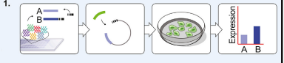
Massively Parallel Reporter Assay
Notes:
In MPRA, a library of thousands of putative regulatory DNA elements with coupled unique tags is synthesized and used to generate a pool of plasmids; this pool is then transfected into cells and the regulatory activity associated with the respective DNA element is assessed by sequencing the abundances of the expressed tags.

Slide 6
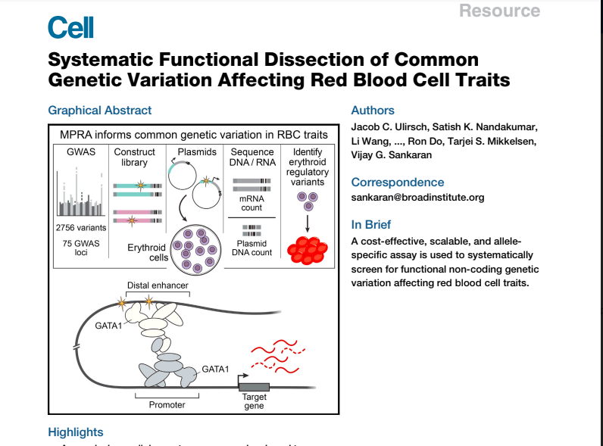
2756 variants in high LD (1000 genomes, CEU) with 75 variants associated with red blood cell traits

Slide 7
3 sliding windows to vary genomic context
14 unique barcodes per construct
inert ORF with minimal promoter
CONSTRUCT | TATA, ORF | BARCODE
Notes:
We modified a recently designed MPRA to screen medium-sized segments of DNA containing each variant of interest. For each allele, we synthesized constructs across three sliding windows (SWs), in order to vary the genomic context and maximize the chances of isolating key regulatory elements. Each construct was assigned 14 unique, designed barcodes. Constructs were ligated into a plasmid backbone, and an inert ORF with a minimal promoter (TATA) was ligated 3’ of the constructs and 5’ of the barcodes to produce the final pooled library of constructs

Slide 8
Transfected into K562 cells, RNA isolated and reverse-transcribed, PCR amplification, deep sequencing
DNA also isolated to determine relative abundance of each construct
Aggregated RNA/DNA ratio = quantification of construct activity

Slide 9
Observation: TF enrichment
Positive control variants that disrupt GATA1 were introduced.
KLF21, DHS, TAL1, ETS/FLI1, AP-1/NFE2, LDB1
Notes:
GATA1, KLF1*, DHS, TAL1, ETS/FLI1, AP-1/NFE2*, LDB1*

Slide 10
variation-scan
retrieve-variation-seq: used variants assayed in RBC MPRA
oligo-analysis: merged sliding windows for background model
matrices: TFs enriched according to article

Slide 11
To do:

