Slide 1
Figure 1 = Panels A–C
Panel | Content | Source
A | Data acquisition & preprocessing schematic | Manual (PowerPoint)
B | PCA + UMAP workflow + biological axis interpretation | Manual (PowerPoint)
C | Differential expression → pathway abstraction | Manual (PowerPoint)

Slide 2
A. Data acquisition & preprocessing Schematic
A. Data acquisition & preprocessing
— Raw expression
— Sample metadata
Preprocessing steps
— Normalization
Canonical outputs
— Processed expression matrices
Raw gene counts
(genes × samples)
• CRISPR CAR-T RNA-seq
• 60 samples
counts_num
Sample metadata
• donor
• guide (RHOG / SafeHarbor)
• activation time (hours)
metadata_samples.csv
analysis_utils/preprocessing.py
(implemented as reusable functions)
expr_logcpm_symbol.parquet
metadata_samples.csv
data/processed/
expr_logcpm.parquet
• ~60k genes
Standardized preprocessing ensures reproducible downstream PCA, UMAP, differential expression, and pathway analyses.
Normalization
• logCPM / log1p
• variance stabilization
— Gene harmonization
Gene ID harmonization
• ENSEMBL → HGNC
• drop unmapped genes
— Symbol collapsing
Duplicate symbol handling
• collapse ENSG → symbol
• mean expression per gene

Slide 3
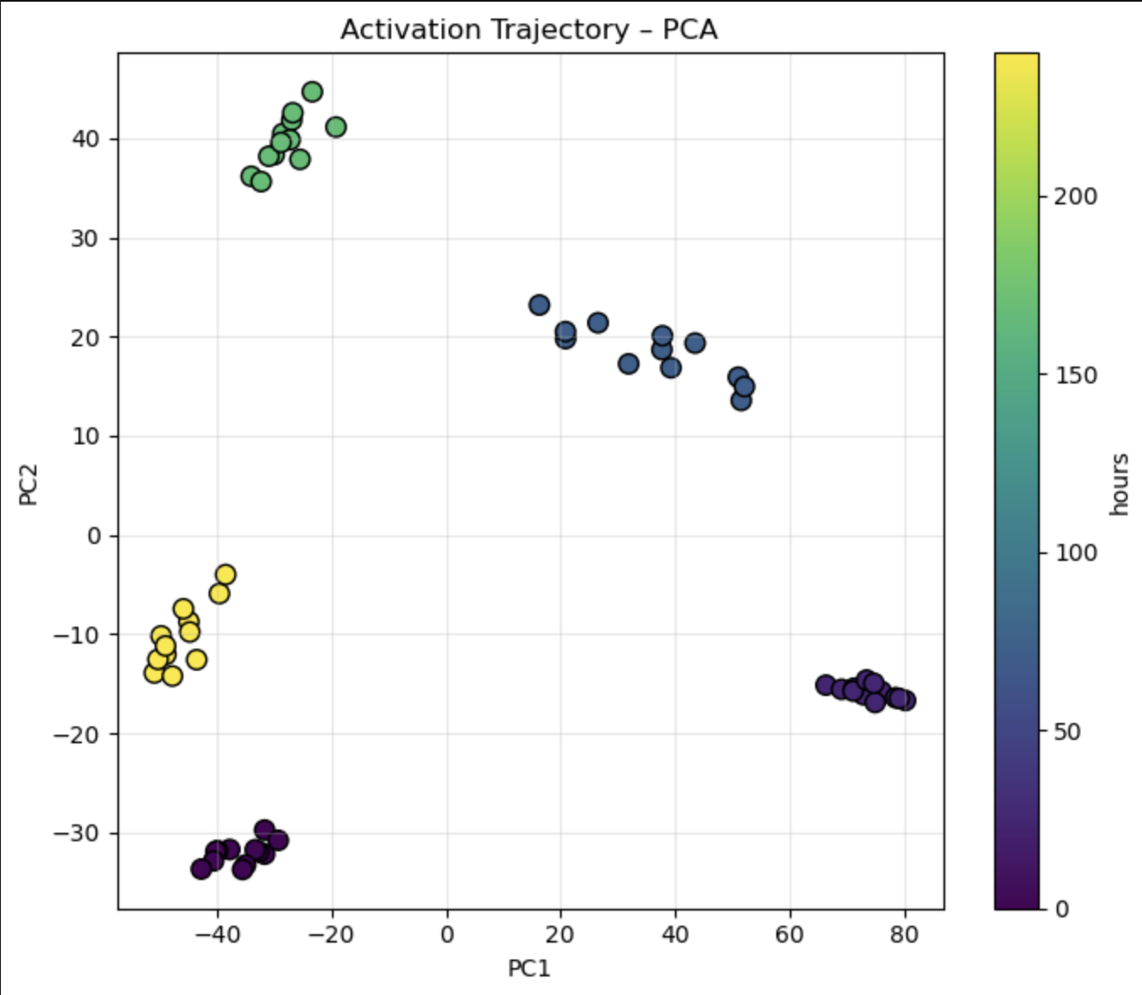
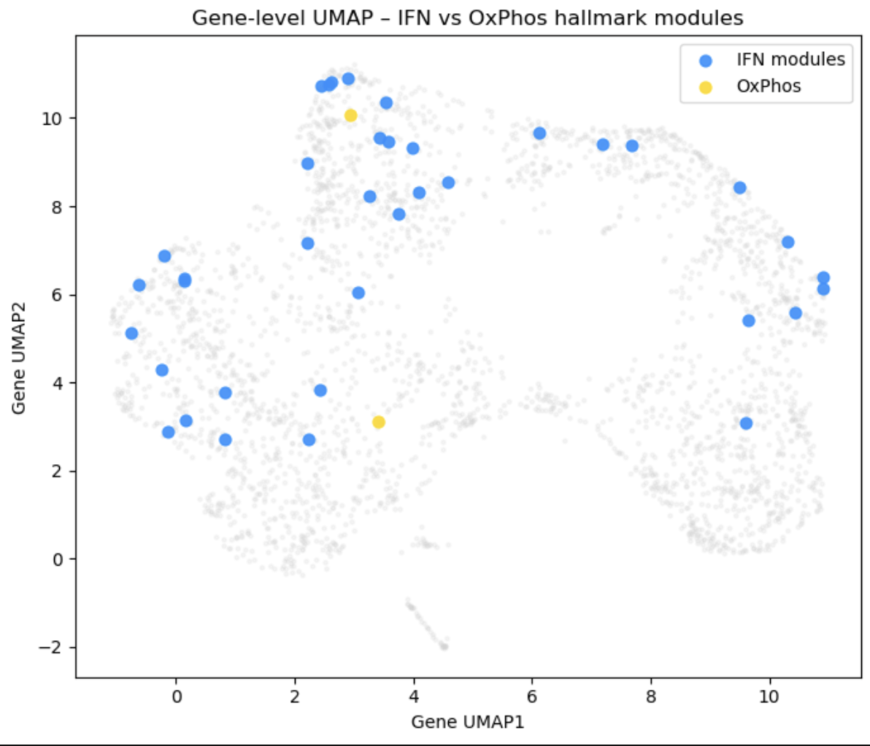
B. Low-dimensional representations for trajectory and structure analysis
Input
Symbol-level normalized expression
• logCPM expression • genes × samples
expr_logcpm_symbol.parquet
PCA computation-outputs PCA Biological Interpretation
of PCA axis
UMAP
Principal Component Analysis (PCA)
• samples × genes
• variance decomposition
analysis_utils/pca_utils.py
PC1: Effector IL2/STAT5 & NFκB activation ↔ Interferon-driven activation
PC2: Interferon stress ↔ Proliferative E2F / OxPhos programs
PC scores
(samples x PCs)
pca_scores.parquet
pca_loadings.parquet
PC loadings
(genes × PCs)
pca_scores.parquet
pca_loadings.parquet
Dimensionality reduction outputs
PCA figures (results/pca/)
UMAP figures (results/umap/)
Metadata with PCs (meta_with_pcs)
Reusable for DE, pathway scoring, and trajectory analysis
Activation trajectories
in PC space
Feature selection
• highly variable genes (HVGs)
UMAP embedding
UMAP (sample-level)
• nonlinear manifold learning
• preserves local structure
analysis_utils/umap_utils.py
UMAP outputs
UMAP coordinates
(samples × 2)
sample_umap_coordinates.csv

Slide 4
Input
Normalized expression + metadata
Differential expression analysis
Linear modeling of gene expression)
Differential expression tables
samples × genes
activation time
perturbation (RHOG / SafeHarbor)
Late vs Early activation
RHOG vs SafeHarbor (time-matched)
effect size: log2 fold-change
significance: FDR-adjusted p-values
analysis_utils/de_utils.py
Gene-level outputs
FDR
gene symbols
Saved as:
results/de/de_late_vs_
results/de/de_rhog_vs_safe_0h.csv
Volcano plots
Gene-level effect size vs significance
|log2FC| ≥ 0.5
FDR ≤ 0.2
Gene set construction
Downregulated genes
Ranked gene lists (log2FC)
Used for enrichment analysis
Pathway enrichment
Hallmark pathway enrichment (MSigDB)
Applied to:
Late vs Early (up / down)
RHOG contrasts (where relevant)
Focus on:
IL2–STAT5 signaling
Interferon α / γ response
Inflammatory response
Apoptosis
E2F targets
OxPhos
Pathway-level outputs
Program-level interpretation
bar plots of −log10(FDR)
pathway–PC correlations (from Panel B)
Saved to:
results/pathways/
enrichment tables
barplots
PC correlation heatmaps
contrasts:
log2FC
highlights strongest
Direction-aware gene sets
Upregulated genes
Enrichr / GSEA-style analysis
enrichment tables
logCPM (symbol-level)
differentially expressed genes
thresholds:
early.csv
Panel C – Differential expression → pathway abstraction

Slide 5
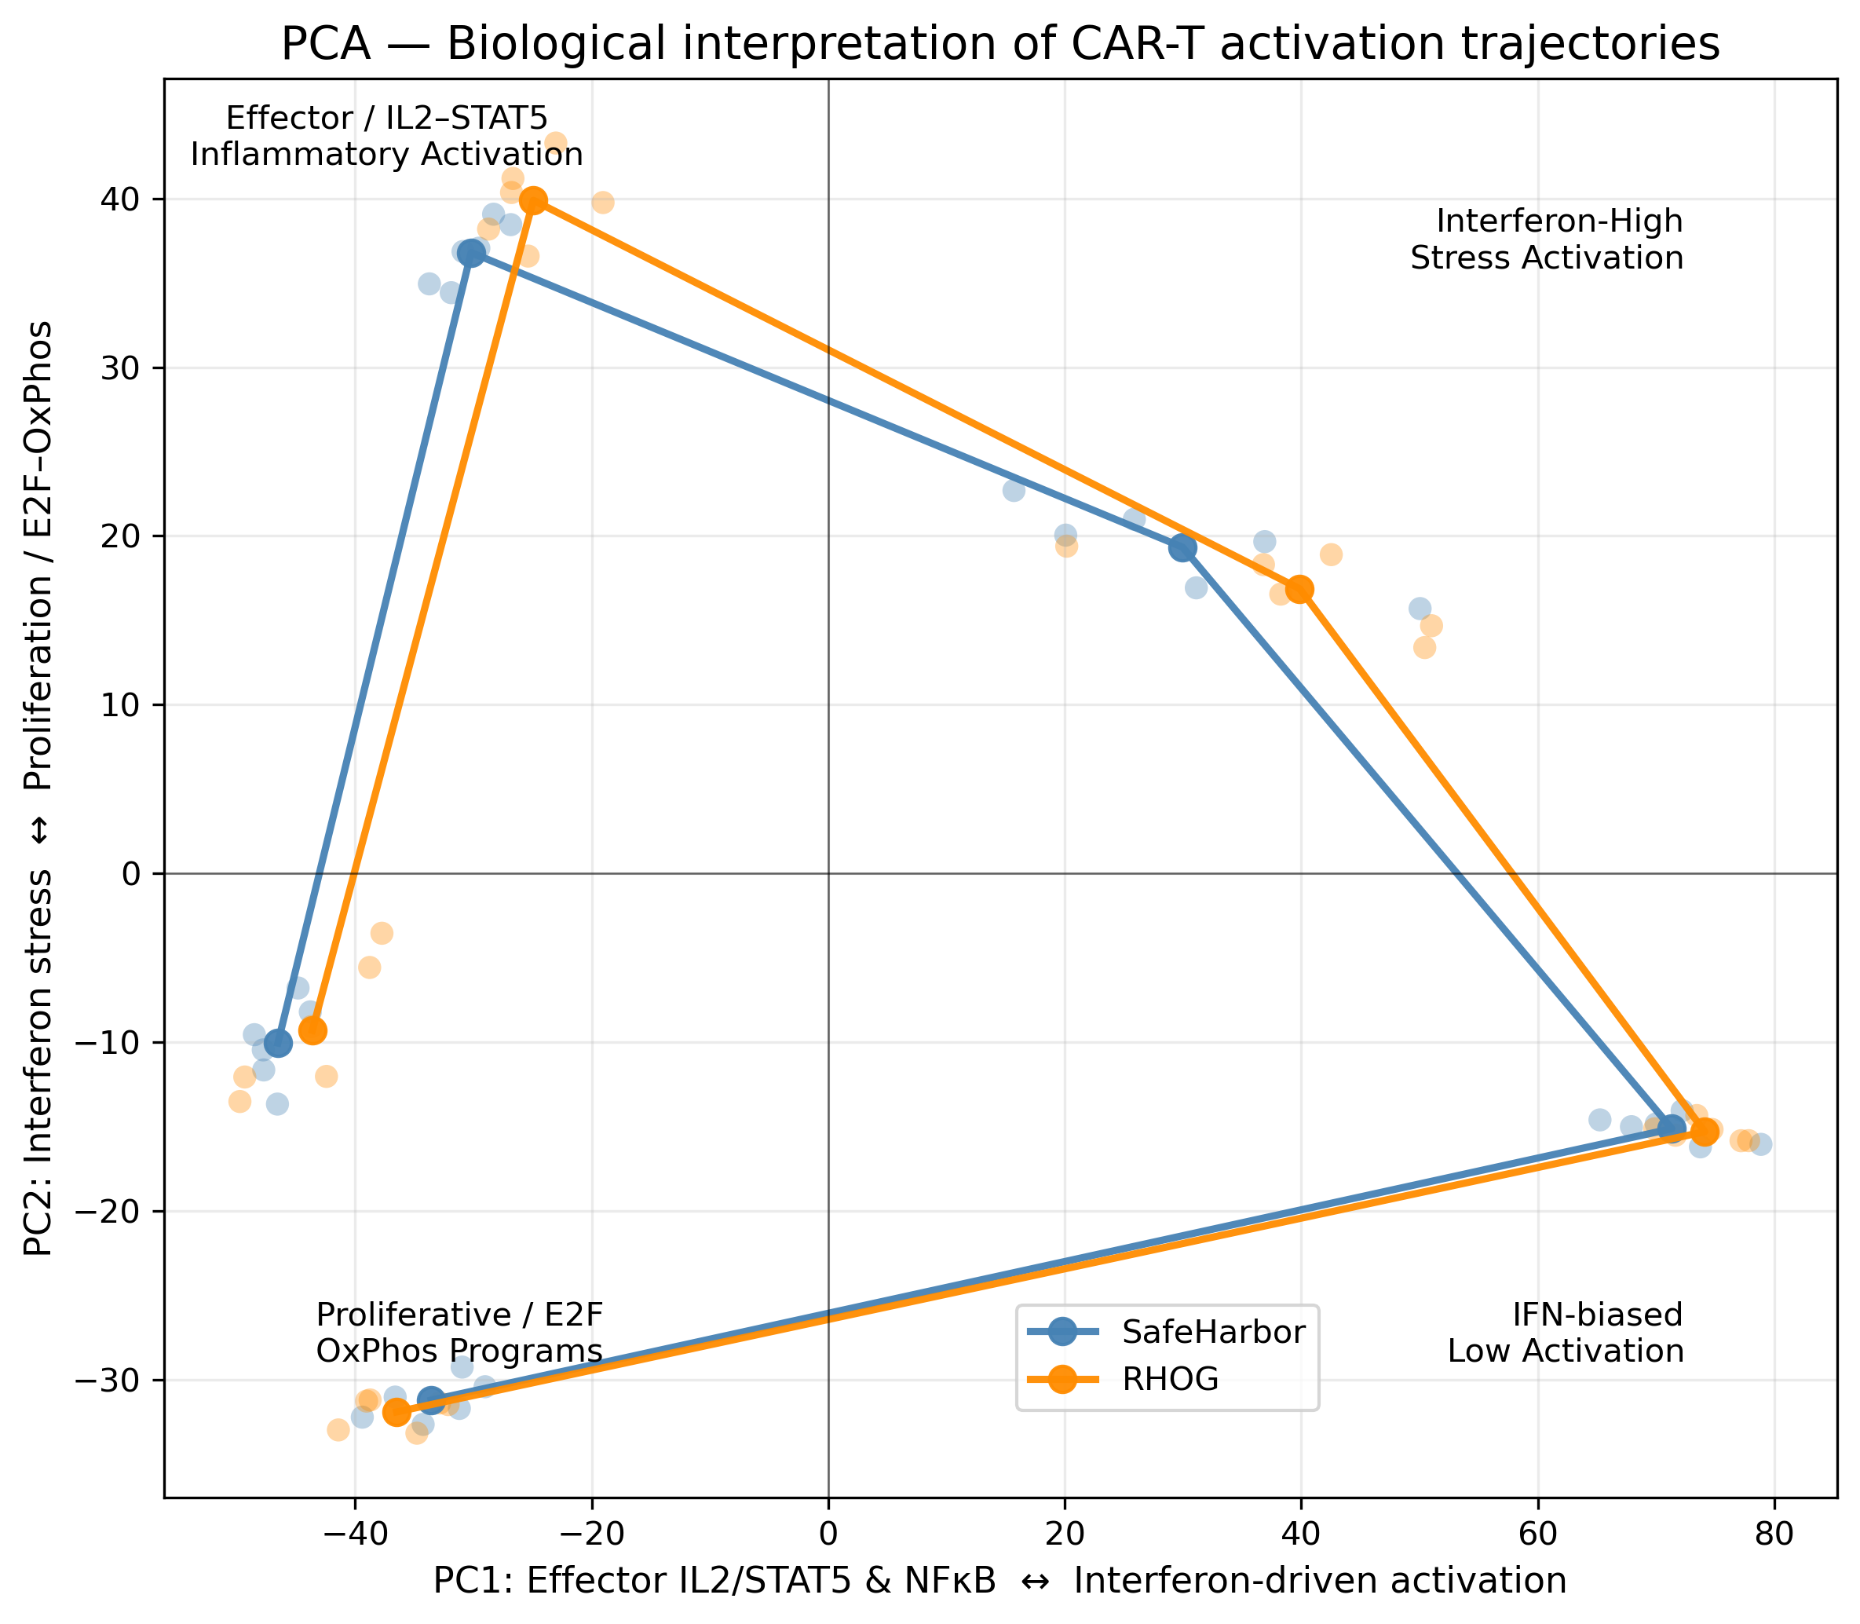
Panel D – Pathways & Module Scores

Slide 6
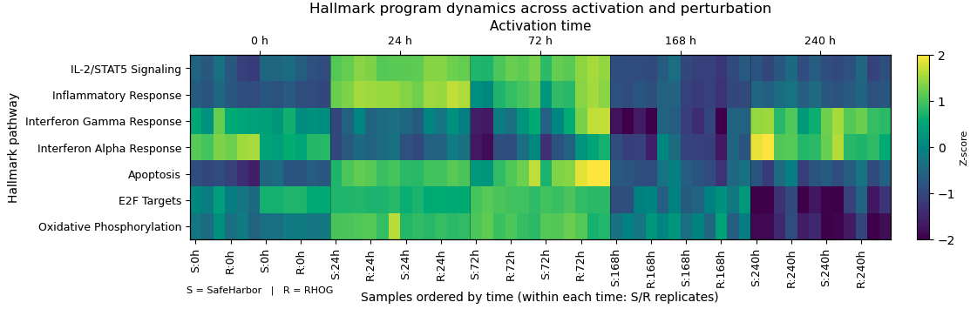
Figure A05. Hallmark pathway dynamics across CAR-T cell activation and RHOG perturbation.
Heatmap showing z-scored Hallmark pathway module scores computed from symbol-level logCPM expression across activation time (0–240 h). Samples are ordered by time, with SafeHarbor (S) and RHOG-knockout (R) biological replicates shown within each time point (n = 6 donors per condition per time). Across donors, CAR-T activation induces coordinated IL-2/STAT5, inflammatory, interferon, apoptotic, E2F, and oxidative phosphorylation programs, revealing a highly conserved temporal structure. RHOG perturbation subtly but consistently reshapes these trajectories, most prominently at late activation stages, highlighting pathway-level effects that are robust to donor-to-donor variability.

