Slide 1
SALES ANALYSIS
Team 6

Slide 2
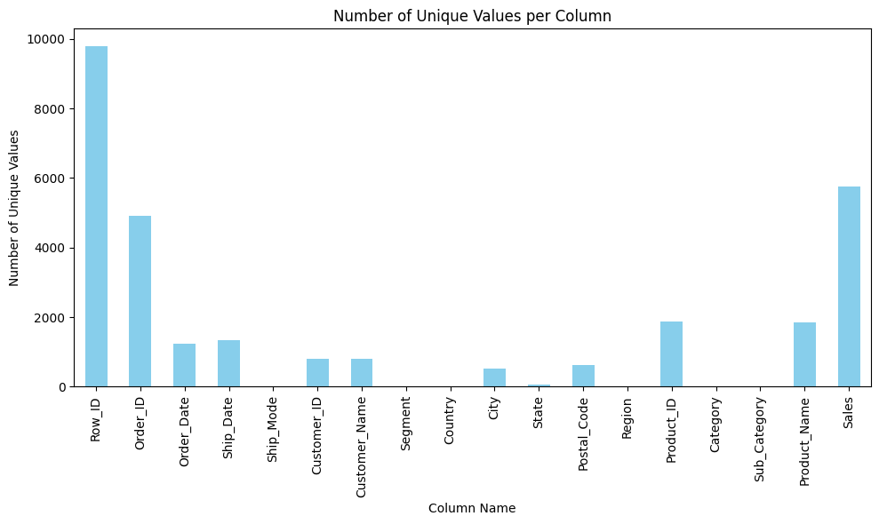
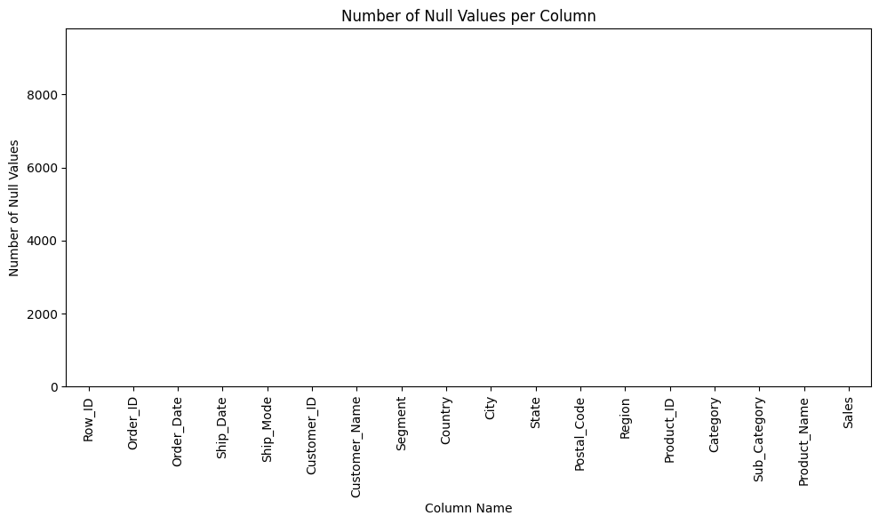
General Analysis
# | Column | Dtype
1 | Row_ID | int64
2 | Order_ID | object
3 | Order_Date | Date
4 | Ship_Date | Date
5 | Ship_Mode | Category
6 | Customer_ID | object
7 | Customer_Name | object
8 | Segment | Category
9 | Country | Category
10 | City | Category
11 | State | Category
12 | Postal_Code | Category
13 | Region | Category
14 | Product_ID | object
15 | Category | Category
16 | Sub_Category | Category
17 | Product_Name | object
18 | Sales | float64
1 Numerical Column
9 Categorical Columns
2 Date Columns
5 Object Columns
Row_ID, Order_ID, Customer_ID and Product_ID are Identifier Columns
9800 Records

Slide 3
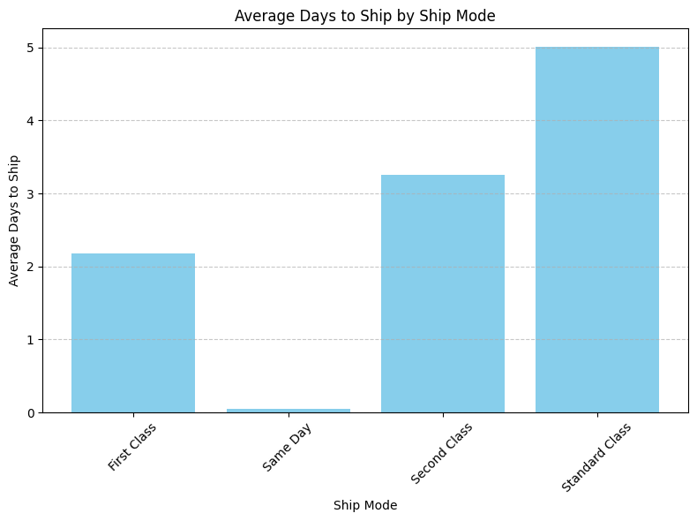
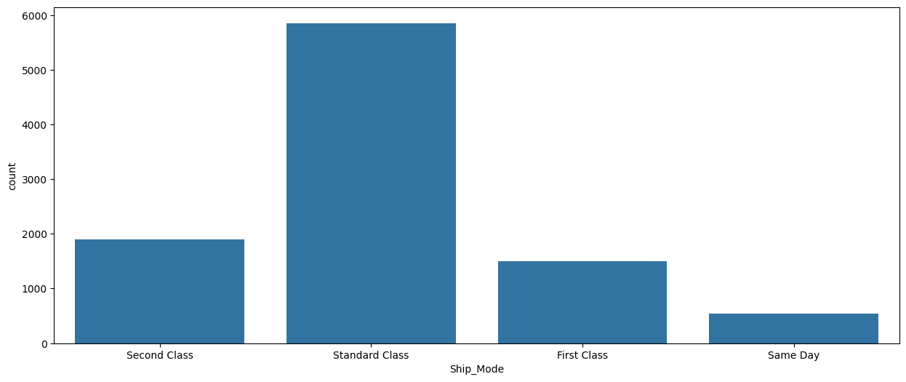
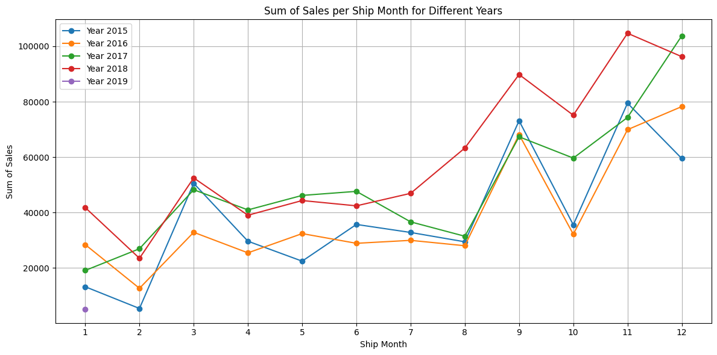
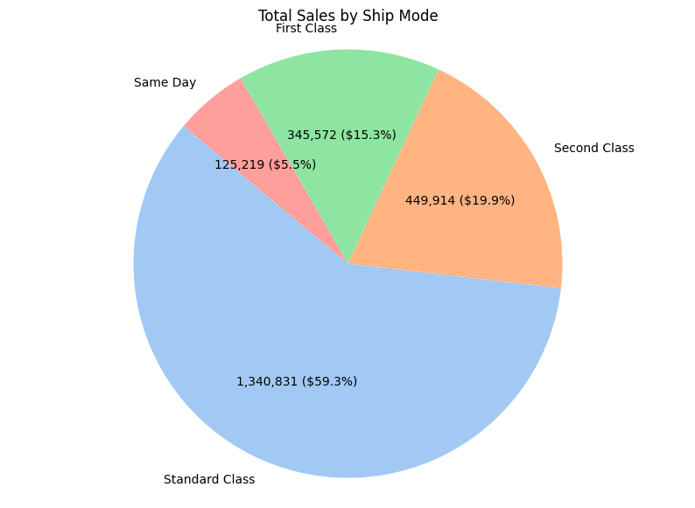

Column Analysis: Ship Mode – Customer Id
The Standard Class takes an average of 5 days, followed by Second Class, which takes an average of 3 days, and Same Day, which explains itself!
Standard Class represents 59.3% of the sales, which suggests that customers prefer that mode of transportation.
Therefore, we can say that December is the month of the year with the highest sales!

Slide 4
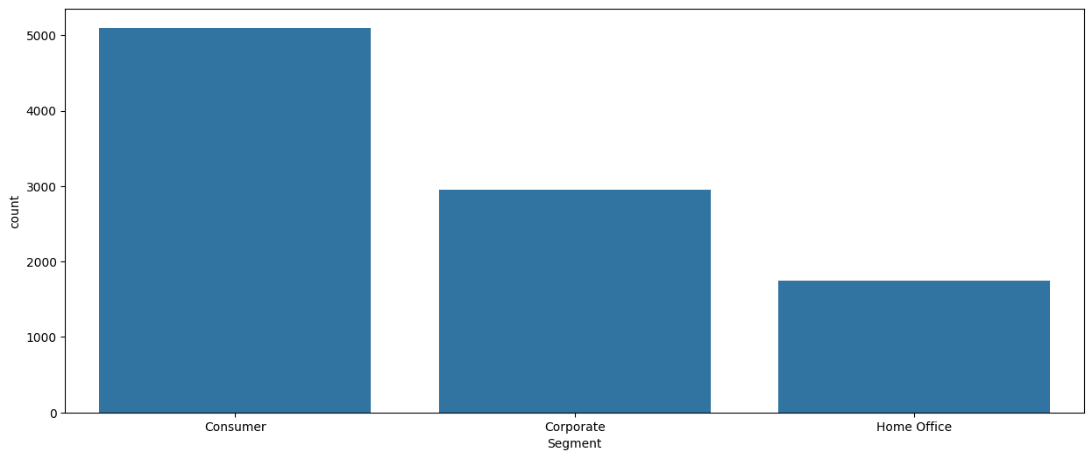


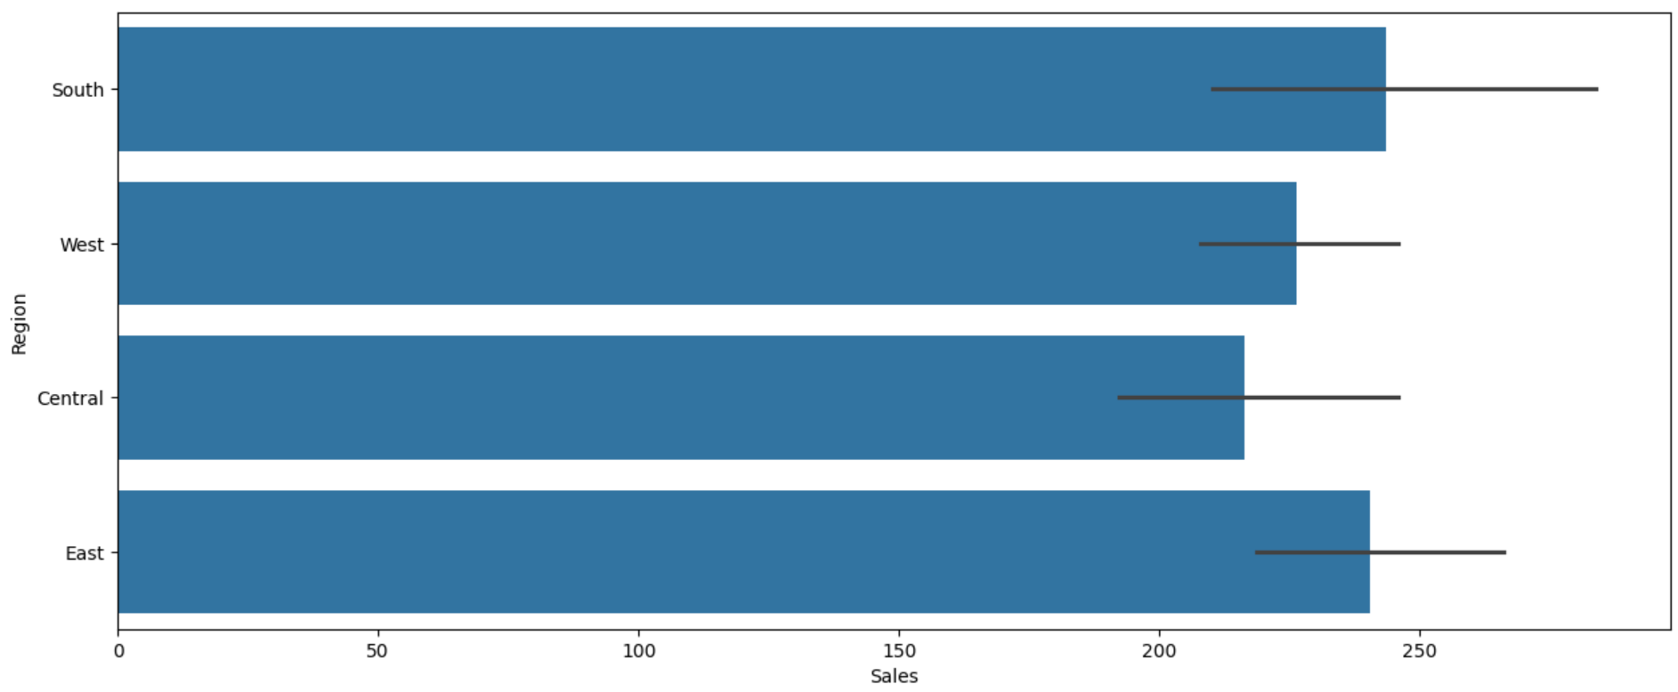
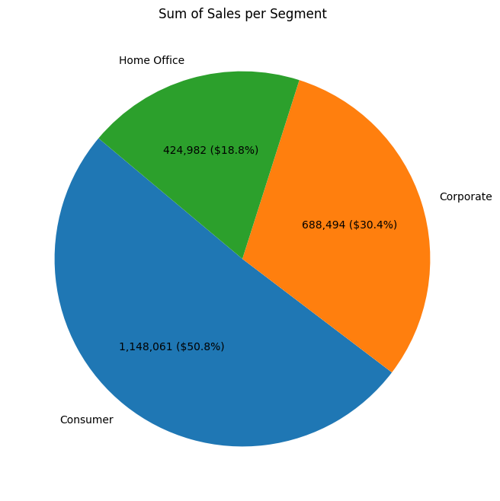
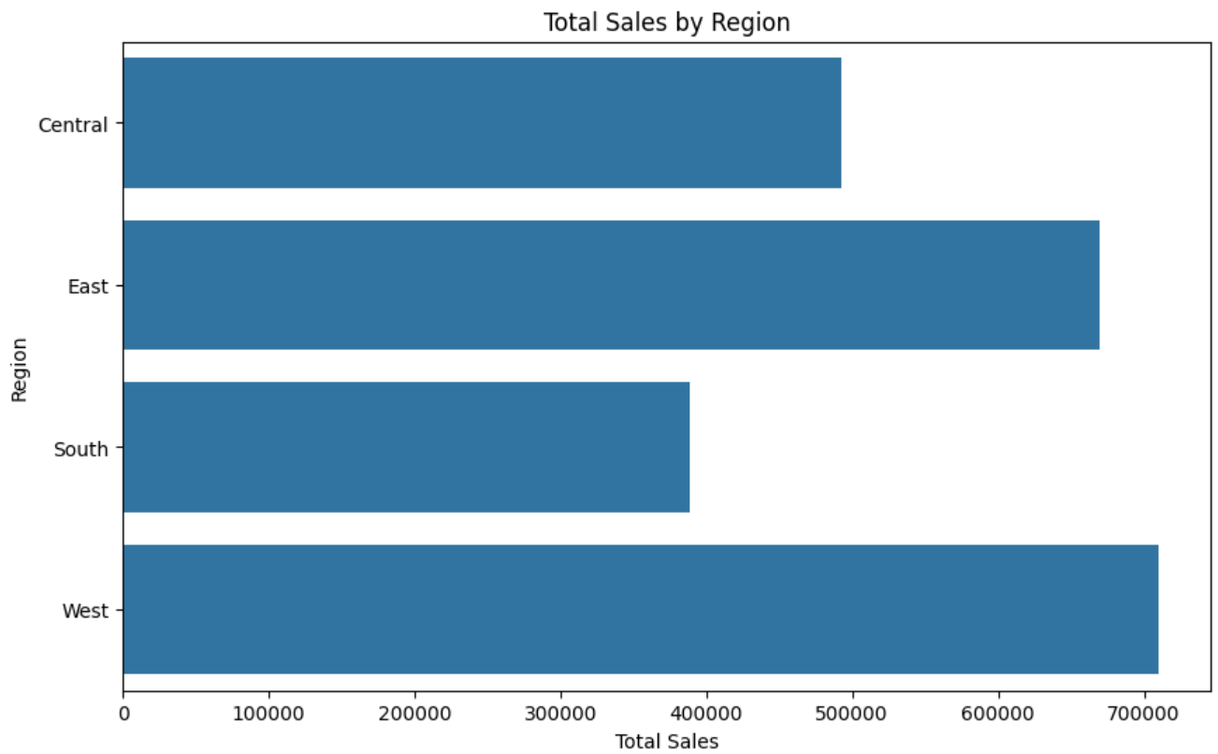
Column Analysis: Segment – customer id
AA-10315 | Alex Avila
AA-10375 | Allen Armold
The customer ID contains information about the customer's name
Customer Type represents 50.8% of the sales, followed by the Corporate Segment and Home Office.
Although the South Region has the highest number of orders, the West Region generates the most sales in terms of revenue. The East Region has the second-highest number of orders and also ranks second in sales revenue.

Slide 5
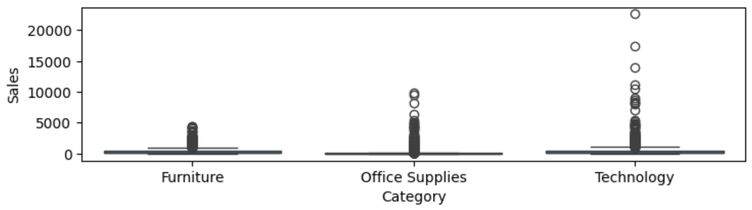
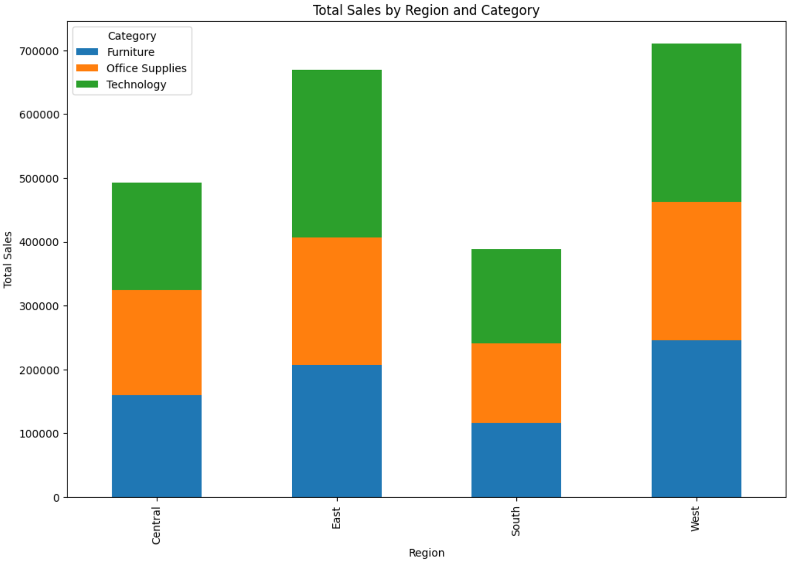
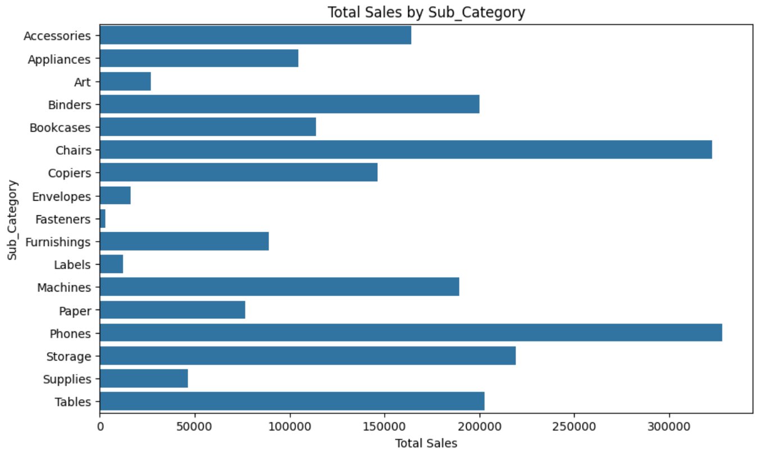
ANALYSIS PRODUCTS
FUR-BO-10001798 | Furniture | Bookcases
FUR-CH-10000454 | Furniture | Chairs

Slide 6
ConcluSion
Missing Quantities: The dataset lacks information on the quantities required for each product, which is essential for understanding demand and inventory needs.
Operational Costs: Details on the operational costs for shipping the products are missing, making it difficult to assess the full cost structure.
Additional Costs: Any other associated costs that were not included in the dataset also need to be provided for a comprehensive analysis.
Without this missing information, it will be challenging to accurately predict sales and provide effective solutions. We advise obtaining the complete data to enable a more precise analysis and better recommendations.

