Slide 1
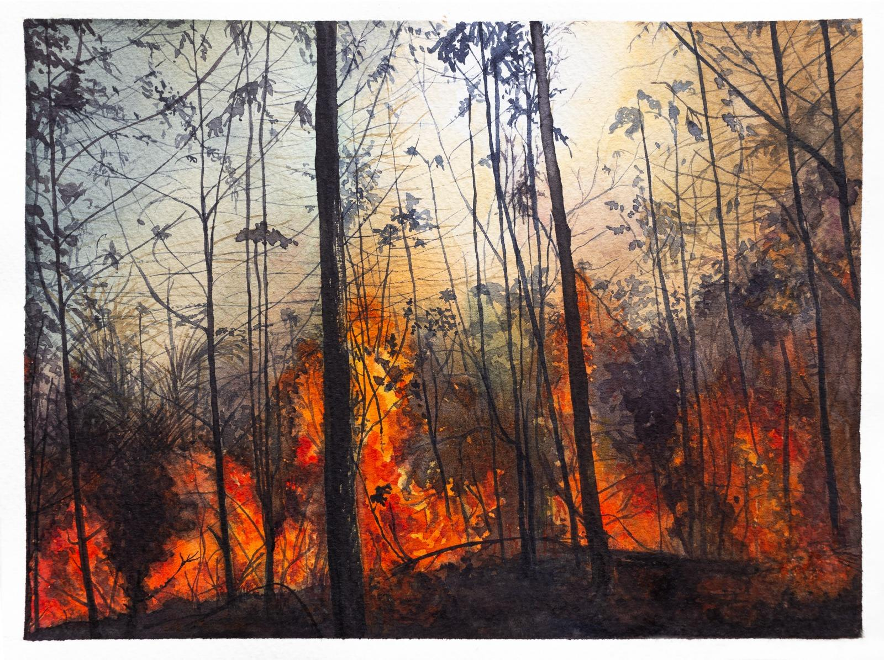
Predicting US Wildfires
Ana Cahet Rachel Star

Slide 2
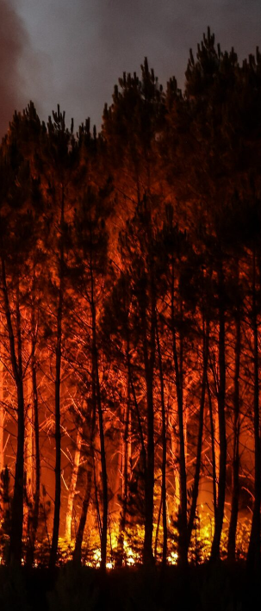
INTRO

Slide 3
Datasets
Final - Working file
Main - Wildfires, location, dates, duration, size, cause, etc
Merged and cleaned dataset
Year range | 2000 - 2020
Wildfires count | 1.7 million
Location | Continental US (48 states)
https://www.kaggle.com/datasets/behroozsohrabi/us-wildfire-records-6th-edition?select=data.csv
Complementary - Weather and topography info
https://www.kaggle.com/datasets/cdminix/us-drought-meteorological-data
Notes:
Final dataset had no records of: Alaska (AK), Connecticut (CT), Hawaii (HI)

Slide 4
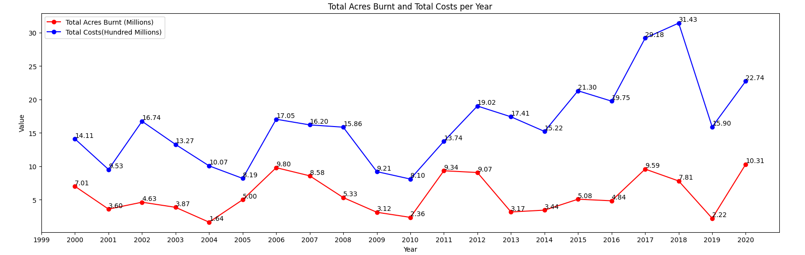
Problem
Wildfires impact
Human: health, lives, property
Wildlife: ecosystems, biodiversity
Costs:
Avg. Acres per year: 5.7 million
Avg. Spent per year: US$ 1.6 billion
https://www.kaggle.com/datasets/dylanfox10/federal-wildfires-acres-cost-temp-19852020
Notes:
Human: effects of smoke from wildfires can range from eye and respiratory tract irritation to more serious disorders, including reduced lung function, bronchitis, exacerbation of asthma and heart failure, and premature death
Wildlife: The aftermath of wildfires often alters vegetation structure and composition, impacting habitat availability for various species. High-intensity wildfires can dramatically reshape ecosystems and reduce biodiversity
Costs: acres top 1 - 2020 with 10.31 millions acres burnt
Financial top 1 - 2018 3.1 billion dollars - COST JUST TO PUT OUT FIRE, NOT INCLUDED PROPERTY DAMAGE, ETC

Slide 5
Objectives
Understand trends of wildfires and climate in the US
Use machine learning/deep learning models to predict the CAUSE of the wildfires:
Help solving undetermined causes (27%)
Lead to more prevention opportunities, saving money, lives & environment
Notes:
Determining a wildfire cause can range from relatively straightforward (when reported by the responsible party) to extremely challenging (in remote areas), involving a process of eliminating natural and accidental causes through investigation of the point of origin, burn patterns, weather data, and witness interviews, etc. And to complicate matters, sometimes there may not be enough evidence to eliminate more than one cause, so “ undetermined” becomes the cause.

Slide 6
OVERVIEW

Slide 7
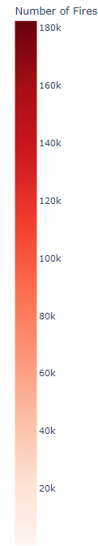
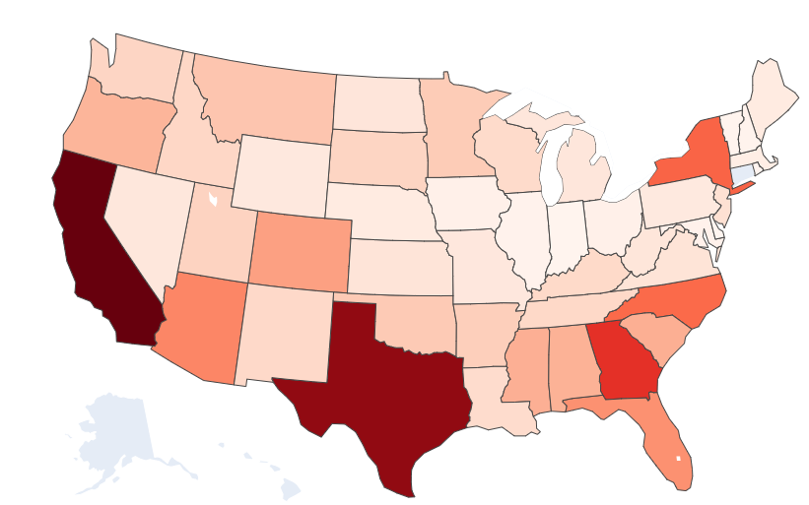
Wildfires x State
California - 182k
Texas - 167k
Georgia - 121k
New York - 94k
North Carolina - 91k
Notes:
Total wildfire count - over the course of 20 years
Interestingly, California, holding the top position with 182,000 wildfires, exhibits nearly twice the number of wildfires compared to North Carolina, which ranks fifth with 91,000 wildfires.

Slide 8
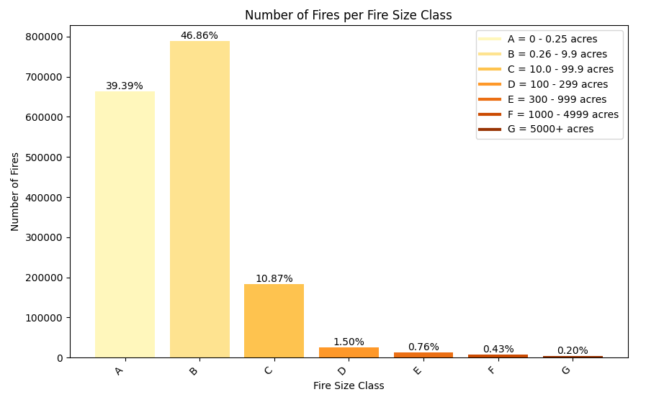
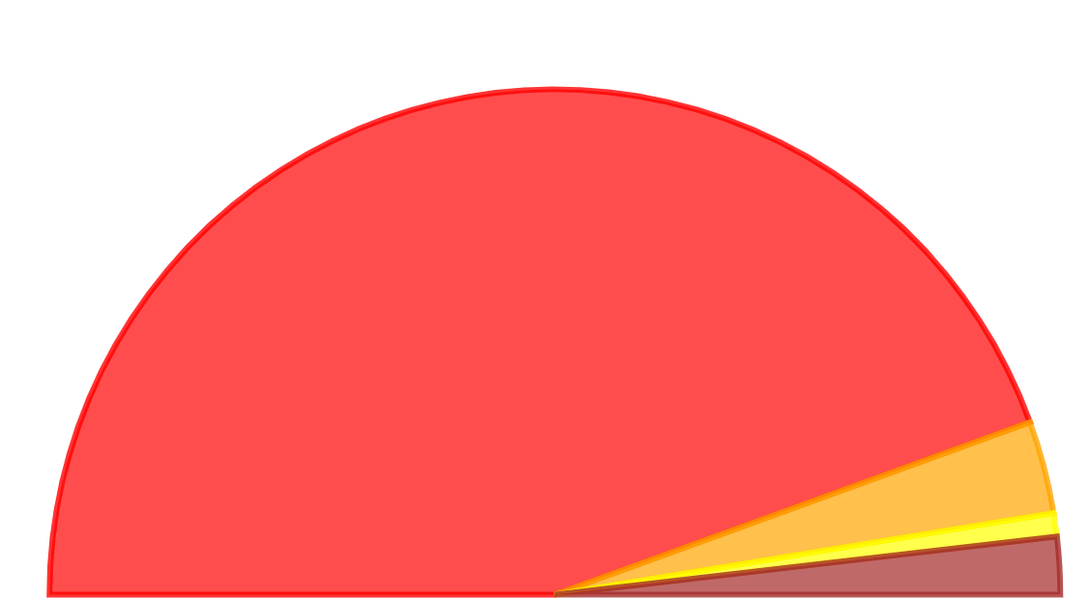




Size & Duration
Majority of fires:
“Small” - 86,25% < 10 acres
Put out the same day ( ≈ 90%)
Wildfire duration in days
88.9 %
5.9 %
1.5 %
3.7 %
Notes:
Single fire that lasted longer took almost a year to be put out: 364 days
Single fire the burnt more acres: 662,700 (megafire: more than 100,000)

Slide 9
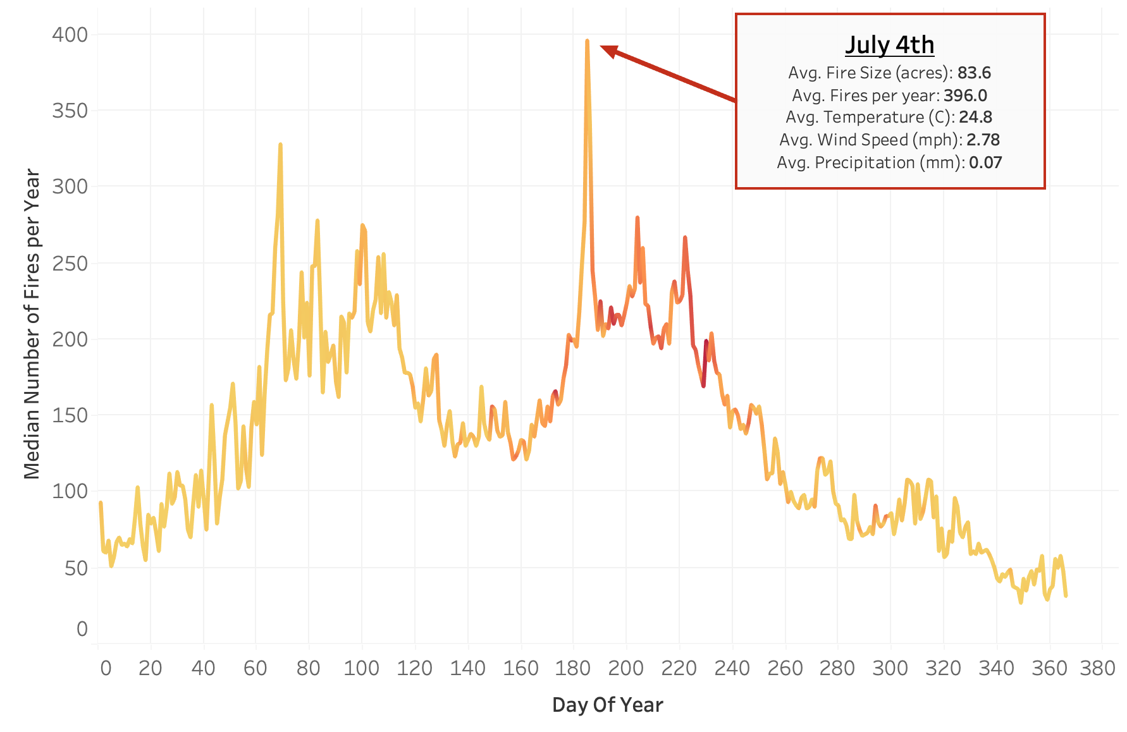
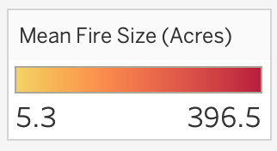
Seasonality
Notes:
Graph examines the median number of fires per year against the day of the year - clear peak in number of fires at 4th of July
Perhaps odd to see a peak in Springtime, but the temperatures will begin to climb whilst precipitation is still relatively low
The largest fires happen in the summer months

Slide 10
Data Cleaning
Feature Engineering/Editing
Data Modelling
Removing unnecessary columns
Joined datasets, removed fires missing climate data
Cleaned categorical variables
Filled in NA’s based on other data
Encoded and ‘categorised’ necessary categorical features
Combined categorical groups based on confusion matrices created by models
Refined imbalanced dataset using under- and over- sampling methods.
We ran and evaluated various models, using them to refine the dataset and determine the best model:
Logistic regression
Decision Tree
Neural Network
Random Forest
Notes:
Examples of unnecessary columns:

Slide 11
MODELS

Slide 12

Logistic Regression & Neural Networks
A type of algorithm utilized for prediction by assuming a linear relationship between the input features (columns) and the output classes
It assigns weights (coefficients) to the different features, enabling a clear understanding of their impact on the prediction
Considered a white-box baseline model, logistic regression serves as an excellent starting point due to its simplicity in interpretation. It establishes a benchmark for evaluating more sophisticated models
Inspired by the functioning of the human brain, a neural network comprises interconnected nodes (neurons) organized in layers
As a deep learning model, neural networks are more complex, also assigning weights to input features and utilizing various activation functions
Logistic regression can be conceptualized as a single-layer neural network. Logistic functions are often used as activation functions in neural network hidden layers
temperature
temperature
arson
arson
wind
wind
natural
natural
date
date
fireworks
fireworks
location
location
LR function
Input (features)
Output (classes)
Input (features)
Hidden Layers
Output (classes)

Slide 13
Decision Tree
Day of Year
> 150
Whitebox model
Model splits data based on conditions for each ‘node’, until a classification can be made
First, calculates the ‘root node’
Then, refines values, orders, and levels
Fire Year
< 2009
County, State
< 2
Fire Size
< 0.1
Temp
>15
Precip
< 0.3
Natural
Arson
Smoking
Natural

Slide 14
Data Input
Random Forest
Arson
Natural
Arson
Random Forest Prediction: Arson
An ‘ensemble’ of decision trees
Each tree is built using a different random sample of the dataset
Each tree may predict a different class for a data point
The ‘majority class’ prediction will be returned as the random forest output
Majority Class: Arson

Slide 15
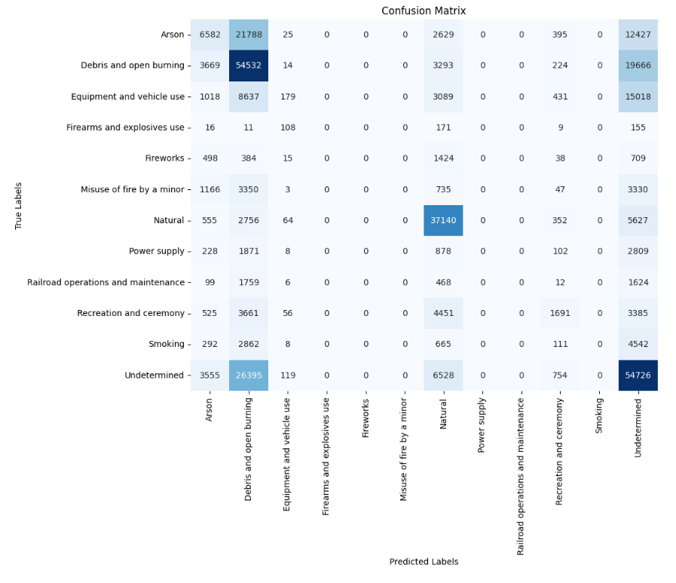
Confusion Matrix
Neural network/logistic regression - 1st attempt
True vs Predicted
Was not able to predict: ‘Firearms’, ‘Fireworks’, ‘Minor’, ‘Smoking’…
Most of predictions mapped to ‘Undetermined’

Slide 16
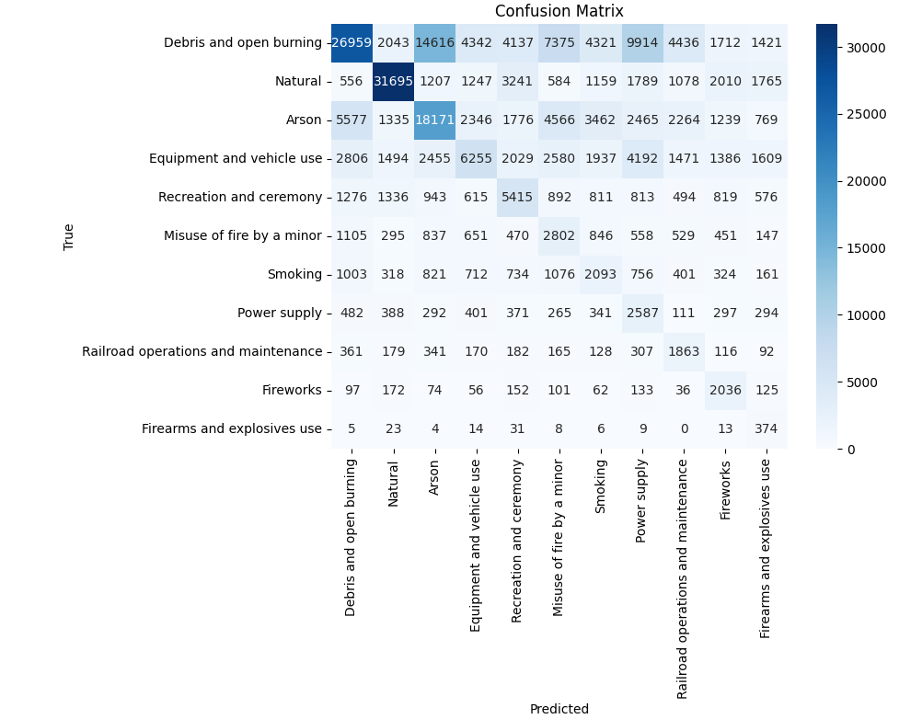
Confusion Matrix
Balanced Random Forest
Identify where categories are being mis-labelled
Allows us to adjust categories by combining them
Leads to improved model performance

Slide 17
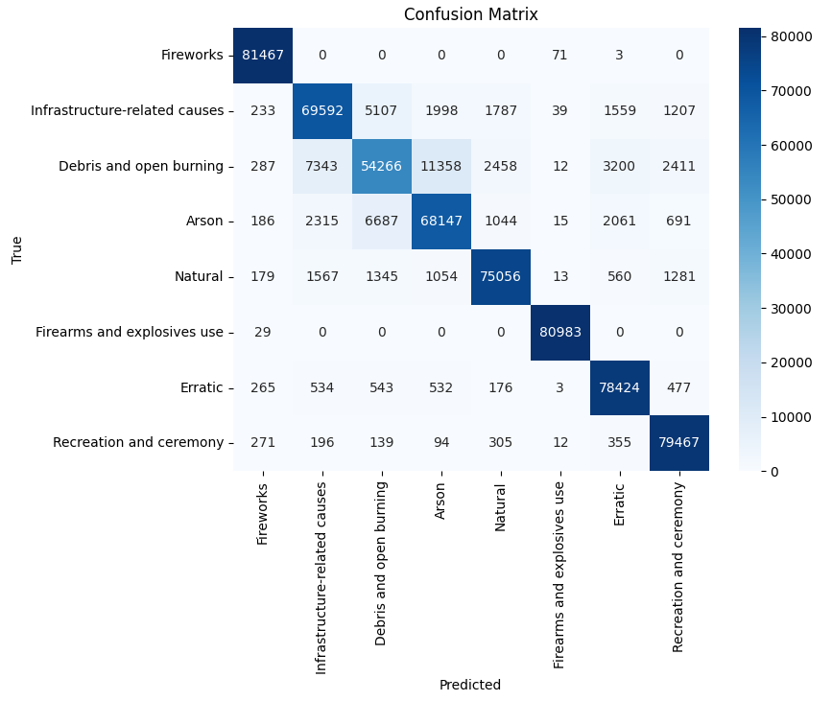
Confusion Matrix
Random Forest model with Over-sampling
Clearly shows better classification

Slide 18
Models
An evaluation metric which combines measures of precision (how well the model can identify an instance of a class) and recall (how well the model can identify all instances of a class).
Model | F1-Score
Logistic Regression | 0.37
Decision Tree, with ‘oversampling’ | 0.87
Neural Network | 0.57
Balanced Random Forest, with ‘oversampling’ | 0.64
Random Forest | 0.59
Random Forest, with ‘oversampling’ | 0.90
A method to balance sample size of categories, by creating false data for categories of smaller sample size.

Slide 19
Target variable: NWCG General Cause
Initial Causes
Final causation groups
Arson
Debris and open burning
Firearms and explosives use
Fireworks
Natural
Recreation and ceremony
Arson
Debris and open burning
Firearms and explosives use
Fireworks
Natural
Recreation and ceremony
Equipment and vehicle use
Power generation/transmission/distribution
Railroad operations and maintenance
Infrastructure-related causes
Misuse of fire by a minor
Smoking
‘Erratic’ - erratic behaviours
Other causes
Missing data/not specified/undetermined)
Undetermined (removed)

Slide 20
Random Forest Model Evaluation
Feature | Importance
Day of Year | 0.14
Elevation | 0.13
County, State | 0.12
Temperature | 0.11
Wind Speed | 0.10
Fire Size | 0.09
Precipitation | 0.08
Fire Year | 0.08
State | 0.08
Day of Week | 0.05
Duration | 0.02
Class | f1-score
Arson | 0.83
Debris and open burning | 0.73
Erratic behaviour | 0.94
Firearms and explosives use | 0.99
Fireworks | 0.99
Infrastructure-related causes | 0.85
Natural | 0.93
Recreation and ceremony | 0.96
How important the data features are in determining the right class
How well each class can be predicted

Slide 21
CLASSIFICATION INSIGHTS

Slide 22
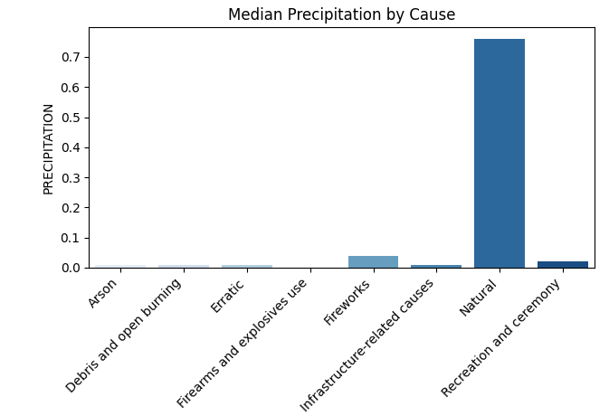
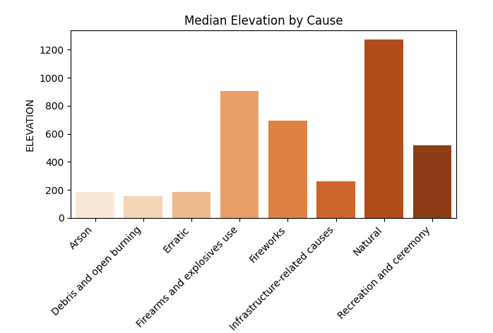
Precipitation & Elevation
General
Human-related fires: drier weather
Natural fires: higher elevation
Notes:
As expected the great majority of the fires occurred with no precipitations, but here we can see a difference between natural and human-related
Elevation, second most important feature (out of 11) and we can see there’s a clear distinction in the median elevation for each type of fire. With natural fires happening in more elevated areas, followed by firearms and explosives and fireworks

Slide 23
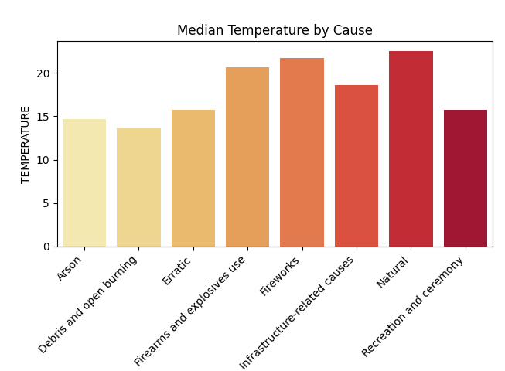
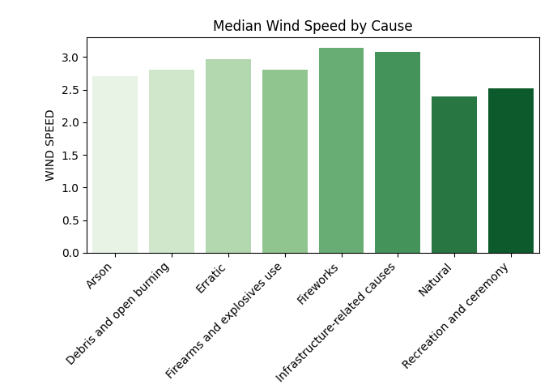
Temperature & Wind
General
Human-related fires: higher wind speed
Natural fires & Fireworks: higher temperature
Notes:
Wind speed: not so clear distinction as the features in the previous slide, most fires occur at 1-4 m/s. But we can see that human-related fires occurs with slightly higher winds
Temperature (4/11 in importance): there’s also a clear distinction, with Natural and fireworks occurring in higher temperatures

Slide 24
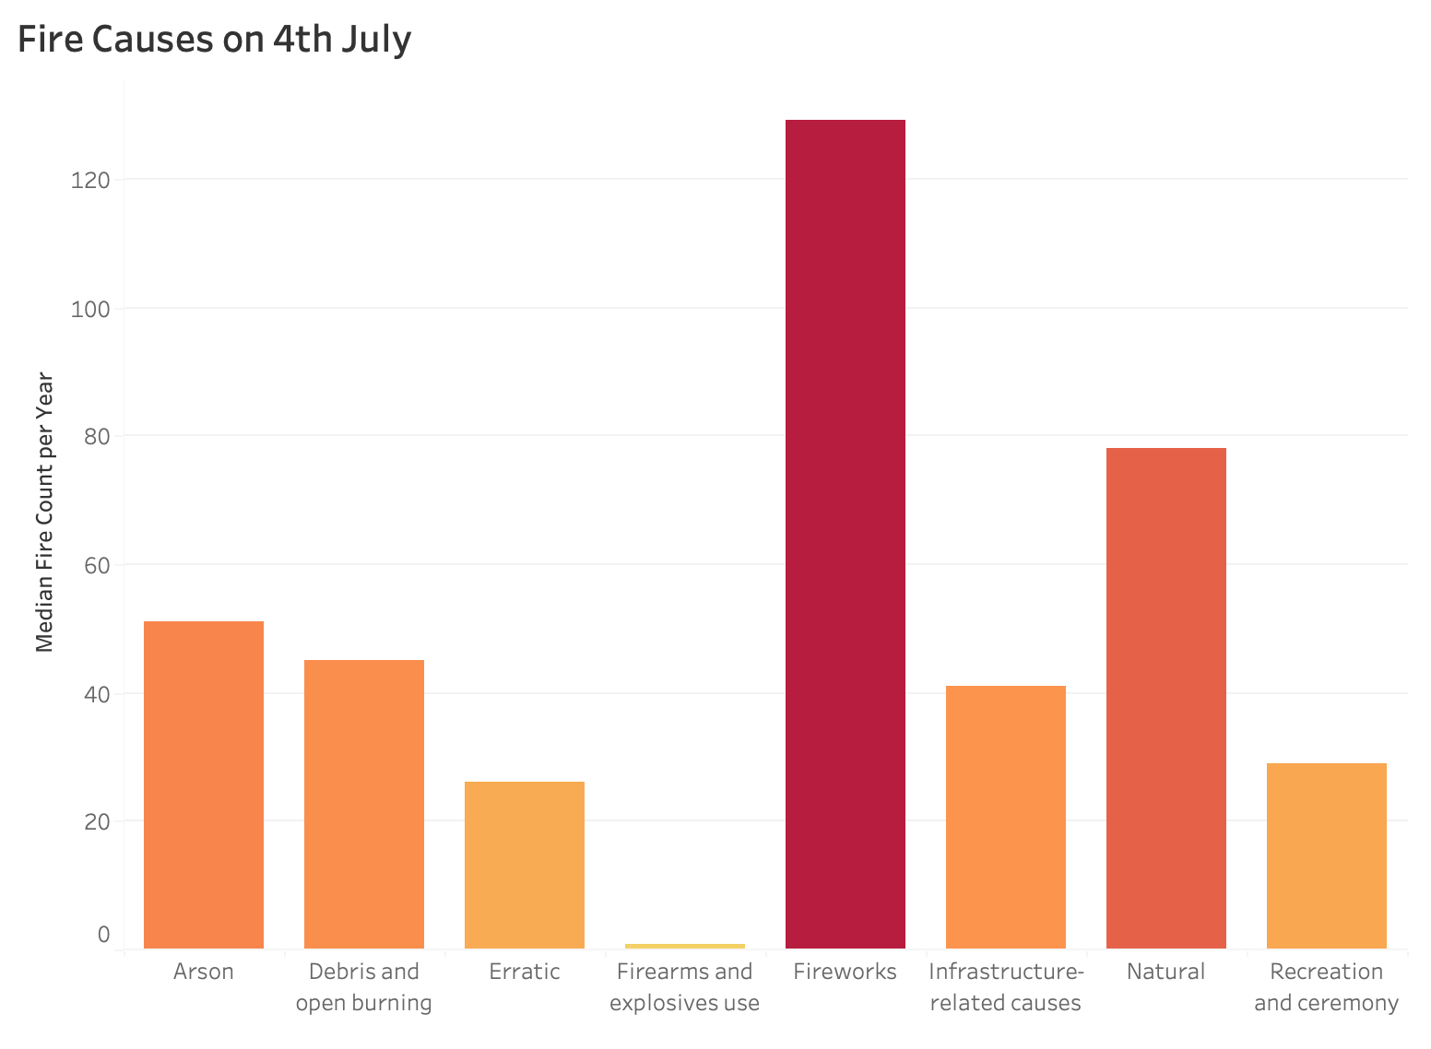
4th of July… Fireworks!
Specific
A
Notes:
On that note, here we can see why Fireworks fires occur mostly on 4th of July, one of the warmer months.

Slide 25
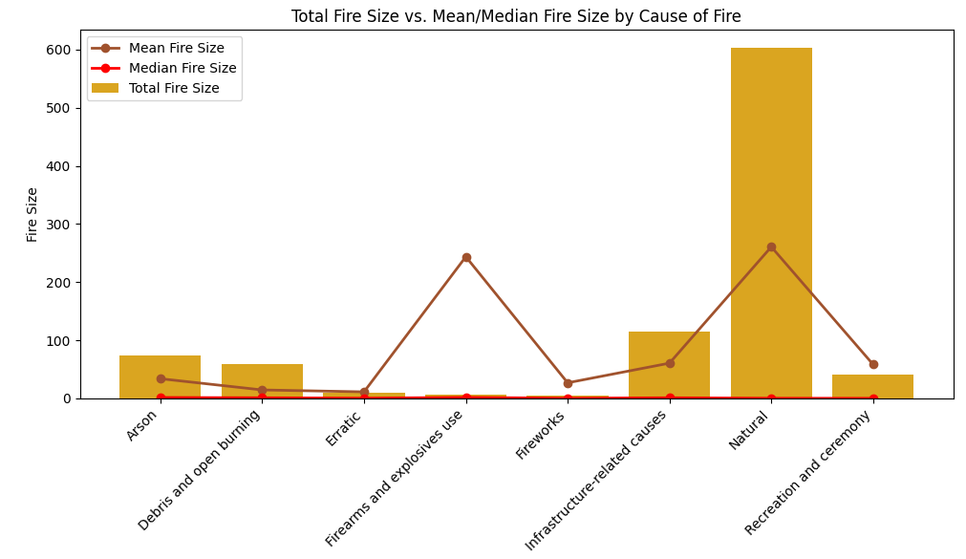
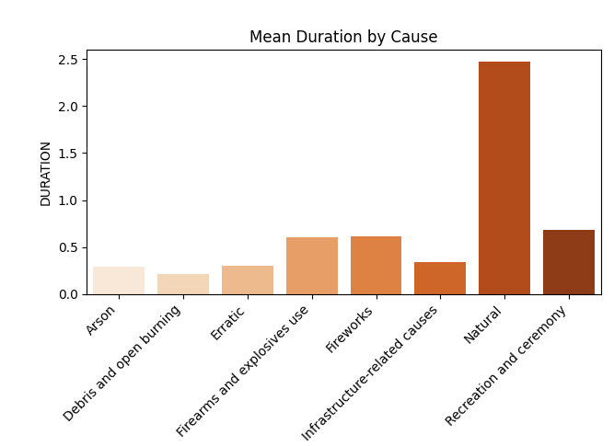
Size & Duration
General
Firearms & Explosives tend to generate bigger fires
However, in total, Natural fires burnt more acres and, on average, are harder(take longer) to put out

Slide 26
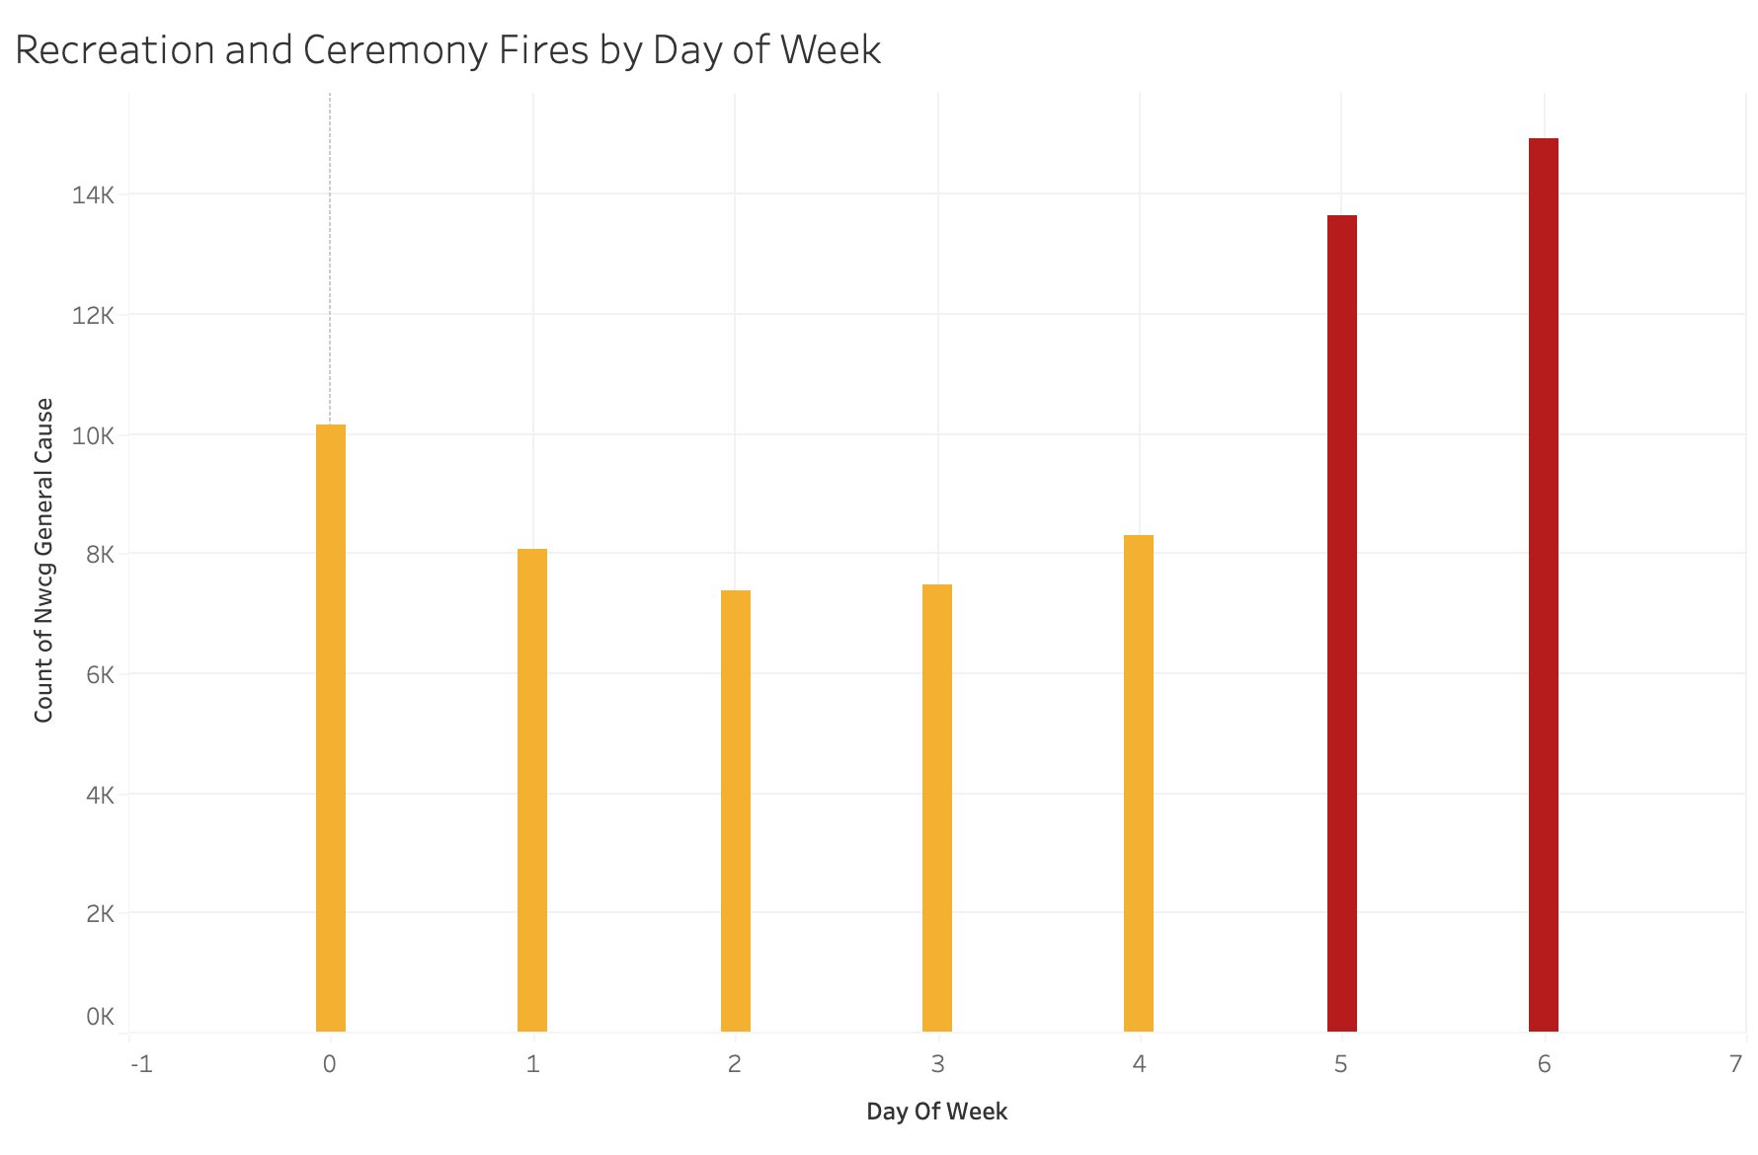
Recreation & Ceremony
Specific
Recreational fires exhibit twice the frequency of occurrence between Sunday (highest - 14k) and Wednesday (lowest - 7k)
In contrast, other fire causes do not demonstrate such notable variations between different days of the week
A
Mon
Tue
Wed
Thu
Fri
Sat
Sun

Slide 27
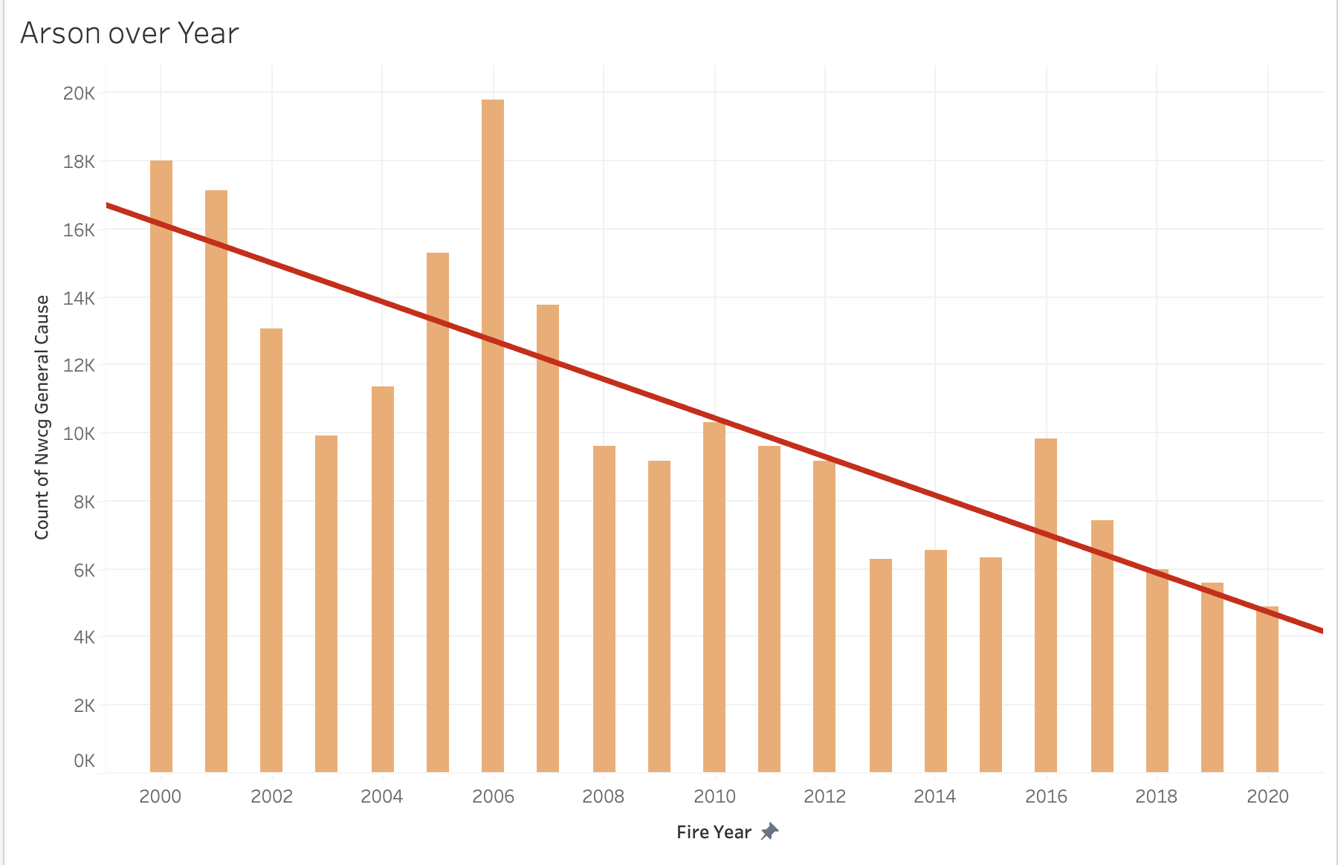
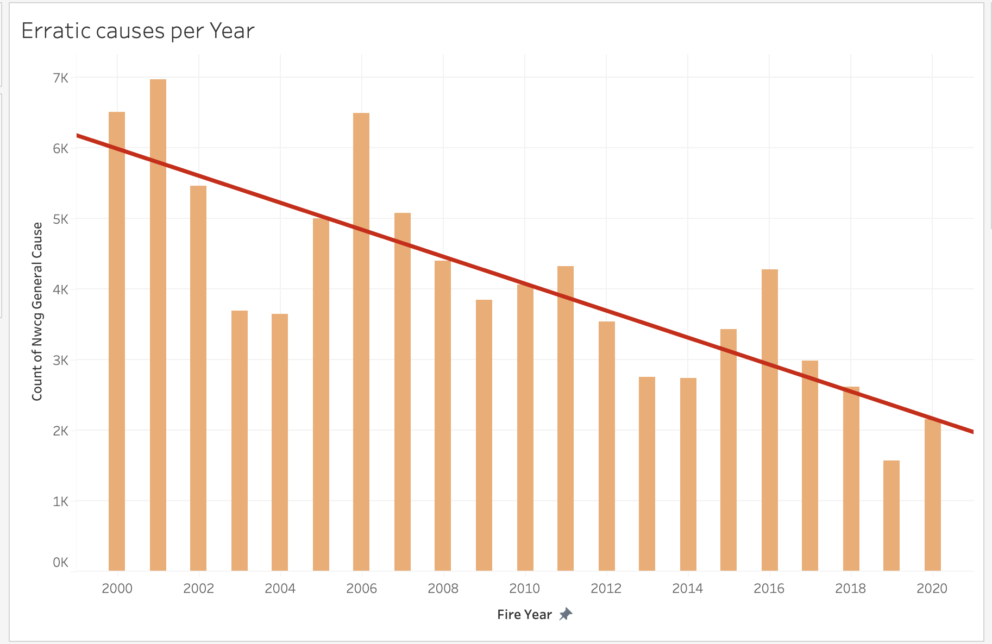
Arson & Erratic Over Years
Specific
Significant decline in the occurrences of two causes:
Arson: Potentially attributed to its classification as a felony, punishable by imprisonment and fines.
Erratic (Smoking + Minor): Potentially influenced by a decrease in the number of people smoking.
Other wildfire causes fluctuated but not so significantly

Slide 28
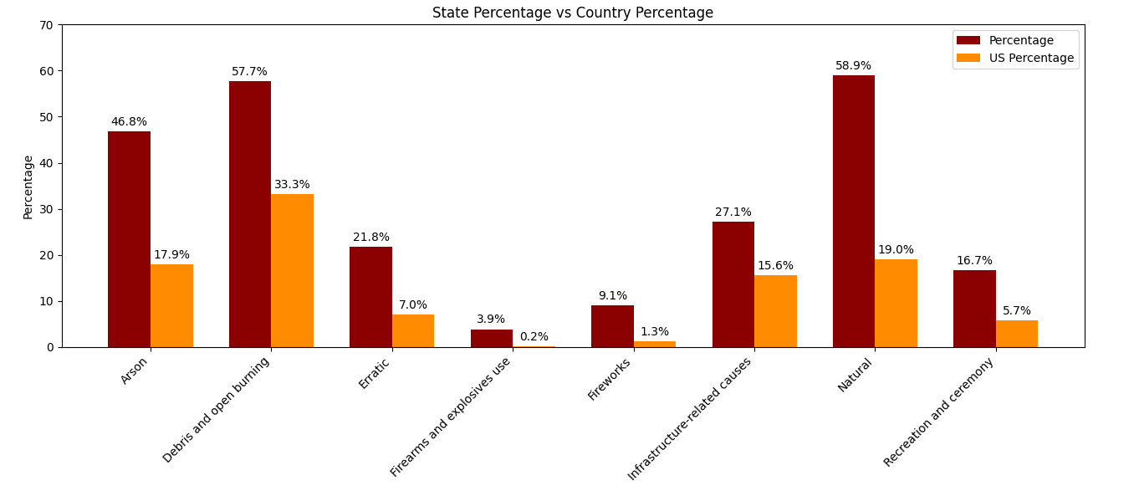
State-wise info
Specific
Washington
South Dakota
Idaho
Oklahoma
Georgia
New Jersey
Michigan
Utah
Notes:
This illustrates the disparity between the overall percentage of fire causes and their distribution within individual states. For instance, while Natural causes constitute 19% of the total number of fires nationally, they account for over half of the fires in Utah. A similar pattern is observed for Debris and open burning in Georgia (the third state with the most fires) and Arson in Oklahoma (the tenth state with the most fires).

Slide 29
APPLICATION & PROSPECTS

Slide 30
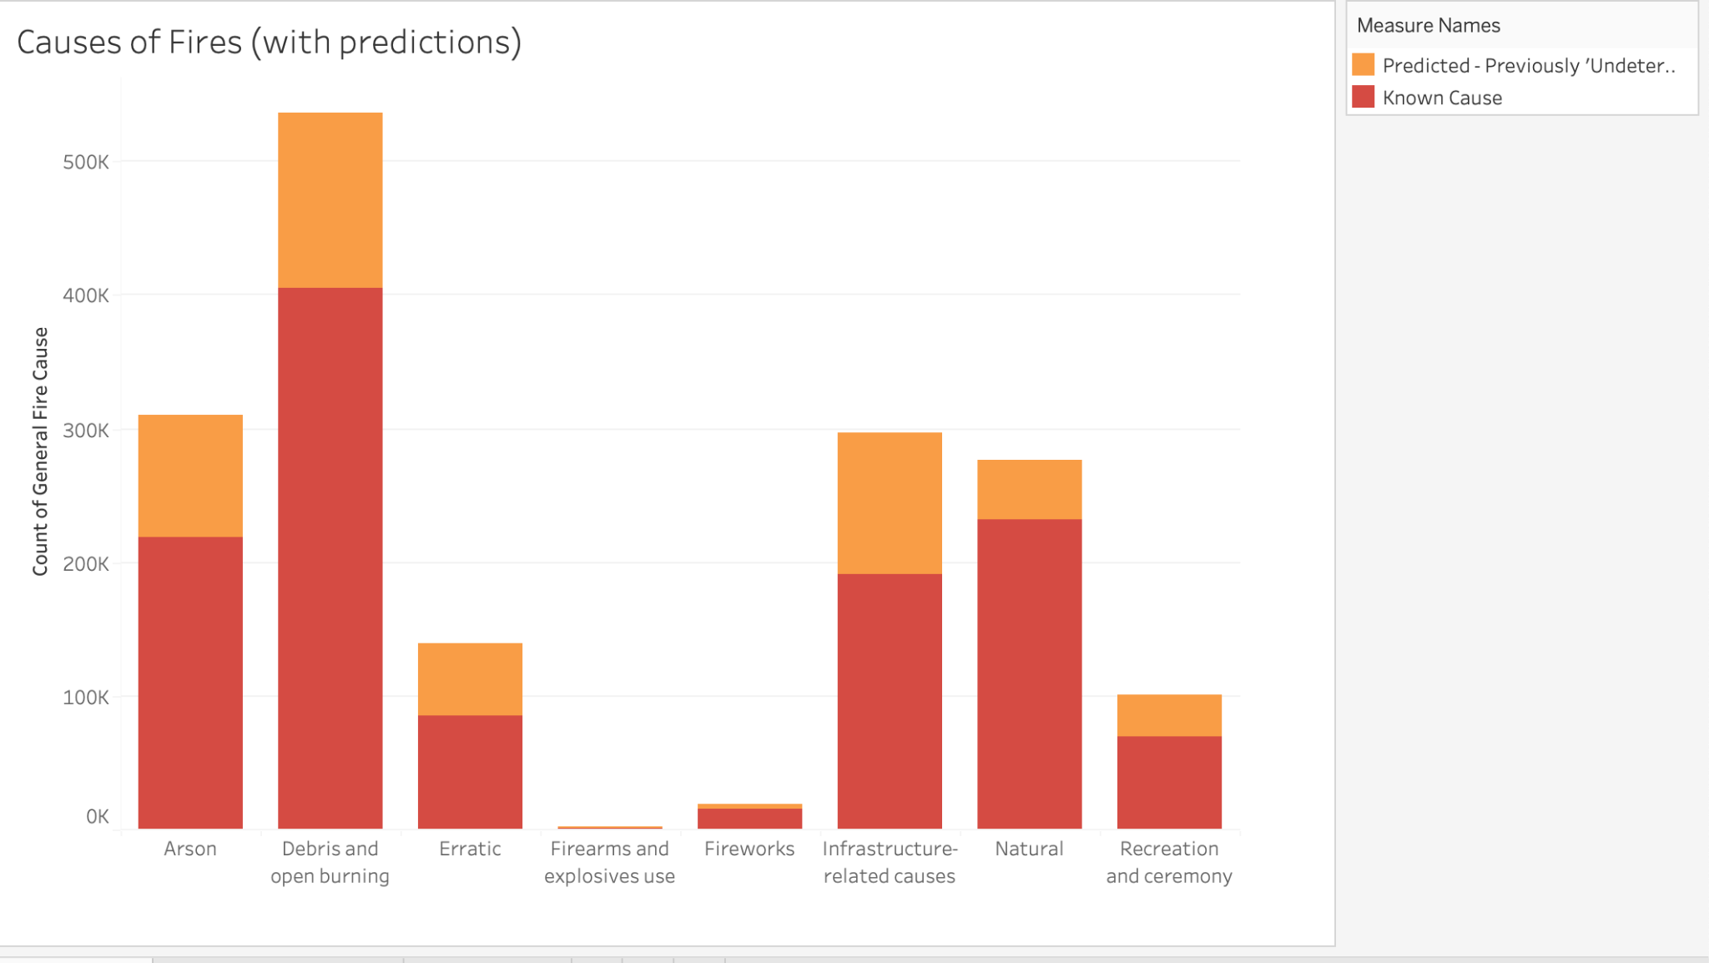
Example of model use
Predicting the ‘undetermined’ data removed earlier
Good distribution of these predictions

Slide 31
Conclusions
Future Work
Random Forest, with over-sampling to balance the dataset, is the best model to predict wildfire causes in the US
Understanding causes will save money, wildlife, lives, and the environment
Application to other locations/worldwide
Further refinement to hyperparameters of Random Forest model

Slide 32
Thank You!
Ana Cahet
www.linkedin.com/in/anacahet
Rachel Star
www.linkedin.com/in/rachelstar/

