Slide 1
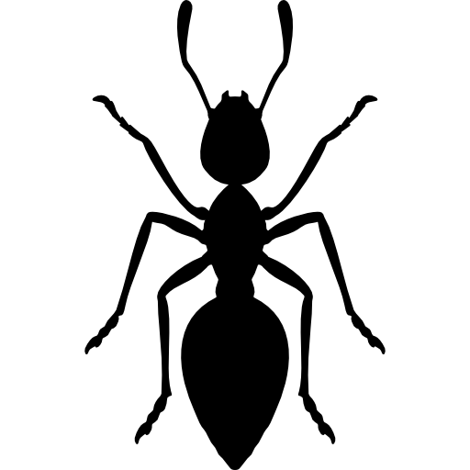



BIODIVERSITY DATA
BIOMASS DATA
ENVIRONMENTAL DATA
SPATIAL METADATA
i) INVERTEBRATE SPECIES COMPOSITION
ii) INVERTEBRATE BIOMASS FOR PITFALL TRAPS
vi) DEPLOYMENT DATES FOR LOGGERS
ix) PITFALL TRAP LOCATIONS
timestamp
trap_id
taxonomy
Iife_stage
method
number_caught
comments
timestamp
trap_id
serial_number
logger_type
trap_id
latitude
longitude
timestamp
trap_id
weight
number
comments
iv) VEGETATION SPECIES COMPOSITION
iii) INVERTEBRATE BIOMASS FOR SUBTERRANEAN TRAPS
vii) SOIL TEMPERATURE AND MOISTURE
x) SUBTERRANEAN TRAP LOCATIONS
year
month
trap_id
height
veg_taxon
cover_percentage
timestamp
serial_number
sensor_name
height
value
trap_id
latitude
longitude
timestamp
trap_id
weight
number
comments
v) VERTEBRATE SPECIES COMPOSITION
viii) MACROHABITATS
xi) CAMERA TRAP LOCATIONS
camera_id
latitude
longitude

