Slide 1


Automatske migracije baza podataka
Notes:
Rikard Pavelić – Nova Generacija Softvera d.o.o.
Marko Elezović – Element d.o.o.

Slide 2
NoSQL dokument
KORISNIK
{ "id" : "69435151530", "name" : "Pero Peričić", "number" : "+385 1 234-678" }

Slide 3
NoSQL dokument - migracija
KORISNIK (stari)
{ "id" : "69435151530", "name" : "Pero Peričić", "number" : "+385 1 234-678" }
KORISNIK (novi)
{ "id" : "69435151530", "name" : "Pero Peričić", "phoneNumber" : "+385 1 234-678" }

Slide 4
Evolucija modela
KORISNIK (stari)
{ "id" : "69435151530", "name" : "Pero Peričić", "number" : "+385 1 234-678" }
KORISNIK (novi)
{ "id" : "69435151530", "name" : "Pero Peričić", "phoneNumber" : "+385 1 234-678" }

Slide 5
Evolucija modela
KORISNIK (stari)
{ "id" : "69435151530", "name" : "Pero Peričić", "number" : "+385 1 234-678" }
Ich DROP
KORISNIK (novi)
{ "id" : "69435151530", "name" : "Pero Peričić", "phoneNumber" : "+385 1 234-678" }
Ich CREATE

Slide 6

Evolucija modela
KORISNIK (stari)
{ "id" : "69435151530", "name" : "Pero Peričić", "number" : "+385 1 234-678" }
Ich DROP?
Pitaj svoj mozak!
KORISNIK (novi)
{ "id" : "69435151530", "name" : "Pero Peričić", "phoneNumber" : "+385 1 234-678" }
Ich CREATE?

Slide 7
Evolucija modela
KORISNIK (stari)
{ "id" : "69435151530", "name" : "Pero Peričić", "number" : "+385 1 234-678" }
Ich ALTER!
Pitaj svoj mozak!
Du nicht DROP
Du nicht CREATE
Du ALTER!
KORISNIK (novi)
{ "id" : "69435151530", "name" : "Pero Peričić", "phoneNumber" : "+385 1 234-678" }
Ich ALTER!

Slide 8
Evolucija modela
root Korisnik(id) {
String(11) id;
String(80) name;
String(50) number;
}
Pitaj svoj mozak!
Du nicht DROP
Du nicht CREATE
Du ALTER!
root Korisnik(id) {
String(11) id;
String(80) name;
String(50) phoneNumber;
}

Slide 9
Mozak stvara ALTER skriptu
root Korisnik(id) {
String(11) id;
String(80) name;
String(50) number;
}
Pitaj svoj mozak!
Du nicht DROP
Du nicht CREATE
Du ALTER!
root Korisnik(id) {
String(11) id;
String(80) name;
String(50) phoneNumber;
}
ALTER TABLE "Korisnik" DROP COLUMN "number";
ALTER TABLE "Korisnik"
ADD ("phoneNumber" VARCHAR2(50));
ALTER TABLE "Korisnik"
RENAME COLUMN "number" TO "phoneNumber";

Slide 10
Live demo - brzo u Eclipse!

Slide 11
Zijev…
Za ovako jednostavan alter nam možda i ne treba mozak,
no što kada je model kompliciraniji?

Slide 12
NoSQL dokument
{
"id" : 1398377244087,
"name" : "Ivan Horvat",
"accounts" : [{
"IBAN" : "HR8923600001100000011",
"currency" : "HRK",
"transactions" : [{
"inflow" : 0.00,
"outflow" : 75.00,
"description" : "Kupovina u DMu",
"paymentOn" : "2013-05-13"
}, {
"inflow" : 2383.77,
"outflow" : 0.00,
"description" : "Plaća minimalac",
"paymentOn" : "2013-05-10"
}
]
}, {
"IBAN" : "HR3623600002500000025",
"currency" : "EUR",
"transactions" : [{
"inflow" : 0.00,
"outflow" : 45.00,
"description" : "Diablo III expansion",
"paymentOn" : "2013-05-03"
}
]
}
]
}
Kolekcije objekata unutar
kolekcija objekata…

Slide 13
NoSQL dokument
{
"id" : 1398377244087,
"name" : "Ivan Horvat",
"accounts" : [{
"IBAN" : "HR8923600001100000011",
"currency" : "HRK",
"transactions" : [{
"inflow" : 0.00,
"outflow" : 75.00,
"description" : "Kupovina u DMu",
"paymentOn" : "2013-05-13"
}, {
"inflow" : 2383.77,
"outflow" : 0.00,
"description" : "Plaća minimalac",
"paymentOn" : "2013-05-10"
}
]
}, {
"IBAN" : "HR3623600002500000025",
"currency" : "EUR",
"transactions" : [{
"inflow" : 0.00,
"outflow" : 45.00,
"description" : "Diablo III expansion",
"paymentOn" : "2013-05-03"
}
]
}
]
}
Kolekcije objekata unutar
kolekcija objekata nisu problem!
Oracle je ORDBMS

Slide 14
Modeliramo dokument
{
"id" : 1398377244087,
"name" : "Ivan Horvat",
"accounts" : [{
"IBAN" : "HR8923600001100000011",
"currency" : "HRK",
"transactions" : [{
"inflow" : 0.00,
"outflow" : 75.00,
"description" : "Kupovina u DMu",
"paymentOn" : "2013-05-13"
}, {
"inflow" : 2383.77,
"outflow" : 0.00,
"description" : "Plaća minimalac",
"paymentOn" : "2013-05-10"
}
]
}, {
"IBAN" : "HR3623600002500000025",
"currency" : "EUR",
"transactions" : [{
"inflow" : 0.00,
"outflow" : 45.00,
"description" : "Diablo III expansion",
"paymentOn" : "2013-05-03"
}
]
}
]
}
module Accounting
{
root Customer(id) {
long id;
String name;
List<Account> accounts;
}
value Account {
String(21) IBAN;
String(3) currency;
List<Transaction> transactions;
}
value Transaction {
Decimal(2) inflow;
Decimal(2) outflow;
String(80) description;
Date paymentOn;
}
}

Slide 15
Model stvara DDL
CREATE TABLE "Accounting"."Customer"(
"id" NUMBER(20,0) NOT NULL,
"name" CLOB NOT NULL,
"accounts" "Accounting"."-Account-A-" NOT NULL,
CONSTRAINT "PK_Customer" PRIMARY KEY ("id")
);
CREATE OR REPLACE TYPE "-Account-A-" AS
VARRAY(32768) OF "Accounting"."Account";
CREATE OR REPLACE TYPE "Account" AS OBJECT (
"IBAN" VARCHAR2(22) NOT NULL,
"currency" VARCHAR2(3) NOT NULL,
"transactions" "Accounting"."-Transaction-A-" NOT NULL
);
CREATE OR REPLACE TYPE "-Transaction-A-"
AS VARRAY(32768) OF "Accounting"."Transaction";
CREATE OR REPLACE TYPE "Transaction" AS OBJECT (
"inflow" NUMBER(22,2) NOT NULL,
"outflow" NUMBER(22,2) NOT NULL,
"description" VARCHAR2(80) NOT NULL,
"paymentOn" DATE NOT NULL
);
module Accounting
{
root Customer(id) {
long id;
String name;
List<Account> accounts;
}
value Account {
String(21) IBAN;
String(3) currency;
List<Transaction> transactions;
}
value Transaction {
Decimal(2) inflow;
Decimal(2) outflow;
String(80) description;
Date paymentOn;
}
}

Slide 16
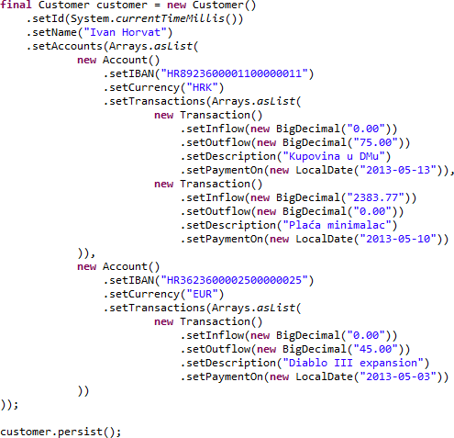
Model stvara Java klase
module Accounting
{
root Customer(id) {
long id;
String name;
List<Account> accounts;
}
value Account {
String(21) IBAN;
String(3) currency;
List<Transaction> transactions;
}
value Transaction {
Decimal(2) inflow;
Decimal(2) outflow;
String(80) description;
Date paymentOn;
}
}

Slide 17
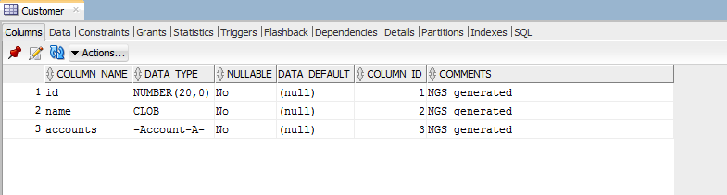
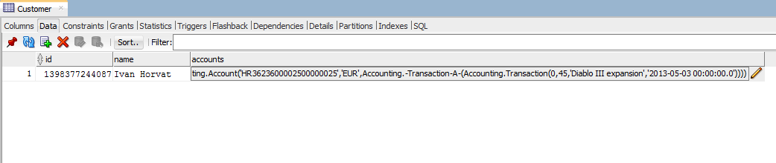
NoSQL 1=1 SQL
{
"id" : 1398377244087,
"name" : "Ivan Horvat",
"accounts" : [{
"IBAN" : "HR8923600001100000011",
"currency" : "HRK",
"transactions" : [{
"inflow" : 0.00,
"outflow" : 75.00,
"description" : "Kupovina u DMu",
"paymentOn" : "2013-05-13"
}, {
"inflow" : 2383.77,
"outflow" : 0.00,
"description" : "Plaća minimalac",
"paymentOn" : "2013-05-10"
}
]
}, {
"IBAN" : "HR3623600002500000025",
"currency" : "EUR",
"transactions" : [{
"inflow" : 0.00,
"outflow" : 45.00,
"description" : "Diablo III expansion",
"paymentOn" : "2013-05-03"
}
]
}
]
}

Slide 18
NoSQL 1=1 SQL
{
"id" : 1398377244087,
"name" : "Ivan Horvat",
"accounts" : [{
"IBAN" : "HR8923600001100000011",
"currency" : "HRK",
"transactions" : [{
"inflow" : 0.00,
"outflow" : 75.00,
"description" : "Kupovina u DMu",
"paymentOn" : "2013-05-13"
}, {
"inflow" : 2383.77,
"outflow" : 0.00,
"description" : "Plaća minimalac",
"paymentOn" : "2013-05-10"
}
]
}, {
"IBAN" : "HR3623600002500000025",
"currency" : "EUR",
"transactions" : [{
"inflow" : 0.00,
"outflow" : 45.00,
"description" : "Diablo III expansion",
"paymentOn" : "2013-05-03"
}
]
}
]
}
Impedance mismatch = rješen
Vrijeme je za evoluciju sheme

Slide 19
Use case: promjena nested tipa
{
"id" : 1398377244087,
"name" : "Ivan Horvat",
"accounts" : [{
"IBAN" : "HR8923600001100000011",
"currency" : "HRK",
"transactions" : [{
"inflow" : 0.00,
"outflow" : 75.00,
"description" : "Kupovina u DMu",
"paymentOn" : "2013-05-13"
}, {
"inflow" : 2383.77,
"outflow" : 0.00,
"description" : "Plaća minimalac",
"paymentOn" : "2013-05-10"
}
]
}, {
"IBAN" : "HR3623600002500000025",
"currency" : "EUR",
"transactions" : [{
"inflow" : 0.00,
"outflow" : 45.00,
"description" : "Diablo III expansion",
"paymentOn" : "2013-05-03"
}
]
}
]
}

Slide 20
Use case: promjena nested tipa
{
"id" : 1398377244087,
"name" : "Ivan Horvat",
"accounts" : [{
"IBAN" : "HR8923600001100000011",
"currency" : "HRK",
"transactions" : [{
"inflow" : 0.00,
"outflow" : 75.00,
"description" : "Kupovina u DMu",
"paymentOn" : "2013-05-13"
}, {
"inflow" : 2383.77,
"outflow" : 0.00,
"description" : "Plaća minimalac",
"paymentOn" : "2013-05-10"
}
]
}, {
"IBAN" : "HR3623600002500000025",
"currency" : "EUR",
"transactions" : [{
"inflow" : 0.00,
"outflow" : 45.00,
"description" : "Diablo III expansion",
"paymentOn" : "2013-05-03"
}
]
}
]
}
{
"id" : 1398377244087,
"name" : "Ivan Horvat",
"accounts" : [{
"IBAN" : "HR8923600001100000011",
"currency" : "HRK",
"transactions" : [{
"inflow" : 0.00,
"outflow" : 75.00,
"description" : "Kupovina u DMu",
"paymentOn" : "2013-05-13T17:03:12.124+02:00"
}, {
"inflow" : 2383.77,
"outflow" : 0.00,
"description" : "Plaća minimalac",
"paymentOn" : "2013-05-10T12:57:40.630+02:00"
}
]
}, {
"IBAN" : "HR3623600002500000025",
"currency" : "EUR",
"transactions" : [{
"inflow" : 0.00,
"outflow" : 45.00,
"description" : "Diablo III expansion",
"paymentOn" : "2013-05-03T02:30:11.102+02:00"
}
]
}
]
}

Slide 21
Use case: promjena nested tipa
{
"id" : 1398377244087,
"name" : "Ivan Horvat",
"accounts" : [{
"IBAN" : "HR8923600001100000011",
"currency" : "HRK",
"transactions" : [{
"inflow" : 0.00,
"outflow" : 75.00,
"description" : "Kupovina u DMu",
"paymentOn" : "2013-05-13"
}, {
"inflow" : 2383.77,
"outflow" : 0.00,
"description" : "Plaća minimalac",
"paymentOn" : "2013-05-10"
}
]
}, {
"IBAN" : "HR3623600002500000025",
"currency" : "EUR",
"transactions" : [{
"inflow" : 0.00,
"outflow" : 45.00,
"description" : "Diablo III expansion",
"paymentOn" : "2013-05-03"
}
]
}
]
}
{
"id" : 1398377244087,
"name" : "Ivan Horvat",
"accounts" : [{
"IBAN" : "HR8923600001100000011",
"currency" : "HRK",
"transactions" : [{
"inflow" : 0.00,
"outflow" : 75.00,
"description" : "Kupovina u DMu",
"paymentOn" : "2013-05-13T17:03:12.124+02:00"
}, {
"inflow" : 2383.77,
"outflow" : 0.00,
"description" : "Plaća minimalac",
"paymentOn" : "2013-05-10T12:57:40.630+02:00"
}
]
}, {
"IBAN" : "HR3623600002500000025",
"currency" : "EUR",
"transactions" : [{
"inflow" : 0.00,
"outflow" : 45.00,
"description" : "Diablo III expansion",
"paymentOn" : "2013-05-03T02:30:11.102+02:00"
}
]
}
]
}

Slide 22
Use case: promjena nested tipa
{
"id" : 1398377244087,
"name" : "Ivan Horvat",
"accounts" : [{
"IBAN" : "HR8923600001100000011",
"currency" : "HRK",
"transactions" : [{
"inflow" : 0.00,
"outflow" : 75.00,
"description" : "Kupovina u DMu",
"paymentOn" : "2013-05-13"
}, {
"inflow" : 2383.77,
"outflow" : 0.00,
"description" : "Plaća minimalac",
"paymentOn" : "2013-05-10"
}
]
}, {
"IBAN" : "HR3623600002500000025",
"currency" : "EUR",
"transactions" : [{
"inflow" : 0.00,
"outflow" : 45.00,
"description" : "Diablo III expansion",
"paymentOn" : "2013-05-03"
}
]
}
]
}
{
"id" : 1398377244087,
"name" : "Ivan Horvat",
"accounts" : [{
"IBAN" : "HR8923600001100000011",
"currency" : "HRK",
"transactions" : [{
"inflow" : 0.00,
"outflow" : 75.00,
"description" : "Kupovina u DMu",
"paymentOn" : "2013-05-13T17:03:12.124+02:00"
}, {
"inflow" : 2383.77,
"outflow" : 0.00,
"description" : "Plaća minimalac",
"paymentOn" : "2013-05-10T12:57:40.630+02:00"
}
]
}, {
"IBAN" : "HR3623600002500000025",
"currency" : "EUR",
"transactions" : [{
"inflow" : 0.00,
"outflow" : 45.00,
"description" : "Diablo III expansion",
"paymentOn" : "2013-05-03T02:30:11.102+02:00"
}
]
}
]
}

Slide 23
Evoluirajmo model
module Accounting
{
root Customer(id) {
long id;
String name;
List<Account> accounts;
}
value Account {
String(21) IBAN;
String(3) currency;
List<Transaction> transactions;
}
value Transaction {
Decimal(2) inflow;
Decimal(2) outflow;
String(80) description;
Date paymentOn;
}
}
module Accounting
{
root Customer(id) {
long id;
String name;
List<Account> accounts;
}
value Account {
String(21) IBAN;
String(3) currency;
List<Transaction> transactions;
}
value Transaction {
Decimal(2) inflow;
Decimal(2) outflow;
String(80) description;
Timestamp paymentOn;
}
}

Slide 24
Pali mozak!
module Accounting
{
root Customer(id) {
long id;
String name;
List<Account> accounts;
}
value Account {
String(21) IBAN;
String(3) currency;
List<Transaction> transactions;
}
value Transaction {
Decimal(2) inflow;
Decimal(2) outflow;
String(80) description;
Date paymentOn;
}
}
module Accounting
{
root Customer(id) {
long id;
String name;
List<Account> accounts;
}
value Account {
String(21) IBAN;
String(3) currency;
List<Transaction> transactions;
}
value Transaction {
Decimal(2) inflow;
Decimal(2) outflow;
String(80) description;
Timestamp paymentOn;
}
}

Slide 25
ALTER TYPE "Accounting"."Transaction" ADD ATTRIBUTE "paymentOn$" TIMESTAMP WITH TIME ZONE CASCADE;
CREATE TABLE "-m-Accounting_Customer_23" AS
SELECT "entity$".ROWID AS current$,
ROWNUM AS index$,
c$.OBJECT_VALUE AS "accounts"
FROM "Accounting"."Customer" "entity$" CROSS JOIN TABLE("entity$"."accounts") c$;
CREATE TABLE "-m-465259636" AS
SELECT "entity$".ROWID AS current$,
ROWNUM AS index$,
c$.OBJECT_VALUE AS "transactions"
FROM "-m-Accounting_Customer_23" "entity$" CROSS JOIN TABLE("entity$"."accounts"."transactions") c$;
UPDATE "-m-465259636" t$ SET t$."transactions"."paymentOn$" = CAST(t$."transactions"."paymentOn" AS TIMESTAMP WITH TIME ZONE);
ALTER TYPE "Accounting"."Transaction" DROP ATTRIBUTE "paymentOn" INVALIDATE;
ALTER TYPE "Accounting"."Transaction" ADD ATTRIBUTE "paymentOn" TIMESTAMP WITH TIME ZONE CASCADE;
ALTER TYPE "Accounting"."Transaction" DROP ATTRIBUTE "paymentOn$" CASCADE;
UPDATE "-m-465259636" t$ SET t$."transactions"."paymentOn"= t$."transactions"."paymentOn$";
UPDATE "-m-Accounting_Customer_23" cur$
SET cur$."accounts"."transactions" =
(SELECT CAST(COLLECT("transactions") AS "Accounting"."-Transaction-A-")
FROM "-m-465259636" entity$
WHERE current$ = cur$.ROWID);
UPDATE "Accounting"."Customer" cur$
SET cur$."accounts" =
(SELECT CAST(COLLECT("accounts") AS "Accounting"."-Account-A-")
FROM "-m-Accounting_Customer_23" entity$
WHERE current$ = cur$.ROWID);
DROP TABLE "-m-465259636";
DROP TABLE "-m-Accounting_Customer_23";
Notes:
/* Promjena atributa "Transaction" UDTa (user defined type) u Oracle bazi iz date u timestamp tip podatka. "Transaction" UDT se koristi unutar "Account" UDTa kao kolekcija (array "Transaction" tipa) "Account" UDT se koristi unutar "Customer" tablice kao kolekcija (array "Customer" tipa) Oracle ima nekoliko ogranicenja koja nam otezavaju ovaj posao. 1. Ukoliko se UDT vec koristi nemoguce je promijeniti tip podatka . PLS-00719, ORA-02303 2. Ukoliko postoje tipovi ili tablice koje dependaju nad UDTom nemoguce je napraviti rename vec postojeceg atributa. Zbog toga se promjena tipa (Transaction) mora odraditi slijedecim koracima: 1. dodavanje privremenog atributa paymentOn$ tipa timestamp u tip Transaction 2. prebacivanje vrijednosti originalnog atributa paymentOn u paymentOn$ u cijelom sustavu - zahtjeva pronalazenje svih tablica ili tipova koji koriste Transaction tip ili njegovu kolekciju 3. brisanje paymentOn atributa 4. dodavanje atributa originalnog imena (paymentOn) tipa timestamp 5. prebacivanje vrijednosti iz paymentOn$ u paymentOn u cijelom sustavu 6. brisanje privremene kolone paymentOn$ */ --Definicije tipova: create or replace TYPE "Transaction" AS OBJECT ("inflow" NUMBER(22,2), "outflow" NUMBER(22,2), "description" VARCHAR2(80), "paymentOn" DATE); create or replace TYPE "Account" AS OBJECT ("IBAN" VARCHAR2(21), "currency" VARCHAR2(3), "transactions" "Accounting"."-Transaction-A-"); --"Accounting"."-Transaction-A-" je kolekcija tipova Transaction -- Prvo dodajemo dummy atribut ciljanog tipa. ALTER TYPE "Accounting"."Transaction" ADD ATTRIBUTE "paymentOn$" TIMESTAMP WITH TIME ZONE CASCADE; -- Radimo pomocnu tablicu u koju cemo unnestati array "accounts" iz "Customer" tablice. Time smo izvadili objekte tipa "Account" iz kolekcije CREATE TABLE "-m-Accounting_Customer_23" AS SELECT "entity$".ROWID AS current$, ROWNUM AS index$, c$.OBJECT_VALUE AS "accounts" FROM "Accounting"."Customer" "entity$" CROSS JOIN TABLE("entity$"."accounts") c$; -- Radimo drugu pomocnu tablicu u koju cemo unnestati array "transactions" iz svakog pojedinog "Account" objekta. Time smo izvadili objekte tipa "Transaction" iz kolekcije CREATE TABLE "-m-465259636" AS SELECT "entity$".ROWID AS current$, ROWNUM AS index$, c$.OBJECT_VALUE AS "transactions" FROM "-m-Accounting_Customer_23" "entity$" CROSS JOIN TABLE("entity$"."accounts"."transactions") c$; -- Napokon radimo pretvorbu tipa iz date u timestamp (iz paymentOn u paymentOn$) UPDATE "-m-465259636" t$ SET t$."transactions"."paymentOn$" = CAST(t$."transactions"."paymentOn" AS TIMESTAMP WITH TIME ZONE); -- Brisemo "paymentOn" atribut ALTER TYPE "Accounting"."Transaction" DROP ATTRIBUTE "paymentOn" INVALIDATE; -- Dodajemo novi "paymentOn" atribut jer oracle ne podrzava preimenovanje atributa unutar typea. ALTER TYPE "Accounting"."Transaction" ADD ATTRIBUTE "paymentOn" TIMESTAMP WITH TIME ZONE CASCADE; -- Brisemo nepotrebni dummy atribut ALTER TYPE "Accounting"."Transaction" DROP ATTRIBUTE "paymentOn$" CASCADE; -- Prebacujemo podatke iz dummy atributa u novi atribut UPDATE "-m-465259636" t$ SET t$."transactions"."paymentOn" = t$."transactions"."paymentOn$"; -- backtrack azuriramo podatke i spremamo ih kamo spadaju. -- Prvi nivo: iz unnestanih transakcija u array transakcija unutar "accounts" UPDATE "-m-Accounting_Customer_23" cur$ SET cur$."accounts"."transactions" = (SELECT CAST(COLLECT("transactions") as "Accounting"."-Transaction-A-") FROM "-m-465259636" entity$ WHERE current$ = cur$.ROWID); -- Drugi nivo: iz unnestanih account objekata u array unutar originalne tablice UPDATE "Accounting"."Customer" cur$ SET cur$."accounts" = (SELECT CAST(COLLECT("accounts") as "Accounting"."-Account-A-") FROM "-m-Accounting_Customer_23" entity$ WHERE current$ = cur$.ROWID); -- Cleanup DROP TABLE "-m-465259636"; DROP TABLE "-m-Accounting_Customer_23";

Slide 26
Live demo - brzo u Eclipse!

Slide 27
Use case: one to many
{
"id" : 1398377244087,
"name" : "Ivan Horvat",
"account" : {
"IBAN" : "HR8923600001100000011",
"currency" : "HRK",
"transactions" : [{
"inflow" : 0.00,
"outflow" : 75.00,
"description" : "Kupovina u DMu",
"paymentOn" : "2013-05-13"
}, {
"inflow" : 2383.77,
"outflow" : 0.00,
"description" : "Plaća minimalac",
"paymentOn" : "2013-05-10"
}
]
}
}
{
"id" : 1398377244087,
"name" : "Ivan Horvat",
"accounts" : [{
"IBAN" : "HR8923600001100000011",
"currency" : "HRK",
"transactions" : [{
"inflow" : 0.00,
"outflow" : 75.00,
"description" : "Kupovina u DMu",
"paymentOn" : "2013-05-13"
}, {
"inflow" : 2383.77,
"outflow" : 0.00,
"description" : "Plaća minimalac",
"paymentOn" : "2013-05-10"
}
]
}]
}

Slide 28
Use case: one to many
{
"id" : 1398377244087,
"name" : "Ivan Horvat",
"account" : {
"IBAN" : "HR8923600001100000011",
"currency" : "HRK",
"transactions" : [{
"inflow" : 0.00,
"outflow" : 75.00,
"description" : "Kupovina u DMu",
"paymentOn" : "2013-05-13"
}, {
"inflow" : 2383.77,
"outflow" : 0.00,
"description" : "Plaća minimalac",
"paymentOn" : "2013-05-10"
}
]
}
}
{
"id" : 1398377244087,
"name" : "Ivan Horvat",
"accounts" : [{
"IBAN" : "HR8923600001100000011",
"currency" : "HRK",
"transactions" : [{
"inflow" : 0.00,
"outflow" : 75.00,
"description" : "Kupovina u DMu",
"paymentOn" : "2013-05-13"
}, {
"inflow" : 2383.77,
"outflow" : 0.00,
"description" : "Plaća minimalac",
"paymentOn" : "2013-05-10"
}
]
}]
}
Pitaj svoj mozak!

Slide 29
Use case: one to many
{
"id" : 1398377244087,
"name" : "Ivan Horvat",
"account" : {
"IBAN" : "HR8923600001100000011",
"currency" : "HRK",
"transactions" : [{
"inflow" : 0.00,
"outflow" : 75.00,
"description" : "Kupovina u DMu",
"paymentOn" : "2013-05-13"
}, {
"inflow" : 2383.77,
"outflow" : 0.00,
"description" : "Plaća minimalac",
"paymentOn" : "2013-05-10"
}
]
}
}
{
"id" : 1398377244087,
"name" : "Ivan Horvat",
"accounts" : [{
"IBAN" : "HR8923600001100000011",
"currency" : "HRK",
"transactions" : [{
"inflow" : 0.00,
"outflow" : 75.00,
"description" : "Kupovina u DMu",
"paymentOn" : "2013-05-13"
}, {
"inflow" : 2383.77,
"outflow" : 0.00,
"description" : "Plaća minimalac",
"paymentOn" : "2013-05-10"
}
]
}]
}
Pitaj svoj mozak!
"Model mora zadržati podatak,
samo property treba renameati i pretvoriti u kolekciju"

Slide 30
Evoluirajmo model
module Accounting
{
root Customer(id) {
long id;
String name;
Account account;
}
value Account {
String(21) IBAN;
String(3) currency;
List<Transaction> transactions;
}
value Transaction {
Decimal(2) inflow;
Decimal(2) outflow;
String(80) description;
Date paymentOn;
}
}
module Accounting
{
root Customer(id) {
long id;
String name;
List<Account> accounts;
}
value Account {
String(21) IBAN;
String(3) currency;
List<Transaction> transactions;
}
value Transaction {
Decimal(2) inflow;
Decimal(2) outflow;
String(80) description;
Timestamp paymentOn;
}
}

Slide 31
Pali mozak!
module Accounting
{
root Customer(id) {
long id;
String name;
Account account;
}
value Account {
String(21) IBAN;
String(3) currency;
List<Transaction> transactions;
}
value Transaction {
Decimal(2) inflow;
Decimal(2) outflow;
String(80) description;
Date paymentOn;
}
}
module Accounting
{
root Customer(id) {
long id;
String name;
List<Account> accounts;
}
value Account {
String(21) IBAN;
String(3) currency;
List<Transaction> transactions;
}
value Transaction {
Decimal(2) inflow;
Decimal(2) outflow;
String(80) description;
Timestamp paymentOn;
}
}

Slide 32
CREATE TYPE "Accounting"."-Account-A-“
AS VARRAY(32768) OF "Accounting"."Account";
ALTER TABLE "Accounting"."Customer" ADD "accounts" "Accounting"."-Account-A-";
UPDATE "Accounting"."Customer" t$
SET t$."accounts" = "Accounting"."-Account-A-"(t$."account");
ALTER TABLE "Accounting"."Customer" DROP COLUMN "account";
Notes:
kreiranje kolekcija tipa Account (zbog “jednostavnosti” uzeli smo varray).
Dodavanje nove kolone u Customer tablicu
Ubacivanje zapisa iz stare kolone u novi array.
Brisanje starog zapisa

Slide 33
Pri razvoju projekata, neki patterni se kronično pojavljuju.
Na one na koje često nalijećemo pišemo specijalizirani migrator – time postajemo jako DRY.
Kada kompajleri posjeduju velike količine patterna drugima počinju sličiti magiji,
no magija je samo jako istrenirani migracijski mozak.
U ovih par primjera smo pokazali "jednostavne" promjene tipova i naziva properyja, no u razvoju se pojavljuje i puno "kompozitnih" patterna koji uključuju promjene koje
utječu na više koncepata odjednom.

Slide 34
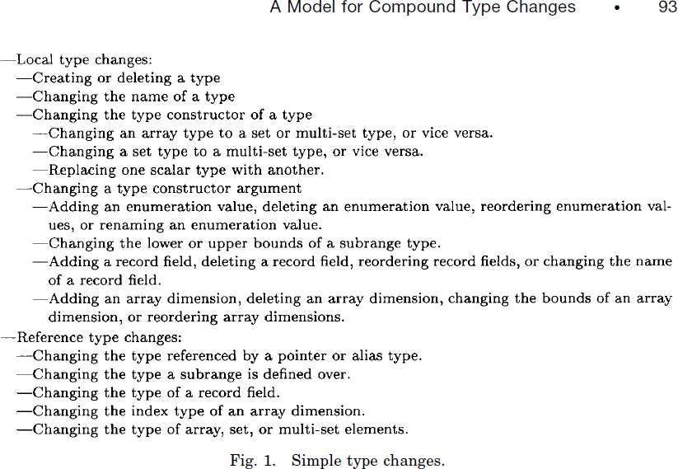
Barbara Staudt Lerner:
"A Model for Compound Type Changes Encountered in Schema Evolution"
Notes:
Barbara Staudt Lerner:
"A Model for Compound Type Changes Encountered in Schema Evolution"
ACM Transactions on Database Systems, Vol. 25, No. 1, March 2000, Pages 83–127.

Slide 35
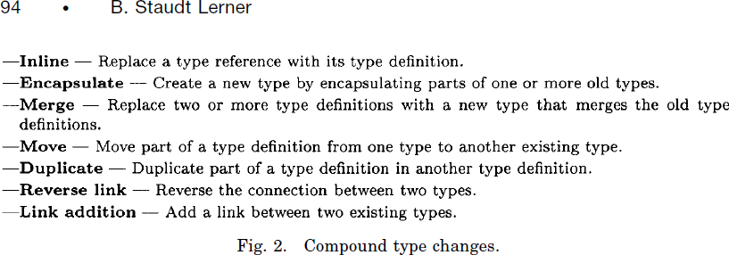
Barbara Staudt Lerner:
"A Model for Compound Type Changes Encountered in Schema Evolution"
Notes:
Barbara Staudt Lerner:
"A Model for Compound Type Changes Encountered in Schema Evolution"
ACM Transactions on Database Systems, Vol. 25, No. 1, March 2000, Pages 83–127.

Slide 36
Par kompozitnih primjera iz: "A Model for Compound Type Changes Encountered in Schema Evolution"
root Person {
String name;
PersonalInfo personal;
}
entity PersonalInfo {
Address address;
Phone phone;
MaritalStatus maritalStatus;
int numChildren;
}
root Person {
String name;
Address address;
Phone phone;
PersonalInfo personal;
}
entity PersonalInfo {
MaritalStatus maritalStatus;
int numChildren;
}
Pitaj svoj mozak!
"Ovo je MOVE: Podatak treba preskočiti entity boundary."
Notes:
Barbara Staudt Lerner:
"A Model for Compound Type Changes Encountered in Schema Evolution"
ACM Transactions on Database Systems, Vol. 25, No. 1, March 2000, Pages 83–127.
Potpuni model:
module MovingExample
{
root Person {
String name;
PersonalInfo personal;
}
entity PersonalInfo {
Address address;
Phone phone;
MaritalStatus maritalStatus;
int numChildren;
}
value Address {
String street;
String city;
String state;
int zipcode;
}
value Phone {
String number;
}
enum MaritalStatus {
DIVORCED;
MARRIED;
OTHER;
SEPARATED;
SINGLE;
WIDOWED;
}
}

Slide 37
Par kompozitnih primjera iz: "A Model for Compound Type Changes Encountered in Schema Evolution"
root PersonalInfo {
String name; Address address;
Phone phone;
MaritalStatus maritalStatus;
int numChildren;
}
entity EmployeeInfo {
String name;
int id;
int salary;
}
root Person {
String name; Address address;
Phone phone;
MaritalStatus maritalStatus;
int numChildren;
int id;
int salary;
}
Pitaj svoj mozak!
"Prepoznajem MERGE: Dva entiteta se mergeju u novi koji ima sumu njihovih podataka"
Notes:
Barbara Staudt Lerner:
"A Model for Compound Type Changes Encountered in Schema Evolution"
ACM Transactions on Database Systems, Vol. 25, No. 1, March 2000, Pages 83–127.
Potpuni model:
module MergingExample
{
value PersonalInfo {
String name;
Address address;
Phone phone;
MaritalStatus maritalStatus;
int numChildren;
}
value EmployeeInfo {
String name;
int id;
int salary;
}
value Address {
String street;
String city;
String state;
int zipcode;
}
value Phone {
String number;
}
enum MaritalStatus {
DIVORCED;
MARRIED;
OTHER;
SEPARATED;
SINGLE;
WIDOWED;
}
}

Slide 38
Par kompozitnih primjera iz: "A Model for Compound Type Changes Encountered in Schema Evolution"
root Person {
String name; Address address;
}
value Address {
String street;
String city;
String state;
int zipcode;
}
root Person {
String name; String street;
String city;
String state;
int zipcode;
}
Pitaj svoj mozak!
"Ovo sada je INLINE: Address tip mora nestati, a njegovi podaci moraju biti prebačeni u Person"
Notes:
Barbara Staudt Lerner:
"A Model for Compound Type Changes Encountered in Schema Evolution"
ACM Transactions on Database Systems, Vol. 25, No. 1, March 2000, Pages 83–127.

Slide 39
Hvala!
dsl-platform.com
Kontakt:
Marko Elezović
Element d.o.o., CEO
marko@dsl-platform.com
Rikard Pavelić
Nova Generacija Softvera d.o.o., CEO
rikard@dsl-platform.com

