Slide 1


Mathematical models of proliferative control
Postgraduate Diploma Programme
Quantitative Life Sciences
Ana Milena Forero Pinto
Supervisors:
Prof. Antonio Celani
Dr. Alberto Puliafito
Aug 2021

Slide 2
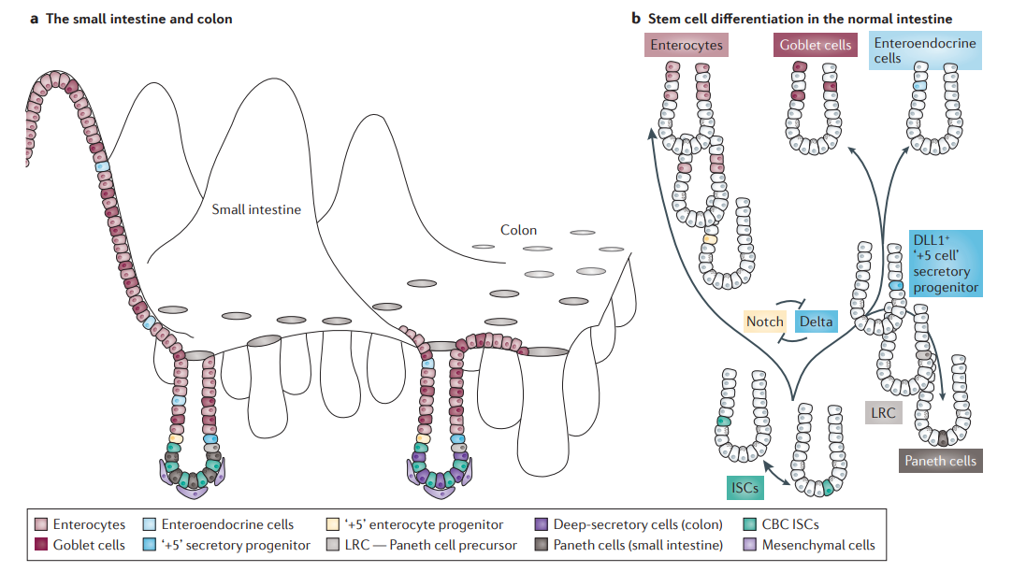
Tissues are organized communities of cells performing different functions
Enterocytes are involved in the uptake of nutrients.
Globlet cells produce mucus.
Enteroendocrine cells produce hormones.

Slide 3
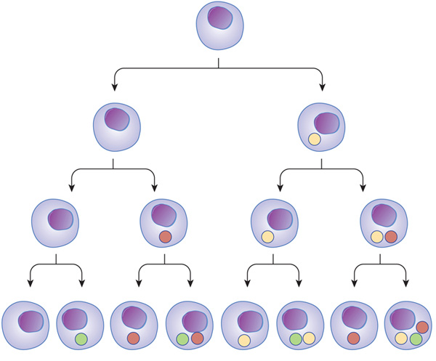
Cell lineages track cellular differentiation
cellular hierarchy of the intestine
Stem cell
Cells can differentiate depending on which genes are expressed and which proteins are encoded in the expressed genes.

Slide 4
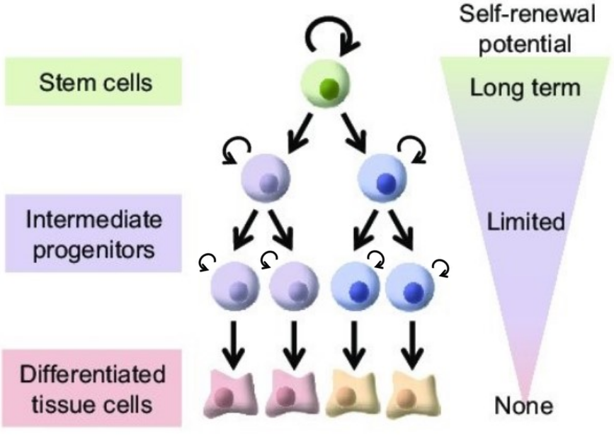
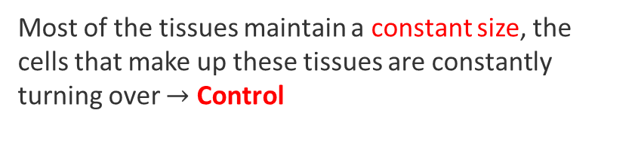
Constant size and tissue maintenance are consequences of …
Most of the tissues maintain a constant size, the cells that make up these tissues are constantly turning over $→$ Control
To do so, its rates of cell death, cell division and differentiation must remain in balance.
In order to coordinate their function, organization, and rates of death and division, the cells in a tissue are constantly processing and responding to signals from one another.
proliferation, differentiation and interaction among cell types.

Slide 5
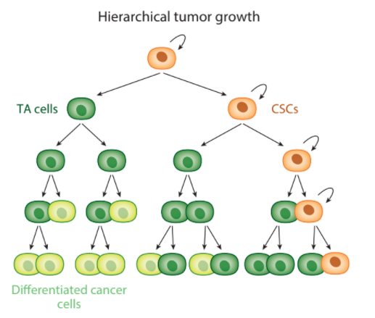
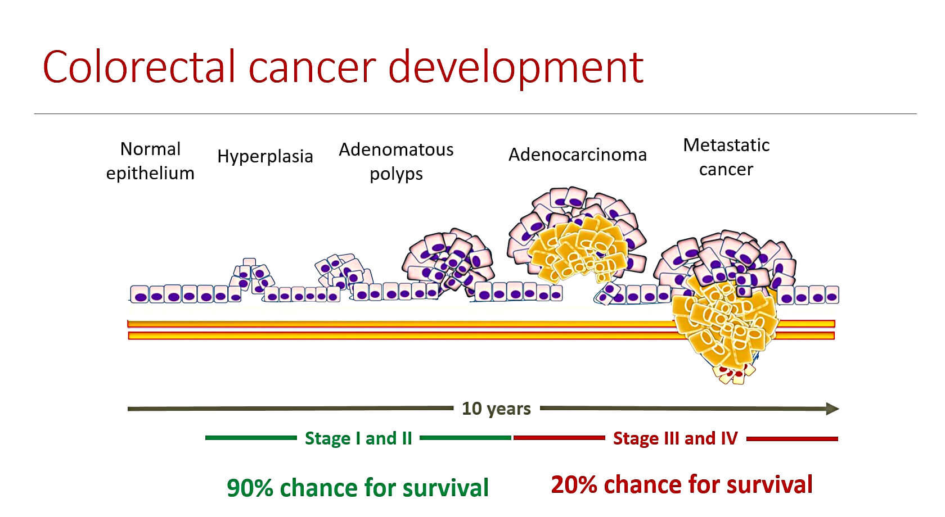
Uncontrolled proliferation is one characteristic of cancer

Slide 6
What is this project about?
We studied two scenarios of cell proliferation
Normal tissue growth
Control of tumor growth
A review of the work of Lander et al.[1] on the different feedback control strategies on a three stages cell lineage model.
Find the optimal drug treatment that targets the specific cell types in the lineage and controls cancer cells’ proliferation.
[1] A. D. Lander et al. Cell lineages and the logic of proliferative control. PLOS Biology, 7:1–1, 01 2009

Slide 7
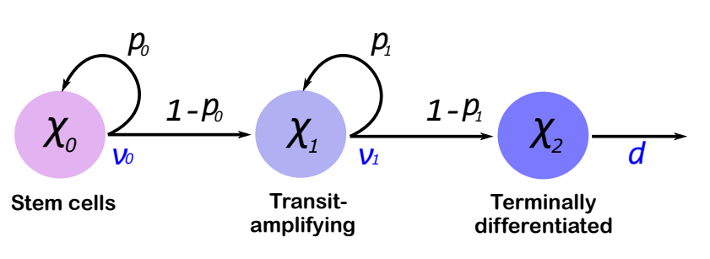

Cell lineage as a model for tissue growth
$$\dot{χ_{0}}\left(t\right)=\left(2p_{0}−1\right)v_{0}χ_{0}\left(t\right)$$
$$\dot{χ_{1}}\left(t\right)=2\left(1−p_{0}\right)v_{0}χ_{0}\left(t\right)+\left(2p_{1}−1\right)v_{1}χ_{1}\left(t\right)$$
$$\dot{χ_{2}}\left(t\right)=2\left(1−p_{1}\right)v_{1}χ_{1}\left(t\right)−d χ_{2}\left(t\right)$$

Slide 8
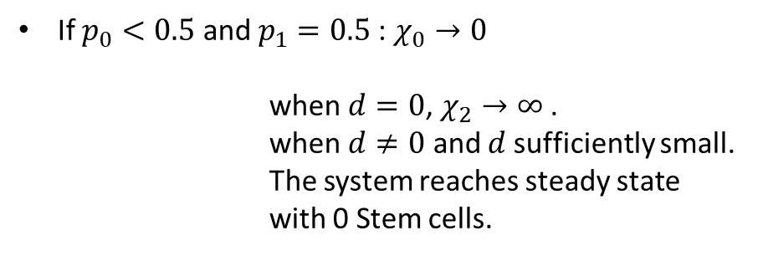

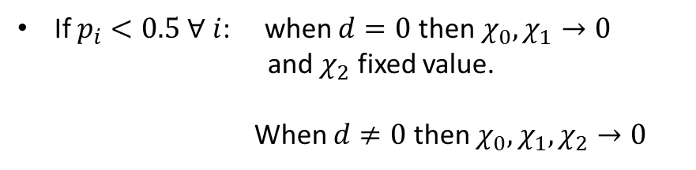
The open-loop system can achieve steady- state
If $p_{i}>0.5$ for any $i$: $χ_{2}→∞$
A quickly inspection:
If $p_{i}<0.5$ $∀$ $i$: when $d=0$ then $χ_{0},χ_{1}→0$
and $χ_{2}$ fixed value.
When $d≠0$ then ${χ_{0},χ_{1}, χ}_{2}→0$
$$\dot{χ_{0}}\left(t\right)=\left(2p_{0}−1\right)v_{0}χ_{0}\left(t\right)$$
$$\dot{χ_{1}}\left(t\right)=2\left(1−p_{0}\right)v_{0}χ_{0}\left(t\right)+\left(2p_{1}−1\right)v_{1}χ_{1}\left(t\right)$$
$$\dot{χ_{2}}\left(t\right)=2\left(1−p_{1}\right)v_{1}χ_{1}\left(t\right)−d χ_{2}\left(t\right)$$
If $p_{0}<0.5$ and $p_{1}=0.5$: $χ_{0}→0$
when $d=0$, $χ_{2}→∞$ .
when $d≠0$ and $d$sufficiently small.
The system reaches steady state
with 0 Stem cells.

Slide 9



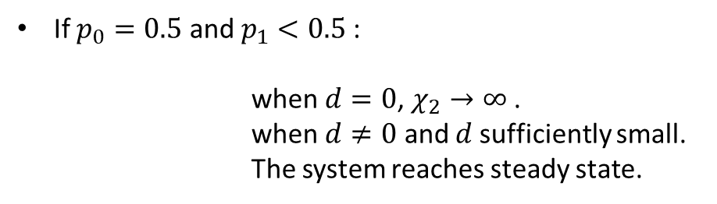


The open-loop system can achieve steady- state
If $p_{0}=0.5$ and $p_{1}<0.5$:
when $d=0$, $χ_{2}→∞$ .
when $d≠0$ and $d$sufficiently small. The system reaches steady state.
$$χ_{0}→χ_{0}\left(0\right)=χ_{0}^{∗}$$
A quickly inspection:
$$\dot{χ_{0}}\left(t\right)=\left(2p_{0}−1\right)v_{0}χ_{0}\left(t\right)$$
$$\dot{χ_{1}}\left(t\right)=2\left(1−p_{0}\right)v_{0}χ_{0}\left(t\right)+\left(2p_{1}−1\right)v_{1}χ_{1}\left(t\right)$$
$$\dot{χ_{2}}\left(t\right)=2\left(1−p_{1}\right)v_{1}χ_{1}\left(t\right)−d χ_{2}\left(t\right)$$
$$χ_{1S}=\frac{ξ}{1−2p_{1}}χ_{0}^{∗}$$
$$χ_{2S}=\frac{2ξ}{δ}\frac{1−p_{1}}{1−2p_{1}}χ_{0}^{∗}$$
$$ξ=\frac{v_{0}}{v_{1}}$$
$$δ=\frac{d}{v_{1}}$$

Slide 10

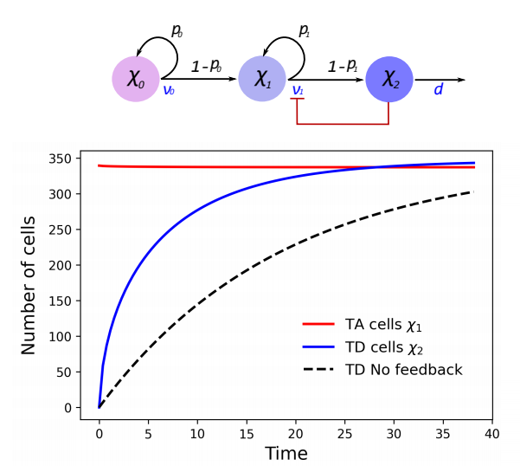








One negative feedback loop is not a good control strategy
$$S_{p_{1}}=\frac{p_{1}}{χ_{2}}\frac{dχ_{2}}{dp_{1}}≥1,$$
$$p_{1}∈\left[1−\frac{1}{\sqrt{2}},0.5\right)$$
$$S_{v_{0}}=1$$
The dynamics needs to be under control!
$$v_{1}→\frac{v_{1}}{1+hχ_{2}}$$
$$τ=v_{1}t$$
$$\dot{χ_{0}}\left(τ\right)=0 →\dot{χ_{0}}\left(τ\right)= χ_{0}^{∗}$$
$$\dot{χ_{1}}\left(τ\right)=ξχ_{0}^{∗}+\left(2p_{1}−1\right)\frac{1}{1+hχ_{2}}χ_{1}\left(τ\right)$$
$$\dot{χ_{2}}\left(τ\right)=2\left(1−p_{1}\right)\frac{1}{1+hχ_{2}}χ_{1}\left(τ\right)−δ χ_{2}\left(τ\right)$$

Slide 11



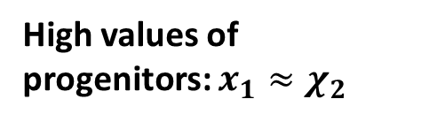
One negative feedback loop is not a good control strategy
Fast regeneration
High values of progenitors: $x_{1}≈χ_{2}$

Slide 12
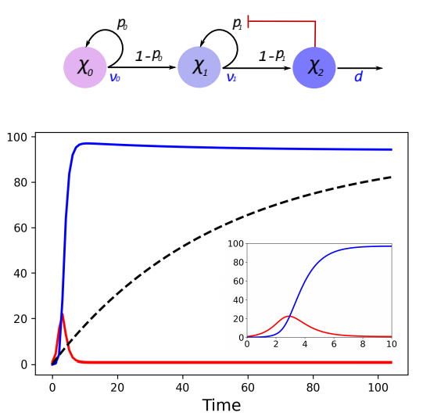

One negative feedback loop is not a good control strategy
Fast regeneration
Significantly low progenitor loads

Slide 13


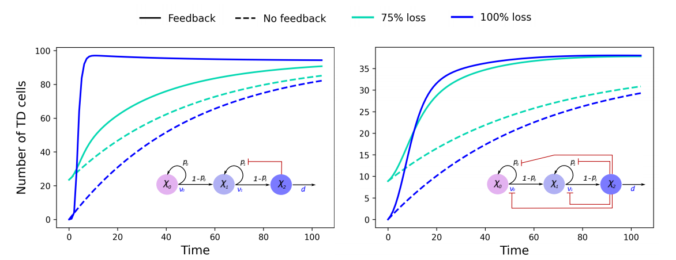
One negative feedback loop is not a good control strategy

Slide 14


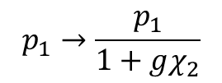
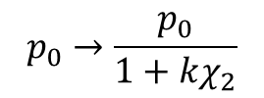
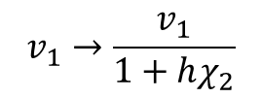
Negative feedback in all parameters improve the drawbacks of previous strategies
$$v_{0}→\frac{v_{0}}{1+jχ_{2}}$$
$$v_{1}→\frac{v_{1}}{1+hχ_{2}}$$
$$p_{0}→\frac{p_{0}}{1+kχ_{2}}$$
$$p_{1}→\frac{p_{1}}{1+gχ_{2}}$$
$$\frac{2p_{0}−1}{k}>\frac{2p_{1}−1}{g}$$

Slide 15
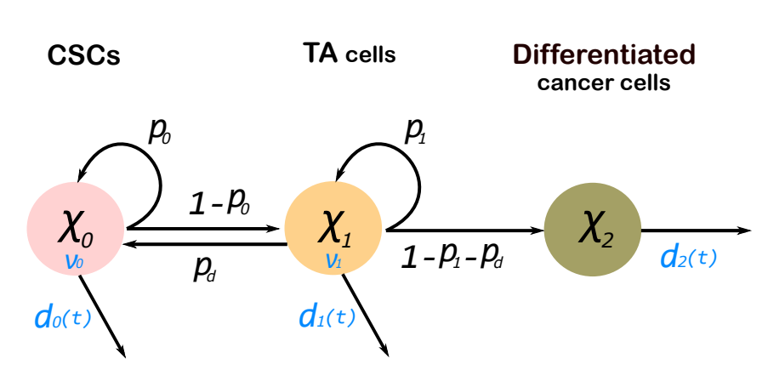
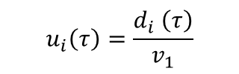

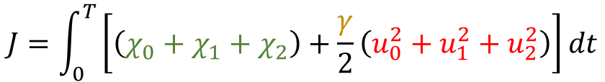

A model for control of tumor growth
$$\dot{χ_{0}}=\left(2p_{0}−1\right)ξχ_{0}+2 p_{d}χ_{1}−u_{0}χ_{0}=f_{0}$$
$$\dot{χ_{1}}=2\left(1−p_{0}\right)ξχ_{0}+\left(2p_{1}−1\right)χ_{1}−u_{1}χ_{1}=f_{1}$$
$\dot{χ_{2}}=2\left(1−p_{1}−p_{d}\right)χ_{1}−u_{2}χ_{2}$ $=f_{2}$
$$u_{i}\left(τ\right)=\frac{d_{i} \left(τ\right)}{v_{1}}$$
$$x\left(0\right)=\left(χ_{0}\left(0\right),χ_{1}\left(0\right),χ_{2}(0)\right)$$
$$J=\int_{0}^{T}{\left[\left(χ_{0}+χ_{1}+χ_{2}\right)+\frac{γ}{2}\left(u_{0}^{2}+u_{1}^{2}+u_{2}^{2}\right)\right]dt}$$
Total amount
of cancer cells
Drug side effects
Weight

Slide 16







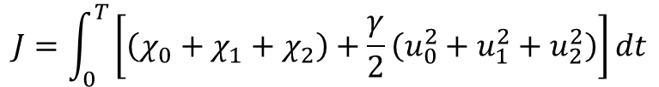







We applied optimal control theory
$$J=\int_{0}^{T}{\left[\left(χ_{0}+χ_{1}+χ_{2}\right)+\frac{γ}{2}\left(u_{0}^{2}+u_{1}^{2}+u_{2}^{2}\right)\right]dt}$$
$$u^{∗}\left(τ\right)=\left(u_{0}^{∗}\left(τ\right),u_{1}^{∗}\left(τ\right),u_{2}^{∗}(τ)\right)$$
$$ℋ=C\left(x, u\right)+λ{\left(t\right)}^{⊺}f\left(x,u \right)$$
$$C\left(x, u\right)$$
Sufficient conditions:
$$i=0,1,2$$
$${\dot{x}}_{i}=\frac{∂ℋ}{∂λ_{i}}$$
Forward-Backward Sweep Method
$${\dot{λ}}_{i}=−\frac{∂ℋ}{∂x_{i}}$$
$$\dot{χ_{0}}=\left(2p_{0}−1\right)ξχ_{0}+2 p_{d}χ_{1}−u_{0}χ_{0}$$
$$\dot{λ_{0}}=−1−\left[\left(2p_{0}−1\right)ξ−u_{0}\right]λ_{0}−2\left(1−p_{0}\right)ξλ_{1}$$
$$\dot{χ_{1}}=2\left(1−p_{0}\right)ξχ_{0}+\left(2p_{1}−1\right)χ_{1}−u_{1}χ_{1}$$
$$\dot{λ_{1}}=−1−2p_{d}λ_{0}−\left(2p_{1}−1−u_{1}\right)λ_{1}−2\left(1−p_{1}−p_{d}\right)λ_{2}$$
$$\dot{χ_{2}}=2\left(1−p_{1}−p_{d}\right)χ_{1}−u_{2}χ_{2}$$
$$\dot{λ_{2}}=−1+u_{2}λ_{2}$$
$$\frac{∂ℋ}{∂u_{i}}=0$$
$$u_{i}=\frac{λ_{i}χ_{i}}{γ}$$
Boundary conditions:
$$λ_{i}\left(T\right)={\left.\frac{∂φ}{∂x_{i}}\right|}_{t=T}=0$$
$$x_{i}(0)=χ_{i}\left(0\right)$$

Slide 17
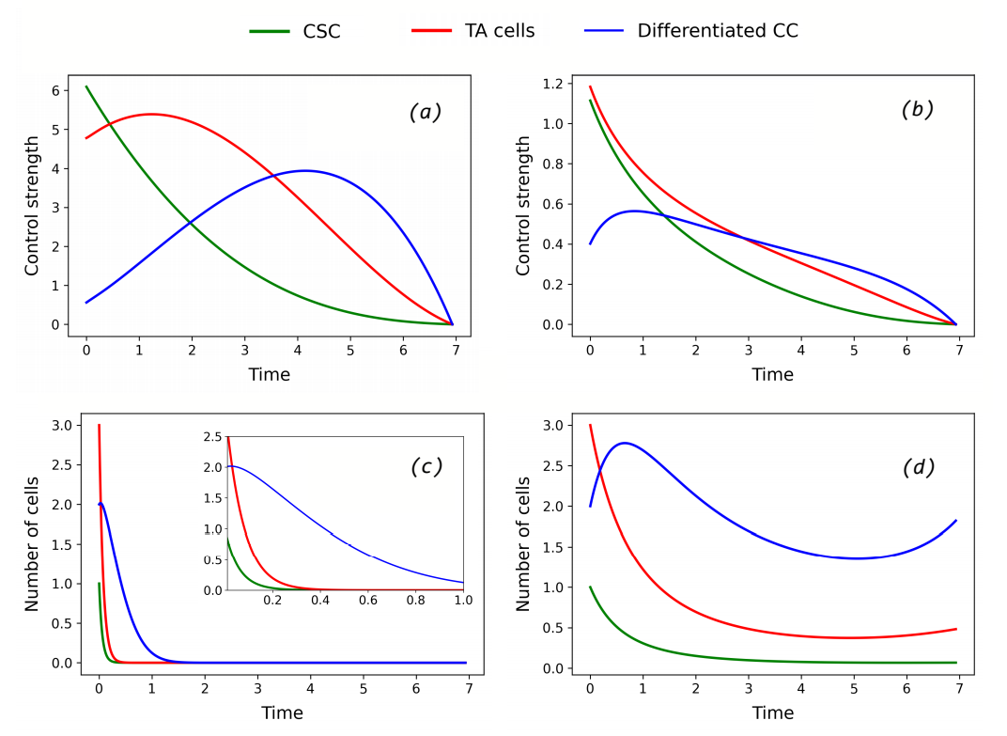


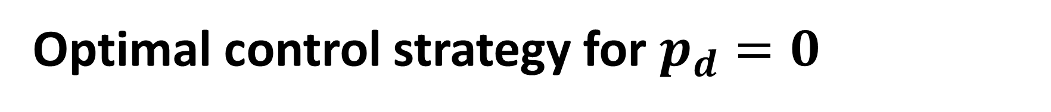





Optimal control strategy for $p_{d}=0$
Parameters:
$$p_{0}=p_{1}=0.51$$
$$p_{d}=0$$
$$ξ=1$$
$$γ=10$$
Initial conditions:
$$χ_{0}=1$$
$$χ_{1}=3$$
$${ χ}_{2}=2$$

Slide 18
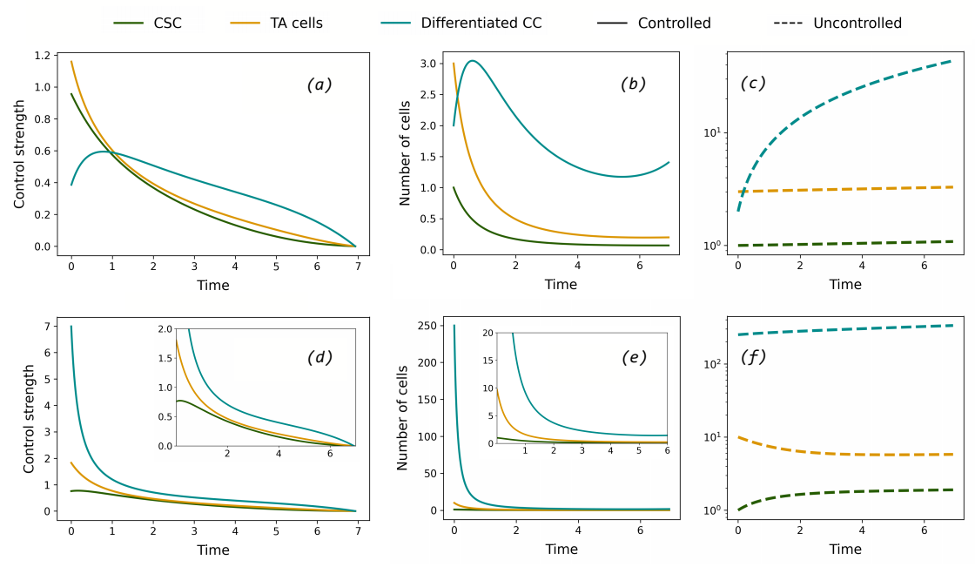

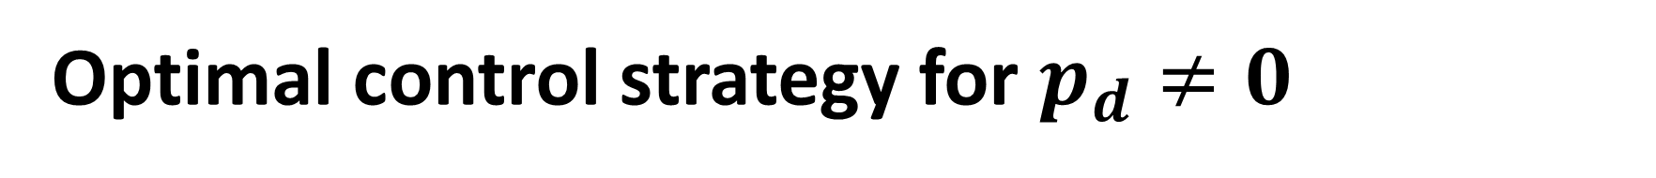






Optimal control strategy for $p_{d}≠0$
Parameters:
$$p_{0}=0.41$$
$$p_{1}=0.31$$
$$p_{d}=0.031$$
$$ξ=1$$
$$γ=10$$
Initial conditions:
Figures (a), (b) and (c)
$$χ_{0}=1, { χ}_{1}=3, { χ}_{2}=2$$
Figures (d), (e) and (f)
$$χ_{0}=1, { χ}_{1}=10, { χ}_{2}=250$$

Slide 19
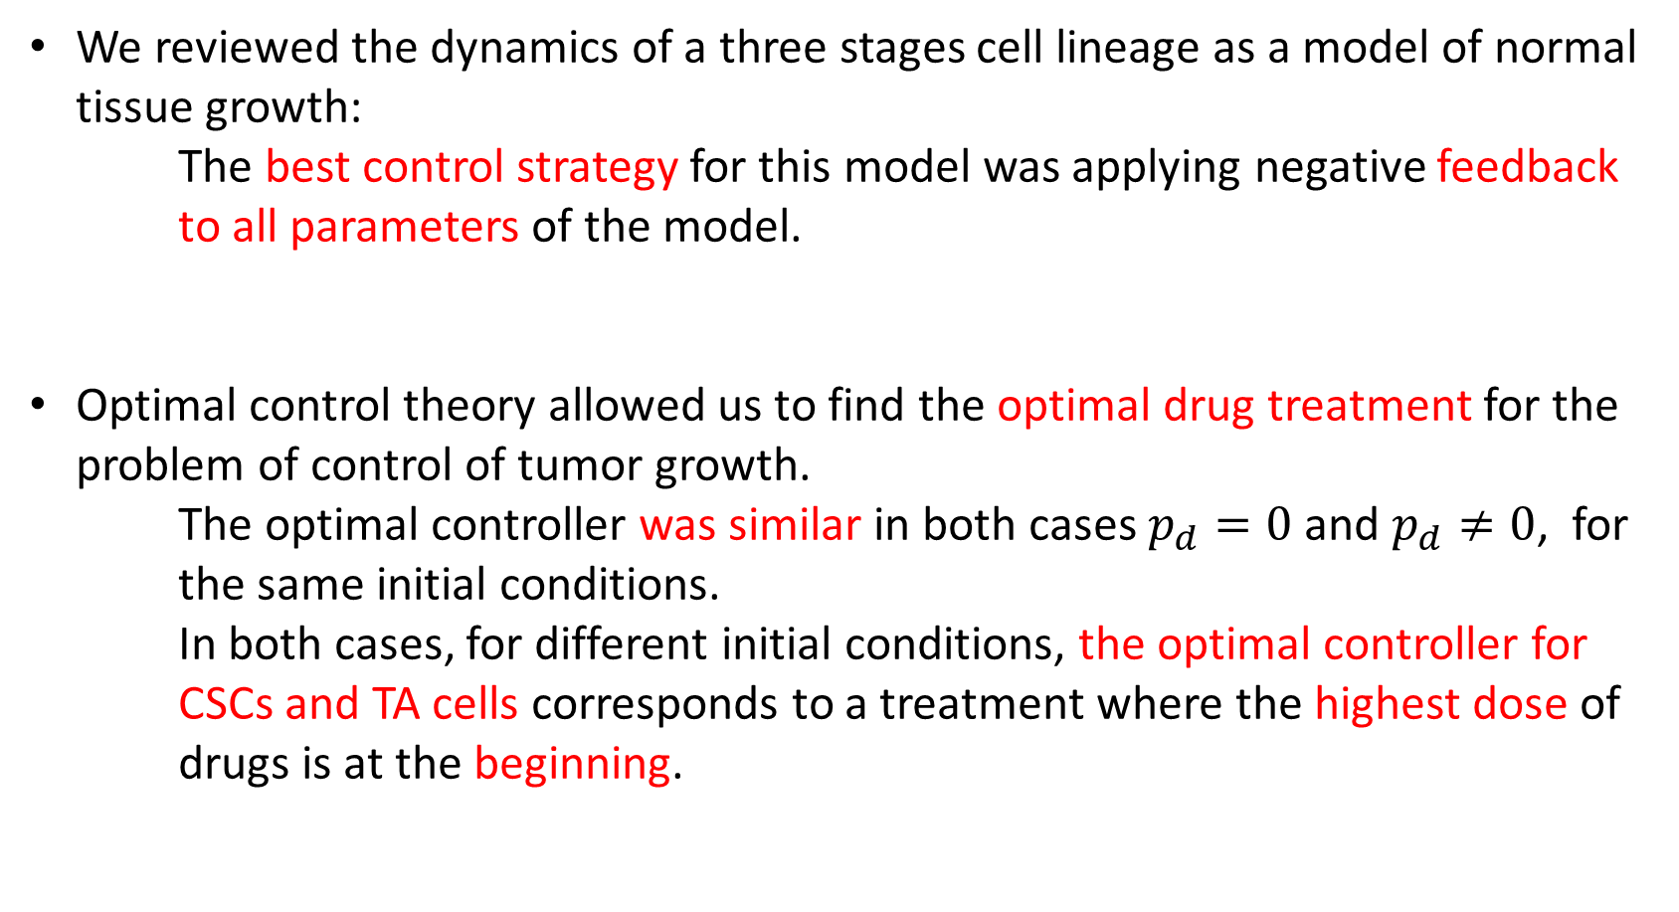
In summary…
We reviewed the dynamics of a three stages cell lineage as a model of normal tissue growth:
The best control strategy for this model was applying negative feedback to all parameters of the model.
Optimal control theory allowed us to find the optimal drug treatment for the problem of control of tumor growth.
The optimal controller was similar in both cases $p_{d}=0$ and $p_{d}≠0$, for the same initial conditions.
In both cases, for different initial conditions, the optimal controller for CSCs and TA cells corresponds to a treatment where the highest dose of drugs is at the beginning.

Slide 20

What is next?
Explore different therapeutic strategies; e.g., controlling feedback loops.
Study the effects of introducing noise to the model, for which we can apply stochastic optimal control concepts.
More complex models can also be done; e.g., Branched cell lineages.
$$p_{1} →\frac{p_{1}}{1+g\left(t\right)χ_{2}}$$

Slide 21
Thank you!

Slide 22
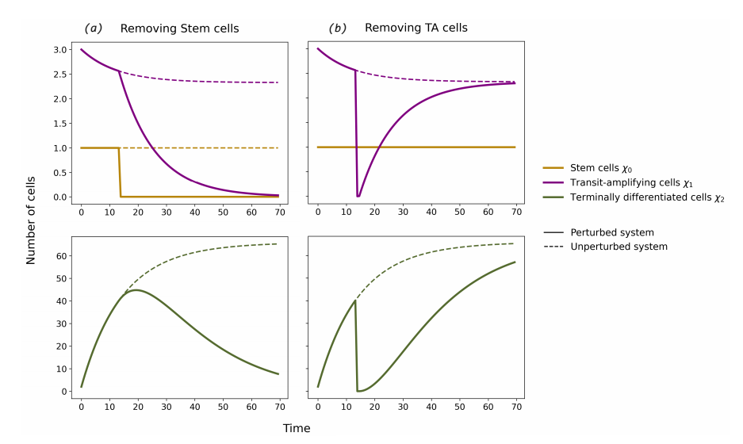
Removing stem cells leads to a complete loss of all cell types

Slide 23
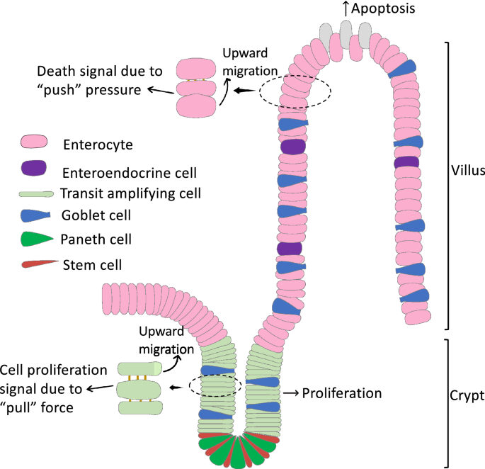

Slide 24
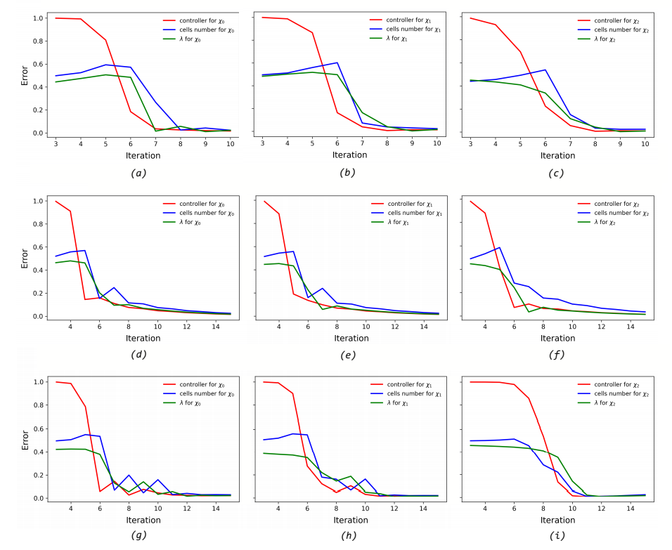

Slide 25
