Slide 1

Deterministic and Expected Policy Gradient methods
Papers:
David Silver, Guy Lever, Nicolas Heess, Thomas Degris, Daan Wierstra, et al.. Deterministic Policy Gradient Algorithms. ICML, Jun 2014, Beijing, China. ffhal-00938992f
Kamil Ciosek and Shimon Whiteson. Expected Policy Gradients. Apr 2018. arXiv:1706.05374 [stat.ML].
Ana Milena Forero Pinto
Reinforcement Learning Exam
Quantitative Life Sciences Diploma program
ICTP, Trieste
2021

Slide 2
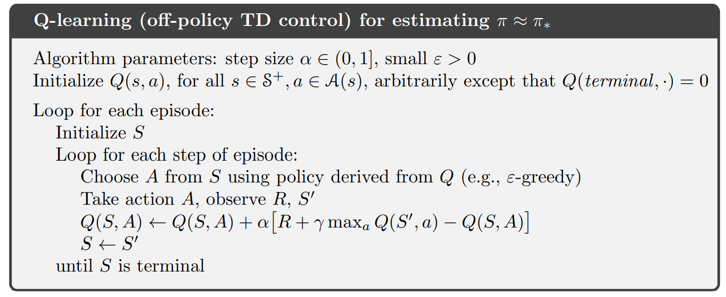
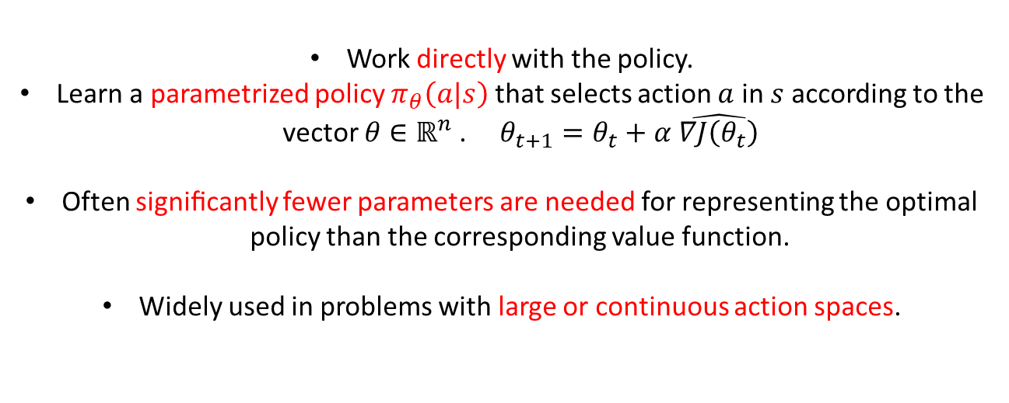
Reminding …
Sutton & Barto (2018)
Action - value methods
Policies don’t exist without
the action-value estimates.
(Implicit)
Work directly with the policy.
Learn a parametrized policy $π_{θ}\left(a|s\right)$ that selects action $a$ in $s$ according to the vector $θ∈ℝ^{n}$. $θ_{t+1}=θ_{t}+α \hat{∇J\left(θ_{t}\right)}$
Often signiﬁcantly fewer parameters are needed for representing the optimal policy than the corresponding value function.
Widely used in problems with large or continuous action spaces.
Policy gradient methods

Slide 3

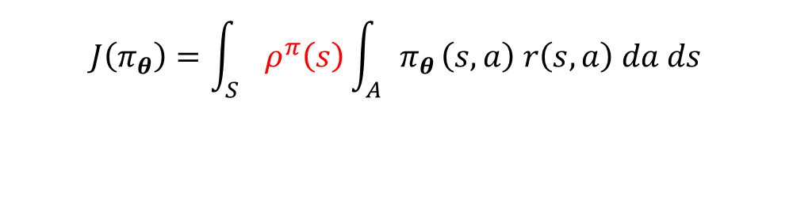

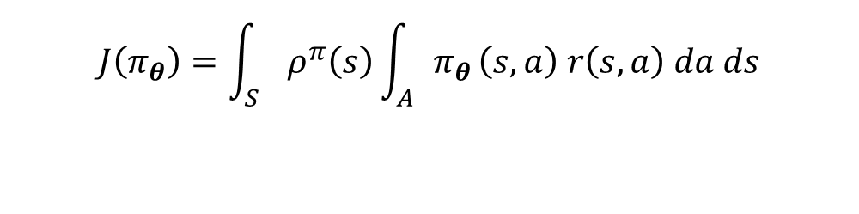
Stochastic vs Deterministic Policy Gradients:
An optimal policy maximizes the total return:
$$J\left(π\right)=𝔼\left[r_{0}^{γ}\right]=𝔼\left[\sum_{t=0}^{∞}{γ^{t}}r(s_{t},a_{t})\right]$$
$$J\left(π_{θ}\right)=\int_{S}{ρ^{π}\left(s\right)\int_{A}{π_{θ}}\left(s,a\right) r\left(s,a\right) da ds}$$
$$J\left(π_{θ}\right)=\int_{S}{ρ^{π}\left(s\right)\int_{A}{π_{θ}}\left(s,a\right) r\left(s,a\right) da ds}$$
$$γ:\text{discount} \text{factor}, 0≤γ≤ 1$$
$$=𝔼_{s\sim ρ^{π}, a\sim π_{θ}}\left[r\left(s,a\right)\right]$$
Probability density at state s’ for “t+1” steps from s.
$$ρ^{π}\left(s′\right)=\int_{S}{\sum_{t=0}^{∞}{γ^{t} p_{0}\left(s\right) p\left(s→s^{′},t+1,π\right) ds}}$$
$$p\left(s→s^{′},1,π\right)=p\left(s^{′}|s,π\right)$$
Stochastic
Deterministic
$$π_{θ}\left(a | s\right)=P\left[a|s,θ\right]$$
$$a=μ_{θ}\left(s\right)$$

Slide 4
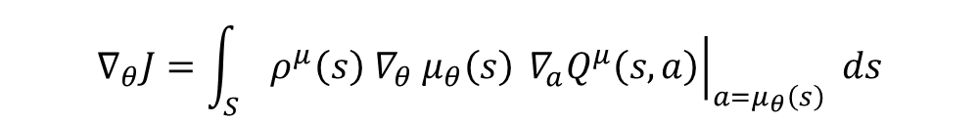
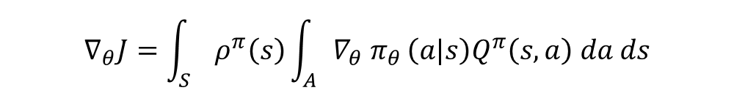
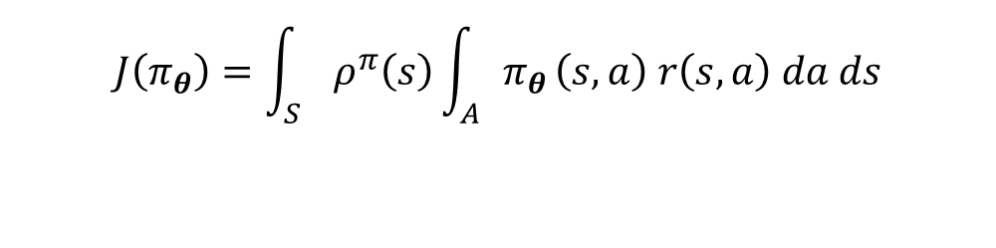


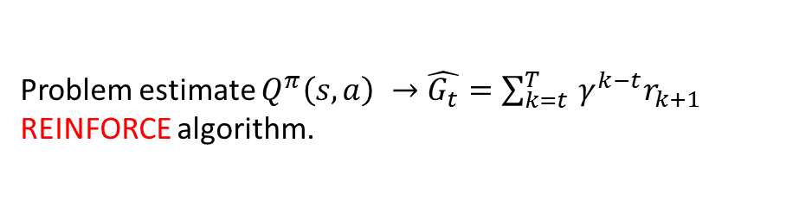
Policy Gradient Theorem:
Stochastic
Deterministic
$$J\left(π_{θ}\right)=\int_{S}{ρ^{π}\left(s\right)\int_{A}{π_{θ}}\left(s,a\right) r\left(s,a\right) da ds}$$
$$J\left(μ_{θ}\right)=\int_{S}{ρ^{μ}\left(s\right)r\left(s, μ_{θ}\left(s\right)\right)ds}$$
$$=𝔼_{s\sim ρ^{π}, a\sim π_{θ}}\left[r\left(s,a\right)\right]$$
$$=𝔼_{s\sim ρ^{μ}}\left[r\left(s, μ_{θ}\left(s\right)\right)\right]$$
$$∇_{θ}J=\int_{S}{ρ^{π}\left(s\right)\int_{A}{{∇_{θ} π}_{θ}}\left(a|s\right)Q^{π}\left(s,a\right) da ds}$$
$$∇_{θ}J=\int_{S}{ρ^{μ}\left(s\right){{ ∇}_{θ} μ}_{θ}\left(s\right){\left.{ ∇}_{a}Q^{μ}\left(s,a\right)\right|}_{a=μ_{θ}\left(s\right)} ds}$$
$$=𝔼_{s\sim ρ^{μ}}\left[{{ ∇}_{θ} μ}_{θ}\left(s\right){\left.{ ∇}_{a}Q^{μ}\left(s,a\right)\right|}_{a=μ_{θ}\left(s\right)}\right]$$
$$=𝔼_{s\sim ρ^{π}, a\sim π_{θ}}\left[{Q^{π}\left(s,a\right){ ∇}_{θ} \text{log} π}_{θ}\left(a| s\right)\right]$$
For some stochastic policies,
The deterministic gradient is a limiting case
of the stochastic one.
Problem estimate $Q^{π}\left(s,a\right) →\hat{G_{t}}=\sum_{k=t }^{T}{γ^{k−t}r_{k+1}}$
REINFORCE algorithm.

Slide 5



Policy Gradient Theorem:
Stochastic
Deterministic
$$J\left(π_{θ}\right)=\int_{S}{ρ^{π}\left(s\right)\int_{A}{π_{θ}}\left(s,a\right) r\left(s,a\right) da ds}$$
$$J=\int_{S}{ρ^{μ}\left(s\right)r\left(s, μ_{θ}\left(s\right)\right)ds}$$
$$=𝔼_{s\sim ρ^{π}, a\sim π_{θ}}\left[r\left(s,a\right)\right]$$
$$=𝔼_{s\sim ρ^{μ}}\left[r\left(s, μ_{θ}\left(s\right)\right)\right]$$
$$∇_{θ}J=\int_{S}{ρ^{π}\left(s\right)\int_{A}{{∇_{θ} π}_{θ}}\left(a|s\right)Q^{π}\left(s,a\right) da ds}$$
$$∇_{θ}J=\int_{S}{ρ^{μ}\left(s\right){{ ∇}_{θ} μ}_{θ}\left(s\right){\left.{ ∇}_{a}Q^{μ}\left(s,a\right)\right|}_{a=μ_{θ}\left(s\right)} ds}$$
$$=𝔼_{s\sim ρ^{μ}}\left[{{ ∇}_{θ} μ}_{θ}\left(s\right){\left.{ ∇}_{a}Q^{μ}\left(s,a\right)\right|}_{a=μ_{θ}\left(s\right)}\right]$$
$$=𝔼_{s\sim ρ^{π}, a\sim π_{θ}}\left[{Q^{π}\left(s,a\right){ ∇}_{θ} \text{log} π}_{θ}\left(a| s\right)\right]$$
Some conditions on $ν_{σ}$
$$\lim_{σ →0}{∇_{θ}J}\left(π_{μ_{θ}, σ}\right)=∇_{θ}J\left(μ_{θ}\right)$$
$${ π}_{μ_{θ}, σ}\left(a| s\right)=ν_{σ}\left(μ_{θ}\left(s\right),a\right)$$

Slide 6
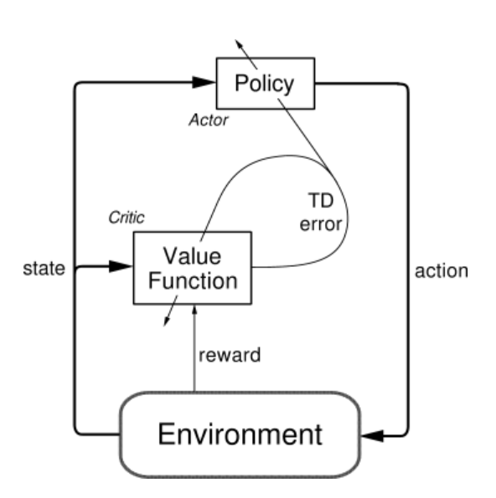

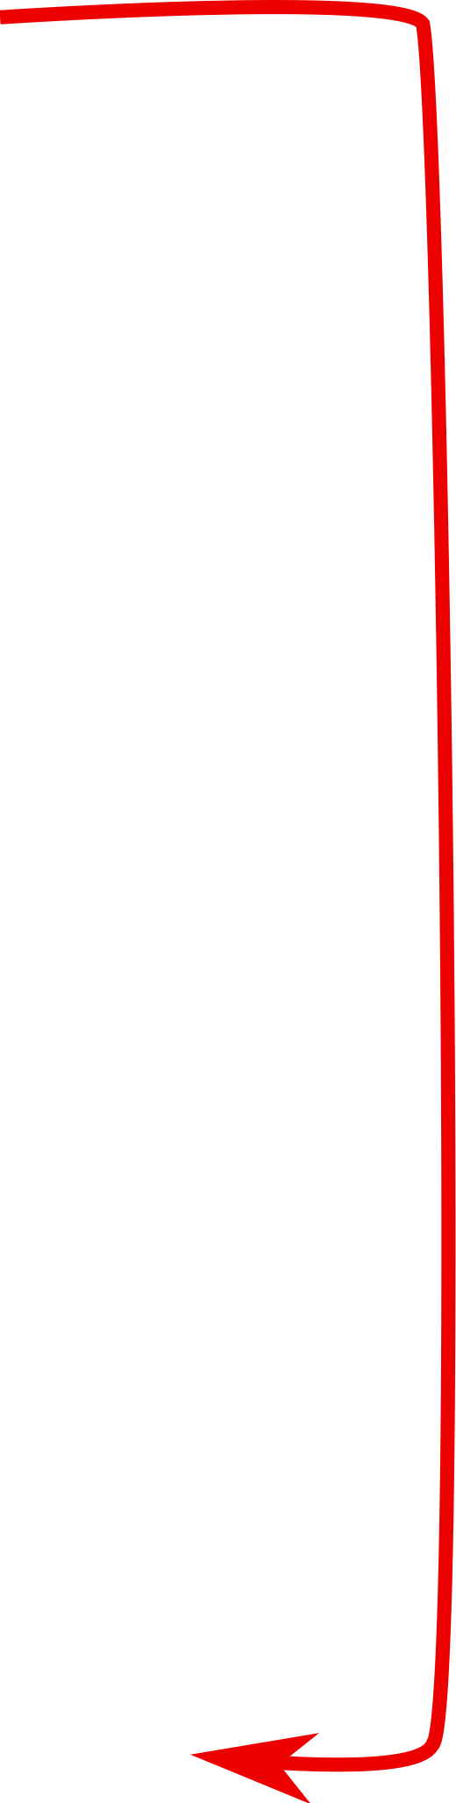


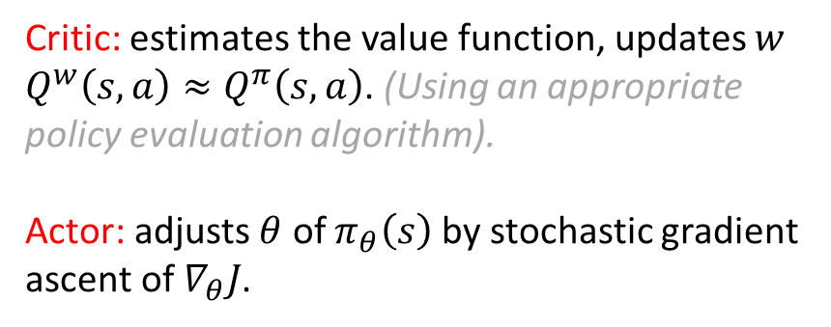
Actor-Critic Algorithms:
Hybrid policy gradient method: value-based + policy-based algorithms.
Critic: estimates the value function, updates $w$ $Q^{w}\left(s,a\right)≈Q^{π}\left(s,a\right)$. (Using an appropriate policy evaluation algorithm).
Actor: adjusts $θ$ of $π_{θ}\left(s\right)$ by stochastic gradient ascent of $∇_{θ}J$.
$$θ_{t+1}=θ_{t}+α \hat{∇J\left(θ_{t}\right)}$$
Stochastic estimate
Sutton & Barto (1998)

Slide 7
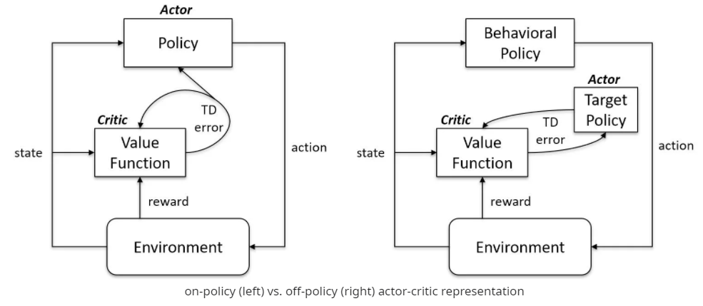
Actor-Critic Algorithms:
On-policy
Off-policy
Figure: https://www.reddit.com/r/reinforcementlearning/comments/hd35zt/onpolicy_vs_offpolicy_actorcritic/

Slide 8

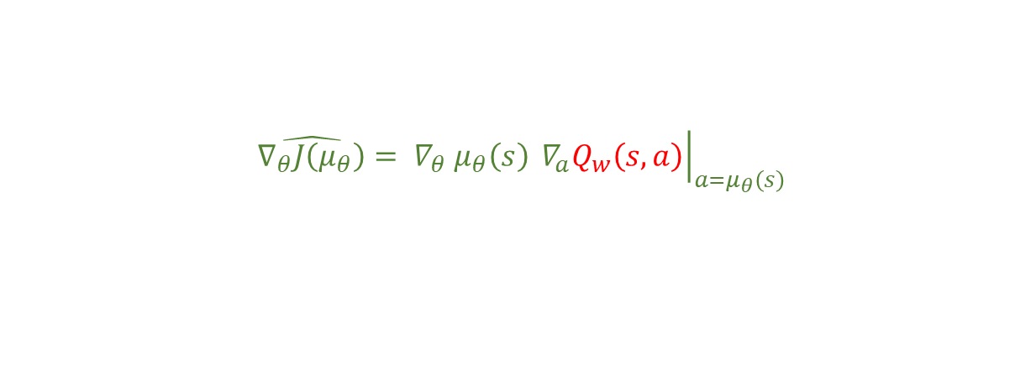



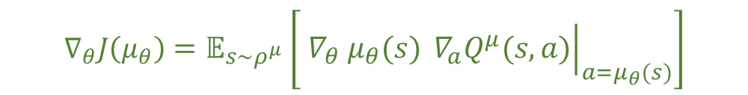
Actor-Critic Algorithms:
Stochastic
Deterministic
$$∇_{θ}J\left(μ_{θ}\right)=𝔼_{s\sim ρ^{μ}}\left[{{ ∇}_{θ} μ}_{θ}\left(s\right){\left.{ ∇}_{a}Q^{μ}\left(s,a\right)\right|}_{a=μ_{θ}\left(s\right)}\right]$$
$$∇_{θ}J\left(π_{θ}\right)=𝔼_{s\sim ρ^{π}, a\sim π_{θ}}\left[{Q^{π}\left(s,a\right){ ∇}_{θ} \text{log} π}_{θ}\left(a| s\right)\right]$$
$${\hat{∇_{θ}J\left(π_{θ}\right)}=Q_{w}\left(s,a\right){ ∇}_{θ} \text{log} π}_{θ}\left(a| s\right)$$
$${{ \hat{∇_{θ}J\left(μ_{θ}\right)}= ∇}_{θ} μ}_{θ}\left(s\right){\left.{ ∇}_{a}Q_{w}\left(s,a\right)\right|}_{a=μ_{θ}\left(s\right)}$$
$$a\sim π_{θ}\left(a| s\right)$$
$$a=μ_{θ}\left(s\right)$$
On-policy:
To update the Critic:
(e.g. TD in SARSA)
$$δ_{t}=r_{t}+γQ_{w}\left(s_{t+1}, a_{t+1}\right)−Q_{w}\left(s_{t}, a_{t}\right)$$
$$w_{t+1}=w_{t}+α_{w}{ δ}_{t} ∇_{w}Q_{w}\left(s_{t}, a_{t}\right)$$
To update the Actor:
$$θ_{t+1}=θ_{t}+α_{θ}\hat{∇_{θ}J}$$

Slide 9


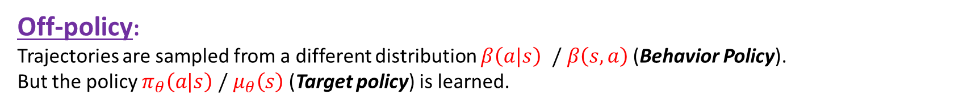


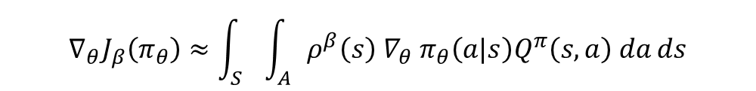

Actor-Critic Algorithms:
Off-policy:
Trajectories are sampled from a different distribution $β\left(a|s\right)$ $/ β\left(s,a\right)$ (Behavior Policy).
But the policy $π_{θ}\left(a|s\right) /{ μ}_{θ}\left(s\right)$ (Target policy) is learned.
Stochastic
Deterministic
Here $β\left(s,a\right)$ is used to ensure enough exploration.
$$J_{β}\left(π_{θ}\right)=\int_{S}{\int_{A}{ρ^{β}\left(s\right) { π}_{θ}\left(a|s\right)Q^{π}\left(s,a\right) da} ds}$$
$$J_{β}\left(μ_{θ}\right)=\int_{S}{ρ^{β}\left(s\right) Q^{μ}\left(s,μ_{θ}\left(s\right)\right) ds}$$
$$∇_{θ}J_{β}\left(π_{θ}\right)≈\int_{S}{\int_{A}{ρ^{β}\left(s\right) {∇_{θ} π}_{θ}\left(a|s\right)Q^{π}\left(s,a\right) da}ds}$$
$$∇_{θ}J_{β}\left(μ_{θ}\right)≈\int_{S}{ρ^{β}\left(s\right) ∇_{θ}μ_{θ}\left(a|s\right) Q^{μ}\left(s,a\right) ds}$$
$$=𝔼_{s\sim ρ^{β}, a\sim β}\left[\frac{π_{θ}\left(a|s\right) }{β_{θ}\left(a|s\right)}{Q^{π}\left(s,a\right){ ∇}_{θ} \text{log} π}_{θ}\left(a| s\right)\right]$$
$$=𝔼_{s\sim ρ^{β} }\left[{{ ∇}_{θ} μ}_{θ}\left(s\right){\left.{ ∇}_{a}Q^{μ}\left(s,a\right)\right|}_{a=μ_{θ}\left(s\right)}\right]$$

Slide 10
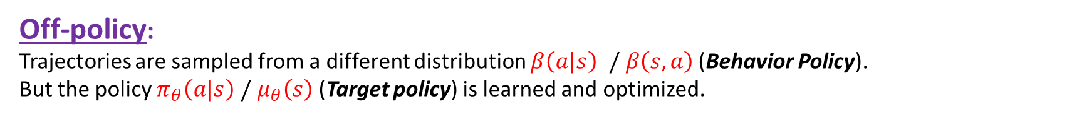
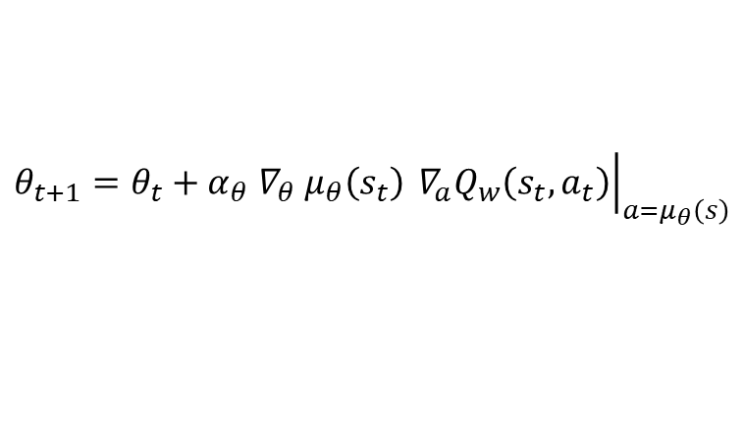
Actor-Critic Algorithms:
Off-policy:
Trajectories are sampled from a different distribution $β\left(a|s\right)$ $/ β\left(s,a\right)$ (Behavior Policy).
But the policy $π_{θ}\left(a|s\right) /{ μ}_{θ}\left(s\right)$ (Target policy) is learned and optimized.
Off-Policy Deterministic Actor-Critic (OPDAC)
Critic:
Q-learning update:
$$δ_{t}=r_{t}+γQ_{w}\left(s_{t+1}, μ_{θ}\left(s_{t+1}\right)\right)−Q_{w}\left(s_{t}, a_{t}\right)$$
$$w_{t+1}=w_{t}+α_{w}{ δ}_{t} ∇_{w}Q_{w}\left(s_{t}, a_{t}\right)$$
Actor:
$$θ_{t+1}=θ_{t}+α_{θ}{{ ∇}_{θ} μ}_{θ}\left(s_{t}\right){\left.{ ∇}_{a}Q_{w}\left(s_{t},a_{t}\right)\right|}_{a=μ_{θ}\left(s\right)}$$

Slide 11
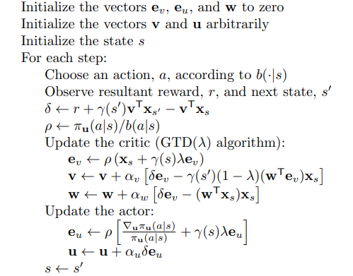
Actor-Critic Algorithms:
Off-Policy Stochastic Actor-Critic . (Off-PAC Algorithm)
Behavioral policy to generate trajectories
$$δ_{t}=r_{t+1}+γV^{v}\left(s_{t+1}\right)−V^{v}\left(s_{t}\right)$$
Importance sampling ratio
Degris et al. (2012)

Slide 12
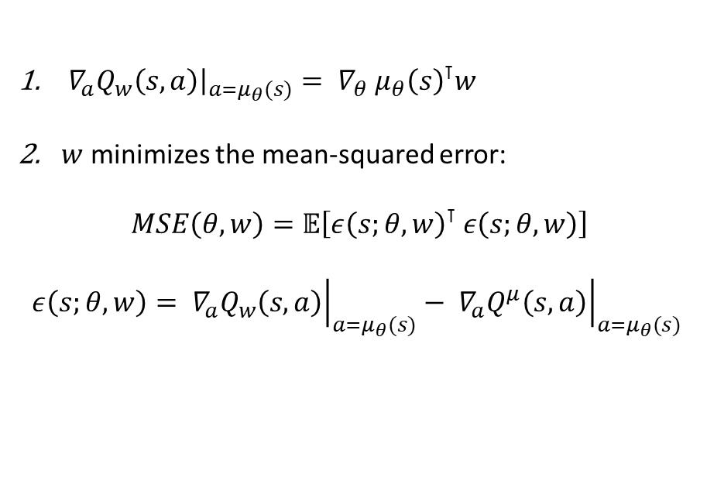
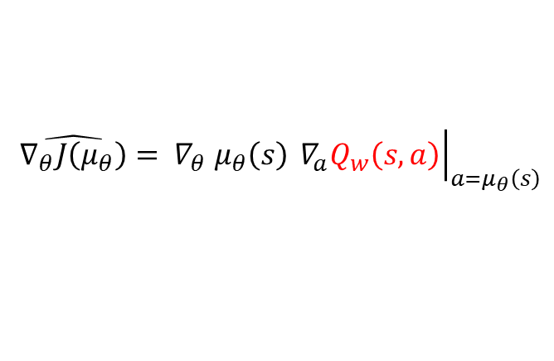


Compatible function approximation:
Find$Q_{w}\left(s,a\right)$ such that${ ∇}_{a}Q^{π(or μ)}\left(s,a\right)$ can be replaced by ${ ∇}_{a}Q_{w}\left(s,a\right)$.
We say that the function approximator $Q_{w}\left(s,a\right)$is compatible with the policy $π \left(or μ\right).$
Stochastic
Deterministic
${ ∇}_{w}Q_{w}\left(s,a\right)={ ∇}_{θ} \text{log} π_{θ}\left(a|s\right)$
$$Q_{w}\left(s,a\right)={{ ∇}_{θ} \text{log} π_{θ}\left(a|s\right)}^{⊺}w$$
$w$ minimizes the mean-squared error:
$MSE\left(θ, w\right)=𝔼\left[{\left(Q_{w}\left(s,a\right) −Q^{π}\left(s,a\right)\right)}^{2}\right]$
${\left.{ ∇}_{a}Q_{w}\left(s,a\right)\right|}_{a=μ_{θ}(s)}={{{ ∇}_{θ} μ}_{θ}\left(s\right)}^{⊺}w$
$w$ minimizes the mean-squared error:
$MSE\left(θ, w\right)=𝔼\left[ε{\left(s;θ, w\right)}^{⊺} ε\left(s;θ, w\right)\right]$
$$ε\left(s;θ, w\right)={\left.{ ∇}_{a}Q_{w}\left(s,a\right)\right|}_{a=μ_{θ}(s)}−{\left.{ ∇}_{a}Q^{μ}\left(s,a\right)\right|}_{a=μ_{θ}(s)}$$
$${\hat{∇_{θ}J\left(π_{θ}\right)}=Q_{w}\left(s,a\right){ ∇}_{θ} \text{log} π}_{θ}\left(a| s\right)$$
Then there is no bias in $∇_{θ}J\left(p_{θ}\right)=𝔼\left[\hat{∇_{θ}J\left(p_{θ}\right)}\right]$
$${{ \hat{∇_{θ}J\left(μ_{θ}\right)}= ∇}_{θ} μ}_{θ}\left(s\right){\left.{ ∇}_{a}Q_{w}\left(s,a\right)\right|}_{a=μ_{θ}\left(s\right)}$$

Slide 13


Compatible function approximation:
Deterministic:
$$Q_{w}\left(s,a\right)={\left(a−μ_{θ}\left(s\right)\right)}^{⊺}{{ ∇}_{θ }μ_{θ}(s)}^{⊺}w+V^{v}\left(s\right)$$
$$A^{w}\left(s\right)={φ\left(s,a\right)}^{⊺}w$$
Advantage:
$${\text{def}\text{:} φ\left(s,a\right)={ ∇}_{θ} μ}_{θ}\left(s\right) \left(a−μ_{θ}\left(s\right)\right)$$
Baseline:
$$V^{v}\left(s\right)=v^{⊺}φ\left(s\right)$$
Compatible Off-Policy Deterministic Actor-Critic (COPDAC-Q)
Critic:
$$δ_{t}=r_{t}+γQ_{w}\left(s_{t+1}, μ_{θ}\left(s_{t+1}\right)\right)−Q_{w}\left(s_{t}, a_{t}\right)$$
$$w_{t+1}=w_{t}+α_{w}{ δ}_{t}φ\left(s_{t},a_{t}\right)$$
$$v_{t+1}=v_{t}+α_{v}{ δ}_{t}φ\left(s_{t}\right)$$
Actor:
$$θ_{t+1}=θ_{t}+α_{θ}{{ ∇}_{θ} μ}_{θ}\left(s_{t}\right)\left({{{ ∇}_{θ} μ}_{θ}\left(s_{t}\right)}^{⊺}w_{t} \right)$$

Slide 14
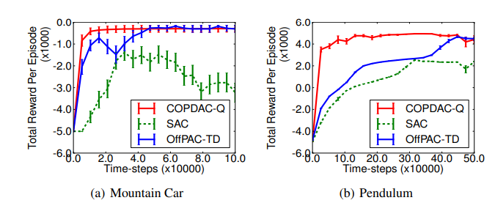
Applications of Deterministic Policy Gradient

Slide 15
Expected Policy Gradients (EPG)
Motivations:
The theory of the methods of Stochastic and Deterministic Policy Gradients is quite fragmented. Each one has a different Policy Gradient Theorem.
Stochastic Policy Gradients (SPG) usually needs many trajectories for learning. (Expensive)
Deterministic Policy Gradients (DPG) mitigates SPG problems but learns off-policy which needs a good behavioral policy (Difficult to design in practice).
EPG is on-policy
General Policy Gradient theorem
&
Stochastic + Deterministic Policy Gradient theorems
Has a lower variance than SPG

Slide 16





Expected Policy Gradients (EPG)
Main Algorithm:
$$∇_{θ}J\left(π_{θ}\right)=𝔼_{s\sim ρ^{π}, a\sim π_{θ}}\left[{{(Q}^{π}\left(s,a\right)+b\left(s\right)){ ∇}_{θ} \text{log} π}_{θ}\left(a| s\right)\right]$$
$$∇_{θ}J\left(π_{θ}\right)=\int_{S}{ρ^{π}\left(s\right)}\int_{A}{π_{θ}\left(a| s\right) {{(Q}^{π}\left(s,a\right)+b\left(s\right)){ ∇}_{θ} \text{log} π}_{θ}\left(a| s\right) da}ds$$
$$=\int_{S}{ρ^{π}\left(s\right)}I_{π}^{Q}\left(s\right)ds$$
Some approximation of $I_{π}^{Q}\left(s\right)$
$$\hat{∇_{θ}J\left(π_{θ}\right)}=\sum_{t=0}^{T}{γ^{t}{ \hat{I}}_{π}^{\hat{Q}}\left(s_{t}\right)}$$
Approximate gradient:
(trajectory $τ$ of length $T$)
$$g_{t}$$

Slide 17
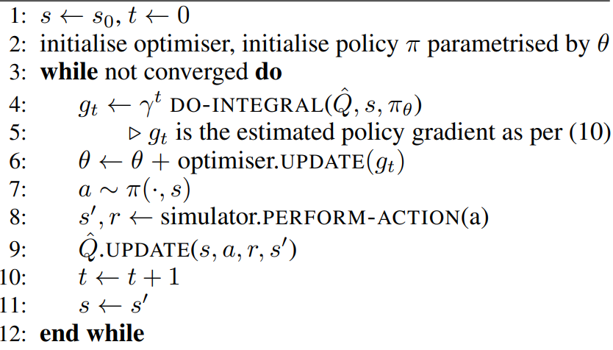
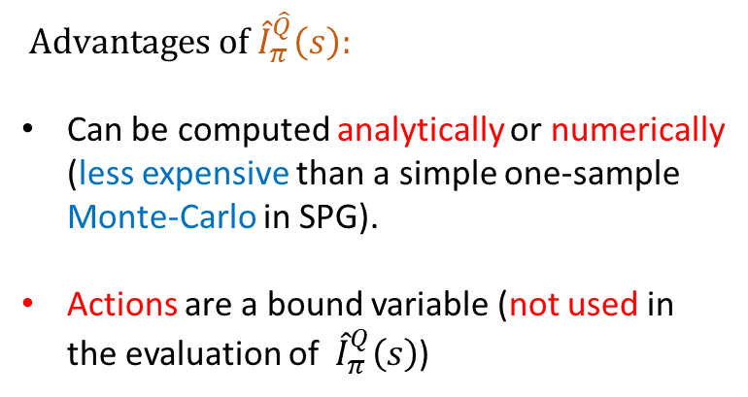

Expected Policy Gradients (EPG)
$$\hat{∇_{θ}J\left(π_{θ}\right)}=\sum_{t=0}^{T}{γ^{t}{ \hat{I}}_{π}^{\hat{Q}}\left(s_{t}\right)}$$
Main algorithm:
${ \text{Advantages} \text{of} \hat{I}}_{π}^{\hat{Q}}\left(s\right):$
Can be computed analytically or numerically (less expensive than a simple one-sample Monte-Carlo in SPG).
Actions are a bound variable (not used in the evaluation of ${ \hat{I}}_{π}^{Q}\left(s\right)$)

Slide 18
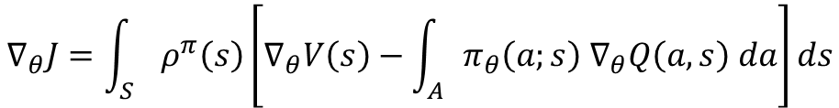
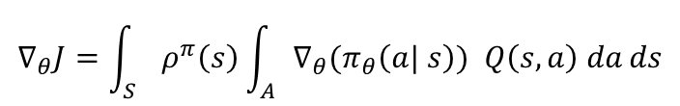
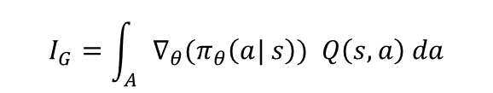

Expected Policy Gradients (EPG)
General Policy Gradient theorem
$$∇_{θ}J=\int_{S}{ρ^{π}\left(s\right)\left[∇_{θ}V\left(s\right)−\int_{A}{π_{θ}\left(a;s\right) ∇_{θ}Q\left(a,s\right) da}\right]ds}$$
$$I_{G}$$
$$∇_{θ}V=∇_{θ}\int_{A}{π_{θ}\left(a| s\right) Q\left(s,a\right) da}=\int_{A}{{∇_{θ}(π}_{θ}\left(a| s\right)) Q\left(s,a\right) da}+\int_{A}{{ π}_{θ}\left(a| s\right){ ∇}_{θ}Q\left(s,a\right) da}$$
$$I_{G}=\int_{A}{{∇_{θ}(π}_{θ}\left(a| s\right)) Q\left(s,a\right) da}$$
$$∇_{θ}J=\int_{S}{ρ^{π}\left(s\right)\int_{A}{{∇_{θ}(π}_{θ}\left(a| s\right)) Q\left(s,a\right) da}ds}$$
Stochastic Policy Gradient Theorem

Slide 19

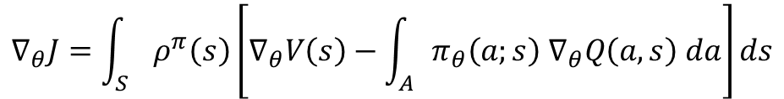
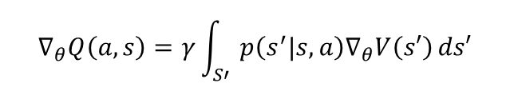

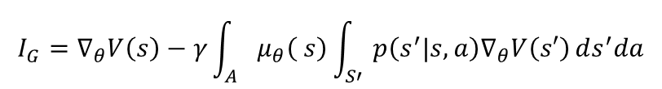

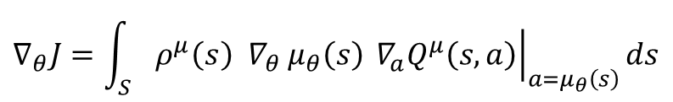
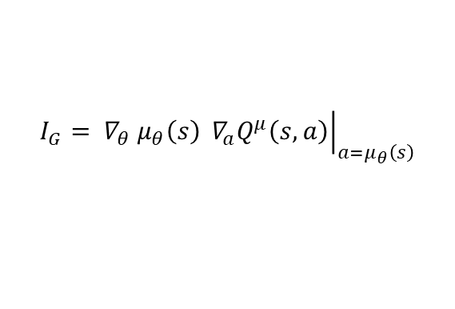
Expected Policy Gradients (EPG)
General Policy Gradient theorem
$$∇_{θ}J=\int_{S}{ρ^{π}\left(s\right)\left[∇_{θ}V\left(s\right)−\int_{A}{π_{θ}\left(a;s\right) ∇_{θ}Q\left(a,s\right) da}\right]ds}$$
$$I_{G}$$
$$I_{G}=∇_{θ}V\left(s\right)−\int_{A}{μ_{θ}\left(s\right) ∇_{θ}Q\left(a,s\right) da}$$
$$Q\left(a,s\right)=\int_{S′}{p\left(s^{′}|s,a\right) \left[r\left(s,a\right)+γV_{θ}\left(s′\right)\right] ds′}$$
$$∇_{θ}Q\left(a,s\right)=γ\int_{S′}{p\left(s^{′}|s,a\right)∇_{θ}V\left(s′\right)}ds′$$
$$I_{G}=∇_{θ}V\left(s\right)−γ\int_{A}{μ_{θ}\left( s\right)\int_{S′}{p\left(s^{′}|s,a\right)∇_{θ}V\left(s′\right)}ds^{′}da}$$
$$I_{G}=∇_{θ}V\left(s\right)−γ\int_{S′}{p\left(s^{′}|s\right)∇_{θ}V\left(s′\right)}ds^{′}$$
From a proof of DPG theorem in Silver’s paper
$$I_{G}={{ ∇}_{θ} μ}_{θ}\left(s\right){\left.{ ∇}_{a}Q^{μ}\left(s,a\right)\right|}_{a=μ_{θ}\left(s\right)}$$
$$p\left(s→s^{′},1,μ\right)=p\left(s^{′}|s,μ\right)$$
$$∇_{θ}J=\int_{S}{ρ^{μ}\left(s\right){{ ∇}_{θ} μ}_{θ}\left(s\right){\left.{ ∇}_{a}Q^{μ}\left(s,a\right)\right|}_{a=μ_{θ}\left(s\right)}ds}$$
Deterministic Policy Gradient Theorem

Slide 20
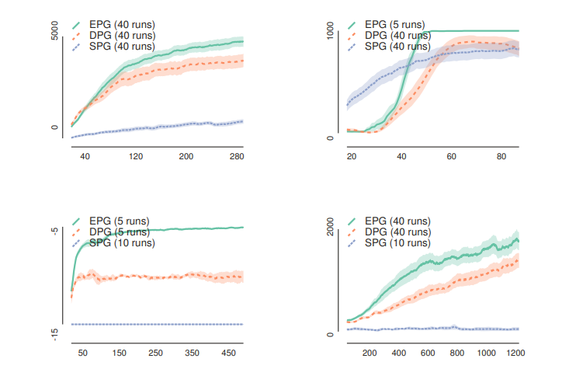
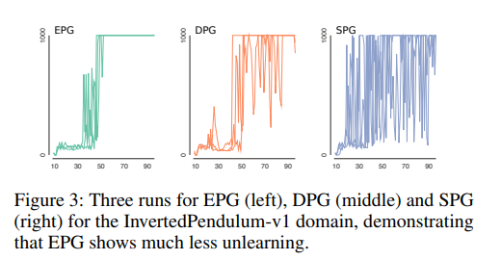
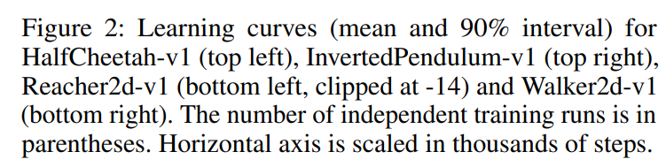
Expected Policy Gradients (EPG): Applications

Slide 21
Conclusions
In Deterministic Policy Gradient methods (DPG) the gradients can be estimated more efficiently than in SPG avoiding the integral over the action space.
Even though DPG has some difficulties (choice of a good behavioral policy), it outperformed its stochastic counterpart.
Expected Policy Gradient methods (EPG) are introduced to overcome Stochastic Policy Gradients (SPG) and DPG difficulties.
The authors of the second paper used EPG to prove a new general policy gradient theorem.
EPG outperformed SPG and DPG in four domains.

