Slide 1
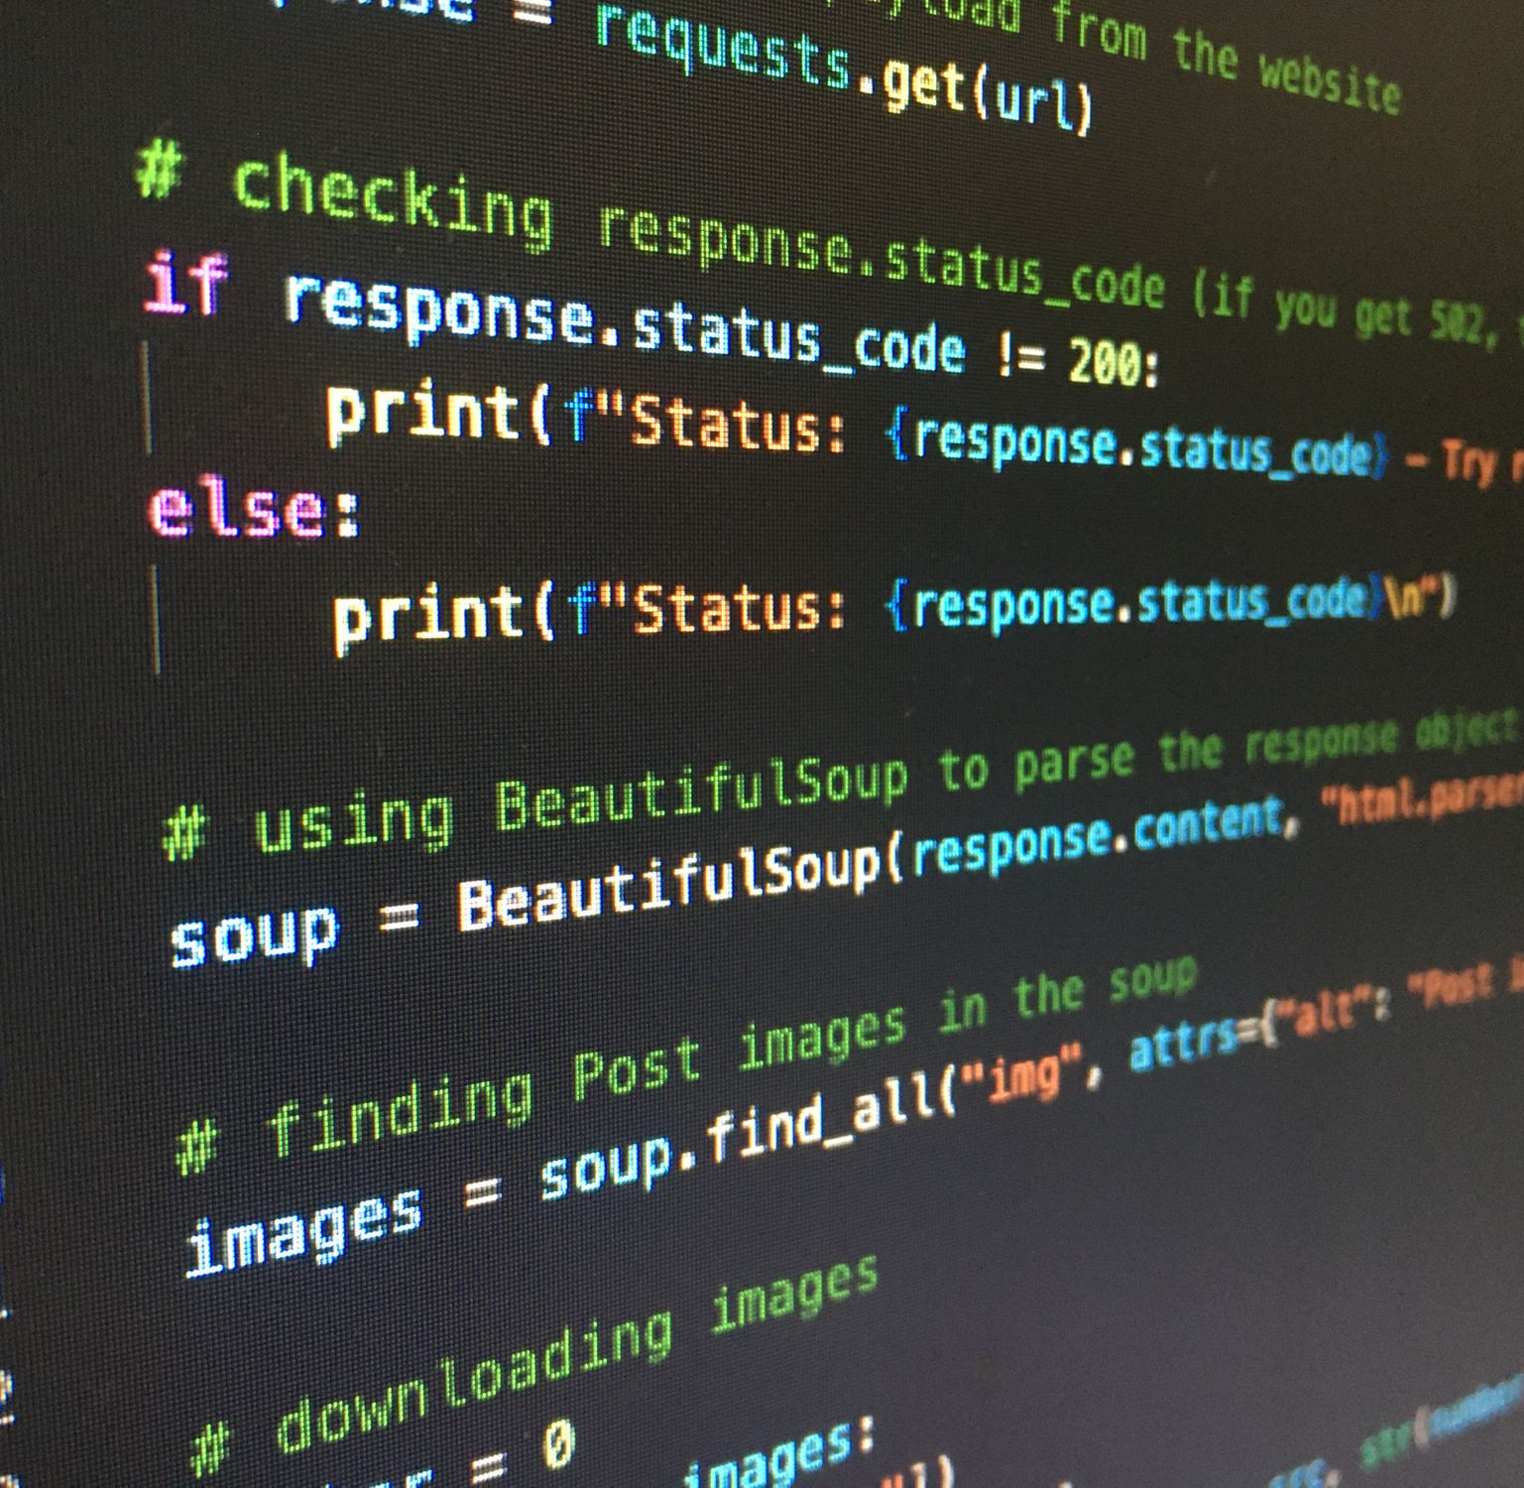
Ψ
Advanced Python for Psychologists
Dominique Makowski – July 2022
Prerequisites
Create a GitHub account
Install git -> https://git-scm.com/download

Slide 2

About this workshop
Flexible and interactive: the only goal is to be useful to you!
dom.makowski@gmail.com
https://github.com/DominiqueMakowski/teaching/
Real-time feedback (pace, pauses, issues…)
Why Python?
Why not SPSS? Matlab? R?
Free, Powerful, Versatile (machine learning, stats, signal processing, experiments…), Demanded (💰), Beginner-friendly
My own journey with Python
TO TELL ME WHAT YOU NEED

Slide 3

What do you do?
What’s your experience & need with Python?

Slide 4

Advanced Python
Personal coding vs. re-usable coding
Modularity
Functions
Re-usability
Packaging
Availability
Open-sourcing, contributing
Efficiency
Vectorization, profiling, …
Beginner Pythonista
Expert Pythonista

Slide 5
Program (theoretical)
9am – 2pm
Day 1: Python basics
Morning
Setting-up Python, VS-code
Python basics
Afternoon
Installing packages
Numpy, scipy & pandas
Day2: Modularity
Morning
NeuroKit & Signal Processing Basics
Afternoon
Packaging
Docstrings
Day 3: Reproducibility and Packaging
Morning
Posting package on GitHub
Afternoon
On-demand
Homework: Create your own accessible and documented Python package to reproduce the creation of descriptive statistics of heart rate (Mean, SD, etc.) given a file containing an ECG signal
Pass if:
Installation instructions work (I can install)
Documentation website contains examples that I can run locally
The functions are documented
Bonus:
You leave one typo that you reference in an issue
Make a Pull Request on a classmate’s package to address that issue

Slide 6
Basic Python

Slide 7
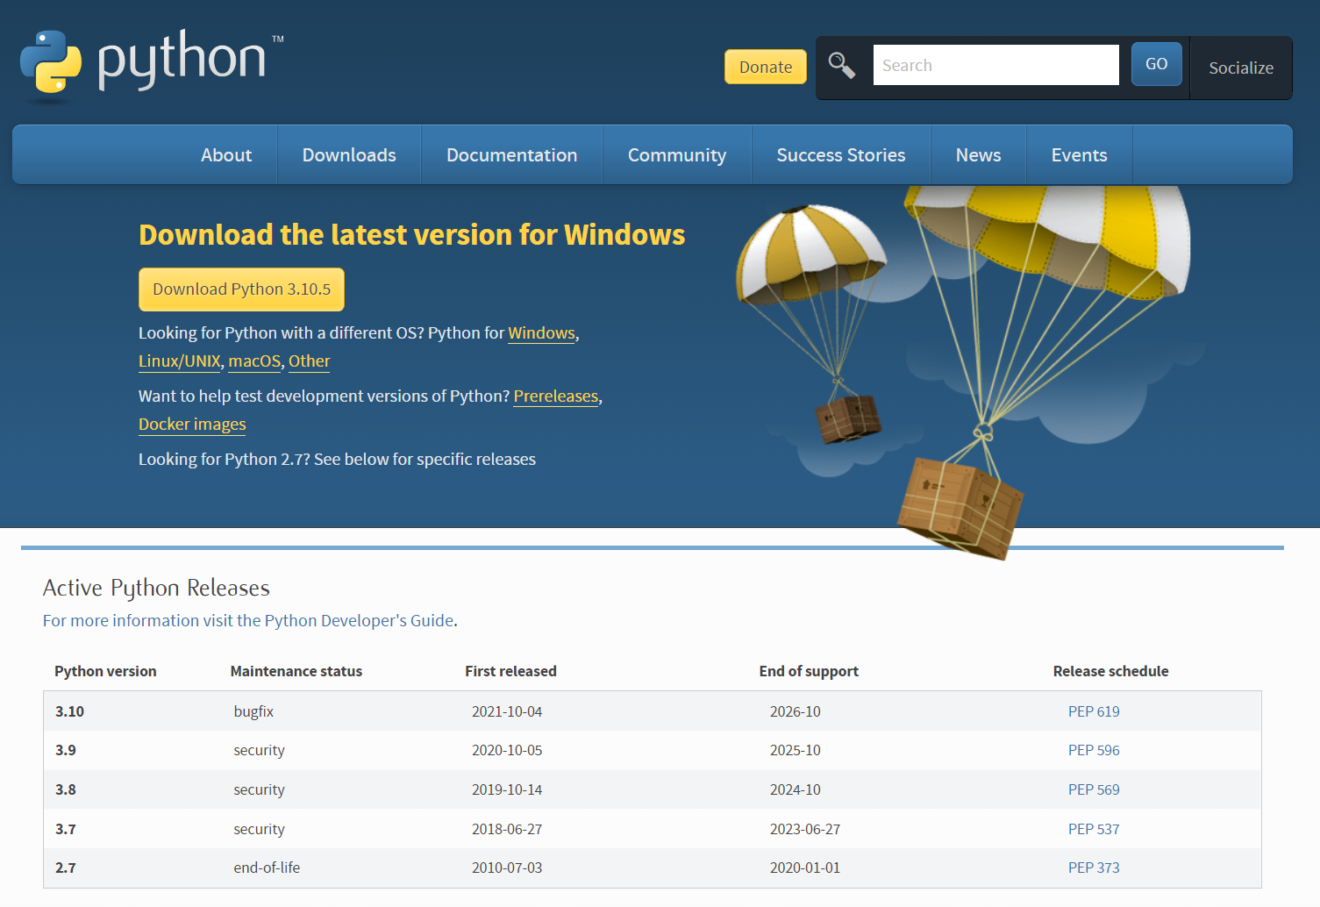
Setting-up Python
Python
Installation
python.org/downloads
Download Python 3 (= 3.x)
Install it

Slide 8
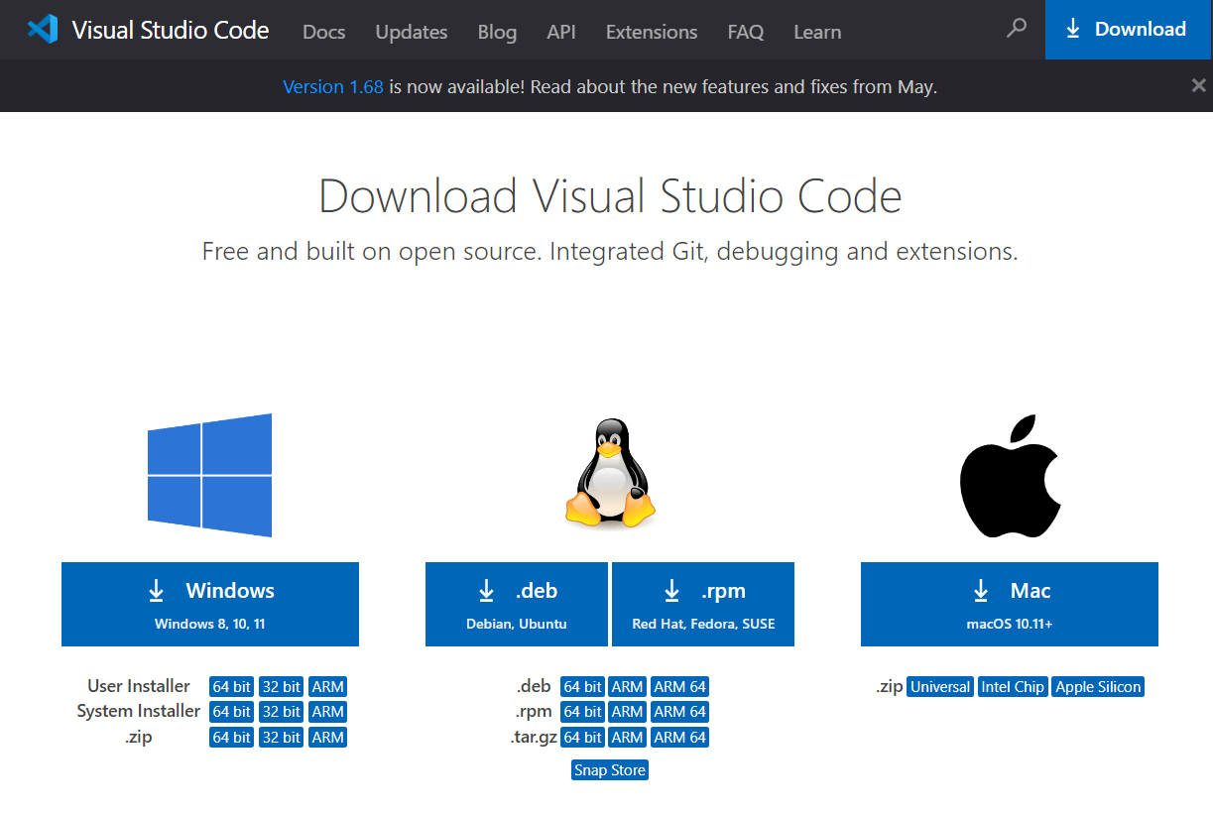
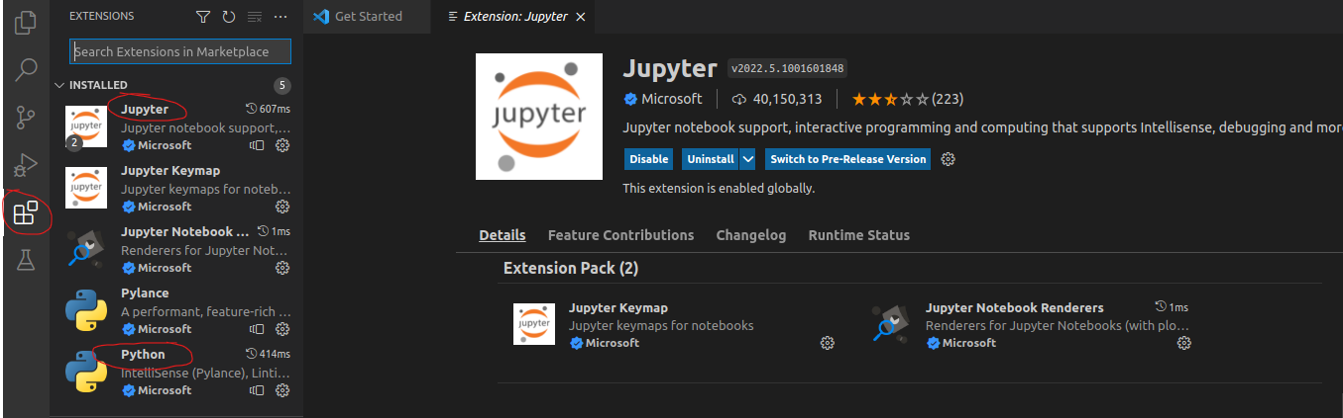
Setting-up Python
VS CODE
Still painful and clunky, but becoming the default 🤷
Installation
Download VS Code
code.visualstudio.com/download
Install it
Extensions
Open, select theme and mark the rest as done
Go to “Extensions”
Install Python & Jupyter

Slide 9
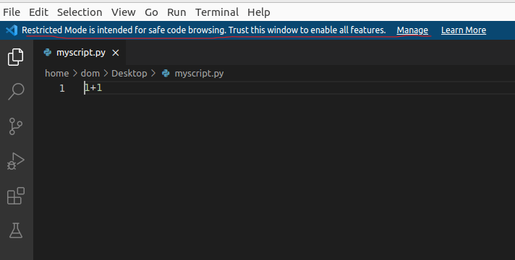
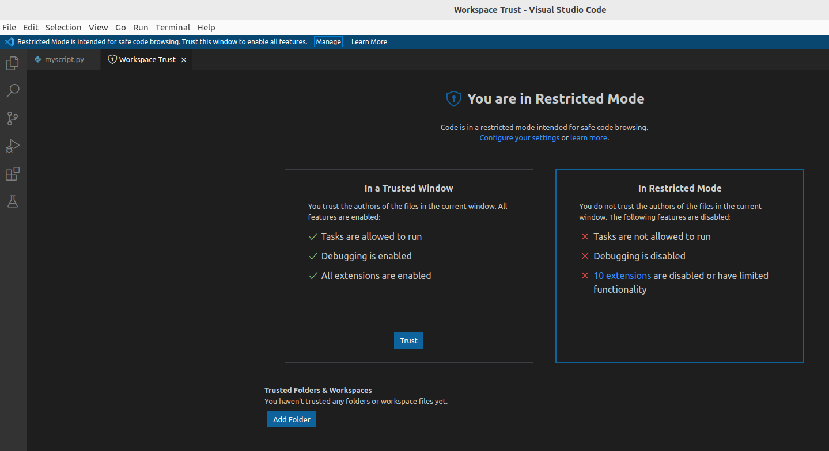
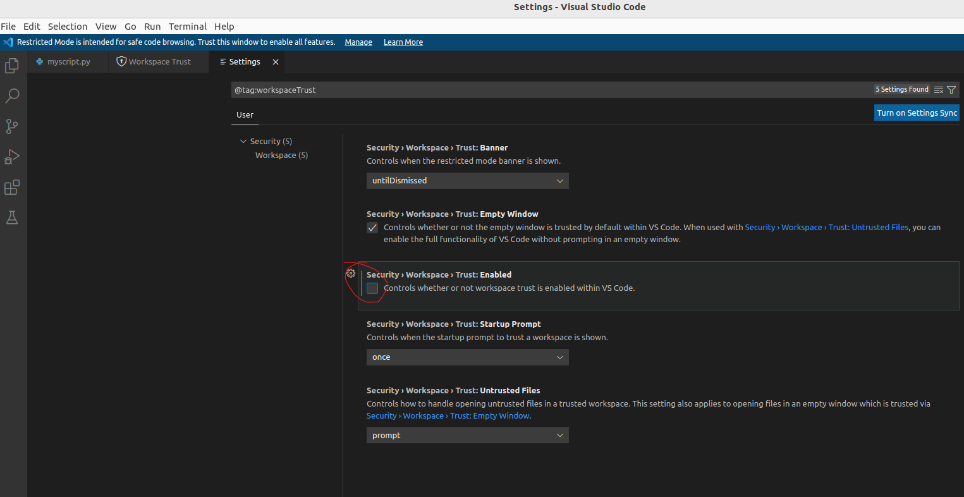
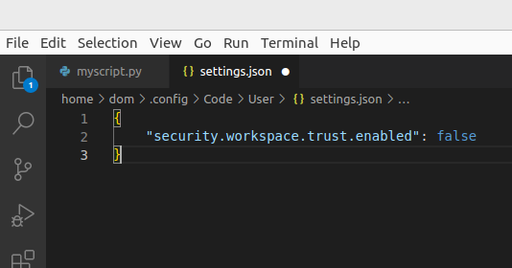
Setting-up Python
Create your first script
From VScode
New file -> Python File -> Save it somewhere (myscript.py)
Edit first settings in VScode
Disable “Trust mode” on Vscode if need be
Manage
Configure your settings
Untick Trust: Enabled
Restart
See the change in settings
View -> Command Palette -> “Settings”
Open Settings (JSON)
Settings in VSCode are just a file! Can be shared, copy-pasted, etc.

Slide 10
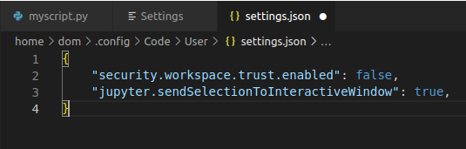
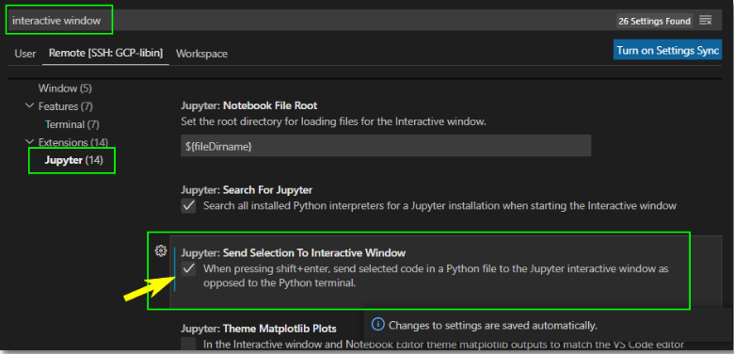
Setting-up Python
Interactive Mode
Add directly Interactive Python
"python.dataScience.sendSelectionToInteractiveWindow": true
Case sensitive (camelCase)
Don’t forget commas!

Slide 11
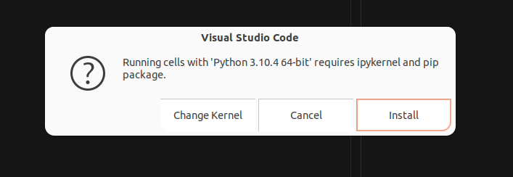
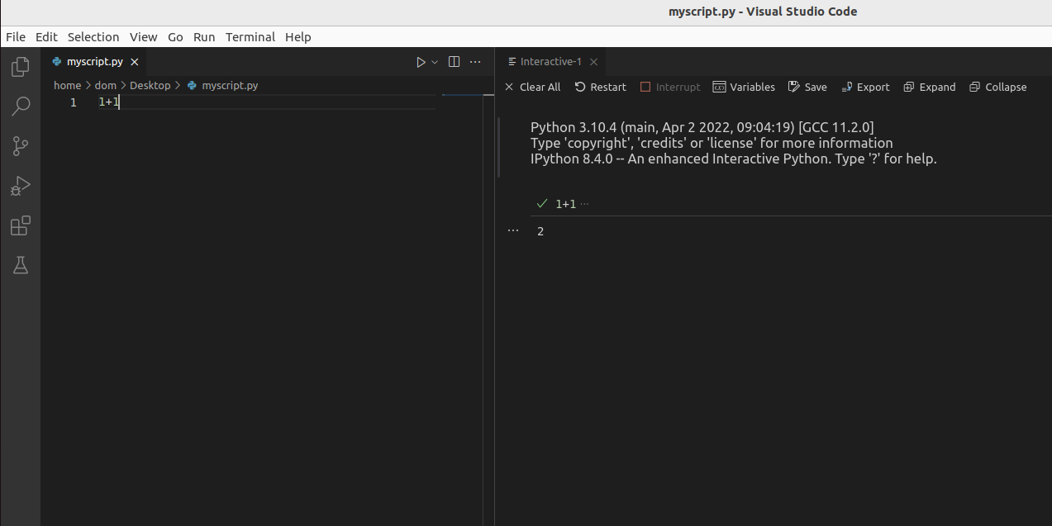
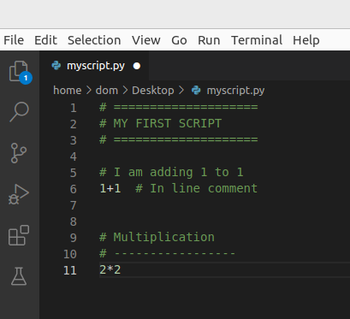
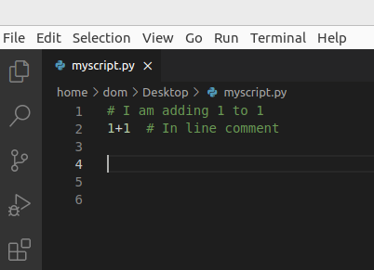
Setting-up Python
Interactive Mode
Go back to your script
Type “1+1”
Select the line
Press SHIFT + ENTER
If prompted install ipykernel / pip
(if nothing happens and it says that pip is not available, let me know!)
Difference script / “console”
Comments !!!
# + space
# + 2 spaces if in-line
Great way to structure and document your code
Syntax & style matters!

Slide 12
Exercice time 💪 (1 min)
Goal: what does “**” do?
1**2; 3**2; 2**3

Slide 13
Basic Python
Basic Control Flow
If, else
Create “blocks”
Must end by “:”
Must be indented by 4 spaces
Operations
+, -, *, **, …
Modulo
Equivalence
Data Types
Operations behave differently on different types (e.g., for numbers, addition; for strings, concatenation)
Booleans (binary)
Numbers
Integers (int())
Floats (float())
Strings
Strings (“…”)
f-string (f“…”)
Check for types: isinstance(3, float)
Variables
myvar = 3

Slide 14
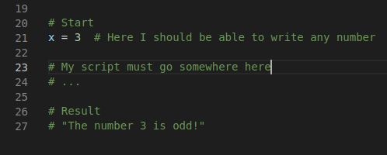
Exercice 1 💪 (5 min)
Goal: write a script that checks if a variable is odd or even
# Start:
x = 3
# Result:
“The number 3 is odd”

Slide 15

Basic GitHub
GitHub
Why? It’s the future.
Super useful for storing projects, data, scripts, & sharing what you want
Became the default repository for neuroscience & psychology
Create your own page: create a new repository called MyName/MyName
Must contain a README.md file is the base component of every repo
This files (and everywhere on GitHub, stackoverflow, …) uses “Markdown” (MD)
*italic*
**bold**
# Title
## Subtitle
### Subtitle
`inline code`
```python
A code chunk
```

Slide 16
Goal: Create your personal GitHub page
Use some Markdown syntax
Post your profile as a answer to the GitHub discussion
Exercice 2 💪 (8 min)

Slide 17
Basic Python
Code can be broken
Advanced Python means building reliable and solid code
Functions
Basis of code modularity
Allows the code to be easily re-usable
A good way to think about the code is to think in terms of functions
A function is created with:
def myfunction(x):
y = x + 1
return y
Minimal function
Arguments
Return object
Indentation!

Slide 18
Goal: Create a function that:
Takes an input
Checks whether an input is odd or even
Returns True/False
Robust (deals with unexpected inputs)
Is documented (some comments explain what the code does)
Post your function as an answer to the GitHub discussion
Exercice 3 💪 (10 min)

Slide 19
Basic Python
Lists and Dictionaries
Containers of multiple things
Lists are ordered
Dictionaries contain items that have names (“keys”)
mylist = [1, 2, 3]
mydict = {"A": 1, "B": 2, "C": 3}
Indexing []: an essential skill
mylist[1]
mylist[0:2]
Indexing in Python starts from 0!
mydict[1]
mydict["b"]
mydict["B"]

Slide 20
Without trying, what’s the output of:
mydict = {"1": 0, "2": 42, "x": 7}
x = str(1 + 1)
y = mydict[x]
print(y)
Exercice 4 💪 (1 min)

Slide 21
Basic Python
Loops
Allows to iterate over stuff
for loop: one (or multiple) variables that change at every loop
mylist = [2, 4, 5]
for myvar in mylist:
print("current value is" + str(myvar))
Is there a way to simplify the string concatenation?
A convenient way of creating a “list”-like object to iterate on is range()
for i in range(10):
print(i)

Slide 22
Exercice 5 💪 (10 min)
Create a function that takes a number as an input, and prints the Fibonacci sequence (0, 1, 1, 2, 3, 5, …) up until that number
Post your solution as a comment to the discussion

Slide 23
Basic Python
Advanced iteration
Get index and content at the same time
enumerate()
mylist = [2, 4, 5]
for myvar in mylist:
print("current value is" + str(myvar))
Enumerate on dictionaries
dict.keys() or mydict.items()
mydict = {"A": 1, "B": 2, "C": 3}
for k in mydict.keys():
print(k)
for k, item in mydict.items():
print(k)
print(item)

Slide 24
Basic Python
Can also iterate on strings
sentence = "Hello World"
for l in sentence:
print(l)
Add / remove from containers
Lists: mylist.append(what), mylist.insert(where, what)
Dicts: mydict.pop(what), mydict["key"] = x
Methods
Some objects have “methods” (functions attached to them)
Some of them act “in-place” (no return)
Strings have methods too (e.g., .replace(), .lower(), …)
sentence = "Hello World"
sentence.replace("Hello", "Goodbye")
Sentence
Other useful methods include .index() fors lists
mylist = ["x", "y", "z"]
mylist.index("y")

Slide 25
Exercice 6 💪 (15 min)
Create an encoder that changes each letter of a sentence into the next alphabetical order
Post your solution as a comment to the discussion
Expected:
>>> x = encode(“Hello World”)
>>> print(x)
“ifmmp xpsme”
Hint: your function might include:
alphabet = ["a", "b", "c", "d", "e", "f", "g", "h", "i", "j", "k", "l", "m", "n", "o", "p", "q", "r", "s", "t", "u", "v", "w", "x", "y", "z"]
Notes:
s = "Hello World"
def encoder(sentence):
# Initialize Encoded word
encoded = ""
# Defined alphabet
alphabet = ["a", "b", "c", "d", "e", "f", "g", "h", "i", "j", "k", "l", "m", "n", "o", "p", "q", "r", "s", "t", "u", "v", "w", "x", "y", "z"]
# Make sure it's lowercase
sentence = sentence.lower()
for l in sentence:
if l == " ":
encoded += " "
else:
idx = alphabet.index(l)
encoded += alphabet[idx + 1]
return encoded
encoder(s)

Slide 26
Basic Python
Functions with multiple arguments
Mandatory arguments vs Optional arguments
def myfunction(arg1, arg2, arg3=True, arg4=5):
…
myfunction(3, 4, arg4=2)

Slide 27
Exercice 7 💪 (10 min)
Add an encoder feature
Post your solution as a comment to the discussion
Expected:
>>> x = decoder(“Hello World”, encode=True)
>>> print(x)
“ifmmp xpsme”
>>> y = decoder(“ifmmp xpsme”)
>>> print(y)
“hello world”

Slide 28
Basic Python
Functions can use other functions
Utility functions that are meant to be “internal” (non- “exposed”)
Convention to start with “_”
decoder(“Hello World”, encode=True)
Split the two parts into two “internal” functions

Slide 29
Exercice 8 💪 (10 min)
Split the two parts into two “internal” functions
Expected:
def decoder(sentence, encode=True)
if encode is True:
return _encode(sentence)
else:
return _decode(sentence)
def _encode(sentence):
pass
def _decode(sentence):
pass
Can catch bugs using if, elif, else

Slide 30
Basic Python
Import
Loads packages (or scripts) into memory
import this
Packages
Most functionalities comes from packages
Packages need to be “imported” every time
Add “import os”
Function “os.listdir()”
Useful for listing files / participants

Slide 31
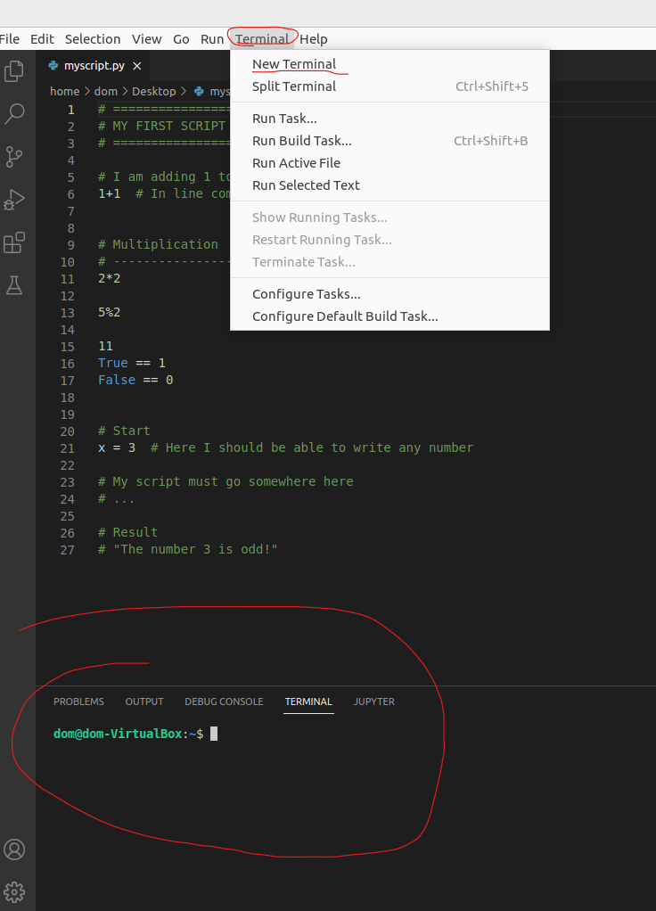
Basic Python
Installing packages
You don’t install Python packages from Python
Need to do it from the “terminal” using another package called “pip”
Installation instructions can be found usually on PyPI or GitHub
Install “black”
Google “black python package”
Find “pip” instructions

Slide 32
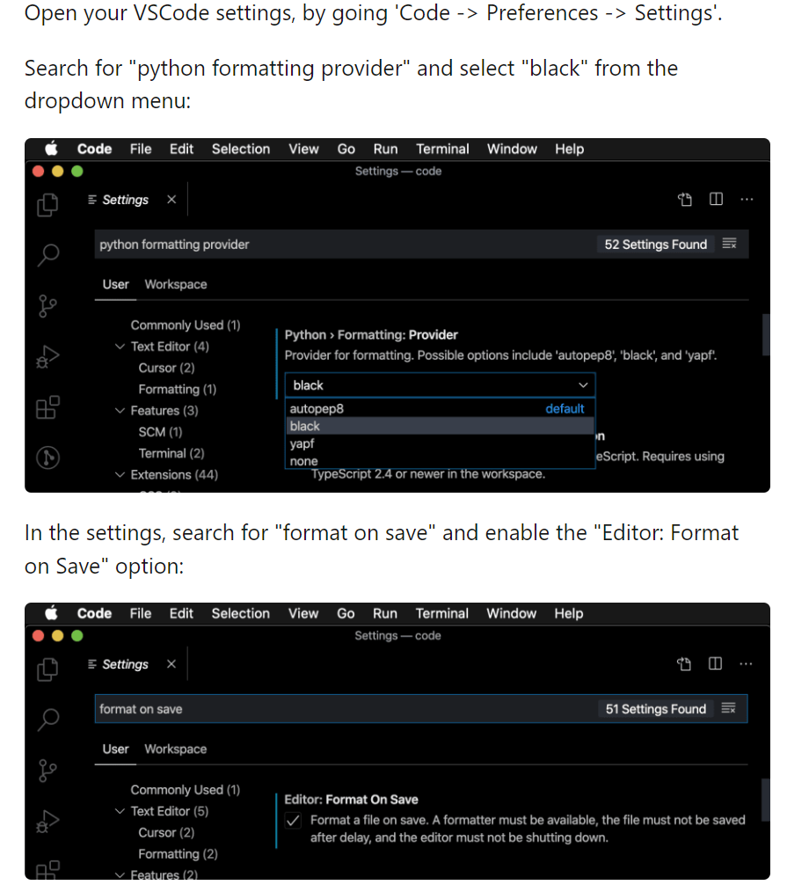
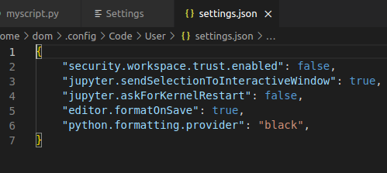
Basic Python
Autoformatting
Settings (UI)
Python formatting provided
“black”
Format on save

Slide 33
Exercice 9 💪 (5 min)
Goal: install packages: numpy, scipy, matplotlib, pandas, statsmodels, scikit-learn
Successfully import them at the top of a file

Slide 34
Advanced Python

Slide 35
Exercice 10 💪 (5 min)
Goal: Create a function that takes a list of numbers and adds 1 to each number
Expected:
>>> addone([2, 4, 5, 6])
[3, 5, 6, 7]

Slide 36
Generation of numbers
np.arrange(10)
np.linspace(0, 9, 10)
np.random.normal(0, 1, 10)
Advanced Python
List comprehension
list1 = [1, 2, 3]
[l + 1 for l in list1]
Numpy
For math & matrix-operations
import numpy as np
Difference List vs. Array/Vector
Vector = vectorized operations
list2 = [2, 3, 4]
list1 + list2
Convert list into vector
x1 = np.array(list1)
x2 = np.array(list2)
x1 + x2
x1 + 2.5
x1**2

Slide 37
Exercice 11 💪 (5 min)
Goal: Create a function that adds 1, 2, …, i to a list
Expected:
>>> addrange([0, 0, 0, 0])
[1, 2, 3, 4]
>>> addrange([5, 6, 7, 8])
[6, 8, 10, 12]
Hint: use len(x) to get the length of a list/vector

Slide 38
Advanced Python
Conditional indexing
x = np.array([1, 2, 3, 4, 5])
x[::2]
idx = x <= 3
idx
x[idx]
x[idx] = -1
x

Slide 39
Advanced Python
Operations and math
np.sum(), np.mean(), np.median(), np.diff(), np.std()…
Function or method
np.sum() ⬄ x.sum()
Missing values
np.nan()
# Initialize vector
x = np.array([3, 5, np.nan, 3, 2])
np. mean(x)
# Solution 1: Filter out NaNs
np.isnan(x)
x[~np.isnan(x)].mean()
# Solution 2: Nan-friendly functions
np.nanmean(x)

Slide 40
Exercice 12 💪 (15 min)
Goal:
Create a function that takes a vector, and replaces values that are > or < 3*SD by NaN
Another function that returns a string with the mean, SD, and the number of outliers
Expected:
>>> drop_outlier([2, 4, 3, 1, 2, 54, 2, -42])
[2, 4, 3, 1, 2, np.nan, 2, np.nan]
>>> describe([2, 4, 3, 1, 2, np.nan, 2, np.nan])
“2.33 +- 0.94, 2 outliers”
Hint: np.round(x, 2)

Slide 41
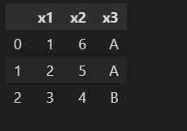
Advanced Python
Dataframes
Dataframes are “tables” (± 2D “matrix”)
Multiple types (difference with Arrays)
They have (named) columns and rows
Implemented in the pandas package
import pandas as pd
data = {"x1": [1, 2, 3], "x2": [6, 5, 4], "x3": ["A", "A", "B"]}
data = pd.DataFrame(data)
data
Select cols
data["x1"]
Note: returns a Series, can be converted to vector with data["x1"].values
data[["x1", "x2"]]

Slide 42
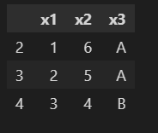
Advanced Python
Select rows (filtering)
Row names = index
Can be modified (or reset)
data.index = [2, 3, 4]
data
Need to “loc” (location) to filter
data.loc[data["x1"] >= 2]
data.loc[0:2]
Need to “iloc” (index-based location) to select by index
data.iloc[0:2]

Slide 43
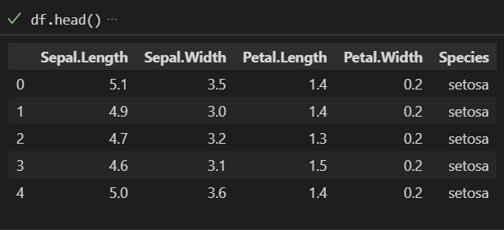
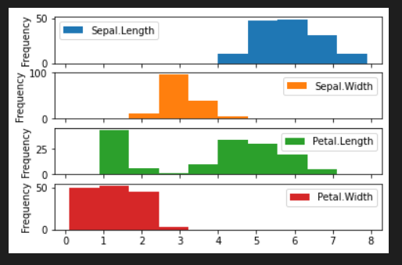
Advanced Python
Data Reading
https://github.com/DominiqueMakowski/teaching/blob/master/Python/2022_Zurich
Open “iris.csv”
Click “raw”
Right-click and download
df = pd.read_csv("iris.csv")
df.head()
df.describe()
df[“Species”].describe()
Plotting
df.plot.hist(subplots=True)
df.plot.scatter(x="Petal.Length", y="Sepal.Width")
Plotting uses matplotlib as a backend
A statistics-friendly alterantive is seaborn

Slide 44
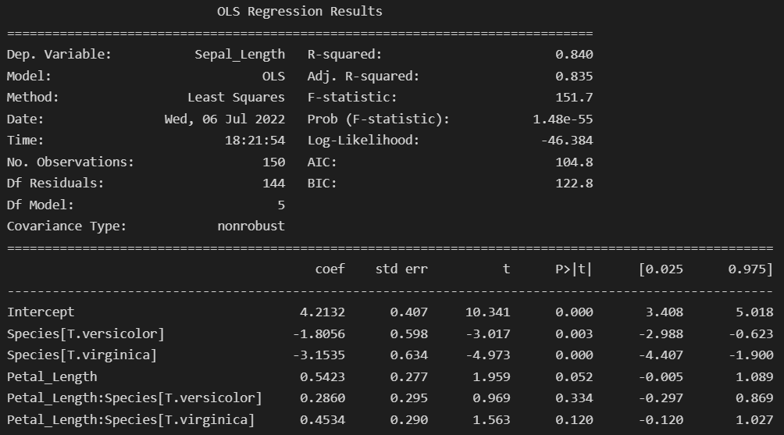
Advanced Python
Statistics
scikit-learn (sklearn): machine-learning oriented
statsmodels: R-like approach
import statsmodels.api as sm
import statsmodels.formula.api as smf
df = pd.read_csv("iris.csv")
df.columns = [s.replace(".", "_") for s in df.columns]
results = smf.ols("Sepal_Length ~ Petal_Length * Species", data=df).fit()
print(results.summary())

Slide 45

Advanced Python
What to do from there?
Exploratory approach to Python: search, copy/paste & try
Goal-driven learning + community-based learning

Slide 46
GitHub

Slide 47
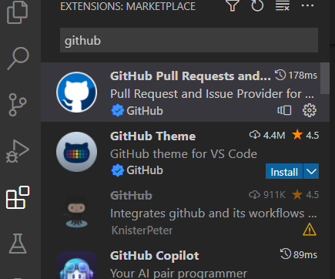
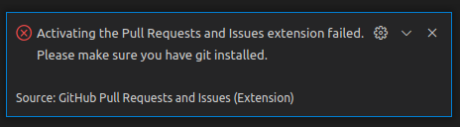
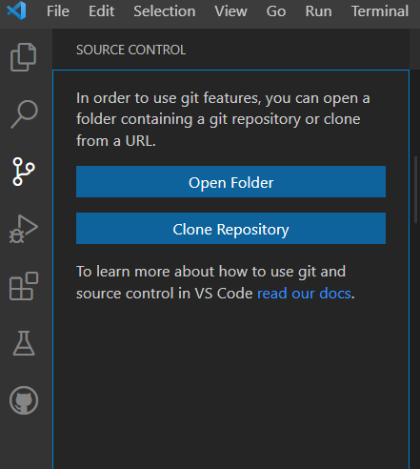
GitHub
GitHub on VScode
Install git (https://git-scm.com/download)
GitHub Pull Requests and Issues
Go to “Clone Repository” (clone from GitHub)
Sign in
GitHub locally:
You can “clone” a repo
= download it from GitHub to your machine locally

Slide 48
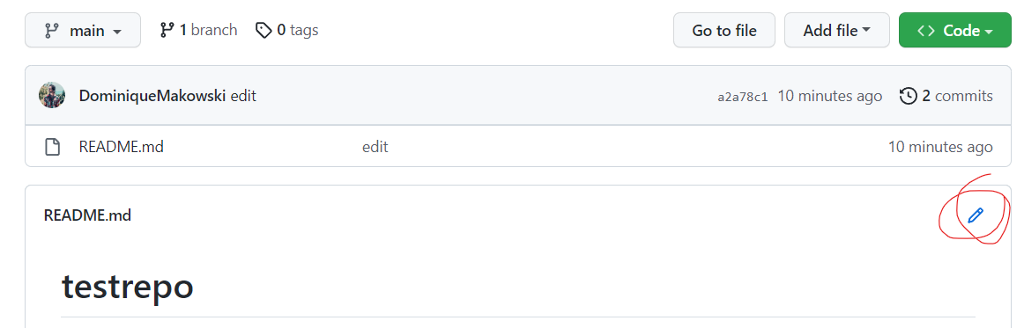
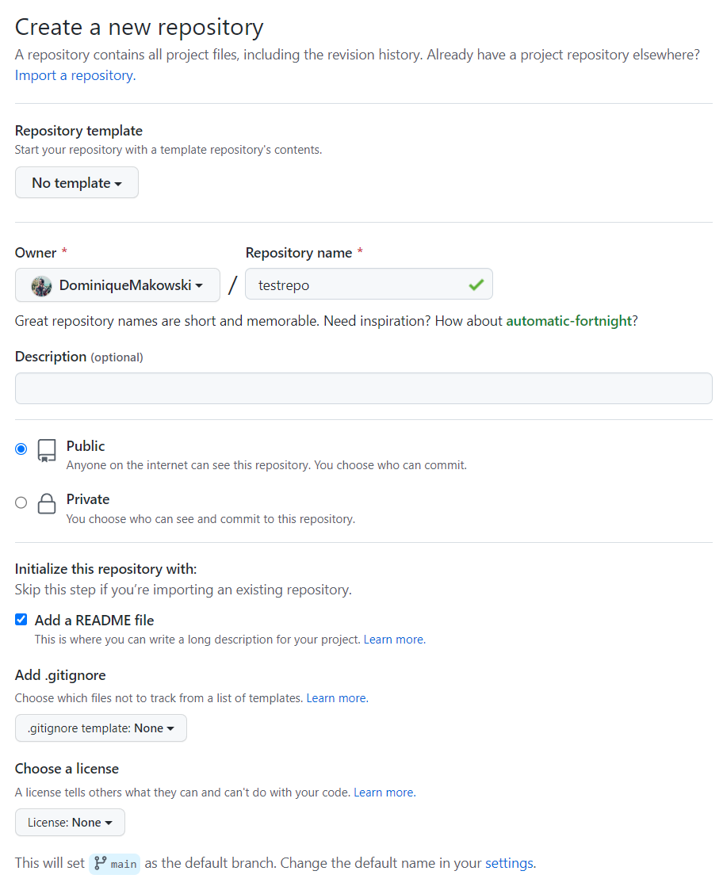
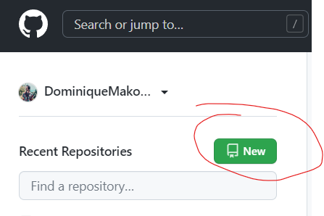
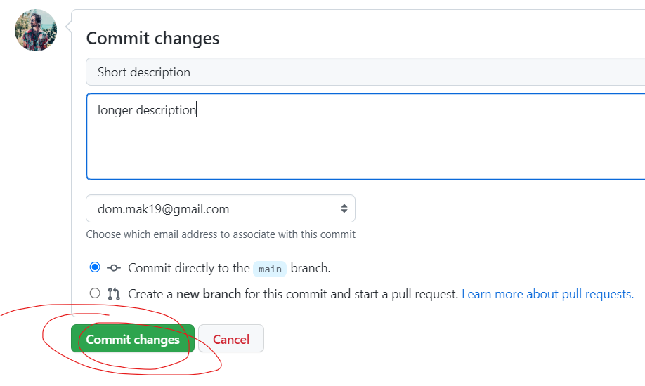
Exercice time 💪 (2 min)
Goal: Create and edit your own test repo
Create a new repo called “testrepo” with a README file
Edit the file in the browser
Commit the change

Slide 49
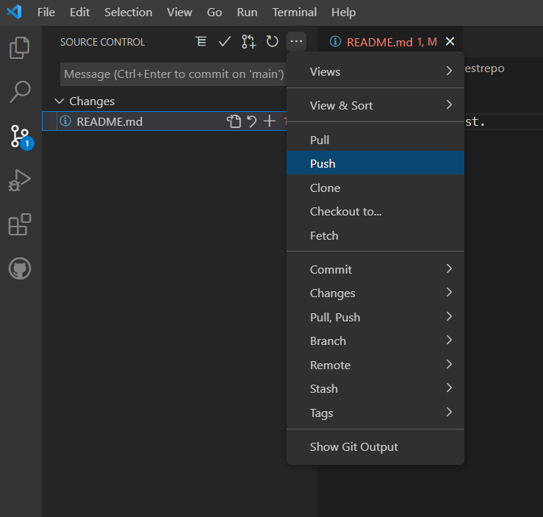
Exercice time 💪 (2 min)
Goal: Create, clone and edit your own test repo
Create a new repo called “testrepo” with a README file
Clone it from VS code, and save it somewhere (e.g., desktop)
Open the folder in Vscode
Edit the README locally
Commit

Slide 50
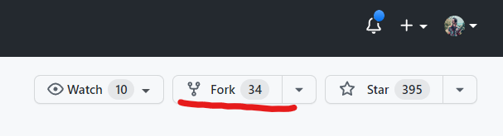
GitHub
GitHub workflow:
If repo is not yours, you first “fork” it
(copy and create your own personal version)
You can then “clone” it locally

Slide 51
Goal: Create a Pull Request (PR):
Delete the line that is assigned to you
Exercice time 💪 (10 min)

Slide 52
Goal: Create another Pull Request (PR):
Add something to the README of the testrepo of another person
Jasmin -> Rebecca C. -> Rebecca J. -> Pascal -> Sven -> Zita -> Carlo -> Flora -> Martyna -> Nathalie -> Ana Elisa -> Lena -> Georgia ->
Breakout rooms for mutual help
Exercice time 💪 (15 min)

Slide 53
Signal Processing
&
Jupyter notebooks

Slide 54
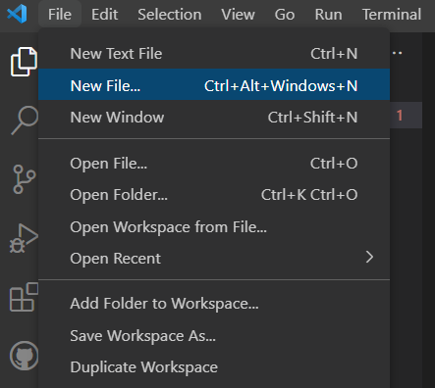
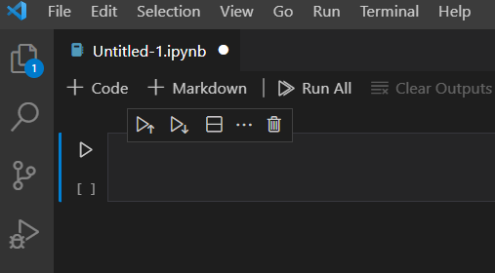
Jupyter
Create notebook:
New file -> Notebok (*.ipynb)
Notebooks mix cells with text (in markdown) with code

Slide 55
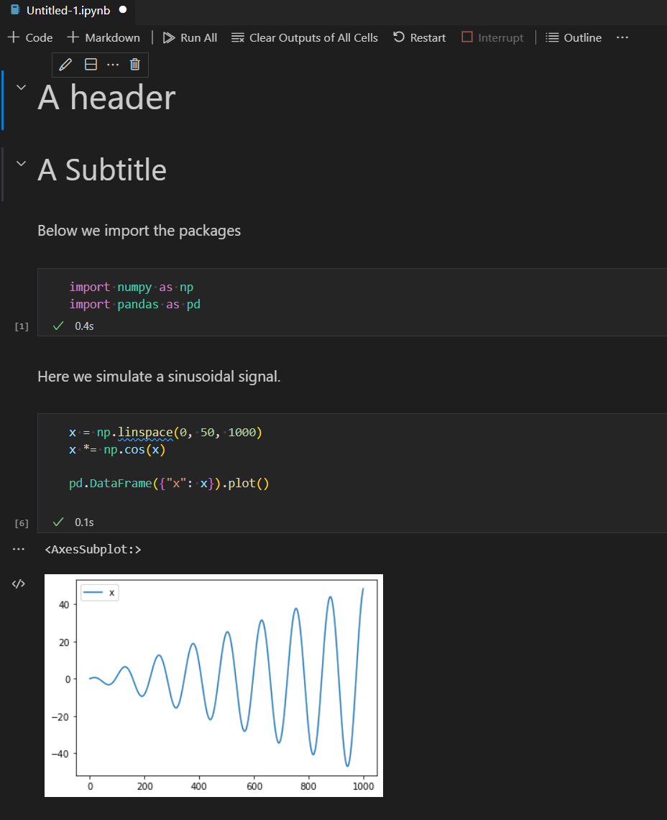
Goal:
Reproduce this notebook
Save it in your testrepo
Push it to GitHub
See how it renders on GH
Exercice time 💪 (10 min)

Slide 56
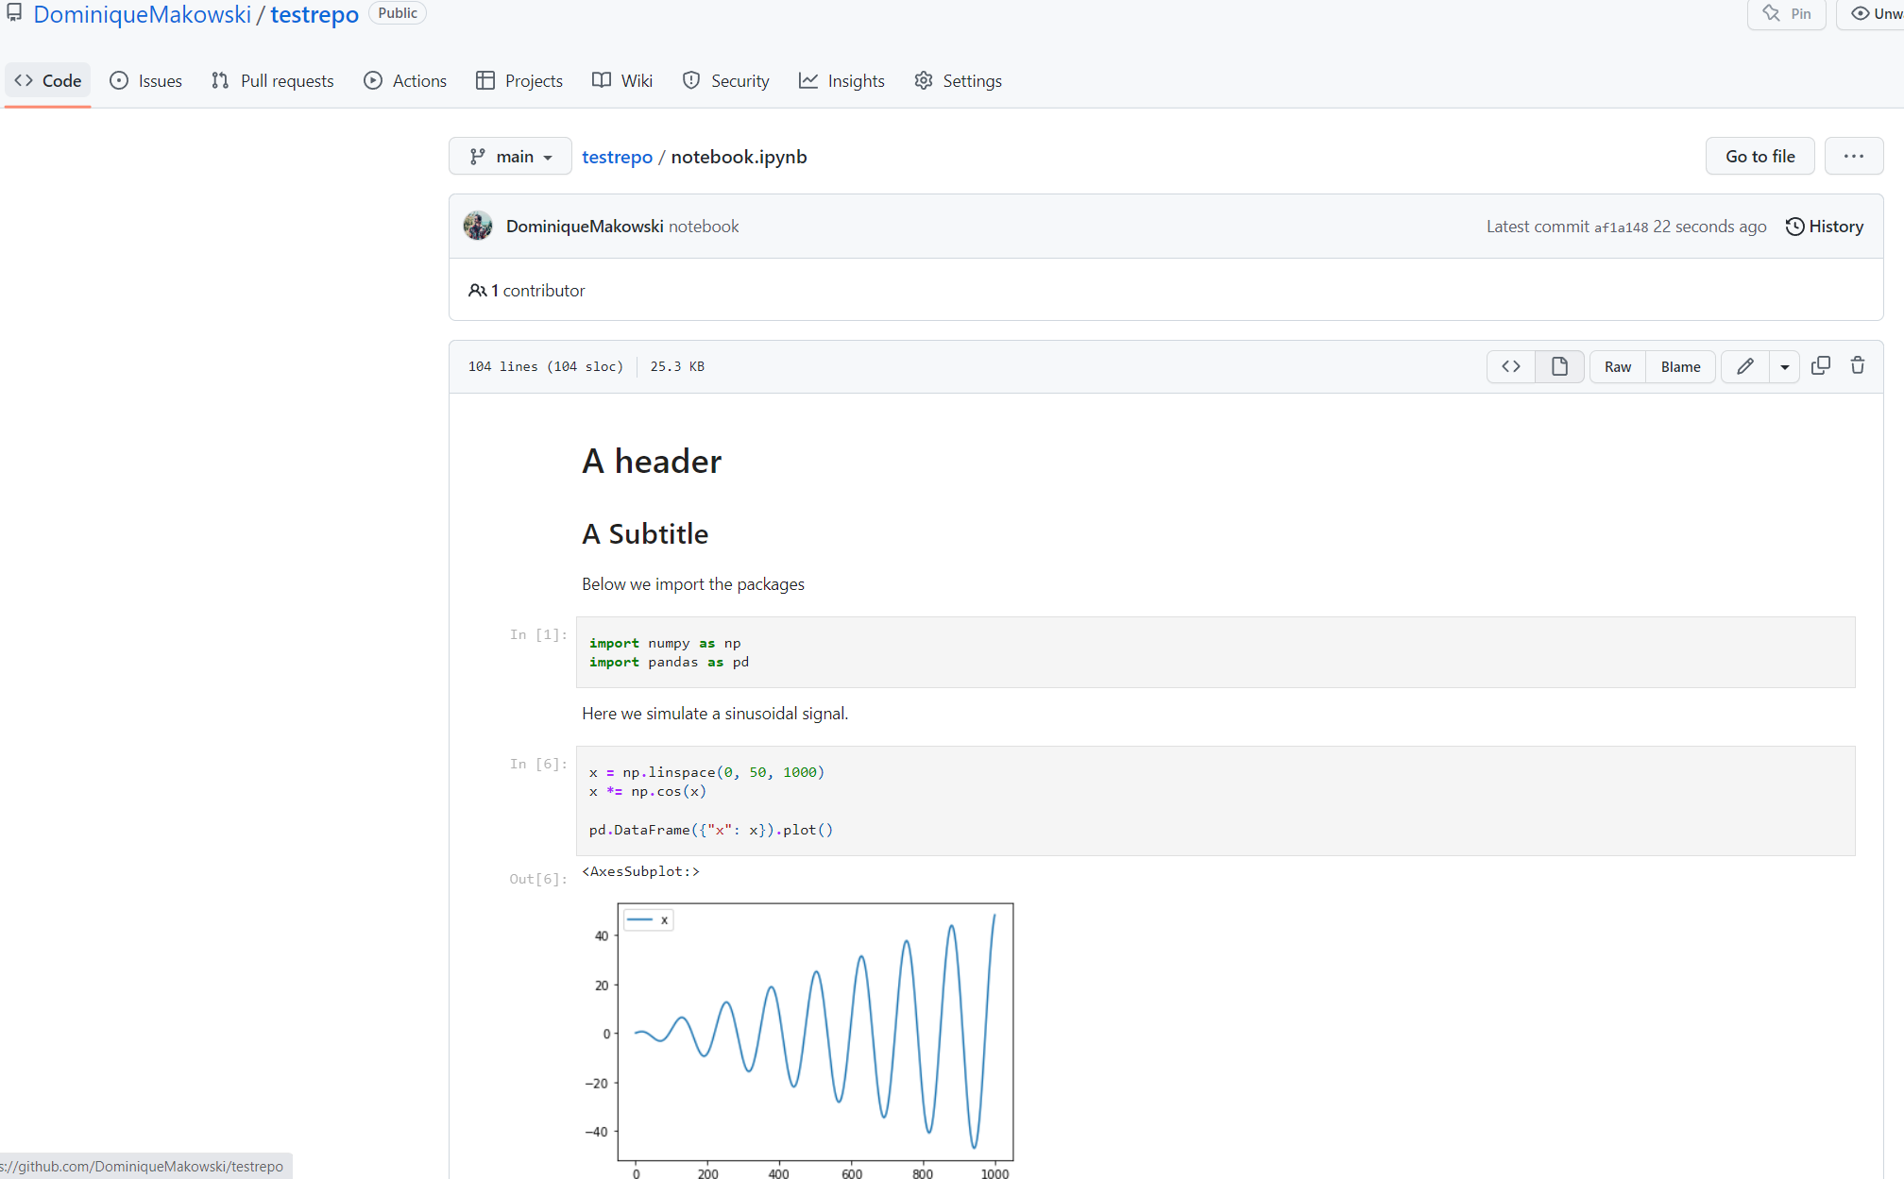

Slide 57
Jupyter
Notebooks can be great to communicate data analysis results, or for tutorials / examples

Slide 58
Packaging

