Slide 1
Exemplaric Expressivity of Modal Logics
Ana Sokolova University of Salzburg
joint work with
Bart Jacobs Radboud University Nijmegen
TexPoint fonts used in EMF.
Read the TexPoint manual before you delete this box.: AAAAAAAAAA

Slide 2
Outline
Expressivity:
logical equivalence = behavioral equivalence
For three examples:
Transition systems
Markov chains
Markov processes
Boolean modal logic
Finite conjunctions probabilistic modal logic

Slide 3
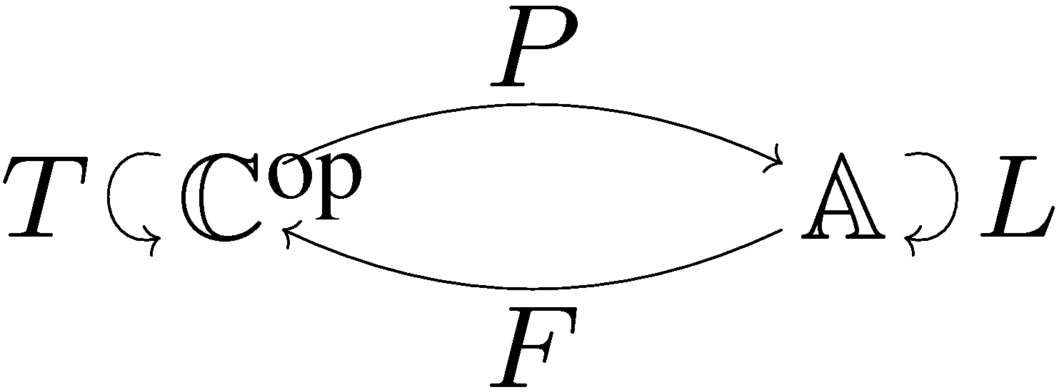
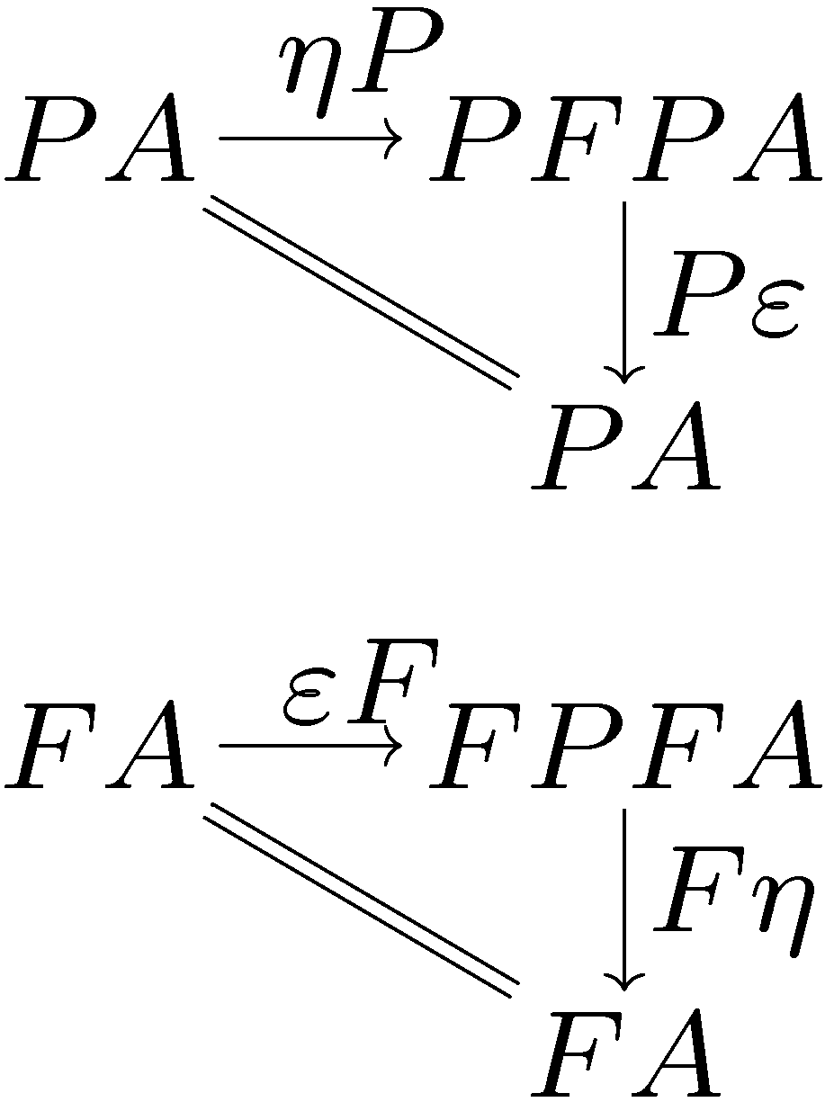
Via dual adjunctions
Predicates on spaces
Dual
Theories on models
Behaviour
(coalgebras)
Logics
(algebras)

Slide 4
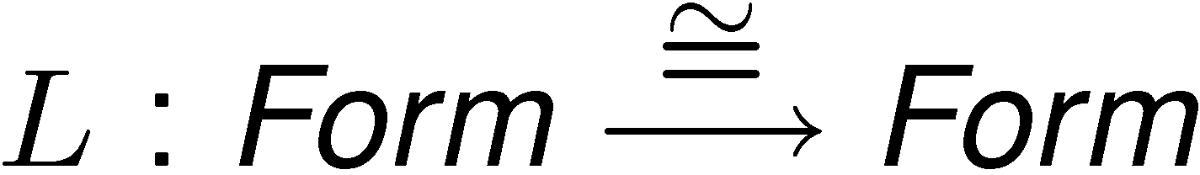

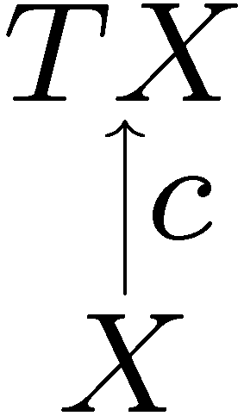
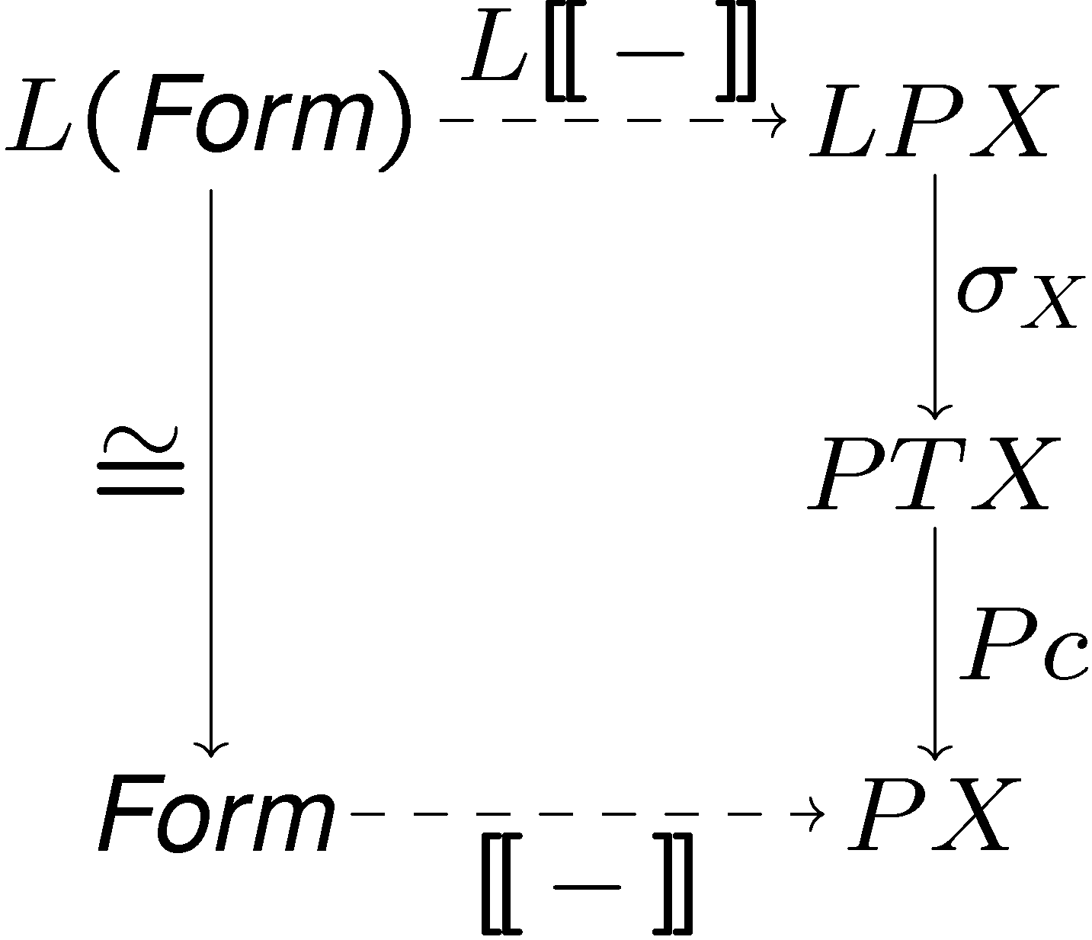
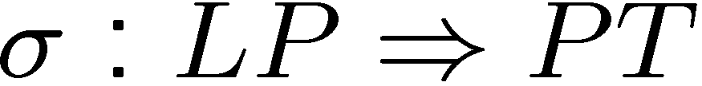
Logical set-up
If L has an initial algebra of formulas
A natural transformation
gives interpretations

Slide 5
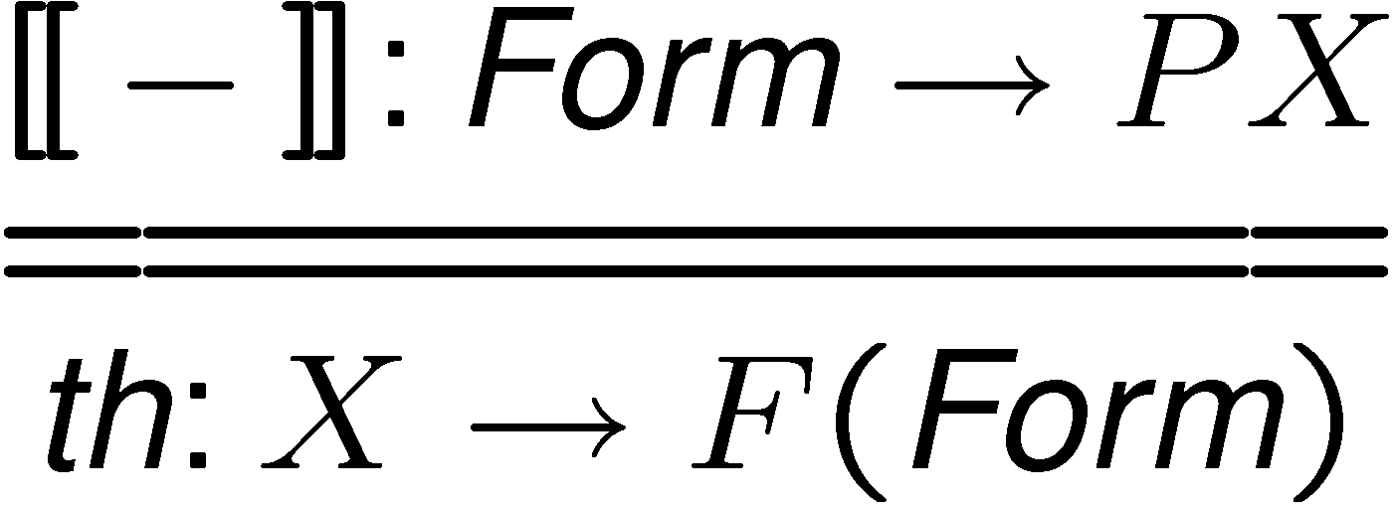
Logical equivalence behavioural equivalence
The interpretation map yields a theory map
Aim: expressivity
which defines logical equivalence
behavioural equivalence is given by
for some coalgebra homomorphisms
h₁ and h₂

Slide 6
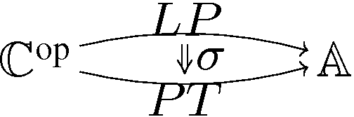
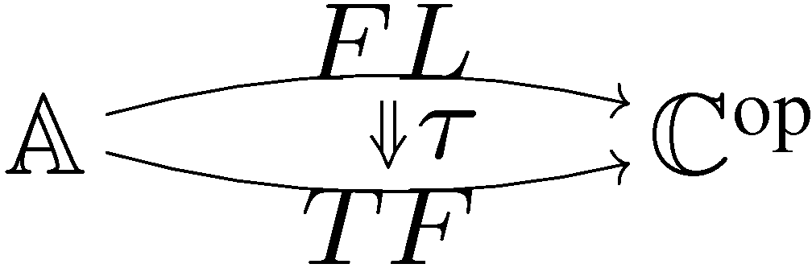
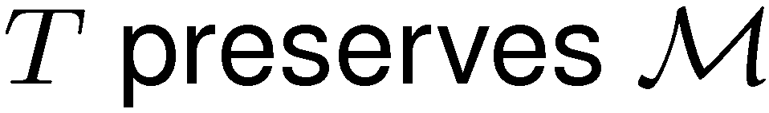
Expressivity
Bijective correspondence between
and
If and the transpose of the interpretation is componentwise mono, then expressivity.
Factorisation system on
with diagonal fill-in

Slide 7
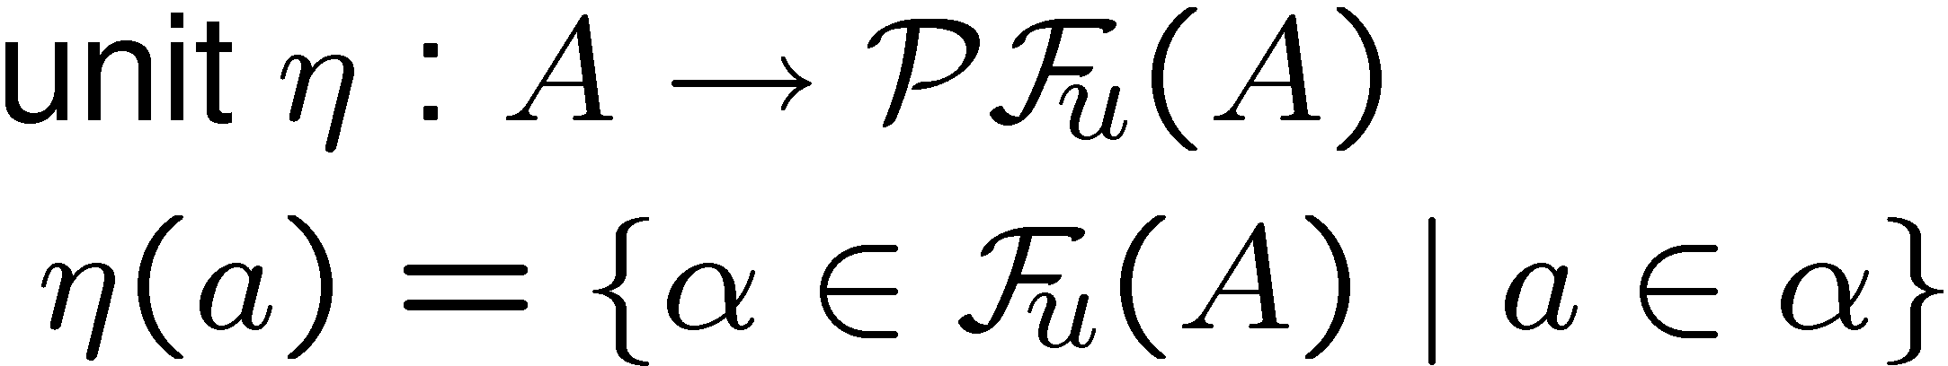
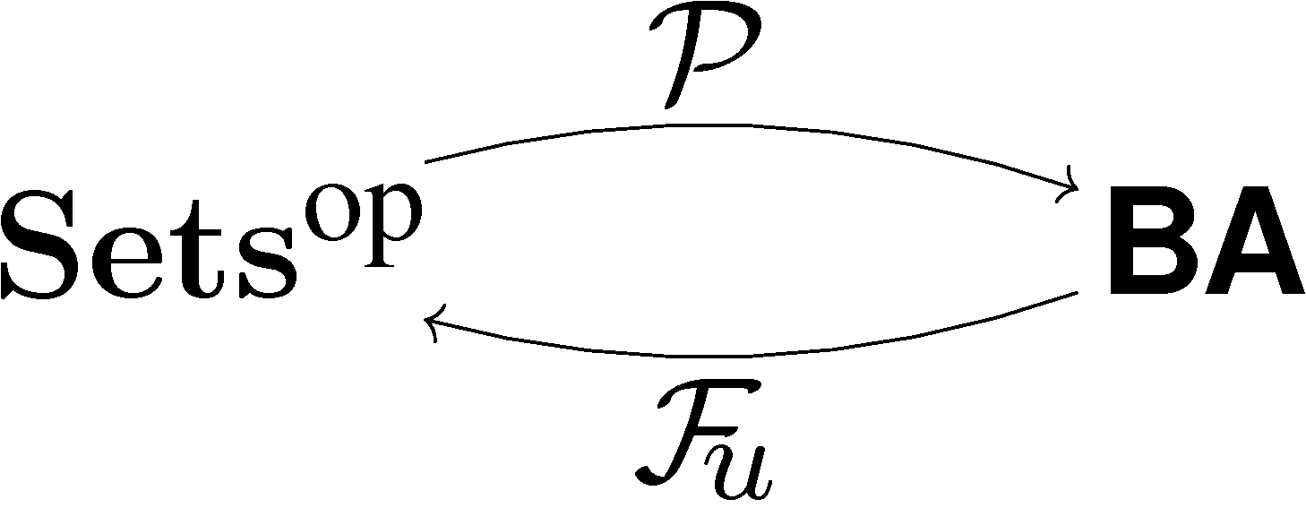
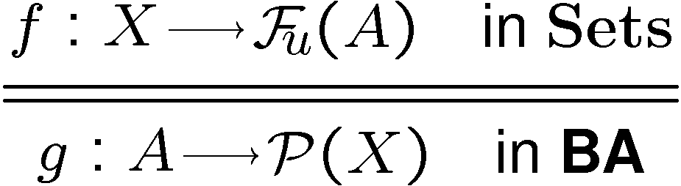

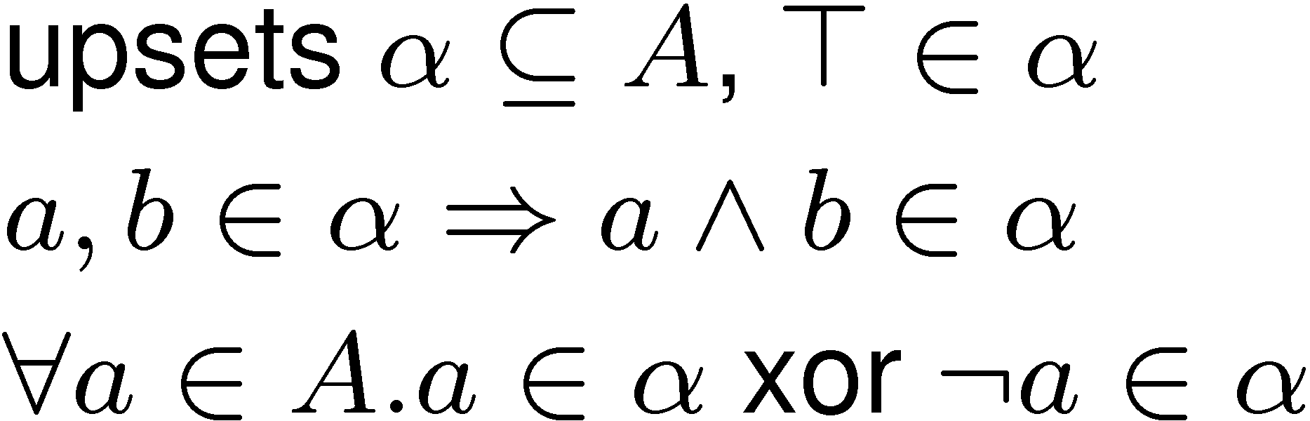
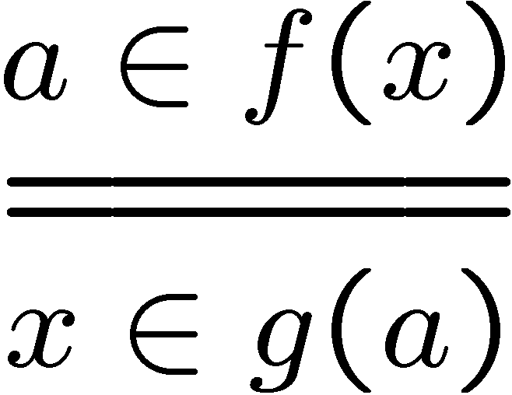
Sets vs. Boolean algebras
contravariant powerset
Boolean algebras
ultrafilters

Slide 8
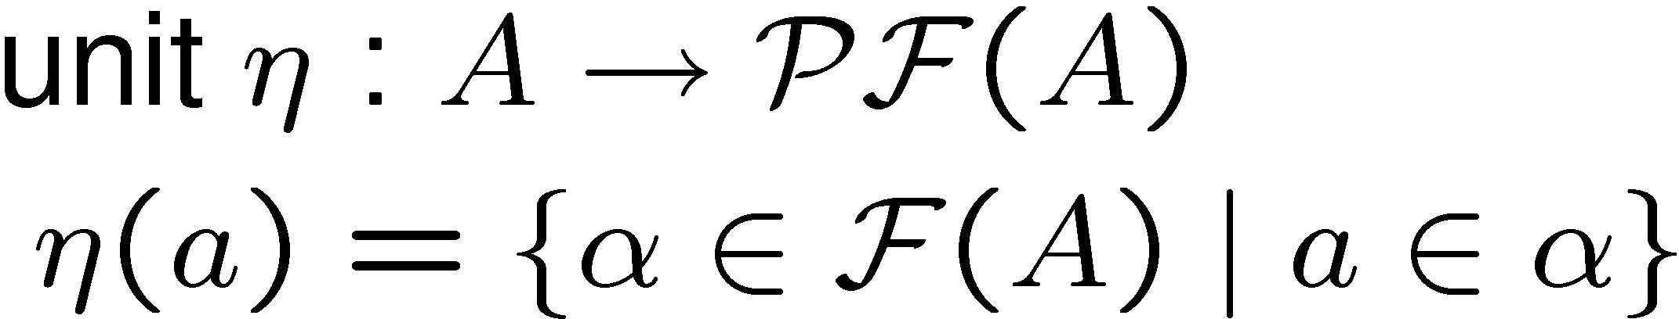
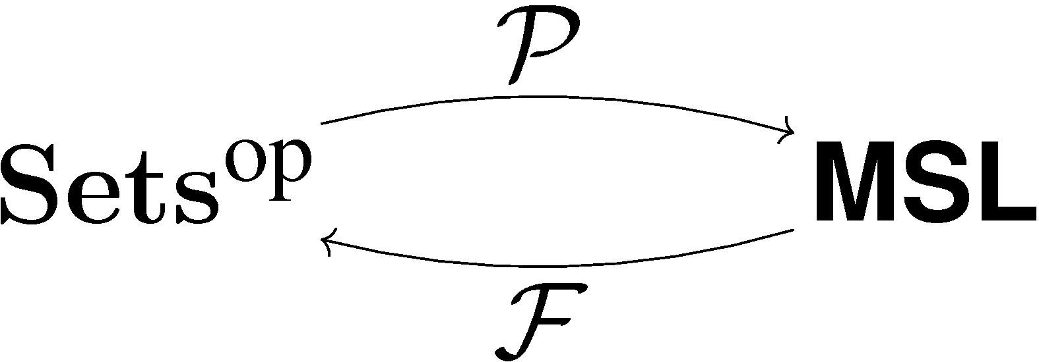
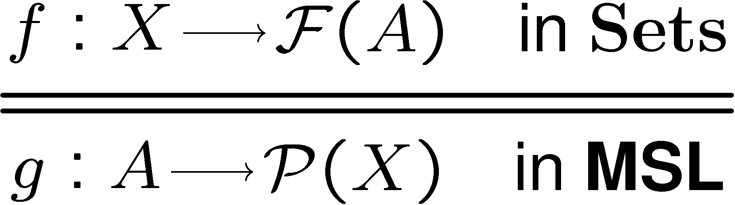
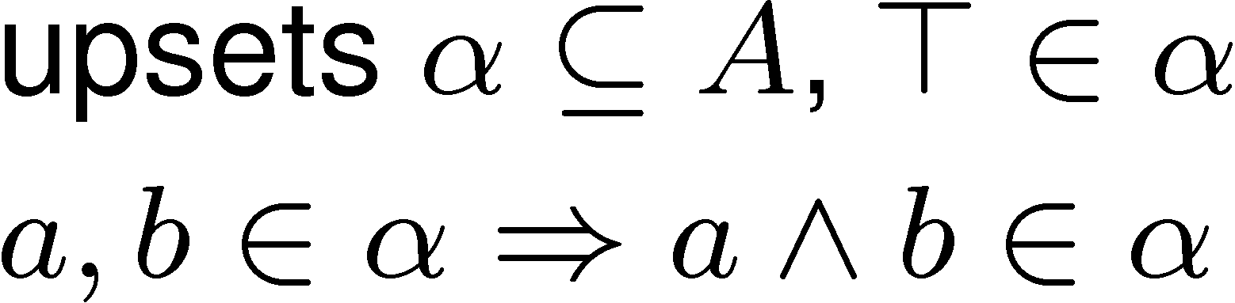
Sets vs. meet semilattices
contravariant powerset
meet semilattices
filters

Slide 9
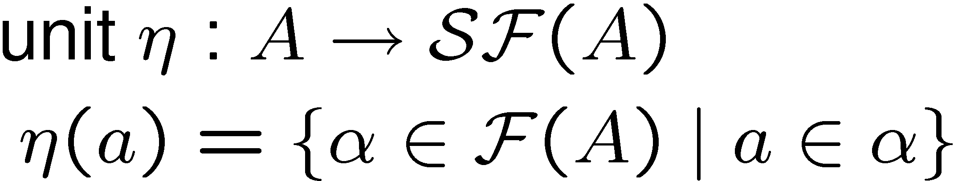

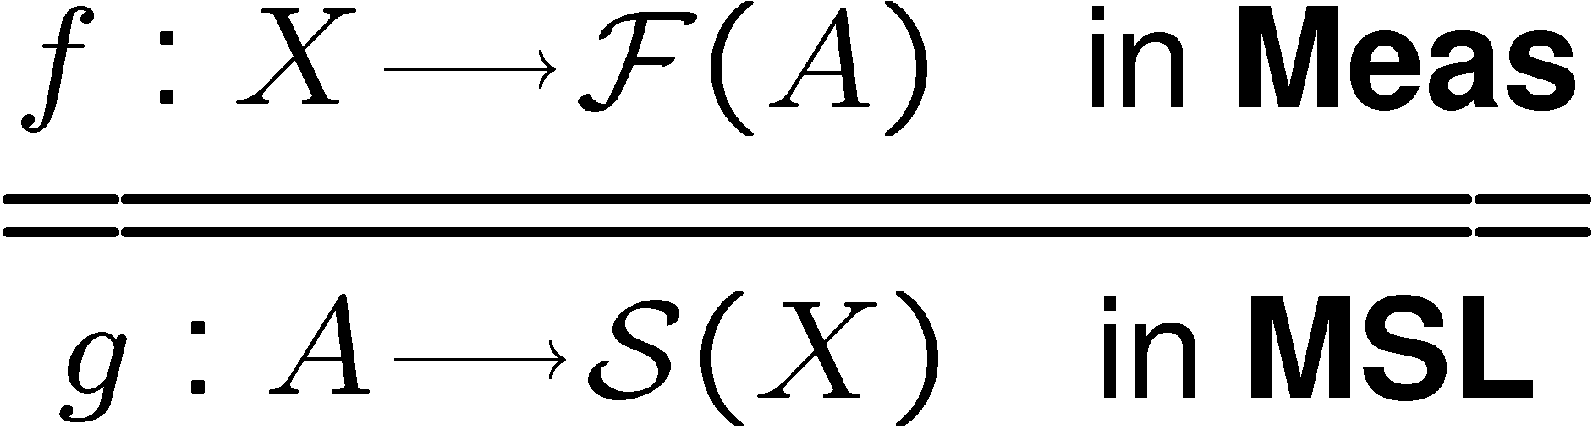
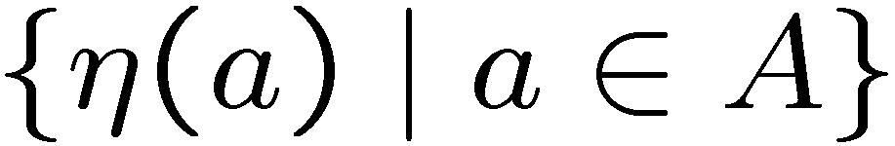

Measure spaces vs. meet semilattices
maps a measure space to its ¾-algebra
¾-algebra:
“measurable”
subsets closed under empty, complement, countable union
measure spaces
filters on A with
¾-algebra generated by

Slide 10
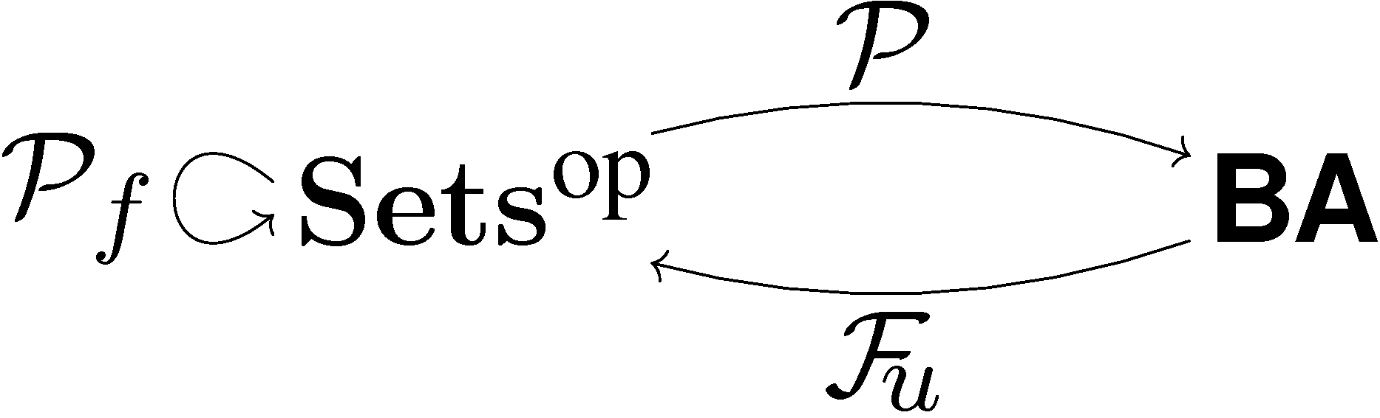

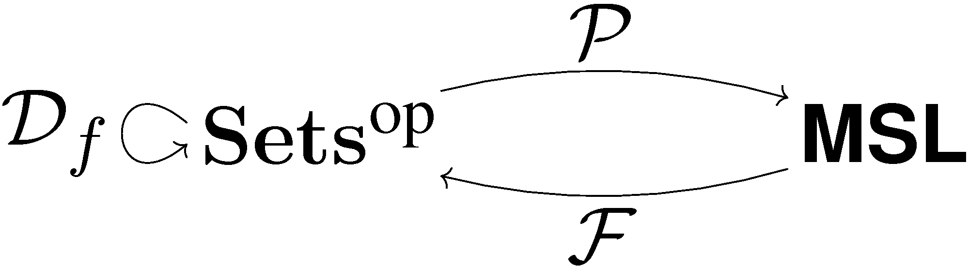


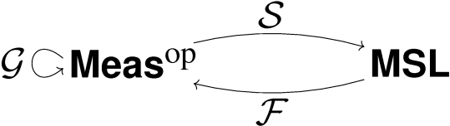
Behaviour via coalgebras
Transition systems
Markov chains
Giry monad
Markov processes

Slide 11
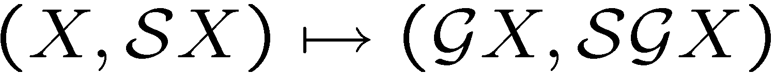
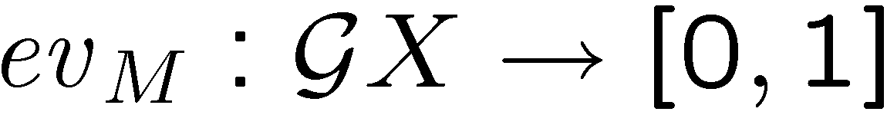
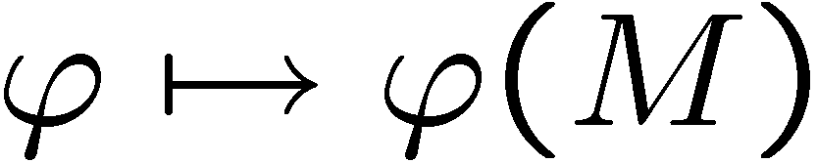
The Giry monad
countable union of pairwise disjoint
the smallest making
measurable
generated by
subprobability measures

Slide 12
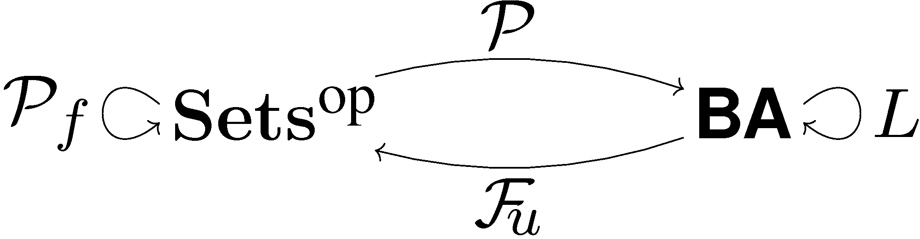
Logic for transition systems
Modal operator
models of boolean logic with fin.meet preserving modal operators
expressivity
L = GV
V - forgetful

Slide 13
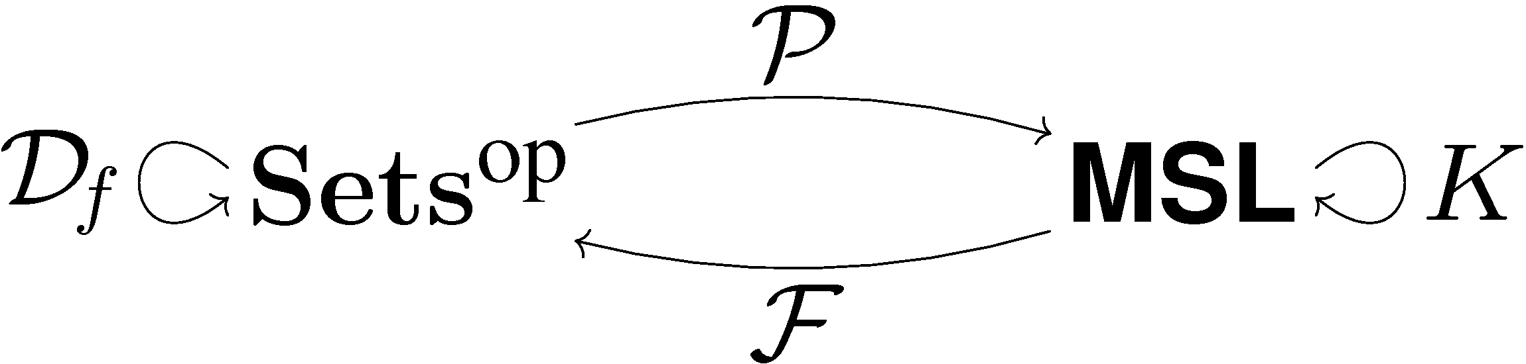

Logic for Markov chains
Probabilistic modalities
models of logic with fin.conj. and
monotone modal operators
expressivity
K = HV
V - forgetful

Slide 14

Logic for Markov processes
General probabilistic modalities
models of logic with fin.conj. and
monotone modal operators
expressivity
the same K

Slide 15
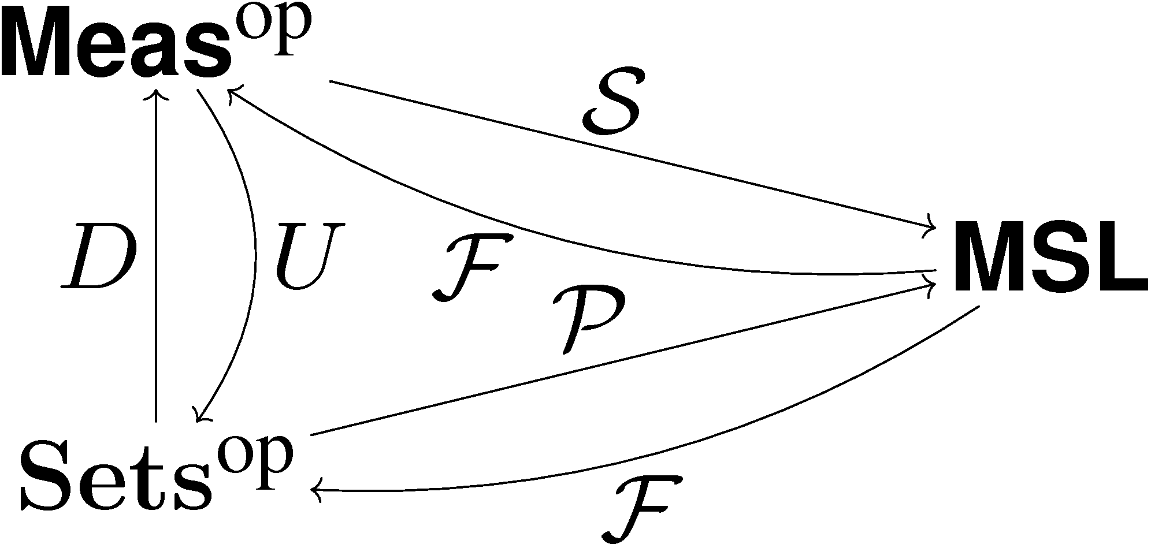
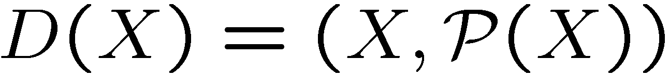



Discrete to indescrete
The adjunctions are related:
forgetful
functor
discrete
measure
space

Slide 16
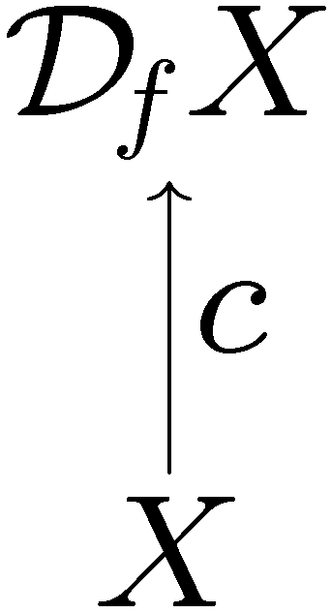
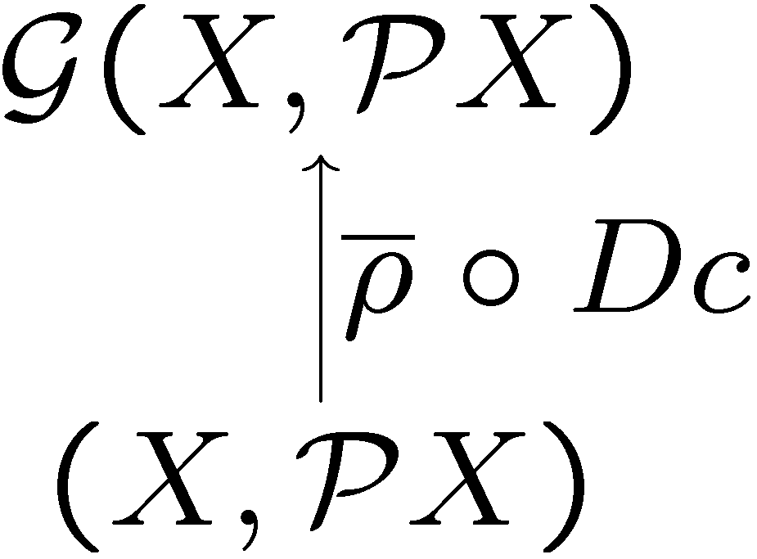
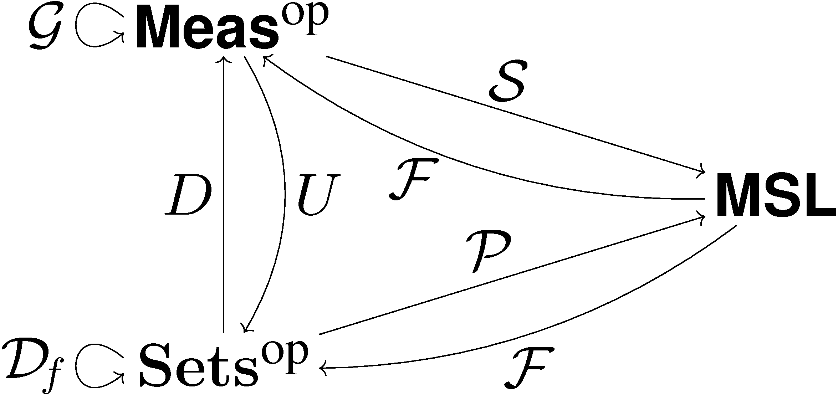

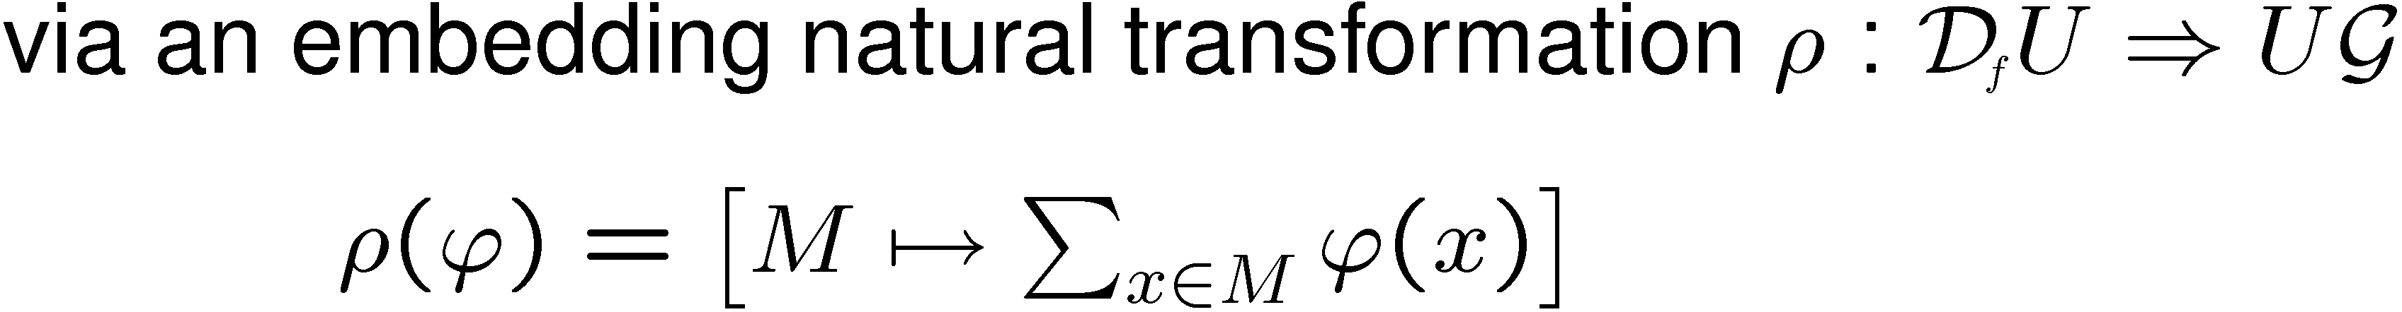
Discrete to indiscrete
Markov chains as Markov processes

Slide 17
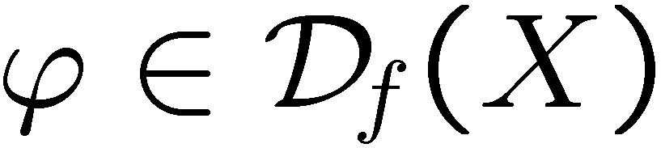
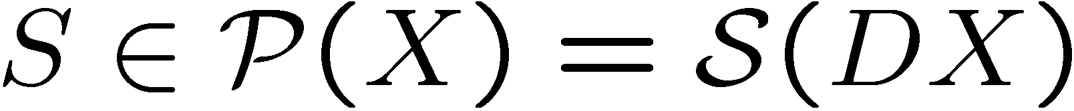
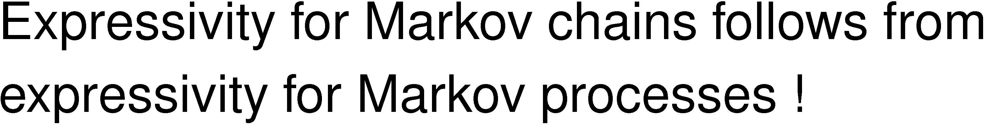
Discrete to indiscrete

Slide 18
Conclusions
Expressivity
For three examples:
Transition systems
Markov chains
Markov processes
Boolean modal logic
Finite conjunctions probabilistic modal logic
in the setting of dual adjunctions !

