Slide 1



The Microcosm Principle and Concurrency in Coalgebra
Ana Sokolova
University of Salzburg, Austria
Ichiro Hasuo
Kyoto University, Japan
PRESTO Promotion Program, Japan
Bart Jacobs
Radboud University Nijmegen, NL
Technical University Eindhoven, NL

Slide 2

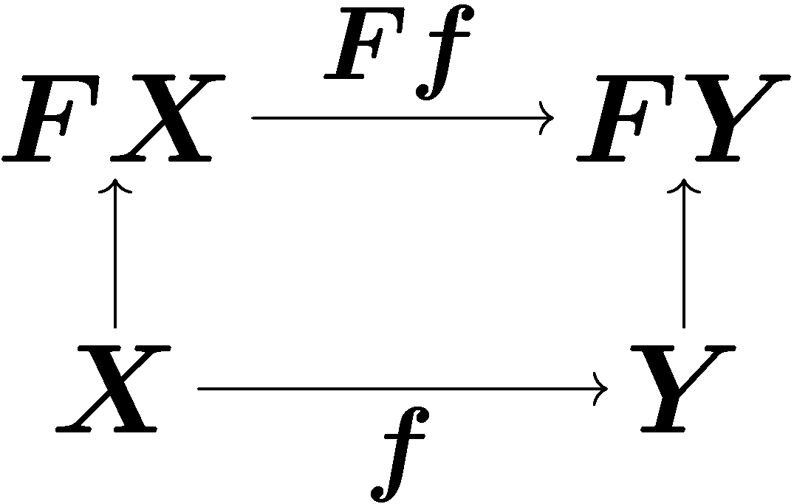
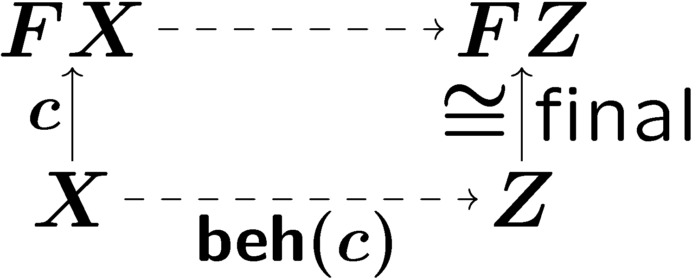
A short review of coalgebra/coinduction
Theory of coalgebra
Categorical theory of state-based systems
in Sets : bisimilarity
in Kleisli: trace semantics
[Hasuo,Jacobs,Sokolova LMCS´07]
 | categorically
system | coalgebra
behavior-preserving map | morphism of coalgebras
behavior | coinduction (via final coalgebra)

Slide 3
Coalgebra example – LTS
1
C = Sets, F = P_{fin}(Σ x _)
a
b
2
3
a
a
F-coalgebra = LTS
4
coalgebra c: X → FX
states X = { 1,2,3,4} labels Σ = {a,b}
transitions c(1) = {(a,2), (b,3)}, c(2) = ∅, …

Slide 4
Concurrency
C || D
running C and D in parallel
is everywhere
computer networks
multi-core processors
modular, component-based design of complex systems
is hard to get right
exponentially growing complexity
need for a compositional verification

Slide 5
Compositionality
aids compositional verification
Behavior of C || D
is determined by
behavior of C and behavior of D
Conventional presentation
behavioral equivalence
bisimilarity
trace equivalence
...
„bisimilarity is a congruence“

Slide 6
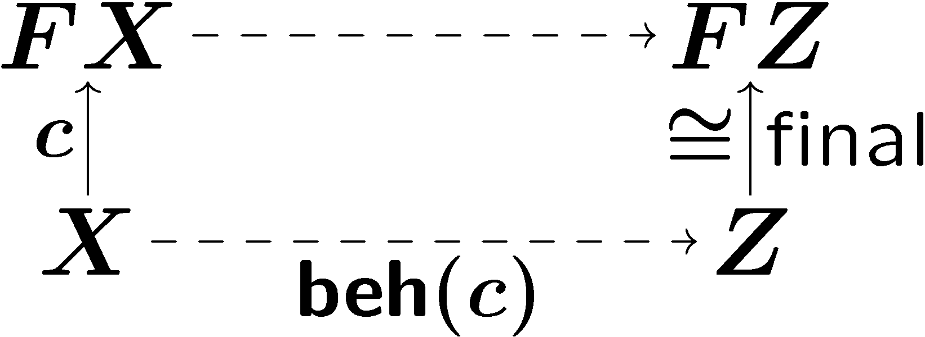
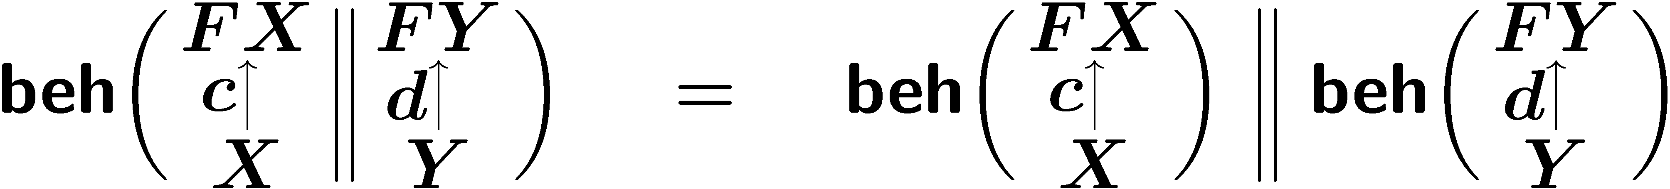
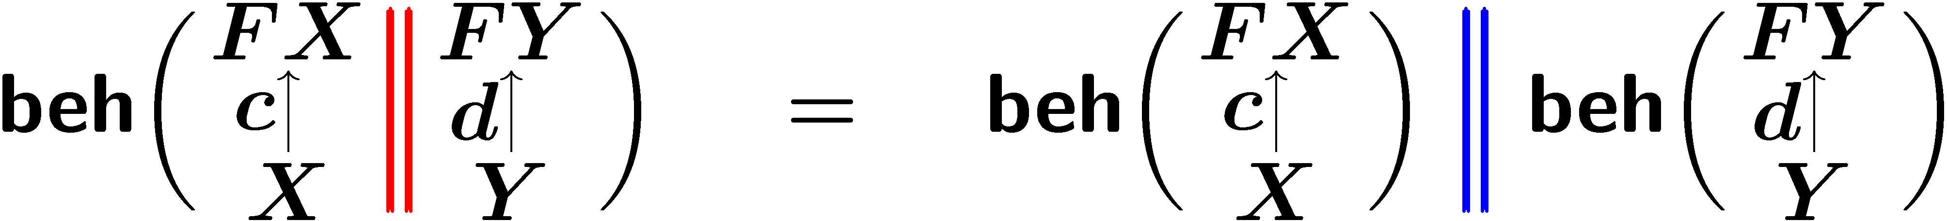
Compositionality in coalgebra
Final coalgebra semantics as
process semantics.
Coalgebraic compositionality
|| : Coalg_{F} x Coalg_{F} → Coalg_{F}
composing coalgebras/systems
|| : Z x Z → Z
composing behavior

Slide 7
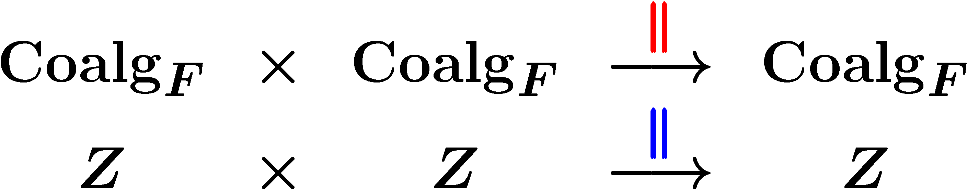
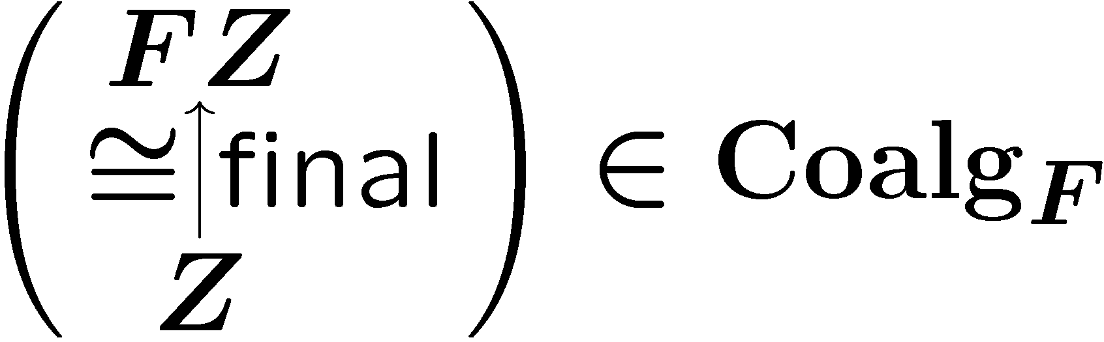
the microcosm principle
Nested algebraic structures:
with
inner interpretation
X 2 C
outer interpretation
algebraic theory
operations
binary ||
equations
e.g. assoc. of ||
The same “algebraic theory”
operations (binary ||)
equations (e.g. associativity of ||)
is carried by
the category Coalg_{F} and
its object Z 2 Coalg_{F}
in a nested manner!
“Microcosm principle” (Baez & Dolan)

Slide 8

Microcosm in macrocosm
We name this principle the microcosm principle, after the theory, common in pre-modern correlative cosmologies, that every feature of the microcosm (e.g. the human soul) corresponds to some feature of the macrocosm.
John Baez & James Dolan
Higher-Dimensional Algebra III:
n-Categories and the Algebra of Opetopes
Adv. Math. 1998

Slide 9
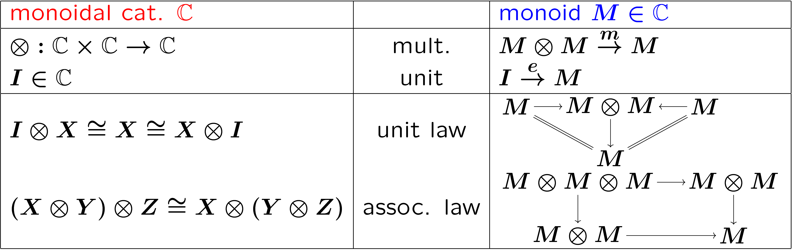
The microcosm principle: you may have seen it
monoid in a monoidal category
inner depends on outer

Slide 10
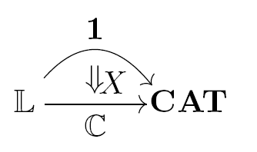
Formalizing the microcosm principle
What do we mean by
“microcosm principle”?
mathematical definition of such nested models?
inner model
as lax natural trans.
algebraic theory
as Lawvere theory
outer model
as prod.-pres. functor

Slide 11
Outline
for arbitrary algebraic theory
generic compositionality theorem
microcosm for concurrency
(|| and ||)
2-categorical formulation
parallel composition
via sync nat. trans.

Slide 12
Parallel composition of coalgebras
via sync
Part 1

Slide 13
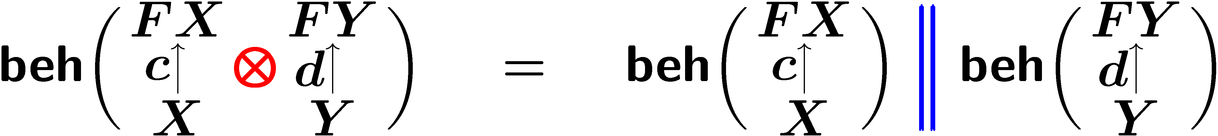
Parallel composition of coalgebras
bifunctor Coalg_{F} x Coalg_{F} → Coalg_{F}
usually denoted by ­ (tensor)
Aim
Theorem
­ : Coalg_{F} x Coalg_{F} → Coalg_{F}
F with sync
lifting
sync_{X,Y} : FX ­ FY → F(X ­ Y)
­ : C x C → C

Slide 14
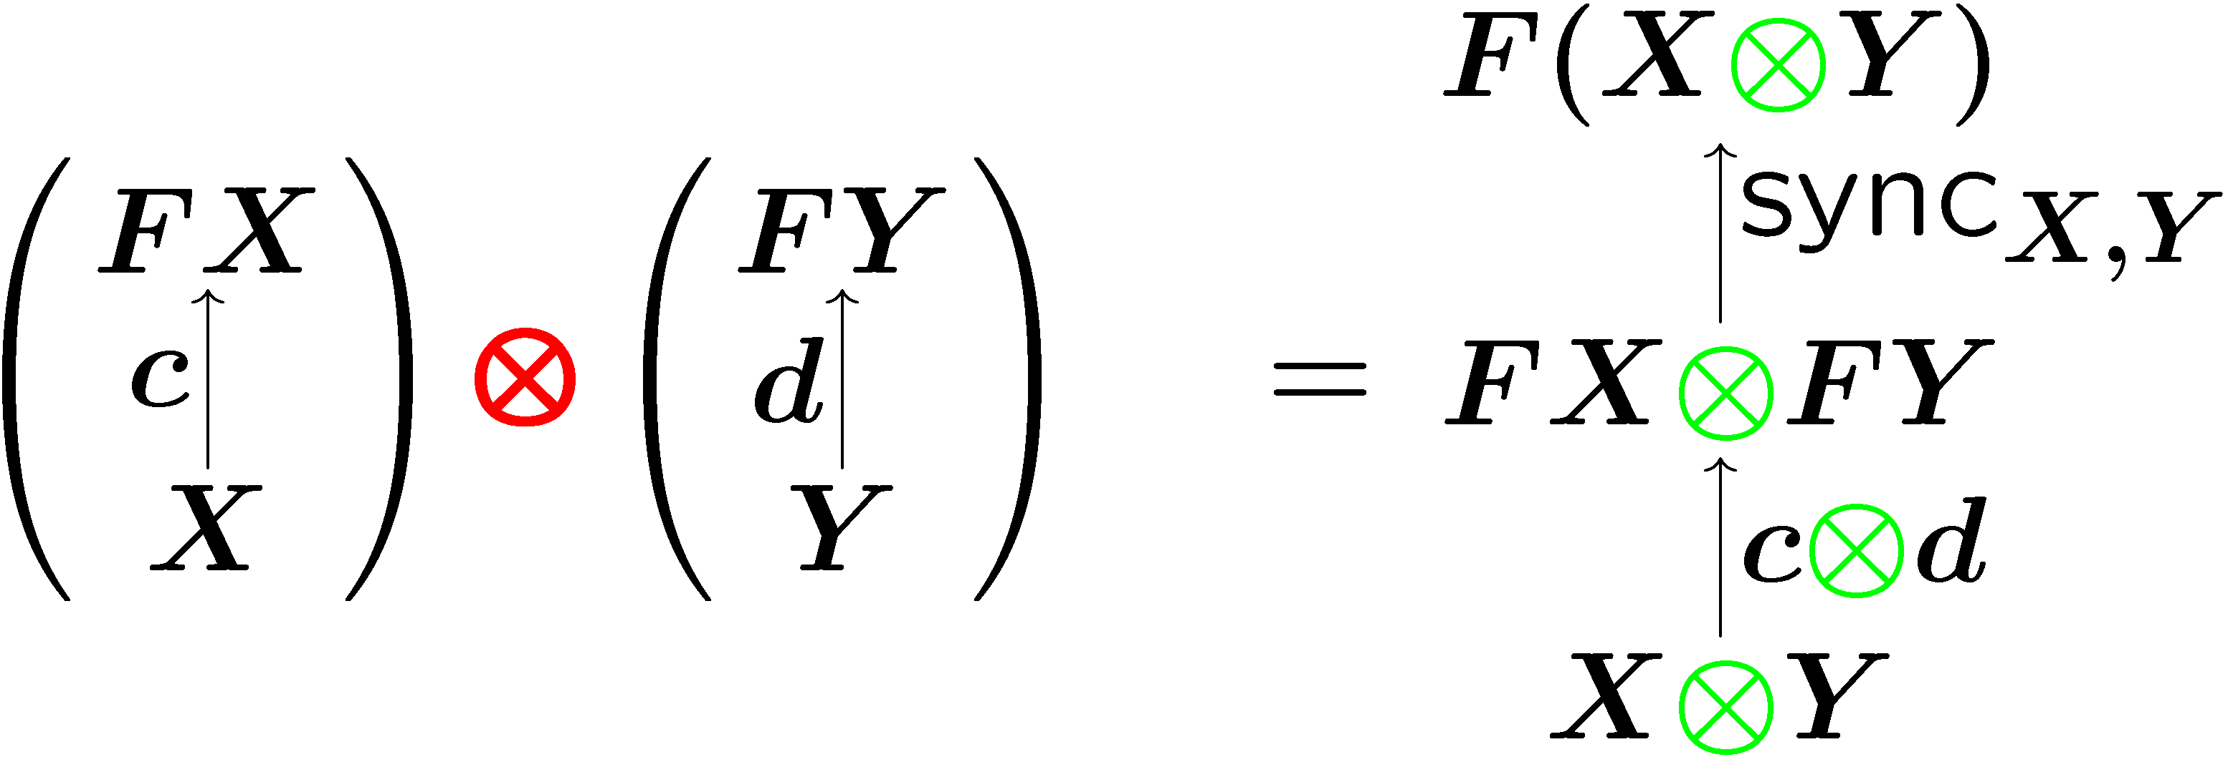
Parallel composition via sync
sync_{X,Y} : FX ­ FY → F(X ­ Y)
­ on the base category
different sync
different ­

Slide 15


Examples of sync : FX ­ FY → F(X ­ Y)
­ : Coalg_{F} x Coalg_{F} → Coalg_{F}
F with sync
lifting
x : Sets x Sets → Sets
CSP-style (Hoare)
CCS-style (Milner)
Assuming
C = Sets, F = P_{fin}(Σ x _)
F-coalgebra = LTS

Slide 16
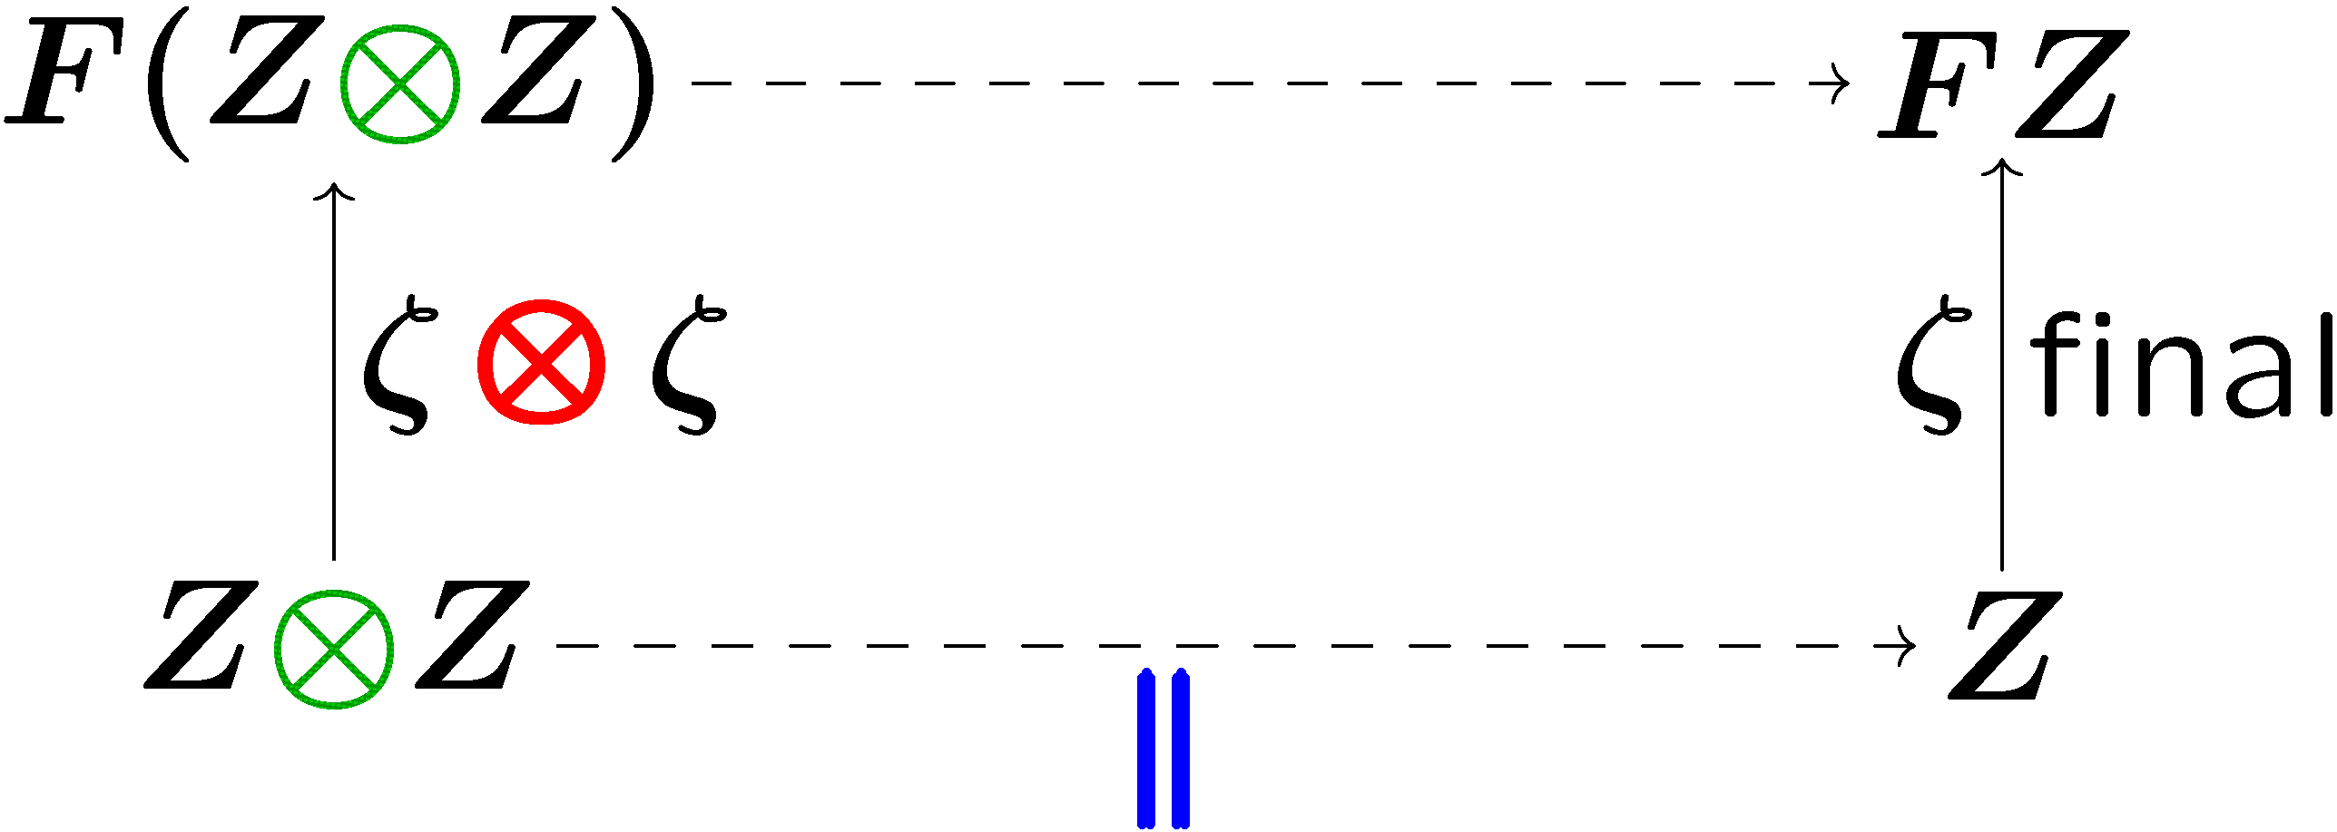
Inner composition
Aim
|| “composition of states/behavior”
arises by coinduction

Slide 17
Compositionality theorem
Theorem
for ­ by and || by
­ : Coalg_{F} x Coalg_{F} → Coalg_{F}
F with sync
lifting
­ : C x C → C
Assumptions: ­ , sync, final exists

Slide 18
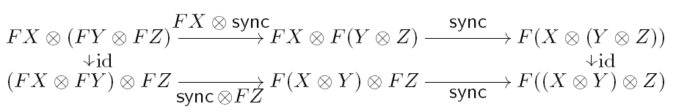
Equational properties
associative
­ : Coalg_{F} x Coalg_{F} → Coalg_{F}
commutativity?
lifting
F with
“associative“
sync
arbitrary algebraic theory?
associative
­ : C x C → C

Slide 19
for arbitrary algebraic theory
2-categorical formulation of
the microcosm principle
Part 2

Slide 20
Lawvere theory L
a category representing an algebraic theory
Definition
A Lawvere theory L is a small category
with objects natural numbers
that has finite products

Slide 21
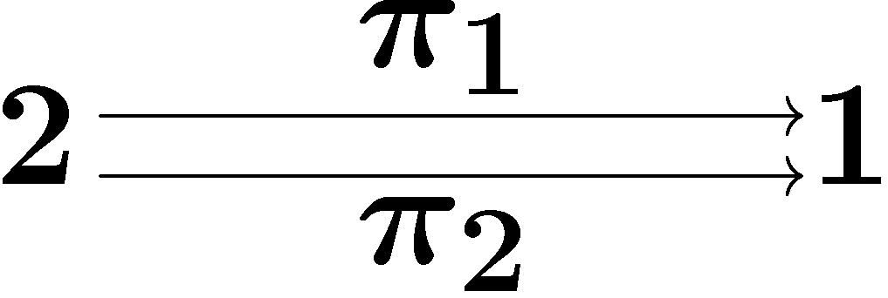



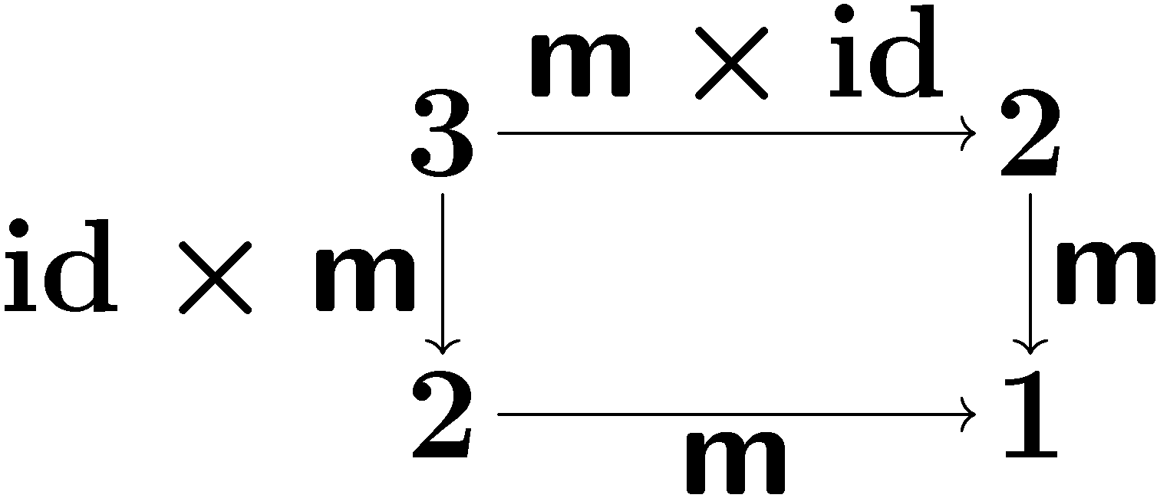
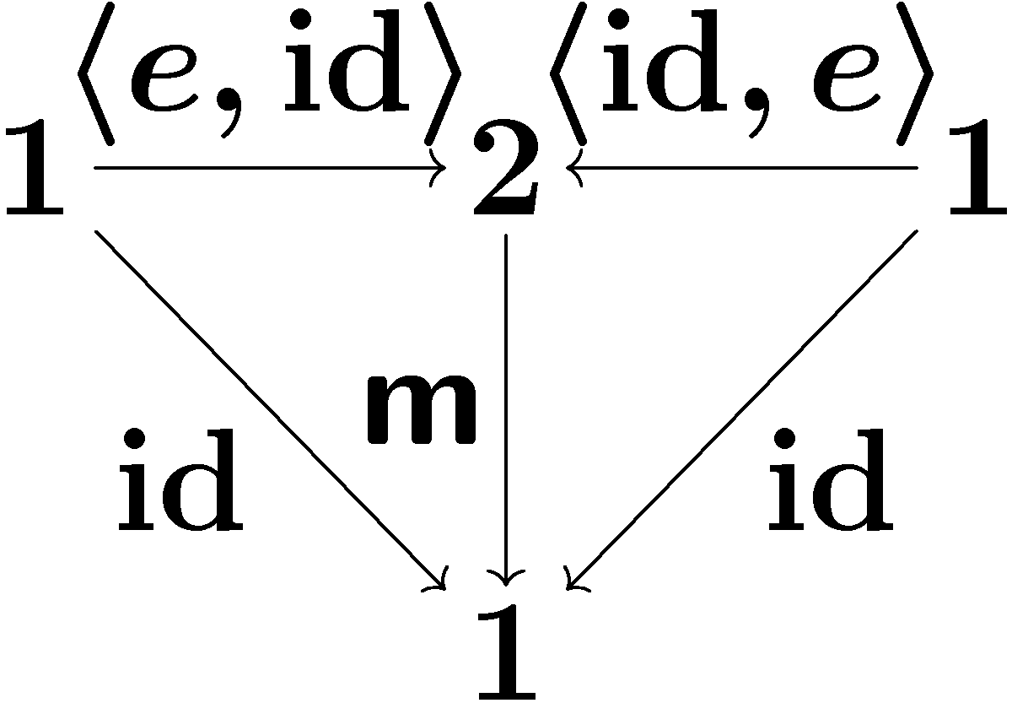
Lawvere theory
other arrows:
projections
composed terms
algebraic theory | as category L
operations | as arrows
equations | as commuting diagrams
m (binary)
e (nullary)
assoc. of m
unit law

Slide 22
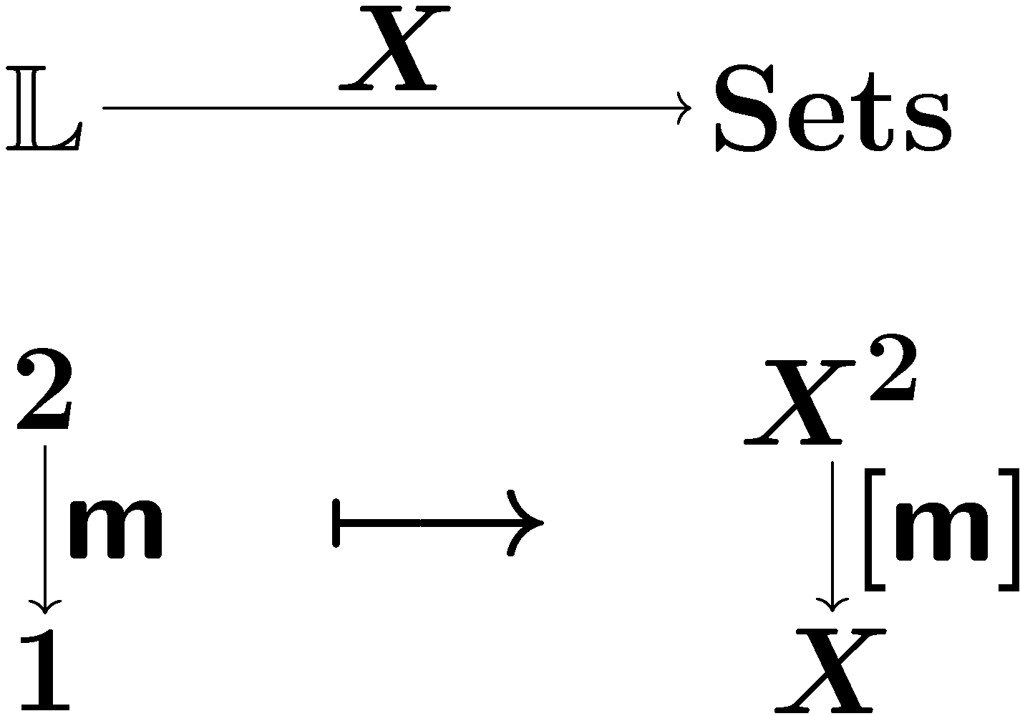
Models for a Lawvere theory L
Standard: set-theoretic model
a set with L-structure, L-set
(product-preserving)
binary op. on X
what about nested models?
X 2 C

Slide 23
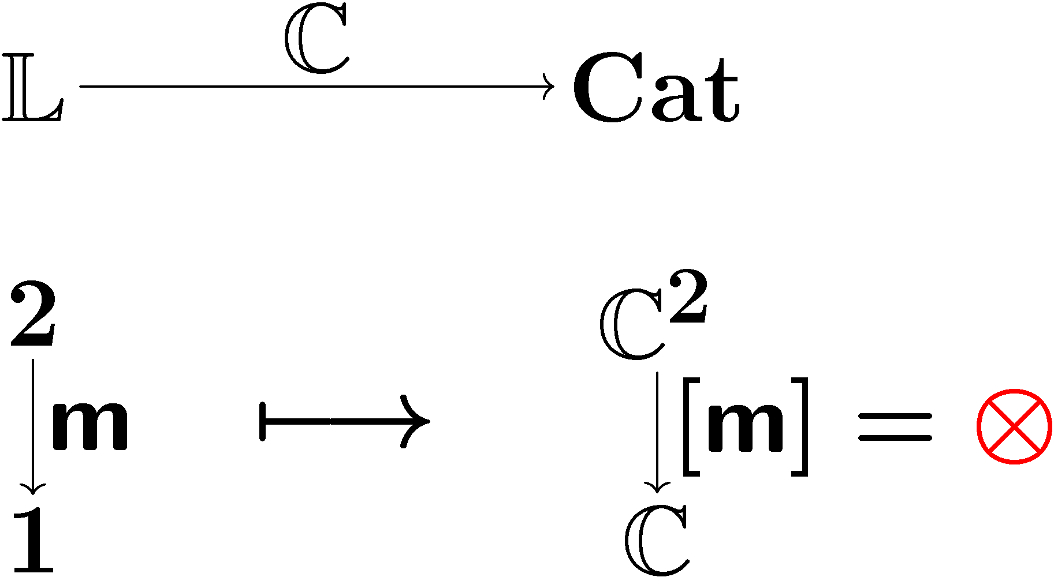
Outer model: L-category
outer model
a category with L-structure, L-category
(product-preserving)

Slide 24
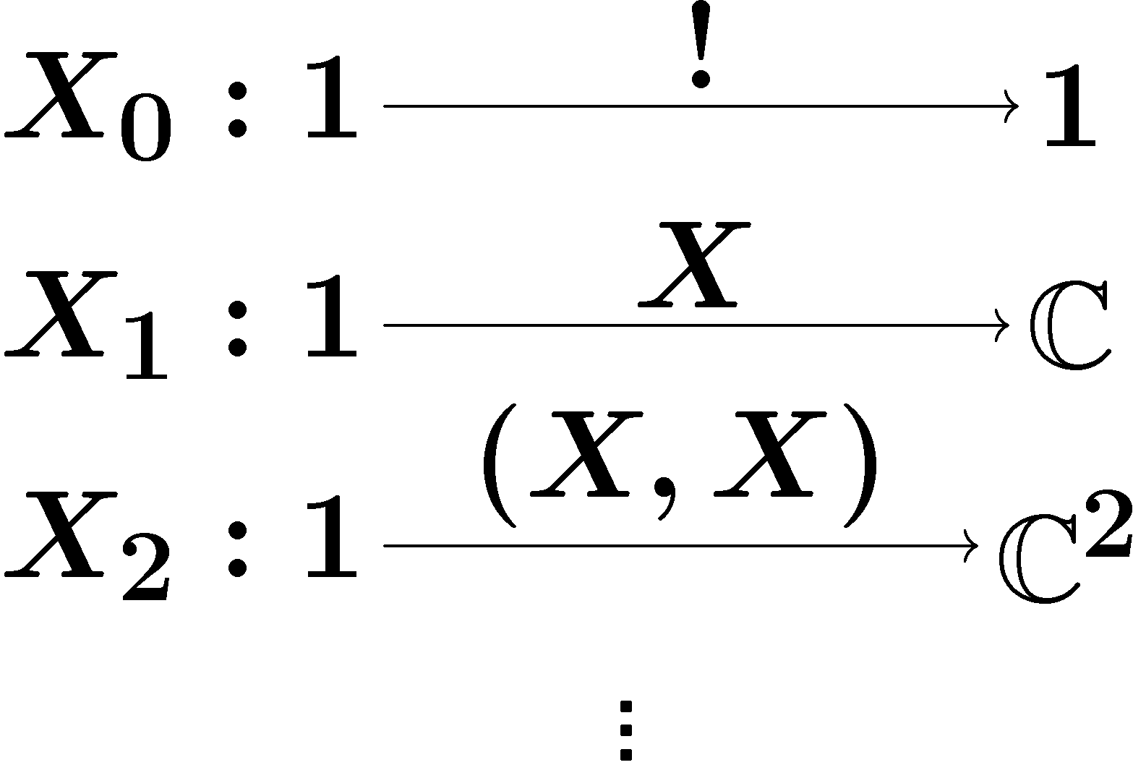
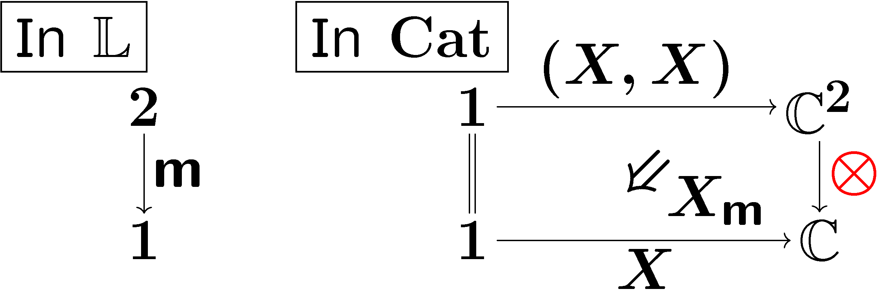

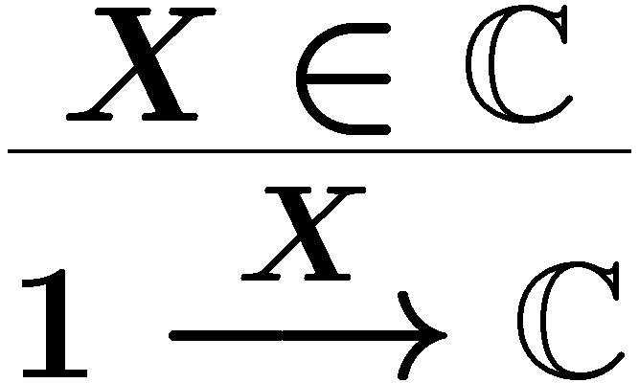
Inner model: L-object
Definition
inner alg. str.
by
mediating 2-cells
Given an L-category C,
an L-object X in it
is a lax natural transformation
compatible with products.
components
lax naturality
X: carrier obj.
Definition
Components

Slide 25
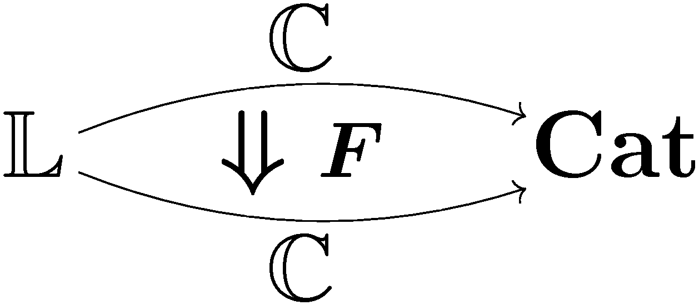
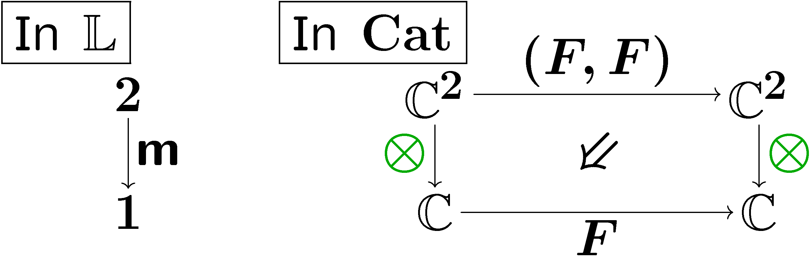
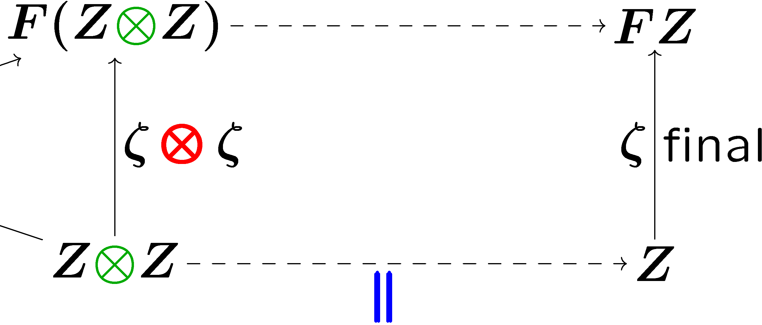
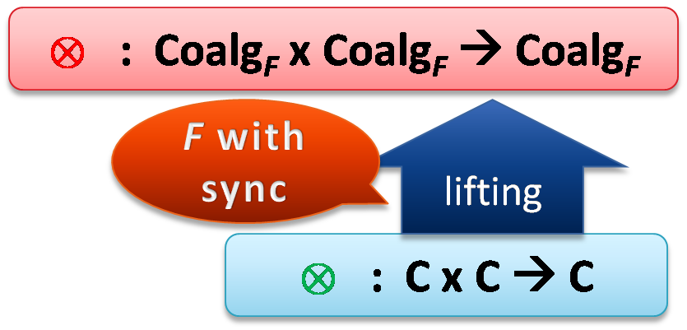
Results
lax L-functor = F with sync
lax L-functor?
lax natur.
trans.
Theorem
Equations are built in!
Coalg_{F} is an L-category
lax L-functor F
lifting
lax naturality?
L-category C
Theorem
The final object of an L-category is an L-object
Generalizes
Generalizes
Notes:
which is DELETE?

Slide 26
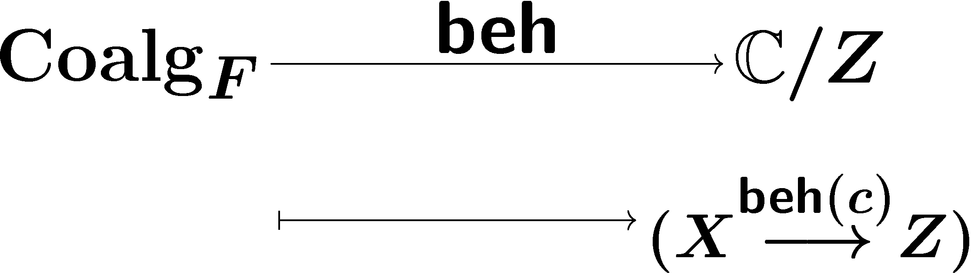
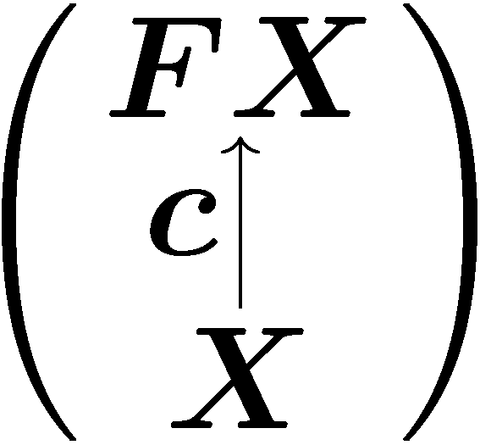
Compositionality theorem
Theorem
The behaviour functor beh is a strict L-functor
In a situation
by coinduction
Coalg_{F} is an L-category
The final object of an L-category is an L-object
lax L-functor F
lifting
L-category C
Assumptions: C is an L-category, F is lax L-functor, final exists

Slide 27
Related and future work: bialgebras
Bialgebraic structures
[Turi-Plotkin, Bartels, Klin, …]
algebraic structures on coalgebras
In the current work
Equations, not only operations ,are an integral part
The algebraic structures are nested, higher dimensional
Missing
Full GSOS expressivity

Slide 28
Conclusion
inner interpretation
Microcosm principle
X 2 C
outer interpretation
algebraic theory
operations
equations
2-categorical formulation
Concurrency in coalgebra as motivation and CS example

