Slide 1
Exemplaric Expressivity of Modal Logics
Ana Sokolova University of Salzburg
joint work with
Bart Jacobs Radboud University Nijmegen
TexPoint fonts used in EMF.
Read the TexPoint manual before you delete this box.: AAAAAAAAAA

Slide 2
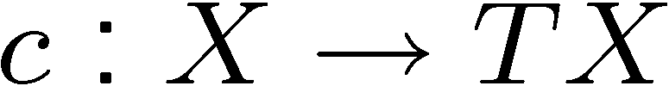
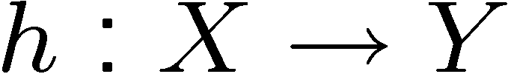
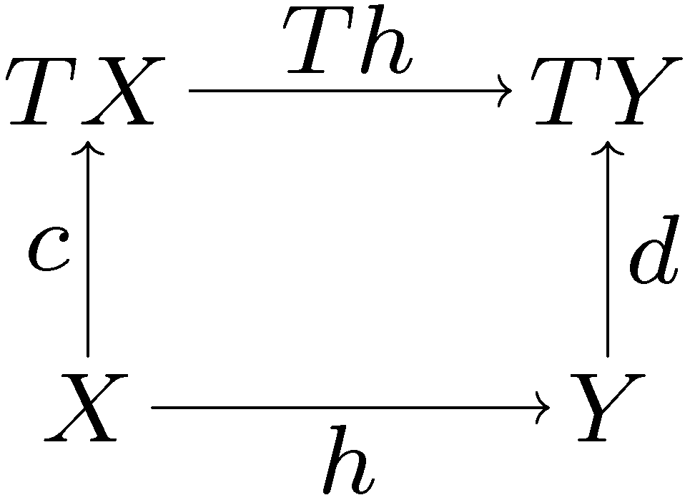
It is about...
Coalgebras
Modal logics
Behaviour functor !
Generalized transition systems
In a studied setting of dual adjunctions

Slide 3
Outline
Expressivity:
logical equivalence = behavioral equivalence
For four examples:
Transition systems
Markov chains
Multitransition systems
Markov processes
Boolean modal logic
Finite conjunctions „valuation“ modal logic

Slide 4
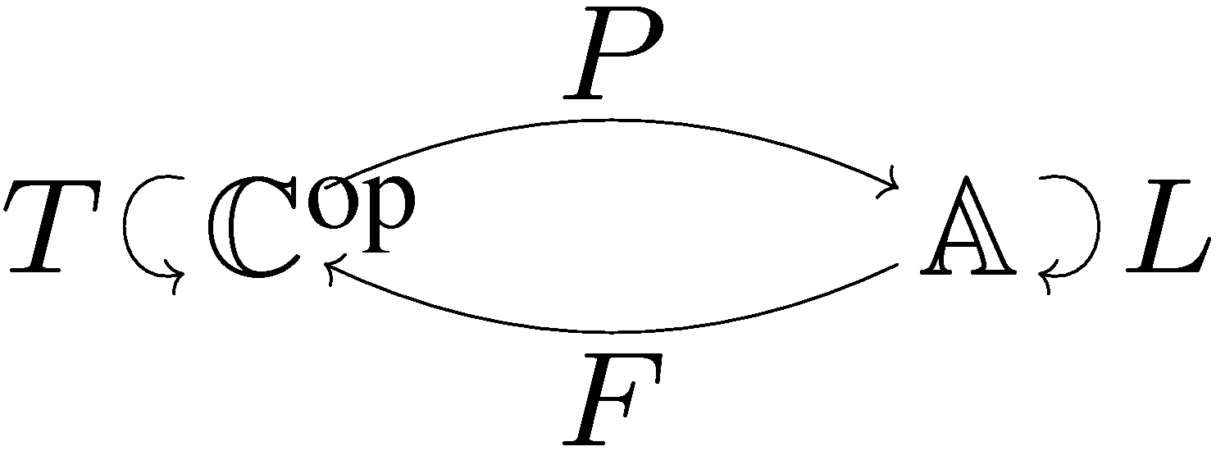
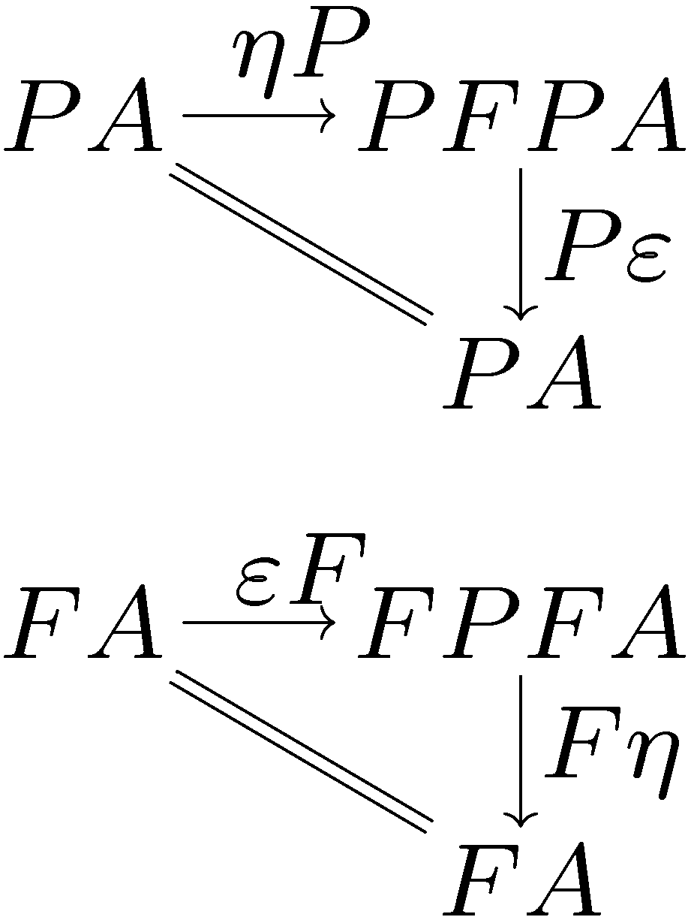
Via dual adjunctions
Predicates on spaces
Dual
Theories on models
Behaviour
(coalgebras)
Logics
(algebras)

Slide 5
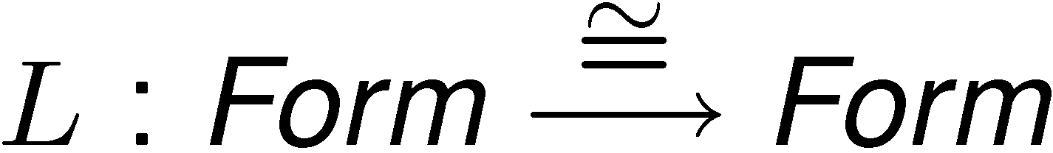

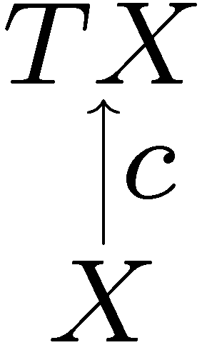
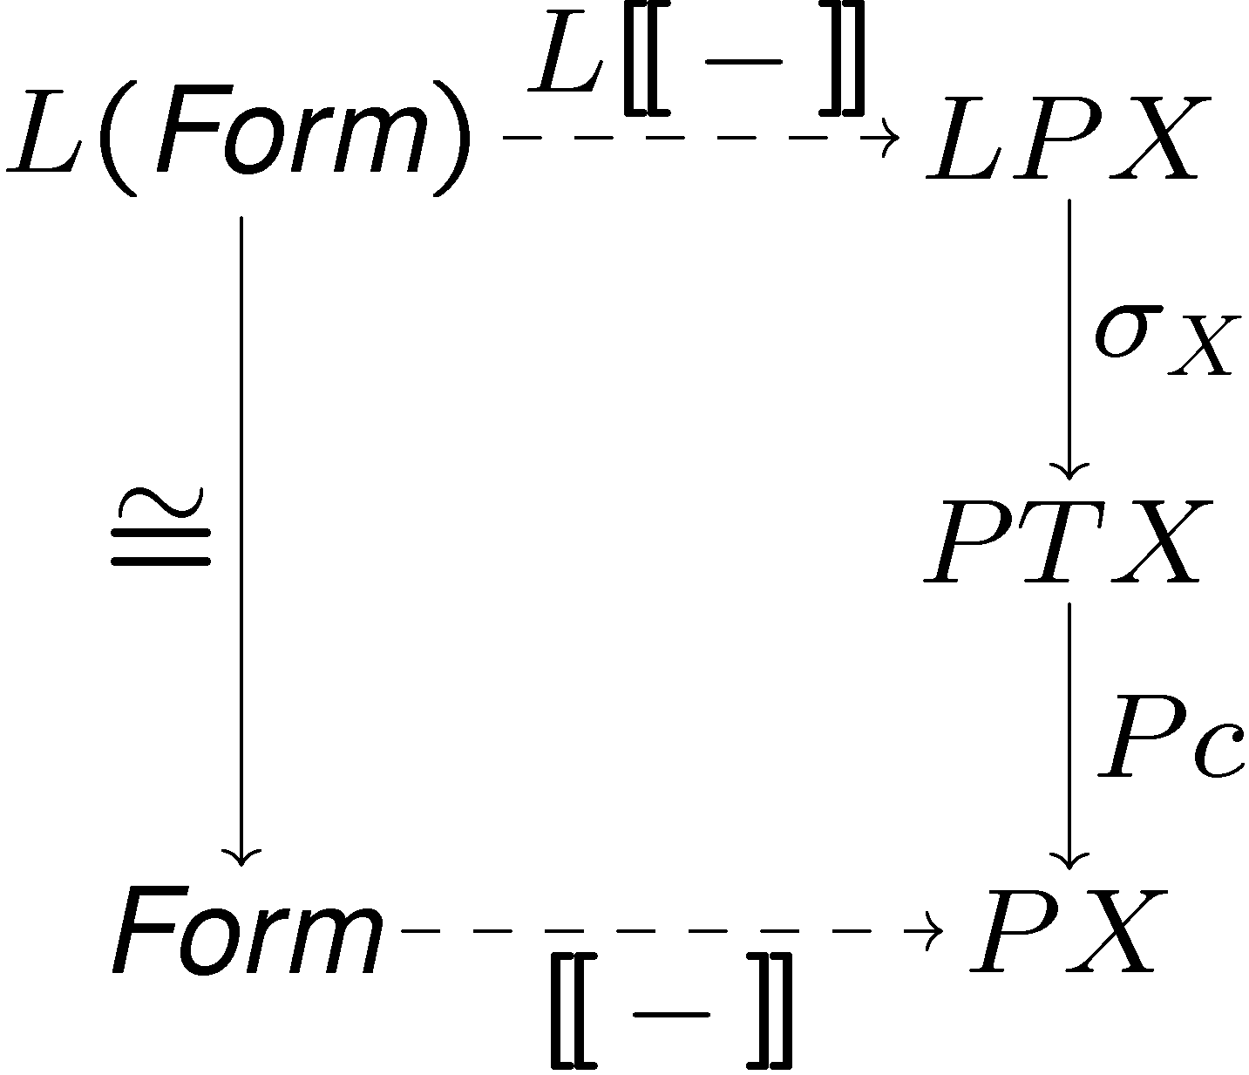
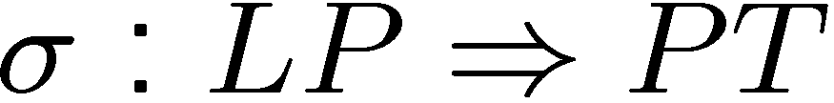
Logical set-up
If L has an initial algebra of formulas
A natural transformation
gives interpretations

Slide 6
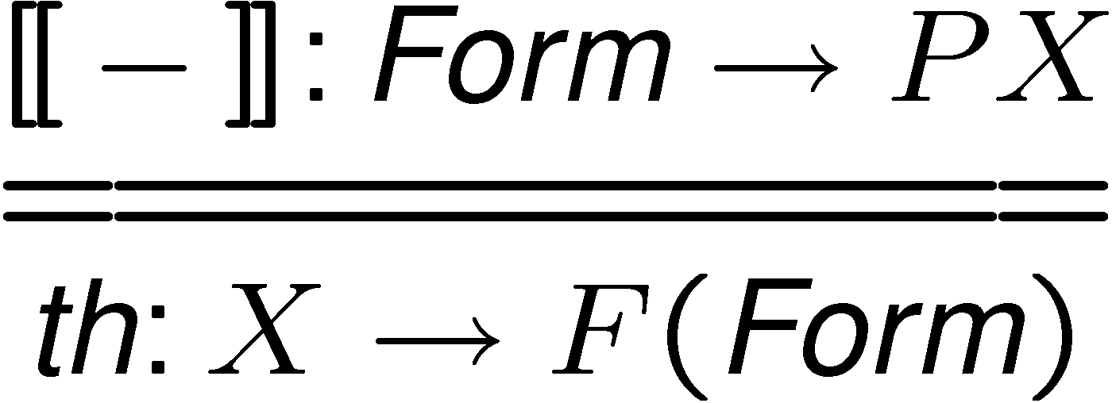
Logical equivalence behavioural equivalence
The interpretation map yields a theory map
Aim: expressivity
which defines logical equivalence
behavioural equivalence is given by
for some coalgebra homomorphisms
h₁ and h₂

Slide 7
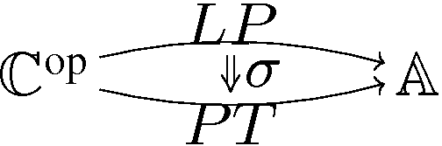
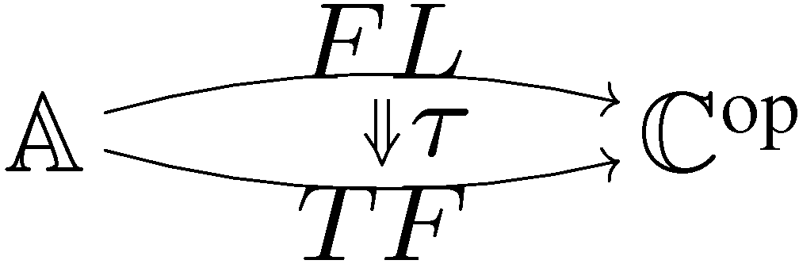
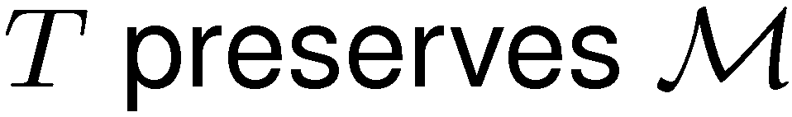
Expressivity
Bijective correspondence between
and
If and the transpose of the interpretation is componentwise abstract mono, then expressivity.
Factorisation system on
with diagonal fill-in

Slide 8
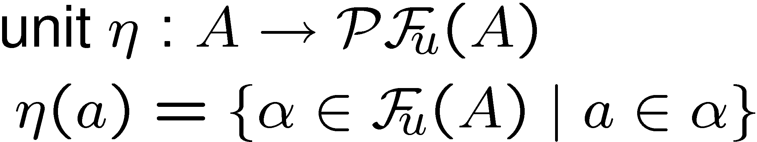
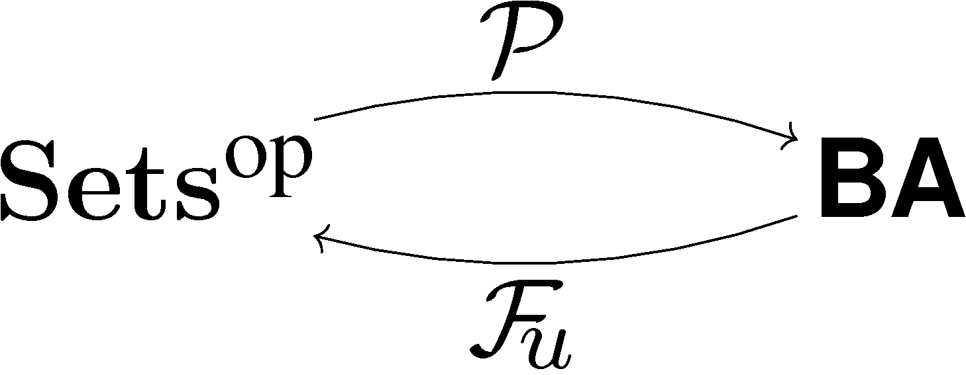
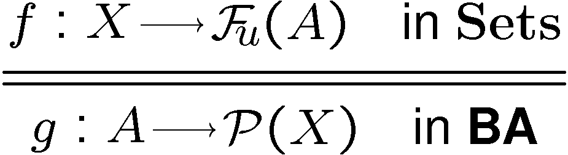

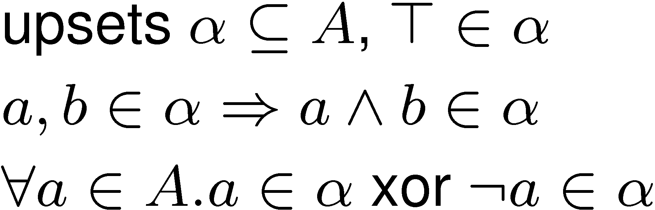
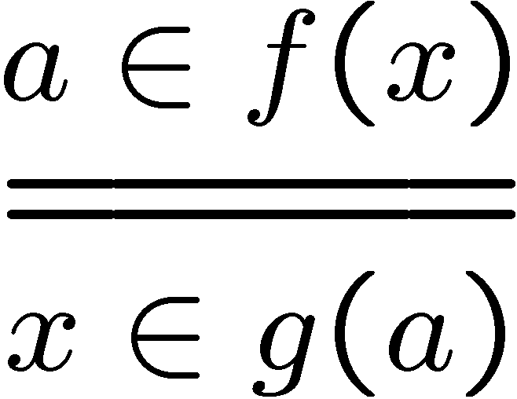
Sets vs. Boolean algebras
contravariant powerset
Boolean algebras
ultrafilters

Slide 9
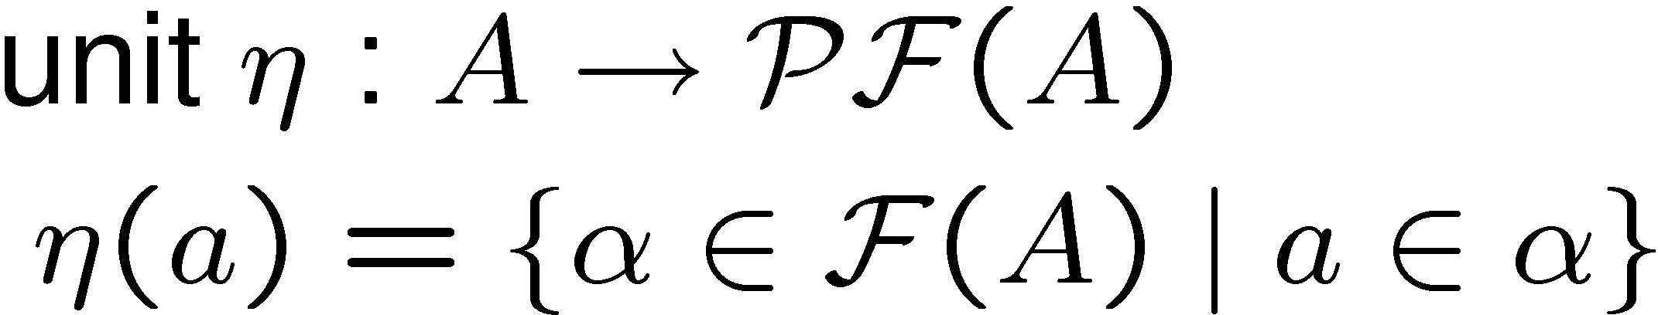
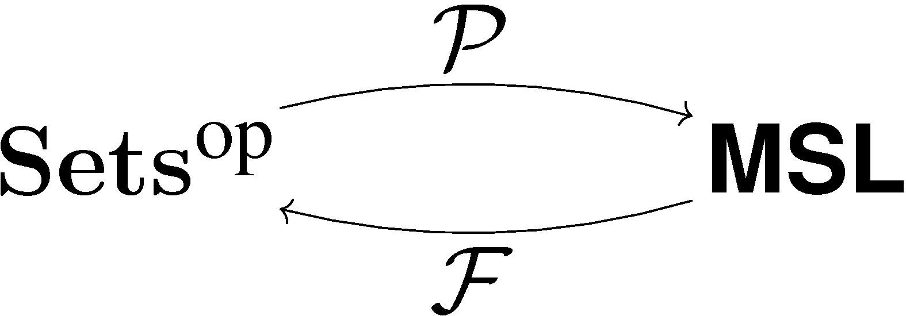
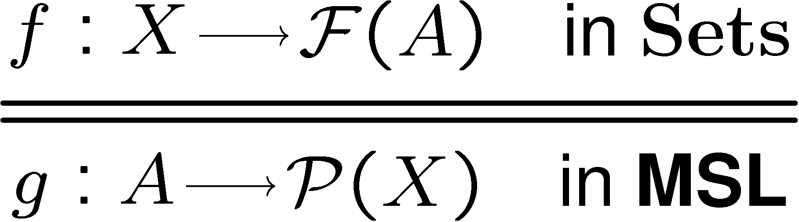
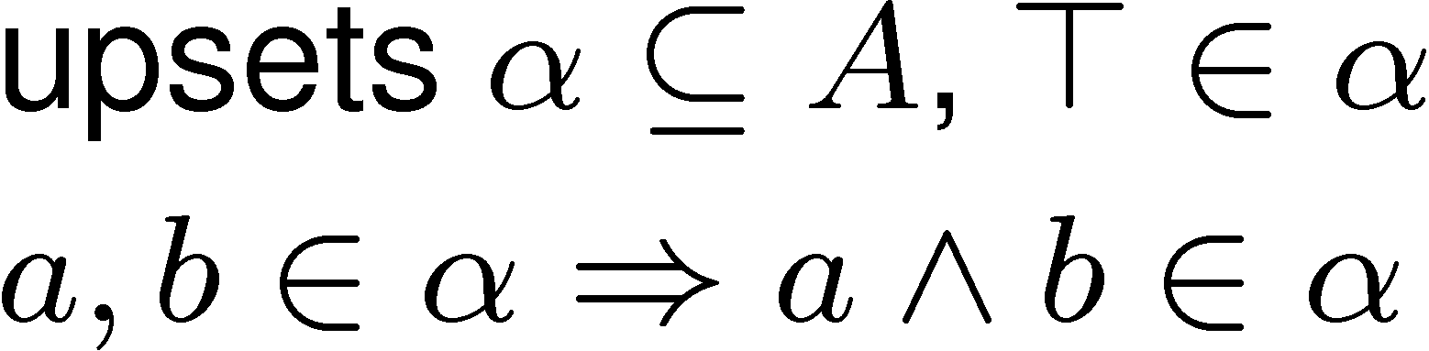
Sets vs. meet semilattices
contravariant powerset
meet semilattices
filters

Slide 10
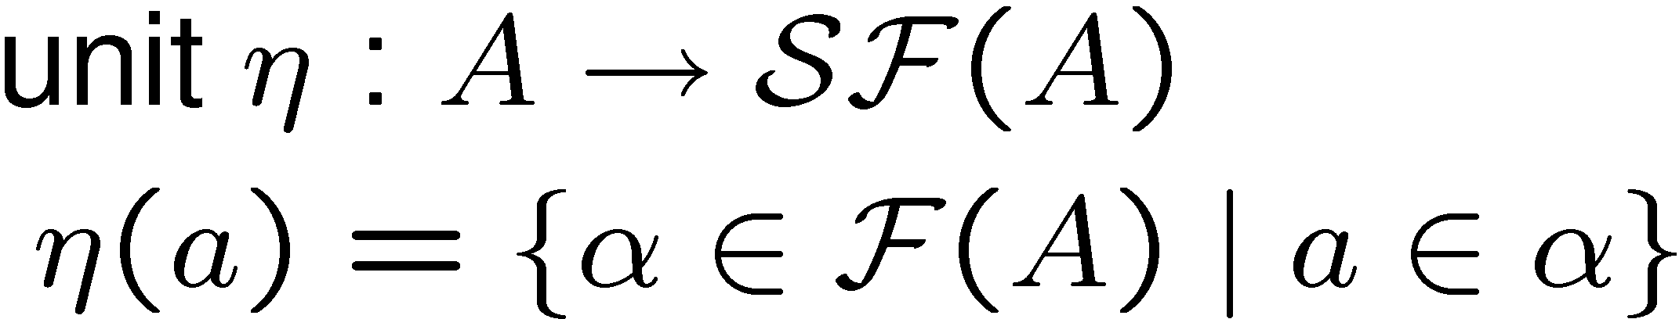

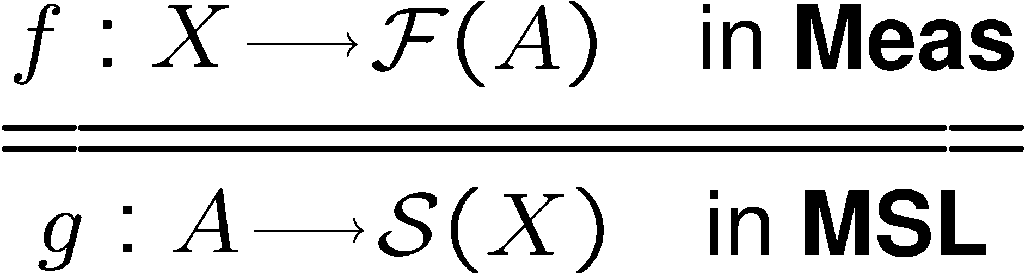
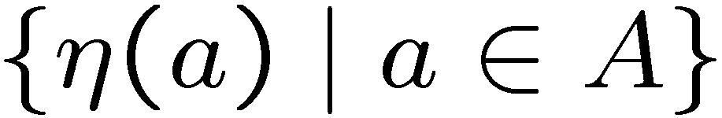

Measure spaces vs. meet semilattices
maps a measure space to its ¾-algebra
¾-algebra:
“measurable”
subsets closed under empty, complement, countable union
measure spaces
filters on A with
¾-algebra generated by

Slide 11
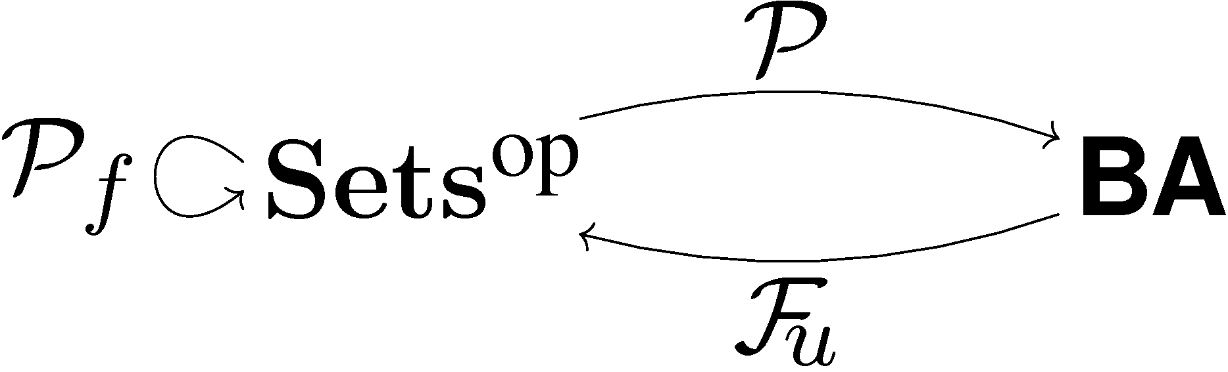

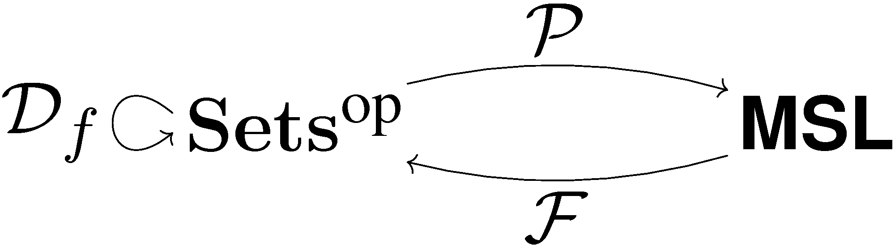

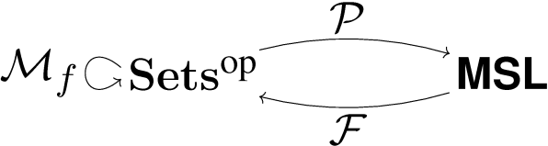

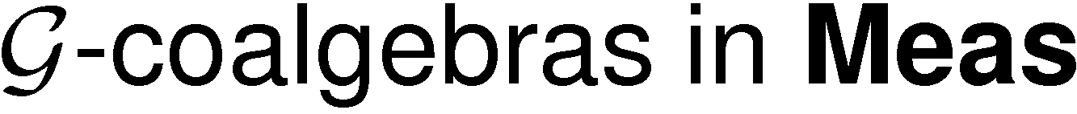
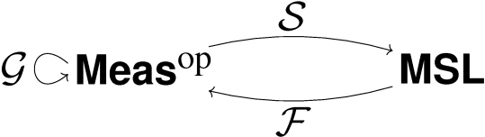
Behaviour via coalgebras
Transition systems
Markov chains/Multitransition systems
Giry monad
Markov processes

Slide 12
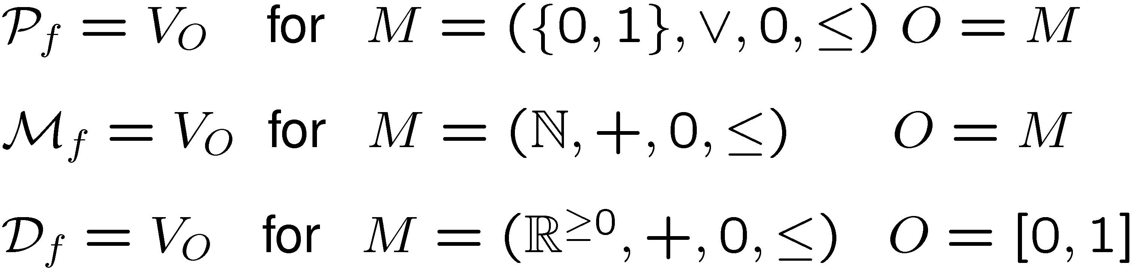
What do they have in common?
They are instances of the same functor
Not cancellative

Slide 13
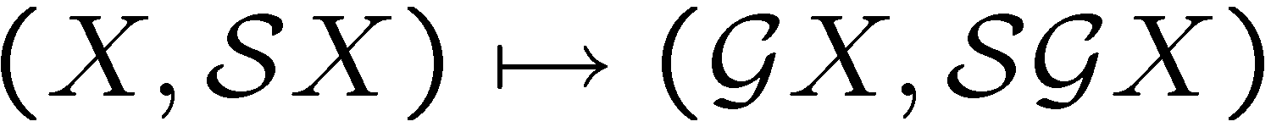
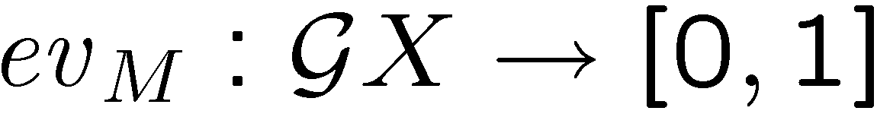
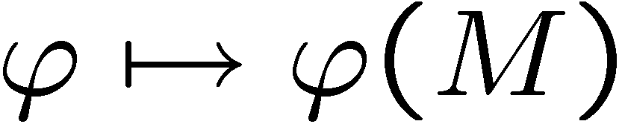
The Giry monad
countable union of pairwise disjoint
the smallest making
measurable
generated by
subprobability measures

Slide 14
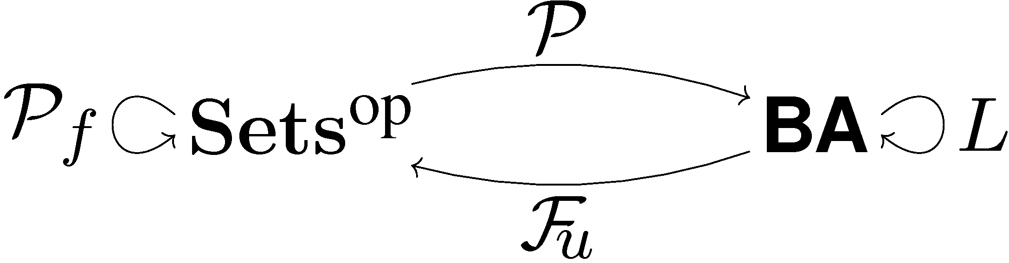
Logic for transition systems
Modal operator
models of boolean logic with fin.meet preserving modal operators
expressivity
L = GV
V - forgetful

Slide 15
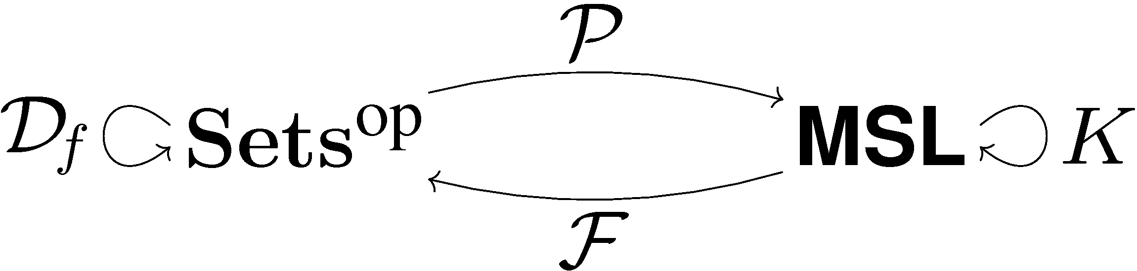
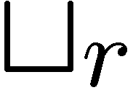
Logic for Markov chains
Probabilistic modalities
models of logic with fin.conj. and
monotone modal operators
expressivity
K = HV
V - forgetful

Slide 16
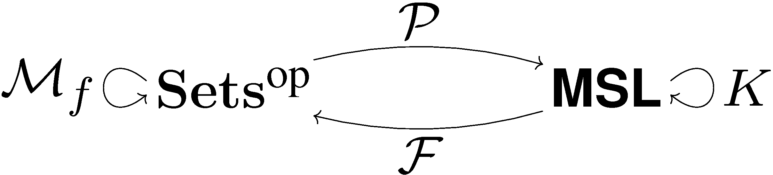
Logic for multitransition ...
Graded modal logic modalities
models of logic with fin.conj. and
monotone modal operators
expressivity
K = HV
V - forgetful

Slide 17

Logic for Markov processes
General probabilistic modalities
models of logic with fin.conj. and
monotone modal operators
expressivity
the same K

Slide 18
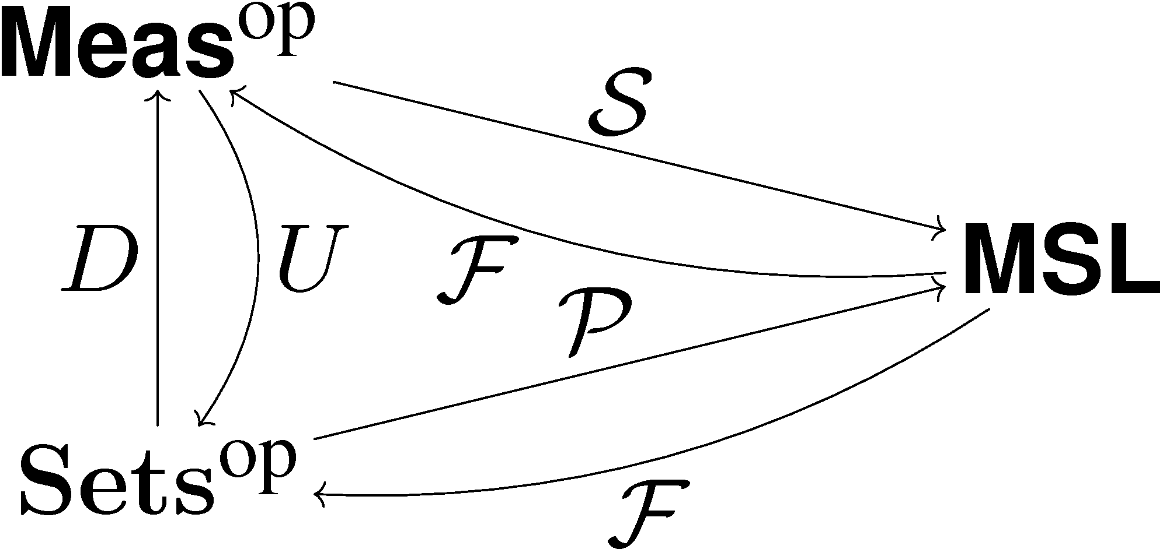
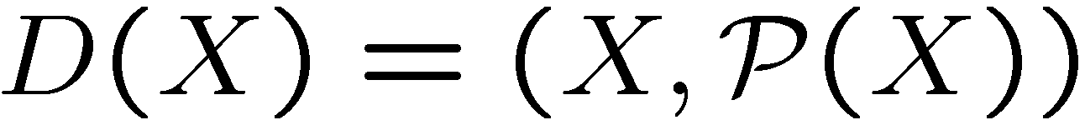



Discrete to indiscrete
The adjunctions are related:
forgetful
functor
discrete
measure
space

Slide 19
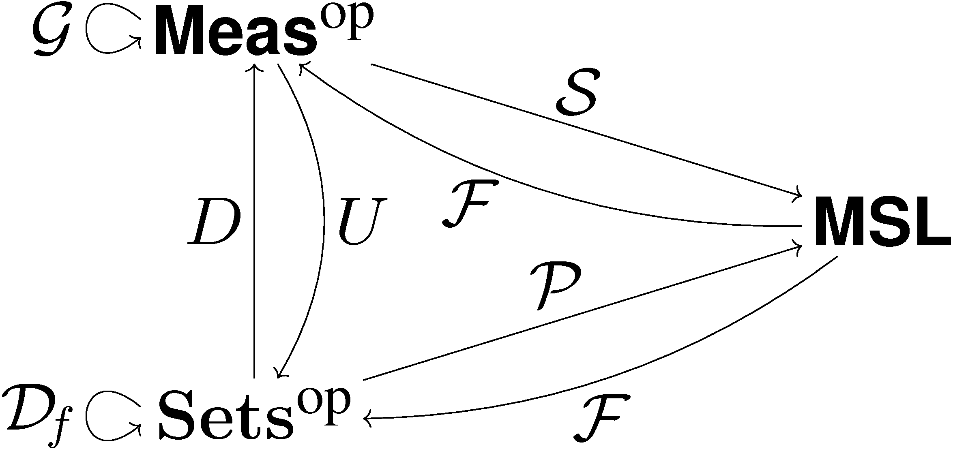
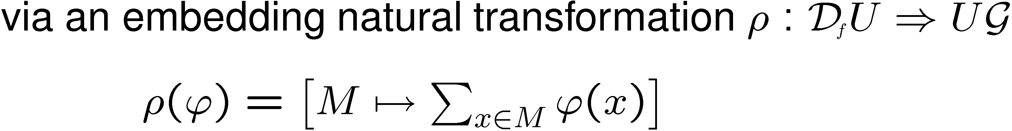
Discrete to indiscrete
Markov chains as Markov processes

Slide 20
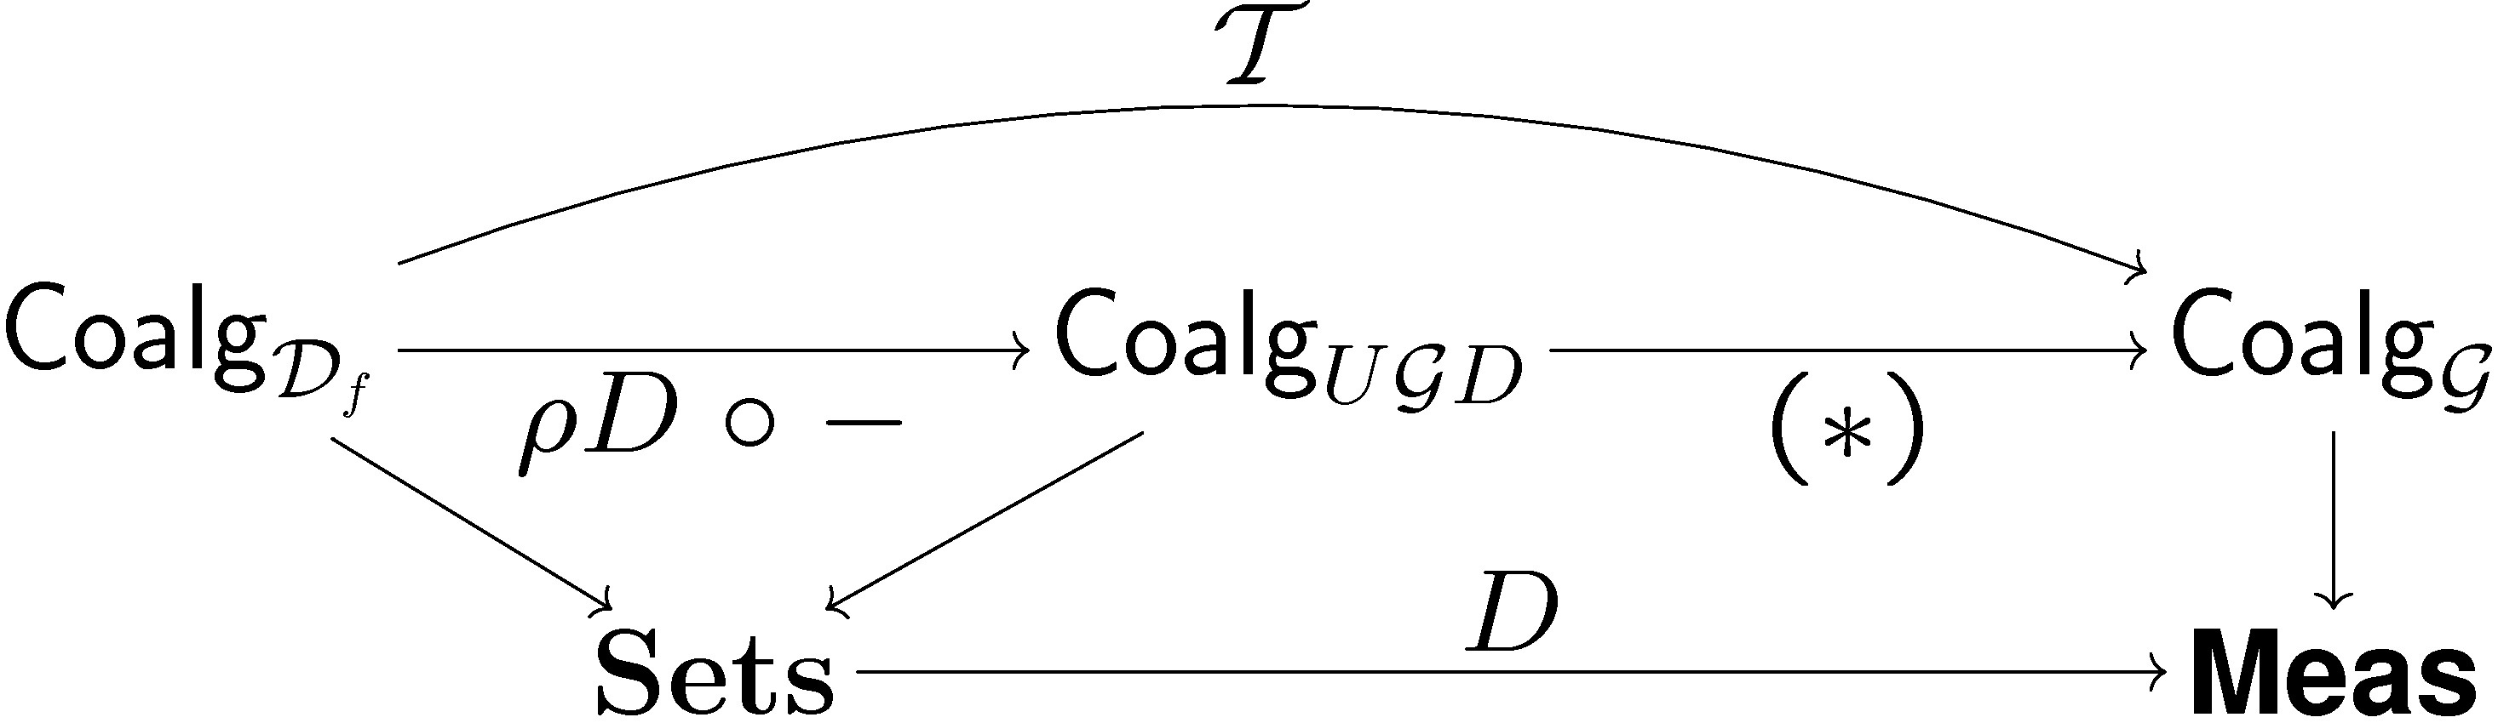
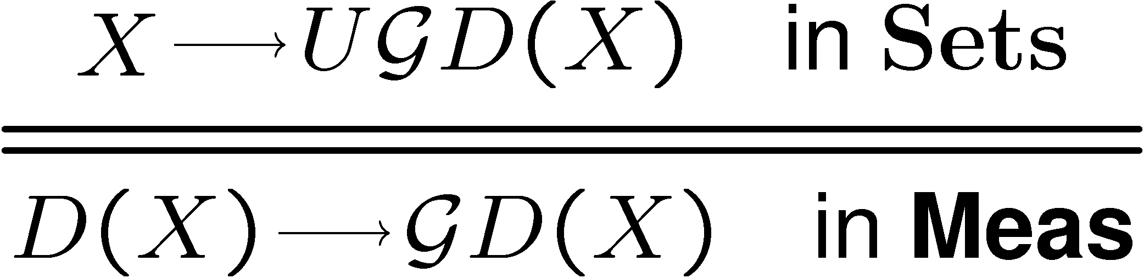
Discrete to indiscrete
So we can translate chains into processes
Behavioural equivalence coincides
Also the logic theories do

Slide 21
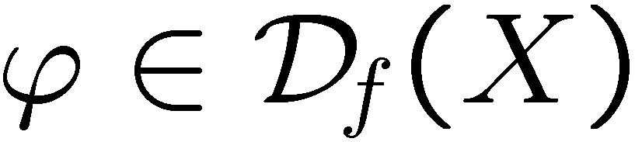
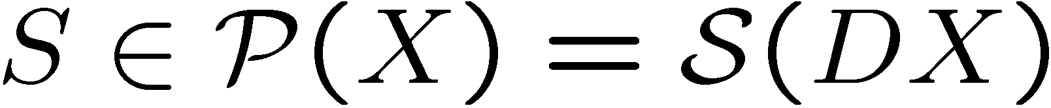
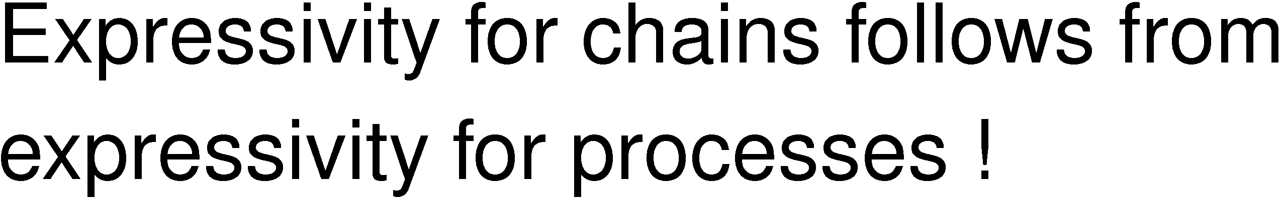
Or directly ...

Slide 22
Conclusions
Expressivity
For four examples:
Transition systems
Multitransition systems
Markov chains
Markov processes
Boolean modal logic
Finite conjunctions ``valuation´´ modal logic
in the setting of dual adjunctions !

