Slide 1
Ideological Differences Between East and West - Politics: Only one party in Soviet Union vs. free elections with choice of parties in West - Social structure: Everyone equal in Soviet Union vs. inequality in West - Economy: All property owned by state in Soviet Union vs. private property in West - Rights: Few individual rights in Soviet Union vs. more freedoms in West

Slide 2
Differences Between Leaders - Roosevelt (USA): Believed in democracy but wanted to accept Soviet Union as superpower - Churchill (Britain): Did not trust Stalin and wanted to limit Soviet control of Eastern Europe - Stalin (Soviet Union): Believed West wanted to destroy communism so stood firm in negotiations

Slide 3
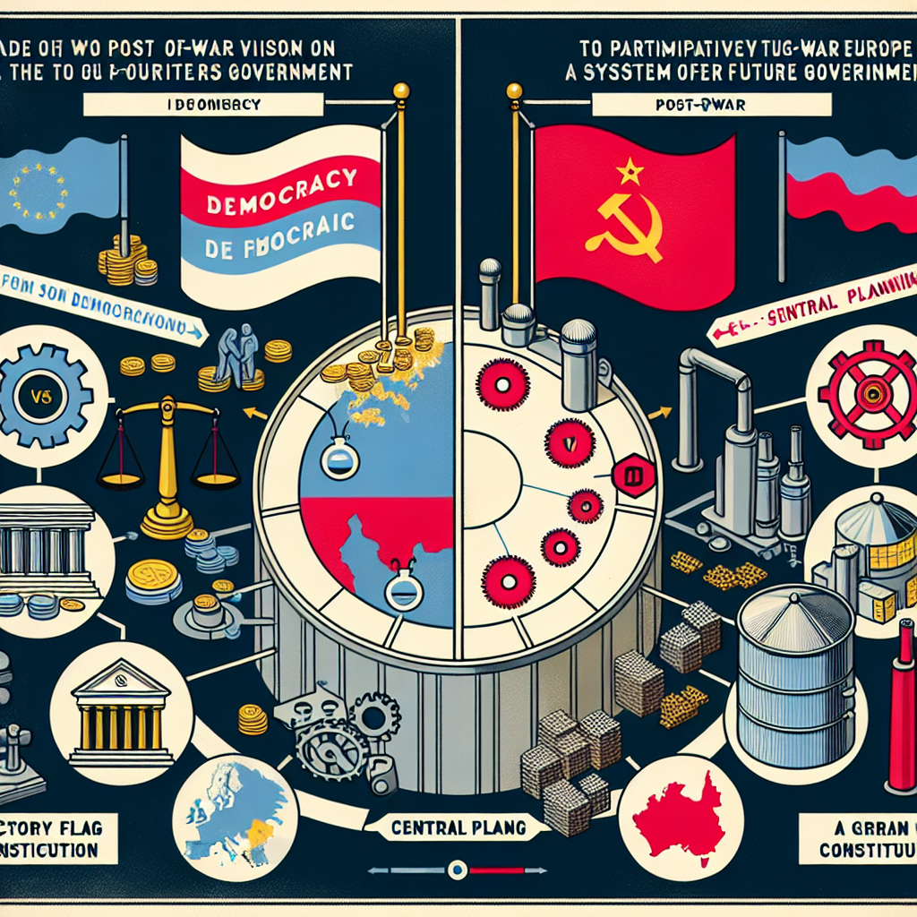
Post-War Vision Differences - USA saw allied victory as triumph for capitalism and democracy - Soviet Union saw victory as validation of communism and right to spread ideology - Led to rivalry over how to govern post-war Europe

