Slide 1

Please fill out the mid-term FCQ!
Notes:
https://i.pinimg.com/originals/8c/cf/ec/8ccfec7d5cb3c92265cbf153523eb9b5.jpg

Slide 2
Please fill out the mid-term FCQ!
But seriously, lecture will start a few minutes late to give you time to do this…
Notes:
https://i.pinimg.com/originals/8c/cf/ec/8ccfec7d5cb3c92265cbf153523eb9b5.jpg

Slide 3

CSCI 3753: Operating Systems, Fall 2019
Erika Hunhoff, based off slides by Anh Nguyen
Department of Computer Science

Slide 4

Announcements
FCQ
Problem Set 2
PA3

Slide 5
Week 7: PA2 Review & PA3

Slide 6
Week 7: PA2 Review & PA3

Slide 7
C strings
…
‘\0’
Null Terminator
Char
1 byte
Notes:
What is a C String?

Slide 8
C strings
…
‘\0’
Null Terminator
Char
1 byte
Notes:
How does strlen work?

Slide 9
Character buffers
…
Char
1 byte
Notes:
What is a character buffer?

Slide 10
Character buffers
…
Char
1 byte
Notes:
What is a buffer?
What is the length of the buffer?
What happens if you call strlen on the buffer?

Slide 11
String in a character buffer
…
…
Char
1 byte
Notes:
Length of the string and the buffer
Now what happens if you call strlen on the buffer?

Slide 12
Also a string in a character buffer
…
…
Char
1 byte
Notes:
Length of the string and the buffer
Now what if you call strlen on the buffer?

Slide 13
Sizes and lengths
sizeof(arg)
strlen(str)
Sizeof() give you the size of the data type of the arg in bytes
How many bytes until a null-terminator?
See also: strnlen()
Notes:
What happens when you do sizeof() buffer?
How do you get the actual size of a buffer? What (conceptually) is the size of a buffer?

Slide 14
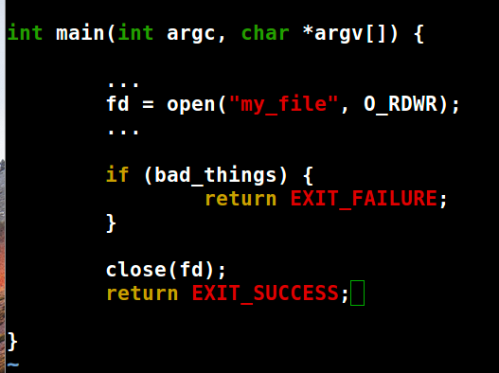
Find the error!
Notes:
File descriptor not closed!

Slide 15

Find the error!
The file isn’t closed before returning!
Notes:
File descriptor not closed!
Generally speaking, in C, you will have to do cleanup whether you success or you fail.
This goes for malloc’d memory, open files, and other system resources

Slide 16
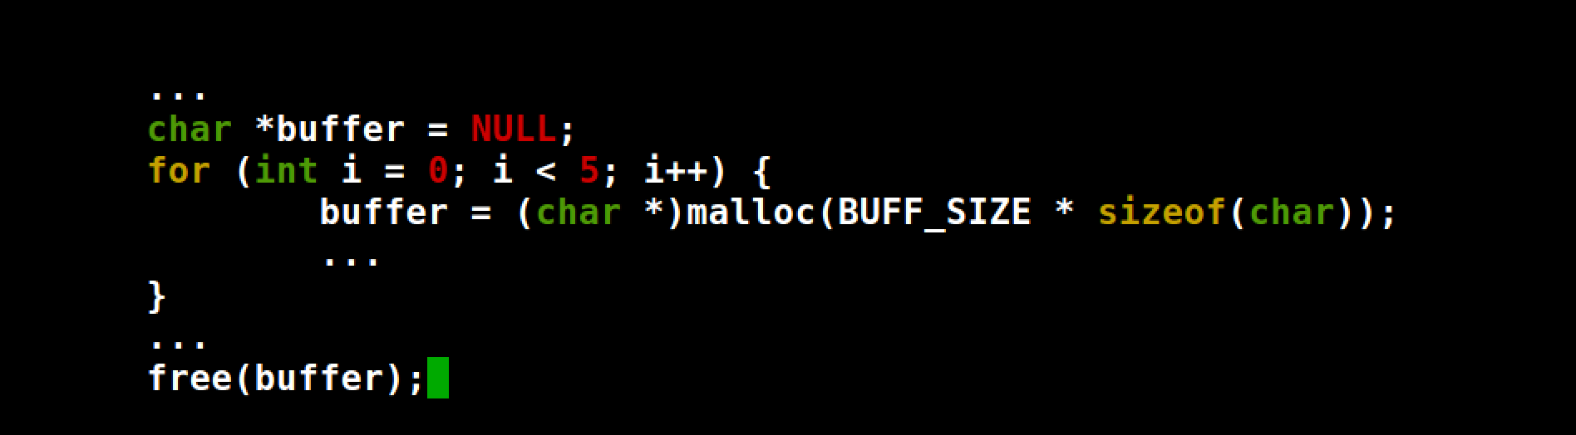
Find the error!
Notes:
What’s the error

Slide 17
Find the error!
Of the five sections of memory malloc()’d, only the last one is free()’d!
Notes:
Be very careful about overwriting your only handle to malloc’d memory. You can either free in the loop, or use a different pointer for each section of memory.

Slide 18
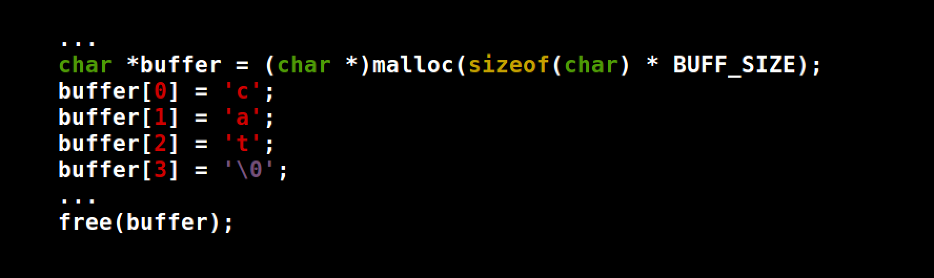
Find the error!
Notes:
Looks good but…

Slide 19
Find the error!
If malloc() failed, you’ll be writing somewhere you shouldn’t!
Notes:
It’s rare, but sometimes malloc can fail. This is probably only going to happed during a catastrophic system failure, but if that’s the case you still want to be able to do your cleanup and exit gracefully.

Slide 20
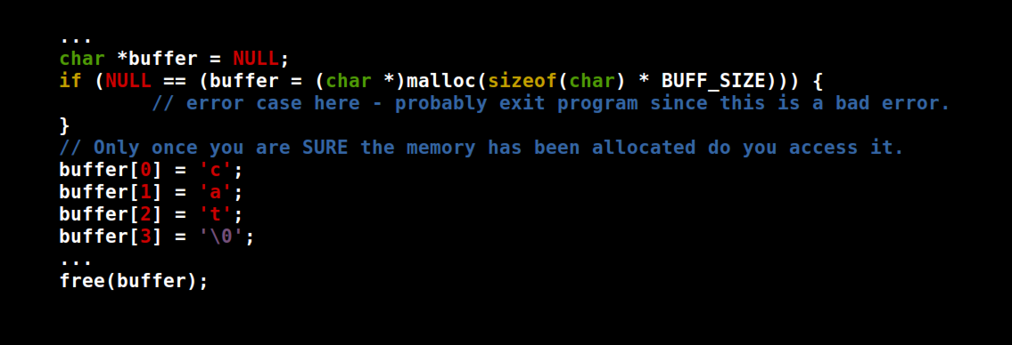
Common Pattern in C Programming: Check Returns Values!
Notes:
Not just with malloc – MANY functions in C work this way. If a function returns a value, it’s typically useful. So use it! Do not ignore!

Slide 21
What does it mean to handle errors ‘gracefully’?
Should NEVER segfault
A user should be able to get an error, but should never be able to ‘crash’ your program with invalid input.
Ideally, should print an error message
Notes:
Try to write ‘bulletproof’ code

Slide 22
Week 7: PA2 Review & PA3

Slide 23
Overview
Domain Name
IP Address

Slide 24
Overview
GOAL: Use pthreads to create a DNS name resolution engine.
For (each file):
For (each line in file):
Read the domain name from the line
Find the IP for the domain name
Write the IP in a results file

Slide 25
Overview
The requestors (producers) will…
The resolvers (consumers) will…
Get the next line from a file
Parse the line for a domain name
Place each domain name onto a shared buffer
Record the processing in a file
Get the next request (domain) from the shared buffer
Look up the IP address using the domain name
Log the information into the output file

Slide 26
Overview
The requestors (producers) will…
The resolvers (consumers) will…
Get the next line from a file
Parse the line for a domain name
Place each domain name onto a shared buffer
Record the processing in a file
Get the next request (domain) from the shared buffer
Look up the IP address using the domain name
Log the information into the output file

Slide 27
Overview
The requestors (producers) will…
The resolvers (consumers) will…
Get the next line from a file
Parse the line for a domain name
Place each domain name onto a shared buffer
Record the processing in a file
Get the next request (domain) from the shared buffer
Look up the IP address using the domain name
Log the information into the output file

Slide 28
Read data from multiple files.
Total runtime is …
End Goal
Requester
Thread Pool
stdout
gettimeofday()
P
C
. . .
Shared Buffer
. .
P
C
Resolver
Thread Pool
Conversion
log
Data files
Look up the required information for the request, log the results
facebook.com
youtube.com
yahoo.com
Parsing log
Store a single request in an entry of a shared buffer of given size
results-ref.txt
input/name*.txt
util.c
util.h
Each line is a request that must be processed individually.
Record which process handled which request
Each dotted line is around a shared resource that must be protected from race conditions.

Slide 29
Program Inputs (Arguments)
./multi-lookup 10 5 requester_log.txt results.txt name1.txt name2.txt

Slide 30
Program Inputs (Arguments)
./multi-lookup 10 5 requester_log.txt results.txt name1.txt name2.txt
Number of requester threads to place into the thread pool

Slide 31
Program Inputs (Arguments)
./multi-lookup 10 5 requester_log.txt results.txt name1.txt name2.txt
Number of resolver threads to place into the thread pool

Slide 32
Program Inputs (Arguments)
./multi-lookup 10 5 requester_log.txt results.txt name1.txt name2.txt
Requestor log: the file into which all the requestor status information is written.
Line format: Thread <thread id> serviced ### files
Get ID with: pthread_self()

Slide 33
Program Inputs (Arguments)
./multi-lookup 10 5 requester_log.txt results.txt name1.txt name2.txt
Results log: The file into which all the converter status information is written.
Per line format: www.google.com, 74.125.224.81

Slide 34
Program Inputs (Arguments)
./multi-lookup 10 5 requester_log.txt results.txt name1.txt name2.txt
Data files: List of filenames that are to be processed. Each file contains a list of domain names, one per line, that are to be resolved.

Slide 35
Program Limits
MAX INPUT FILES = 10
MAX RESOLVE THREADS = 10
MAX NAME LENGTH = 1025 characters
MAX IP LENGTH = INET6_ADDRSTRLEN or 46

Slide 36
Error Handling
If domain name cannot be resolved,
Output a blank string in the format “ , “
Print a message to stderr alerting the user
If output file path is bad,
Print an appropriate error to stderr
Exit the program
If input file path is bad,
Print an appropriate error to stderr
Move on to the next file

Slide 37
Focus
Synchronization
Deadlock/busy wait
→ Suggested solutions
Mutex
Semaphore
Conditional variables

Slide 38

CAUTION: WHAT FOLLOWS IS AN EXAMPLE OF HOW TO BREAK PA3 INTO SMALLER CHUNKS. IT MAY NOT BE THE OPTIMAL WAY TO APPROACH THE PROBLEM. THINK CRITICALLY BEFORE YOU CODE.
Notes:
Things like logging, etc.

Slide 39
Implementation Step 1
Action: Create a program to create a single requestor thread that will repeatedly read a line from a given file and add an entry into the shared buffer
Validation: Does the buffer have the correct number of entries?
Requester
Thread Pool
Main Thread
start P
wait P
P
Shared Buffer

Slide 40
Implementation Step 2
Action: Use the result in step 1. Once the requestor is done, start a resolver thread to take items out of the buffer. Then, write the results to an output file.
Validation: Does the output file contain the entries stored in the buffer?
Requester
Thread Pool
Resolver
Thread Pool
Main Thread
start P
wait P
start C
wait C
P
C
Shared Buffer
Output File

Slide 41
Implementation Step 3
Action: Try to make the requestor and resolver run concurrently. Multiple processes accessing and modifying the same data can cause race conditions. You must protect the critical sections where shared resources are accessed with a mutex.
Requester
Thread Pool
Resolver
Thread Pool
Main Thread
start P
start C
wait P
wait C – exits when no data and no active P
P
Shared Buffer
C
Output File

Slide 42
Implementation Step 4
Action: Create multiple requestor threads to read from different files. A requestor will terminate when all lines from the file have been processed.
Requester
Thread Pool
Resolver
Thread Pool
Main Thread
For each P
start P
start C
For each P
wait P
wait C
P
. . .
Shared Buffer
C
P
Output File

Slide 43
Implementation Step 5
Action: Create multiple resolver threads to read the output from multiple requestor threads via a single shared buffer. The resolver will wait for data (spin wait is acceptable) but will terminate if there are no active resolvers and the buffer is empty.
Requester
Thread Pool
Resolver
Thread Pool
Main Thread
For each P
start P
For each C
start C
For each P
wait P
For each C
wait C
P
C
. . .
Shared Buffer
. .
P
C
Output File

Slide 44
Implementation Step 6
Action: Add logging to the requester threads. Then add output logging to the resolver threads. Files are a shared resource and therefore must be protected from multiple processes accessing it.
Requester
Thread Pool
Resolver
Thread Pool
Main Thread
For each P
start P
For each C
start C
For each P
wait P
For each C
wait C
Check P log file
P
C
. . .
Shared Buffer
. .
P
C
Output File
Parsing log

Slide 45
Implementation Step 7
Action: Add details: actual DNS functionality, argument parsing etc. for main, error checking as necessary, etc.
Test your program a lot! Try to break it!
Leave plenty of time for this step.

Slide 46
Memory Leaks
To verify that you do not leak memory, use valgrind to test your program
To install valgrind, use the following command:
sudo apt-get install valgrind
To use valgrind to monitor your program, use this command:
valgrind ./pa3main <your program args…>
Notes:
Other checks as well:

Slide 47
Notes:
Do the demo!

Slide 48

Week TODO Checklist
Midterm FCQ
PA3

Slide 49
PA3Resolver

