Slide 1
Week 2: VMs, Containers, Orchestration and Kubernetes, Edge, and Cloud Native
Deep Learning in the Cloud and at the Edge
Dima Rekesh
Esteban Arias
Ryan DeJana
Brad DesAulniers
Prabs Attaluri
Alexandra Savelieva

Slide 2
Agenda
News
The Edge
Containers
Kubernetes
Lab
Homework
Notes:
Lab can take up to 60 mins

Slide 3
What is the Edge?
Edge computing optimizes devices and web applications by bringing computing closer to the source of the data.
This minimizes the need for long distance communications, which reduces latency and bandwidth usage.
Notes:
Edge computing is a networking philosophy focused on bringing computing as close to the source of data as possible in order to reduce latency and bandwidth use. In simpler terms, edge computing means running fewer processes in the cloud and moving those processes to local places, such as on a user’s computer, an IoT device, or an edge server. Bringing computation to the network’s edge minimizes the amount of long-distance communication that has to happen between a client and server.

Slide 4
So what is the network edge?
For Internet devices, the network edge is where the device, or the local network containing the device, communicates with the Internet.
The edge is a bit of a fuzzy term;
A IoT camera can be considered the network edge,
BVut so is the user’s router, ISP, or even a local server are also considered the edge.
The important takeaway is that the edge of the network is geographically close to the device

Slide 5
What’s different?
Early computing: Centralized applications only running on one isolated computer
Personal computing: Decentralized applications running locally
Cloud computing: Centralized applications running in data centers
Edge computing: Centralized applications running close to users, either on the device itself or on the network edge

Slide 6
An example
Consider a building secured with dozens of high-definition IoT video cameras. These are "dumb" cameras that simply output a raw video signal and continuously stream that signal to a cloud server for motion-detecting processing
There is a constant and significant strain on the building’s Internet infrastructure. Additionally, there is very heavy load on the cloud server that has to process the video footage from all the cameras simultaneously.

Slide 7
Imagine…
Computation is moved to the network edge. What if each camera used its own internal computer to run the motion-detecting application and then sent footage to the cloud server as needed?
Significant reduction in bandwidth use
The cloud server would now only be responsible for storing the important footage, meaning that the server could communicate with a higher number of cameras without getting overloaded.
This is what edge computing looks like.

Slide 8
So Why?
Cost savings - edge computing helps minimize bandwidth use and server resources
Performance – less latency, faster response
Privacy – your data stays local

Slide 9
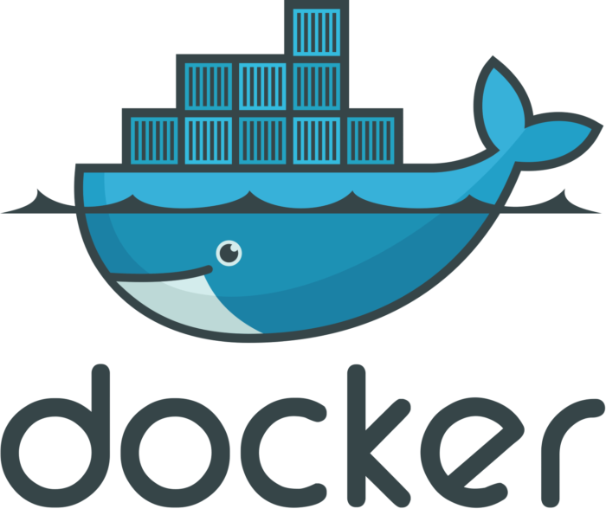
Containers
Containers package applications and their dependencies and run them in isolated environments. They provide a lightweight method of packaging and deploying applications in a standardized way across many different types of infrastructure via the leveraging features provided by the operating system.
Containers are an operating system-level virtualization method for running multiple isolated systems (containers) on a host. Containers provide operating system-level virtualization, not via a virtual machine, but rather provide a virtual environment that has its own process and network space.
Notes:
Containers provide a lightweight method of packaging and deploying applications in a standardized and portable way. This approach works cross different types of infrastructure, e.g. workstations, servers, or even virtual machines.
And like VMs, containers are a virtualization technology that enables the running of multiple isolated “systems” (containers) on a single host. Unlike VMs, which provide an entire operating system, containers provide a virtual environment based
operating system-level VM means there is no hypervisor, everything is within the host OS.

Slide 10
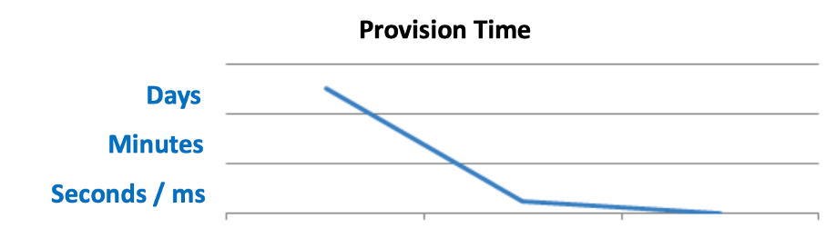
What Is Driving Interest?
Provision in seconds/milliseconds
Near bare metal runtime performance
VM-like agility: it’s still “virtualization”
Flexibility
Containerize a “system”
Containerize “application(s)” (better!)
Lightweight
Just enough operating system
Minimal per container penalty
Open source—free—lower TCO
Manual
VM
Notes:
What is driving container adoption? Well, containers have a very very fast provision time, often measured in seconds or milliseconds. They are also very performant.
Containers also provide a great deal of agility and portability, even more so than VMs.
They are also lightweight. There is just enough OS to run things, and there is a minimal per container penalty; hosts can run many many more times containers than VMs. They are also fast, often seeing near bare metal runtime performance.
Containers technology is open source; you can get started for free and often see a lower cost of ownership than priority software.

Slide 11
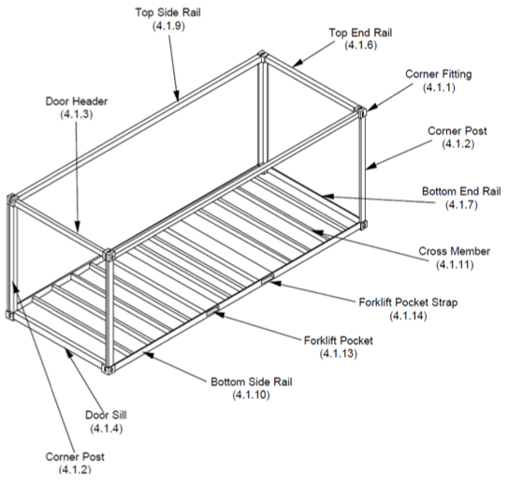
Why Containers Work!
Developers
Worry about what is inside
Code
Libraries
Apps
Data
All servers look the same
Operations
Worry about what is outside
Logging
Remote access
Monitoring
Networking
All containers start, stop, attach, etc., in the same way
Notes:
Like their namesake, software containers are a contract. Like those shipping goods, develops worry about what is inside, in the software case it isn’t coffee beans but rather Code, Libraries, Apps, and data. To the container, all (compatible) servers look the same.
Like their shipping operations counterparts, operations teams don’t need to worry about the inside, but rather the outside; which in this case is logging, remote access, networking, monitoring, etc. To operations, all containers are managed, start, stopped, attached, etc, in the exact same way.

Slide 12
Containers and VMs
Some software just can’t be containerized
Specific OS requirements
Specific modules
Too old
The usage of usage of VMs as the hosts for containers
Better isolation
Easier scaling
Notes:
As I’ve alluded to before, it isn’t just containers vs VMs, its is also containers and VMs. First, some software just won’t run in a container as it has very specific OS requirements (windows XXX or BSD, etc). Or very specific kernel module requirements, more maybe just too old. VMs are also a great host for containers as they have better isolation than bare metal and can scale very very easily.

Slide 13
Containers feel like a VM but…
Not exactly like a VM
Uses the host kernel
Can’t use a different OS
Can’t have its own kernel modules
Doesn’t need syslog, cron, etc.
To the host machine, it is just a bunch of (visible) processes
Notes:
As we look closer, it is not exactly a VM. Unlike a VM, one of the features of a container is that it shares the host’s kernel. This means a container can’t be a different OS than it’s host (note, for linux, you can use say a RedHat host with a Ubuntu container as they both are still linux. You can’t use different kernel modules.
To the host, a container is nothing more than a bunch of visible processes.
Note, Containers in a non-Linux host, such as macOS, often require a Virtual Machine to run.

Slide 14
Why Docker?
Docker is ubiquitous and available on all platforms
Your workstation
Your Jetson
The Cloud
Industry standard
Supports full life cycle
Notes:
Let’s dive into Docker.
Why docker? Docker is ubiquitous, it runs on your workstation, your Jetson device, and the cloud.
It is an industry standard and easily supports the full container lifecycle. In other words, it has everything we need to get started.

Slide 15
Note About CPUs
Docker images can support multiple architectures, which means that a single image may contain variants for different architectures.
When running an image with multi-architecture support, Docker will automatically select an image variant which matches your OS and architecture.
However, if you build your own images, you’ll need to be aware of the architecture with which you are building one.
An x86 image will not run on your Jetson!
Notes:
I’ve alluded to this.
End with
Your CPU architecture matters. Typically, images built on one CPU architecture won’t run on another.

Slide 16
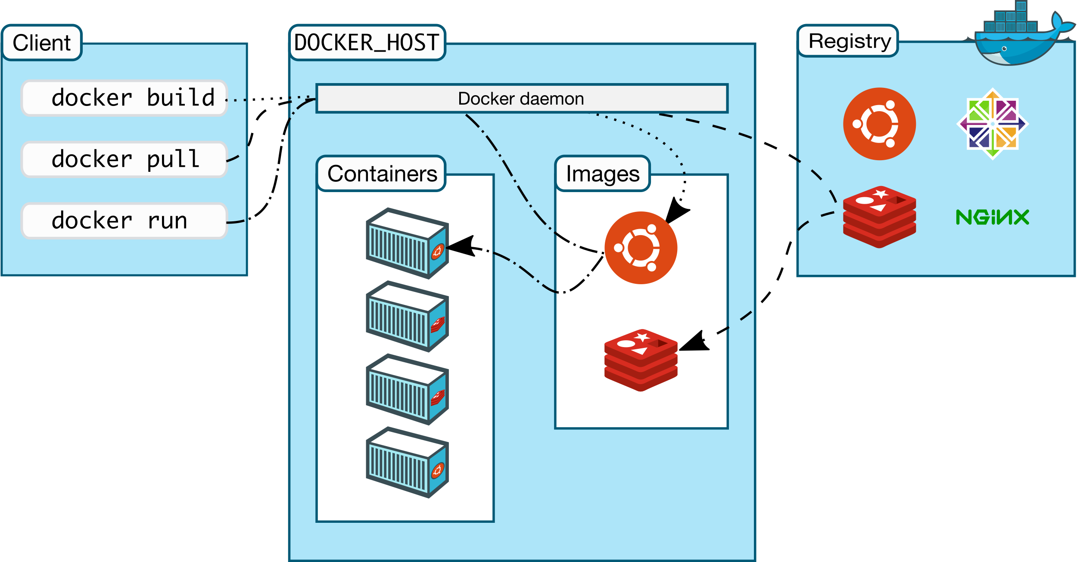
Docker Architecture
Notes:
Quick reminder of our docker arch.

Slide 17
Components
Daemon (dockerd): It listens for Docker API requests and manages Docker objects such as images, containers, networks, and volumes. A daemon can also communicate with other daemons to manage Docker services.
Client: The primary way that many Docker users interact with Docker; when you use commands such as docker run, the client sends these commands to dockerd, which carries them out. The Docker command uses the Docker API. The Docker client can communicate with more than one daemon.

Slide 18
Components (cont.)
Registries: A Docker registry stores Docker images. When you use the docker pull or docker run commands, the required images are pulled from your configured registry. When you use the docker push command, your image is pushed to your configured registry.
DockerHub: public registry that anyone can use; this is the default registry
NGC: NVIDIA registry that hosts a variety of GPU enabled images
Notes:
Suggest signing up for DockerHub.

Slide 19
Example Dockerfile
FROM ubuntu:18.04
COPY . /app
RUN make /app
CMD python /app/app.py
FROM creates a layer from the ubuntu:18.04 Docker image
COPY adds files from your Docker client’s current directory
RUN builds your application with make
CMD specifies what command to run within the container

Slide 20
Nvidia GPU and Docker
Run with docker by specifying the
docker run --rm --runtime=nvidia
Possible to configure the default runtime via the /etc/docker/daemon.json configuration file
{
"default-runtime": "nvidia",
"runtimes": {
"nvidia": {
"path": "nvidia-container-runtime",
"runtimeArgs": []
}
}
}
Notes:
With our Jetson device, you can specify the NVIDIA runtime with the –runtime flag or by configuring the docker deamon to use it by default.

Slide 21
What Is Kubernetes?
“Kubernetes”—Greek for governor, helmsman, captain
Open-source container orchestration system developed by Google, based on lessons learned from Google’s Project Borg
Now part of the Cloud Native Computing Foundation
Aims to provide a “platform for automating deployment, scaling and operations of application containers across clusters of hosts”
Can be thought of the new Enterprise “Linux”
Provides a common experience across data centers and hardware architecture
Notes:
Ok, this is one of my favorite technologies. K8s is an industry leading orchestration technology. It name builds on the nautical theme of docker.

Slide 22
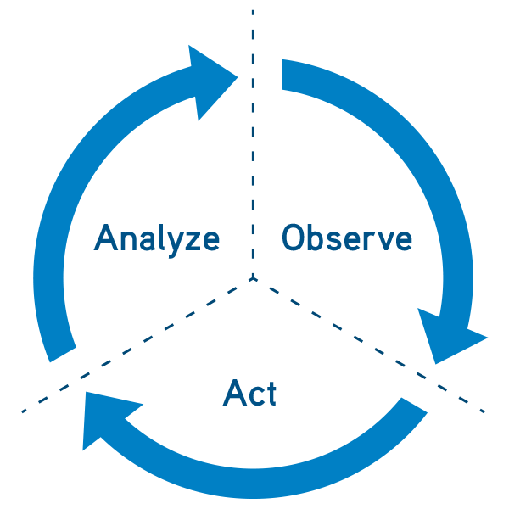
Declarative in Nature
User specifies the desired state, not the steps on how to get there.
The system looks at the current state and determines the sequence of commands to transition the system to the desired state. This is done through a reconciliation loop.
This not only simplifies the user experience but enables self healing. If there is an unintended state change leading to a state drift, say a container cashing, the system may autonomously determine and apply the set of mitigating actions that lead back to the specified state.
Notes:
Unlike some approaches, where you specify how to get to the state, k8s is declarative.
This is very very powerful.
Extendable

Slide 23
Declaring With YAML
apiVersion: apps/v1
kind: Deployment
metadata:
name: ml-model-serving
labels:
app: ml-model
spec:
replicas: 10
selector:
matchLabels:
app: ml-model
template:
metadata:
labels:
app: ml-model
spec:
containers:
- name: ml-rest-server
image: ml-serving:1.0
ports:
- containerPort: 80
How many pods should be running?
How do we find pods that belong to this deployment?
What should a pod look like?
Add a label to the pods so our deployment can find the pods to manage.
What containers should be running in the pod?
Notes:
Yaml is the primary language for k8s.
We have a basic template
While JSON is supported, recommend to use YAML

Slide 24
Basic Objects
Pod
Deployment
Service
Job
Notes:
Talk to each of the object types
Pods -> lowest level, made of one or more containers hat share a network namespace
Deployment ->A deployment object encompasses a collection of pods defined by a template and a replica count.
Service -> abstraction for how to reach a Pod, provides a stable address
Job -> run to complete task; container is not restarted when it exits successfully

Slide 25
Kubernetes at the Edge
Edge nodes add another layer in the IT infrastructure required by enterprises and service providers in their on-premises and cloud data center architecture.
It is important to manage the workloads at the edge level in the same dynamic and automated way as with on-premises or cloud.
Kubernetes is infrastructure-agnostic and can manage a diverse set of workloads from different compute resources seamlessly.
In edge environments, Kubernetes can be useful for orchestrating and scheduling resources from cloud to edge data center workloads.
Notes:
K8s on edge is great

Slide 26
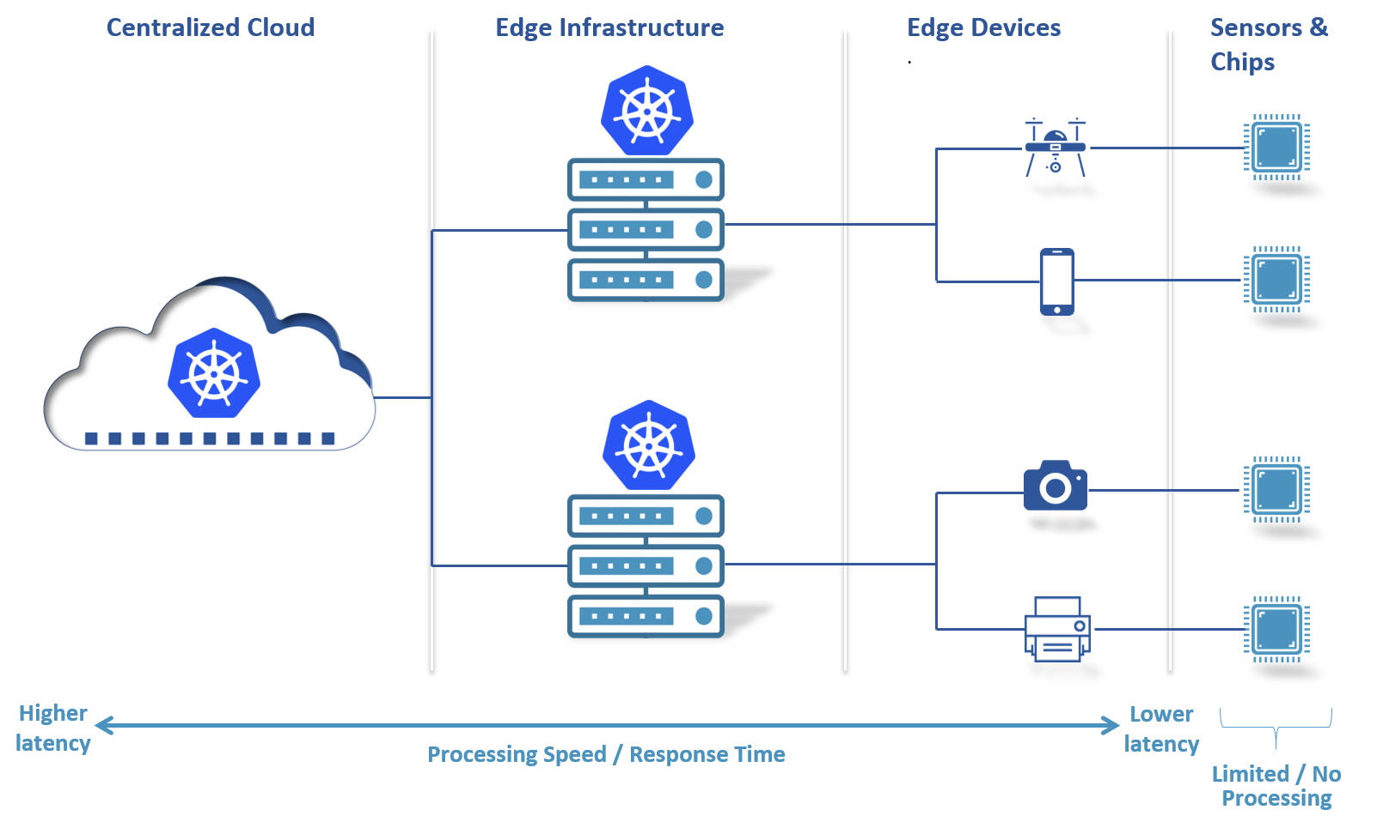
Edge Example 1
Centralized cloud
Edge infrastructure
Edge devices
Sensors and chips
Notes:
Image source:
https://containerjournal.com/topics/container-networking/powering-edge-with-kubernetes-a-primer/

Slide 27
Running Kubernetes at the Edge
A simple way to start is with running Kubernetes on the edge device
K3s fits well here
K3s is packaged as a single under 40 MB binary that reduces the dependencies and steps needed to install, run, and auto-update a production Kubernetes cluster
Works great from something as small as a Raspberry Pi to an AWS a1.4xlarge 32GiB server
edge
edge
Master
Master
Scheduler
Controller
Scheduler
Controller
API server
Etcd
API server
Etcd
Node
Node
Node
Node
Kubelet
Kubelet
Kubelet
Kubelet
Pod
Pod
Pod
Pod
Pod
Pod
Pod
Pod
Notes:
Image source:
https://containerjournal.com/topics/container-networking/powering-edge-with-kubernetes-a-primer/

Slide 28
Kubernetes and Docker
Kubernetes is deprecating Docker as a container runtime after v1.20.
This is about the RUNTIME and not about the images
Docker is not OCI compliant and was not designed for K8S and requires an adapter or shim.
But containerd and CRI-O are
Distributions like k3s are committed to maintaining the docker shim

Slide 29
Cloud Native
“Cloud native” is an approach to building and running applications that exploits the advantages of the cloud computing delivery model.
Cloud native is about how applications are created and deployed, not where. While it implies that the apps live in the public cloud, it is really about the how.
The CNCF defines cloud native a little more narrowly.
The software stack is containerized, where each part of the app is packaged in its own container, dynamically orchestrated so each part is actively scheduled and managed to optimize resource utilization, and microservices-oriented to increase the overall agility and maintainability of applications.
Notes:
What is cloud native?

