Slide 2


A bird’s eye view of dimensionality reduction.
 | Var 1 | Var 2 | Var 3 | …
Exp 1 | 5 | 4 | 6
Exp 2 | 8 | 9 | 5
Exp 3 | 5 | 6 | 3
Exp 4 | 4 | 6 | 7
Exp 5 | 6 | 7 | 2
Exp 6 | 2 | 10 | 7
…
*
$$ℝ^{\exp{x var}}$$
$$⟶ℝ^{\exp{x low}}$$
*These methods can be abstracted to handle other types of data. Also, we’re not even really working with reals.

Slide 3
Dimensionality Reduction techniques fall into two categories: Linear and Non-Linear
Linear:
Easy…Okay, easier
Fast
Can become lossy
Under the hood, it’s matrices
Non-Linear:
Harder
Slower
Structure preserving
Under the hood, it’s optimization

Slide 4
Principle Component Analysis is all about describing your data in terms of variance.
I’m probably going to put a full animation here

Slide 5

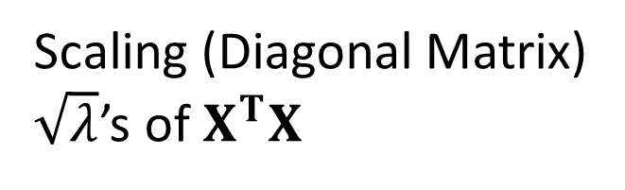
“The” SVD (Singular Value Decomposition)
$$X=UΣV^{T}$$
Square Matrix
Orthonormal Projections
Scaling (Diagonal Matrix)
$\sqrt{λ}$’s of $X^{T}X$

Slide 6
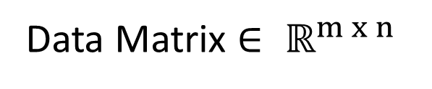
“Thin” SVD
$$X=UΣV^{T}$$
Rotates axes from the origin to the lines of variance in data
Data Matrix $∈ ℝ^{m x n}$

Slide 7
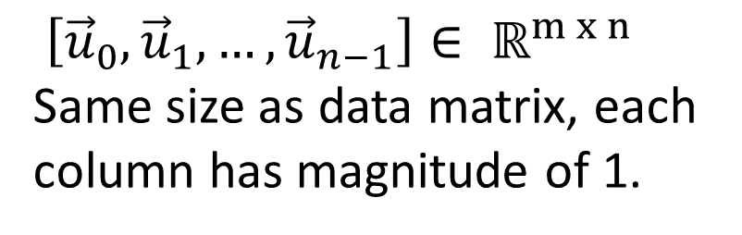

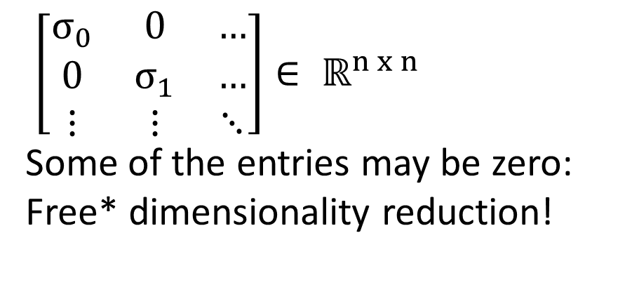
“Thin” SVD
$$X=UΣV^{T}$$
$\left[\begin{matrix}σ_{0} & 0 & … \\ 0 & σ_{1} & … \\ ⋮ & ⋮ & ⋱\end{matrix}\right]∈ ℝ^{n x n}$
Some of the entries may be zero: Free* dimensionality reduction!
$\left[{\vec{u}}_{0},{\vec{u}}_{1}, …,{\vec{u}}_{n−1}\right]∈ ℝ^{m x n}$
Same size as data matrix, each column has magnitude of 1.
*Some terms and conditions may apply;
see Golub and Van Loan (2013) section 5.4.1 for more details
$${\vec{u}}_{i}∈ℝ^{m}$$

Slide 8
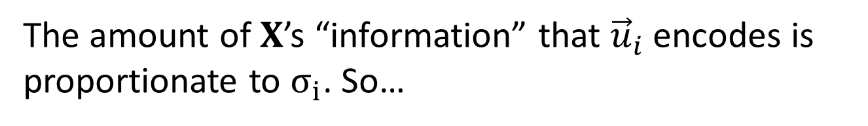
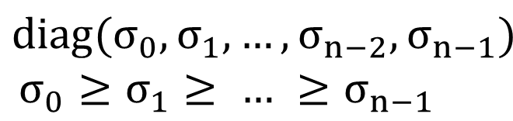

How this information can be used for dimensionality reduction.
$$\left[{\vec{u}}_{0},{\vec{u}}_{1}, …,{\vec{u}}_{n−2},{\vec{u}}_{n−1}\right]$$
$$diag(σ_{0},σ_{1}, …,σ_{n−2},σ_{n−1})$$
$$σ_{0}≥σ_{1}≥ … ≥σ_{n−1}$$
The amount of $X$’s “information” that ${\vec{u}}_{i}$ encodes is proportionate to $σ_{i}$. So…

Slide 9
A quick second lens of PCA
Linear combination of features discussion

Slide 10
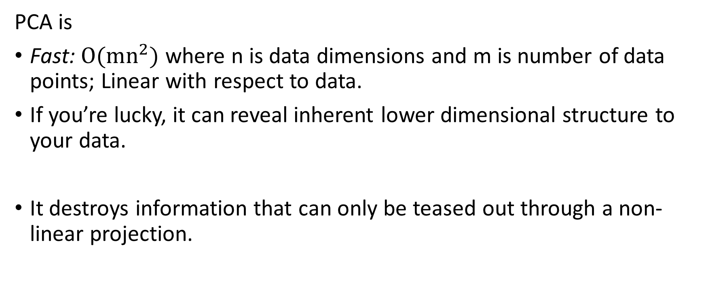
PCA: Recap
PCA is
Fast: $O(mn^{2})$ where n is data dimensions and m is number of data points; Linear with respect to data.
If you’re lucky, it can reveal inherent lower dimensional structure to your data.
It destroys information that can only be teased out through a non-linear projection.

Slide 11
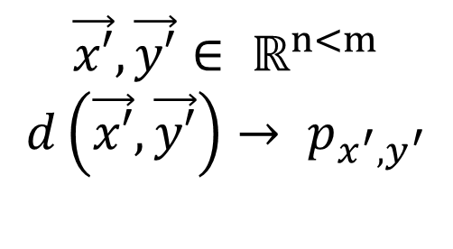
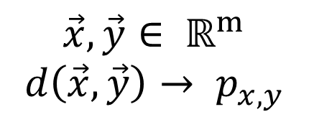
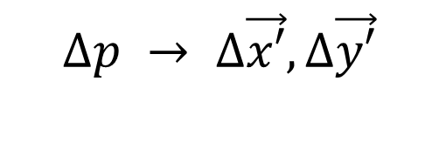
Overview of Non-Linear dimensionality reduction.
$$\vec{x′},\vec{y′}∈ ℝ^{n<m}$$
$$d\left(\vec{x′},\vec{y′}\right)→ p_{x^{′},y^{′}}$$
$$\vec{x},\vec{y}∈ ℝ^{m}$$
$$d\left(\vec{x},\vec{y}\right)→ p_{x,y}$$
$$∆p → ∆\vec{x′}, ∆\vec{y′}$$

Slide 12
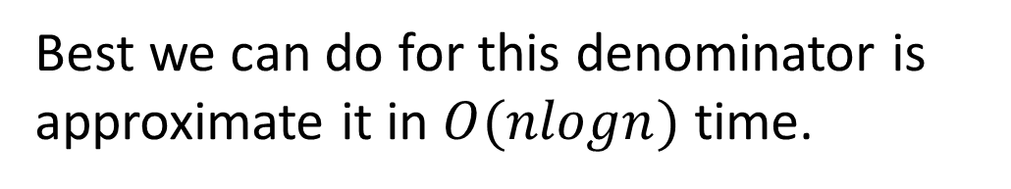
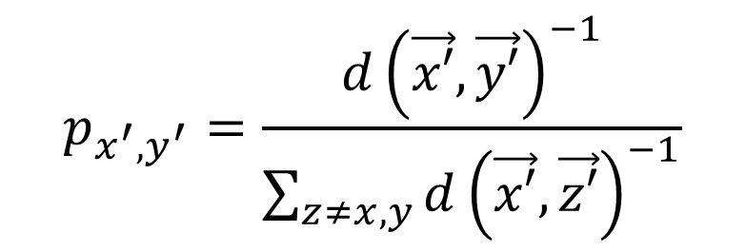
tSNE - Gaussian Distributions
$$p_{x^{′},y^{′}}=\frac{{d\left(\vec{x′},\vec{y′}\right)}^{−1}}{\sum_{z≠x,y}{{d\left(\vec{x′},\vec{z′}\right)}^{−1}}}$$
Best we can do for this denominator is approximate it in $O(nlogn)$ time.

Slide 13
Quick Diversion: k Nearest Neighbor graphs

Slide 14
Uniform Manifold Approximation and Projection

Slide 15
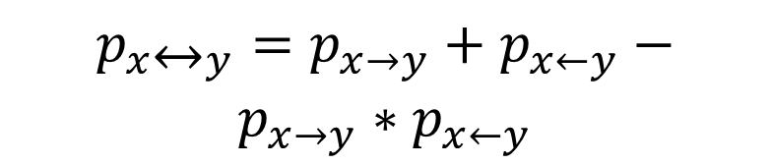


Uniform Manifold Approximation and Projection
$$p_{x→y}= e^{−(d\left(x,y\right)−ρ)}$$
$p_{x↔y}=p_{x→y}+p_{x←y}−$ $p_{x→y}∗p_{x←y}$
$$p_{x↔y}= e^{−(d\left(x,y\right)−ρ)}$$
A constant value in the low dimensional case.

Slide 16
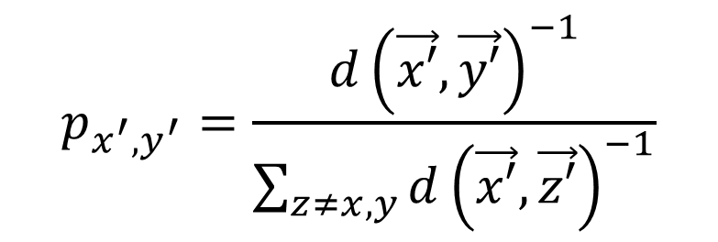
Well then what is UMAP?
$$p_{x^{′},y^{′}}=\frac{{d\left(\vec{x′},\vec{y′}\right)}^{−1}}{\sum_{z≠x,y}{{d\left(\vec{x′},\vec{z′}\right)}^{−1}}}$$

Slide 17
Basis for the tutorial – approximate k-nearest neighbors

Slide 18
