Slide 1
Peter the Great Saint-Petersburg Polytechnic University,
Higher School of Applied Mathematics and Computational Physics, Russia
Feature Based Plant Seedlings Classification
Dmitri Jakovlev, Iuliia Kamaletdinova and Georgy Shevlyakov
georgy.shevlyakov@phmf.spbstu.ru
2019 г.

Slide 2
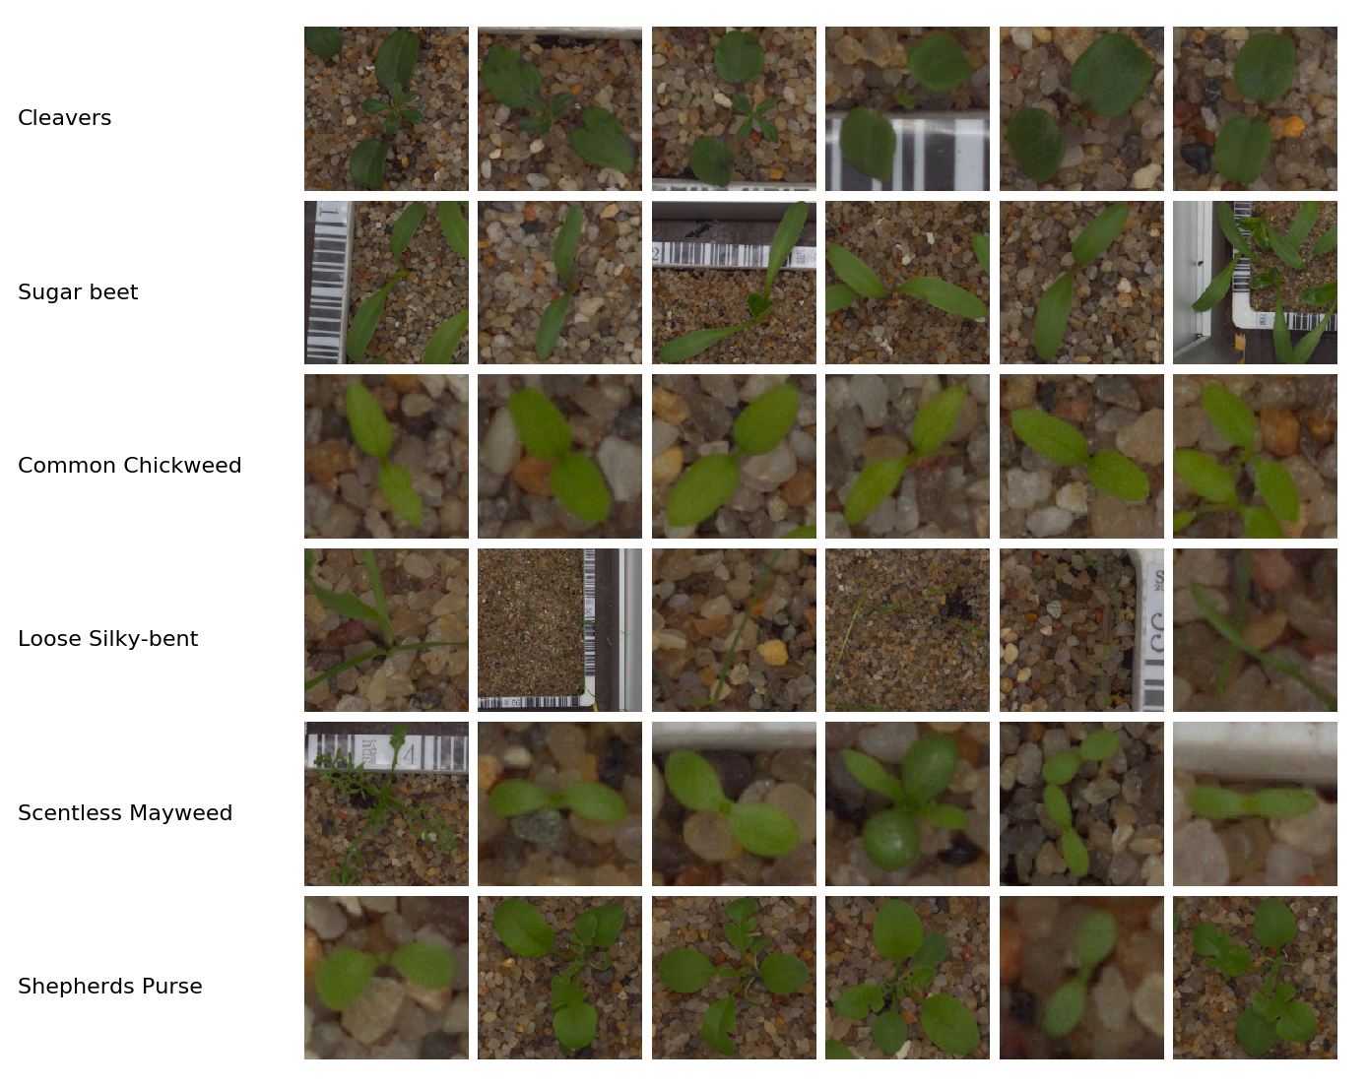
Plant Seedlings Classification

Slide 3
Data
Dataset:
960 images
12 species
Resolutions vary from 50x50px to 2000x2000px
Preprocessing steps:
Resolution reducing
Segmentation
Denoising

Slide 4
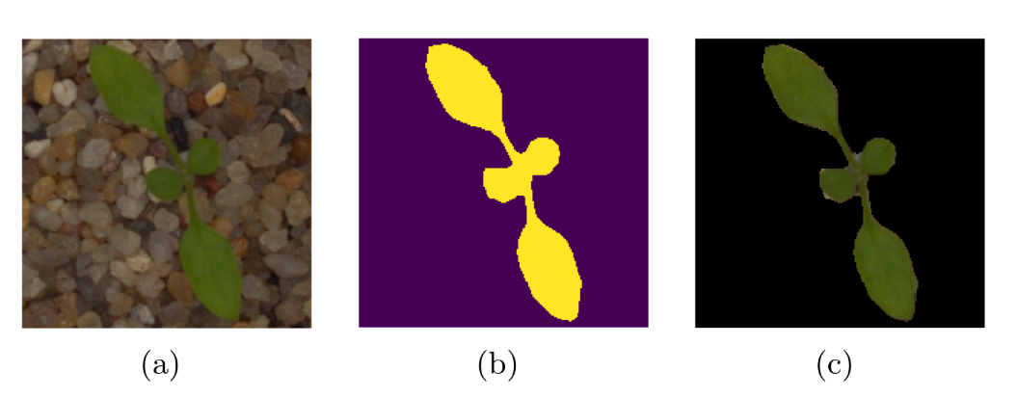
Segmentation

Slide 5
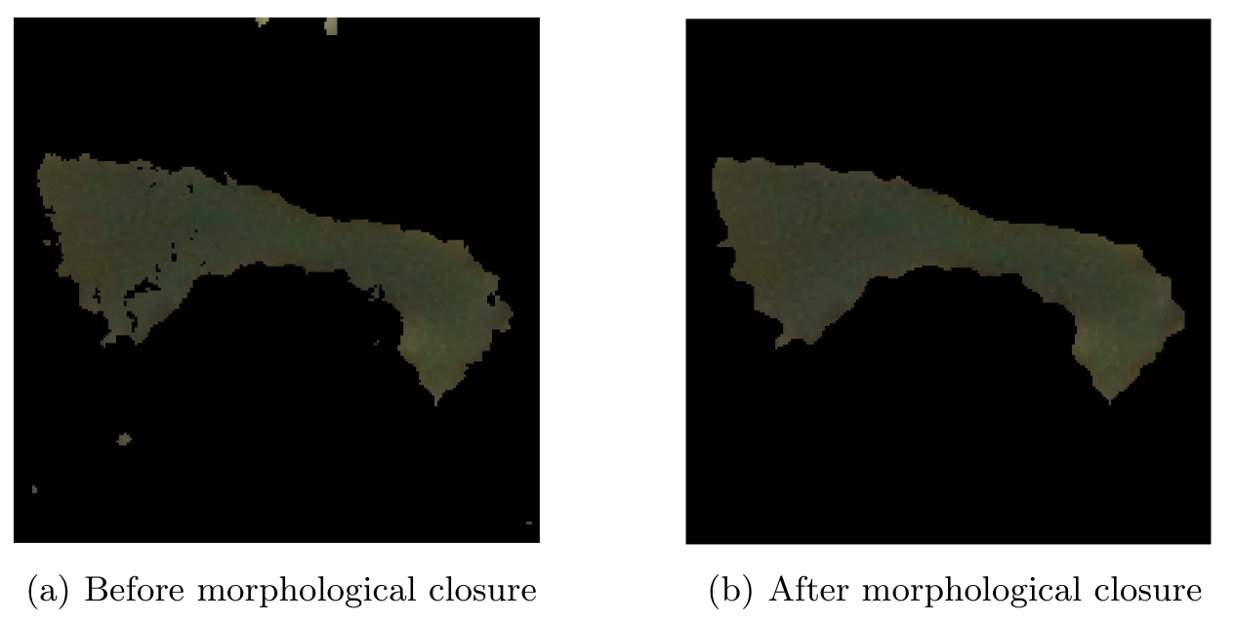
Denoising (Segmentation improvement)

Slide 6
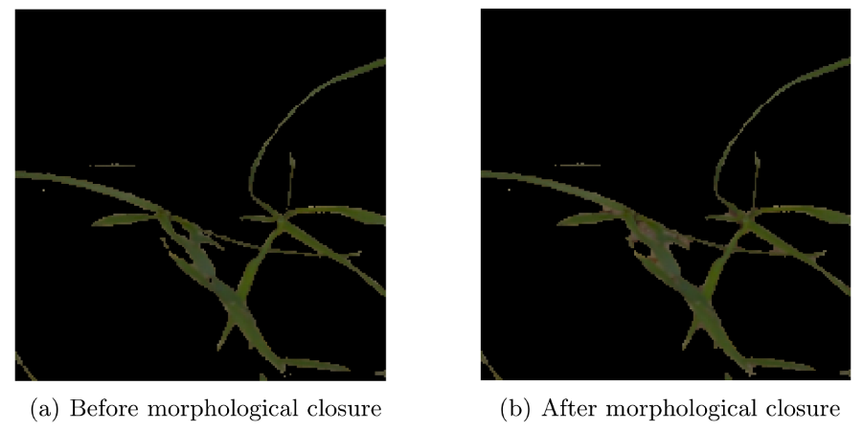
Denoising (Segmentation degradation)

Slide 7
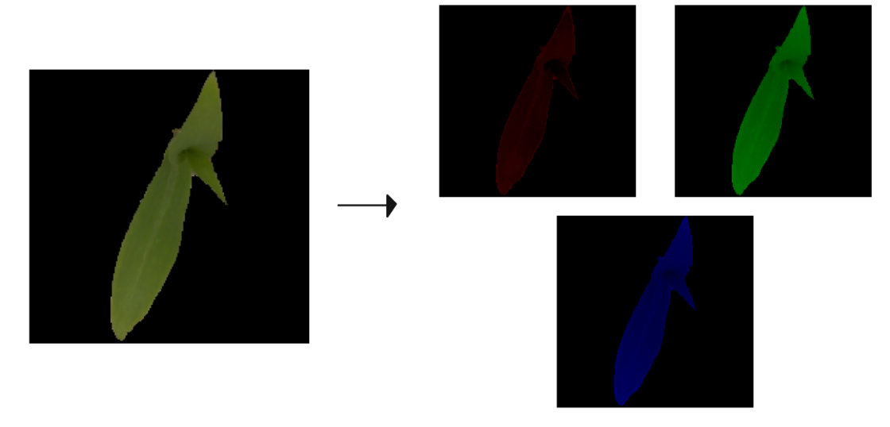
Color Features

Slide 8
Shape features
Total perimeter
Entire area
Maximal contour area
Rectangularity
Circularity

Slide 9
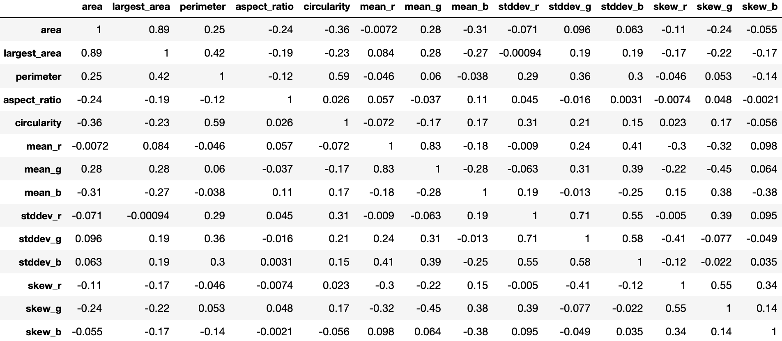
Feature correlation matrix ?

Slide 10
Classification methods
SVM
K-Nearest Neighbors
Naive Bayes
Decision Tree

Slide 11



Results
Type | F-Score
Sugar beet | 0.91
Fat Hen | 0.89
Scentless Mayweed | 0.87
Charlock | 0.94
Small-flowered Cranesbill | 0.97
Maize | 0.92
Shepherds Purse | 0.77
Common Wheat | 0.84
Common Chickweed | 0.96
Cleavers | 0.87
Loose Silky-bent | 0.86
Black-grass | 0.62
Micro-averaged F-score | 0.88
${Precision}_{micro}=\frac{\sum_{k∈C}{TP_{k}}}{\sum_{k∈C}{TP_{k}}+FP_{k}}$,
${Recall}_{micro}=\frac{\sum_{k∈C}{TP_{k}}}{\sum_{k∈C}{TP_{k}}+FN_{k}}$,
$F_{micro}=\frac{2{Precision}_{micro}{Recall}_{micro}}{{Precision}_{micro}+ {Recall}_{micro}}$,

Slide 12
Results by classification method
Method | Micro-averaged F-score
naiveBayes | 0.72
kNN | 0.82
Decision Tree | 0.73
SVM | 0.88

Slide 13
Conclusion
The feature-based method is applied to the new practically important real-life image classification task.
The constructed algorithm is implemented and evaluated on the real plant dataset containing images of 12 different types of seedlings: the features are selected and extracted by using computer vision algorithms.
It follows from Table 3 that the best performance is reached with the Support Vector Machines algorithm whereas the K-Nearest Neighbors algorithm is slightly worse.
Future works aim at improving segmentation output and at the usage of other types of image features.

