Slide 1

Customer Shopping Behavior Analysis
Uncovering spending patterns, customer segments, product preferences, and subscription behavior from 3,900 transactions to guide strategic business decisions.

Slide 2
Dataset at a Glance
3,900
18
37
Purchases
Features
Missing
Rows of transactional data
Columns per record
Null values in Review Rating
Key Feature Groups
Demographics: Age, Gender, Location, Subscription Status
Purchase Details: Item, Category, Amount, Season, Size, Color
Behavior: Discounts, Promo Codes, Frequency, Review Rating, Shipping

Slide 3

Data Preparation in Python
01
Load & Explore
Imported with pandas; used df.info() and .describe() for structure review.
02
Clean & Impute
Imputed missing Review Ratings using median per product category; renamed columns to snake_case.
03
Feature Engineering
Created age_group bins and purchase_frequency_days; dropped redundant promo_code_used.
04
Database Load
Connected to MySQL and loaded the cleaned DataFrame for SQL analysis.

Slide 4
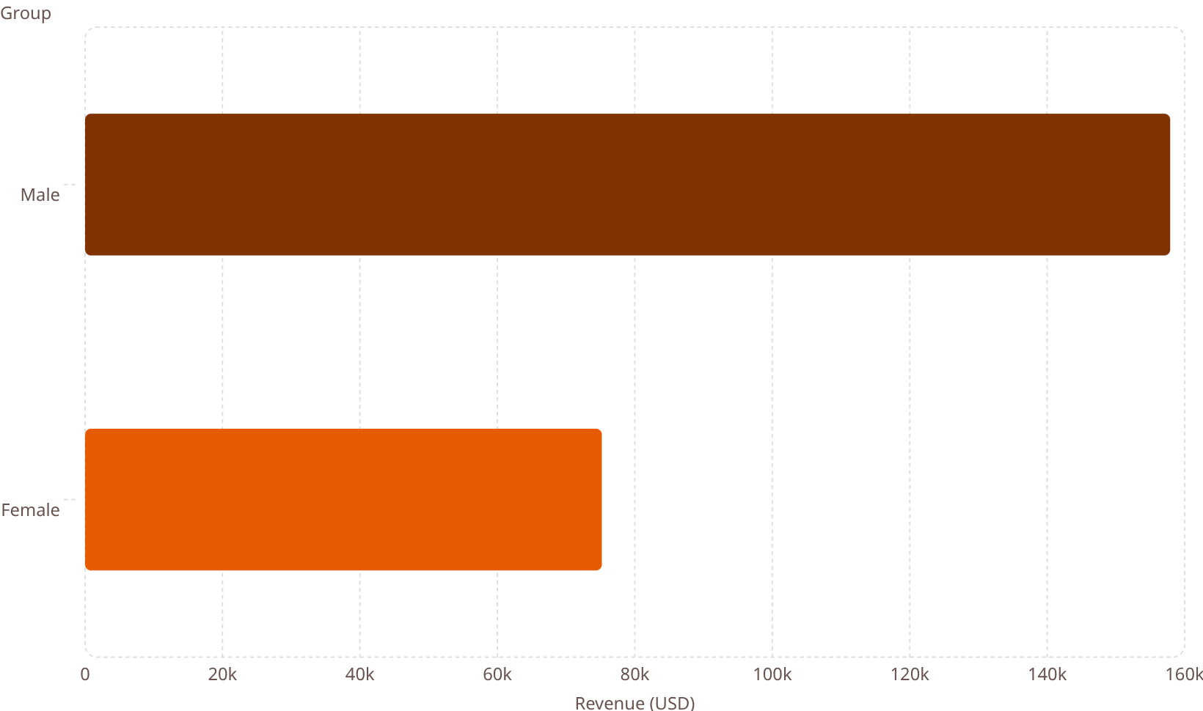

Revenue & Spending Insights
Shipping Type vs. Avg. Spend
158k
Shipping Type
Avg. Purchase (USD)
Standard
$58.46
Express
$60.48
75.2k
839 discount users still spent above average — discounts don't always erode value.

Slide 5
Top-Rated Products & Discount Dependency
Top 5 Products by Avg. Rating
Most Discount-Dependent Products
Product
Avg. Rating
Product
Discount Rate
Gloves
3.86
Hat
50.00%
Sandals
3.84
Sneakers
49.66%
Boots
3.82
Coat
49.07%
Hat
3.80
Sweater
48.17%
Skirt
3.78
Pants
47.37%

Slide 6
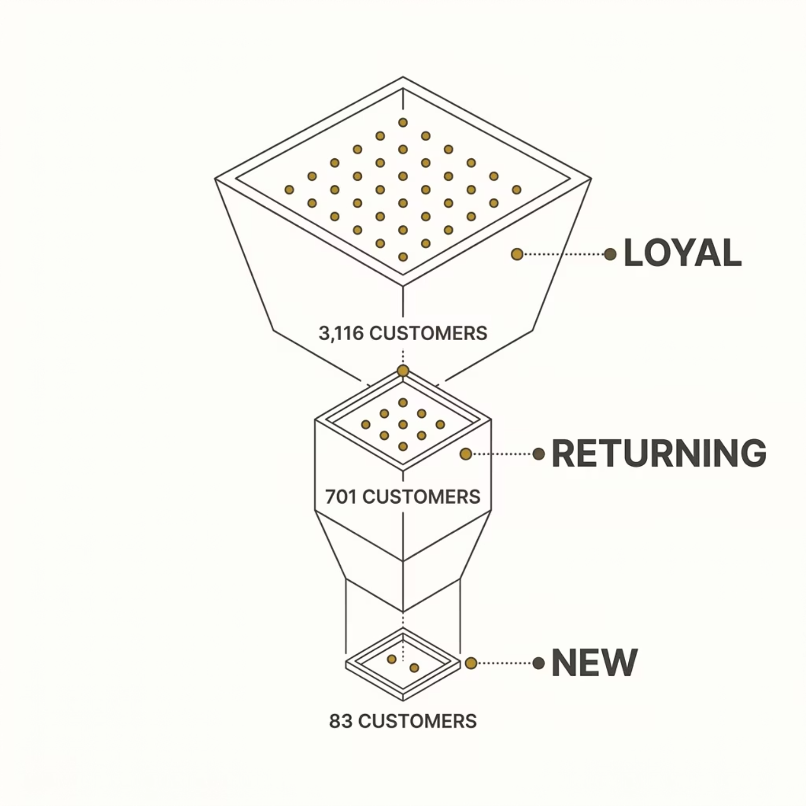


Customer Segmentation
Segment Breakdown
The vast majority of customers — 3,116 (80%) — are classified as Loyal, with 701 Returning and just 83 New customers.
A loyal customer base is a strong foundation — the opportunity lies in converting Returning buyers into Loyal ones.

Slide 7

Subscriptions & Repeat Buyers
Subscriber vs. Non-Subscriber Spend
27%
Status
Avg. Spend
Total Revenue
Non-Subscribers·73%
·73%
·
Subscribers
$59.49
$62,645
Subscribers·27%
·27%
·
Non-Subscribers
$59.87
$170,436
73%
Of repeat buyers (>5 purchases), 958 subscribe vs. 2,518 who don't — a major conversion opportunity.

Slide 8
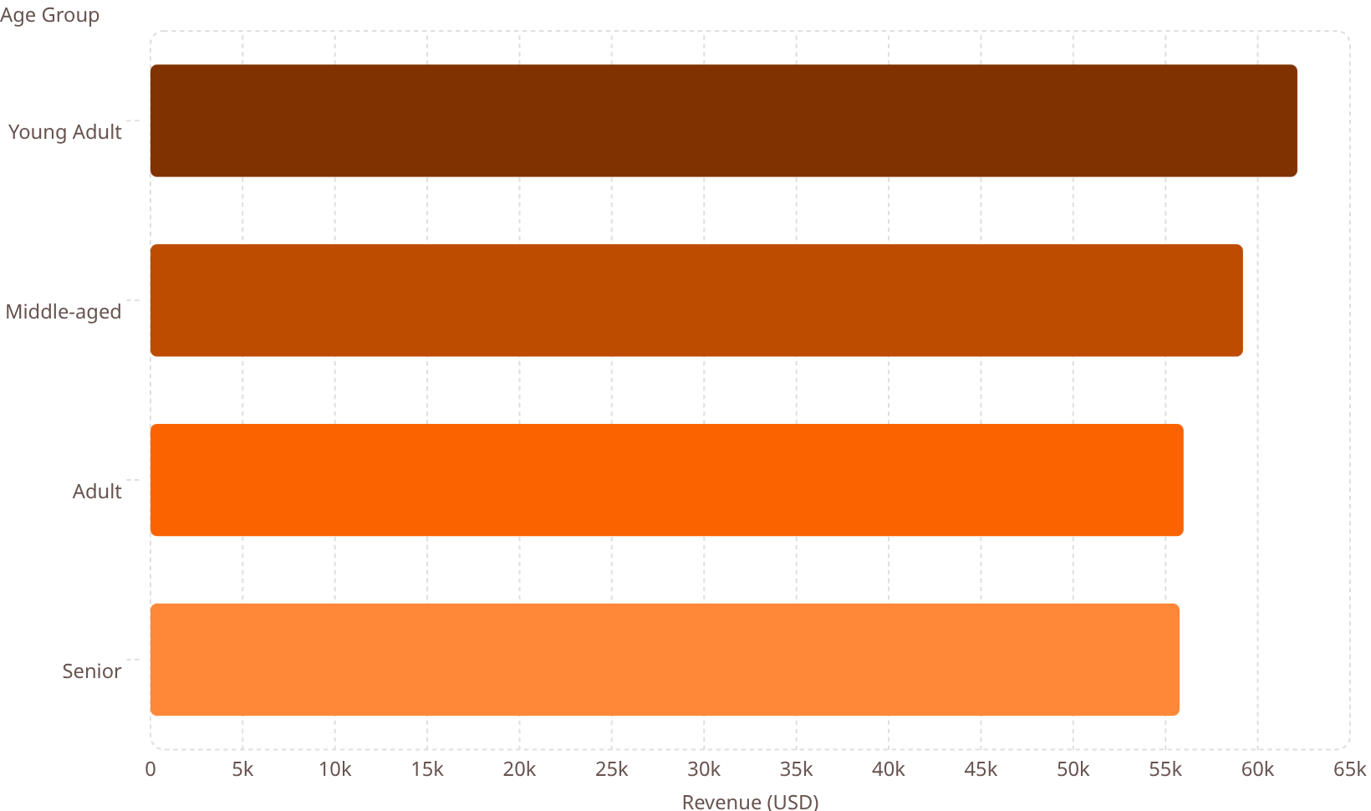
Top Products by Category & Revenue by Age
Top Products per Category
62.1k
Category
#1
#2
#3
Accessories
Jewelry
Sunglasses
Belt
59.2k
Clothing
Blouse
Pants
Shirt
56k
Footwear
Sandals
Shoes
Sneakers
55.8k
Outerwear
Jacket
Coat
—

Slide 9
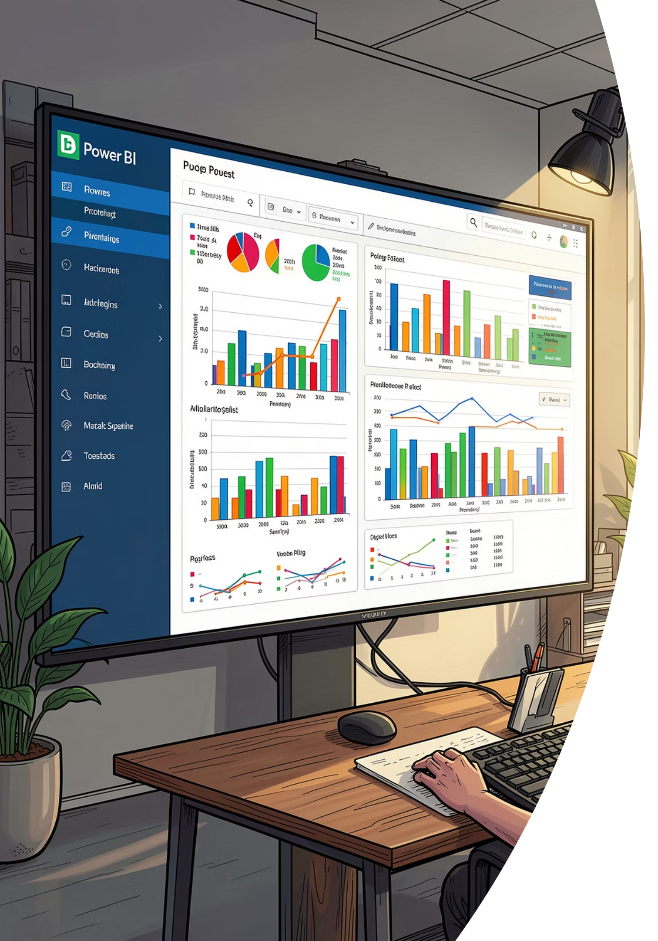
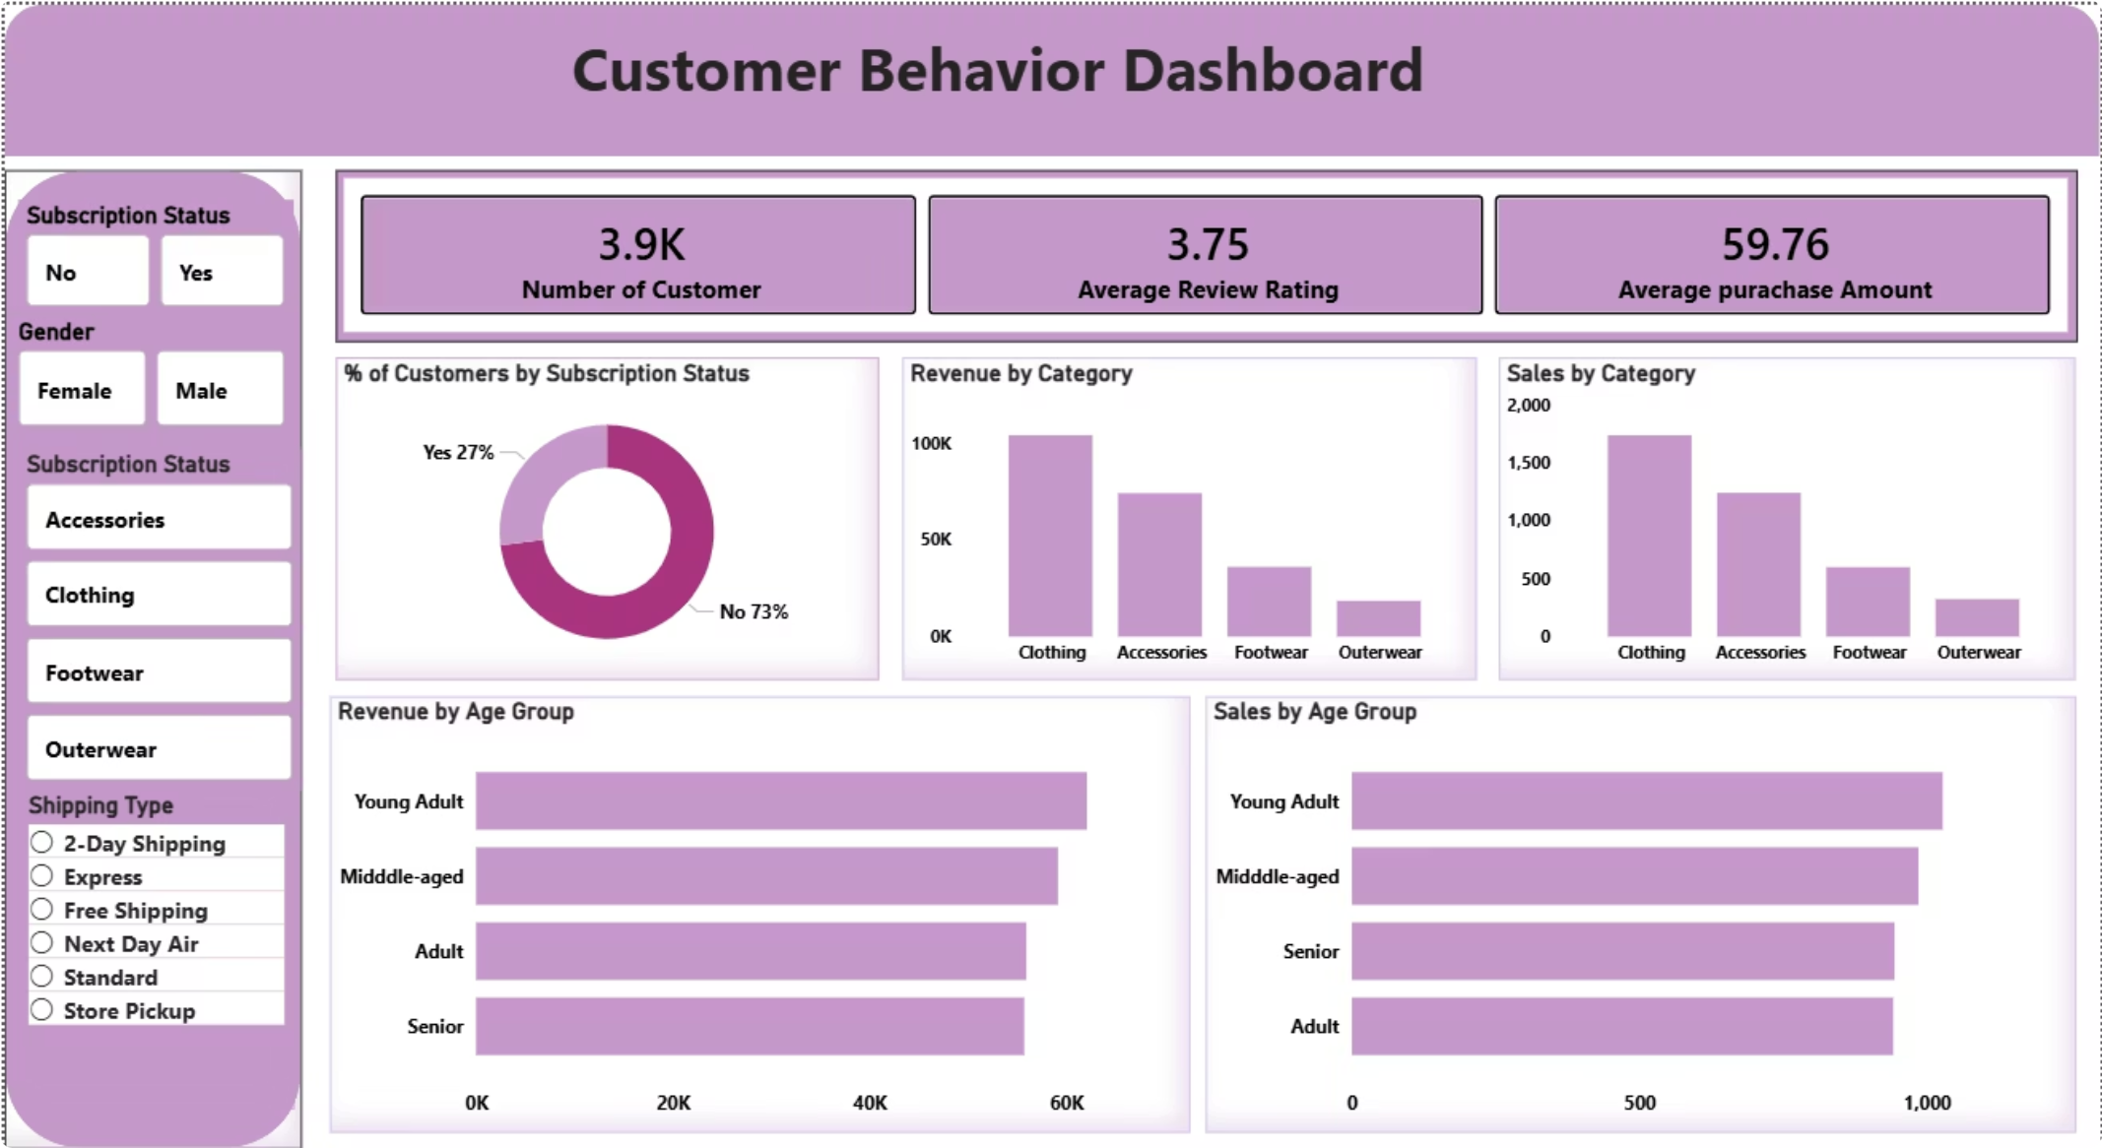
Power BI Dashboard
3.9K
$59.76
Total Customers
Avg. Purchase Amount
3.75
Avg. Review Rating
Interactive filters by Subscription Status, Gender, Category, and Shipping Type. Visualizations include revenue/sales by category and age group, plus subscription donut chart.

Slide 10

Business Recommendations
Boost Subscriptions
Loyalty Programs
Review Discount Policy
Promote exclusive benefits to convert the 73% non-subscriber base.
Reward repeat buyers to accelerate movement into the Loyal segment.
Balance sales boosts with margin control — especially for high-dependency products.
Targeted Marketing
Product Positioning
Focus on Young Adults and express-shipping users — the highest-revenue segments.
Highlight top-rated (Gloves, Sandals) and best-selling items in campaigns.

