Slide 1














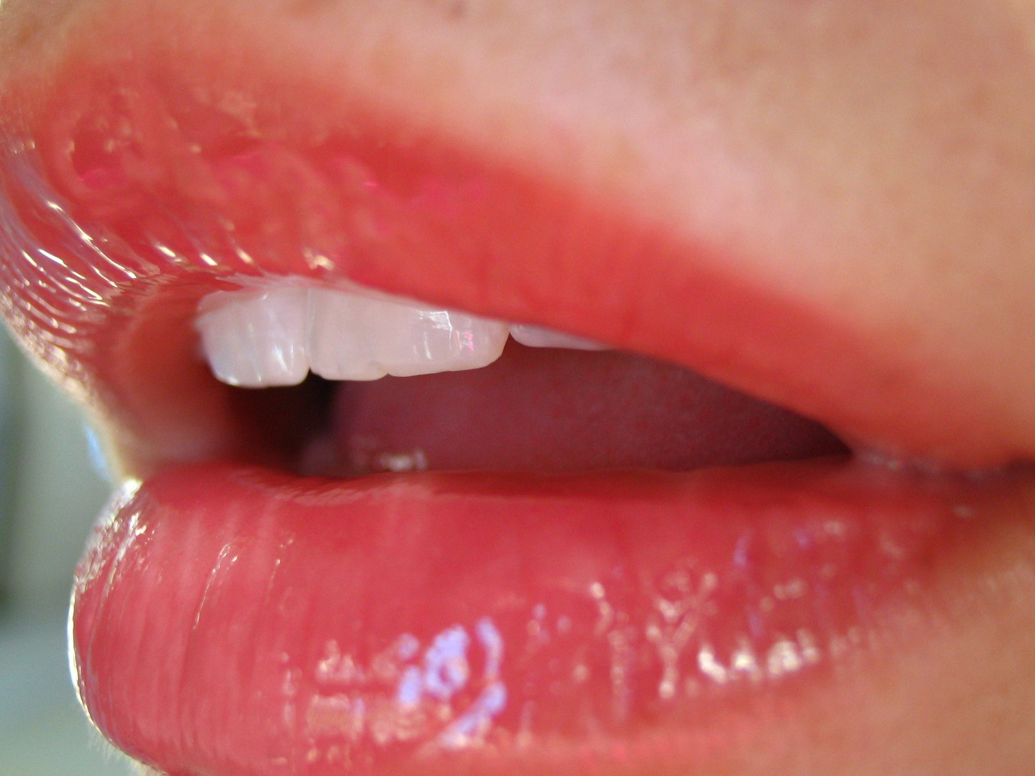
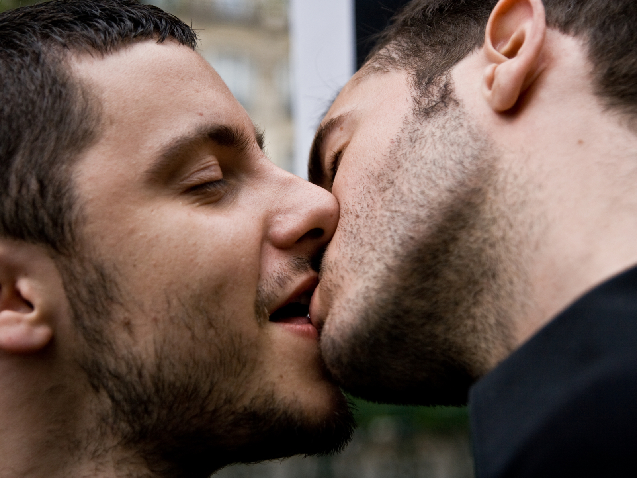
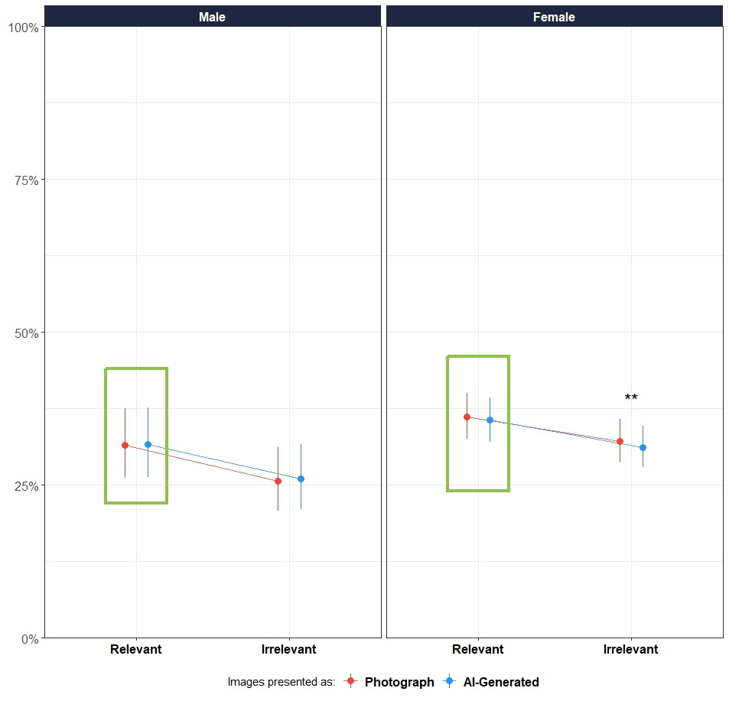
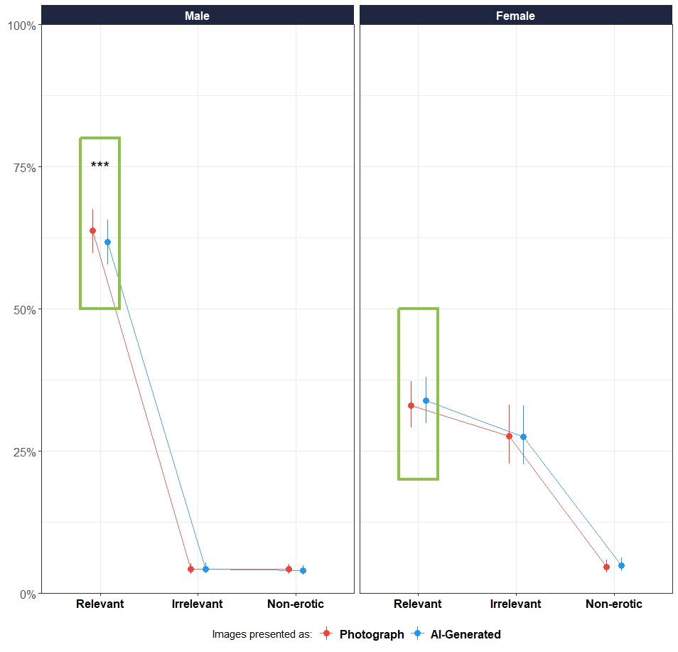
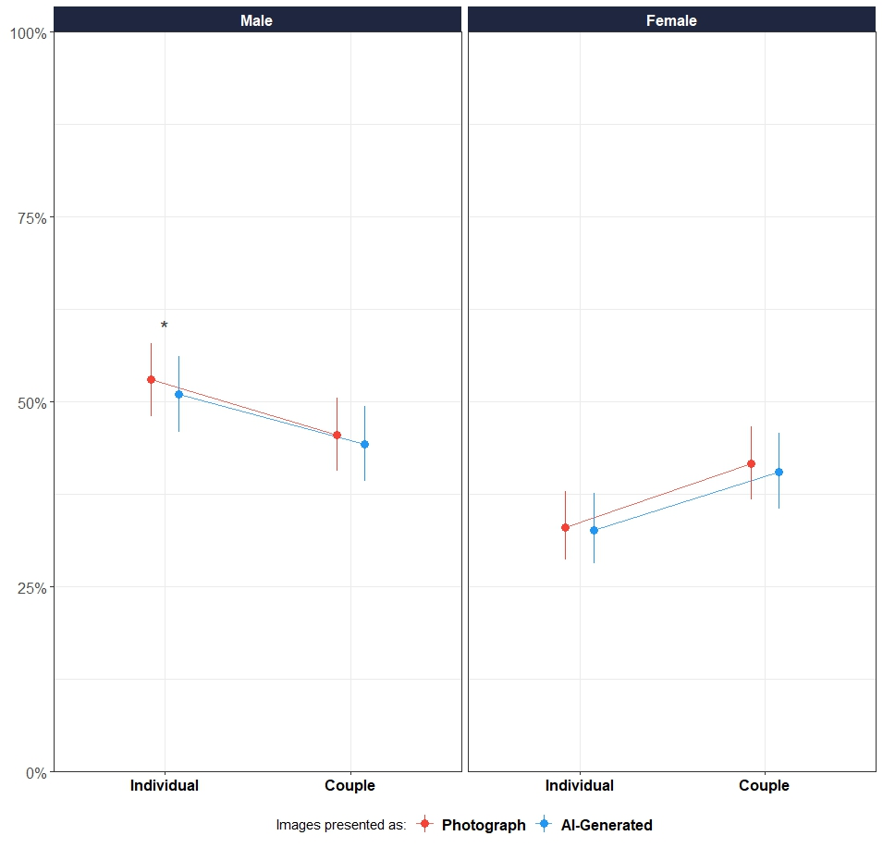


Do We Find AI-Generated Less Emotional? The Impact Of Reality Beliefs On Affective Responses
Neves, A.¹, Viola, M. ², Sperduti, M.³, Marini, M. ⁴, Ansani, A.⁵ ,Olivera La Rosa .A. ⁶, Corradi, G.⁷, & Makowski, D .¹
¹ University of Sussex; ²Roma Tre University, ³Tor Vergata University of Rome, ⁴ Sapienza University of Rome, ⁵University of Jyväskylä, ⁶ Universidad Católica Luis Amigó, ⁷ Universidad Complutense de Madrid Email: A.Neves@sussex.ac.uk
SCAN ME FOR MORE DETAILS ! !
Advances in AI and immersive technology (e.g., VR) are making it increasingly difficult to distinguish between real and artificial content - a challenge with serious consequences, such as misinformation¹.
For instance, deepfake technologies can generate realistic fake videos of politicians, spreading false narratives².
In a “post-truth” era³, where emotions often outweigh facts, it is vital to understand how ambiguous or synthetic stimuli drive affect.
Emotions shape how we interpret and respond to our environment⁴ and play a key role in how we process ambiguous or fictional content. Studies show that framing stimuli as fictional reduces emotional impact:
↓ Valence & intensity for neutral/negative videos⁵
↓ Intensity for negative pictures⁶ ↓ Physiological arousal, subjective arousal, intensity & valence for negative and neutral images⁷
INTRODUCTION
STUDY 1
DATABASE: American Multiracial Face Database⁸
PHASE 1
AI-GENERATED
STIMULI #1
SUBJECTIVE SCALES
PHOTOGRAPH
STIMULI #2
SUBJECTIVE SCALES
PHOTOGRAPH
STIMULI #3
VARIABLE: Attractiveness
STUDY 2
DATABASES: Nencki Affective Picture System⁹ AND NAPS Erotic subset (NAPS ERO¹⁰)
STIMULUS
PHASE 2
STIMULI #3
REALNESS SCALE
STIMULI #5
REALNESS SCALE
STIMULI #1
REALNESS SCALE
STIMULI #8
REALNESS SCALE
VARIABLE: Arousal
STUDY 3
DATABASE: NAPS Erotic subset (NAPS ERO¹⁰)
VARIABLE: Arousal
“AI-Generated” beliefs leads to a decrease in emotional responses
STUDY 1 - FACES
STUDY 2 - EROTIC + NON-EROTIC
STUDY 3 - EROTIC
RESULTS
Figure 1. Estimated marginal means of attractiveness ratings across image relevance (relevant vs. irrelevant) and condition (photograph vs. AI-generated). Error bars represent 95% confidence intervals. Estimates are based on a generalized linear mixed model with participant- and stimulus-level random effects. ** p < . 01.
Figure 2. Estimated marginal means of arousal ratings across image relevance (relevant vs. irrelevant vs non-erotic) and condition (photograph vs. AI-generated). Error bars represent 95% confidence intervals. Estimates are based on a generalized linear mixed model with participant- and stimulus-level random effects. *** p < . 001.
Figure 3. Estimated marginal means of arousal ratings across stimuli type - image of an individual or a couple - and condition (photograph vs. AI-generated). Error bars represent 95% confidence intervals. Estimates are based on a generalized linear mixed model with participant- and stimulus-level random effects. * p < . 05. All pictures were relevant.
N: 206 participants (Mean age = 27.8, SD = 13.6, range: (18, 69); Gender: 76.7% women, 23.3% men)
Effect of condition: Significant only for women, and only for irrelevant images (e.g., heterosexual women rating female faces); β = –0.05, 95% CI [–0.08, –0.001], p = .006.
Moderation by Honesty-Humility¹¹: Among women, higher Honesty-Humility predicted lower attractiveness ratings for AI-labelled irrelevant images vs photos (β = –0.03, p = .008).
N: 705 participants (M age = 30.2, SD = 11.8, range = 18–80); 35.7% women, 64.3% men.
Effect of condition: Significant only for men, and only for relevant images (e.g., heterosexual men rating erotic images of women); β = –0.07, 95% CI [–0.13, –0.006], p < .001.
Moderation by AI-arousal feedback: Men who believed AI images were less arousing rated them lower in arousal than photo-labelled images (β = –0.16, p = .009).
N: 197 participants (M age = 36.5, SD = 13.1, range = 18–80); 48.2% women, 51.8% men.
Effect of condition: Significant only for men, and only for erotic images of individuals; β = –0.08, 95% CI [–0.15, –0.01], p = .019.
Moderation by AI-attractiveness feedback : Among men, those who believed AI images were more attractive also rated them as more arousing (β = 0.14, p = .034).
Perceived artificiality reduces emotional responses, but only in specific gender and relevance contexts - women for irrelevant images (e.g., same-gender faces), and men for relevant erotic images.
Among women, the effect was stronger for those high in Honesty-Humility, suggesting that individual moral traits influence reactions to artificial or fictional stimuli.
Beliefs about AI played a key role: men who believed AI images were less arousing rated them lower, while others rated them higher when they believed AI images were more attractive.
^{REFERENCES}
¹ Miller, E. J., Foo, Y. Z., Mewton, P., & Dawel, A. (2023). How do people respond to computer-generated versus human faces? A systematic review and meta-analyses. Computers in Human Behavior Reports.
² Meskys, E., Kalpokiene, J., Jurcys, P., & Liaudanskas, A. (2020). Regulating deep fakes: legal and ethical considerations. Journal of Intellectual Property Law & Practice, 15(1), 24-31.
³ Lewandowsky, S., Ecker, U. K., & Cook, J. (2017). Beyond misinformation: Understanding and coping with the “post-truth” era. Journal of applied research in memory and cognition, 6(4), 353-369.
⁴ Mocaiber, I., Pereira, M. G., Erthal, F. S., Machado-Pinheiro, W., David, I. A., Cagy, M., ... & de Oliveira, L. (2010). Fact or fiction? An event-related potential study of implicit emotion regulation. Neuroscience Letters, 476(2), 84-88.
⁵ Sperduti, M., Arcangeli, M., Makowski, D., Wantzen, P., Zalla, T., Lemaire, S., ... & Piolino, P. (2016). The paradox of fiction: Emotional response toward fiction and the modulatory role of self-relevance. Acta psychologica, 165, 53- 59.
⁶ Sperduti, M., Makowski, D., Arcangeli, M., Wantzen, P., Zalla, T., Lemaire, S., ... & Piolino, P. (2017). The distinctive role of executive functions in implicit emotion regulation. Acta psychologica, 173, 13-20. ⁷ Makowski, D., Sperduti, M., Pelletier, J., Blondé, P., La Corte, V., Arcangeli, M., ... & Piolino, P. (2019). Phenomenal, bodily and brain correlates of fictional reappraisal as an implicit emotion regulation strategy. Cognitive, Affective, & Behavioral Neuroscience, 19, 877-897.
⁸ Chen, J. M., Norman, J. B., & Nam, Y. (2021). Broadening the stimulus set: Introducing the American multiracial faces database. Behavior Research Methods, 53, 371-389.
⁹ Wierzba, M., Riegel, M., Pucz, A., Leśniewska, Z., Dragan, W. Ł., Gola, M., ... & Marchewka, A. (2015). Erotic subset for the Nencki Affective Picture System (NAPS ERO): cross-sexual comparison study. Frontiers in psychology, 6, 1336. ¹⁰ Marchewka, A., Żurawski, Ł., Jednoróg, K., & Grabowska, A. (2014). The Nencki Affective Picture System (NAPS): Introduction to a novel, standardized, wide-range, high-quality, realistic picture database. Behavior research methods, 46, 596-610.
¹¹ Olaru, G., & Jankowsky, K. (2022). The HEX-ACO-18: Developing an age-invariant HEXACO short scale using ant colony optimization. Journal of Personality Assessment, 104(4), 435-446.
DISCUSSION
Key takeaway: emotional responses to “AI‑generated” media are shaped not only by the content itself, but also by beliefs about its origin.
Next step: assess physiological indices to test whether they align with these subjective patterns.

