Slide 1
OPSINTEL
AI
Evidence-based pipeline investigation
From failed overnight run to traceable next action - powered by Exasol Personal
EXATHON INDIA 2026 / TRACK 04: THE WORK BEHIND THE WORK
Public prototype • MIT licensed • Synthetic data
01
Notes:
Sources: README.md; ExaThon India 2026 Track 04 submission context.

Slide 2
THE PROBLEM
The failure is visible. The explanation is scattered.
MANUAL
OPSINTEL
Evidence lives in separate views
01
Select the failed run
The engineer finds the run, compares row counts, searches logs, and decides what to inspect next.
02
Review cited status, counts, and logs
03
Compare candidate explanations
04
Human verifies before action
Expected benefit: fewer context switches. The impact study will measure time and evidence selection.
OPSINTEL AI / EXATHON INDIA 2026
02
Notes:
Sources: README.md problem statement; app/db.py incident retrieval; reports/impact-study-protocol.md. The comparison states an expected benefit only. No measured time saving is claimed.

Slide 3
PRODUCT WORKFLOW
Operational evidence flows through Exasol, FastAPI, and the dashboard
01
02
03
04
05
Pipeline runs
and logs
→
Exasol SQL
analytics
→
FastAPI rules
and candidates
→
Dashboard + optional
LLM narrative
→
Engineer verifies
and confirms
Safety boundary
Rules produce the category and candidates. The optional LLM only summarizes retrieved evidence. Confirmation and repairs stay human-controlled.
OPSINTEL AI / EXATHON INDIA 2026
03
Notes:
Sources: README.md architecture; app/db.py; app/main.py; app/investigator.py; app/llm.py; frontend/src/App.jsx. Deterministic rules produce classifications and candidates. The optional OpenAI Responses API integration receives only bounded evidence and candidates, returns a structured narrative and evidence gaps, and is disabled by default. It cannot confirm a root cause or execute a repair.

Slide 4
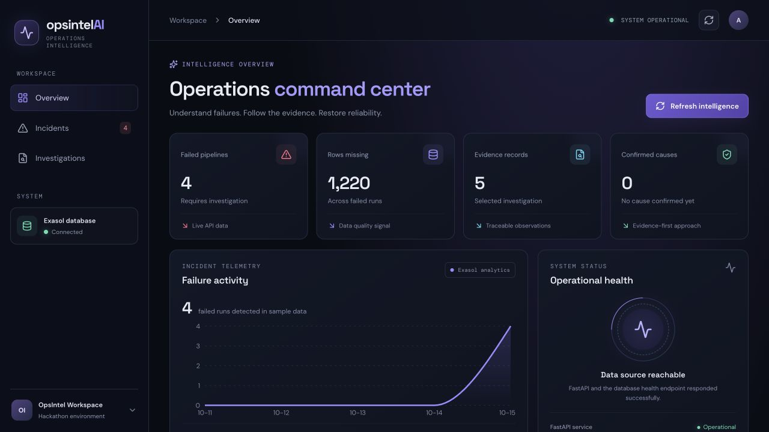
LIVE PRODUCT
The dashboard reads incident telemetry calculated in Exasol
4
failed pipeline runs
1,220
aggregate missing rows
in the captured 4-case baseline
✓ Captured baseline: 4 incidents
✓ Current seed: 11 incident scenarios
✓ All values are synthetic
OPSINTEL AI / EXATHON INDIA 2026
04
Notes:
Sources: docs/images/dashboard-overview.png; frontend/src/App.jsx totalMissing calculation; sql/seed.sql. Missing rows total 20 + 0 + 200 + 1000 = 1,220 across four demo incidents.

Slide 5
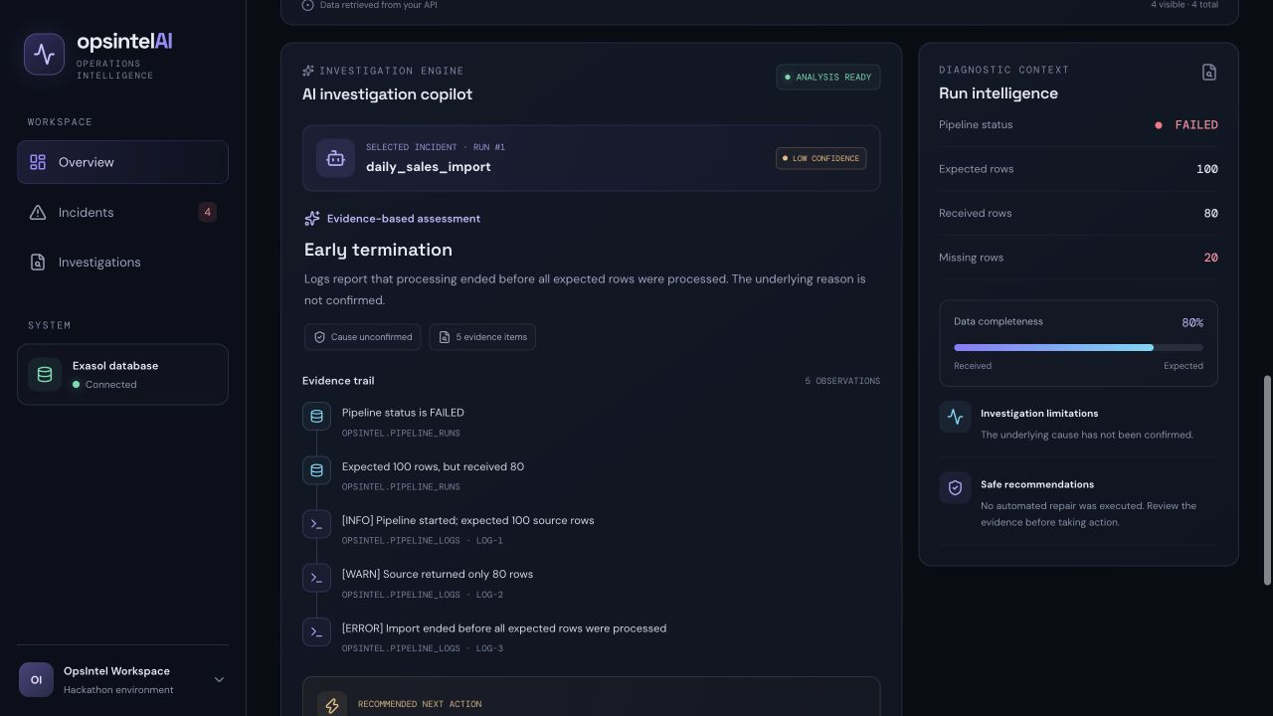
INVESTIGATION EXPERIENCE
Every recommendation points back to source evidence
Selected run
daily_sales_import
OBSERVATION
Expected: 100 rows
Received: 80 rows
Missing: 20 rows
EVIDENCE TRAIL
PIPELINE_RUNS: status and row counts
LOG-1: expected 100 source rows
LOG-2: source returned only 80 rows
LOG-3: import ended before completion
CANDIDATES
CONFIRMATION
Source shortfall or early termination
Confidence: low
None
Human verification required
OPSINTEL AI / EXATHON INDIA 2026
05
Notes:
Sources: sql/seed.sql; app/investigator.py; docs/images/investigation-evidence.png. Run 1 has expected 100, actual 80, three logs, five observations, two candidates, low confidence, and confirmed_root_cause None.

Slide 6
WHY EXASOL
Exasol computes incident context before FastAPI responds
ANALYTICAL FEATURES
QUERY USED BY GET /analytics/trend
01
Previous run status with LAG
SELECT RUN_DAY, COUNT(*) AS TOTAL_RUNS,
SUM(IS_INCIDENT) AS INCIDENT_COUNT,
ROUND(AVG(COMPLETENESS_PCT), 1) AS AVG_COMPLETE
FROM OPSINTEL.PIPELINE_HEALTH_FEATURES
GROUP BY RUN_DAY;
02
Rolling actual-row baseline
03
Rolling failure rate
RECORDED EXASOL OUTPUT · PRIOR 4-CASE SEED
04
Missing rows and completeness
5 runs · 4 incidents · 56.0% complete
FastAPI reads the view directly
The API reads the view directly; window calculations stay beside the run history. Re-run the expanded seed before the live demo.
05
OPSINTEL AI / EXATHON INDIA 2026
06
Notes:
Sources: sql/analysis/pipeline_health_features.sql; app/db.py get_pipeline_trend; app/main.py analytics_trend; frontend/src/App.jsx. A live local Exasol query returned 2026-10-15, 5 runs, 4 incidents, 56.0% average completeness, and 16.0% average rolling failure rate. The frontend fetches /analytics/trend, whose handler calls get_pipeline_trend against OPSINTEL.PIPELINE_HEALTH_FEATURES.

Slide 7
WHAT EXASOL MADE POSSIBLE
One SQL layer turns telemetry into explainable incident context
01
02
03
Window analytics
Failure cascade
Shared evidence
LAG, rolling baselines and failure rates compare each run with recent history inside Exasol.
CONNECT BY traverses pipeline dependencies so one upstream failure can explain several downstream incidents.
FastAPI returns the same SQL-derived metrics and source records that judges can inspect in the dashboard.
IMPLEMENTED CASCADE QUERY
customer_sync
→
daily_reporting · customer_orders_sync · billing_customer_export
Performance comparison status: DuckDB baseline recorded at 1M and 10M rows; the same-machine Exasol run is pending. No database-winner claim is made.
OPSINTEL AI / EXATHON INDIA 2026
07

Slide 8
MEASURED EVIDENCE
Measured separately: performance, software tests and synthetic cases
16 / 16
predefined synthetic challenge cases
3.025 s
1,000,000-row import
473 ms
71/71
median analytical query
automated tests passed
Exasol benchmark: 1M-row import 3.025 s; analytical query median 473 ms, p95 504 ms, 7 repeats, local single-user. Tests: 71/71. Regression: 16/16. Project-authored holdout: 27/27—not independent.
OPSINTEL AI / EXATHON INDIA 2026
08
Notes:
Sources: reports/exasol-benchmark.json; reports/evaluation.md; scripts/benchmark_exasol.py; tests/run_evaluation.py; tests/test_llm.py. Benchmark: 1,000,000 imported synthetic run rows, 20 pipelines, 7 query repetitions, 473.209 ms median, 503.947 ms nearest-rank p95, 3.025 s import. Verification: 49 tests and 16/16 predefined synthetic cases. Local single-user result only.

Slide 9
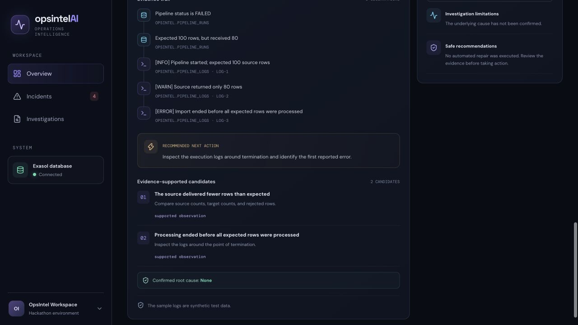
TRUST AND SAFETY
The product is designed to abstain before it overclaims
OBSERVATION
Source-backed facts
CANDIDATE
Evidence-supported possibility
CONFIRMATION
Reserved for human verification
INSUFFICIENT EVIDENCE EXAMPLE
Worker exited with code 71. No diagnostic details.
Result: unclassified. Optional summary cannot confirm a cause or run a repair.
OPSINTEL AI / EXATHON INDIA 2026
09
Notes:
Sources: app/investigator.py assess_root_causes and investigate_pipeline; app/llm.py; tests/run_evaluation.py; tests/test_llm.py. The unknown worker-exit case remains unclassified. The optional summary cannot change confirmed_root_cause, and model or network failure leaves the deterministic investigation available. No repair is executed.

Slide 10
VALIDATION ROADMAP
What is proven, and what must be proven next
PROVEN NOW
DEFINED, NOT COMPLETED
PRODUCTION WORK
01 Live Exasol-backed demo
01 External holdout: 0 reviewer cases
01 Live Airflow / dbt connectors
02 One-million-row benchmark
02 Controlled Exasol comparison
02 Authentication and authorization
03 71 automated tests
03 Impact study: 0/40 trials (0/4 people)
03 Concurrent workload testing
04 LLM claims cite evidence IDs
04 Clean-machine rehearsal
04 Audited retention and monitoring
Evaluation workflows are ready. External cases and participant trials remain pending.
OPSINTEL AI / EXATHON INDIA 2026
10
Notes:
Sources: evaluation/README.md; evaluation/holdout_template.csv; reports/impact-study-protocol.md; reports/evaluation.md; docs/deployment.md. Holdout, human impact, clean-clone, and independent LLM summary-quality results remain pending.

Slide 11
OPSINTEL AI
Follow the evidence.
Investigate faster.
Confirm carefully.
github.com/Anafa-thabassum/opsintel-ai
Live demo: one incident, five observations, one safe next action
11
Notes:
Repository: https://github.com/Anafa-thabassum/opsintel-ai

