Slide 1

LESSON 21
CAN bus through TWAI
Two ESP32-C3 nodes, TJA1050 transceivers, and a logic analyzer on the bus
Embedded Software Development in C/C++
Module M5 | Fri 2026-11-13 | 4 academic hours

Slide 2
Tonight
Why CAN exists and where it runs: cars, trucks, industrial machines, drones
Physical layer: two wires, dominant and recessive, 120 ohm at both ends
Frame anatomy, arbitration by ID, acknowledge, error counters
TWAI = Espressif's name for the CAN controller inside the ESP32-C3
Lab 1: two nodes on one bus, heartbeat frames, LED command frames
Lab 2: break the bus on purpose and read the damage in PulseView
Last technical session
Monday: cross-platform comparison and final project approval. Bring your project idea in writing.
Lesson 21 | CAN bus through TWAI and bus diagnosis
2

Slide 3
PART 1
What CAN is
A bus built for machines that must not stop talking

Slide 4


Why CAN
Multi-master
Robust
Cheap
No master, no polling. Any node sends when the bus is idle. Collisions are resolved by priority, not by retry.
Differential pair, 15-bit CRC, every receiver acknowledges, faulty nodes remove themselves from the bus.
Two wires, one transceiver per node, the controller is inside the MCU. Born at Bosch in 1986 for cars; now everywhere.
Compared with what you already know
UART: two nodes only. I2C and SPI: one master, centimetres. CAN: up to 40 m at 1 Mbit/s, dozens of nodes, no master.
Lesson 21 | CAN bus through TWAI and bus diagnosis
4

Slide 5
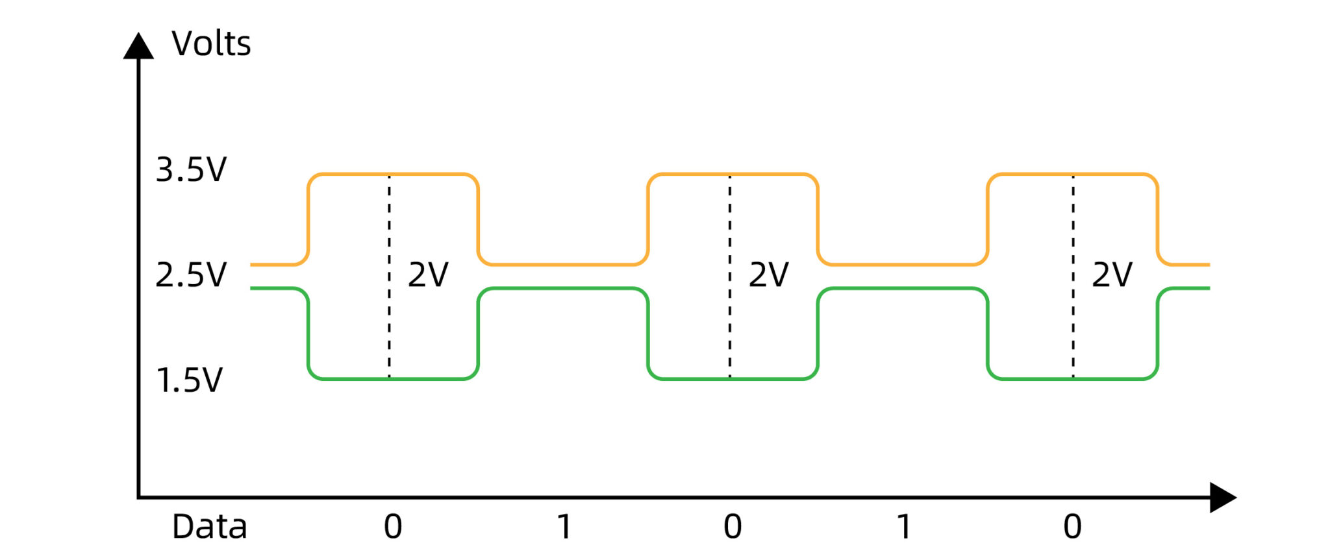
Physical layer: CAN_H and CAN_L
State | Bit | CAN_H | CAN_L | Diff
Recessive | 1 | 2.5 V | 2.5 V | 0 V
Dominant | 0 | 3.5 V | 1.5 V | 2 V
Diagram: come-star.com/blog/can-bus-wiki
Dominant always wins: one node pulling 0 overrides every node sending 1 (wired-AND)
The transceiver (TJA1050) turns the MCU's TXD / RXD into the differential pair; twisted pair cable, short stubs
120 ohm at each END of the bus: two resistors, 60 ohm measured between CAN_H and CAN_L
Measure before power
Our modules have 120 ohm on board (R1, marked 121): one module ~120 ohm, two wired together ~60 ohm.
Lesson 21 | CAN bus through TWAI and bus diagnosis
5

Slide 6
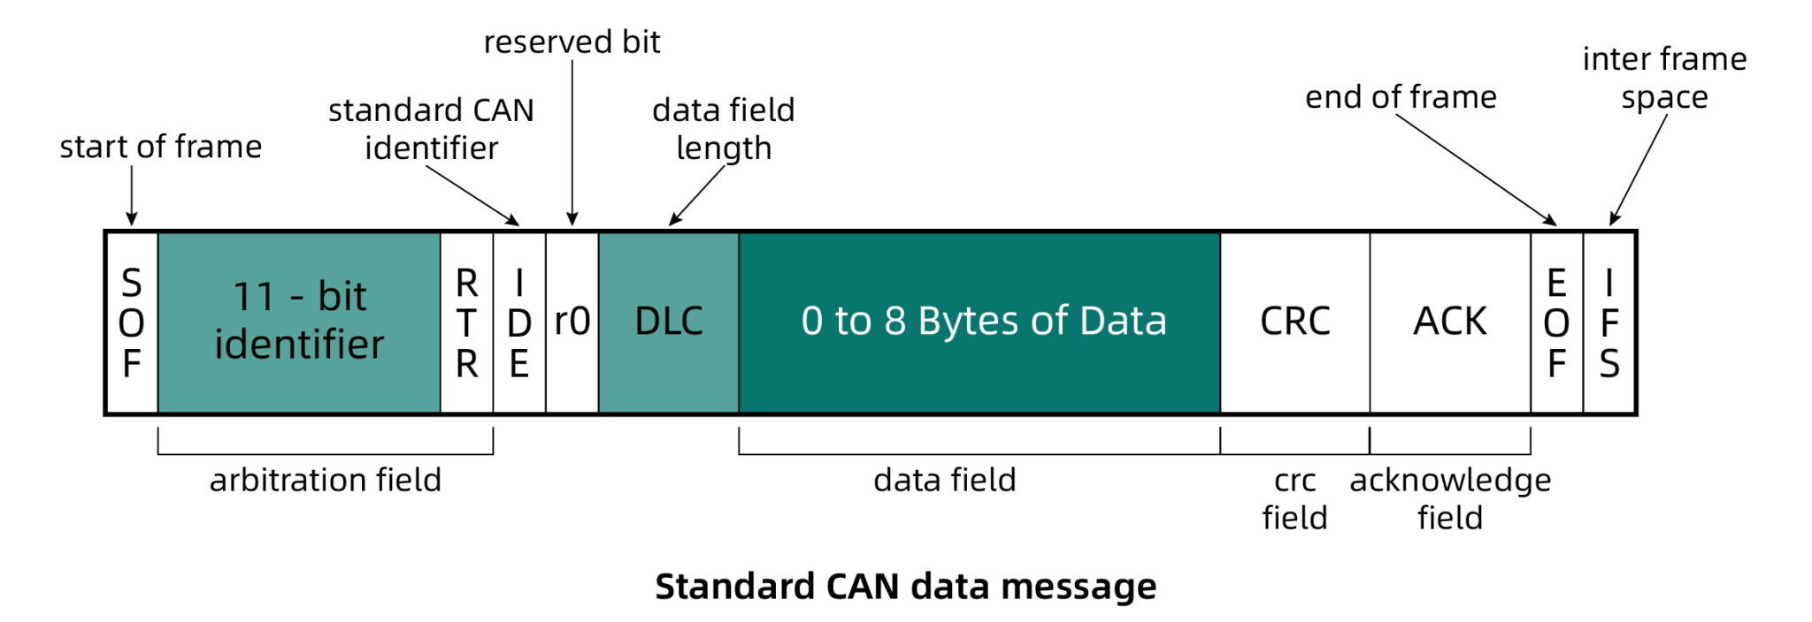
A classic CAN frame (11-bit ID)
Diagram: come-star.com/blog/can-bus-wiki
You never build this by hand
The controller does it all. Your code fills ID, DLC and up to 8 data bytes (twai_message_t); the rest is hardware.
Lesson 21 | CAN bus through TWAI and bus diagnosis
6

Slide 7
Frame fields
Field | Bits | What it is
SOF | 1 | Start of frame, one dominant bit
Identifier | 11 | Message ID and priority: 0x000 .. 0x7FF, lower wins
RTR + IDE + r0 | 3 | Remote request, extended-ID flag (0 = 11-bit), reserved
DLC | 4 | Data length 0 .. 8 bytes
Data | 0 .. 64 | The payload
CRC + delimiter | 16 | 15-bit CRC computed by the controller
ACK + delimiter | 2 | Sender sends 1, any receiver that liked the CRC writes 0
EOF + IFS | 10 | Seven recessive bits, then three bits of silence
Bit stuffing
After five equal bits the controller inserts one opposite bit, the receiver drops it. Frame length on the analyzer varies.
Lesson 21 | CAN bus through TWAI and bus diagnosis
7

Slide 8
Arbitration: the lower ID wins, bit by bit
bit: 10 9 8 7 6 5 4 3 2 1 0
node A 0 0 1 0 0 0 0 0 0 0 1 ID 0x101
node B 0 0 1 0 0 0 0 0 0 1 0 ID 0x102
node C 0 0 1 1 0 0 0 0 0 0 0 ID 0x180
bus 0 0 1 0 . . . . . . .
^ C sent 1, read 0 -> C stops, retries later
^ B sent 1, read 0 -> B stops
A finishes its frame; B and C send right after, in that order
Every sender reads the bus while writing the ID; the first node to see a 0 where it wrote 1 backs off
No data is lost in a collision: the loser just waits one frame
Consequence: ID is priority. Give the alarm 0x010 and the chatter 0x500
Two nodes must never send the same ID - arbitration cannot separate them
Lesson 21 | CAN bus through TWAI and bus diagnosis
8

Slide 9
ACK and the error state machine
ACK: every receiving node overwrites the ACK slot with 0, even if the frame is not for it
No ACK = nobody heard me. The controller retransmits at once, forever, and counts an error
Two counters per node: TEC (transmit errors) and REC (receive errors), +8 per error, -1 per good frame
State | Condition | Behaviour
Error active | TEC < 128 and REC < 128 | Normal. Signals errors with 6 dominant bits (error flag)
Error passive | TEC or REC >= 128 | Still talks, but may not shout: passive error flag, waits longer
Bus off | TEC > 255 | Off the bus. Needs explicit recovery (128 x 11 recessive bits)
This is tonight's diagnosis lab
A lonely node, a wrong bit rate, a pulled RXD wire: all end in error passive or bus off. You will watch it happen.
Lesson 21 | CAN bus through TWAI and bus diagnosis
9

Slide 10
Bit rate and sample point
Everyone on the bus must use the same bit rate. Tonight: 500 kbit/s, 2 us per bit
Each bit is cut into time quanta; the receiver samples at about 75-87 % of the bit
Resynchronisation on every recessive-to-dominant edge; bit stuffing (a 6th equal bit is inserted) keeps edges coming
TWAI hides this: TWAI_TIMING_CONFIG_500KBITS() fills the whole struct
Wrong rate on one node: it sees garbage, flags errors on every frame, and poisons the bus for everyone
Analyzer math from session 15
500 kbit/s x 10 = 5 MHz sampling is plenty; 8 MHz in PulseView. One second of capture = 8 M samples, fine over USB.
Lesson 21 | CAN bus through TWAI and bus diagnosis
10

Slide 11
PART 2
Hardware
TJA1050 is a 5 V part. The ESP32-C3 is not.

Slide 12
TJA1050 module to the ESP32-C3 Super Mini
TJA1050 pin | Goes to | Note
VCC | C3 5V pin (USB 5 V) | The transceiver needs 4.75 .. 5.25 V. Not 3V3
GND | C3 GND | Common ground with every other node too
TXD | C3 GPIO 10 | 3.3 V high; the module has 10 ohm (R2) in series. Works in practice
RXD | divider -> C3 GPIO 3 | Swings to 5 V. 10k series, 20k to GND -> 3.3 V
CAN_H / CAN_L | the bus | Same wire colour for H on every module
TJA1050 RXD --[ 10k ]--+-- C3 GPIO 3 (5 x 20/30 = 3.33 V)
|
[ 20k ]
|
GND
No divider = dead pin
C3 pins are rated 3.6 V max. Check the divider with the multimeter before connecting GPIO 3.
Lesson 21 | CAN bus through TWAI and bus diagnosis
12

Slide 13
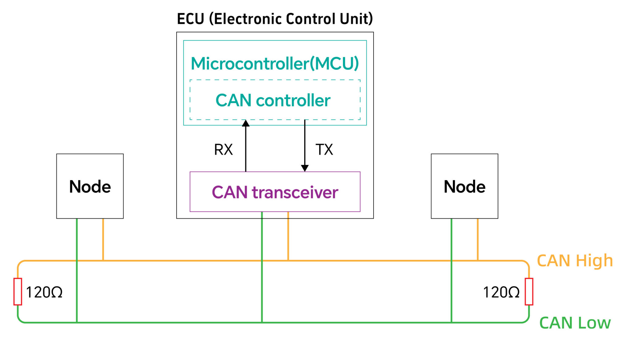
Pin budget and bus topology
Kept from sessions 18-20: buttons 0 / 1, pot 4, RGB 5 / 6 / 7, AHT10 on 8 / 9
New: CAN TX GPIO 10, CAN RX GPIO 3. Both were free. 2 is strapping, 20 / 21 are UART0
Real bus: a line with 120 ohm at both ends, nodes on short stubs (picture)
Tonight: two modules = the two ends. Both carry their own 120 ohm, nothing to add
Diagram: come-star.com/blog/can-bus-wiki
node 1 (120R on board) node 2 (120R on board)
C3 --- TJA1050 CAN_H ========== CAN_H TJA1050 --- C3
CAN_L ========== CAN_L
GND ------------------------------------------------ GND
One common GND between the two boards, even though CAN is differential. Station 3 = the logic analyzer
Lesson 21 | CAN bus through TWAI and bus diagnosis
13

Slide 14
PART 3
TWAI in code
driver/twai.h from ESP-IDF, available under Arduino core 2.x

Slide 15
Driver lifecycle: configure, install, start
#include "driver/twai.h"
static const gpio_num_t CAN_TX_PIN = GPIO_NUM_10;
static const gpio_num_t CAN_RX_PIN = GPIO_NUM_3;
void canBegin(void) {
twai_general_config_t g = TWAI_GENERAL_CONFIG_DEFAULT(
CAN_TX_PIN, CAN_RX_PIN, TWAI_MODE_NORMAL);
twai_timing_config_t t = TWAI_TIMING_CONFIG_500KBITS();
twai_filter_config_t f = TWAI_FILTER_CONFIG_ACCEPT_ALL();
ESP_ERROR_CHECK(twai_driver_install(&g, &t, &f));
ESP_ERROR_CHECK(twai_start());
}
TWAI = Two-Wire Automotive Interface. Espressif's name, same protocol
Modes: NORMAL, NO_ACK (self-test with one board), LISTEN_ONLY (sniffer)
Filter: accept all tonight; hardware filtering by ID is possible
Stop / uninstall exist too; you need them to change the bit rate
Lesson 21 | CAN bus through TWAI and bus diagnosis
15

Slide 16
Transmit: fill the struct, hand it to the queue
twai_message_t msg = {};
msg.identifier = 0x100U + NODE_ID; // 11-bit ID
msg.extd = 0; // standard frame
msg.data_length_code = 4U;
msg.data[0] = (uint8_t)(counter >> 8);
msg.data[1] = (uint8_t)(counter);
msg.data[2] = (uint8_t)(pot >> 8);
msg.data[3] = (uint8_t)(pot);
esp_err_t err = twai_transmit(&msg, pdMS_TO_TICKS(10U));
if (err != ESP_OK) {
Serial.printf("TX fail: %s\n", esp_err_to_name(err));
}
twai_transmit() only queues the frame; the controller sends it when the bus is idle and arbitration is won
Timeout 0 = do not block. ESP_ERR_TIMEOUT = queue full, the bus is not draining
Byte order is yours to define: we send big-endian, 2 bytes per value
ESP_ERR_INVALID_STATE = driver not started or bus off
Lesson 21 | CAN bus through TWAI and bus diagnosis
16

Slide 17
Receive: poll the queue in loop(), no blocking
void canPoll(void) {
twai_message_t rx;
while (twai_receive(&rx, 0) == ESP_OK) {
if (rx.identifier == CMD_LED_ID
&& rx.data_length_code == 4U
&& rx.data[0] == NODE_ID) {
setRgb(rx.data[1], rx.data[2], rx.data[3]);
} else if (rx.identifier >= HEARTBEAT_BASE_ID
&& rx.identifier < HEARTBEAT_BASE_ID + 8U) {
printHeartbeat(rx);
}
}
}
The driver has an RX queue (default 5 frames); drain it every loop() pass
A frame is received even if nobody is addressed - CAN is broadcast, addressing is a convention inside the data
rx.rtr, rx.extd, rx.data_length_code: always check DLC before reading data[]
Lesson 21 | CAN bus through TWAI and bus diagnosis
17

Slide 18
Status, alerts and bus-off recovery
twai_status_info_t st;
twai_get_status_info(&st);
// st.state: TWAI_STATE_RUNNING / BUS_OFF / RECOVERING
// st.tx_error_counter, st.rx_error_counter
// st.msgs_to_tx, st.msgs_to_rx, st.bus_error_count
uint32_t alerts = 0U;
if (twai_read_alerts(&alerts, 0) == ESP_OK) {
if (alerts & TWAI_ALERT_BUS_OFF) {
twai_initiate_recovery(); // then wait for BUS_RECOVERED
}
if (alerts & TWAI_ALERT_BUS_RECOVERED) { twai_start(); }
}
Enable alerts at install: g.alerts_enabled = TWAI_ALERT_BUS_OFF | ERR_PASS | BUS_ERROR | ...
Error passive and bus off are not crashes: the firmware keeps running, only the bus is gone
The demo prints TEC / REC every 5 s. Watch them climb in Lab 2
Lesson 21 | CAN bus through TWAI and bus diagnosis
18

Slide 19
Lab 1: two nodes, one firmware
Frame | ID | DLC | Data | Who sends
Heartbeat | 0x101 / 0x102 | 4 | counter (2 B), pot (2 B) | both nodes, every 1 s
LED command | 0x200 | 4 | target node, R, G, B | button A on any node
LED off | 0x200 | 4 | target node, 0, 0, 0 | button B on any node
NODE_ID comes from platformio.ini: envs node1 / node2 set -D NODE_ID=n. Two stations, a pair per station; the third pair runs the analyzer
Button A targets the OTHER node with a colour that depends on your pot position; button B turns it off
Serial shows every received heartbeat and the TEC / REC counters every 5 s
Env selftest: TWAI_MODE_NO_ACK, one board, no bus - the node hears its own frames. Use it at home
Done when
Both monitors show the other node's heartbeat counting up, and a button on one board lights the LED on the other.
Lesson 21 | CAN bus through TWAI and bus diagnosis
19

Slide 20
PART 4
Lab 2: Bus diagnosis
Symptom -> hypothesis -> capture -> compare -> conclusion

Slide 21
Logic analyzer on the CAN bus
Clip D0 to the C3 side of the RXD divider (3.3 V) - never to the 5 V side, never to CAN_H / CAN_L
RXD shows the whole bus: every frame from every node, including ACK bits and error flags
D1 on TXD of the same node: now you can tell what this node sent from what it heard
PulseView: 8 MHz, 2 s; add decoder CAN, bit rate 500000, channel CAN RX = D0
Record a known-good capture of Lab 1 FIRST and save it. Every fault is compared against it
What a good frame looks like
SOF, ID 0x101, DLC 4, four data bytes, CRC, then one dominant ACK bit written by the other nodes. 2 us per bit, about 110 us per frame.
Lesson 21 | CAN bus through TWAI and bus diagnosis
21

Slide 22
Injected faults
Fault | Symptom in Serial | Evidence in the capture | Why
One node alone on the bus | TX fail: ESP_ERR_TIMEOUT, TEC climbs to 128, then stops | Same frame repeated back to back, ACK slot stays recessive, error flags | Nobody ACKs; retransmit until error passive
One node at 250 kbit/s | That node: RX nothing, REC climbs. The other: bus errors | Frames twice as long from it; the other's frames unreadable to it | Bit timing mismatch
RXD wire pulled | Node sends, hears nothing, no ACK seen -> errors | Analyzer on the bus side still shows frames | Fault is local, not on the bus
Not injected tonight: missing termination. Our 120 ohm are soldered in, and on 30 cm of wire at 500 kbit/s it would not show anyway
Rule of the lab
Write the hypothesis down before you capture. A capture without a hypothesis is a screenshot.
Lesson 21 | CAN bus through TWAI and bus diagnosis
22

Slide 23
Lab 2 procedure
1. Known-good capture of the running bus, saved as good.sr
2. The instructor breaks one thing. You see only the serial output of your node
3. Symptom in one sentence, hypothesis in one sentence, in the shared doc
4. Capture at the analyzer station, compare with good.sr, point at the evidence
5. Conclusion. Then fix it and confirm the counters go back to 0 (or recover the bus)
Three rounds, roles rotate between the pairs: node 1, node 2, analyzer
Recovery
After bus off the node does not come back on its own. twai_initiate_recovery() in the demo, or reset the board. Know which one you did.
Lesson 21 | CAN bus through TWAI and bus diagnosis
23

Slide 24
Summary
CAN: multi-master, differential, priority by ID, every receiver acknowledges
Error counters and three states: active, passive, bus off. Faults are visible, not silent
TJA1050 is 5 V: divider on RXD, common GND, 120 ohm at both ends only
TWAI: install, start, transmit, receive, status, alerts - six functions do the job
Diagnosis: known-good capture first, hypothesis before capture, evidence before conclusion
Homework
No coding. Fill in homework/final-project-template.md for your final project and push it as students/<you>/final-project.md by Monday 12:00. Approval in session 22.
Lesson 21 | CAN bus through TWAI and bus diagnosis
24

